Slide 1





Grace Kelly, SERRC
Christina Kasprzak, NECTAC/ECO
December, 2012
Measuring Child Outcomes

Slide 2
Agenda
Why child outcomes data is critical
Child Outcomes Summary (COS) process
Authentic Assessment
Child Development
Practice with Written Child Example
(If time allows) Introduction to integrating child outcomes measurement into IFSP/IEP process

Slide 3
Why Child Outcomes Data
is Critical

Slide 4
Federal Background
Government Performance and Results Act (GPRA)
Program Assessment Rating Tool (PART)
Individuals with Disabilities Education Act (IDEA)
Notes:
GPRA – 1993, PART 2002, IDEA reauthorization – 1994.

Slide 5
Individuals with Disabilities Education Act
SEC. 616. <<NOTE: 20 USC 1416.>> MONITORING, TECHNICAL ASSISTANCE, AND ENFORCEMENT. ``(a) Federal and State Monitoring.-…..
…..
``(2) Focused monitoring.--The primary focus of Federal and State monitoring activities described in paragraph (1) shall be on-- ``(A) improving educational results and functional outcomes for all children with disabilities;

Slide 6
PART evaluation results (2002)
130 programs examined in 2002; 50% programs had no performance data
Programs looking at inputs, not results
Part C and Section 619
  No long-term child outcome goals or data
  Need to develop a strategy to collect annual performance data in a timely manner
Notes:
During the 2003 budget period, the Administration rated approximately 130 federal programs on their effectiveness using part
50% of the these programs had no performance data
Programs tend to use inputs or process data, rather than results or outcome data
Specifically for Part C and Section 619: did not do well in the area of accountability/results because there were no long-term child outcome goals; no child outcome data. The recommendation from the PART is that OSEP needs to develop a strategy to collect annual performance data (child and family outcomes) in a timely manner

Slide 7
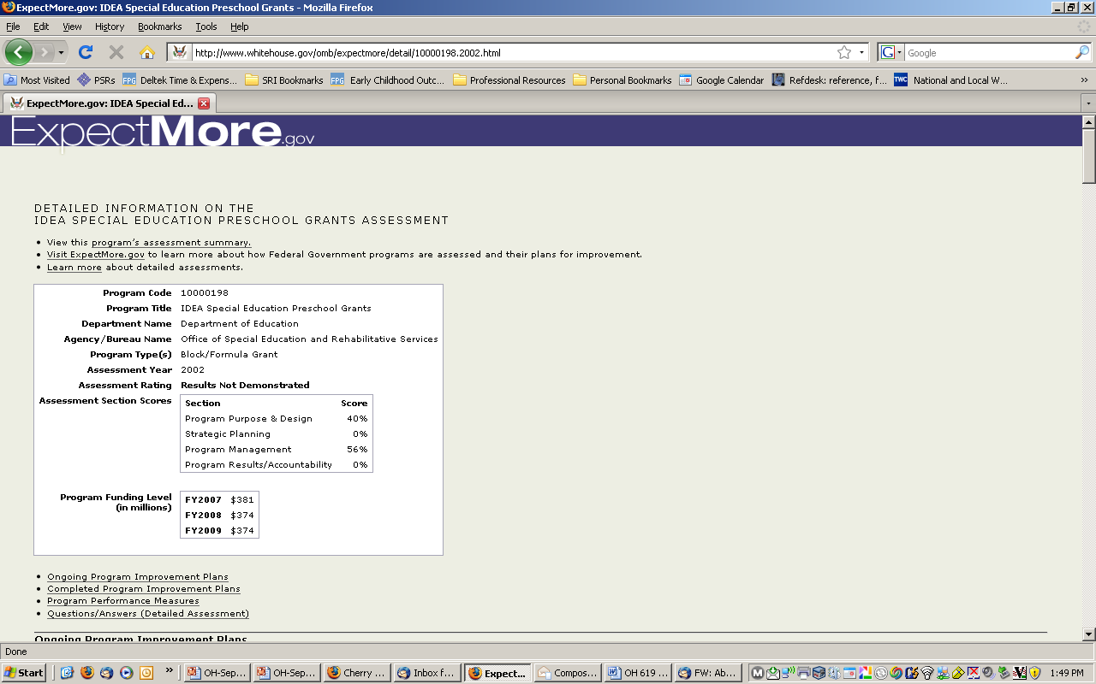

Slide 8
How Office of Special Education (OSEP) responded
Required states to submit outcome data in their Annual Performance Report (APR)
Funded the Early Childhood Outcomes (ECO) Center to do research, make recommendations, and assist states

Slide 9
Goal of early intervention
“…To enable young children to be active and successful participants during the early childhood years and in the future in a variety of settings – in their homes with their families, in child care, in preschool or school programs, and in the community.”
(from Early Childhood Outcomes Center, http://www.fpg.unc.edu/~eco/pdfs/eco_outcomes_4-13-05.pdf)

Slide 10
Three child outcomes
  Positive social emotional skills (including positive social relationships)
  Acquisition and use of knowledge and skills (including early language/ communication)
  Use of appropriate behaviors to meet their needs
Notes:
Functional, not isolated skills in domains
Across 0-5
What any parent would want for their child
PLAY Step by Step Video

Slide 11
Step by Step video
Available online:
http://projects.fpg.unc.edu/~eco/pages/videos.cfm
Notes:
Functional, not isolated skills in domains
Across 0-5
What any parent would want for their child

Slide 12
Outcomes Jeopardy
Pointing to the cabinet for cereal | Reading the letter “S” on the Stop sign | Washes hands before lunch
Biting | Plays by himself in the classroom | Plays with rhyming words
Building a castle from blocks with a friend | Problems sleeping | Sharing a cookie at lunchtime
$100
$100
$100
$200
$200
$200
$300
$300
$300
Notes:
Check your knowledge of the three child outcomes!! You remember how to play Jeopardy. Make sure you are in ‘slide show’ mode and click on each box so that the ‘door’ slides away. Behind the door is the answer to the question. You provide the question, which might be ‘What is Outcome 1?’ ‘What is Outcome 2?’ or ‘What is Outcome 3?’ Record your responses on the ‘Jeopardy Score Sheets’.

Slide 13
Child Outcomes Summary (COS) Process

Slide 14
What is the Child Outcomes Summary (COS) Process?
A team process for reviewing child assessment data from different sources culminating in the ‘rating’ of a child’s functioning on a scale of 1-7
Considers the child’s functioning across situations and settings
Compares child’s functioning to same age peers

Slide 15
WHO participates in the rating decision?
Professional and parent team members participate in the rating discussion
Parent input is respectfully considered
Multiple sources of assessment information are considered (observation, family report, formal ‘testing’) for the rating

Slide 16
Why the COS Process?
No assessment developed for this purpose
Division of Early Childhood, Council for Exceptional Children recommended practices

Slide 17
Defining Assessment
“Assessment is a generic term that refers to the process of gathering information for decision-making.” (McLean, 2004).
Early childhood assessment is a flexible, collaborative decision-making process in which teams of parents and professionals revise their judgments and reach consensus about changing developmental, educational, medical and mental health service needs of young children and their families.” (Bagnato & Neisworth, 1991)

Slide 18
DEC recommended practices on early childhood assessment
1. Professionals and families collaborate in planning and implementing assessment.
Assessment is individualized and appropriate for the child and family.
Assessment provides useful information for intervention.
Professionals share information in respectful and useful ways.
Professionals meet legal and procedural requirements and meet recommended practice guidelines.
Notes:
Division of Early Childhood, Council for Exceptional Children
Professional Org that guides good practice across the country

Slide 19
Purposes of the COS
It is not an assessment tool
It uses information from multiple sources, including assessment tools, observations, and family interview to get a global sense of how the child is doing at one point in time

Slide 20
Features of the COS
7-point rating scale
Rating is based on the child’s functioning:
  What the child does across settings and situations
  Compared with what is expected given the child’s chronological age (do not correct for prematurity for COS process!)

Slide 21
The two COS questions
a. To what extent does this child show age-appropriate functioning, across a variety of settings and situations, on this outcome? (Rating: 1-7)
b. Has the child shown any new skills or behaviors related to [this outcome] since
the last outcomes summary? (Yes-No)

Slide 22
Why two questions?
a. The first question compares the child’s functioning to age expectations, on a scale of 1-7
b. The second question is only addressed after the entry COS (annually or at exit depending upon state procedures) and compares child’s skills with his or her earlier functioning

Slide 23
Why two COS questions?
Progress data for federal reporting are calculated from the COS ratings (entry versus exit) plus the yes/no progress question
The yes/no progress question differentiates between children who made absolutely NO progress or regressed -- and children who gained at least one new skill

Slide 24
Summary ratings are based on…
Types of Information
  Curriculum-based assessments (e.g., HELP)
  Norm-referenced assessments (e.g.,
  BDI-2)
  Developmental screenings (e.g.,
  Ages & Stages)
  Observation and report
Sources of Information
  Routines Based Interview (family information)
  Service providers
  Therapists
  Physicians
  Child care providers
  Teachers
  People familiar with the child in all of the settings and situations he’s in

Slide 25
Among them, IFSP/IEP team members must:
Know about the child’s functioning across settings and situations
Understand age-expected child development
Understand the content of the three child outcomes
Know how to use the rating scale
Understand age expectations for child functioning within the child’s culture

Slide 26




7-point COS rating scale

Slide 27
7 – Completely
Child shows functioning expected for his or her age in all or almost all everyday situations that are part of the child’s life
Functioning is considered appropriate for his or her age
No one has any concerns about the child’s functioning in this outcome area

Slide 28
6 – Between completely and somewhat
Child’s functioning generally is considered appropriate for his or her age but there are some significant concerns about the child’s functioning in this outcome area
These concerns are substantial enough to suggest monitoring or possible additional support
Although age-appropriate, the child’s functioning may border on not keeping pace with age expectations

Slide 29
5 – Somewhat
Child shows functioning expected for his or her age some of the time and/or in some settings and situations
Child’s functioning is a mix of age-appropriate and not age-appropriate behaviors and skills
Child’s functioning might be described as like that of a slightly younger child

Slide 30
4 – Between somewhat and nearly
Child shows occasional age-appropriate functioning across settings and situations
More functioning is not age-appropriate than age-appropriate

Slide 31
3 – Nearly
Child does not yet show functioning expected of a child of his or her age in any situation
Child uses immediate foundational skills, most or all of the time across settings and situations
Immediate foundational skills are the skills upon which to build age-appropriate functioning
Functioning might be described as like that of a younger child

Slide 32
2 – Between nearly and not yet
Child occasionally uses immediate foundational skills across settings and situations
More functioning reflects skills that are not immediate foundational than are immediate foundational

Slide 33
1 – Not yet
Child does not yet show functioning expected of a child his or her age in any situation
Child’s functioning does not yet include immediate foundational skills upon which to build age-appropriate functioning
Child functioning reflects skills that developmentally come before immediate foundational skills
Child’s functioning might be described as like that of a much younger child

Slide 34
Rating Scale Jeopardy
Age appropriate functioning – no concerns | Mix of age appropriate and not age appropriate functioning | No age appropriate functioning – not yet showing immediate foundational skills
Some age appropriate functioning but very little | No age appropriate functioning – lots of immediate foundational skills | Age appropriate functioning – some concerns
Rarely shows age appropriate functioning | No age appropriate functioning – some immediate foundational skills | Age appropriate functioning
$100
$100
$100
$200
$200
$200
$300
$300
$300
Notes:
Now let’s check your knowledge of the 7 points on the Child Outcomes Summary rating scale. As with Outcomes Jeopardy, make sure you are in ‘slide show’ mode and click on each box so that the ‘door’ slides away. Behind the door is the answer to the question. You provide the question, which might be ‘What is a rating of 1?’ ‘What is a rating of 2?’ and so on. Record your responses on the ‘Jeopardy Score Sheets’.

Slide 35
Assessment:
Authentic Assessment & standardized assessment tools

Slide 36
What is Authentic Assessment?
Adapted from materials developed by Naomi Younggren, 2011
Assessment of the young child’s skills in the real life contexts of family, culture and community rather than discrete isolated tasks irrelevant to daily life.

Slide 37
Authentic Assessment
Adapted from materials developed by Naomi Younggren, 2011
Yields functional & contextually relevant information about the child’s strengths & needs
More culturally sensitive & individually focused
Not domain based & discipline specific
Not deficit driven
Not threatening

Slide 38
Reality
Adapted from materials developed by Naomi Younggren, 2011
Traditional standardized evaluation alone:
  do not provide the information needed to develop functional IFSPs/IEPs that can be implemented within the day to day routines of the family/school house/community/child care…
  do not determine what the child is able to do, likes to do, or needs to do in regards to the family’s/players’ priorities.
  do not provide a clear understanding of the child’s abilities across environments and care providers – this is accomplished through observation and information sharing
  (Bagnato, Neisworth, Munson, 1997)

Slide 39
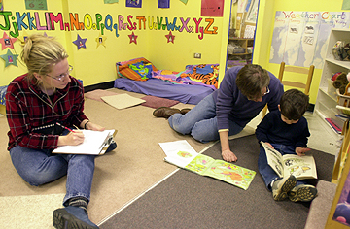
Who Does IT?
Adapted from materials developed by Naomi Younggren, 2011
Familiar and knowledgeable caregivers in the child’s life
Providers
Teachers
Other sources less familiar can contribute some too

Slide 40
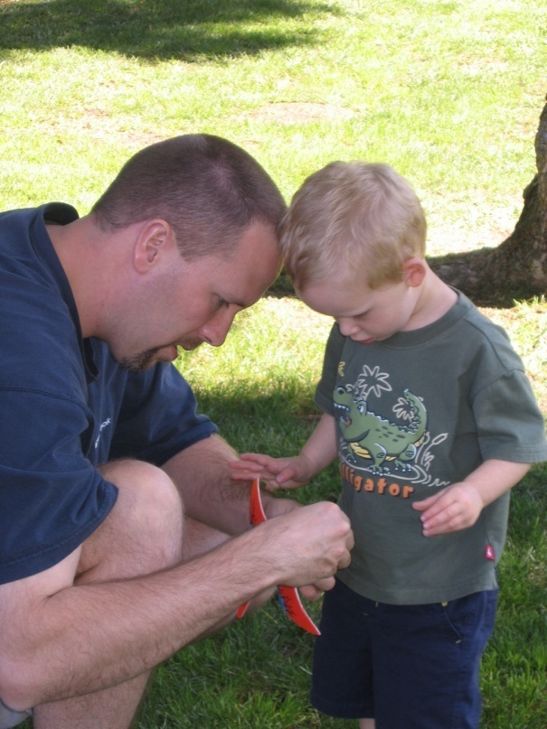
Involving Families
Adapted from materials developed by Naomi Younggren, 2011
More than asking questions, or going over questionnaires, and developmental profiles
Listening to the family story and hearing about the child’s engagement, independence, and social relationships with various day-to-day routines and activities
Asking parents to show or describe
Observing how the parent engages
the child
Setting up play scenarios

Slide 41
Involving families in a conversation about their child’s functioning
Avoid jargon
Avoid questions that can be answered with a yes or no
  “Does Anthony finger feed himself?”
Ask questions that allow parents to tell you what they have seen
  “Tell me how Anthony eats”
Notes:
Information about the family is critical to a COSF rating that reflects all the settings and situations that make up the child’s natural environment

Slide 42
What we should expect from family involvement
That they can provide rich information about their child’s functioning across settings and situation – YES!
That they will know whether their child is showing age appropriate behavior? Maybe… but not necessarily!
Notes:
Part of our job in IFSP development is to help the family understand where the child is, where he is going, and when he gets there. The same is true for the COSF discussion. The family input should help the rest of the team where the child is (skills and behaviors shown at home and in the community), the progress the family would like to see and, in subsequent data collection, the new skills and behaviors the child is showing at home and in the community. Refer to blocks/bucket list without numbers to illustrate a tool that can be used to assist with this communication.

Slide 43


Strategies for Involving Families in the COS Rating Discussion
Individualizing to family; giving family choice
Using the ‘words’ rather than numbers when discussing ratings with families
Other?
43

Slide 44
When Is IT Done?
Adapted from materials developed by Naomi Younggren, 2011
Over time
“One-time observations even in the natural context, are insufficient and often misleading”
(Bagnato, Neisworth, Pretti-Frontczak, 2010)

Slide 45
Tools for Authentic Assessment
Adapted from materials developed by Naomi Younggren, 2011
OBSERVATION
Authentic assessment involves…
OBSERVATION of the child in natural circumstances
information shared about the OBSERVATIONs of people familiar with the child
Notes:
Play the video(s) – discuss observations for outcome 1, 2, and/or 3 (depending on time and video)

Slide 46
Tools Beyond Observation
Adapted from materials developed by Naomi Younggren, 2011
Record review
Developmental history
Interviews
Checklists/rating scales
Anecdotal recordings
Portfolios
Technology

Slide 47
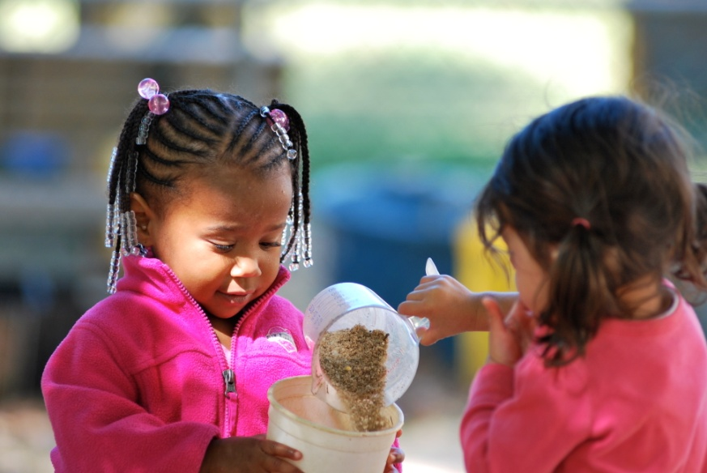

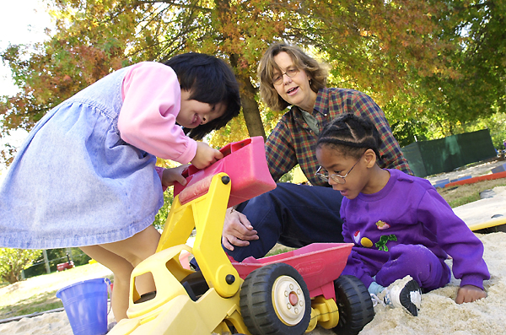
Pictures for Assessment
Adapted from materials developed by Naomi Younggren, 2011

Slide 48

Where is IT Done?
Adapted from materials developed by Naomi Younggren, 2011
Only in the children’s natural everyday settings, activities, and routines

Slide 49
Assessment should focus on…
What does the child usually do?
Actual performance across settings and situations
How the child uses his/her skills to accomplish tasks
Not the child’s capacity to function under unusual or ideal circumstances
Not necessarily the child’s performance in a structured testing situation

Slide 50
Activity
What are functional skills?
Versus discrete skills?
Notes:
Functional skills exercise

Slide 51
Activity – Video (observing)
Observe outcomes 1, 2, and 3.
  Jonah (19 mo)
  Haley (30 mo)
What did you observe?
What else might you want to know?
Notes:
Video clip(s) from Results Matter

Slide 52
Crosswalks
Identify relationships between assessment instruments and the three child outcome
Display how content on a given assessment instrument is related to each outcome
Are not meant to be used as a “checklist” or “score sheet” for measuring child outcomes
Find crosswalks on http://www.fpg.unc.edu/~eco/pages/crosswalks.cfm

Slide 53
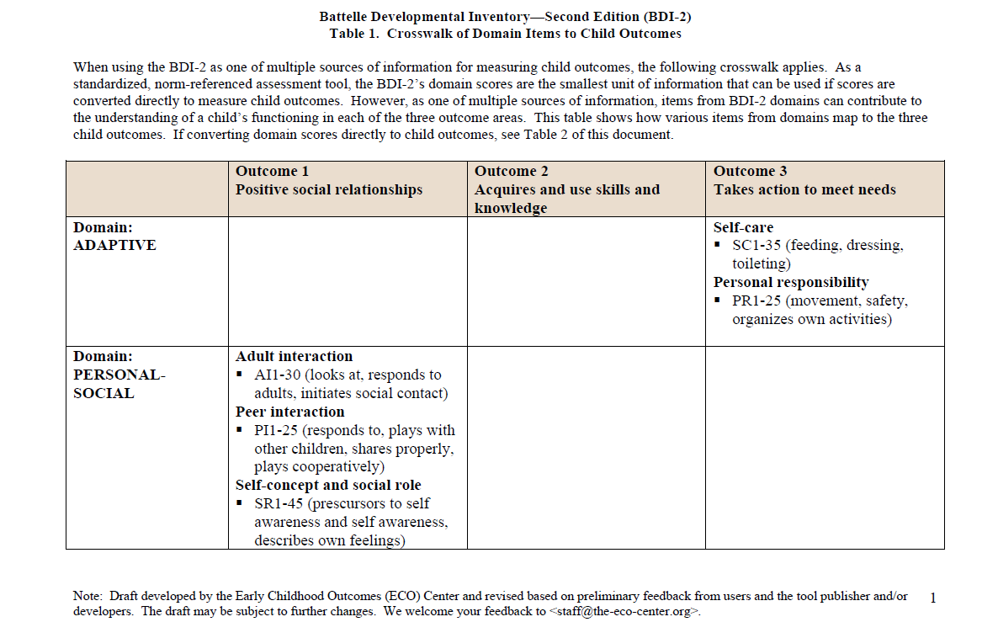
BDI Crosswalk example

Slide 54
BDI Crosswalk – Discussion Groups
What do you notice about the crosswalk?
Which outcome area(s) have the most items? Which the least?
To what extent are the items functional vs. discrete skills?
What types of information would you want to know in each outcome areas that is not included in the assessment?
What are the implications for the need for other data sources?
Notes:
Small group discussions and debrief

Slide 55
  Federal data requirement:
  Comparing child’s functioning to age expectations

Slide 56
What are foundational skills?
Foundational skills are….
  Skills and behaviors that occur earlier in development and serve as the foundation for later skill development
  Teachers and interventionists often use foundational skills to help children move to the next level developmentally

Slide 57
What are immediate foundational skills?
Immediate foundational skills are…
  Skills that are conceptually linked to later skills and immediately precede the later skills developmentally
  Example: Children play alongside one another before they interact in play

Slide 58
Immediate foundational skills
The set of skills and behavior that occur developmentally just prior to age-expected functioning
Are the basis on which to build age-expected functioning
Functioning looks like a younger child
Notes:
The focus is on functionally meaningful actions. Many assessment tools have items that measure discrete skills that aren’t individually meaningful to the child. The skills are meaningful only when they are integrated with other things so that the child can accomplish something.

Slide 59
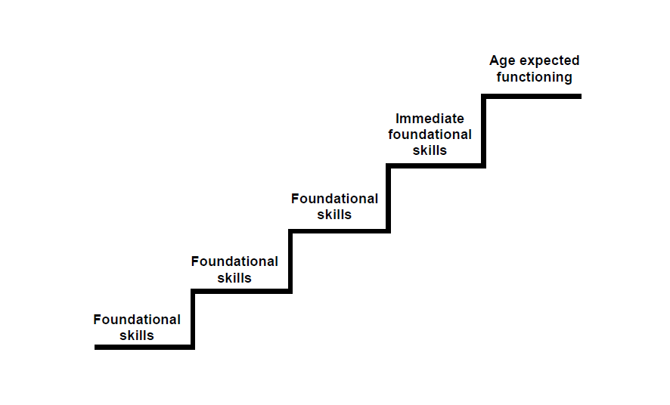
How foundational skills lead to age-expected functioning

Slide 60
Age Expectation Resources:
ND resource
CDC Milestones http://www.cdc.gov/NCBDDD/actearly/pdf/checklists/All_Checklists.pdf
Other? E.g. ELGs
Notes:
Video Activity to practice AE, IF, F based on CDC milestones
Start by talking about “What do we expect for a child of age X”
Then play video and ask them to sort by outcome(s)
Then discuss AE, IF, F for the skills observed

Slide 61
Activity
Determine which skills are:
  Age expected (AE)
  Immediate foundational (IF)
  Foundational (F)
Notes:
Video Activity to practice AE, IF, F based on CDC milestones
Show 2 kids at 18 mo; 2 kids at 3 years
Start by talking about “What do we expect for a child of age X”
Then play video and ask them to sort by outcome(s)
Then discuss AE, IF, F for the skills observed

Slide 62
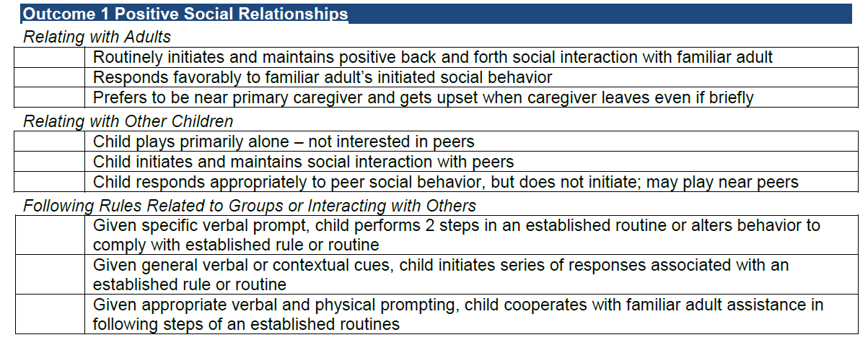
skills/behaviors for a 30 month old child

Slide 63
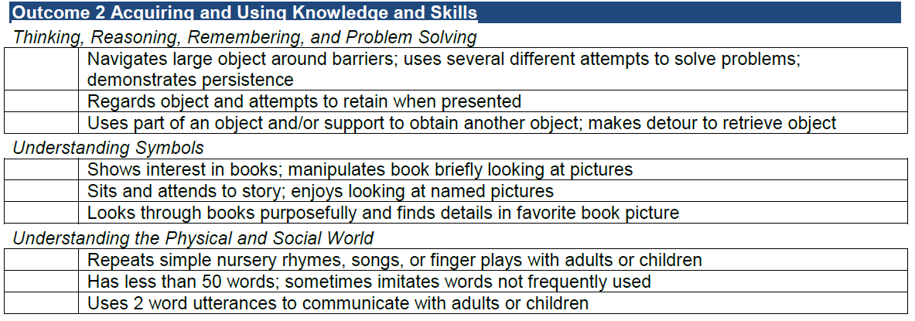
skills/behaviors for a 30 month old child

Slide 64
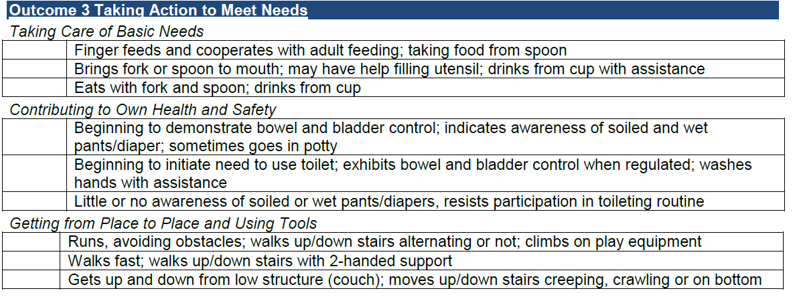
skills/behaviors for a 30 month old child

Slide 65
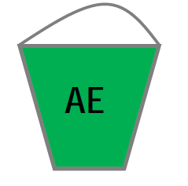
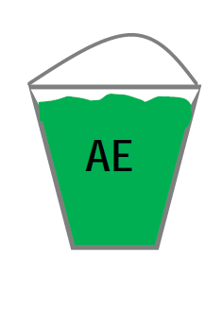


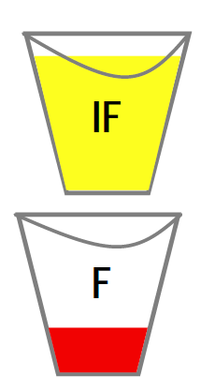
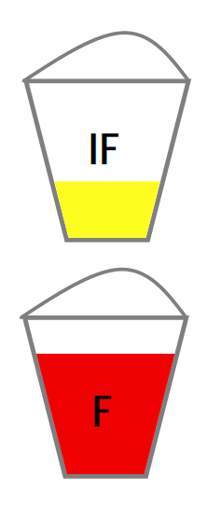
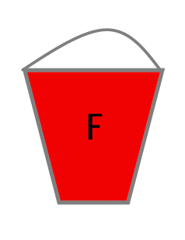
“Buckets List”
7
6
5
4
3
2
1

Slide 66
Is the rating subjective?
What is subjective?
  personal attitudes, opinions, feelings
The child outcome summary ratings involve clinical decision making from the team based on observation and other data
  much like that used in deciding on goals and intervention strategies
Notes:
A question that sometimes arises in the context of the summary of functional performance process is whether or not rating a child’s functioning on the 7-point scale is ‘subjective.’ Subjectivity can be defined as related to the ‘mind’ of the rater, rather than the nature of the subject being rated. If your team determines a rating based on what is in their minds, rather on the what the child demonstrates and the rating criteria, the rating may be subjective. If the rating is based on the child’s demonstrated functioning, as compared to age-expected functioning and the criteria for each of the 7 points, it is a data based decision – not unlike the decisions the team makes when designing an appropriate program for a child.
Next section on age – anchoring – a practice, that when used consistently, helps ensure the proper application of the rating.

Slide 67
Informed Decisions
Conditions:
Operational definitions of the observed attributes
Structured rating format to record informed opinion
Gather data from multiple sources
Establish consensus-decision making process
Provide training to facilitate reliable ratings
Research on clinical judgment shows that professionals can reach reliable conclusions under certain conditions
The process meets all of these conditions.
Notes:
Rating a child’s functioning based on assessment data draws upon the clinical judgment that professionals develop as part of their experience and training. Research shows that practitioners will reach the same conclusions when certain conditions are in place.

Slide 68
Child Development

Slide 69
Child Development Slides

Slide 70
Child Example

Slide 71
Evan & Finley Child Examples
What you’ll need:
Decision tree
Team of 3

Slide 72
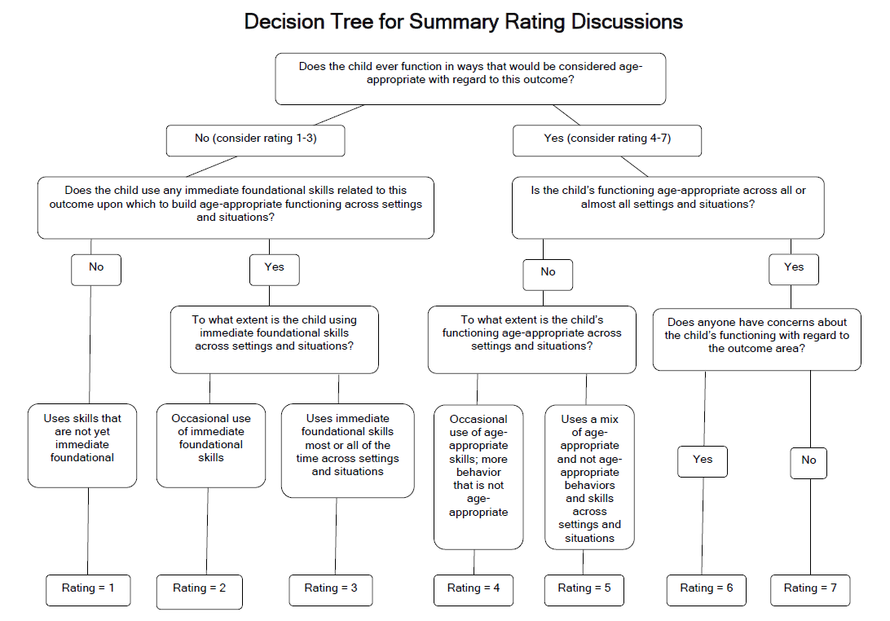
Decision Tree

Slide 73
Where to focus in deciding the rating
Focus on the child’s overall functioning across settings and situations
Functioning that is displayed rarely and/or when the child is provided with a lot of unusual support or prompts is of little significance for the rating

Slide 74
The process for answering questions
Discuss the child’s current functioning in this outcome area across settings and situations
Identify areas where the child’s functioning is age appropriate
If not all functioning is age appropriate, identify areas where the child’s functioning reflects immediate foundational skills
Decide which rating best describes the child’s current functioning

Slide 75
Small Group Instructions
Form a team of 3
Assign each team member to watch for an outcome area
Discuss age expectations (Evan 18 mo; Finely 36 mo)
After watching, the team should discuss the child’s skills and behaviors – what is AE, IF, F?
What else would you want to know?
Use the decision tree to determine a (potential) rating

Slide 76
Small Group Debrief
What rating did you come up with and why?
What was easy about the exercise?
What was hard?
What else did you want to know about the child’s functioning?

Slide 77
  Introduction to: Integrating the COS process into the IFSP/IEP process

Slide 78
Integrating Outcomes into the IFSP Process
IFSP Process
Identification and Referral
IFSP Development
Intake and Family Assessment
Child Evaluation and Functional Assessment
Service Delivery and Transition

Slide 79
Background
Desire to make outcomes ‘fit’ into existing processes (not an extra/separate piece)
Local programs naturally integrated to make the outcomes process efficient and effective
Family involvement from the beginning improve data collection and communication with family
Notes:
Integration of the child outcomes measurement with the IFSP/IEP process emerged in the last couple years. As states were rolling out their child outcomes measurement systems, there was a desire from the field to make outcomes ‘fit’ into existing processes – so that it would not be this ‘extra’ or ‘separate’ piece (disconnected from the work professionals were doing with children and families).
And we found, at the national level, that some local programs had naturally integrated to make the outcomes process efficient and effective. So, it emerged from local programs. Local programs figured out how to make it fit naturally into their IFSP/IEP processes.
Essentially, local programs figured out how to involve families in the outcomes measurement from the beginning and found that that improved their data collection and also improved their work with families.

Slide 80
Next Steps
Continuing Needs
Evaluation

Slide 81
Find more resources at:
ECO: http://www.the-eco-center.org/
Self-directed learning page: http://projects.fpg.unc.edu/~eco/pages/selflearning.cfm

Slide 82
Information about ordering the Just Being Kids videos:
© 2001 JFK Partners and Early Childhood Connections
Just Being Kids is a collaborative publication of:
JFK Partners, University of Colorado Health Sciences Center
and
Early Childhood Connections, Colorado Department of Education
For more information about Early Childhood Connections visit:
www.cde.state.co.us/earlychildhoodconnections
For more information about ENRICH and JFK Partners visit:
www.jfkpartners.org
The Just Being Kids videotape and facilitator’s guide is distributed by Western
Media Products.
To order:
Call toll-free: 1 (800) 232-8902
On-line: www.media-products.com
Fax: (303) 455-5302
Mail: P.O. Box 591, Denver, CO 80201

Slide 83
Information about the Results Matter Video Library:
These videos have been produced to help providers better understand ways to use observation, documentation, and assessment to inform practice. You can watch the clips online or download QuickTime versions of the videos for use in educational and professional development activities.
http://www.cde.state.co.us/resultsmatter/RMVideoSeries.htm
For more information about these video clips please contact Larry Edelman at Larry.Edelman@ucdenver.edu.

Slide 84
Information about ordering the Learning Happens videos:
Learning Happens DVD
Claire Lerner and Rebecca Parlakian
ISBN: 9781934019085
Item No.: V507-OLB
Learning Happens features 30 video vignettes that show parents and children—aged birth to 3 years—interacting during everyday play and routines. These vignettes provide rich examples of how:
development unfolds from birth to age 3
young children acquire school readiness skills through everyday interactions and activities
parents and caregivers support children’s early learning and development through daily interactions and activities
These vignettes serve as powerful tools for professionals to use both in direct work with families and for training other early child development professionals. They act as catalysts for discussion about all aspects of early development and provide vivid illustrations of the significant influence parents have in getting their young children ready for school.

