Slide 1



Christina Kasprzak
Austin, Texas, March 2010
Increasing the Quality of
Child Outcomes Data

Slide 2
Objective for the day
To share with you ideas and resources for use in training and TA that will help districts to report more consistent, accurate COSF data
2

Slide 3
Ways of increasing the consistency and accuracy of COSF data
Selecting formal assessments for use with COSF
COSF training and training materials and activities
Reviewing COSF ratings for quality
Analyzing aggregate data

Slide 4
Selecting and implementing good formal assessments as an essential component of good child outcomes measurement
Assessment considerations in reporting child outcomes data
a. No assessment developed for this purpose
b. No ‘perfect’ assessment
c. Formal assessment is one piece of information
d. Formal assessment can provide consistency across teachers/providers, programs, state
e. Formal assessment can ground teachers/providers in age expectations

Slide 5
Defining Assessment
“Assessment is a generic term that refers to the process of gathering information for decision-making.” (McLean, 2004).
Early childhood assessment is a flexible, collaborative decision-making process in which teams of parents and professionals revise their judgments and reach consensus about changing developmental, educational, medical and mental health service needs of young children and their families.” (Bagnato & Neisworth, 1991)

Slide 6
DEC recommended practices on early childhood assessment
1. Professionals and families collaborate in planning and implementing assessment.
Assessment is individualized and appropriate for the child and family.
Assessment provides useful information for intervention.
Professionals share information in respectful and useful ways.
Professionals meet legal and procedural requirements and meet recommended practice guidelines.

Slide 7
Purposes of Assessment
Screening – Is there a suspected delay? Does the child need further assessment?
Eligibility Determination – Is the child eligible for specialized services?
Program Planning – What content should be taught? How should the content be taught?
Progress Monitoring – Are children making desired progress?
Program Evaluation/Accountability – Is the program achieving its intended outcomes?

Slide 8
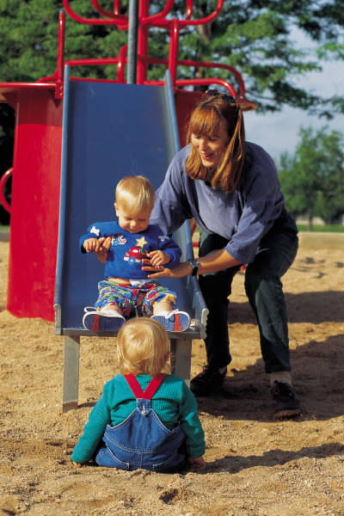
Types of Assessment
Norm-referenced instrument
Criterion-Referenced instrument
Curriculum-based instrument
Direct observation
Progress monitoring
Parent or professional report
(and any combination of above)

Slide 9
PROS and CONS of Norm referenced instruments
PROS
Provides information on development in relation to others
Already used for eligibility
Diagnosis of developmental delay
Standardized procedures
CONS
Does not inform intervention
Information removed from context of child’s routines
Usually not developed or validated with children w/ disabilities
Does not meet many recommended practice standards
May be difficult to administer or require specialized training.

Slide 10
PROS and CONS of Criterion Referenced instruments
PROS
Measures child’s performance of specific objectives
Direct link between assessment and intervention
Provides information on child’s strengths and emerging skills
Helps teams plan and meet individual child’s needs
Meets recommended assessment practice standards
Measures child progress
May be used to measure program effectiveness
CONS
Requires agreement on criteria and standards
Criteria must be clear and appropriate
Usually does not show performance compared to other children
Does not have standard administration procedures
May not move child toward important goals
Scores may not reflect increasing proficiency toward outcomes

Slide 11
PROS and CONS of Curriculum-based instruments
PROS
Provides link between assessment and curriculum
Expectations based upon the curriculum and instruction
Can be used to plan intervention
Measures child’s current status or curriculum
Evaluates program effects
Often team based
Meets DEC and NAEYC recommended standards
Represents picture of the child’s performance
CONS
May not have established reliability and validity
May not have procedures for comparing child to a normal distribution
Generally linked to a specific curriculum
Sometimes comprised of milestones that may not be in order of importance

Slide 12
Again…
No assessment developed for this purpose
No ‘perfect’ assessment
Formal assessment is one piece of information
Formal assessment can provide consistency across teachers/providers, programs, state
Formal assessment can ground teachers/providers in age expectations

Slide 13
Benefits of limiting assessment tools used for COSF
Ensure use of quality assessments as foundation for COSF
Increase the consistency across individuals and programs (ensure the quality of the data)
Reduce Cost/Resources it takes to train and support many tools
Other benefits?

Slide 14
What types of criteria to consider in the process of selecting tools for use with COSF
How well does it cover the 3 outcome areas?
How functional is the information collected about the child?
Does the instrument allow a child to show their skills and behaviors in natural settings and situations?
Does the instrument incorporate observation, parent input, or other sources?
Is the instrument limited to an ideal testing situation?

Slide 15
Assessment Tool Trends
More and more states establishing a list of ‘approved’ instruments
Most frequently used tools (reported by States):
  Creative Curriculum - AEPS
  BDI-2 - High Scope
  Brigance - Work Sampling System

Slide 16
Highlights of New Hampshire Criteria
Adaptation for children with special needs
Alignment with fed/state/local standards
Encourages team and family collaboration
Family involvement in the assessment process
Comprehensiveness
Cultural sensitivity
Developmentally appropriate
Multiple means for child expression
Reliability/validity
System for documenting progress
For more info: http://ptan.seresc.net/forms/pseo/AssessmentBooklet.pdf

Slide 17
Highlights of Illinois Criteria
A good assessment system ...
Is authentic, focusing on knowledge and skills as applied in everyday contexts
includes information from those who see the child using his/her skills in everyday environments
is based on multiple methods for collecting information
relies primarily on procedures that capture the ongoing life of the classroom and typical, familiar, daily activities of interest to and important to children
includes information from parents and other caregivers on children's use of skills at home and in the community
recognizes individual diversity of learners (culture, language, ability)
relates to curriculum and teaching, including improvement of instruction
provides useful information for overall evaluation of the program, including program improvement
For more info: http://www.isbe.net/earlychi/html/ec_speced_outcomes.htm

Slide 18
Highlights of Colorado Criteria
Reliable and valid
Authentic assessment procedures aligned with guidance from major education orgs e.g. NAEYC, DEC
Naturalistic observation central to the assessment
Use of anecdotal records, work sampling, and portfolios
Ongoing; the assessment is completed over time
Opportunities for families to participate in the assessment process
Appropriate for the majority of children, including children with disabilities
Significant positive feedback from local stakeholders
Yields data that informs practices as well as for reporting on requirements
Crosswalks well with Colorado’s Building Blocks
Yields data to inform practices as well as for reporting requirements
For more info: http://www.cde.state.co.us/resultsmatter/download/rm_docs_assessment_selection.pdf

Slide 19
Highlights of North Dakota Criteria
How well does the instrument address each of the three outcome areas?
Are the items, activities and materials culturally appropriate for the different populations served?
Is the instrument appropriate for children with disabilities?
Do we have information on reliability and validity?
Who is intended to administer the instrument? Do we have the qualified personnel or the capacity to train personnel?
Are there clear guides/instructions for how to adapt with diverse populations?
To what extent is the instrument being used in the state?
For more info: http://www.dpi.state.nd.us/speced/early/outcomes_process_guide.pdf

Slide 20
What do you think are values or priorities that would drive YOUR assessment choices?
Activity 1:
review of assessments

Slide 21
Activity:
Review of assessments based on criteria
Break into small groups
Each group assigned a different tool (have copy of tool and crosswalk)
Review the tool against the criteria (handout: Selecting Assessment Tools for Use in Child Outcomes Measurement
Whole group debrief of tools’ strengths
and weaknesses

Slide 22
Application
How could you use an activity
like this in your training and TA?
What experiences or resources do you have about assessment that you already use in your training and TA?

Slide 23

Promoting Data Quality:
The Latest Resources from ECO

Slide 24
Promoting Quality Data
Through training and training
materials, such as:
  Refresher trainings
  Videos of team discussions
  Written child examples
  Review of completed COSFs

Slide 25
Refresher trainings
Training Resources Page:
www.fpg.unc.edu/~eco/pages/training_resources.cfm#COSFTopics
Refresher PPT: Background on Requirements
www.fpg.unc.edu/~eco/assets/ppt/Refresher-background_revised.ppt
Refresher PPT: COSF
www.fpg.unc.edu/~eco/assets/ppt/Refresher-COSF_revised.ppt
*Also includes: Suggested Activities & Participant Materials

Slide 26
Refresher:
Child Outcome
Summary Form

Slide 27
Essential Knowledge for Completing the Child Outcomes Summary Form
Between them, team members must:
1. Know about the child’s functioning across settings and
situations
2. Understand age-expected child development
3. Understand the content of the three child outcomes
4. Know how to use the rating scale
5. Understand age expectations for child functioning
within the child’s culture

Slide 28
Important point
It is not necessary that all team members be knowledgeable in all 5 areas
Especially, no expectation that parents understand the rating scale or typical child development
But the professionals have to!

Slide 29
Essential Knowledge for Completing the Child Outcomes Summary Form
Between them, team members must:
1. Know about the child’s functioning across settings and
situations
2. Understand age-expected child development
3. Understand the content of the three child outcomes
4. Know how to use the rating scale
5. Understand age expectations for child functioning
within the child’s culture

Slide 30
1. Know about the child’s functioning across settings and situations
How we learn about the child’s functioning across settings and situations:
Good Assessment

Slide 31
DEC* recommended practices for assessment
Involve multiple sources
  Examples: family members, professional team members, service providers, caregivers
Involve multiple measures
  Examples: observations, criterion- or curriculum-based instruments, interviews, norm-referenced scales, informed clinical opinion, work samples
*Division for Early Childhood

Slide 32
Assessment practices appropriate for outcomes measurement: ASHA*
ASHA recommended practices:
  Gather information from families, teachers, other service providers
  Collect child-centered, contextualized, descriptive, functional information
(*American Speech-Language-Hearing Association)
Notes:
A balanced assessment, according to ASHA, includes information from families, teachers, other service providers, and information that is child-centered, contextualized, descriptive and functional.

Slide 33
Assessment instruments
Assessment the tool vs. assessment the process
Assessment tools can inform us about children’s functioning in each of the three outcome areas
Challenge:
  There is no assessment tool that assesses the three outcomes directly

Slide 34
Essential Knowledge for Completing the Child Outcomes Summary Form
Between them, team members must:
1. Know about the child’s functioning across settings and
situations
2. Understand age-expected child development
3. Understand the content of the three child outcomes
4. Know how to use the rating scale
5. Understand age expectations for child functioning
within the child’s culture

Slide 35
Resources for understanding age-expected child development
ECO link
http://www.fpg.unc.edu/~eco/pdfs/Age-expected_child_dev_9-5-07.pdf
(under “ECO Tools”)
New course coming soon
  Watch ECO web site
  www.the-eco-center.org

Slide 36
Essential Knowledge for Completing the Child Outcomes Summary Form
Between them, team members must:
1. Know about the child’s functioning across settings and
situations
2. Understand age-expected child development
3. Understand the content of the three child outcomes
4. Know how to use the rating scale
5. Understand age expectations for child functioning
within the child’s culture

Slide 37
Outcomes Jeopardy
Pointing to the cabinet for cereal | Reading the letter “S” on the Stop sign | Washes hands before lunch
Biting | Plays by himself in the classroom | Plays with rhyming words
Building a castle from blocks with a friend | Problems sleeping | Sharing a cookie at lunchtime
$100
$100
$100
$200
$200
$200
$300
$300
$300
Notes:
Click over each cell to reveal example from the outcomes categories. Have participants identify which examples are 1) positive social relationships 2) acquiring and using knowledge and skills or 3) taking action to meet needs

Slide 38
Children have positive social relationships
Involves:
  Relating with adults
  Relating with other children
  For older children, following rules related to groups or interacting with others
  Includes areas like:
  Attachment/separation/autonomy
  Expressing emotions and feelings
  Learning rules and expectations
  Social interactions and play

Slide 39
Children acquire and use knowledge and skills
Involves:
  Thinking
  Reasoning
  Remembering
  Problem solving
  Using symbols and language
  Understanding physical and social worlds
Includes:
  Early concepts—symbols, pictures, numbers
  Imitation
  Object permanence
  Expressive language and communication
  Early literacy

Slide 40
Children take appropriate action to meet their needs
Involves:
  Taking care of basic needs
  Getting from place to place
  Using tools (e.g., fork, toothbrush, crayon)
  In older children, contributing to their own health and safety
Includes:
  Integrating motor skills to complete tasks
  Self-help skills (e.g., dressing, feeding, grooming, toileting, household responsibility)
  Acting on the world to get what one wants

Slide 41
Essential Knowledge for Completing the Child Outcomes Summary Form
Between them, team members must:
1. Know about the child’s functioning across settings and situations
2. Understand age-expected child development
3. Understand the content of the three child outcomes
4. Know how to use the rating scale
5. Understand age expectations for child functioning within the child’s culture

Slide 42
The two COSF questions
a. To what extent does this child show age-appropriate functioning, across a variety of settings and situations, on this outcome? (Rating: 1-7)
b. Has the child shown any new skills or behaviors related to [this outcome] since the last outcomes summary? (Yes-No)

Slide 43
7 – Completely
Child shows functioning expected for his/her age in all or almost all everyday situations that are part of the child’s life
  Home, store, park, child care, with strangers, etc.
Functioning is considered appropriate for his/her age
No one has any concerns about the child’s functioning in this outcome area

Slide 44
6 – Between completely and somewhat
Child’s functioning generally is considered appropriate for his or her age but there are some significant concerns about the child’s functioning in this outcome area
These concerns are substantial enough to suggest monitoring or possible additional support
Although age-appropriate, the child’s functioning may border on not keeping pace with age expectations

Slide 45
5 – Somewhat
The child shows functioning expected for his/her age some of the time and/or in some situations
The child’s functioning is a mix of age-appropriate and not appropriate functioning
The child’s functioning might be described as like that of a slightly younger child
Notes:
We use the terminology that behaviors MIGHT BE more like those of younger children intentionally. For example, a child with autism does not display typical behaviors, but the behaviors observed would not be described as those of a younger child either.

Slide 46
4 – Between somewhat and nearly
Child shows occasional age appropriate functioning across settings and situations
More functioning is not age appropriate than age appropriate

Slide 47
3 – Nearly
Child does not yet show functioning expected of a child of his or her age in any situation
Child uses immediate foundational skills, most or all of the time across settings and situations
Immediate foundational skills are the skills upon which to build age-appropriate functioning
Functioning might be described as like that of a younger child

Slide 48
2 – Between nearly and not yet
Child occasionally uses immediate foundational skills across settings and situations
More functioning reflects skills that are not immediate foundational than are immediate foundational

Slide 49
1 – Not yet
The child does not yet show functioning expected of a child his/her age in any situation
The child’s functioning does not yet include immediate foundational skills upon which to build age-appropriate functioning
Child functioning reflects skills that developmentally come before immediate foundational skills
The child’s functioning might be described as like that of a much younger child

Slide 50
Rating Scale Jeopardy
Age appropriate functioning – no concerns | Mix of age appropriate and not age appropriate functioning | No age appropriate functioning – not yet showing immediate foundational skills
Some age appropriate functioning but very little | No age appropriate functioning – lots of immediate foundational skills | Age appropriate functioning – some concerns
Rarely shows age appropriate functioning | No age appropriate functioning – some immediate foundational skills | Age appropriate functioning
$100
$100
$100
$200
$200
$200
$300
$300
$300
Notes:
Click over each cell to reveal example from the outcomes categories. Have participants identify which number on the rating scale corresponds to the examples.

Slide 52
Essential Knowledge for Completing the Child Outcomes Summary Form
Between them, team members must:
1. Know about the child’s functioning across settings and
situations
2. Understand age-expected child development
3. Understand the content of the three child outcomes
4. Know how to use the rating scale
5. Understand age expectations for child functioning
within the child’s culture

Slide 53
Videos of Team Discussions

Slide 54
Training Activities
Training Resources Page:
www.fpg.unc.edu/~eco/pages/training_resources.cfm#COSFTopics
Training Activities Page:
www.fpg.unc.edu/~eco/pages/training_activities.cfm
e.g.
Quality review of COSF team discussion (video example)
Quality review of Family Participation (video example)

Slide 55
Activity 2:
Quality review of
COSF team discussion
55

Slide 56

Quality Review of COSF Team Discussion
Ethan
4 Yr 10 mo
Team: parents,
ECSE teacher,
SLP, OT

Slide 57
Quality Review of COSF Team Discussion
1. What were the overall strengths and weaknesses of the team discussion?
2. How well did the team use assessment information in this discussion?
3. To what extent was the family involved in the discussion?

Slide 58
Quality Review of COSF Team Discussion
4. To what extent did the discussion focus on the child’s skills and behaviors in everyday life?
5. What key information might you record from this discussion using the Child Outcomes Summary Form (COSF)?
6. What additional information would you need to determine a rating for this outcome using the COSF?
58

Slide 59
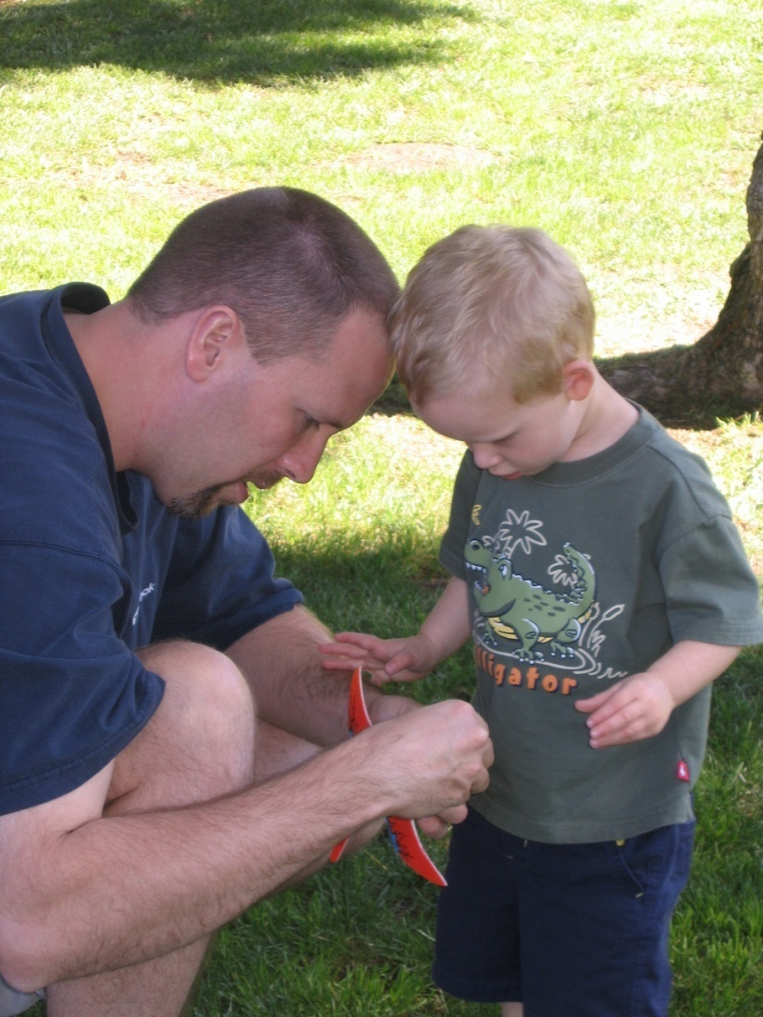
Involving Families in the COSF Process
59

Slide 60
Informing Families
What is being done to inform families about
the data collection?
  Why it is occurring
  What it involves
  What it means for them and their child
60

Slide 61
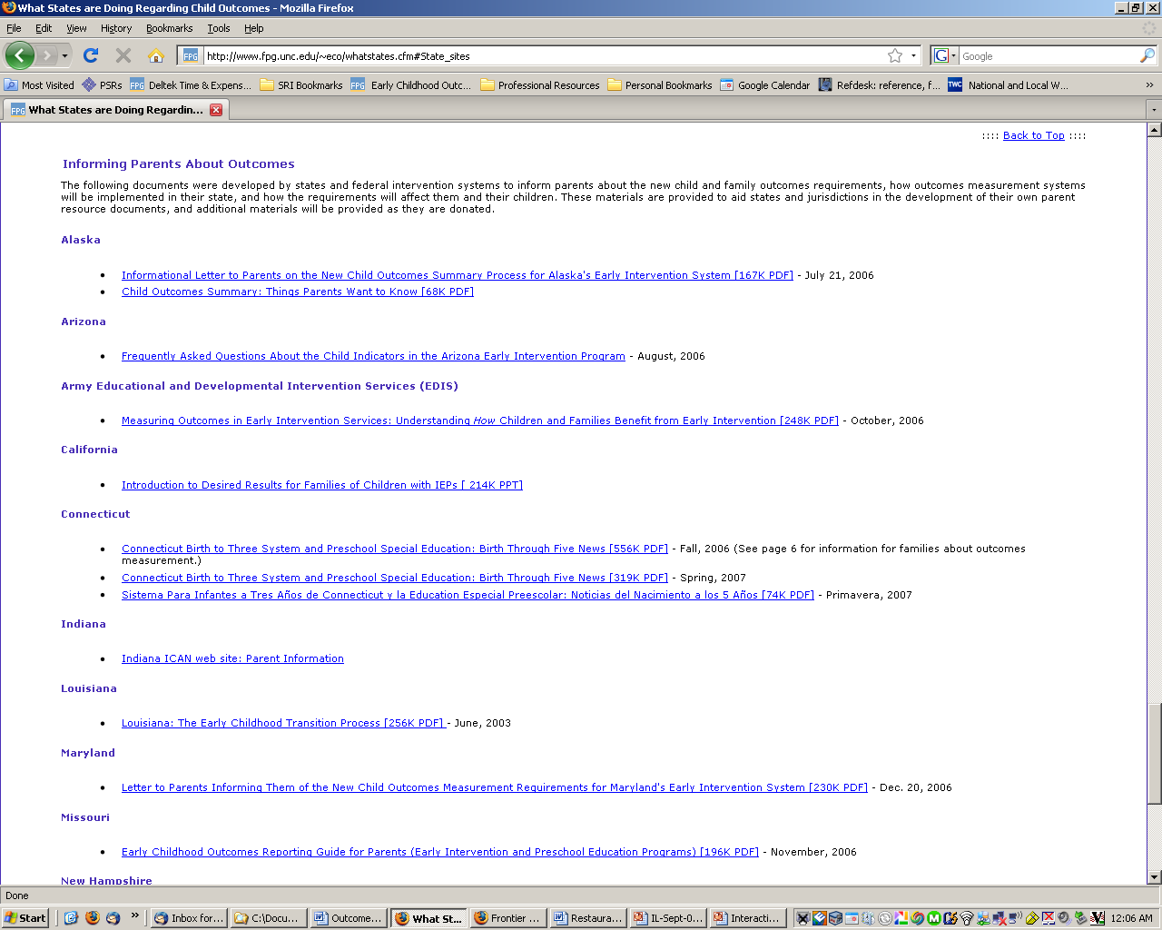
State Materials: Informing
Parents about Outcomes
61

Slide 62
Preparing Families
Helping families be active participants in the discussion
  What is working?
  What is not working?
General principle: Families need to know what to expect
62

Slide 63
What Do We Expect from Families
Yes - That they will be able to provide rich information about their child’s functioning across settings and situation
Maybe but not necessarily – That they will know whether their child is showing age appropriate behavior
63

Slide 64
Involving Families in a Conversation about Their Child
Avoid jargon
Avoid questions that can be answered with a yes or no
  “Does Anthony finger feed himself?”
Ask questions that allow parents to tell you what they have seen
  “Tell me about how Anthony eats”
64

Slide 65

Strategies for Involving Families in the COSF Rating Discussion
Individualizing to family; giving family choice
Using the ‘words’ rather than numbers when discussing ratings with families
Other?
65

Slide 66

Involving Families in the
Rating Discussion
What % of families are participating?
What is working?
What is not working?
66

Slide 67
Families’ Right to
COSF Information
All families have a right to know what ratings have given to their child -- and to the records containing the information.
67

Slide 68
Application
How could you use the videos in your training and TA?
What experiences or resources do you have with using videos in your training and TA?
68

Slide 69
Activity 3:
Written child example
69

Slide 70
Training Activities
Training Resources Page:
www.fpg.unc.edu/~eco/pages/training_resources.cfm#CO
FTopics
Training Activities Page:
www.fpg.unc.edu/~eco/pages/training_activities.cfm
e.g.
Written Child Example

Slide 71
Small group activity
Count off by 1-4
Break into 4 small groups
Each small group reads ONE of the data sources
  Family report
  Preschool classroom observation
  Child care provider
  Formal assessment
71

Slide 72
Small group activity
Discuss Ava’s skills and behaviors Outcome 1
Record skills and behaviors on blank summary of relevant results
Code Ava’s skills and behaviors for Outcome 1 by approximation to age expectations
  AA=age appropriate
  IF=immediate foundational
  F=foundational
72

Slide 73
Small group activity
Count off 1-4 again
Re-gather into new groups with all data sources represented
Share what you discussed in your initial group to get a complete picture of Ava
Based on all the data sources and coding, what would be an appropriate rating for Outcome 1?
73

Slide 74
Small group activity
Review the ECO-coded skills for Ava
  How does your assignment of AA, IF & F compare to the ECO version?
  What difference, if any, do you see?
  What are implications for the rating?
74

Slide 75
Small group activity
Repeat the entire process of reviewing data sources for Ava with Outcomes 2 & 3
75

Slide 76
Application
How could you use this child example in
your training and TA?
What experiences or resources do you
have with using child examples in your
training and TA?
76

Slide 77
Reviewing COSF Ratings
for Quality
77

Slide 78
Training Activities
Training Resources Page:
www.fpg.unc.edu/~eco/pages/training_resources.cfm#COSFTopics
Training Activities Page:
www.fpg.unc.edu/~eco/pages/training_activities.cfm
e.g.
COSF Quality Review
78

Slide 79

Quality Review of Completed COSFs
Is the COSF complete?
Is there adequate evidence for the basis for the rating?
Does the evidence match the appropriate outcome area?
Is the evidence based on functional behaviors?
79

Slide 80
Quality Review of Completed COSFs
Is there evidence that the child’s functioning across settings and situations considered?
Are the ratings consistent with the evidence?
80

Slide 81
Quality Review of COSF
Activity 4:
Review completed COSF
with errors
81

Slide 82
Application
How could you use this COSF review
example in your training and TA?
What experiences or resources do you
have with using COSF review examples
in your training and TA?
82

Slide 83
Looking at Data
83

Slide 84
Continuous Program Improvement
Reflect
Are we where we want to be?
Check
(Collect and analyze data)
Plan (vision)
Program characteristics
Child and family outcomes
Implement
84

Slide 85

Using data for program improvement = EIA
Evidence
Inference
Action
85

Slide 86

Evidence
Evidence refers to the numbers, such as
  “45% of children in category b”
The numbers are not debatable
86

Slide 87
Inference
How do you interpret the #s?
What can you conclude from the #s?
Does evidence mean good news? Bad news? News we can’t interpret?
To reach an inference, sometimes we analyze data in other ways (ask for more evidence)
87

Slide 88

Inference
Inference is debatable -- even reasonable people can reach different conclusions
Stakeholders can help with putting meaning on the numbers
Early on, the inference may be more a question of the quality of the data
88

Slide 89
Action
Given the inference from the numbers, what should be done?
Recommendations or action steps
Action can be debatable – and often is
Another role for stakeholders
Again, early on the action might have to do with improving the quality of the data
89

Slide 90
Promoting quality data through data analysis
90
Notes:
90

Slide 91
Promoting quality data through data analysis
Examine the data for inconsistencies
If/when you find something strange, look for other data that might help explain it.
Is the variation caused by something other than bad data?
91
Notes:
91

Slide 92
The validity of your data is questionable if…
The overall pattern in the data looks “strange’:
  Compared to what you expect
  Compared to other data
  Compared to similar states/regions/school districts
92
Notes:
92

Slide 93
Let’s look at some data …
93
Notes:
93

Slide 94
COSF Ratings – Outcome 1 Entry data (fake data)
Rating | Statewide # | Statewide%
1 | 300 | 15%
2 | 421 | 21%
3 | 516 | 25%
4 | 604 | 29%
5 | 101 | 5%
6 | 109 | 5%
7 | 0 | 0%
94
Notes:
94

Slide 95
Frequency on Outcome 1 - Statewide
95

Slide 96
COSF Ratings – Outcome 1 Entry data (fake data)
Rating | Group 1 # | Group 2 # | Group 3 # | Group 4 #
1 | 30 | 11 | 10 | 12
2 | 40 | 10 | 42 | 42
3 | 50 | 20 | 23 | 23
4 | 64 | 31 | 32 | 34
5 | 10 | 40 | 45 | 44
6 | 10 | 52 | 50 | 40
7 | 0 | 4 | 2 | 2
96
Notes:
96

Slide 97
COSF Ratings – Outcome 1 Entry data (fake data)
Rating | Group 1 % | Group 2 % | Group 3 % | Group 4 %
1 | 15 | 7 | 5 | 6
2 | 20 | 6 | 21 | 21
3 | 25 | 12 | 11 | 12
4 | 31 | 18 | 16 | 17
5 | 5 | 24 | 22 | 22
6 | 5 | 31 | 25 | 20
7 | 0 | 2 | 1 | 1
97
Notes:
97

Slide 98
Comparison of two Groups

Slide 99
Average Entry Scores on Outcomes
Group | Social-Emotional | Knowledge and Skills | Action to Meet Needs
1 | 4.5 | 4.6 | 4.7
2 | 5.3 | 5.2 | 4.7
3 | 4.9 | 4.9 | 4.9
4 | 6.4 | 5.9 | 6.6
5 | 5.3 | 4.3 | 4.9
6 | 3.8 | 2.9 | 3.9
Total | 5.03 | 4.63 | 4.95

Slide 100
Outcome 3: Appropriate Action (fake data)
 | Entry
Exit | 1 | 2 | 3 | 4 | 5 | 6 | 7 | total
1 | 1 | 4 | 2 |  |  |  |  | 7
2 | 1 | 1 | 5 | 6 | 9 | 3 | 1 | 26
3 |  | 2 | 15 | 14 | 27 | 19 | 6 | 83
4 |  | 4 | 4 | 21 | 39 | 28 | 12 | 108
5 |  | 1 | 12 | 14 | 71 | 86 | 48 | 232
6 |  | 1 |  | 3 | 21 | 48 | 63 | 136
7 |  |  |  | 2 | 18 | 23 | 56 | 99
Review Total | 2 | 13 | 38 | 60 | 185 | 207 | 186 | 691
100
Notes:
100

Slide 101
OSEP Categories – Outcome 2: fake data
OSEP Categories | Group 1 (%) | Group 2 (%) | Group 3 (%)
e. Maintained Age Appro Trajectory | 23 | 16 | 24
d. Changed Traj – Age Appro | 15 | 23 | 13
c. Changed Traj – Closer to Age Appropriate | 32 | 34 | 37
b. Same Trajectory -Progress | 28 | 21 | 25
a. Flat Trajectory – No Prog. | 2 | 6 | 1
101
Notes:
101

Slide 102
Questions to ask
102
Do the data make sense?
  Am I surprised? Do I believe the data? Believe some of the data? All of the data?
If the data are reasonable (or when they become reasonable), what might they tell us?
Notes:
102
Can’t use data for program improvement until you believe them.

Slide 103
Examining COSF data at one time point
One group - Frequency Distribution
  Tables
  Graphs
Comparing Groups
  Graphs
  Averages

Slide 104
What we’ve looked at:
Do outcomes vary by:
    Unit/District/Program?
    Rating at Entry?
    Amount of movement on the scale?
    % in the various progress categories?

Slide 105
What else might you want to look at?
Do outcomes vary by child/family variables
or by service variables, e.g. :
    Services received?
    Age at entry to service?
    Type of services received?
    Family outcomes?
    Education level of parent?
105
Notes:
105

Slide 106
Activity 5:
Reviewing sample data

Slide 107
Application
How could you use this type of data
discussion in your training and TA?
What experiences or resources do you
have with discussing outcomes data in
your training and TA?

Slide 108

Keeping our
eye on the prize:
High quality services
for children and families
that will lead to good outcomes.

