Slide 1
Session 2: Establishing State Context
Building the Case
Expanding Access to Public and Private Insurance Funding for Early Intervention

Slide 2
Overview of the Case Building Series
Session 1: Getting Started and Building Relationships
Session 2: Establishing State Context
Session 3: Conducting Relevant Data Analysis
Notes:
The series addresses the planning and preparation needed to build your State specific case for expanding access to Medicaid or Private Insurance. This session will focus on establishing state context.

Slide 3
Session 2 Outcomes
Learn
Identify
Understand
Develop
Participants will:
Develop an understanding of the baseline information needed to be presented regarding federal and state requirements for Part C
Understand the audience and information needed to make a convincing argument for funding expansion
Identify, organize and build a network of stakeholders that will support funding expansion goals
Learn effective communication strategies to gain access and support of high-level decision makers

Slide 4
ECTA Systems Change Model- Framework Connections
Finance Planning Process/Forecasting
Fiscal Data
Procurement
Resource Allocation, Use of Funds and Disbursement
Monitoring and Accountability of Funds and Resources
Governance
Result
Quality
Standards
Finance
Implementation
of
Effective Practices
Positive outcomes for children with disabilities and their families
Building
High-Quality
Systems
Accountability & Quality Improvement
Personnel / Workforce
Data
Systems
Notes:
ECTA System Framework has 6 components:
Governance, Accountability, Data System, Finance, Personnel/Workforce and Quality Standards.
The systems Framework addresses indicators of quality for each of these system components.
Within the Finance Component, there are 5 sub-components:
Finance Planning Process/Forecasting
Fiscal Data
Procurement
Resource Allocation, Use of Funds and Disbursement
Monitoring and Accountability of Funds and Resources
A high-quality system supports the implementation of effective practices, which result in positive outcomes for children with disabilities and their families.

Slide 5
Establishing the Context cont’d
Why is context important?
The goal of early intervention is to enable young children to be active and successful participants during the early childhood years and in the future.
To meet this goal, financial resources are needed.
We encounter politics in all aspects of our work; understanding and navigating the politics at the program, state, and national level requires intentional relationships and defined strategies.

Slide 6
Hearing the Experience from a prior Part C Coordinator
Andy Gomm of New Mexico discusses the experience of Part C seeking to expand services reimbursed through private insurance.
Click on the image to the right to view the video.
A transcript of the video is available in the notes.
Notes:
Video transcript:
Ron Benham: Why did you choose to move forward to access private insurance in New Mexico during your tenure?
Andy Gomm of New Mexico: So, back in 2005, New Mexico was facing a budget shortfall. We were increasing the number of children served at pretty much an exponential rate due to some probably good Child Find and awareness in the state of the importance of Early Intervention. And going back to the state to request additional funds, we were already maximizing Medicaid. We had a strong relationship with our Medicaid office and they were a full partner in paying for Early Intervention. But with all of that, we were still facing a shortfall. And so we started to look with our Interagency Coordinating Council for other revenue sources. We considered family fees and based on the experience of other states rejected that. It didn't feel appropriate for our state. So, we started to look at private insurance as a way to fill a gap in our funding and started at that time to talk to other states that had had experience.

Slide 7
What is the political context you have to address?

Slide 8
How do you address political environment ?
Conduct an environmental scan:
Who has a vested interest in this issue?
What data do you have to support the need?
Determine if there is a history associated with the issue.
Identify the power base in the legislative and executive branches.
Determine the relevancy of the issue to the legislative agenda.
What resources are needed? And who else is asking for resources?
Who would support it? Who would not?
Notes:
Conduct a political environmental scan:
Who can make the decision to move forward?
Does your Governor support early intervention?
Do you have informal connections to the Governor?
What about his/her spouse?
Has your preliminary direction/planning been shared with your Commissioner?
Do they understand how this supports the lead agency’s mission?
Does your lead agency Commissioner/Director support your proposed direction?
Does your lead agency Commissioner/Director understand what resources are needed to support the program?

Slide 9
How do you gain legislative support?
Identify champions who have influence with the legislators (e.g., business leaders, parents, community members) who will advocate.
Identify legislators who may have an interest or have a family member with a delay or disability.
Focus your message on common concerns for both parties when presenting.
Establish a clear concise message that everyone follows.
Tell the story of how legislative support makes a difference for children with disabilities.
Utilize political relationships with state professional chapters (e.g., American Academy of Pediatrics, ASHA, Family Voices etc.).
Notes:
What are those political strategies that support the program?
Nonpartisan
Honest about budget needs
Using best data available
Mobilized our champions at different times; had both republicans and democrats
Parents as advocates
Utilized editorials in news paper

Slide 10
Considerations of Legislative Intent
What are the policy implications of the changes you want to make?
What are the legislative priorities for the upcoming session?
Who are the advocates? Who would be opposed and why?
Consider building relationships first through providing information and buy-in for the change, then seek legislative change.
How does legislative support for this issue, make a difference for other priorities?
You may have to have a long game strategy; the change you want may take several years.
Notes:
You and ultimately your senior state lead agency staff and stakeholders must be able to answer the questions on this slide.
Do your homework so that potential roadblocks will be identified early.

Slide 11
What is the impact of COVID-19 on legislative agenda?
The pandemic has stretched state and federal resources at a time when families have great needs.
What expansions that have occurred in the Part C program do you need legislative action on to continue?(e.g., telehealth, Medicaid expansion)
Assess whether this is the right time to proceed, engaging and educating policymakers is important even when you don’t have an ask.
Notes:
What other actions has the State taken to address the impacts of this historic crisis?
Has Part C been impacted to date, either negatively or positively?
Have there been expansions in other program insurance (telehealth, mental health, substance use disorders, COVID-19 financial exposure)?
What are other sister agency priorities, and how will the lead agency avoid interagency conflict?
Do you have knowledge of superseding budget priorities?
If it’s an election year, is the right time for this change?
If the Medicaid budget is frozen, is it the right time to pursue this change?

Slide 12
How do stakeholders support a successful advocacy effort?
Share stories, data and resources on your issue.
Frame the message for the various audiences.
Visit legislators when they are not in session and in their home offices; invite them to visit your program.
Use social media to tell the story (e.g., Facebook, Twitter); place op-eds in the paper; attend townhalls; make calls to legislative offices.
Build strong partnerships with networks and coalitions who have similar issues.
Notes:
What are the levers that can be pulled to support the program?
Maintenance of Effort (MOE) https://ectacenter.org/topics/finance/moe.asp
Maximizing funding; using state funds to match federal funds
Other agency decision makers in the State for this program
Education or Human Services advocacy groups
Early Intervention provider organization
Broader Early Education and Child Care providers

Slide 13
Reflection Questions
How are you adjusting your approach to leading in an uncertain environment?
What are your state’s ongoing challenges?
What are your state’s opportunities?
As state and federal resources are stretched, how do you make the case that EI is a critical priority?

Slide 14
Who are your stakeholders? cont’d
Families:
Build on strong relationships with families served
Recognize families as your primary political strength
Seek support from your state Parent Training and Information (PTI) Centers
Notes:
Talk about the advocacy of families for IDEA Part C and the positive impact on very young children and their families
Part C has always had a strong network of families to support the program
Make your families front and center in your advocacy work
Make it personal to friends, neighbors and positive developmental outcomes

Slide 15
Who are your stakeholders?
Building leverage and on-going collaborative partnerships with:
Service providers:
Assess your relationship with your provider community.
Do they have a trade organization?
Providers are key allies if you operate in concert.
Are providers currently politically active?
Are you on the same page regarding system direction?
Notes:
Providers are a key constituency in the selling of your goals of greater financial access.
Are the Early Intervention program's host agency already billing third parties for other services?
Connect as soon as possible with early adopters of your proposed direction.

Slide 16
Who are your stakeholders? cont’d 3
Legislators:
Identify a political champion(s) within your state legislature/general assembly
Work with your Lead Agency’s legislative staff liaison
Legislators with children receiving, or have received, early intervention services
Notes:
Can you name current political champions for Early Intervention services?
Do you have access to your lead agency legislative staff? They will be key for internal support and identifying legislative champions.
Again, be aware of legislators whose children or grand children who have benefitted for Early Intervention services.

Slide 17
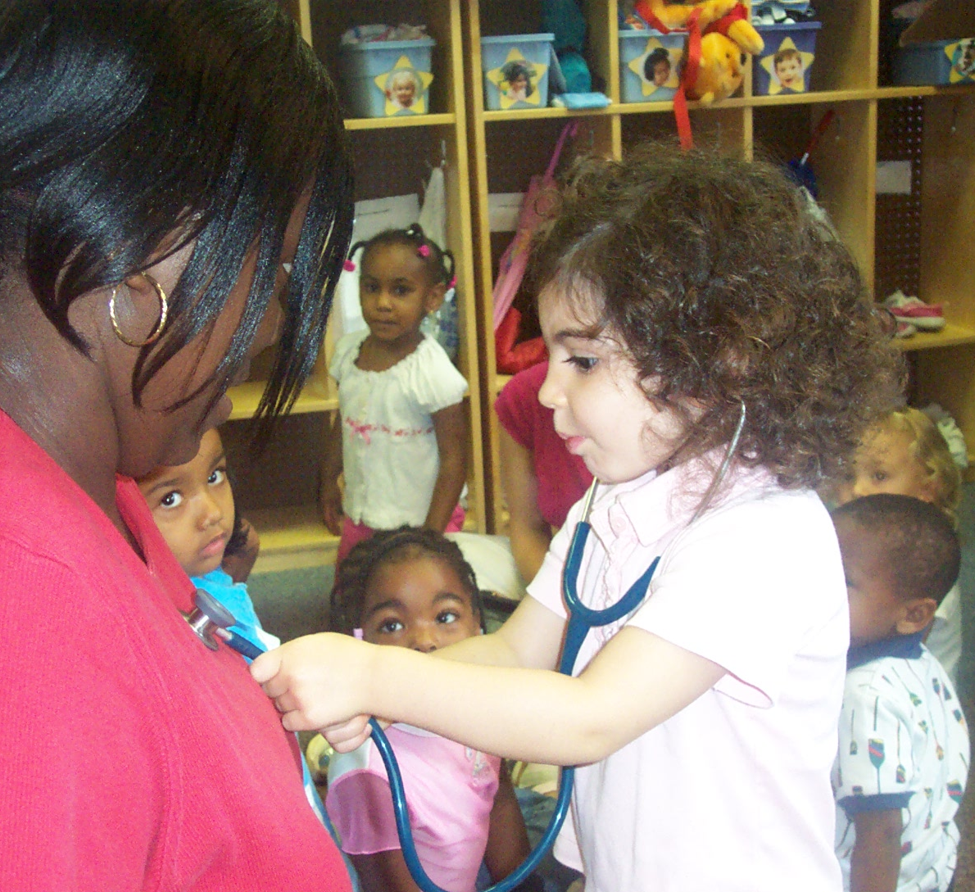
Who are your stakeholders? cont’d 2
Insurers/Benefit Coordinators (if seeking change in insurance status):
Build collegial relationships with benefit coordinators at public and private health plans
Meet regularly with these coordinators
Establish a supportive contact at your state/territorial Division of Insurance
Notes:
Do not, DO NOT, identify potential other payers, their staff or policies as the "enemy".
Make all best efforts to build trusting relationships even if initial efforts are not successful.

Slide 18
Reflection Questions 2
What do your key stakeholders need to know in order to make an informed decision about Part C?
Reflect on changing economic and political context.
How does this inform next steps?
Legislative Priorities
What are the policy implications of the changes you want to make?
What are the legislative priorities for the upcoming session?
Who are the advocates?
Notes:
Suggested considerations as you plan on making system changes.

Slide 19
Building the Network: IN THE END IT’S ABOUT RELATIONSHIPS
Remember the significance of the following four points:
It is all about relationships
Need to support provider community and families in understanding the process
Transparency: Communicate, communicate, communicate with everyone all of the time
Create stakeholder groups to identify and support ongoing implementation issues and avoidance of misunderstanding
Notes:
Communication planning and networking for both
1. Decision makers; and
2. People who will be implementing and or impacted by implementation

Slide 20
Hearing the Experience from a Part C Coordinator & Staff cont’d
Catherine Hancock and Kyla Patterson from Virginia discuss the experience of Part C seeking to expand services reimbursed through Medicaid and the importance of establishing relationships.
Click on the image to the right to view the video.
A transcript of the video is available in the notes.
Notes:
Video transcript:
Ron Benham: Much of what we were talking about, specifically I think for the two of you, is from a Medicaid perspective. What should any state or Part C person at a, let's say an upper level within their management system, know when approaching Medicaid?
Catherine Hancock of Virginia: I think one thing to think about when you're first approaching a Medicaid agency if you're looking to increase your funding for your early intervention program is to establish relationships. I think that is essential. In Virginia we were really lucky to have a very positive working relationship with someone at the Medicaid agency who was really dedicated to early childhood health and related issues and was very interested in early intervention programs. So that, I think that was a huge part of what made our program successful. And I also think be prepared when you go and be prepared with some information about how you expect the long-term save the Medicaid program would be. Because we all know that if you provide services early, you're gonna save money down the road and it includes the quality of a child and family's lifelong trajectory.
Ron Benham: Did you already have a relationship with the individuals in Medicaid because of your own background or Kyla did you have relationships with these people before you got into serious discussions about what you wanted to do?
Kyla Patterson: Well, I think one of the nice things in Virginia is that our code of Virginia establishes the State Medicaid Agency as one of the participating agencies in Part C early intervention and did from the get-go. So they were always engaged in this work in general and they were active participants as well on our State Interagency Coordinating Council.

Slide 21
Understanding the Context within IDEA

Slide 22
What is the intent of Part C?
Congress established this program in 1986 in recognition of "an urgent and substantial need" to:
enhance the development of infants and toddlers with disabilities;
reduce educational costs by minimizing the need for special education through early intervention;
minimize the likelihood of institutionalization, and maximize independent living; and
enhance the capacity of families to meet their child's needs.
Notes:
IDEA’s intent and purpose-
Your intended audience/decisionmakers may not be familiar with IDEA statute and regulations and more specifically, financing the system
To aid states in developing and implementing “a statewide, comprehensive, coordinated, multidisciplinary, interagency system that provides early intervention services for infants and toddlers with disabilities and their families.”
IDEA funds to serve as Glue Money – coordination of existing resources. Building Partnerships (Method).
Times/realities have changed in many if not all states (funding sources have shifted. Some have gone away…)
Part C is NOT intended to be a stand‐alone program serving this population. The intent of Part C is to build interagency partnerships among existing state agencies in health, education, human services and developmental disabilities.
Part C is not like Part B, where there are LEA allocations by formula

Slide 23
What is the purpose of Part C?
Develop and implement a statewide, comprehensive, coordinated, multidisciplinary, interagency system that provides early intervention services.
Facilitate the coordination of payment for early intervention services.
Enhance State capacity to provide quality early intervention services and expand and improve existing early intervention services.
Enhance the capacity of State and local agencies and service providers to identify, evaluate, and meet the needs of all children, including historically underrepresented populations.
Notes:
Purpose of Part C 34 CFR 303.1
These purposes (and the intent of Part C) also drive the allowable use of IDEA Part C funds and reflect the intent of the program. Part C does not have a specific Use of Funds section that describes allowable activities (Similar to state set-asides in Part B).
Where Building the Case is concerned, the intent and purpose of Part C also highlight the need for additional funding sources to support early intervention services. See Bullet # 3
Stakeholders and decision-makers need to understand the intent and purpose of the program, driving the need for additional payor sources in order to maintain and grow the program.
Bullet 1: The terms Statewide comprehensive, coordinated, interagency- Tie-in to the intent of Part C (coordinating existing funding sources)
Statewide- importance of ensuring that any expansions are available to all geographic regions of the State. Consistent implementation statewide.
Bullet 2: Coordination …from Federal, State, local, and private sources (including public and private insurance coverage). -system considerations such as who bills for EI services.
Bullet 3: Expanding access to private insurance and public benefits has the potential to “expand and improve” existing EI services.
Bullet 4: Serving underrepresented populations- particularly minority, low-income, inner-city, and rural children, and infants and toddlers in foster cared plan to provide services. The potential of Medicaid to accomplish this.

Slide 24
What are some of the key Part C requirements to consider?
IDEA regulations related to financing Part C Services:
System of Payments in 34 CFR §§ 303.521;
Use of Public Benefits or Private Insurance in 34 CFR § 303.520;
Payor of Last Resort in 34 CFR § 303.510; and
Methods in 34 CFR § 303.511.
Notes:
Key Financial Regulations:
System of Payment Considerations-
If the state is accessing a new payor source (e.g. private insurance), its system of payments will need to be revised and approved by OSEP to reflect those changes.
Updates to reflect consent requirements specific to private insurance and public benefits.
Any changes will have to comply with the Use of Public Benefits or Private Insurance requirements (Fees, functions that are not subject to fees, for example). Payment of co-pays and deductibles would be considered fees.
Payor of Last Resort reminder- Any new payor sources (Public Benefits or Private Insurance) should be accessed before Part C. *With the exception of interim payments to avoid delay/disruption of services.
Methods- should reflect other agencies that provide and/or pay for EI services, and should be updated to reflect additional payor sources/responsibilities of each agency.
Not listed- Supplement not supplant / MOE - as a protection to ensure continued State funding. It is important that stakeholders/decision makers understand that increases in program income resulting from expanded access to private insurance does not count toward a State’s MOE
State and local funds = Public funding.
State match portion of Medicaid does count.
Note that 303.520 allows for the establishment of a new baseline of State and local expenditures when the State enacts a statute regarding private health insurance that meets IDEA Part C requirements.

Slide 25
What are some of the key Part C requirements to consider? cont’d
IDEA definition of early intervention (EI) services:
Early intervention services are defined in 34 CFR § 303.13
IDEA regulations related to providing EI services:
Early intervention service providers (EIS) - 34 CFR § 303.12
Policy for contracting or otherwise arranging for services in 34 CFR §303.121
Notes:
EI service definitions-
The IDEA regulations provide a (non-comprehensive) list of EI services. State’s have latitude in aligning those definitions with Medicaid and private insurance, to secure payments.
Special Instruction versus Developmental Therapy example.
Medicaid State Plans / Private insurance mandates can expand to cover EI services.
EIS Providers
States also have latitude in establishing qualifications of providers. Revisions to those qualifications (or the Medicaid State Plan) may need to be made in order to allow payments for Part C services.
HMO example. Certification to bill… may result in extra administrative layers, delays/interim payments…

Slide 26
How will you share what your Part C system looks like?
Can you succinctly describe:
Role of Lead Agency
Local Service Delivery Structure
Eligibility Criteria
Percent of Delay
At Risk
Medical Diagnoses
Current Trends
% of children currently served
% you wish to serve, maximizing child find
# Served by birth cohort methodology
Type of Providers
For profit agencies
Non-profit agencies
State/Local governmental employees
Independent Providers
Fund Sources
Federal
State
Local
How does funding flow?
Contracts
Grants
Vouchers
Fee for Service
Capitation
Central Finance
Notes:
You must be able to provide this information, either verbally or within a brief document, in a succinct manner to meet you goal.
Think of your elevator speech and how you would highlight your key points
Keep thinking of how to make your points in as reasonable amount of time as possible

Slide 27
You must be able to tell the story of:
Why you need the change
What will be different if the change is implemented
How this will improve outcomes for infants and toddlers with delays and disabilities, and their families
Notes:
Make sure you can answer these questions in a quick and authentic manner regardless of your audience.

Slide 28
Planning Tool

Slide 29
Sponsors
In association with Part C Fiscal Initiative Partners:
Notes:
This series is being offered by the Early Childhood Technical Assistance Center in association with the Part C Fiscal Initiative Partners.

Slide 30
Find out more at ectacenter.org and dasycenter.org
The content of this presentation was developed under a cooperative agreement, #H326P170001, and a grant, #H373Z120002, from the Office of Special Education Programs, U.S. Department of Education. However, the content does not necessarily represent the policy of the U.S. Department of Education, and you should not assume endorsement by the Federal Government. ECTA Center Project Officer, Julia Martin Eile, and DaSy Center Project Officers, Meredith Miceli and Richelle Davis.

