Slide 1
Developmental Monitoring, Screening, and Early Identification
Christy Kavulic, Office of Special Education Programs
Joan Danaher, Frank Porter Graham Child Development Center
Evelyn Shaw, Frank Porter Graham Child Development Center
DEC Conference
St. Louis, MO
October 2014

Slide 2
Session Outcomes
Awareness of the resources of the Birth to Five. Watch Me Thrive developmental and behavior screening initiative
Awareness of how the Learn the Signs. Act Early developmental milestones and other resources can be used to support families and primary referral sources
Understand the evidence-based practices (EBPs) of an effective developmental and behavioral screening initiative
Articulate the relationship between the EPBs, necessary system supports, and the steps/stages of implementation in order to scale up and sustain an efficient developmental and behavioral screening program.

Slide 3
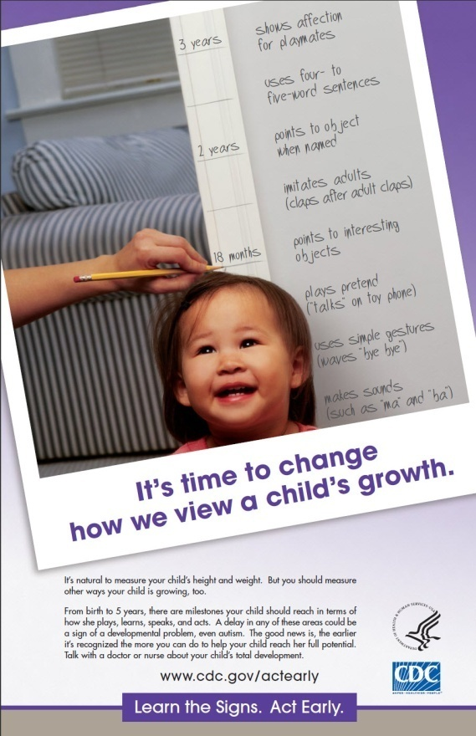
Celebrating Developmental Milestone: Learn the Signs. Act Early.
2014 ECTA Center Webinar on Learn the Signs. Act Early (LTSAE)
http://www.ectacenter.org/~calls/2014/ltsae/ltsae.asp
LTSAE has three components.
Health education campaign
Act Early initiative
Research and evaluation
Notes:
I will highlight two of the three components.

Slide 4
Learn the Signs. Act Early
Mission: To improve early identification of autism and other developmental disabilities so children and their families can get the services and support they need.
Health education campaign on:
Developmental milestones
Tips, resources, and training for different audiences
Free materials
www.cdc.gov/ActEarly

Slide 5
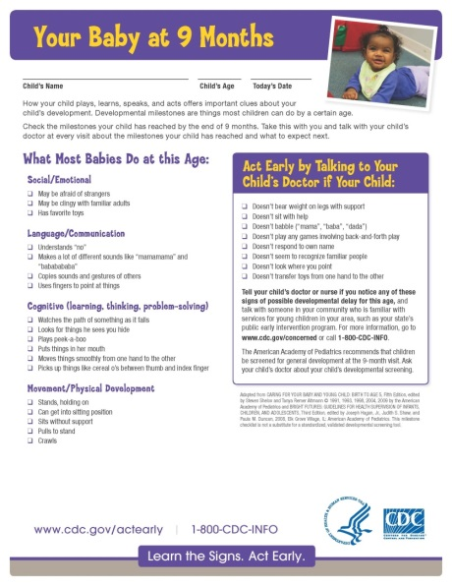
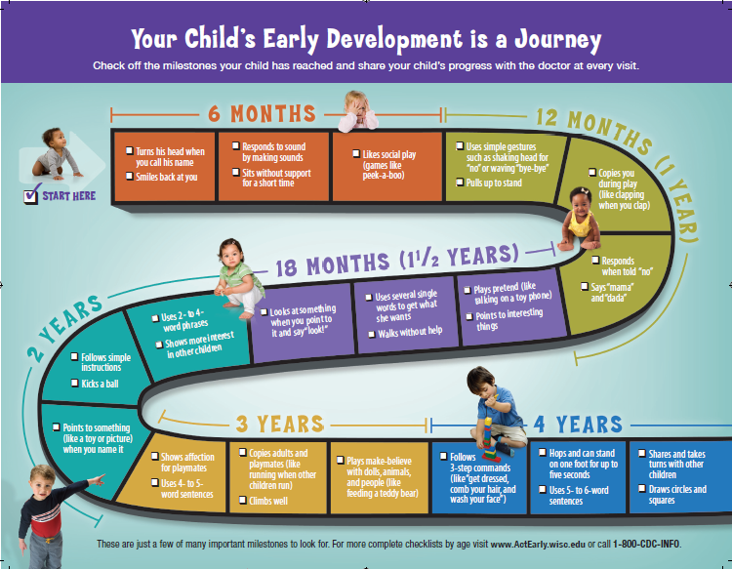
Celebrating Milestones
www.cdc.gov/ActEarly
Notes:
Here’s a quick peek at just a sampling of our most popular materials including a milestone checklist, the Milestones brochure, the Milestone Moments booklet, and growth chart.

Slide 6
Campaign Materials
Free, customizable materials for state and community programs
Are research-based and parent-friendly
Build on AAP gold standard lists
Parents, early educators can use as monitoring tools
Encourage parent-health care provider dialogue
Available in English and Spanish
Useful for
Any program that serves parents of young children and has interest or mandate in child development
www.CDC.gov/ActEarly
ActEarly@cdc.gov
Notes:
The LTSAE materials are based on the gold standard lists of developmental milestones from the American Academy of Pediatrics. They are easy to use and self-explanatory, and they are are available in English and Spanish, and a few materials are available in other languages as well. The materials are a perfect fit for child find efforts for use within communities that are working to educate providers and parents about development and that have as their mission to identify children who may be eligible for early intervention services.
Any program can use the Learn the Signs materials and also any program can put its own logo and contact information on them and make them their own. In fact, we strongly encourage that.
The brochure shown here is a product of great collaboration over an idea that our Act Early Ambassador in Wisconsin, Gail Chodron, and her team initiated, and it's become one of our hallmark products.

Slide 7
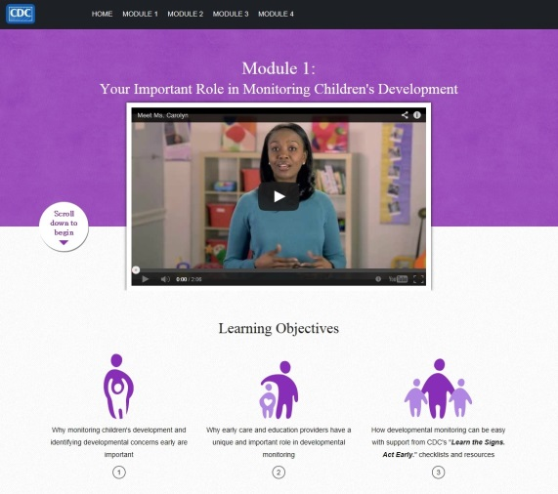
Watch Me! Celebrating Milestones and Sharing Concerns
Training on developmental monitoring w/ LTSAE
For child care professionals (CCPs)
Free, 1 hour, online
CE’s available
4 Modules:
CCPs important role in dev monitoring
Understanding children’s dev milestones
Objective and engaged dev monitoring
How to talk with parents about their child’s development
www.cdc.gov/ActEarly
Notes:
We are really excited about our new training called Watch Me! Celebrating Milestones and Sharing Concerns.
This is a new online training course for child care providers that we expect will be ready to use in July. We developed it in conjunction with a group of partners, who helped us think through the content and who will help us promote and distribute it when it’s ready. We’ve tested it with child care providers and gotten great reviews so far, so we’re hoping people will find it appealing and useful.
We developed this training in collaboration with subject matter experts from the:
National Association of the Education for Young Children
Child Care Aware
American Academy of Pediatrics
HRSA, Administration on Children and Families – Office of head Start and office of Child care
Yale Child Study Center, and
Healthy Child Care America

Slide 8
Positive Parenting Tips
Parenting tip sheets on healthy development from infancy through adolescence
Essentials for Parenting Toddlers and Preschoolers
Common challenges and solutions. Interactive with video examples.
www.cdc.gov/ActEarly

Slide 9
Act Early Initiative
A partnership of CDC, HRSA, AUCD, and AMCHP:
Act Early Summits (2008-2010): state teams at 11 regional summits
Act Early Ambassadors – currently in 30 states
http://www.aucd.org/docs/actearly/ambassadors/2014%20Ambassadors%20Roster_Contact%20Information.pdf
Act Early State System Grants – competitive 2 year state team grants to strengthen state/community systems for early identification and improve coordination of early intervention services for children with signs of ASD/DD
www.cdc.gov/ActEarly
Notes:
promotes collaboration among early childhood programs in states and territories so children with autism or other developmental disabilities can be identified early and get the services and support they and their families need

Slide 10
Celebrating Milestones: State examples
Partnering with public libraries (rural and urban) to promote a public awareness campaign and provide access to materials (ID and NY)
Partnering with Help Me Grow (NH, UT)
Partnering with WIC clinics to use LTSAE materials (ID & MO)
Translation into multiple languages
Using “widgets” (NM, WI)

Slide 11
Educating Primary Referral Sources: State Examples
ID – Partnered with early care and education TA to include developmental milestones in training.
NY – Collaborated with NYS Academies of Pediatricians & Family Physicians, University Centers for Excellence in Developmental Disabilities, Hunter College and FAR Fund to offer two nights of training for physicians with credit hours.
WI – Developed PowerPoint presentations and implementation guidance for early care and education professionals, physicians, and home visitors

Slide 12
Evidence-Base Practices
Supporting Families
Educating Primary Referral Sources

Slide 13
What is Screening?
Brief assessment that uses standardized instruments to identify children at significant risk of having a disorder.
Screening can help determine the presence of risk characteristics for delay or disability.
Does not provide a diagnosis

Slide 14
Universal Screening
Population-based or universal screening – designed to evaluate all children and to identify those at risk for developmental differences.
Generally screen to identify wide range of developmental problems.
Examples include:
Ages and Stages Questionnaire
Infant –Toddler Checklist

Slide 15
Targeted Screening: ASD
“Targeted screening” tools have been developed to focus on specific groups of children
Many children with ASD are not identified with general developmental screening instruments, such as the Ages and Stages Questionnaire
For ASD, targeted screening uses instruments that examine specific behaviors associated with ASD in young children

Slide 16
Examples of ASD Screening Tools
Modified Checklist for Autism in Toddlers (M-CHAT)
Pervasive Developmental Disorders Screening Test (PDDST)
Social Communication Questionnaire (SCQ)
Screening Tool for Autism in Two-year-olds (STAT)

Slide 17
M-CHAT-R & M-CHAT-R/F
Parent questionnaire and follow-up interview for children who screen positive
16 yes/no parent questions
“Does your child use his/her index finger to point, to indicate interest in something?”
18-30 month age span
Minimal experience is needed to administer
Quite accurate when completed with the follow-up interview
May over-identify children as being at risk, although recent revision designed to reduce false positives and increase sensitivity.
M-CHAT is online: www.m-chat.org

Slide 18
Providers and Professionals as Primary Referral Sources
Take notice
Trust your instincts
Prepare to act
Take action

Slide 19
Take Notice
As a professional dealing with many children, it is helpful to become familiar with red flags of ASD such as:
Limited language or social skills
Child not participating in or enjoying pretend play
Child not interacting or playing with peers
Loss of language or social skills at any age

Slide 20
Trust Your Instincts/Prepare to Act
Provider
Understand typical behavior
Document your observations of behaviors that seem out of the ordinary
Notice when child is not meeting developmental milestones
Consultant to Providers
Talk with providers about developmental milestones
Share resources with providers
Encourage ways to document concerns

Slide 21
Take Action: Talking with Families
Provider
Assure family that you are familiar with the child.
Talk about strengths and what child can do.
Describe behaviors (based on observations) and highlight any parents have mentioned.
Listen! Remain objective “this is what I have observed”, but show warmth and caring.
Consultant to Providers
Assure providers understand family dynamics & cultural implications of information.
Encourage listening rather than talking too much.
Practice developing a script with provider prior to discussion with family.
Assist providers in thinking through a next step plan.
Notes:
Provider
Keep “data” on behavior in different situations (play routines, self-care routines)
Describe the data: what the child did/did not do rather than interpret (e.g., “child left play area when approached)
Be prepared to share with parents positive child behaviors/skills along with signs of concerns.
Be clear but avoid highly charged words (e.g., antisocial, behavior problem).
You can say, “I understand you may not see some of these types of behaviors at home because it is a different setting, here’s what I see at the child care center or at preschool.
Do a lot of listening
Try not to pass judgment
Consider cultural differences & sensitivities

Slide 22
Next Steps with Families
Encourage parents to continue to observe their child
Ask if they have spoken with the child’s primary care provider and if he/she noticed any concerns.
Recommend obtaining a screening
Be aware of local resources and share information about the process of early intervention and preschool programs or referrals for screening or evaluation.
Identify the next steps in the process, the resources needed, and be available to assist parents.

Slide 23
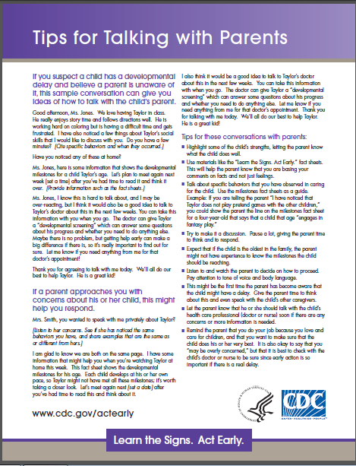
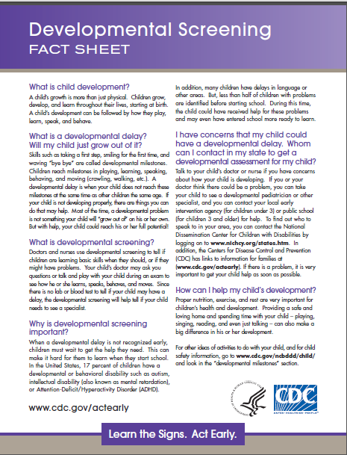
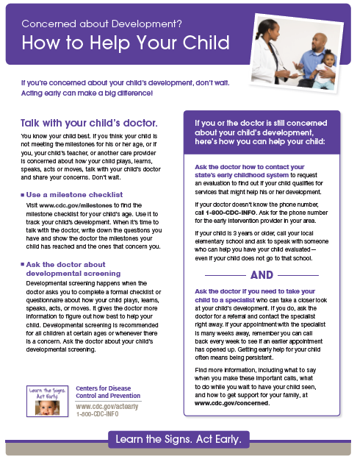
LTSAE Tips and Fact Sheets for Families
Tips for Talking with Parents
Developmental Screening
Concerned About Development?
How to Help Your Child
How to Talk to the Doctor
www.cdc.gov/ActEarly
Notes:
Learn the Signs. Act Early. Developed fact sheets that can be very helpful for providers to have handy if they uncover a potential developmental concern or if they or a parent is worried about a child’s development.

Slide 24
Developmental Screening Passport
What are milestones?
What is developmental screening?
What is a screening passport?
How should I use this passport?
What should I do if I am concerned about my child’s development?
Section that allows parents to list the date of screening, age of their child, type of screening, provider, and result.

Slide 25
Talking to Parents Resources
Birth to Five. Watch Me Thrive! http://www.acf.hhs.gov/programs/ecd/child-health-development/watch-me-thrive
Talking to Parents About Autism
An excellent 15 min. video via YouTube by Autism Speaks
www.autismspeaks.org/whatisit/talking_to_parents_action_kit.php#top
an “action kit” with handouts for early care and education providers to talk with parents about developmental screening
Autism Speaks ASD Glossary
http://www.autismspeaks.org/what-autism/video-glossary

Slide 26
Resources on Evidence Based Practices for Professionals
Evidence based resources found on Birth to Five. Watch Me Thrive!
Tracking, Referral, and Assessment Center for Excellence (TRACE): http://www.tracecenter.info/practiceguides.php
Assuring Better Child Health and Development (ABCD) Resource Center: http://www.nashp.org/abcd-welcome

Slide 27
Universal Checklist - 3 sections
Instructions for completing by any primary referral source
Child and family information: how to contact family
Conditions and Concerns
Universal Referral Form
Collaboration with American Academy of Pediatrics
http://www.medicalhomeinfo.org/downloads/pdfs/EIReferralForm_1.pdf
Utilized by ABCD Initiative and Birth to Five. Watch Me Thrive!
Adopted by Part C programs

Slide 28
http://www.tracecenter.info/practiceguides.php

Slide 29
ABCD State Map
http://www.nashp.org/abcd-map

Slide 30
Implementing Evidence-Based Developmental and Behavioral Screening
Why Knowledge is Not Enough

Slide 31
Challenges: Developmental and Behavioral Screening
Data analyzed from the 2007 National Survey of Children’s Health to estimate prevalence of physician-ordered developmental screening.
Only 21% of parents reported being asked to complete a questionnaire about their child’s development; 42% of parents were informally asked about child’s development (Rice, C., et al, 2014).
The implementation of universal behavioral and developmental screening is variable and often lacking.
There is a “dire need for systems change” to improve use of valid screening tools, access to and coordination of services, and to systematically conduct and monitor child find efforts (Macy, M., Marks, K., & Towle, A. 2014).

Slide 32
Why is Implementation Variable?
Resource and time constraints of implementing routine screenings in practices (Daniels, A. M., et al, 2014, Macy, M. Marks, K. & Towle, A., 2014)
Failure to coordinate screening efforts (Macy, M. Marks, K. & Towle, A., 2014)
Failure to follow-up on a positive screen (Daniels, A. M., et al, 2014; Gaffney, M., et al, 2014; Marshall, J. & Raffael Mendez, L.M., 2014)
Lack of EI and health provider knowledge about screening and/or reluctance to diagnose young children who are at risk for ASD, because symptoms more varied, lack of EI services, and possible negative effects of “labeling” on family (Crais, E. R. et al, 2014; Daniels, A. M., et al, 2014; Pizur-Barnekow, K., et al; 2012)
Notes:
Labeling includes such concerns as: change in the parent-child relationship, reduced expectations for child, and limited access to typical experiences.
USES SPECIFICS FROM EACH ARTICLE AND PROVIDE CITATIONS
Screening for Developmental Delays:
Pediatric Healthcare Professionals’ Views on ASD Screening at 12 – 18 months: Focus groups (8) expressed concerns about and face challengs in screening for ASD in infants and toddlers. Hesitant about ASD screening in general and particular about screening infants and toddlers, challenges in utilizing current ASD screening tools, and frstrations with the state of EI services for children both with and without ASD. Expressed need for research evidence to inform screening practices – link research to practice. Researchers and policymakers struggle with how best to disseminate available evidence regarding early ASD markers and screening guidelines, and how to design effective screening tools that would be used routinely by PHPs. Research-to-practice and practice-to-research gaps continue to exist and will take creative and persistent efforts to overcome. Develop transcollaborative translational teams of PHPs, researchers, early interventionsts, and parents working together to design and implement effective screening tools, and to support their integration into pediatric healthcare settings. “That issue of a village, it really is true, we have to get everyone involved.”
Service Coordinators’ Perception – “Over half of respondents that they have never received a referral from a physician or another EI program because they failed autism specific screening. Over 80% of respondents identified “a lack of knowledge” as the most significant barrier to ASD screening. Conclusions: professional development re: knowledge, teaching their skills, and address potential concerns of parents related to ASD.”
Screening for ASD in 12-Month-Old High-Risk Siblings by Parental Report (2014). Using the First Year Inventory: HR-siblings later diagnosed with ASD showed greater impairments in social communication than those with other developmental outcomes based on parental and clinician ratings. Parental report of decline in play and communication and impaired vocal imitation correctly classified a majority of ASD cases with high specificity.

Slide 33
Addressing the Challenges
The need and opportunity to improve developmental screening rates along with the “will” and knowledge exist.
How are we going to change practice?
How are we going to make our systems more efficient and effective?”
ECTA Center’s tasks include addressing both of those questions.

Slide 34
Addressing the Challenges and Sharing Successes
What about someone in your position- what idea or resource did you personally like? Something you’d love to do/use/share at home?
What aspects of your system might need a “fix”?
What kinds of implementation challenges have you had?

Slide 35
Using Systems Improvement and Implementation Science
State Example

Slide 36
CO: Assuring Better Child health and Development (ABCD)
CO one of 21 states/territories who participated in the ABCD Screening Academy beginning April 2007
Increase the use of a general developmental screening tool (health supervision) during well-child care provided by primary care providers
ABCD grantee developed a strong partnership with EI and a coordinated vision, mission, and purpose. (Governance)
Notes:
(AL, AK, AR, CA, CO, CT, DE, DC, KS, MD, MI, MN, MT, NJ, NM, OH, OK, OR, PR, VA, WI),
who act as young children’s medical homes, as recommended by the AAP..

Slide 37
Challenge for CO
In 2005, only 40% of pediatricians in Colorado were routinely conducting developmental screening
ABCD grantee in CO began collecting data on screening practices in the state and targeted specific communities to improve physician referral rates
With EI in CO, determined how the EI data could be used and shared to increase screening and referral
Data EI was collecting was too broad: could not track which hospital or physician was referring
Notes:
Early Intervention Colorado and ABCD began working together to determine how the EI data could be utilized and shared to increase screening and referral
Quickly realized the data EI was collecting was too broad: could not track which hospital or physician was referring
Adjusted the database to respond to the needs of ABCD

Slide 38
CO: Improving Data Systems
Adjusted database so that it tracks referral activities; can generate reports on referrals at the community and health practice.
EI shares a report quarterly with ABCD that includes:
# of referrals by Community Centered Boards and county
Referral source and which physician/practice
Data Used to:
Determine how well referral systems are working in ABCD supported communities
Target additional referral sources and ensure current referral sources are making appropriate referrals
Identify additional communities in the state for technical assistance

Slide 39
CO: Strengthening Accountability and Quality Improvement
Database allows CO to measure change and quantify results and have a clear and concise snapshot of screening, referral and follow-up activities across the State of Colorado
Information used to guide activities and determine our priorities
Increased number of pediatric practices using standardized developmental screening and subsequent increased referrals to Early intervention (from 5% in 2006 to 90% in 2013)
Increased number of all practices who see children who screen (less than 5% to 45%).

Slide 40
CO: Improving Governance
A statewide HIPAA/FERPA compliant referral form to be used by all referral sources
Referral status feedback loop, mandated by Early Intervention Colorado, between local early intervention programs and the primary referral source.

Slide 41
CO: Personnel/Workforce Development
ABCD can target physician practices that need support to increase referrals
If the data is showing many children dropping out prior to eligibility, ABCD can follow up with outreach
ABCD community trainings on structured screening in all eight pilot communities
Notes:
With Early Learning Challenge grant, ABCD is focusing more on community referral awareness:
Who should be doing surveillance? The different roles of community partners,
How to support families in making it all the way through the early intervention process, not just to referral.

Slide 42
CO: Exploration & Installation
Exploration
Strong core state team - representation from all CO state agencies, private organizations, as well as physicians, parents and all entities that have screening and referral as a component of their work.
Leadership and coordination at the state level is a model for communities interested in initiating screening, referral and follow-up.
Installation - Building System Capacity
Developed database & worked with EI for data queries
Statewide roll out in diverse communities (rural, urban, etc.)

Slide 43
CO: Initial and Full Implementation
Policy changes with HIPPA/FERPA compliant referral form
Mandated feedback loop to referral sources
Developed ABCD “Model Community” document - a step by step guide to use as a blueprint to develop a coordinated local approach to screening, referral and follow-up

Slide 44
CO: Initial and Full Implementation
increasing the use of a objective, validated developmental screening tools at well child visits by providers outside of pilot sites
partnering with Kaiser Permanente and Denver Health to ensure that all of their offices implemented the use of the Ages and Stages Questionnaire (ASQ).

Slide 45
CO: Building on Success/Expansion
Race to the Top/Early Learning Challenge grant dollars to develop a coordinated and quality system:
all children birth to five are screened for developmental delay, referred early when concerns exist, evaluated and connected to services when appropriate
Engage all stakeholders
Provide facilitation, training and technical assistance to local communities across Colorado
Assists physicians in understanding how to identify and care for children with developmental delays
Notes:
http://www.coloradoabcd.org/community-partners/model-community-framework/
ABCD is in the process of working with Colorado Department of Human Services (CDHS), Colorado Department of Public Health (CDPHE), and the Colorado Department of Education (CDE) as part of the Race to the Top grant to develop a Model Community Framework (MCF) loosely based on the SERIES: “An Integrated Approach to Supporting Child Development” article that was published by Children’s Hospital of Philadelphia (summer, 2012

Slide 46
CO: Building on Success/Expansion
Incorporates research and evidence based best practices into the work
Ensure that community partners embed these research/evidence based best practices into the development of their local approach
Focusing more on community referral awareness among community partners
Who should be doing surveillance? How to support families in making it all the way through the early intervention process, not just to referral.

Slide 47
Building on Successes
ABCD is partnering with (Colorado Department of Human Services (CDHS), Colorado Department of Public Health (CDPHE), and the Colorado Department of Education (CDE)
developing a Model Community Framework (MCF) loosely based on the SERIES: “An Integrated Approach to Supporting Child Development” article that was published by Children’s Hospital of Philadelphia (summer, 2012)
The MCF will be offered to 10 additional communities within the state based on a competitive RFP

Slide 48
CO’s ABCD: Model Community Framework (MCF)
ABCD has based its MCF on the idea that screening must happen as part of a spectrum of activities that includes the following essential roles:
Monitoring & Surveillance
Standardized Developmental Screening
Referral
Evaluation
Parent Education
Resources & Support
The MCF Components consist of quality standards, roles/responsibilities, protocols and technical assistance

Slide 49
Take Home Points:
Resources and tools are available to help states and localities implement evidence based developmental and behavioral screening.
Implementing EBPs and strengthening systems takes time!
Requires commitment from stakeholders at the community, local, and state level
Requires cycling back to earlier stages because there will always be new challenges discovered, new policies and system changes, new opportunities, and new providers.

Slide 50
The Bottom Line is . . .
More efficient and effective screening means that children and families who need services receive them as early as possible to maximize the positive developmental and behavioral outcomes of early intervention and early care and education.

