Slide 1
Child Find Self-Assessment (CFSA)
Brenda Wilkins and Jennifer Barrett-Zitkus, OSEP
Margaret Gillis, DaSy
Evelyn Shaw, ECTA
Roy Fowler, Maine Part C Coordinator
Ann Freiburg, Illinois Part C Coordinator

Slide 2
Agenda
National snapshot
Introduction to the Child Find Self-Assessment (CFSA)
State experiences using the CFSA
Resources

Slide 3
In 2017 – 18, 388,694* infants and toddlers from birth to age 3 received Early Intervention services in the U.S. and outlying areas
% by age group
% served by Part C by state
1.25% birth to 1 year
5.43%
3.04% 1 year to 2 years
1.25%
3.04%
5.45% 2 years to 3 years
*Data Downloaded from https://www2.ed.gov/programs/osepidea/618-data/static-tables/2017-2018/part-c/child-count-and-settings/1718-cchildcountandsettings-1.xlsx

Slide 4
National Snapshot: Child Find Special Populations
Child Maltreatment (Children’s Bureau, 2019; Child Maltreatment, 2017)
Over 1/4 of victims (28.5%) under age three; children less than one year have the highest victimization rate (25.3 per 1,000 children).
Voluntary reporting on CAPTA referrals to Part C (National Child Abuse and Neglect Data System or NCANDS) evolving (# of States, additional field).
Neonatal Abstinence Syndrome (NAS)/Prenatal Opioid Exposure
CNS irritability, digestive tract dysfunction, inability to maintain core body temperature; more likely to be born low birth weight (LBW), increase in short-term (high infant mortality rate) and long-term complications.
NAS has increased signiﬁcantly over time (Lynch et al 2018).
Zika infection during pregnancy (Wheller, Anne C, 2018)
Microcephaly and other severe brain defects (not always evident at birth but can appear later); other birth defects (e.g. eye defects, hearing loss, and impaired growth).

Slide 5
Opportunities to Strengthen Child Find
Develop systems to better track and improve earlier identification.
Close gaps in integrating Part C early identification systems within States and local communities.
Reduce gaps in tracking children from concerns to referral, evaluation, and services.
Combine developmental monitoring and screening systems to increase earlier identification (more targeted and appropriate referrals) and receipt of early intervention services.
(Barger, Rice & Simmons, 2016; Barger et al, 2018)

Slide 6
Slide 6
Child Find System
Coordination with referral sources
Clear definition of eligibility
High quality data systems
Evaluation and appropriate identification
Public awareness

Slide 7
Why Focus on Child Find?

Slide 8
Child Find Special Populations
Children who have been maltreated
Children with opioid or other substance exposure
Children exposed to Zika infection
¹
¹ Designed by Icon Pond from Flaticon

Slide 9
Child Find Self-Assessment (CFSA)
Voluntary self-assessment tool to support Part C programs.
Collaborative effort with ECTA, IDC, and DaSy.

Slide 10
How is the CFSA Organized?
Statutory requirements specific to Part C
Highlights the specific requirements all States must have for a Comprehensive Child Find System.
Child Find Best Practices
Evaluates and tracks how a State identifies and implements child find best practices.
Assist States in identifying evidence-based practices to support their Child Find efforts.
Child Find special populations.
Technical Assistance and Resources
Provides an overview of OSEP-funded resources and technical assistance centers that are committed to improving State early intervention and early childhood special education service systems.

Slide 11
Section I
Fillable Word form
Highlights requirements
Includes:
Referral procedures
Timeline
Screening procedures (optional)

Slide 12
Section II Table of Contents

Slide 13
Slide 13

Slide 14
Section II – Best Practice Ratings
No, practice not in place and not planning to work on it at this time.
No, practice not in place but planning to work on it or getting started.
Yes, practice partially implemented.
Yes, practice fully implemented.

Slide 15
Section II - Evidence
Spaces to provide evidence for each best practice (yellow spaces)

Slide 16
Section II – Theme Ratings
None of the practices are yet planned or in place.
Most of the practices are not yet planned or in place.
Some practices are in place; a few may be fully implemented.
At least half of the practices are in place; a few may be fully implemented.
At least half of the practices are in place; some are fully implemented.
At least half of the practices are fully implemented; the rest are partially implemented.
All practices are fully implemented.

Slide 17
Slide 17

Slide 18
Slide 18

Slide 19
Section II – Theme Summary
Summarizes information for each theme for which all best practices rated.
Cannot enter data on this sheet.
Colored bars graphically depict theme ratings.

Slide 20
Section II – Action Plan
Space for States to use ratings and priorities to plan next steps.
Includes sections for documenting:
Members of the Child Find planning team.
Child Find improvement plan (e.g., activities, timeline).
How stakeholders will be involved.

Slide 21
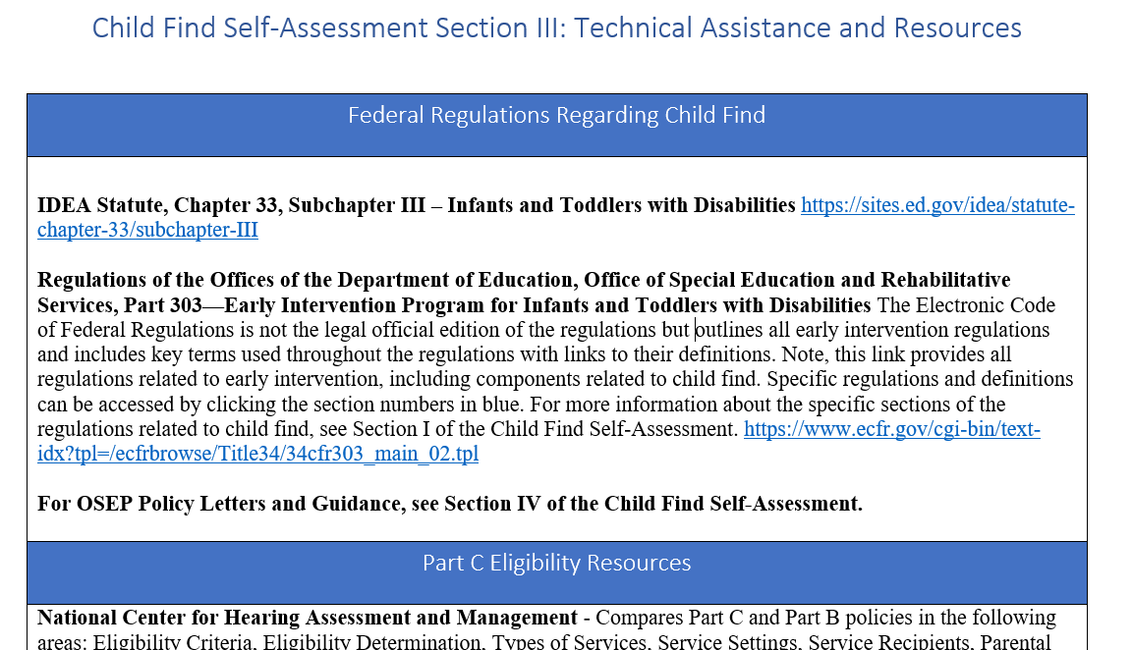
Section III

Slide 22
Section IV

Slide 23
Development
Best practices were identified through thorough review of literature and previous projects funded by OSEP and others focused on Child Find.
Modeled after the ECTA System Framework Self-Assessment.
Externally reviewed by 4 States and piloted in 4 States.
Incorporated feedback from external review and pilot.

Slide 24
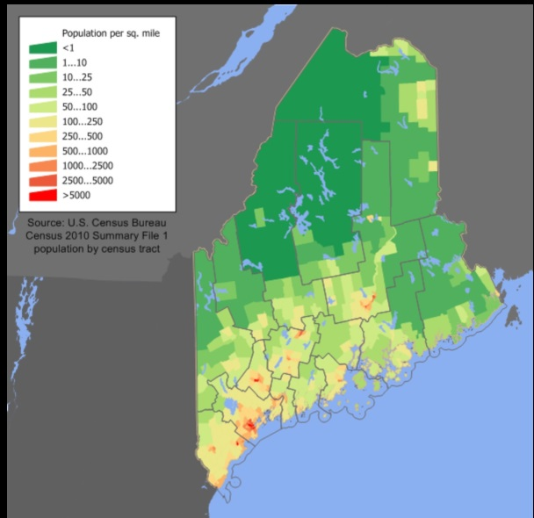
Why did Maine focus on Child Find?
Maine…
perennially falls short of its Part C SPP/APR Child Find targets
ranks 51st in the percentage of identified children under the age of 1 (0.61%)
ranks 47th in the percentage of identified children under the age of 3 (2.39%)
is a large, sparsely populated state and ranges from urban to extremely rural
has experienced a significant increase in its immigrant population

Slide 25
Support from National TA Centers
Maine received significant support from the Early Childhood Technical Assistance Center (ECTA) and the Center for IDEA Early Childhood Data Systems (DaSy) which included:
Clarification on Framework items
A national perspective
How other states implement best practices

Slide 26
What Maine Learned:
Outreach and materials targeting “New Mainers” and increased collaboration with cultural brokers is necessary
Although, in general, significant outreach has occurred, Maine has not evaluated the effectiveness of that outreach
The lack of a state entity that oversees/coordinates developmental screenings is an impediment to increased identification

Slide 27
Next Steps:
Share Child Find Self-Assessment results with regional programs
Conduct facilitated conversations with EI teams at the regional program level to identify opportunities to implement best practices at the local level
Use the Child Find Self-Assessment to engage regional stakeholders and as impetus for the creation of local Interagency Coordinating Councils

Slide 28
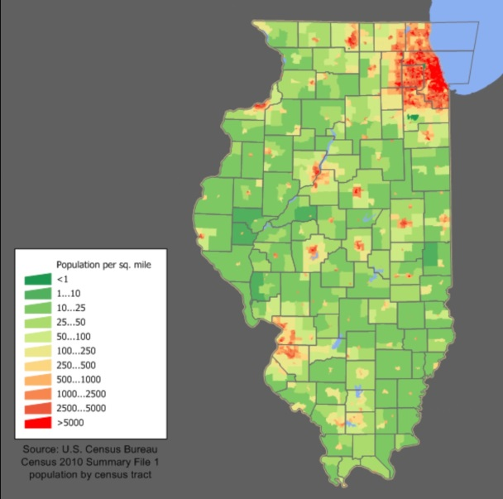
Illinois’ Experience Using the CFSA
Completed a subset of the Best Practices in Section 2 due to limited time
Stakeholders involved included: interventionists, Service Coordinators, Parents, Professional Development, Monitoring, Central Directory, LEAs, SEA, 619, APORS and Bureau of Early Intervention

Slide 29
Illinois Context
Child Find Project housed within the Illinois State Board of Education, supports efforts for children 0-5 across the state
Quarterly workgroup currently focused on more about Transition but includes the Child Find Project manager who provides updates on data collection
Illinois felt we had a decently-organized Child Find system….

Slide 30
Reality Check
What we learned
we do have many policies, procedures, administrative rules, an interagency agreement and some strong collaborations already occurring
we have some inconsistent practices and complicated data collection, but with the best intentions with many recent improvements for more automation, etc.
the stakeholder group has rich history and a wide variety of perspectives
The tool helped us realize the multiple components of Child Find
Having TA team on the stakeholder call helped provide guidance for the context and intent of the tool

Slide 31
Next Steps
Conversations opened opportunities for improvement and a willingness of all represented groups to come to the table with their support
Plan on pulling stakeholders together again to complete the tool and create solid plans for action steps
Identified potential of cross-training about the required components from Part B and Part C perspectives to help improve the Illinois Child Find system
Identified need for be more resources/tools that could help correct and complete data collection of Child Find

Slide 32
Questions?

Slide 33
Child Find Resources
Child Find Self-Assessment https://osep.grads360.org/#program/highlighted-resources
Infographic

Slide 34
Additional Resources
Birth to 5: Watch Me Thrive! https://helpmegrownational.org/hmg-partners/watchmethrive/
TA Resources for State Agencies
Identifying Meaningful Difference in Child Find – Excel Tool https://dasycenter.org/identify-meaningful-differences-in-child-find/
Child Find Data Special Collection – https://dasycenter.org/child-find-special-collections/
Child Find Funnel Diagram Tool – https://dasycenter.org/part-c-child-find-funnel-chart-tool/
State and Jurisdictional Definitions Infants and Toddlers with Disabilities Under IDEA Part C – 2019 Update – coming soon from ECTA

Slide 35
Division for Early Childhood (DEC)
Protection & Well-Being Community of Practice
Archived webinars from March 2018
DEC 2019 Conference panel
https://www.dec-sped.org/protection-and-wellbeing-cop
Position Statement on Low Birth Weight (LBW), Prematurity, and Early Intervention
Approved August 2018
https://www.decdocs.org/position-statement-low-birth-weight
Executive Summary https://www.decdocs.org/executive-summary-low-birth-weight

Slide 36
Slide 29
Visit the DaSy website at: http://dasycenter.org/
Follow DaSy on Twitter: @DaSyCenter
Visit the ECTA website at: http://ectacenter.org/
Follow ECTA on Twitter: @ECTACenter

Slide 37
Thank you
The contents of this tool and guidance were developed under grants from the U.S. Department of Education, #H326P120002 and #H326P170001. However, those contents do not necessarily represent the policy of the U.S. Department of Education, and you should not assume endorsement by the Federal Government. Project Officers: Meredith Miceli, Richelle Davis, and Julia Martin Eile.

Slide 38
OSEP Disclaimer
2019 OSEP Leadership Conference
DISCLAIMER:
The contents of this presentation were developed by the presenters for the 2019 OSEP Leadership Conference. However, these contents do not necessarily represent the policy of the Department of Education, and you should not assume endorsement by the Federal Government.
(Authority: 20 U.S.C. 1221e-3 and 3474)

