Slide 1
Helping Local Programs Improve Outcomes Performance Using the DAC Data Analysis Framework
Sherry Franklin, North Carolina Part C Coordinator
October 27, 2012

Slide 2
NC Part C Context
State Lead Agency
16 Local Lead Agencies
12 State Agencies
4 Contract Agencies
Community Early Intervention Service Providers

Slide 3
Results Component
Continuous Improvement Visit- November 14-18, 2011
Verification
Results Component
May – June: Results Focus Selection
Family Outcomes:
Birth to 1 Child Find

Slide 4
Orienting Programs/Providers to Key Practices that Support Child and Family Outcomes
State Interagency Coordinating Council formed a task group to assist in Results Component Selection
Reviewed Family Outcomes Survey (NCSEAM) and Process
So What?
Reviewed “Relationship of Quality Practices to Child and Family Outcome Measurement Results”

Slide 5
Orienting Programs/Providers to Key Practices that Support Child and Family Outcomes
Families and Stakeholders were able to:
Share their experiences with expected practices
Define common strengths and challenges
Come to consensus on the importance of the skills/training of Early Intervention Service Coordinators
Selection: “Know Your Rights”

Slide 6
Conducting Self-Assessment of State or Local Performance on Practices
FOCUS MONITORING- PROCEDURAL SAFEGUARDS
Use of the Tool to Train Monitors on the Practices That Have a Direct Impact on “Know Your Rights”
Embed Questions Related to Practices in Interview Tools
Selection: “Know Your Rights”

Slide 7
NOW WHAT?
How to get started?
How to implement a statewide change in practice?
How to achieve outcome?

Slide 8
Data Accountability Center (DAC)

Slide 9
Bottom Line
State-Local Partnership
State Implementation Team
Local Implementation Team
Quality Data
Specific Problem/Issue
Data-based Decisions

Slide 10
Our Partnership
Concord
Shelby
Durham
Rocky Mount
Greensboro
Morganton

Slide 11
Implementation Team
Represents community members and systems stakeholders
Advises and assists systems change
Develops & implements clear plans with assignments of tasks/timelines
Keeps implementation process focused
Solves problems that arise during the process.
Fixen, D.L., Naoom, S.F., Blasé, K.A., Freedman, R.M., & Wallace, F. (2005).
Implementation Research; A Synthesis of the Literature. Tampa, Florida:
University of South Florida, National Implementation Research Network

Slide 12
Local Implementation Teams
Each Team Included:
Parent
CDSA (Program) Directors*
Data Person/Quality Assurance staff
Providers/staff involved in issue topic
Others as needed
* Must be a person with influence/authority

Slide 13
State Implementation Team
State Team Included:
Part C Coordinator
ICC members (including parent member)
ICC Staff
Data Person
TA Provider (NECTAC)
Others as needed
* Must be a person with influence/authority

Slide 14
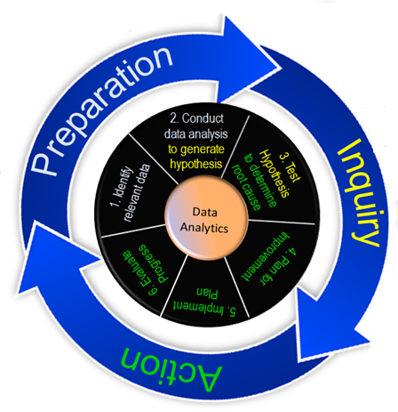
DAC Framework for Data Use
Consists of three phases w/ several steps:
Preparation Phase
Identify relevant data
Conduct data analysis
Inquiry Phase
Determine Root Cause
Action Phase
Plan for improvement
Implement Plan
Evaluate progress

Slide 15
Preparation Phase:
Identify Relevant Data:
Initial Face to Face Meeting
Each team received a 13 page Family Outcomes Profile
Profile demonstrated the CDSA’s data from the NCSEAM Family Survey
Conduct Data Analysis:
After first data analysis, each team requested and received a 7 page “Supplemental Family Outcomes Profile” with additional requested data analysis

Slide 16
CDSA
PROBLEM STATEMENT:
In fiscal year 2010, as documented by family survey results, 74% of families reported that participation in the NC Infant-Toddler Program helped them understand their rights, as compared to the state target of 90%.

Slide 17
Identify Relevant Data

Slide 18
Identify Relevant Data

Slide 19
Identify Relevant Data

Slide 20
Conduct Data Analysis
Table 2: Responses to Knowing Rights
Answer Choices | Frequency | Percent
Very Strongly Agree | 22 | 35.5%
Strongly Agree | 13 | 21.0%
Agree | 22 | 35.5%
Disagree | 4 | 6.5%
Strongly Disagree | 0 | 0%
Very Strongly Disagree | 1 | 1.6%
Total | 62 | 100%

Slide 21
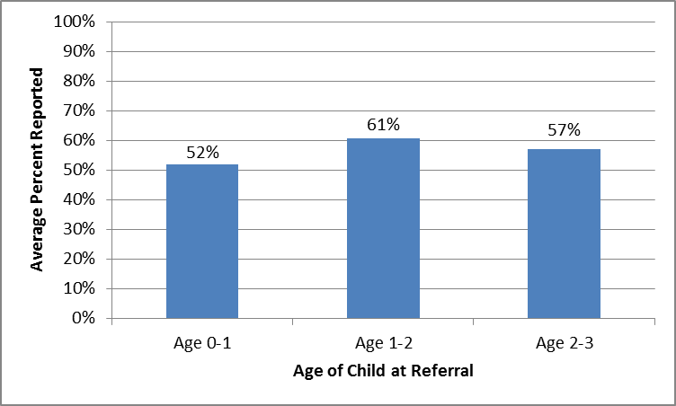
Conduct Data Analysis
Percent reporting ‘strongly agree’ and ‘very strongly agree’ to Q44 (Knowing Rights) by child’s age at referral:

Slide 22
Conduct Data Analysis
Setting Hypothesis
Lack of significant quantitative data to support development of hypothesis
The SURVEY?
Qualitative observations, experience and knowledge of program

Slide 23
WHY HYPOTHESIS?
A hypothesis is defined as “…a starting-point for further investigation from known facts”.

Slide 24
Hypotheses Generated
“If CDSA staff and early intervention service providers use consistent language related to Infant Toddler Program (ITP) rights in the context of the occurring routine or activity, then more families will understand their ITP rights.”
“If service coordinators effectively articulate child and family rights to parents at relevant times then family’s will report knowing their rights.”
“If parents are provided family rights in a variety of ways, this may increase awareness and understanding of rights”.

Slide 25
Inquiry Phase:
Determine Root Cause:
Each team generated and tested hypotheses to determine root cause
Team webinars, conference calls, face to face meetings were methods used to assist with problem solving

Slide 26
Determine Root Cause
Parent Interviews
Staff Interviews/Focus Groups
Observations
Record Reviews
Self Assessment Tools
State/Local Team Collaboration

Slide 27
Record Review Tool
NC ITP DAC Pilot: Family Rights
Observation Tool
Child Name:__________________________________________DOB_____________________Date of Referral:_________
INITIAL CONTACT
Initial Contact Native Language | Is there documentation that rights were explained to the family at the time of initial contact and at any time prior to the initial evaluation? |  |  |  | Documentation in a service note at time of first contact with family following referral to ITP. Document giving copy of NC ITP Child and Family Rights. Best Practices: progress notes indicate explanation of child and family rights (evaluation, natural environments, confidentiality, written prior notice, parental consent, dispute/due process) and in family’s native language
Initial Contact Native Language | 2. Was a copy of the Parent Handbook given to and contents reviewed and discussed with parent? (ITP Policy Bulletins #9 and #10) |  |  |  | Family’s native language or other mode of communication must be used both verbally and in writing.
Consent | Was parental consent regarding financial consent explained & documented. §303.430, §303.520 |  |  |  | Financial consent copy in record and completed through section III(e)
Consent | 4. Was written parental consent obtained prior to the initial evaluation? §303.421, (ITP Policy Bulletin #12) |  |  |  | Use of the NC ITP Consent and Prior Notice for Initial Evaluation form meets this requirement. (Child and family assessment is required regardless of eligibility methods.)

Slide 28
WHAT DID WE LEARN?
Service Coordination staff take the primary responsibility to understand and explain rights to families (vs. evaluation CDSA staff and providers).
Service Coordinators are discussing rights at referral with families and also providing written notification of rights at other required times.
During meetings with Service Coordinators, most families are being asked if they understand rights, but in general more follow-up questions are not being asked to ensure this understanding

Slide 29
WHAT DID WE LEARN?
Service Coordinators often do not explain rights within context of relevant events (just provide a general overview initially and written notification at required times).
Various levels of staff knowledge and comfort (reported and observed) related to understanding and explaining rights to families.
Many families reported feeling overwhelmed by initial information and paperwork (and emotional adjustments); impacted understanding of rights.

Slide 30
What Did We Learn?
Families reported positive experiences with ITP & report that rights were discussed with them. Families remembered conversations about rights, but not when discussed; some families could not name a specific right / safeguard – but knew they were discussed.
One Local Program– Non English speaking families reported less understanding / knowledge about rights- Families did not read / review program written materials.

Slide 31
Remember? Hypotheses Generated
“If CDSA staff and early intervention service providers use consistent language related to Infant Toddler Program (ITP) rights in the context of the occurring routine or activity, then more families will understand their ITP rights.”
“If service coordinators effectively articulate child and family rights to parents at relevant times then family’s will report knowing their rights.”
“If parents are provided family rights in a variety of ways, this may increase awareness and understanding of rights”.

Slide 32
Action Phase:
Plan for improvement
Implement Plan
Evaluate progress

Slide 33
Plan for Improvement
DRAFT IMPROVEMENT PLAN
FFY 2011 Baseline: Goals:
Root Cause:
Benchmarks:
FFY 2012 Target:
FFY 2013 Target:
FFY 2014 Target:
TASK/ACTIVITY | WHY? | BY WHOM? | WHO WILL SUPERVISE? | WHEN? | RESOURCES | HOW TO SELF-ASSESS (EVALUATE PROGRESS)?
Revise Tool from to use in training. Break tool down into individual phase of intake/service delivery to provide training to each team: Administrative Management Clinical EISC's | To provide a tool to be used in training each group to help them know when and how to communicate rights to families. | DAC Team | QI Coordinator and Director | By Sept | Revised Tool | Team Review of revision
Provide Full Team overview of DAC project and survey results | Improve understanding of project/agency… | DAC Team | QI Coordinator | Oct 2012 | ITP Guidelines Pre Test | Pre-test Post-Test (one year) 10/2013
CDSA Team: Morganton | Data:

Slide 34
Improvements Needed
Design specific training for Service Coordinators about family rights and procedural safeguards that can be embedded throughout all program requirements (e.g. revising CDSA staff orientation checklist/content and orientation process)
Parents are overwhelmed during referral / eligibility process with information, paperwork, emotional adjustments to child’s diagnosis – impacts understanding of parental rights. Review these practices in more detail
Develop ITP materials that are understandable, easy to read, and more visually engaging for all audiences
Caregiver’s written materials (explaining rights) not functional for all cultural or literacy needs in local catchment area
Recommendations to improve provider support and understanding of key ITP practices/family rights for both community providers AND interpreters
State Level: explore training modules and review program materials

Slide 35
NEXT STEPS
Implementation of Improvement Plans
Summarize Information from DAC Pilot Experience with State Steering Committee
Use Information for Improvement and Statewide Implementation Strategies
Evaluate Effectiveness

Slide 36
Questions/Comments

