Slide 1

Inquiring Families Want to Know:
Engaging Families in the Outcome Rating Process
Hearing Family Stories
Gaining Family Insight
Involving Families
Adapted from materials developed by Naomi Younggren, 2011

Slide 2
Presenters:
Shannon Dunstan, ID
Kathi Gillaspy, NECTAC/ECO
Pam Miller, MD
Judy Swett, PACER/NECTAC
Jennifer Zielinski, ID
Jennifer Barrett-Zitkus, IL
2

Slide 3
Hearing Family Stories
Empower families to be active members of the IFSP/IEP team
Encourage them to share their thoughts and ideas with you

Slide 4
Gaining Family Insight
Setting the stage so families take an active role in interaction
Listening
Asking good questions
Ask for feedback, invite comments/reactions

Slide 5
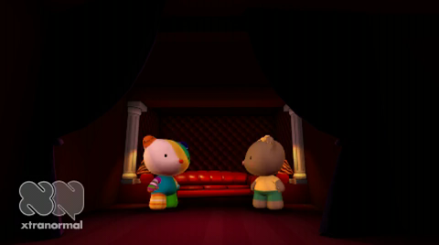
Good Listener??

Slide 6
Interviewing Pointers
Westby, Burda, & Metha, 2003
Use open-ended questions
Use restating – repeating the exact words
Summarize and invite opportunities to correct
Avoid back-to-back and compound questions
Avoid leading questions
Cautiously use "why" questions
Listen more than talk

Slide 7
Parent Roles
Team Member
Information Provider & Receiver
Participant in the COS rating discussion

Slide 8
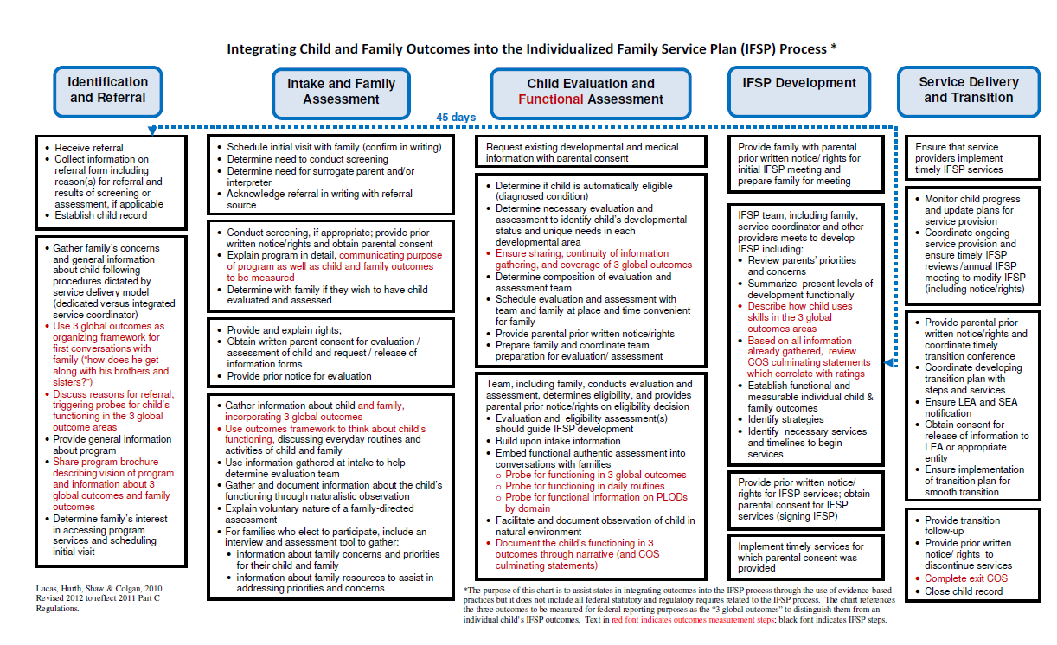
Share Information Early & Often

Slide 9
What We Should Expect from Family Involvement in the COS Rating?
Yes!
  They can provide rich information about their child’s functioning across settings and situation.
Maybe
  They will know whether their child is showing age expected skills.

Slide 10
How Families Can Help
They know their child best. As a partner on the team they can provide information about how their child:
Gets along with family and friends
Manages feelings
Tries to do new things
Communicates new ideas
Tries to be independent
Seeks help when needed

Slide 11

You can't handle the truth!*
Families can handle the truth
We need to be able to share information with them openly and honestly
* Col. Jessup, A Few Good Men
11

Slide 12
Genuinely engage families in the entire process, appreciate their strengths, and reach agreement with them about their child.
-Naomi Younggren

Slide 13
Talking with Families
about Child Outcomes
Illinois Early Intervention Training Program

Slide 14
Illinois
25 Point of Entries (Child and Family Connections)
Designated Service Coordinator Model (450)
Vender Model Provider Base (5,000)
14

Slide 15
Introduction of Child and Family Outcomes
Family
Provider
Service Coordinator

Slide 16

Service Coordinator Overload

Slide 17
Illinois EI Training Program Shift
Family
Service Coordinator
Child and Family Outcomes
Provider

Slide 18

Online Trainings

Slide 19
Online Trainings
System Overview Online
Understanding the Illinois Child Outcomes Process Online Training
The Impact of Early Intervention on Families Online Training

Slide 20

Face to Face Training
System Overview Follow-Up Face to Face
Outcomes in Action Follow-Up
EI Sponsored Trainings
EI Institutes
EI Cohorts

Slide 21

Provider Forums and LIC Meetings
Local Provider Meetings
Local Interagency Meetings

Slide 22





Slide 23
Direct Opportunities for Family Support on Child Outcomes
Referral
Intake (Routines –Based Interview )
IFSP Meetings (Decision Tree)
Monthly Contact
Exit
23

Slide 24
Resources
ECO Outcomes Video
ECO Center Website
Decision Tree
EI Training IFSP Video
Illinois Training Newsletter and Web Site
Illinois Early Intervention Clearinghouse
Project Enhance
24

Slide 25
Talking with Families
A collaboration between Idaho Parents Unlimited and Idaho’s 619 Preschool Special Education Program
25

Slide 26
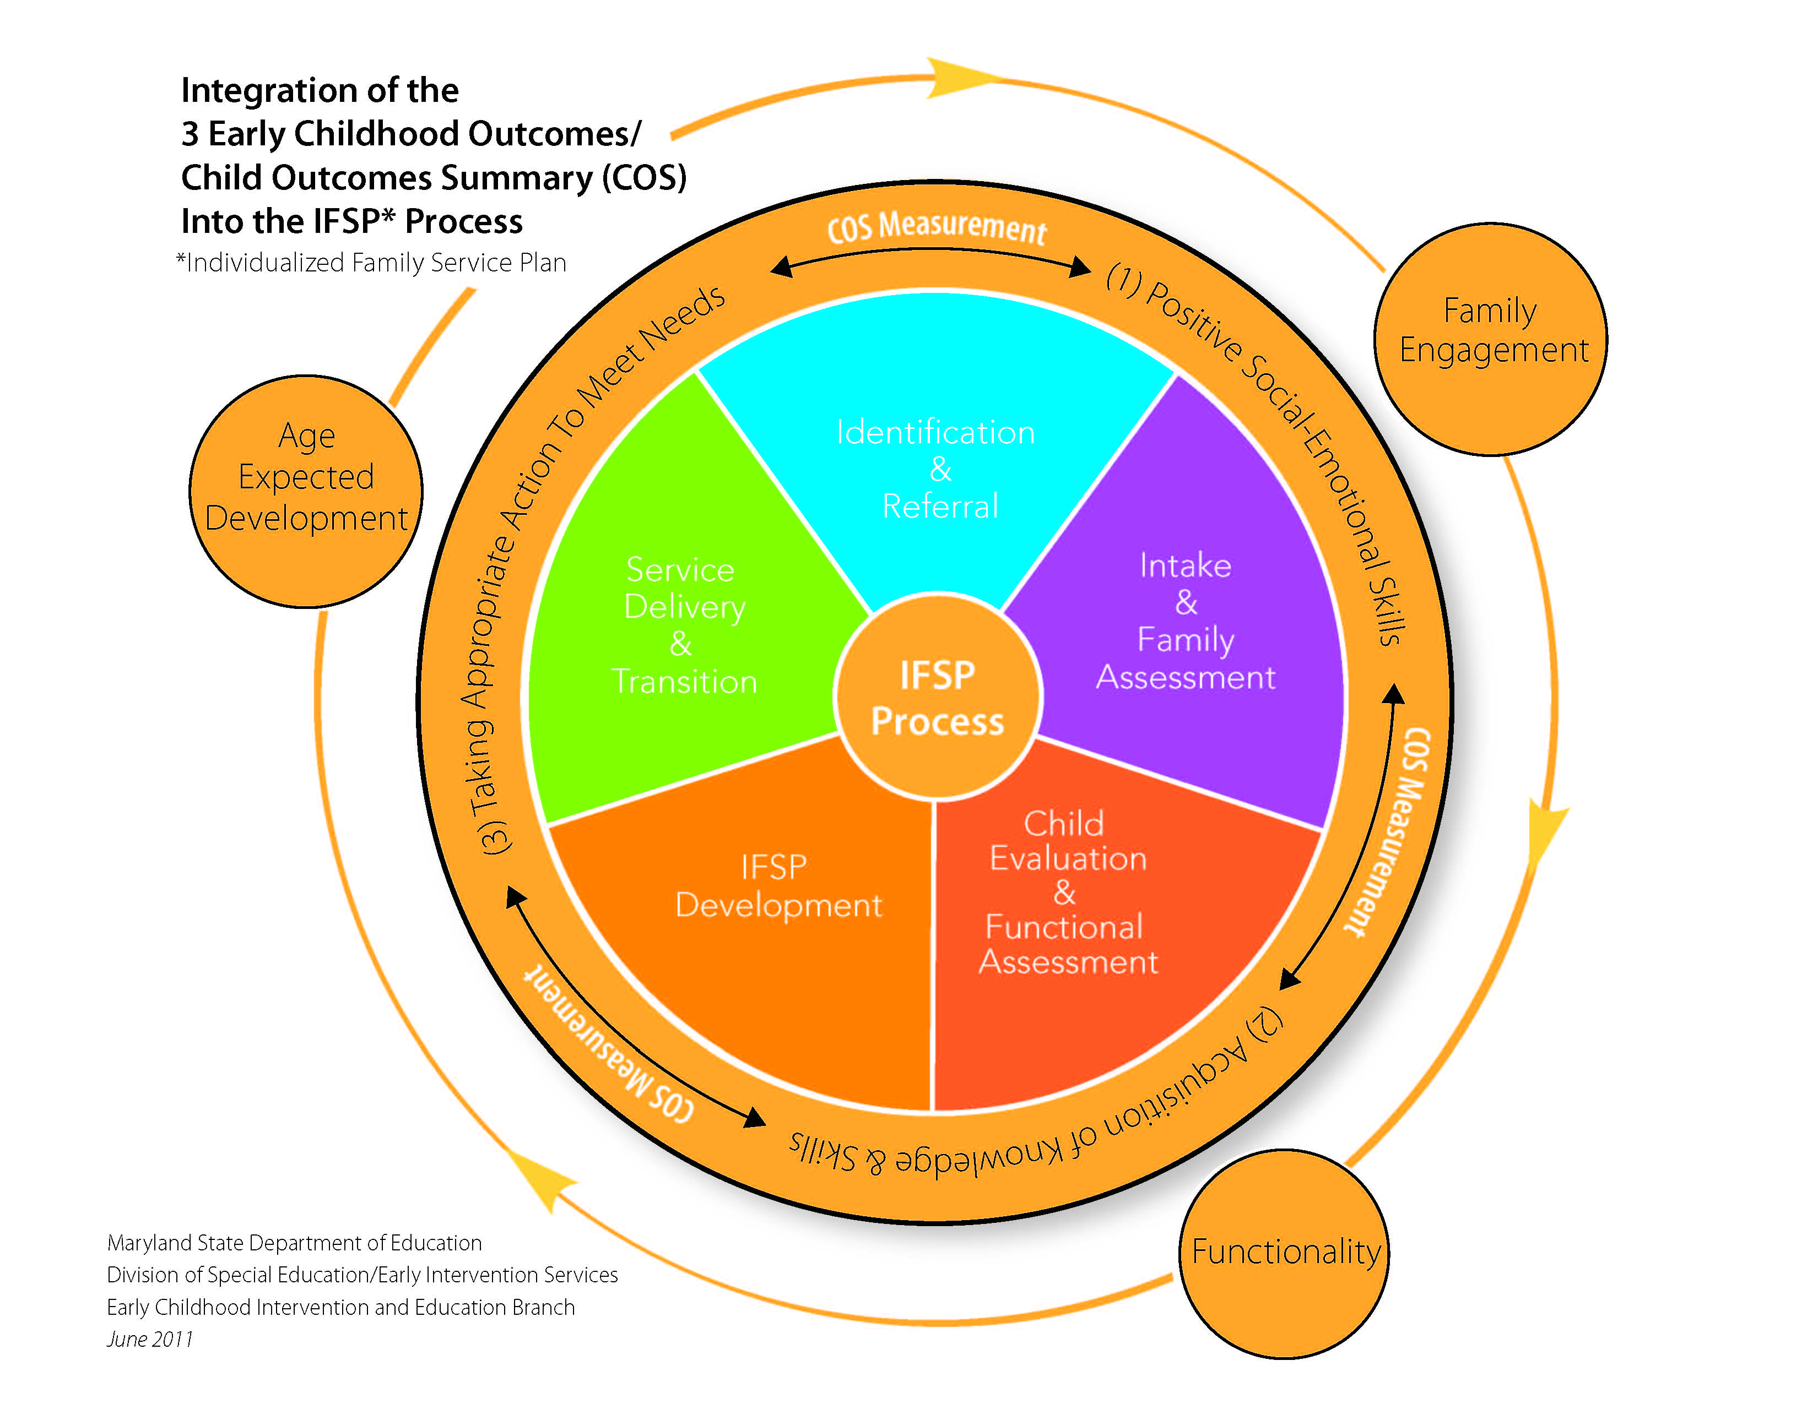
Engaging Families in the Child Outcomes Summary (COS) Process: A Framework
26

Slide 27
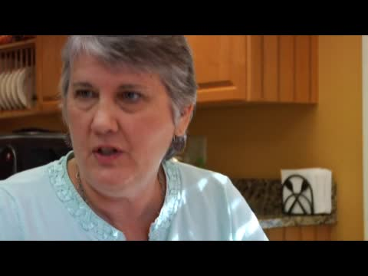
Engaging Families in the Child Outcomes Summary Process:
Video Resource
27
http://marylandlearninglinks.org/11695

Slide 28
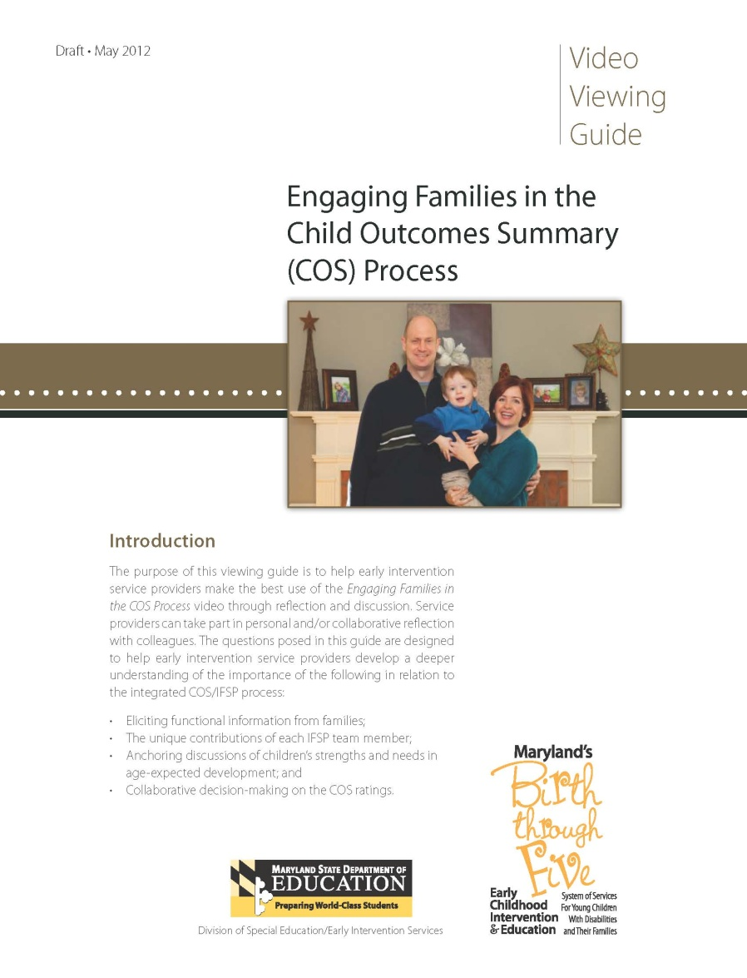
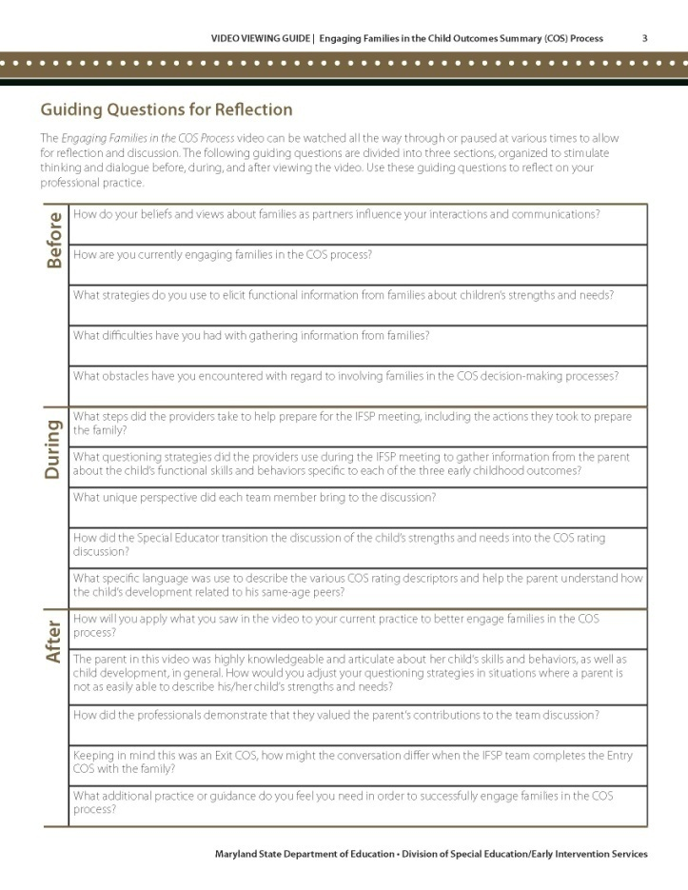
Engaging Families in the Child Outcomes Summary Process: Video Viewing Guide
28

Slide 29
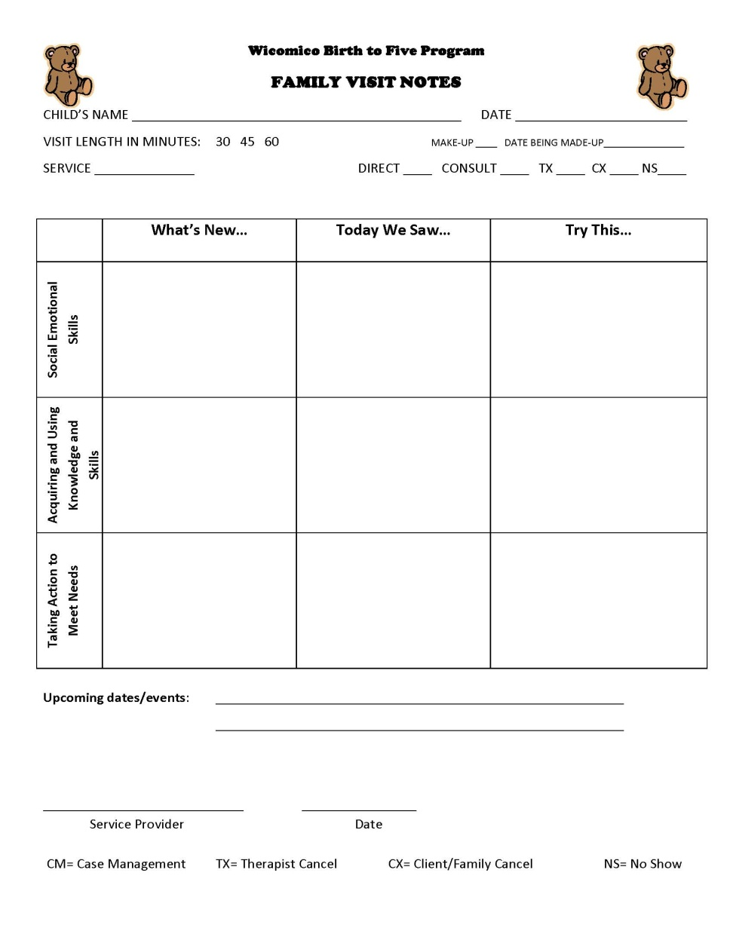
Engaging Families:
Locally Developed Resources
29

Slide 30
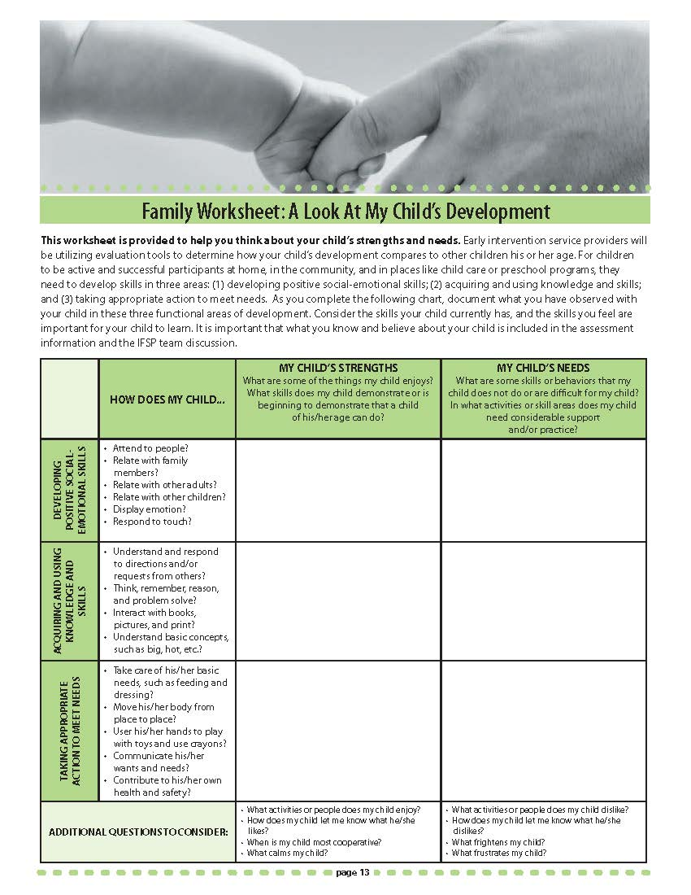

Slide 31
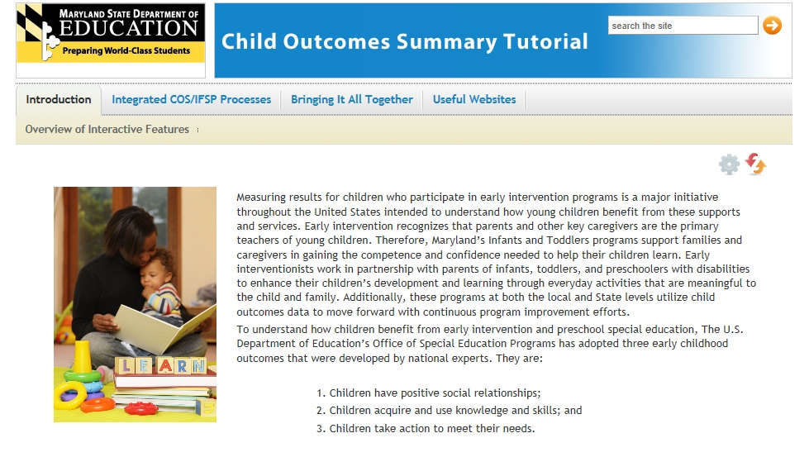
Online COS Tutorial:
Bringing It All Together
31

Slide 32
Questions?
Thank you for coming!
www.the-eco-center.org

