Slide 1






Slide 2
Common Education Data Standards
Lynne Kahn
Tony Ruggiero
Meredith Miceli
Missy Cochenour

Slide 3

Common Education
Data Standards

Slide 4
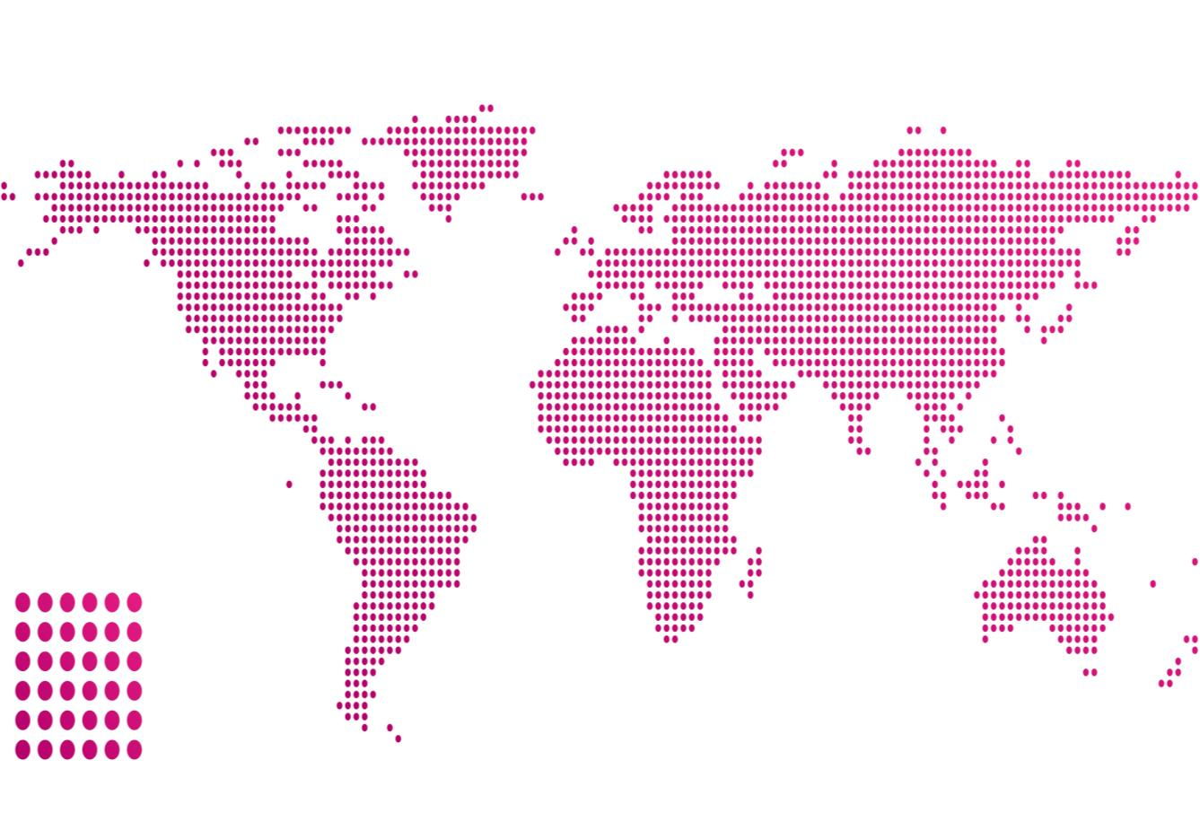
A language is a standard form of communication.
Humans speak many different languages.
But, there are certain things we all need to understand and communicate.
For these, we need a
common language.

Slide 5
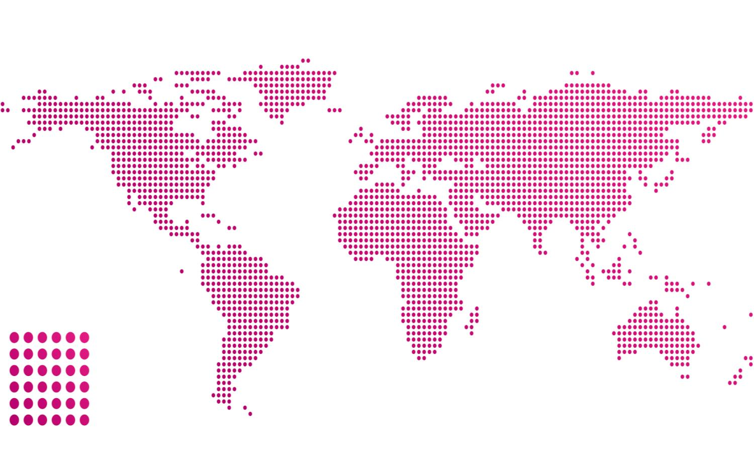
FOR EXAMPLE: Sign symbols
Imagine...
You arrive at an airport in a foreign city where an unfamiliar language is spoken.

Slide 6

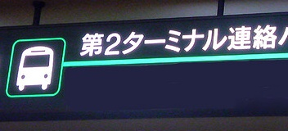
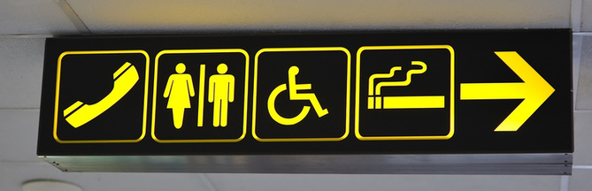
How do you find your way?
Universal travel sign symbols.
Developed in late 1970s to aid wayfinding.
http://www.flickr.com/photos/japanesepod101/3974018590
http://www.flickr.com/photos/japanesepod101/3974042578

Slide 7
Common Education Data Standards
What are we talking about?

Slide 8
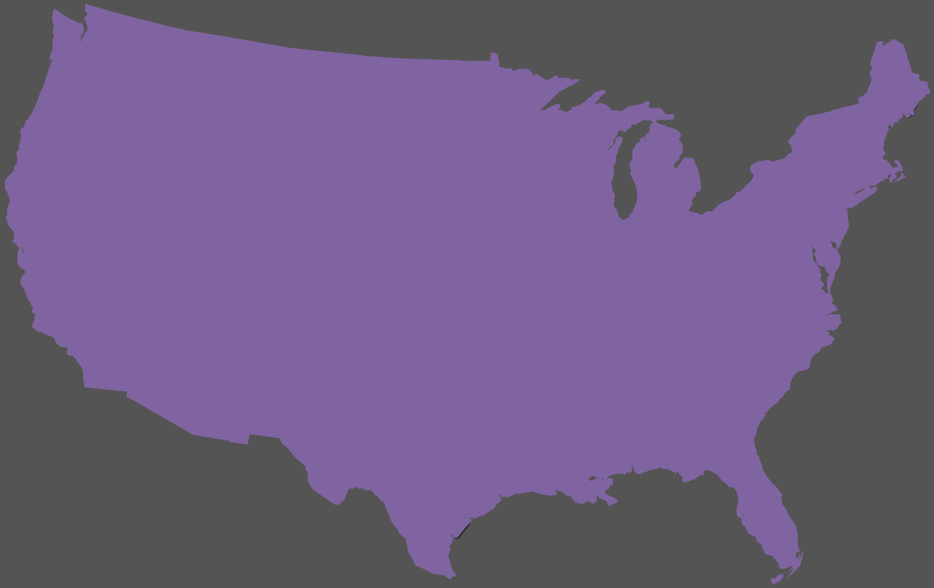
Data standard: an agreed upon set of data names, definitions, options & technical specs
Education institutions across P-20 use many different data standards.
But, there are certain data we all need to understand, compare & exchange.
For these, we need a
common education data standard.

Slide 9
FOR EXAMPLE: Demographic data
Imagine...
Your Early Head Start
has a child also enrolled in
Part C that uses a
different education data standard.

Slide 10

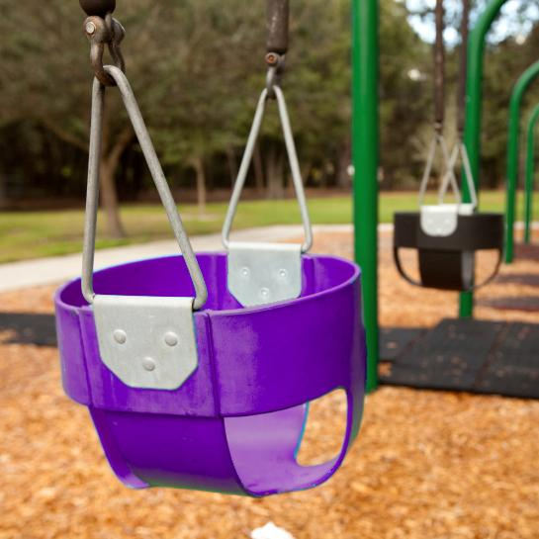
Here’s a
child:
Matthe
SmithIII
Race = Guamanian
Gender = M
Hmmm…
Did you mean:
Matthew ?
Smith ?
Suffix = III ?
Race = NHOPI ?
Sex = M ?
Early Head Start
Part C

Slide 11
What is CEDS?
A national collaborative effort to develop voluntary, common data standards for a key set of education data elements
A vocabulary including standard definitions, option sets & technical specifications to streamline sharing and comparing
Voluntary Common Vocabulary

Slide 12


CEDS is NOT:
Required
All or nothing
A data collection
An implementation
Solely an ED undertaking
A federal unit record system

Slide 13
How do we get it done?
Assemble stakeholders representing the field
Use existing sources of data standards
Check alignment with the field
Review ideas with the public
Model elements
Place in tools
Release

Slide 14
CEDS v3 Stakeholders (1 of 2)
State Agencies
  State Education Agencies
  State Higher Education Agencies
  Social Services Agencies
Local Education Agencies
  K12
  Head Start
  Social Services
Institutions of Higher Education
  Public
  Private
  Community Colleges

Slide 15
CEDS v3 Stakeholders (2 of 2)
U.S. Department of Education
  NCES (SLDS, IPEDS)
  EDFacts
U.S. Health and Human Services
U.S. Department of Labor
Interoperability Standard Organizations
Education Associations
Foundations

Slide 16
Version 3
    K12: RTTT assessment, teaching & learning, record exchange
    Early Learning: assessment, professional development, child outcomes, and federal alignment
    Postsecondary: furthering IPEDS support (CMSS), access, price/tuition, time to degree, Complete College America
    Additional Areas: Career and Technical Education, Workforce, Adult Education

Slide 17
What Does CEDS Provide?

Slide 18







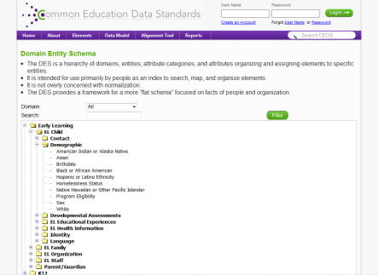
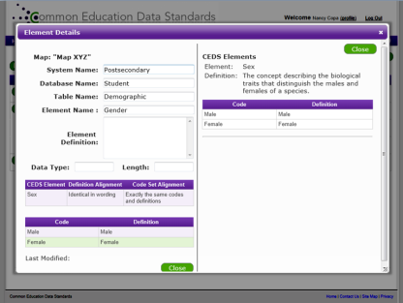
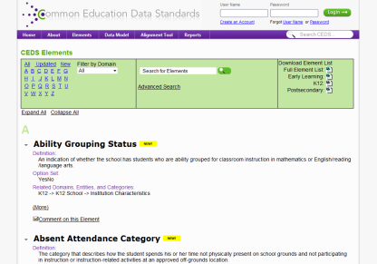
CEDS provides:
A Robust & Expanding Common, Voluntary Vocabulary drawn from existing sources
Powerful Stakeholder Tools
  Align tool
  Connect tool
  Logical Data Model
Notes:
So, as you know, CEDS provides a common, voluntary vocabulary. These standards have been drawn almost entirely from other existing, well-known sources of education data standards. <click>
In addition, CEDS now also offers powerful tools for stakeholders including the Alignment Tool and a Logical Data Model -- tangible resources to enable education data stakeholders to explore and utilize CEDS.

Slide 19
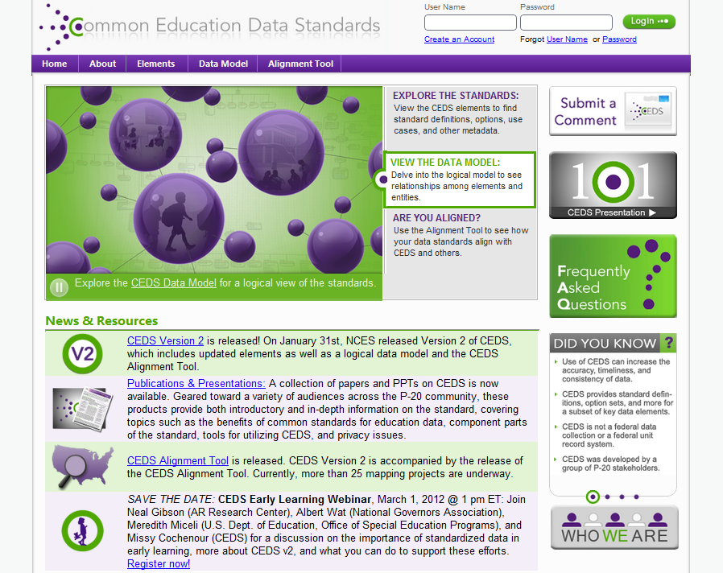
Notes:
This is a view of the CEDS website’s home page, from which you can access the CEDS elements, models, tools, and more.

Slide 20
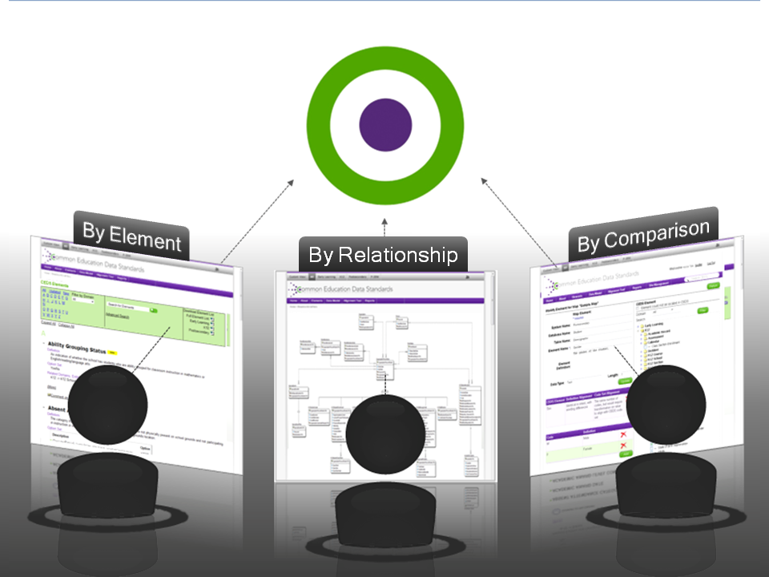
Notes:
CEDS can now be viewed and interacted with in three key ways:
-By element: Via the CEDS Elements page, users can access a searchable glossary of the CEDS "vocabulary," including names, definitions, option sets, technical specifications, and more.
-By relationship: Through the CEDS Data Model, users can explore the relationships that exist among entities and elements—viewable both through a Domain Entity Schema and a Normalized Data Schema.
-By comparison: Supplemental tools, including the CEDS Alignment Tool enable users to take the next step and put CEDS into practice.

Slide 21

Notes:
This is the element page of the CEDS website. Here, users can browse the CEDS elements, through a search engine and domain filter (for example users can choose early learning in the Domain Filer and just see the early learning elements.) The page also includes Excel spreadsheets containing all of the elements for each domain, along with all associated information.

Slide 22
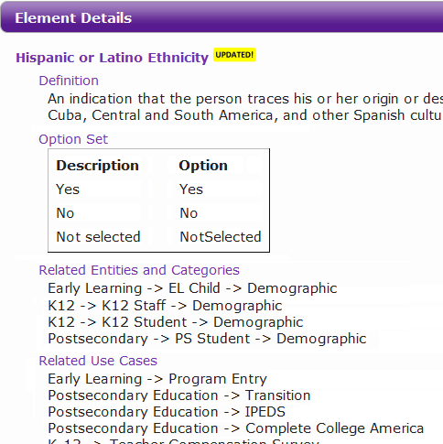
Element Details: The Parts
Element name
Definition
Option set
Domain
Entities
K12
K12 Student
Related Use Cases
Notes:
This presentation will focus on these components of CEDS elements.
Let’s take a closer look at these pieces of information.

Slide 23
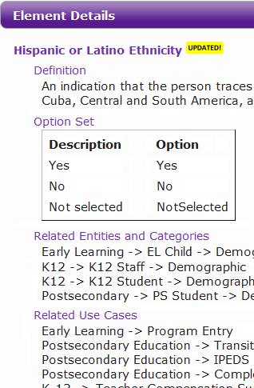
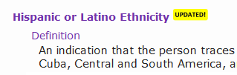
Element Information
Attributes of entities, and units of data that can be defined and measured.
Two parts:
  Name: Common text name for the element
  Definition: A statement of the meaning or significance of an element
Notes:
Elements are attributes of entities, and units of data that can be defined and measured. <click> They are comprised of two parts: Name and definition. In this example, the element called “Hispanic or Latino Ethnicity” indicates whether or not an individual "traces his or her origin or descent to Mexico, Puerto Rico, Cuba, Central and South America, and other Spanish cultures, regardless of race."

Slide 24
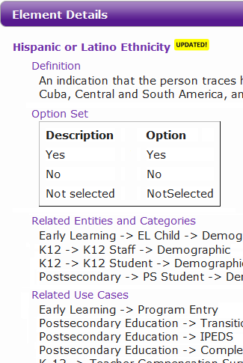
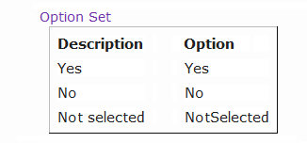
Option Set
Provide recommended alternatives or responses for an element
Can be:
standard set of options:
Ex) LANGUAGE CODE
open-ended:
Ex) FIRST NAME
Notes:
Options sets provide recommended alternatives or responses for an element. The option set for this element includes “Yes”, “No,” and “NotSelected”. <click> For other elements, open-ended options are the appropriate responses, such as in “First Name." In these cases, no options are presented. Other option sets, such as language codes, have a large number of options.

Slide 25
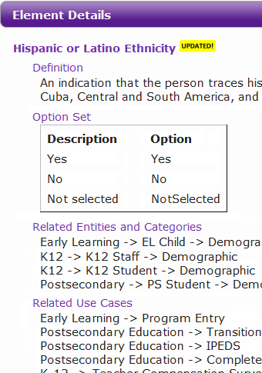
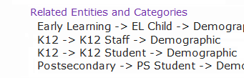
Domain
Management level at which the data are maintained.
Some correspond with sector(s) of P-20 system.
CEDS v2 contains 5 domains:
Early Learning
K12
Postsecondary
Assessments
Learning Standards
Early Learning
K12
K12
Postsecondary
Notes:
Domain indicates the management level at which the data are maintained. <click>
Some domains also correspond with the sector(s) of the P-20 system in which entities exist. <click>
CEDS Version 2 (v2) contains 5 domains: Early Learning, K12, and Postsecondary, as well as Assessments, and Learning Standards.
In this case, you see that Hispanic or Latino Ethnicity is used in three of the domains.

Slide 26
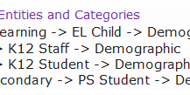
Entity
Persons, places, events, objects, or concepts about which data are collected
Provide context for the data elements
Examples:
Student
Staff
School
EL Child
Assessment
Section
EL Child
K12 Staff
K12 Student
PS Student
Notes:
Entities are persons, places, events, objects, or concepts about which data can be collected. <click>
They provide context for the data elements, which are bits of information that could be used to describe one or more entities. <click
In this example, you see that Hispanic or Latino Ethnicity is associated with Early Learning Child, K12 Staff, K12 Student, and Postsecondary Student. Other examples include assessment, and Calendar.

Slide 27
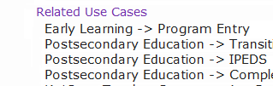
Related Use Cases
Real-world applications for which an element can be used to support.
Examples:
EDFacts & IPEDS reporting
LEA-to-LEA Student Record Exchange
High School Generated Transcript
Notes:
Related Use cases indicate real-world applications for which each element can be used to support.
This element, as you see, is used for postsecondary transition, and IPEDS reporting. <click>
Other examples include EDFacts reporting, LEA-to-LEA Student Record Exchange, and High School Generated Transcript.
In addition to these pieces of information, CEDS also provides some other metadata such as <click> common names, abbreviations, business rules, format, and XML.

Slide 28

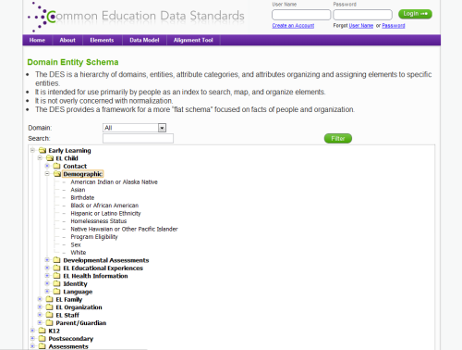
CEDS Logical Data Model
Provides a high-level framework for translating standards into physical models
System-agnostic representation
2 distinct views:
  Domain Entity Schema
  Normalized Data Schema
Notes:
<click> What is the CEDS Data Model?
The CEDS Data Model presents logical view of the standards, its a system-agnostic representation that contains attributes, shows cardinality, and uses the commonly-used names for all entities. When planning to build or modify a database or implementation to align with CEDS, the Data Model provides a high-level framework to translate common entities, elements and relationships into physical models for a specific database platform that addresses the indexing, performance optimization, and normalization or denormalization appropriate for the specific application addressing local information needs.

Slide 29



CEDS
Web-based tool that allows users to:
Import or input their data dictionaries
Align their data to CEDS
Compare themselves with others
Analyze their data in relation to various other CEDS-aligned efforts
Notes:
<click> What is the CEDS Alignment Tool? [Paraphrase slide.]

Slide 30
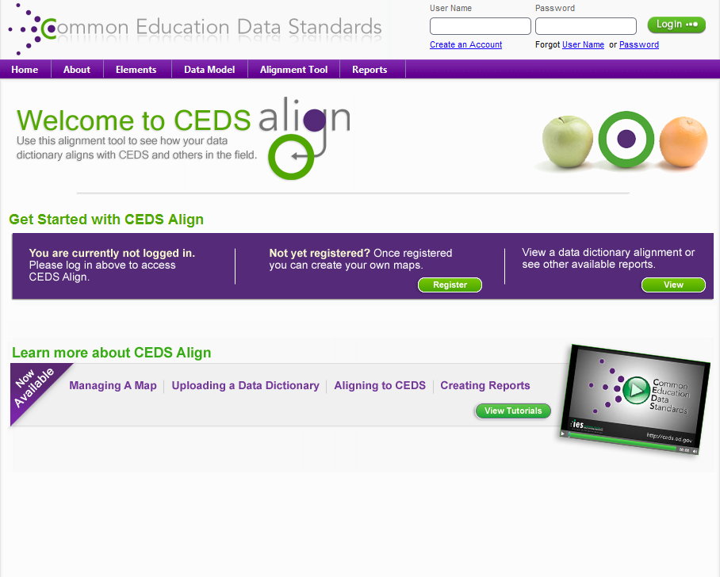

Slide 31
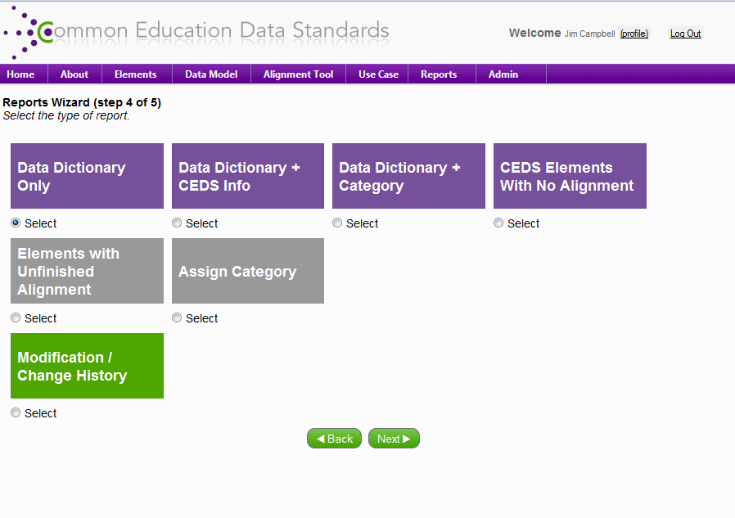

Slide 32
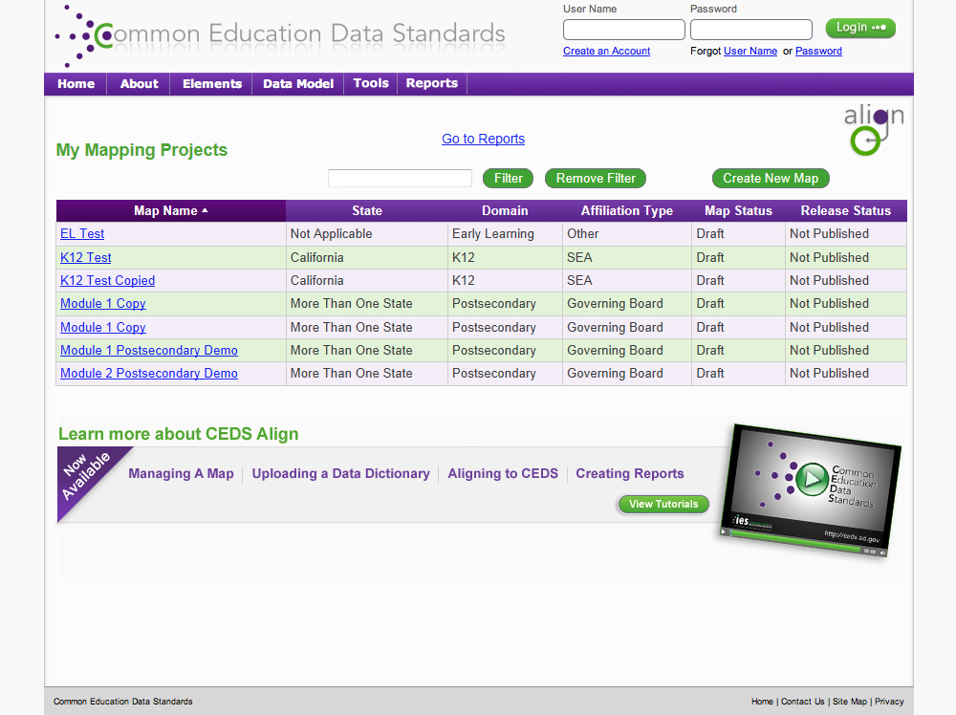

Slide 33
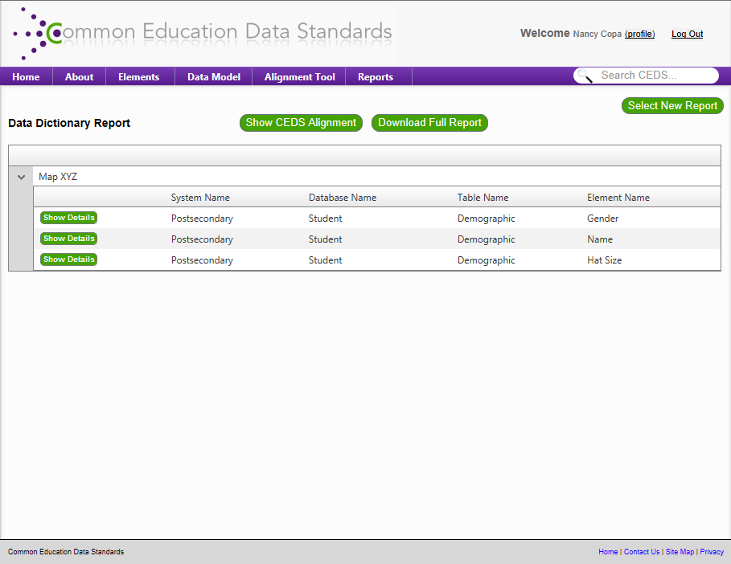
Notes:
After making selections in the report wizard, you have chosen to see Map XYZ’s data dictionary <click>. This is an example of how that might look. A few things to note here. First, in the top right corner <click> you see a way to view the CEDS Alignment. Doing so will take you to this view of the data dictionary… <click to next slide>

Slide 34
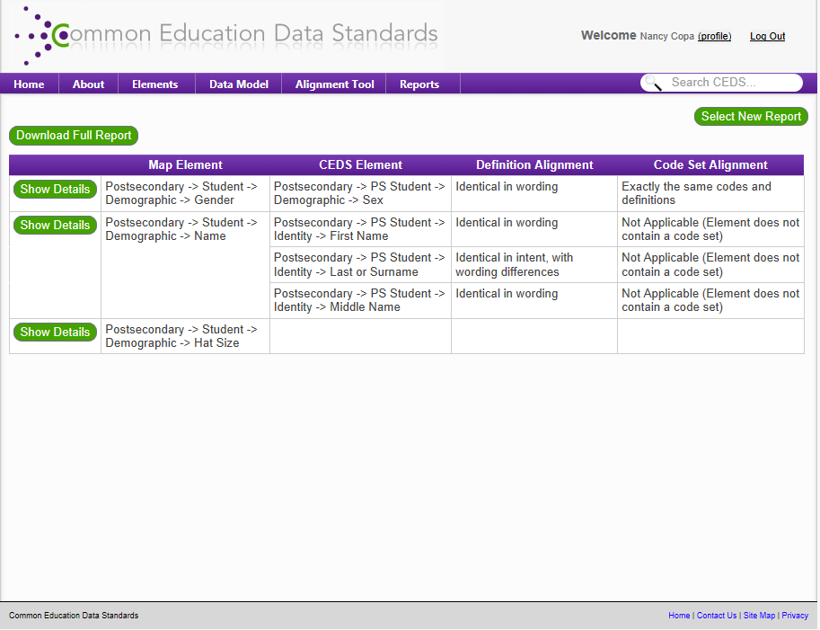
Notes:
You will notice on this view that not only is Map XYZ’s element <click> (from system name down to element name) shown, but also the CEDS element <click> (and it’s entity and group) are shown. The third and fourth columns display how well Map XYZ’s element aligns to the CEDS element. There are two ways to align to a CEDS element, by definition and by code set. Later in this webinar, we show you the actual questions and answer choices that populate these columns. This information is determined by the user entering the information.
In this example, you will notice that Gender aligns to Sex and it’s Level of Alignment is that the two have identical wording, but use different codes. The map’s Name element aligns to THREE CEDS elements. In this case, there is a level of alignment for each of the CEDS elements as alignment may not be identical for all.
Finally, you will notice in the last row that the map’s element “Hat Size” does not align with any of the CEDS Version 2 elements. We will delve into this further momentarily with another report.
Now, I would like to direct your attention to the top left-hand side of the screen to the button that says “Download Full Report” <click>. This button will be available on all of the reports. It will allow you to download all of the information here and in the “Show Details” view. Speaking of “Show Details”, you will notice there are buttons to the left of each row in the table. For any one row you can click “Show Details” to see all of the information on that row. Here is an example of how that will look…<click to next slide>

Slide 35
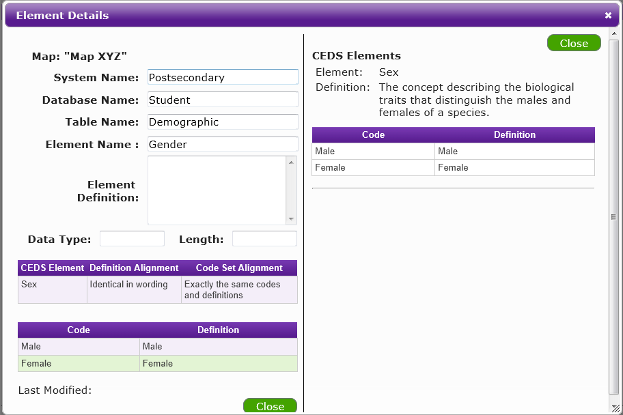
Notes:
On the left hand side you will see all of the information for Map XYZ’s element, and on the right hand side you will see all of the information for the CEDS element.

Slide 36
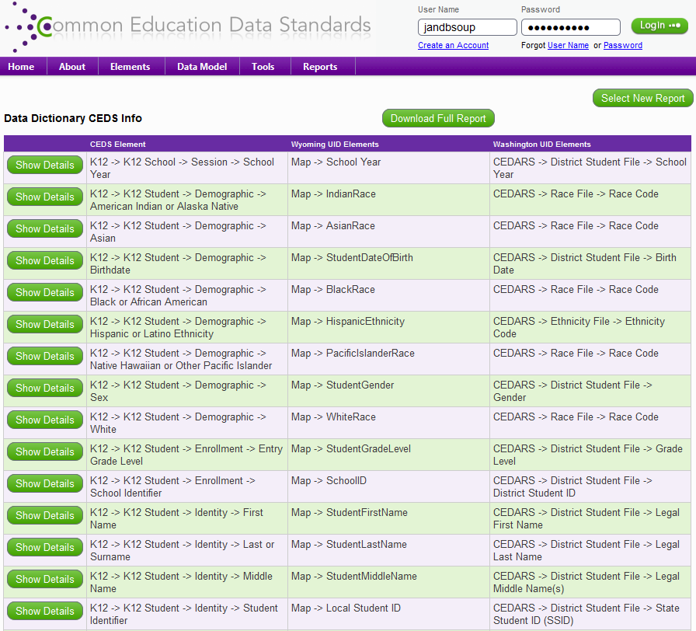

Slide 37
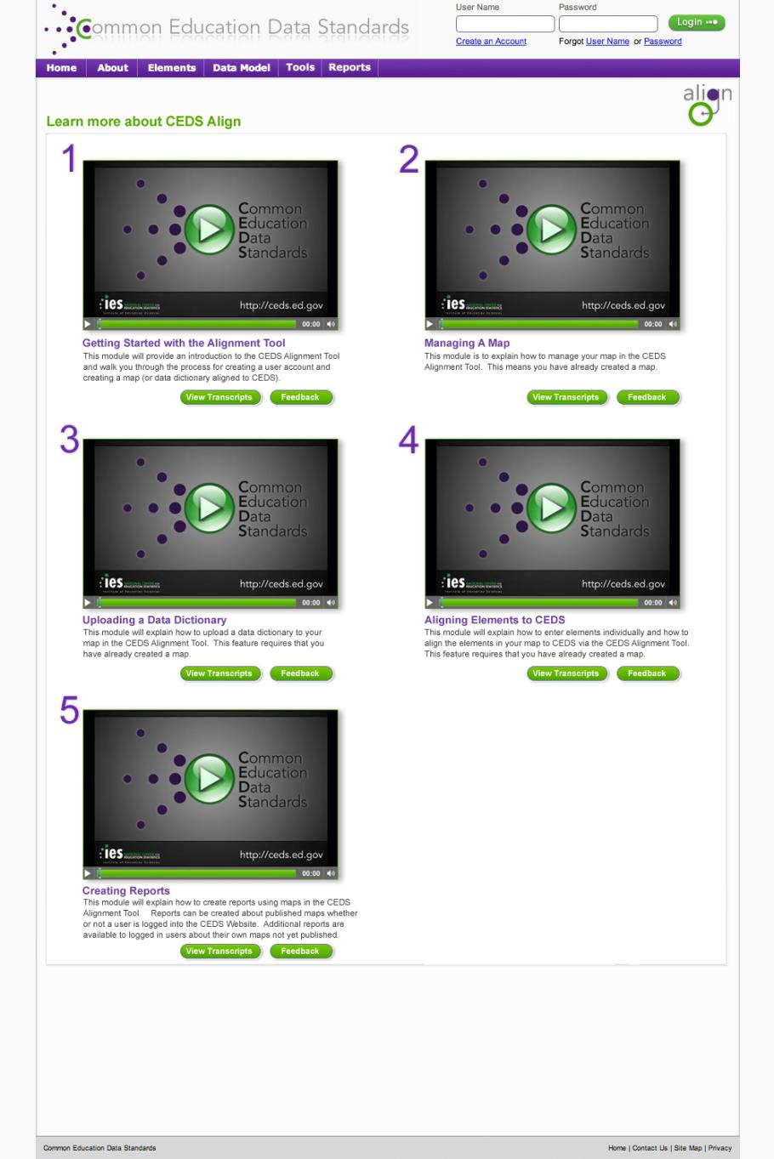

Slide 38

Notes:
In 2012, we will begin developing the Use Case Generator. [Paraphrase slide.] The uses we are talking about here are policy questions, metrics or indicators, other standards, etc. So you can put in your organization’s policy questions and what elements are needed to measure success. That also means you can look at other organization’s policy questions and map your elements to see if you have the information needed to answer them.
This is not available on the CEDS website, yet but will be coming later in 2012.

Slide 39

CEDS
Builds on CEDS Align
Allows stakeholders to connect data elements to practical P-20W applications
  Find out how others are using data to answer policy questions, calculate metrics & indicators, & report to the federal gov’t
  Share their own approaches to using data to meet these and other information needs
Notes:
In 2012, we will begin developing the Use Case Generator. [Paraphrase slide.] The uses we are talking about here are policy questions, metrics or indicators, other standards, etc. So you can put in your organization’s policy questions and what elements are needed to measure success. That also means you can look at other organization’s policy questions and map your elements to see if you have the information needed to answer them.
This is not available on the CEDS website, yet but will be coming later in 2012.

Slide 40
Alignment Exercise
A=B
A,B,C=T
A=4,Z
A=A
A=X

Slide 41

Alignment Exercise
Z=B
X,4,Z=T
A=Z
Z=4,Z
Z=Z
Z=X

Slide 42
Using CONNECT
Notes:
This presentation will introduce you to CEDS: the need it meets

Slide 43
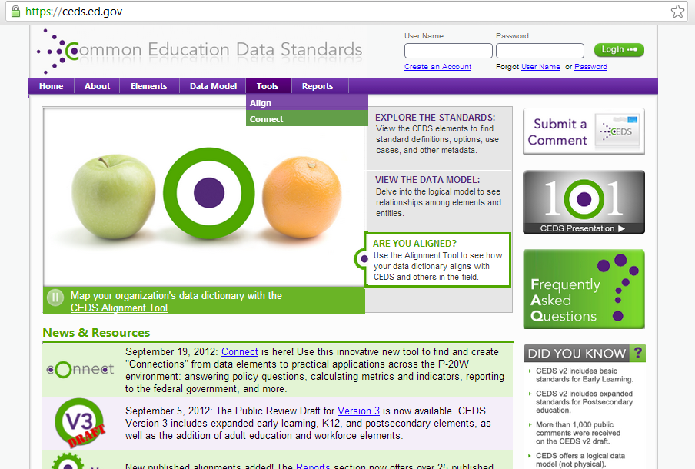
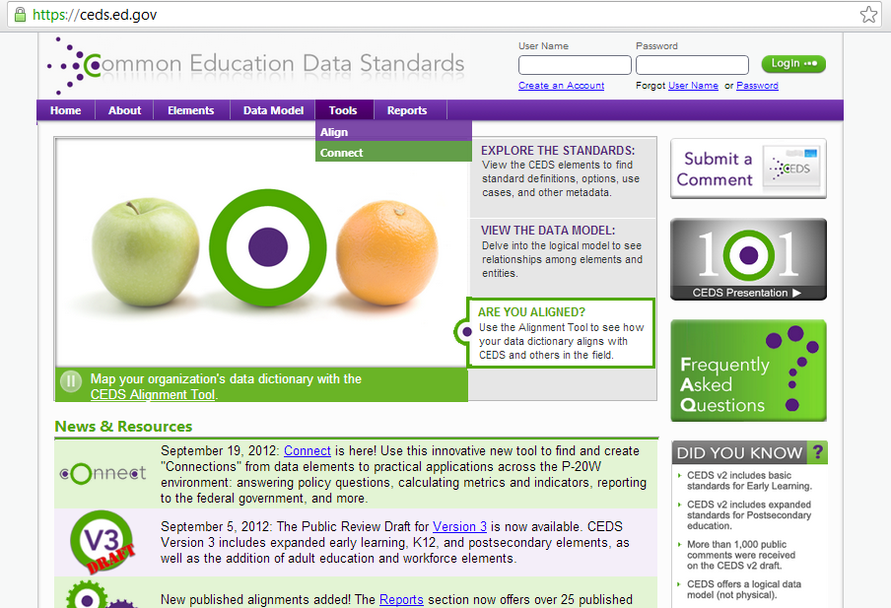


1. Go to ceds.ed.gov and Select Tools/Connect

Slide 44
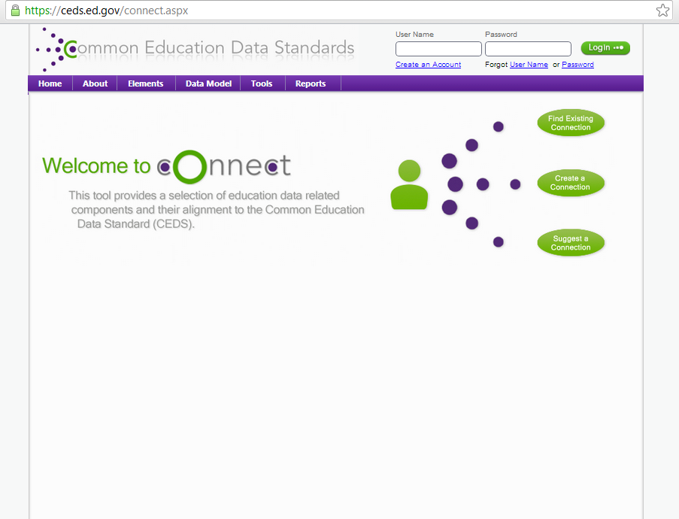

2. Select “Find Existing Connection”

Slide 45
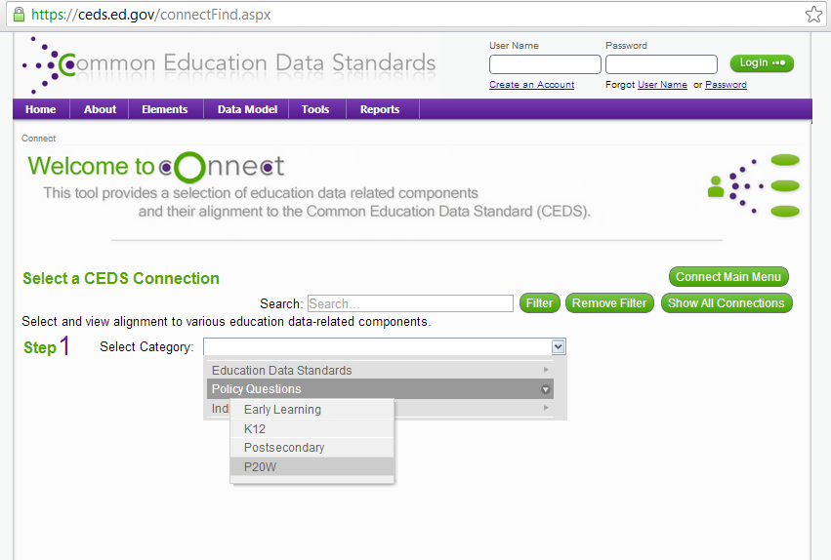
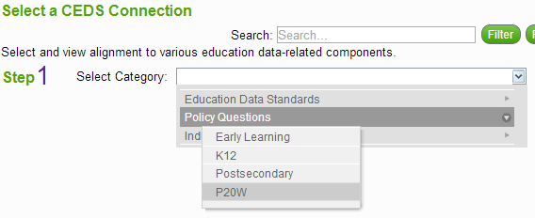
3. Search by Keywords or Select a Category

Slide 46
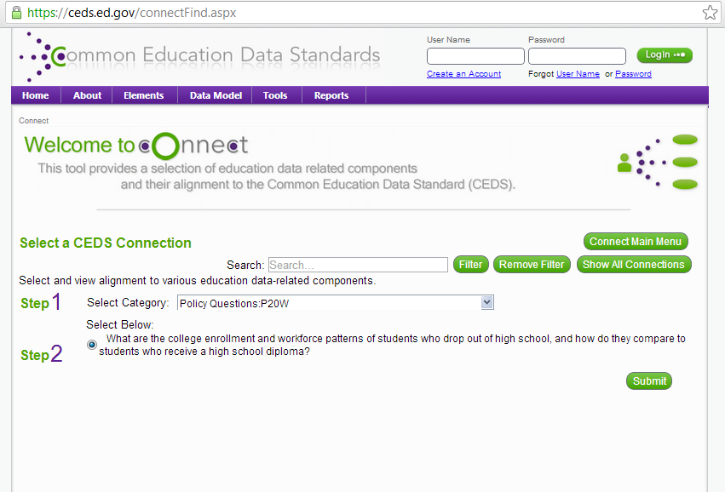
4. This Example Selects a P20W Policy Question

Slide 47
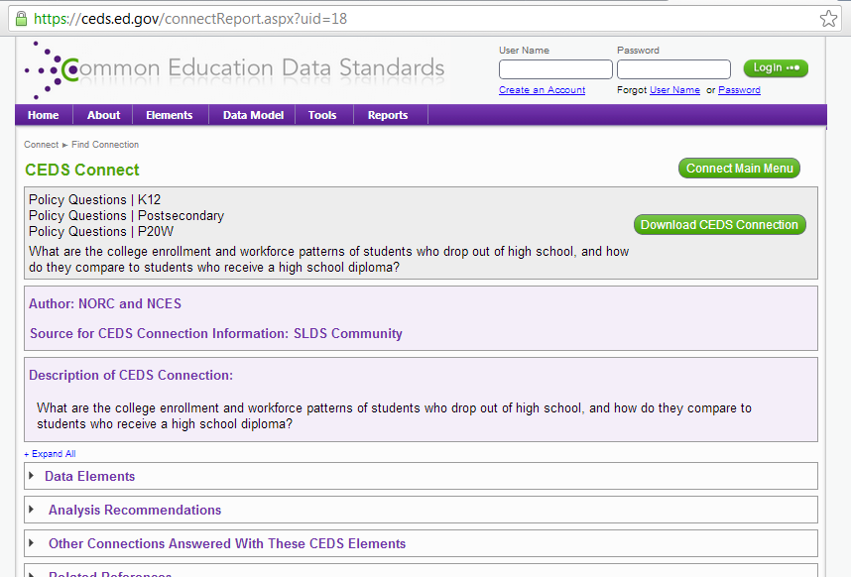
5. View Policy Question information

Slide 48
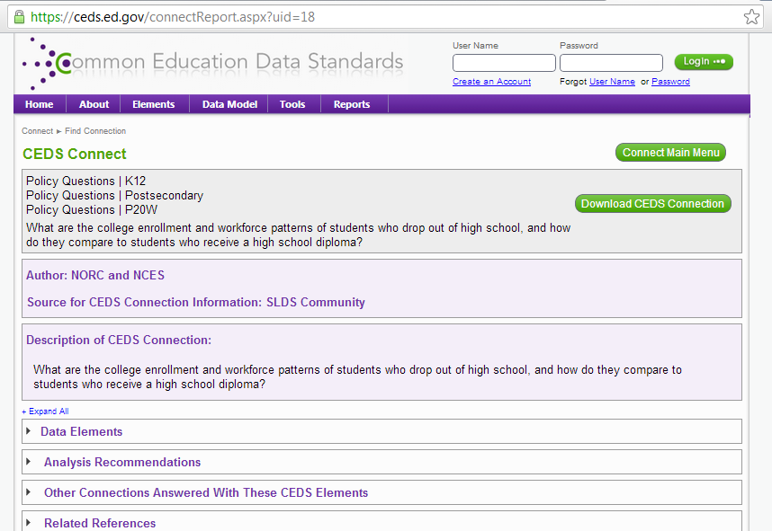
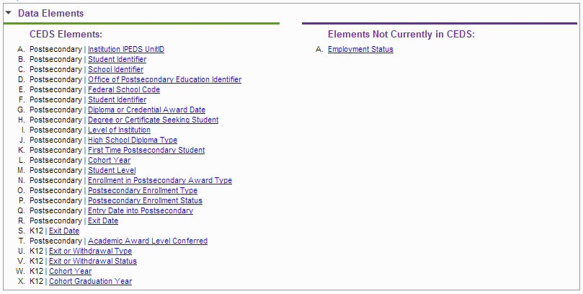
6. View CEDS Elements needed to answer the question

Slide 49
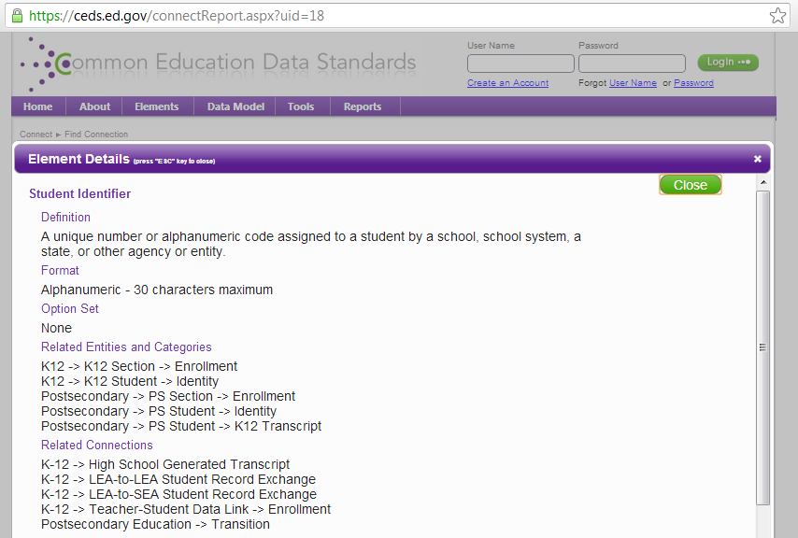
7. Click the Element to view a detailed description

Slide 50
8. Click Analysis Recommendations for formulas, etc.

Slide 51
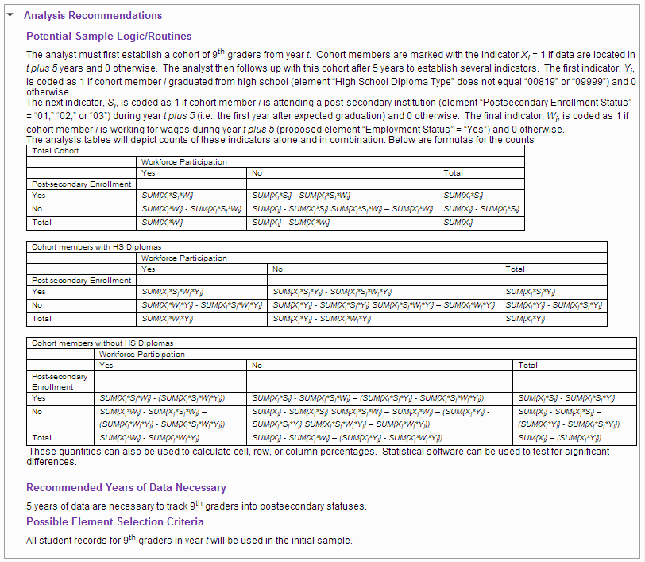
8. Click Analysis Recommendations for formulas, etc.

Slide 52
9. Download the Connection

Slide 53
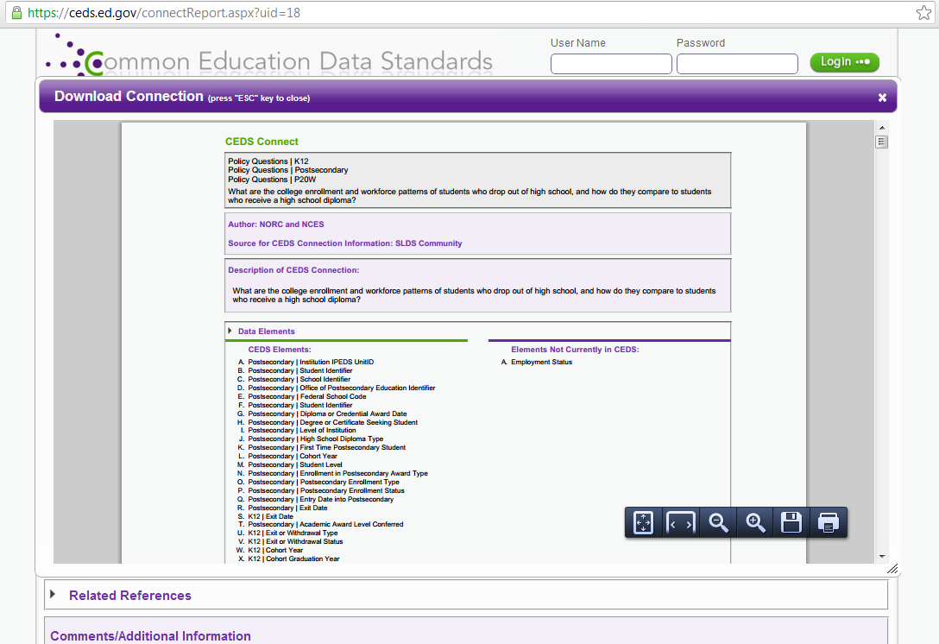
9. Download the Connection

Slide 54
Delaware’s CEDS Example

Slide 55
Delaware
Background
  Delaware Department of Education’s Early Development & Learning Resources Work Group
  Started out as a group of individuals who worked with early childhood programs. Became a formal working group approximately 3 years ago
  First dedicated data person came on board nearly 2 years ago

Slide 56
DE DOE Early Childhood Programs
 | PAT | HS | EHS | ECAP | IDEA 619 Part B
Program Type | State | Federal | Federal | State | Federal
Ages Served | B-3 | 3-5 | B-3 | 4 | 3-5
Populations Served | at risk | Low-Income, Disabilities | Low-Income, Disabilities | Low-Income, Disabilities | Disabilities
Local Programs | NCC | NCC | NCC | NCC | NCC
Local Programs | Kent | Kent | Kent | Kent | Kent
Local Programs | Sussex | Sussex | Sussex | Sussex | Sussex
Number of Programs | 3 | 3 | 2 | 12 | 14
Number of children/families | 1400 | 1265 | 284 | 843 | 1551
Data Location | Visit Track | eSchoolPlus | eSchoolPlus | eSchoolPlus | IEPPLUS
Data Location | DELSIS | ChildPlus | ChildPlus | ChildPlus | eSchoolPlus for COSF
Data Location |  | COPA | COPA | COPA
Data Location | Ages & Stages | Teaching Strategies Gold | Teaching Strategies Gold | Teaching Strategies Gold | Multiple

Slide 57
Early Childhood Data Sources
Delaware Practitioners in Early Childhood Database (DPEC) (DOE)
Office of Child Care Licensing (DSCYF)
Quality Rating Improvement System (QRIS) (UD)
Professional Development Registration Database (UD)
Part C 619 IDEA (DHSS)

Slide 58
Delaware and CEDS
Common Education Data Standards (CEDS)
  Voluntary Common Vocabulary
  CEDS Alignment Tool
    Web based tool that allows stakeholders to
      Import or input their data dictionaries
      Align their data to CEDS
      Compare their data elements to others

Slide 59
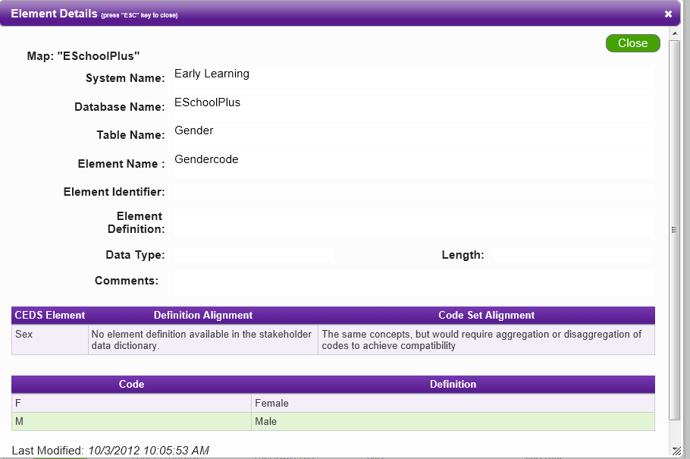
Delaware and CEDS

Slide 60
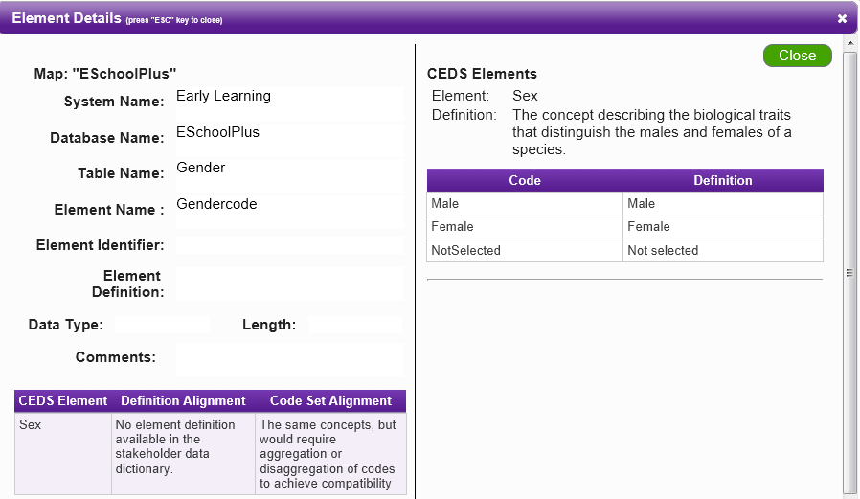

Delaware and CEDS

Slide 61
Delaware and CEDS
CEDS provides a free location to store dictionary
CEDS is helping Delaware to identify data elements
  People know we have data
  Don’t know what we have or what it means

Slide 62
Delaware and CEDS
CEDS is helping Delaware prioritize and organize early childhood data
  Moving away from “collect everything” approach and focus on what we need to collect, report, and analyze
  Provide assistance to start conversations with P-20, various agencies, and own technical department

Slide 63
Delaware and CEDS
CEDS is helping to bring stakeholders together
  Stakeholders want to belong
  This is the starting point for integrating data

Slide 64
Delaware and CEDS
CEDS is an opportunity to build the foundation for Delaware’s data integration work
      Working with the University of Delaware to create an early childhood data dictionary
      EC dictionary will be aligned to CEDS
      Three phases to building EC data dictionary
        DOE EC Programs
        DPEC, OCCL, QRIS, PD
        Related EC data (e.g. Health)

Slide 65
Future
  Fill in gaps in our data dictionary (e.g. add definitions, definition alignment, etc.)
  Add data elements in alignment tool for 2nd phase
  Continue to meet with offices to inform them of our effort and to obtain data element information for data dictionary
  Use Connect Tool for data integration buy-in
  Publish data dictionary

Slide 66
CEDS Speed Session
Notes:
This presentation will introduce you to CEDS: the need it meets

Slide 67
Ground Rules
Group must address
each topic within 2 minutes
Group must drop and change topic when indicated
Group must have a scribe

Slide 68
One area where CEDS would be valuable to my organization is…

Slide 69
A challenge of
CEDS is…

Slide 70
What does it mean to “implement” CEDS?

Slide 71
If CEDS could only standardize one data set, I would want it to be…

Slide 72
A use of CEDS in the Local Level space might be…

Slide 73
When it comes to CEDS communication efforts, I would like to see…

Slide 74
What are the most critical/relevant connections for Connect…

Slide 75
Based on what you’ve seen today, how would these tools be helpful for you in your role?

Slide 76
What other tools would you like to see from CEDS that would help make the data standards beneficial to you?

Slide 77
Q & A

Slide 78
For more information,
visit:
http://ceds.ed.gov

Slide 79




Contacts:
Missy Cochenour
  missy.cochenour@aemcorp.com
Lynne Kahn
  lynne.kahn@unc.edu
Meredith Miceli
  Meredith.Miceli@ed.gov
Tony Ruggiero
  truggiero@doe.k12.de.us
Notes:
Update names and emails

