Slide 1
Taking the Plunge: First Steps to Integrating Child Outcomes into the IFSP/IEP Process
Dana Romary, Part C Wisconsin
Sandi Harrington, Part C Virginia
Anne Brager, Part C Virginia
Kate Rogers, 619 Vermont
Kathi Gillaspy, NECTAC/ECO
Megan Vinh, WRRC

Slide 2
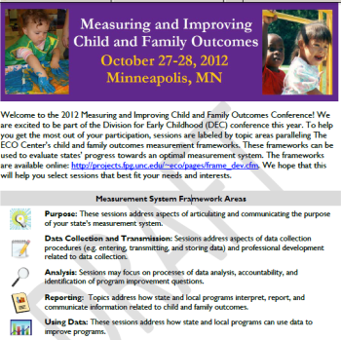
Setting the Context - History
Integrating child outcomes has been a hot topic for conference sessions since 2007
Began as a local initiative
Focus on gathering and using functional information about children

Slide 3
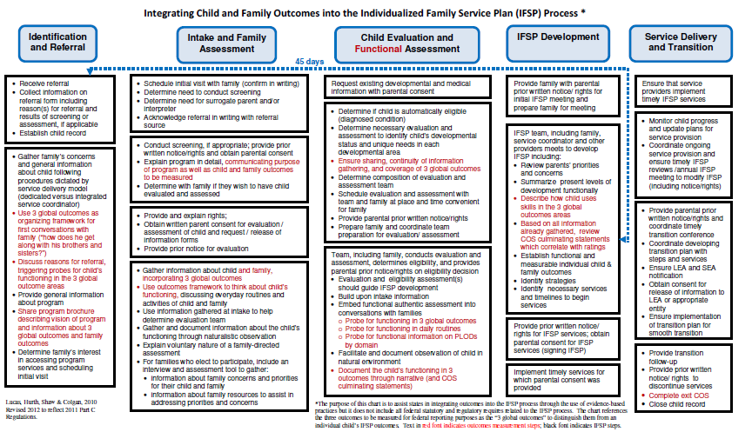
Setting the Context - History
Identification of several benefits
Expansion to integration into the IEP process
Integration Think Tank, April 2010
Development of resources for state and local use
3

Slide 4
Integrating Outcomes Measurement: Focus and Purpose
4

Slide 5
Integrating outcomes is…
Not just about creating a more seamless process…not just details and how
Critical to the picture
of what we are all trying to accomplish
BIG
5

Slide 6
Disconnect?
States accountable for….
Programs working toward….
Providers focus on….
Children achieve….
6

Slide 7
Alignment Across Levels
….the 3 outcomes
States accountable for….
Programs working toward….
Providers focus on….
Children achieve….
7

Slide 8
Ultimate Goals for EI and ECSE
For children:
“To enable young children to be active and successful participants during the early childhood years and in the future in a variety of settings – in their homes with their families, in child care, preschool or school programs, and in the community.”
Based on the ECO stakeholder process when identifying 3 functional outcomes
8

Slide 9
The Pieces
Assessment
Planning
What skills the child uses
What to do next
9

Slide 10
The Pieces
Thinking
Repeat….
Assessment
Planning
What skills the child uses
What to do next

Slide 11

What is the Framework Guiding
Our Thinking?
Providers always bring some kind of framework for where they want to see children go next
Are these guiding ideas explicit or unspoken? Using a unified framework or multiple frameworks?
11

Slide 12
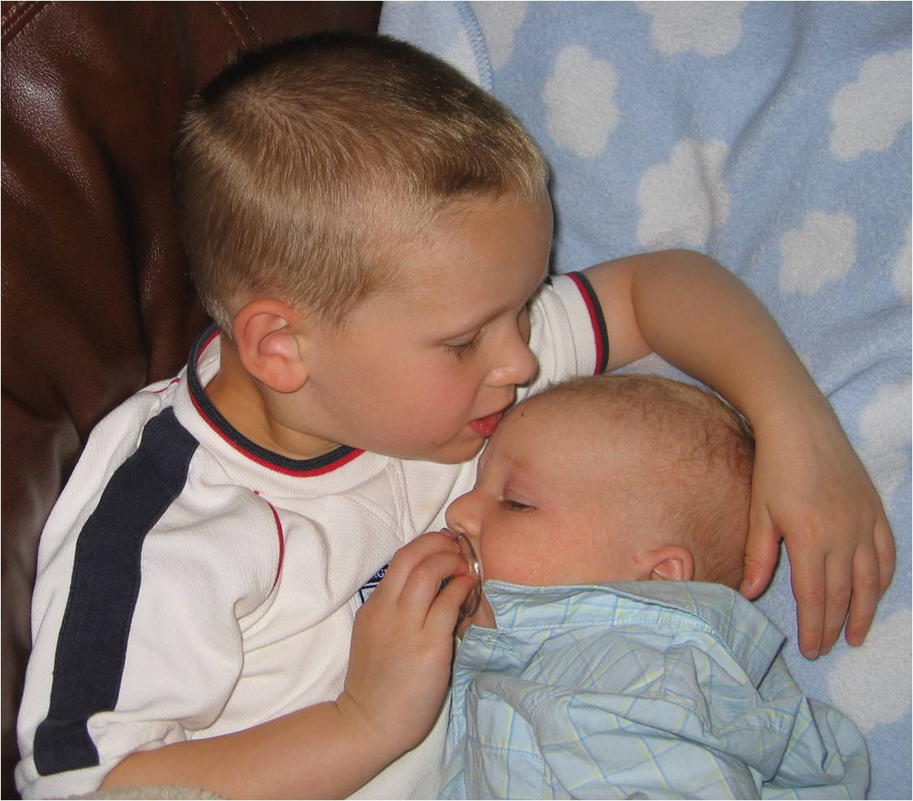
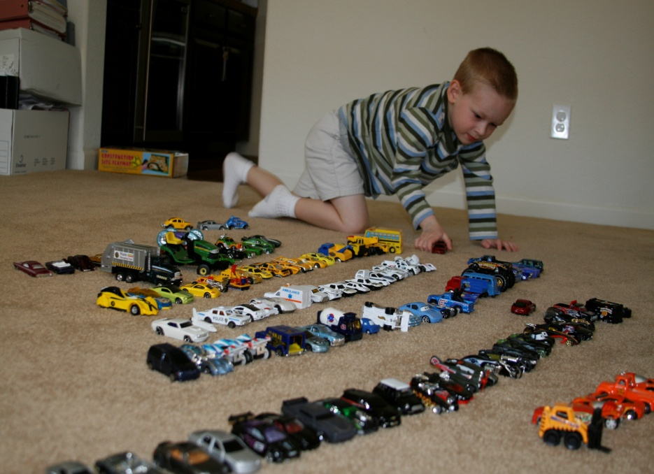
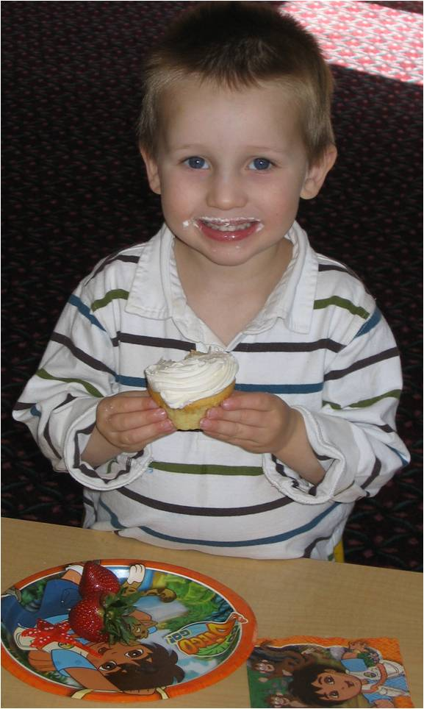
The Outcomes as a Guiding Framework
The 3 functional outcomes can be a framework, a lens, for viewing child functioning and planning intervention
12

Slide 13
Putting the Pieces Together
What we want the child to achieve
Outcomes
Assessment
Planning
What skills the child uses
How we are going to get there
13

Slide 14
Why Use the Outcomes??
Socially validated
They’re functional
They’re integrated
Flexible
14

Slide 15
What Might It Look Like?
Assessment
What does our assessment tell us about child functioning in each outcome area across settings and situations?
15

Slide 16
What Might It Look Like?
IFSP/IEPs
Planning IFSP/IEP goals objectives –
  Has the team considered how to write objectives that continue help the child progress in each of the outcome areas?
  Will the objectives written support effective participation (overarching goal)?
  With outcomes as an organizer for where we want the child to go, use of discrete, domain-specific goals/objectives won’t make sense.
16

Slide 17
What Might It Look Like?
Understandable, Measurable
Emphasis on functional, integrated outcomes throughout the process produces more understandable, measureable objectives.
Reinforces assessment and planning cycle.
Improves practice.
Supports progress in the overarching areas that are central to EI and ECSE.
17

Slide 18
Current Status
9 states are integrating (or in the process of integrating) outcomes into their IFSP
4 states are integrating (or are in the process of integrating) outcomes into their IEP
Integrating Outcomes Learning Community:
  104 members: 87 are state administrators, state TA providers or local providers, 17 are representatives of various TA organizations (ECO, NECTAC, RRCP)
  Membership represents 36 of states and territories
18

Slide 19
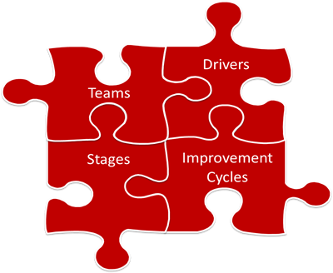
Implementation Frameworks
Source: SISEP eNotes http://sisep.fpg.unc.edu
19

Slide 20
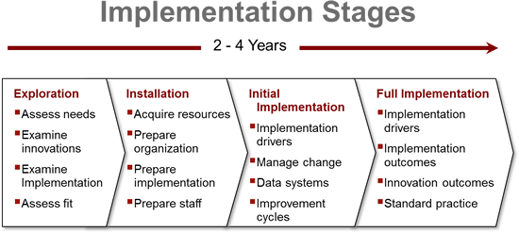
Implementation Stages
Metz & Bartley (March 2012) Active Implementation Frameworks for Program Success. Zero to Three
20

Slide 21
Exploration
Identify champions
Identify stakeholders
Articulate desired outcomes of integrating outcomes measurement
Develop clear understanding / requirements for implementation
Assess “fit”
Assess readiness
Build public awareness support & commitment
21

Slide 22
Installation
Ready the system to initiate new practice
Develop implementation plan
  Identify likely “early adopters”
  Build “transformation zones” for initial implementation
  Develop implementation teams in each zone
  Build initial communication, evaluation, monitoring mechanisms
Develop training and technical assistance resources
22

Slide 23
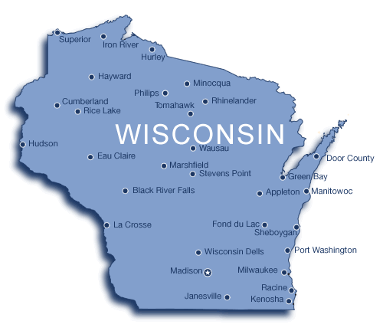
Developing an Integrated IFSP: A Work in Progress
Dana Romary, Birth to 3 Program Coordinator, Wisconsin
23

Slide 24
Wisconsin’s Driving Force:
Create a smooth, uninterrupted and connected IFSP process that encourages team and family participation
24

Slide 25
An abbreviated history
Arriving in Wisconsin four years ago…
  -An initial integrated IFSP was available
  -Only minimal use of the integrated “form”
  -An established work group between C and 619
25

Slide 26
Birth to 3 slows and reflects
We recognized specific Birth to 3 needs related to Child Outcomes
We developed a 3 part Child Outcomes logic model:
  Practice/Policy
  Data
  Training
26

Slide 27
Birth to 3 slows and reflects
…Continued
Prioritized Child Outcomes state wide
Incorporated Child Outcomes agenda items into every On-Site and Self Assessment
Emphasized as “best practice” the use of the integrated IFSP
Continued the editing of the integrated form
Started accepting feedback/suggestions from Counties
Now EXPECTED the use of the Decision Tree
27

Slide 28
Data Improvement
ARRA allows specific Child Outcomes enhancements to our data system
Designed to parallel/coordinate with the ECO calculator
Identifies Child Outcomes “errors “ and we send out notices to correct
Regional meeting begin to introduce Summary Statements but still address reporting categories
Seeing better data but little interest on behalf of Birth to 3 programs
28

Slide 29
The Big Aha
Bring in the Stakeholders
Create an IFSP work group
Include representation from across the state, including:
-Administration
-Providers
-State staff
-Regional TA
Pilot the “form”
Collect feedback from participants
Vet the form through the Department
USE IT!
29

Slide 30
Current Status
It is moving through the vetting process of DHS
Counties and individuals who has used it love it
Service Coordinators have acknowledged it has helped connect the entire IFSP process, as intended.
We are not mandating it’s use.
However, programs and providers seem to be convincing one another therefore no need for the “STATE” to demand it’s use.
On-site visits and annual self assessments revealed Child Outcomes integrated portion
30

Slide 31
Next Steps
On-line module development projected for 2014
Work with 619 regarding Exit Outcomes and IEP participation
Work towards periodic collaborative efforts with 619 when common or when mutually supportive opportunities arrive
31

Slide 32
Lessons Learned
Must have stakeholder input!
Allow the process to work…over time!
Use ECO!
Allow providers to do the talking for you!
32

Slide 33

Live from Vermont!
The new IEP!
Early Childhood Outcomes Conference October 27th, 2012
Kate Rogers ~ Vermont 619 Coordinator

Slide 34
Early
Childhood
Outcomes
PLP
Services
Progress
Goals
Placement

Slide 35
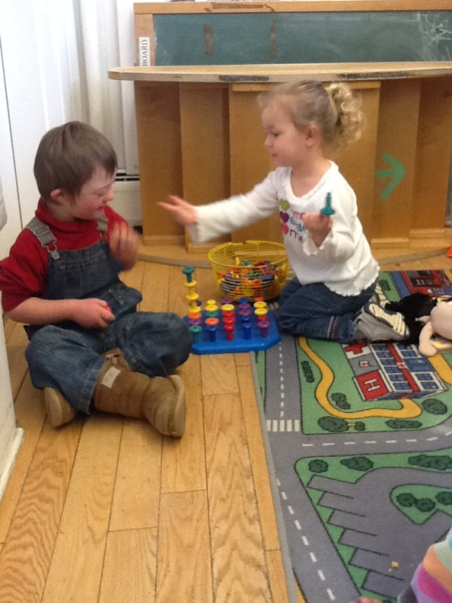
Exploration
Identify the need for change….

Slide 36

2010
School districts dissatisfied with IEP form
Montpelier,
we have
a problem!

Slide 37

Data Collection
HELP!

Slide 38
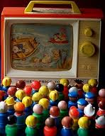
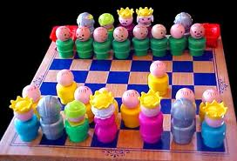
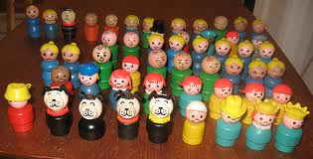
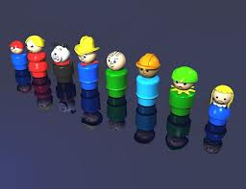
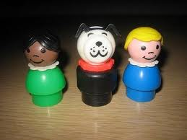
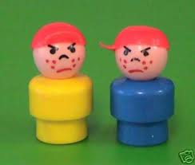
VERMONT’s
Integrated
IEP
VERMONT’s
Integrated
IEP
DOE forms group
Stakeholder input

Slide 39
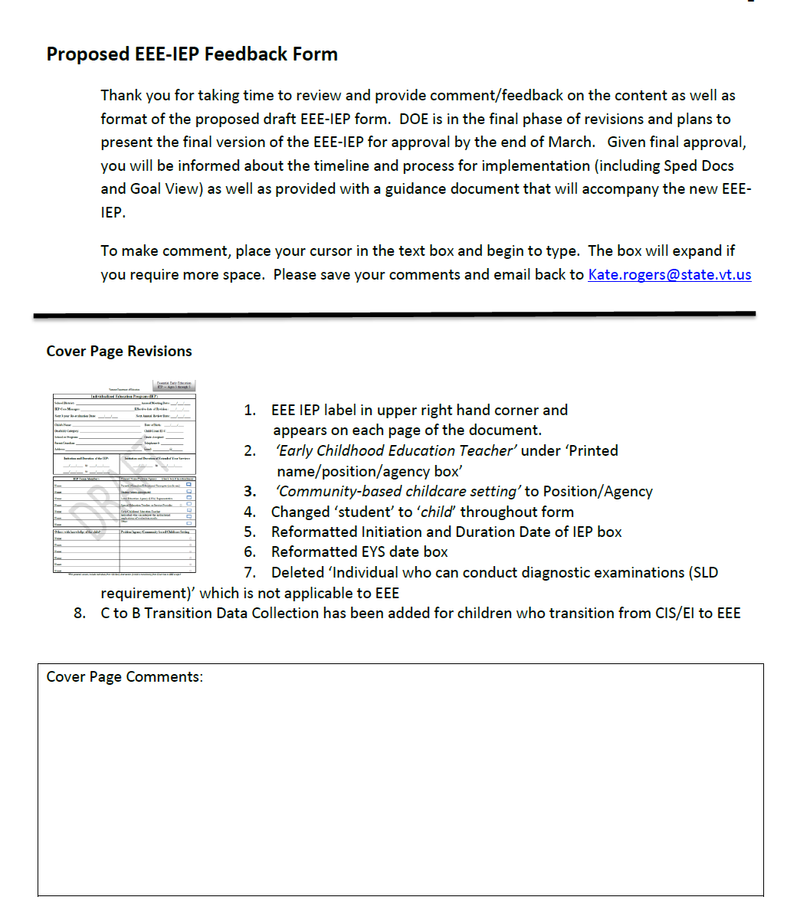
Comments collected via:
Wiki site
Email
Phone
During statewide trainings and meetings

Slide 40


Slide 41
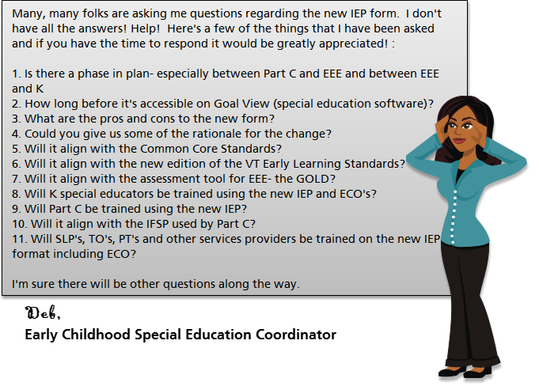

Slide 42
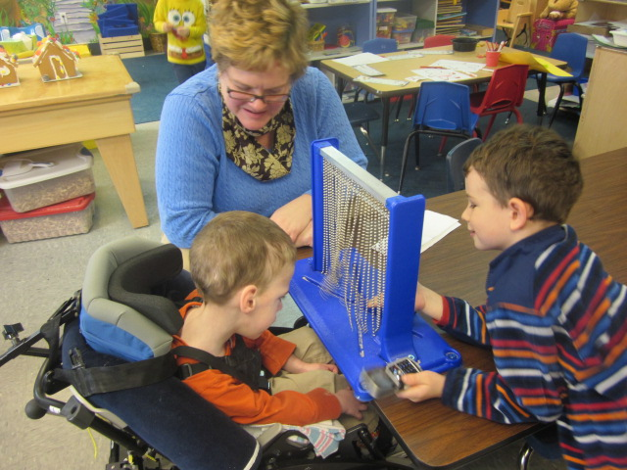
Installation
Establishing the necessary resources required to implement new IEP…

Slide 43
Dept. of Ed
Data Manager
School District Special Education Software Programmers (3)
Focus Monitoring Team
Ongoing review by Division Director and State Special Education Director
School District Consortium
FINAL APPROVAL from SAC and DOE
NECTAC & ECO
Continue stakeholder feedback

Slide 44
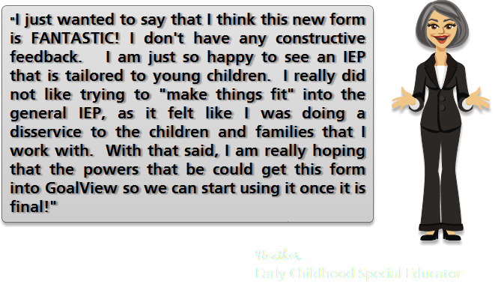

Slide 45
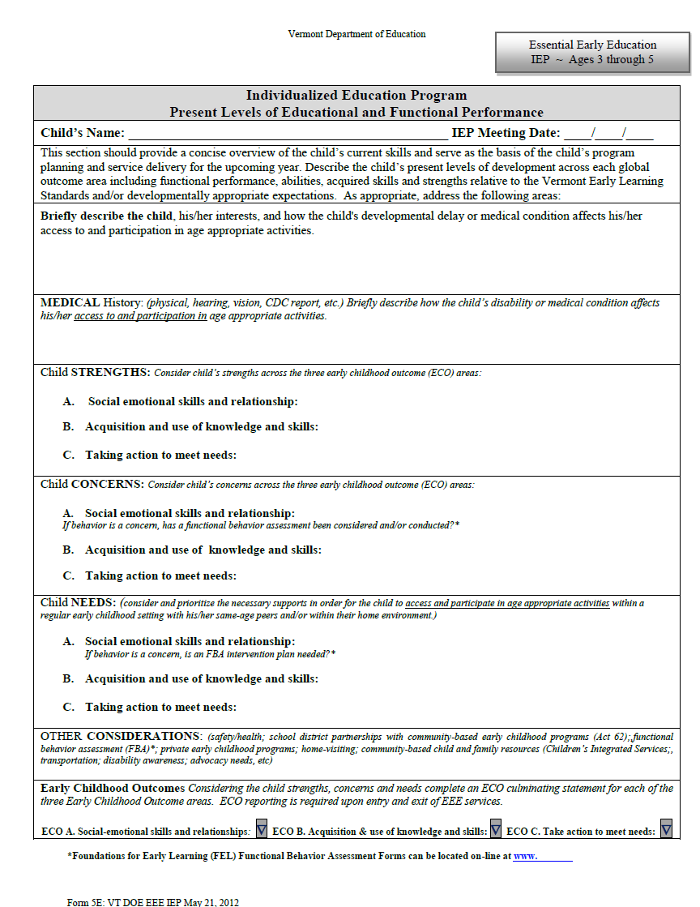
Page 2 Present Levels
Abilities & interests
Medical History
Strengths
Concerns
Needs & Supports
Other Considerations
ECO Culminating
Statements ABC

Slide 46
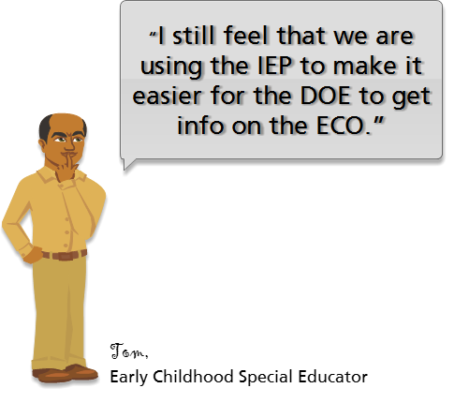

Slide 47
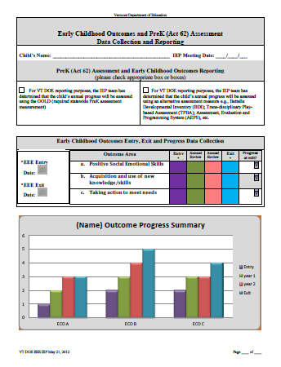
For Data Collection & Reporting
Yeah!

Slide 48
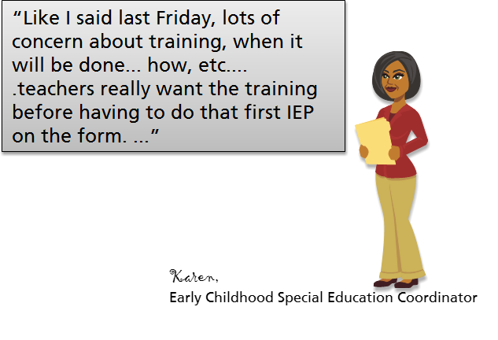


Slide 49
Sept 1
Regional Trainings
Implementation
E-learning
Module
Data collection via Child Count
Software Program ‘Adjustments’

Slide 50
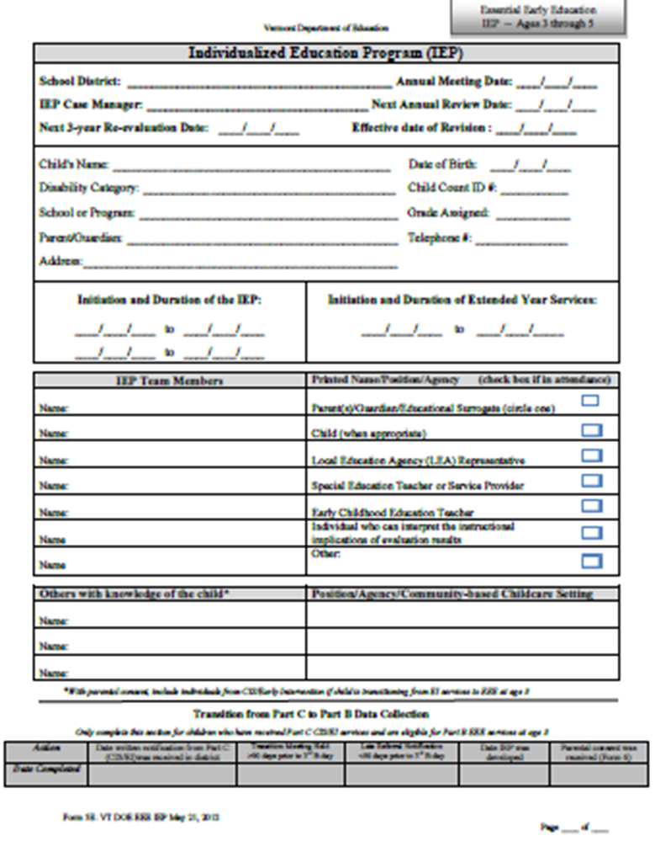
New IEP
August 2012
Regional IEP clinics conducted
Schools begin to use IEP
Resources developed to
support on-going PD:
  IEP workbook
  Sample IEP
  IEP e-learning module
Upcoming trainings:
  Joint Part C/B training on writing functional outcomes and goals/obj

Slide 51
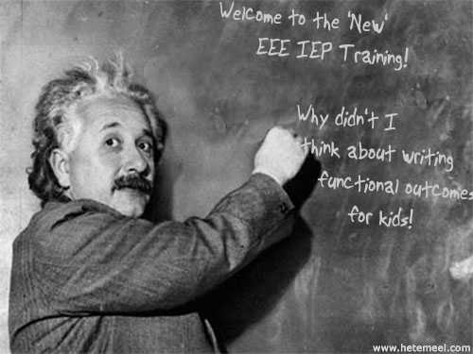
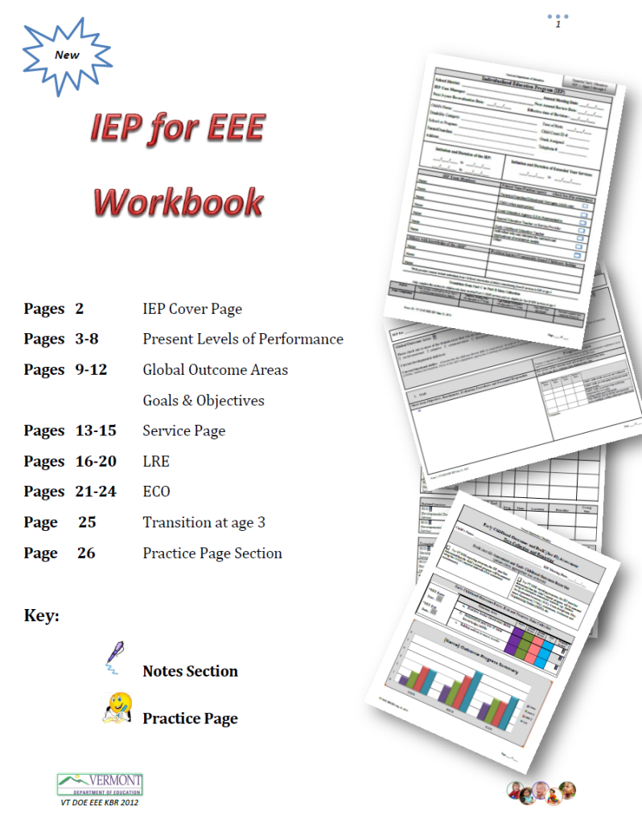

Slide 52
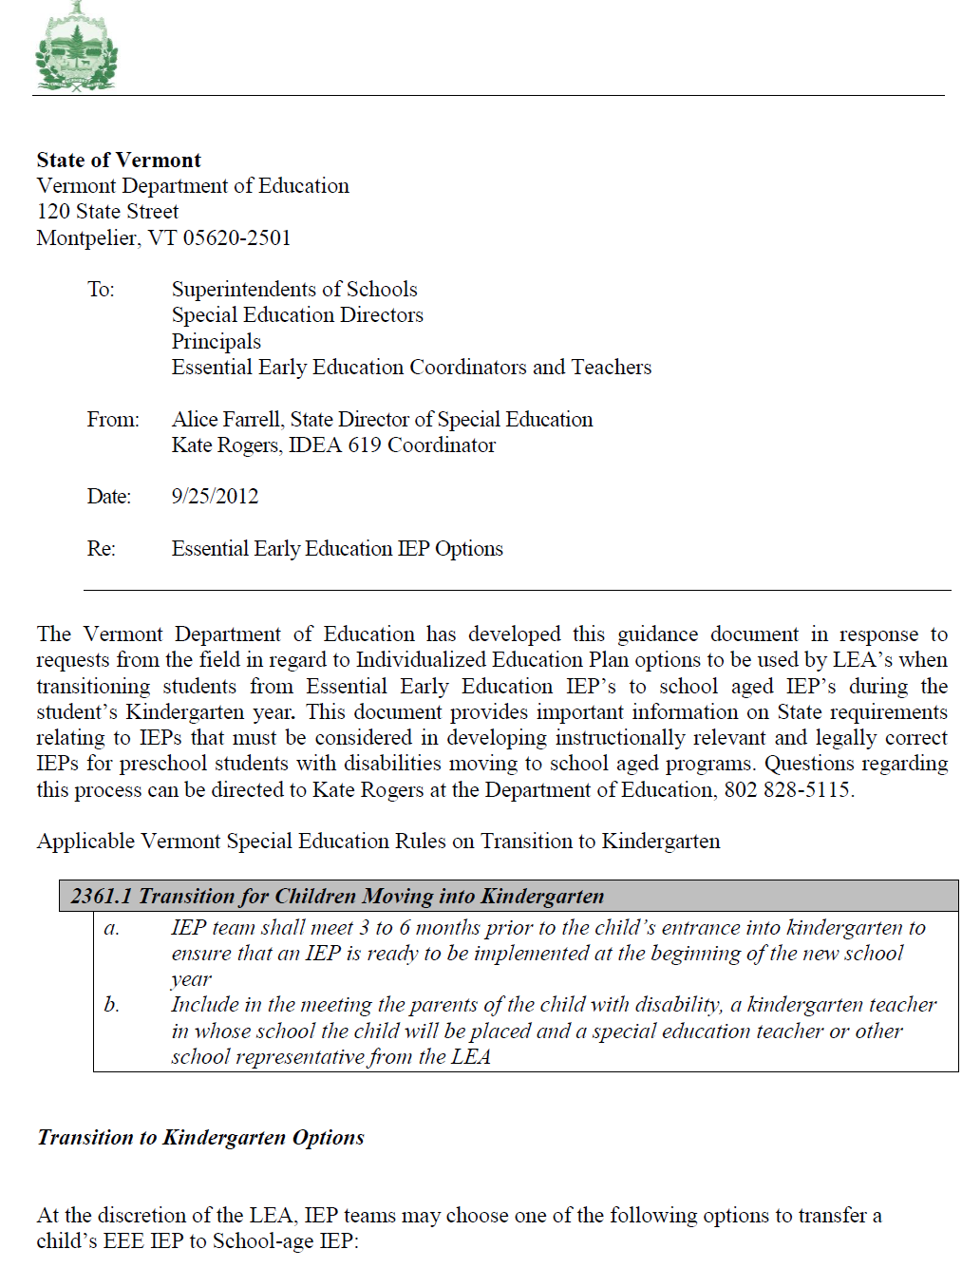
Guidance developed for preschool to school-age IEP transition

Slide 53
So, after 6 weeks…
Software glitches have popped up
Teachers want to make sure they are completing the IEP correctly
Seems overwhelming but easier at the same time (is that possible?)
IEP teams (including related service providers) are requesting training on how to write ‘functional’ goals and objectives

Slide 54
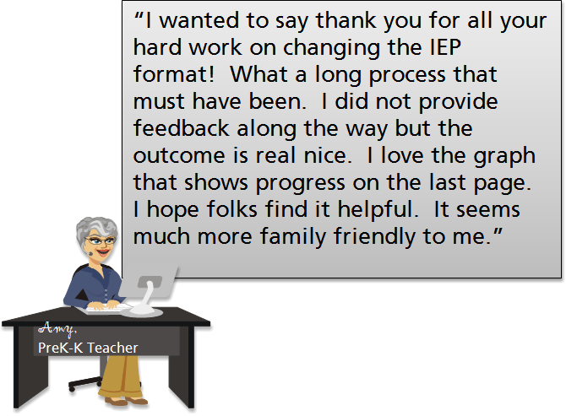

Slide 55
You can locate the new IEP document, materials and resources on the Vermont Department of Education Website:
http://education.vermont.gov/new/html/pgm_earlyed/essential_early.html
Or better yet, give me a call at
802-828-5115 or send me an email kate.rogers@state.vt.us
Thank you!

Slide 56
Infant & Toddler Connection of Virginia
Integrating Outcomes into the IFSP Narrative
Sandi Harrington & Anne Brager
October 27, 2012

Slide 57
Where We Started
December 2006
  Time 2 of the pilot
  We made the leap that the narrative would be in 3 outcome areas not domains.
January –March 2007
  State roll out
  Localities given the option on how to write narratives

Slide 58
Where We Started in Norfolk
Rationale for the change:
  Wanted a functional narrative
  Wanted the family to be involved
  Acknowledged the need for family input for a variety of settings/situations
  Desire to streamline the process
  Meaningful activity vs. one more thing to do

Slide 59
Decision to move to state wide integration
Decision made in Spring 2012 to require integration of child outcomes in IFSP for all IFSPs in Virginia by 7/1/13
Integration includes routines and activities as a more prominent part of the IFSP
Assessment narrative written in the 3 outcome areas, not domains

Slide 60
Where We Are Now
Child Outcomes Workgroup
  New summary statements
  Updated “book”
  Developing changes
Early Implementers
  2 local systems per region (10 total)
  Monthly conference calls / TA

Slide 61
Where We Are Now
Challenges:
  Typical development knowledge is still a concern
  Staff are still struggling with the ratings which is affecting inter-rater reliability
  Cognitive processing to translate from domains to the 3 outcomes on the spot
  Some resistance to change

Slide 62
Statewide Implementation
Revising our booklet of requirements, aids and typical development

Slide 63
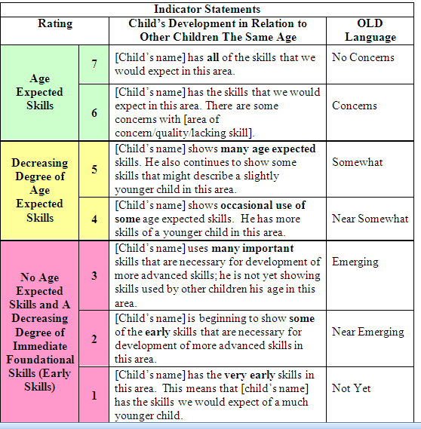
Statewide Implementation
New Summary Statements

Slide 64
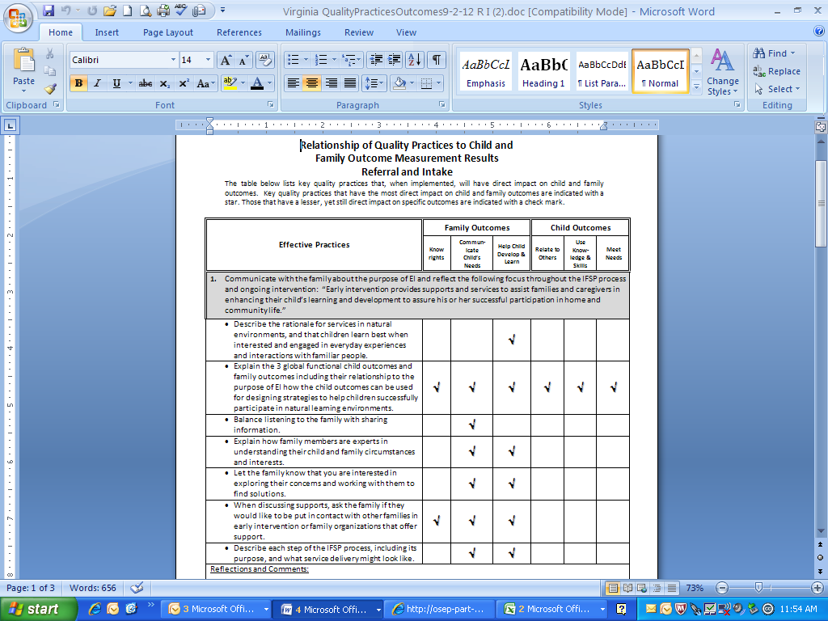
Statewide Implementation
Emphasis on Quality Practices from referral thru transition

Slide 65
Statewide Implementation
1 webinar completed and archived
More planned
Mixture of webinars and face to face training planned
Required trainings- online modules/ EI certification and practice manual

Slide 66
Critical Aspects of Implementation
FEEDBACK
  Supervisors / identified staff to attend assessments/IFSPs
  Feedback at the local and state level to programs on the narratives / outcomes ratings.

Slide 67

Questions?
67

Slide 68
Contact Information
Kathi Gillaspy: kathi.gillaspy@unc.edu
Megan Vinh: mvinh@uoregon.edu
68

