Slide 1
Integrating Outcomes Measurement: Focus and Purpose
Notes:
‘’Come together’ is supposed to go with the music theme… None of the other lyrics of that song make sense for this session, though. Did you know John Lennon wrote it for Timothy Leary??

Slide 2
Integration
Not just about creating a more seamless process…not just details and how
Critical to the picture
of what we are all trying to accomplish
BIG

Slide 3
Disconnect?
States accountable for….
Programs working toward….
Providers focus on….
Children achieve….

Slide 4
Alignment Across Levels
….the 3 outcomes
States accountable for….
Programs working toward….
Providers focus on….
Children achieve….

Slide 5
Ultimate Goals for EI and ECSE
For children:
“To enable young children to be active and successful participants during the early childhood years and in the future in a variety of settings – in their homes with their families, in child care, preschool or school programs, and in the community.”
Based on the ECO stakeholder process when identifying 3 functional outcomes
Notes:
Outcomes aren’t just about accountability…
This is where we want our children (EI and ECSE children) to accomplish and so we want to be accountable for helping children/families achieve this goal…

Slide 6
The Pieces
Assessment
Planning
What skills the child uses
What to do next

Slide 7
The Pieces
Thinking
Repeat….
Assessment
Planning
What skills the child uses
What to do next
Notes:
Regardless of assessment approach…

Slide 8
What is the Framework Guiding Our Thinking?
Providers always bring some kind of framework for where they want to see children go next
Are these guiding ideas explicit or unspoken? Using a unified framework or multiple frameworks?

Slide 9
Examples of Guiding Frameworks
The items on a specific assessment tool
A milestone checklist or series of skills to learn based on a provider’s specialty area
A specific curriculum, with assessment identifying starting point
Whatever the family wants

Slide 10
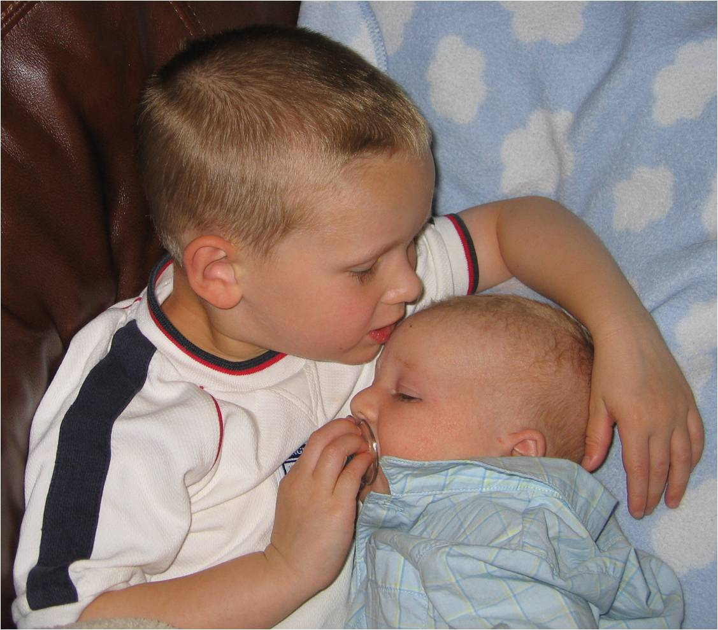
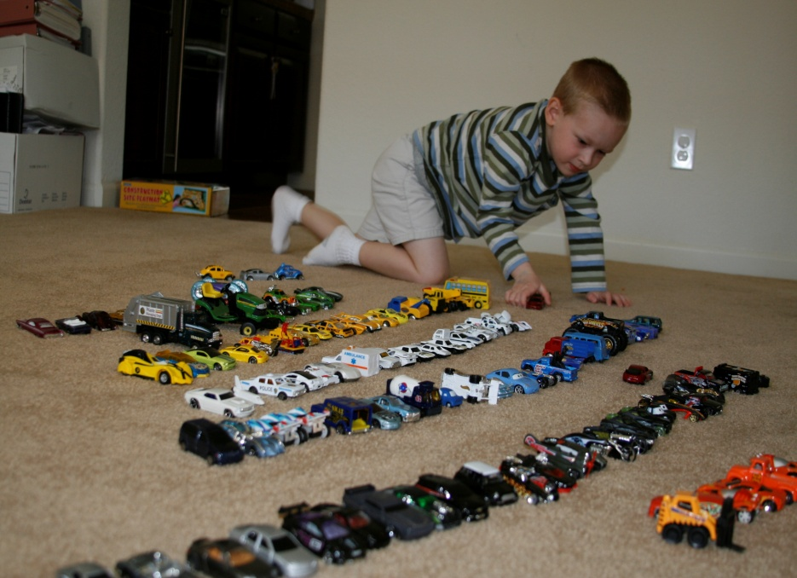
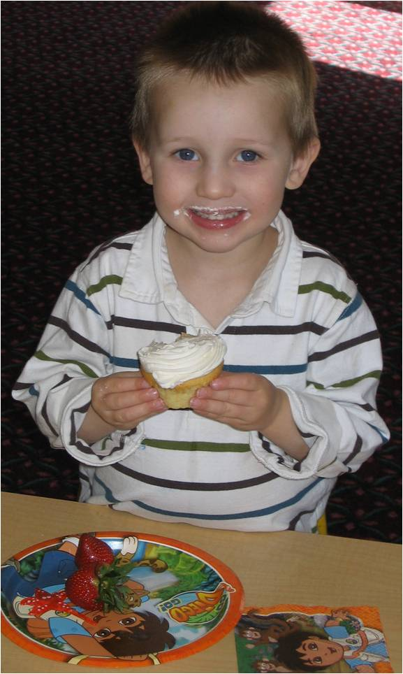
Examples of Guiding Frameworks
The 3 functional outcomes can be a framework, a lens, for viewing child functioning and planning intervention

Slide 11
Putting the Pieces Together
What we want the child to achieve
Outcomes
Assessment
Planning
What skills the child uses
How we are going to get there
Notes:
The outcomes are what we want the child to achieve…
They are a lens that influences how we look at what skills the child uses (what the child can and does do) and something we can use to organize and intentionally shape our planning for how to help the child continue to learn to use his/her skills in richer, more complex, successful ways.

Slide 12
Why Use the Outcomes??
Socially validated as what we’re trying to achieve, a focus that matters
They’re functional – reinforce getting functional information in our assessment and writing functional IFSP/IEP goals/objectives for what to work on
They’re integrated – Emphasize the whole child - a key to overall goal of effective participation
Flexible – not wedded to one particular assessment, curriculum, or level of child functioning

Slide 13
What Might It Look Like? Assessment
Assessment – What does our assessment tell us about child functioning in each outcome area across settings and situations?
Organizer for writing or sharing results
Organizer for planning breadth and type of assessment approaches needed and who should be involved in it
Produces information for outcomes and planning

Slide 14
What Might It Look Like? IFSP/IEPs
Planning IFSP/IEP goals objectives –
Has the team considered how to write objectives that continue help the child progress in each of the outcome areas?
Will the objectives written support effective participation (overarching goal)?
With outcomes as an organizer for where we want the child to go, use of discrete, domain-specific goals/objectives won’t make sense.

Slide 15
What Might It Look Like? Understandable, Measurable
Emphasis on functional, integrated outcomes throughout the process often produces much more understandable, measureable objectives. Families can tell when their children are achieving them.
Reinforces assessment and planning cycle.
Improves practice.
Supports progress in the overarching areas that are central to EI and ECSE.

Slide 16
Ongoing Assessment
Initial IFSP/IEP
Planning and Intervention
IFSP/IEP Review
3 outcomes
Targeted outcomes
3 outcomes

