Slide 1
The State of States’ ECE Data Systems Efforts
Albert Wat, Pre-K Now
NECTAC/ECO Conference – New Orleans, LA
September 20, 2011

Slide 2
Agenda
Introduction: Getting Started
The 10 Fundamentals
Findings from State Analysis
Lessons Learned So Far
Next Steps
Resources

Slide 3
The Early Childhood Data Collaborative
A PARTNERSHIP OF
The Center for the Study of Child Care Employment at UC Berkeley
Council of Chief State School Officers
Data Quality Campaign
National Conference of State Legislatures
National Governors Association Center for Best Practices
Pre-K Now, a campaign of the Pew Center on the States
The ECDC is supported through funding from the Birth to Five Policy Alliance, The Pew Charitable Trusts, and The David and Lucile Packard Foundation.
Visit www.ECEdata.org for more information.
Notes:
Two years ago, these groups came together with the goal of helping state policymakers put in place policies and processes that support the development and use of a well-designed state early care and education system – a data system that would give them access to information to help make decisions about improving program and workforce quality, increasing access to ECE programs, and ultimately, improving young children’s learning and development.
Since then, we’ve developed a policy framework, published a couple of case studies, organized cross-state learning opportunities, and surveyed where states are in this work.
Mention website
Mention funders

Slide 4
Guiding Principles
From compliance to improvement efforts
From fragmented efforts to coordinated systems
From snapshot to longitudinal data
Start with identifying policy questions

Slide 5
Can your state answer these policy questions?
Are children, birth to age five, on track to succeed at school entry and beyond?
Which children have access to high quality early care and education programs?
Is the quality of programs improving over time?
What are the characteristics of effective programs?
How prepared is the workforce to provide effective education and care for all children?
What policies and investments lead to a skilled and stable early childhood workforce?
Notes:
Start with policy questions… In July 2009, we convened a meeting with 40-50 thought leaders around the country.
What’s going on with kids in terms of access and development?
What does program quality look like?
What does the workforce look like and are they well-supported?
5

Slide 6
What are "Early Childhood" Data?
The ECDC recognizes that multiple domains are important to early childhood
This framework focuses on the early care and education (ECE) domain—
Subsidized Child Care
Licensed Child Care
Early Intervention (IDEA Part C)
Early Childhood Special Education (IDEA Part B Section 619)
State Pre-kindergarten
State-funded Head Start or Early Head Start
Notes:
This represents the basic foundation. States (and localities) can choose to be more inclusive.
6

Slide 7
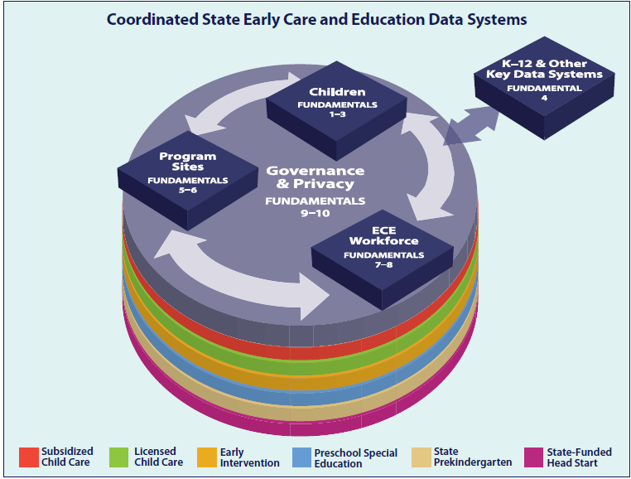
10 FUNDAMENTALS of Coordinated State ECE Data Systems
Notes:
Children, Sites, and Workforce – and how they relate to each other
Linkages to K-12 and other systems that serve young children –
Governance and privacy
7

Slide 8
10 FUNDAMENTALS of Coordinated State ECE Data Systems
Unique statewide child identifier
Child-level demographic and program participation information
Child-level data on child development
Ability to link child-level data with K-12 and other key programs
Unique program site identifier with the ability to link with children and the ECE workforce
Program site structural and quality information
Unique ECE workforce identifier with ability to link with program sites and children
Individual-level data on ECE workforce demographic, education and professional development information
State governance body to manage data collection and use
Transparent privacy protection and security practices and policies
Notes:
Children (1-3)
Sites (5-6)
Workforce (7-8)
Linkage to K-12 and other key programs - for longitudinal and comprehensive perspective
Governance and privacy (9-10)
Importance of a unique identifier
Importance of linking among child, site, and workforce
Data elements to be determined by local/state stakeholders
Governance body:
Oversees the overall mission and development of the data system
Ensures quality of data
Set policies around data sharing and common data definitions and…
Ensure appropriate data access and use – privacy and security of data
Access and use
This needs to be audience specific. Teachers and parents need individual child data, but program administrators and legislators don’t.
Everyone needs support to interpret the data and then use it to inform their actions – importance of partnerships with research and higher ed.
Data systems can’t answer all your questions. Sometimes, you need a more rigorous research design to make definitive conclusions about something and the data system can provide datasets that researchers can mine.

Slide 9
Ensuring Appropriate Access and Use
Data need to be timely and user-friendly.
Balancing access with privacy.
Build stakeholders’ capacity to understand and use data.
Partnering with research and higher ed communities.
Notes:
These are all things that a governance body can facilitate or set policies around – what needs to happen if data are to useful for continuous improvement efforts – or become “actionable.”
Access and use
This needs to be audience specific. Teachers and parents need individual child data, but program administrators and legislators don’t.
Privacy – Transparency - Who has access? How do they get access? What data do they have access to? With whom are the data shared? – and most importantly – WHY? What’s the purpose?
Everyone needs support to interpret the data and then use it to inform their actions – importance of partnerships with research and higher ed.
Data systems can’t answer all your questions. Sometimes, you need a more rigorous research design to make definitive conclusions about something and the data system can provide datasets that researchers can mine.
What researchers can bring to the table…
Training
Interpret data
Conduct more intentional studies to answer policy-relevant questions (trends vs. causation)
Building capacity through…
Training programs
professional development opportunities
communication with parents
Supporting stakeholders to understand AND use the data appropriately
- high-stakes vs. continuous improvement

Slide 10
1. Every State Collects ECE Data in at Least Some ECE Programs
States Collect Child-, Program Site-, and ECE Workforce-Level Data by ECE Program
Notes:
The good news: states are collecting significant data about their early care and education systems.
Every state is collecting child-level, program site-level, and ECE workforce-level data for at least some of the state’s programs. States most frequently maintain child-level data systems and the workforce data systems are the least common across states, especially for subsidized child care.
We also found that most states are using unique IDs to collect and track data about kids and individual program sites. But they are much less likely to use IDs to track individual ECE workforce members.

Slide 11
2. Data Are Uncoordinated Across ECE Programs
States Link Child-, Program Site-, and ECE Workforce-Level Data Across ECE Programs
Notes:
DE can link child-level data across some of its ECE programs. But it cannot link site-level or workforce-level data across any of its ECE programs.

Slide 12
10 FUNDAMENTALS of Coordinated State ECE Data Systems
Notes:
To get a holistic perspective of how the ECE system is performing, Data linkage and coordination are key.
ECE data are largely uncoordinated – in 2 ways: Across ECE programs and within ECE programs. First across programs: To get a comprehensive view of how children are developing, what programs they’re enrolled in, for instance, policy makers and practitioners need child-level data that are coordinated among the major ECE programs. More coordinated data efforts also make collection and quality control more efficient.
Unfortunately, of the 48 states that we surveyed, only one can link child-level and program site-level data across all of the state’s ECE programs, and no states can link workforce-level data across the ECE programs. So why is this significant? We know that at any given moment children can be enrolled in multiple publicly-funded ECE programs, but only one state in the entire country can tell you how many children are in that category. In all the other states, it’s difficult for a child care center director to be strategic about coordinating her resources and programs with a pre-k program or special ed program.
Data are also uncoordinated within each ECE programs. For instance, within a state pre-k program, is it possible for someone to connect a particular child to a particular site and a particular teacher? What we found was that most states cannot connect child-level data or site-level data with workforce-level data. Why does this matter? This means that it’s difficult to get a sense of how workforce quality in child care programs is distributed within a community or across the state. It’s also difficult to understand how changes in workforce quality or investments in professional development relate to child development or program quality.
So we know that states are collecting the data, but they aren’t coordinated across programs and silos to answer even the most basic questions.
12

Slide 13
3. Data Gaps Remain, including Child-Level Development Data
States Collect Child-Level Data on Development by ECE Program
Notes:
To answer the first question about whether children, birth to age five, are on track to succeed, states need data on development. However, very few states have that information. In fact, the ECE programs that do have this information are collecting it to comply with federal regulation. The special education programs, EI and Early Childhood special education, both require states to collect and report outcome data. However, the other ECE programs in which no such mandate exists far less frequently collect this type of data.
Part of the issue has to do with the current state of early childhood assessments and the struggle to adminsiter valid and reliable assessments to young children.
DE collects this data for all ECE programs, except for subsidized child care.

Slide 14
4. Governance Matters When Linking to Other Systems
States Link Child-Level ECE Data with K-12 and Other Key Data Systems
Notes:
Our state analysis also showed that very few states have a single governance body that oversees issues related to ECE data collection and use, and our state analysis reflects the field.
In Delaware…
State is able to link child-level data from the major ECE programs to health data systems.
Data from pre-k and early childhood special education (Part B) can be linked with the K-12 system.
Data from subsidized child care and early intervention can be linked to data systems in social services.
Linkage to health across the board is pretty unique.
Link between early intervention and social services also rather unique.

Slide 15
What does this mean?
Difficult for states to answer questions about access, quality improvements and program performance.
Investments in data systems could be much more strategic and impactful.
Federal policies matter.
Notes:
Relative to other ECE program, special ed programs are…
More likely to include data from all 3 categories - child-level, program-level and staff-level.
More likely to assign unique ID to children and use it to collect data about children’s demographics and program participation.
Much more likely to collect data on child-level assessments
More likely to link child-level data to K-12 data systems

Slide 16
Promising Practices: Maryland
Maryland Model for School Readiness
Kindergarten readiness assessment
Includes demographics and ECE experience
Linkage to K-12 system via unique ID
Child Care Automated Tracking System
All licensed programs serving young children
Uses unique program and workforce ID
Includes program rating, workforce data (e.g., credentials, wages)
Next steps: link MMSR and CCATS, include Head Start data, collect more data about program quality and staff characteristics to inform needs assessment

Slide 17
Maryland Model for School Readiness
Kindergarten Readiness Assessment
Classroom Instruction
Integrated Staff Development
Family Engagement
Coordination with ECE programs
Developmental Domains Assessed
Social and personal development
Language and literacy
Mathematical thinking
Scientific thinking
Social studies
The arts
Physical development
Notes:
Informs instruction in both kindergarten and pre-k settings.
Integrated staff development in early childhood programs at public schools, Head Start, and child care settings. Teachers in all these settings receive similar training on the MMSR.

Slide 18
Maryland Model for School Readiness
In 2010-11, 81% of all kindergartners were “fully” school-ready – an increase of 65% since 2001.
Results and trends disaggregated by
Race, gender, income, home language, and special needs status
Developmental domains
Early childhood participation
Fully-ready children are 8 times more likely to be proficient in both reading and math skills at 3rd grade.
Notes:
Knowing this doesn’t necessarily tell you what contributes to school readiness and how you increase it.

Slide 19
Lessons Learned Thus Far
Consolidated/coordinated governance
Leveraging existing data systems
Buy-in and leadership from policy makers
Track impact of using data systems
Embed research perspective
Public and private funding
Notes:
1. Both PA and MD have a consolidated governance structure when it comes to their ECE programs.
2. Data-driven policy making is becoming a non-negotiable in education, so it may not be as hard a sell. But there may still be concerns about the appropriateness of collecting data about young children and government’s role in their development.
That’s what starting with an effort to get consensus on the critical policy questions is so helpful. It raises everyone’s awareness of what they want to know and what they need in order to find the answers. These days, policymakers want to know whether they’re using their resources efficiently and effectively. Data systems should be a tool to help them do that.
What policy questions are resonating with policy makers. For MD, it was school readiness.
3. Don’t reinvent the wheel. One of the first things you should do, besides getting consensus on the policy questions, is to talk cross agencies and learn what data everyone is collecting and how they’re doing it. That’s what they’ve been doing in RI – taking an inventory of what they already collect, where the data are stored and what the gaps are.
4. Be creative about funding sources. PA leveraged funding from the Office of Special Education. SLDS and RTTT grants. I understand the health care reform legislation, should it be funded, may include funding that could support ECE data systems development.

Slide 20
What about . . . Funding?
Early Childhood Advisory Councils
State Longitudinal Data Systems (SLDS) grants
Race to the Top
Promise Neighborhoods
Philanthropies
Notes:
We have state contact info for ECAC on our website.
SLDS report: http://www.ncsl.org/documents/cyf/coordinated_ece_datasystems.pdf
Promise Neighborhoods application should be released soon and due in “late spring.”

Slide 21
The Time to Act is Now
Articulate the critical policy questions.
Find an appropriate “table” to engage ECE stakeholders
Include K-12, elected officials (and their staff), foundations, business leaders, higher ed
Evaluate current and future data collection and linkage needs based on the state’s critical policy questions.
Use the 10 Fundamentals as a tool
Create a map of what does and does not exist
Strategically govern data collection and use, including privacy, security and confidentiality policies.
Notes:
Importance of communications and getting buy-in from diverse stakeholders.

Slide 22
ECDC Resources
Building and Using Coordinated State Early Care and Education Data Systems
Getting Started: 10 Fundamentals of Coordinated State Early Care and Education Data Systems
A Look at Maryland's Early Childhood Data System
A Look at Pennsylvania's Early Childhood Data System
Coordinated State Early Care and Education Data Systems: What's Next in the States?
New website! www.ecedata.org

Slide 23
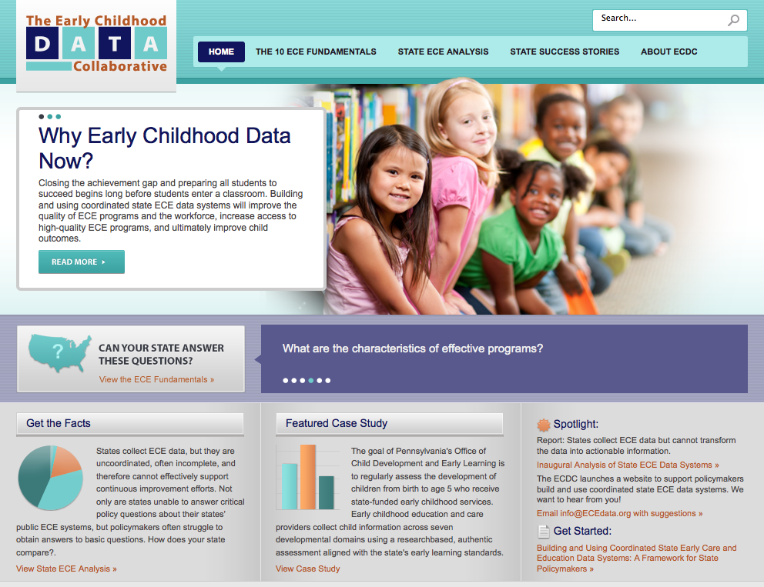

Slide 24
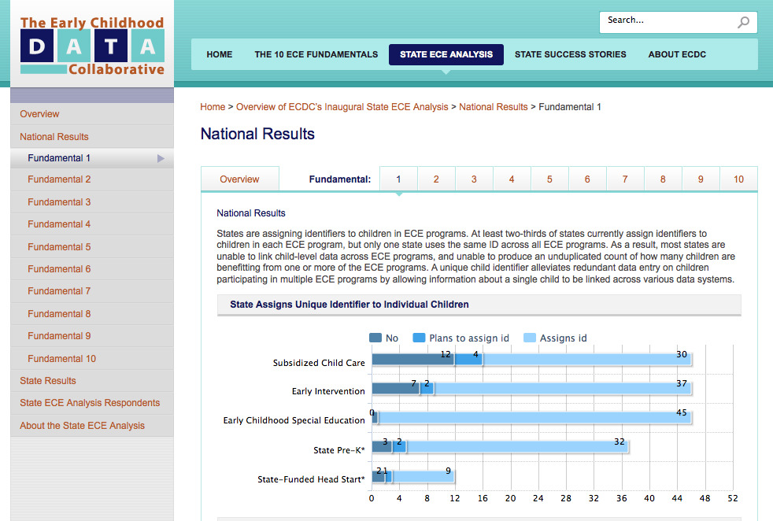

Slide 25
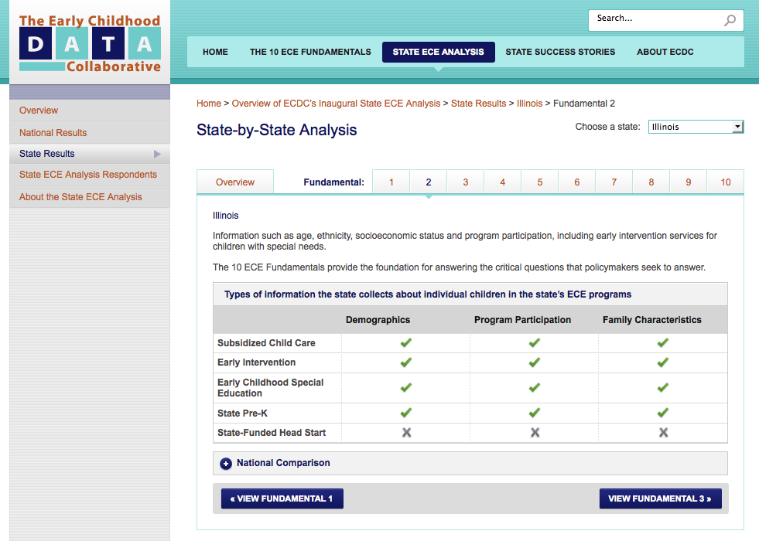

Slide 26
Contact the ECDC:
The Center for the Study of Child Care Employment at UC Berkeley
Marcy Whitebook, mwhbk@berkeley.edu; Fran Kipnis, frankipnis@berkeley.edu
Council of Chief State School Officers
Tom Schultz, thomass@ccsso.org
Data Quality Campaign
Elizabeth Laird, Elizabeth@DataQualityCampaign.org
National Conference of State Legislatures
Phuonglan Nguyen, phuonglan.nguyen@ncsl.org Julie Poppe, julie.poppe@ncsl.org
National Governors Association Center for Best Practices
Amanda Szekely, ASzekely@NGA.ORG
Pre-K Now, a campaign of the Pew Center on the States
Albert Wat, awat@pewtrusts.org
Birth to Five Policy Alliance
Helene Stebbins, helene.stebbins@verizon.net
Visit www.ECEdata.org for more information.

