Slide 1
The role of assessment and data systems in Pennsylvania’s model of systems development
Philip Sirinides, Ph.D., psirinides@pa.gov
Office of Child Development and Early Learning
PA Departments of Education and Public Welfare
www.ocdelresearch.org

Slide 2
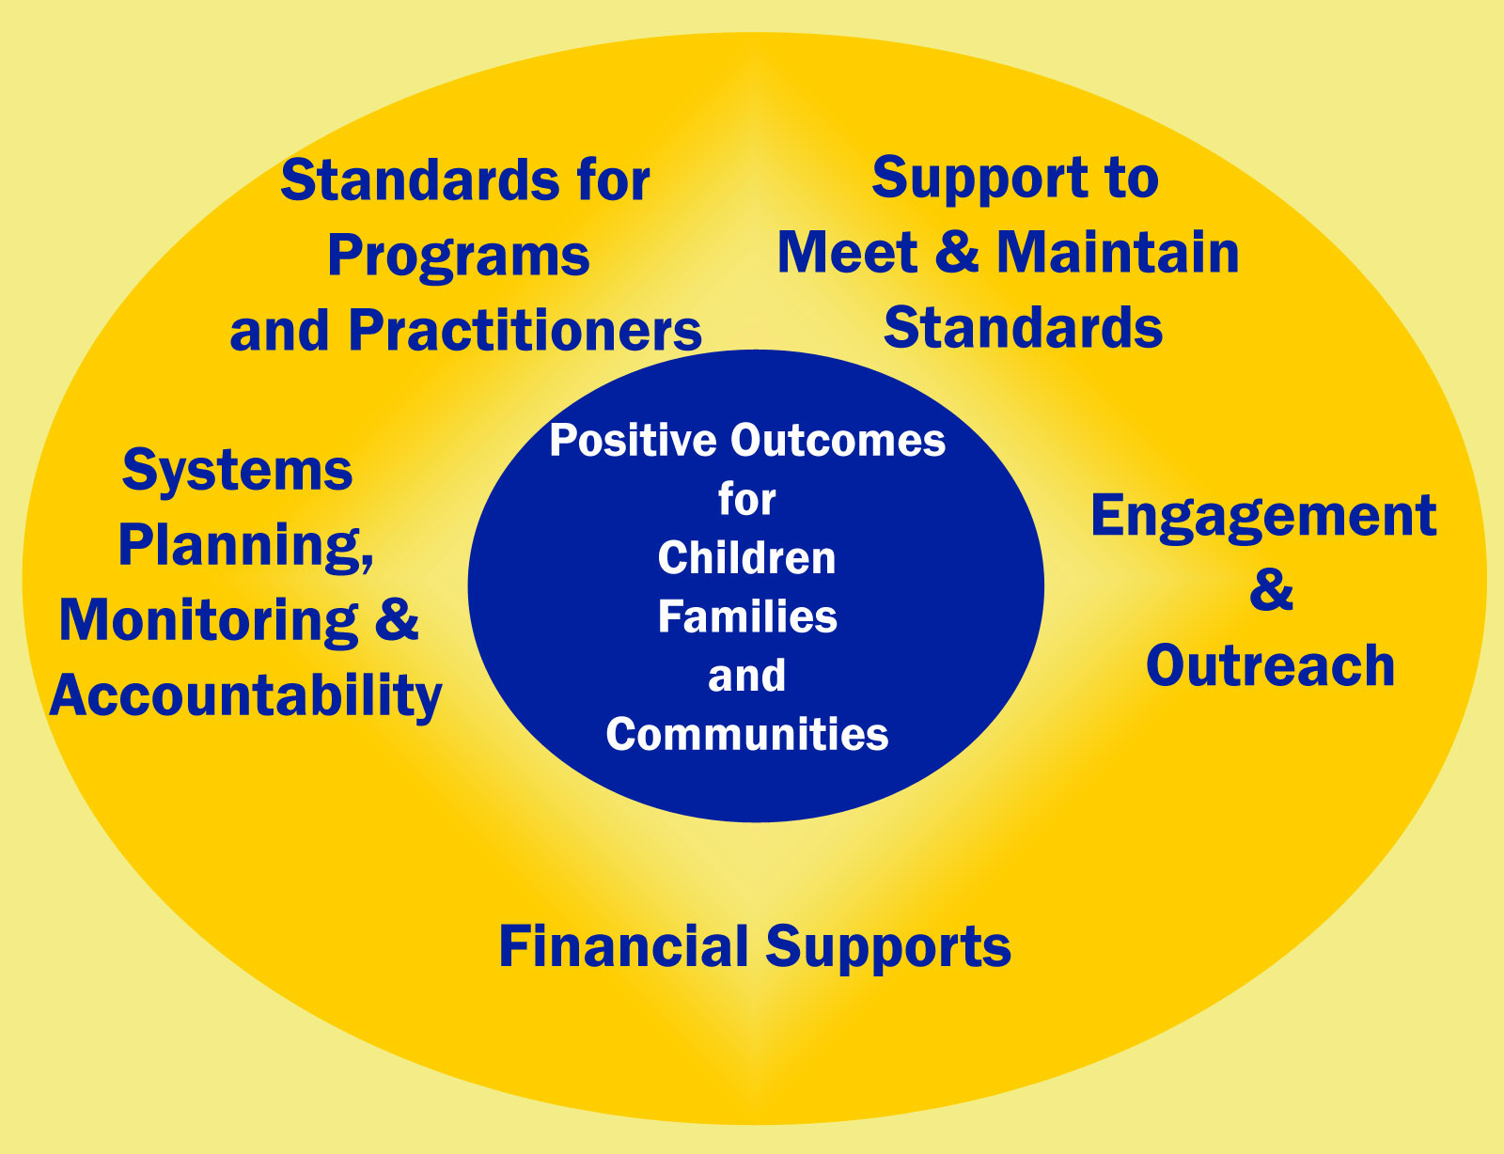
Systems Development Model

Slide 3
Role of data systems in development of coordinated early learning and development system
Data systems inform more strategic investment choices
Data systems assure program integrity
Data systems enable program accountability
Data systems guide supports for provider and workforce

Slide 4
Goals of assessment in a high-quality accountable early learning and development system
understand the status of children across a broad range of cognitive and non-cognitive domains
adapt instruction to meet individualized student and group needs
track achievement and developmental gains over time
inform policy by providing a picture of student outcomes in the service location and across the Commonwealth

Slide 5
Pennsylvania’s proposed future strategy for assessment will move to a child outcomes reporting framework that is:
Standards-based
Birth to age eight
Covers broad range of domains
Informed by authentic assessment
Integrated in state data systems
Modeled on ECO, we will work with multiple valid and approved assessments in use, to align and translate child outcome data to a single reporting framework.

Slide 6
Other “in flight” data system initiatives
Expand state data system to include
Federal Head Start / Early Head Start
Home visiting and family support programs
PA child, youth and family services
From data to information to local action
Longitudinal child outcome reports for providers
Provider dashboard
Community dashboard

