Slide 1

Ensuring Sustainable Change: The Long and Winding Road
September 21, 2011
Early Childhood Outcomes Conference
New Orleans, LA
September 21, 2011
Martha Diefendorf
NECTAC
Notes:
You Tube video of Paul McCartney singing “A Long and Winding Road”

Slide 2
System for Producing Good Child and Family Outcomes
Research
Prof’l Development
Evidence Based Practices
High quality services and supports for children 0-5 and their families
Good outcomes for children and families
Good Federal policies and programs
Good State policies and programs
Good Local policies and programs
Strong Leadership
Adequate funding
Information infrastructure
2
ECO, NECTAC, 2011
Notes:
On Monday, Kathy talked about the critical role of good data in illuminating what is and is not working throughout the system, and used the metaphor of data as light for walking on the sunny side of the street. Data can be considered the sunshine, or street lamps and headlights illuminating the way to our destination -- which is quality, coordinated state EC systems that result in improved trajectories and positive outcomes for children and families.
Yesterday morning, Albert talked about coordinated ECE data systems and a state policy framework for developing them, and we heard from Phil about the exciting story of the development and capacity of PA’s data system.
And in the afternoon, Robin talked about quality practice, what that means, and the connection to improving outcomes.

Slide 3
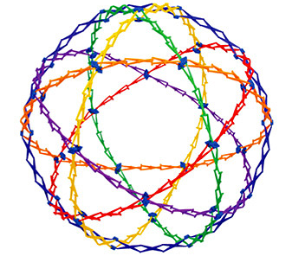
Goal Today
Think about
  how systems improvement frameworks can be used to build infrastructure and ensure sustainable change that supports program quality, implementation processes, and practices that positively impact and child and family outcomes
NECTAC, 2011
Notes:
This morning we will look at key elements of systems improvement frameworks that can be used to build and modify infrastructures that support and sustain ongoing system and program improvements that benefit children and families.
Frameworks for system change can be considered the road maps, guiding the way and keeping us on track.
The path to achieving high quality services and positive outcomes is long and may even be bumpy or winding but there are sign posts, maps and starlight to help us navigate where we want to go.

Slide 4

Improving Early Childhood
Programs and Services
….Through a Systems Change Lens
….Through an Implementation Lens
NECTAC, NIRN 2011
Notes:
We’ll be looking at promoting and maintaining quality programs and practices through two lenses: a systems change lens and an implementation lens.
You may recognize the systems change lens as the long-term systems change (LTSC) process that NECTAC developed and has been using with states for many years.
And the framework based on implementation science is the work of NIRN (National Implementation Research Network). Karen Blasé talked at this conference last year about the excellent work they are doing in the field of Implementation Science.
An aside: We feel fortunate to have NECTAC and NIRN both at the FPG Child Development Institute; we’ve been able to expand each other’s thinking and collaborate.
While you may all be familiar to some extent with these or other helpful frameworks, I want to underscore the importance of the underlying philosophy, perspectives and processes.

Slide 5
Universal Concepts
Systems improvement
  Based on a theory of change.
  Underlying logic applied to any field.
  Process may vary but basic steps always included.
Implementation science
  Universal, like other sciences.
  Applicable for different fields - similar implementation problems and solutions.
  Proper implementation matters (i.e., fidelity).
NECTAC, & NIRN
Notes:
Both are universal concepts.
Systems improvement is based on a theory of change and its underlying logic can be applied to any field. There are various system change models, and the process may vary, but the same basic steps are always included. (I’ll be using the terms systems improvement and long-term systems change interchangeably)
NIRN explains that Implementation science (IS) is universal, like other sciences, such as physics; in different fields, the implementation problems and implementation solutions are similar. Implementation needs to be done right (with high fidelity).
The two frameworks are very similar and have common core elements but they look at change and sustainability from different perspectives.
Caveat: This is my interpretation of what researchers and experts are telling us. In some of the material I’m presenting, you’ll recognize words from Karen Blasé from NIRN, Kathy Hebbeler from ECO, and Lynne Kahn from NECTAC, and I’d like to credit all of them. After my remarks I hope we’ll have time for you to ask questions about what I’ve presented and dig deeper into the relevancy for your work.
We’ll look into the similarities and differences of the 2 lenses of LTSC and IS.

Slide 6
"Piecemeal approaches that are assumed to be the answer are as dangerous as no response at all."
“But incremental steps
according to plan are safe and better than no response at all.”
—Geary Rummler
& Alan Brache
—common sense
NECTAC, 2011
Notes:
"Piecemeal approaches that are assumed to be the answer are as dangerous as no response at all." —Geary Rummler & Alan Brache
“But incremental steps, according to plan, are safe and better than no response at all” (and continuing to take steps is the important thing!)

Slide 7
Focus
Systems Improvement:
“It” - combination of improvement strategies to achieve the intended outcomes.
Implementation Science:
“It” - evidence-based or best practice initiative.
  Regardless, the “It” must be operationalized
NECTAC, 2011
Notes:
A Systems Improvement Framework builds on what already exists and is occurring in the state.
The “it” …. is a combination of improvement strategies to achieve the articulated intended outcomes.
An Implementation Science Framework is particularly useful when introducing a new practice.
The “It” is an evidence-based practice or innovation– something that has been proven to work.
The questions that they answer are different:
In the systems framework: What can the state do to improve the system to address an identified need or challenge to achieve intended outcomes for children/families?
We use best of what is known, to make things better than they are, make changes in the system that supports outcomes; support, encourage improvement across the state through a variety of options and strategies that communities and programs can use and individualize to fit their context, funding, culture, etc.
In the implementation framework, the question is: How can you implement and scale up an evidence-based practice (EBP) to be used with fidelity in a program, across a community, within the state?
In either case, it’s critical to be able to articulate or operationalize what we mean by “IT.”
A practical consideration:
For an evidence-based practice to be “implementable”, it must fit within the context of legal requirements, compliance timelines and funding realities. This has implications for research. Researchers need to understand the realities in states and barriers to implementation.

Slide 8
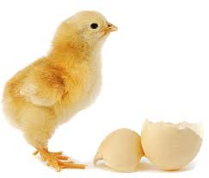
Perspective on System Change
System Improvement
Implementation Science
EXISTING SYSTEM
IS CHANGED TO SUPPORT THE ACCOMPLISHMENT OF INTENTED OUTCOMES
EFFECTIVE PRACTICES
WILL RESULT IN IMPROVED OUTCOMES
EFFECTIVE INNOVATION
IS IMPLELMENTED
WITH FIDELITY
EXISTING SYSTEM
WILL CHANGE TO SUPPORT THE EFFECTIVENESS OF THE INNOVATION
IF
IF
THEN
THEN
NECTAC, 2011
Notes:
The two frameworks are variations on a theme but they both have the same end result in mind. The final destination is positive outcomes for children and families. Similar to “which comes first, the chicken or the egg?”
Depending on your circumstances and needs, you can start where it makes sense to you.
Looking through the lens at the left hand box, once a need is identified and intended outcomes at all levels of the system are agreed upon, If the existing system is changed to support the accomplishment of the intended outcomes….. Then practices will be effective and will result in positive outcomes.
Through the other lens, a proven practice or innovation is selected. If it is implemented with fidelity (following the recipe or road map)….Then the existing system will need to adapt to support the practice’s effectiveness in attaining positive outcomes. If the system doesn’t change, the practice cannot be implemented with fidelity.

Slide 9
Conceptual Framework for Systems Improvement
Model
How:
What:
Why:
Valid, reliable and useful data on child
and family outcomes
Local
Infrastructure
Improved measurement system
State
Infrastructure
Positive outcomes for children and families
Improved
Program
Practices
Professional
Development
System
NECTAC, 2011
Notes:
Let’s take a quick look at the NECTAC model on long-term systems change (LTSC) which many of you are familiar with.
The three circles – state infrastructure, professional development (PD) system and local infrastructure – impact each other, and when they are aligned, they together influence and support development and implementation of The What. The What might be, for instance, an Outcome Measurement System for the purpose of producing valid, reliable and useful data on child and family outcomes.
The What might be improved program practices or something at the practice level for improving child and family outcomes.
This is an interesting phenomenon. Once the Outcome Measurement System (or another structural system such as General Supervision System, Comprehensive Data Collection System) is established and functioning, it becomes part of the infrastructure (the How in the blue box); in fact, it’s an improvement to the infrastructure.

Slide 10
Long-Term Systems Change Plan
. . . . . . Timeline . . . . . . .
Multi-level
Challenges
State level infra
Professional Development
Regional/ local/agency
Providers & practices
Children and families
Multi-level Impacts
State
Personnel Development
Regional/ local/agency
Providers practices
Children
and families
Strategies
Activity 1
Activity 4
Benchmarks
Activity 2
Benchmarks
Benchmarks
Activity 3
Benchmarks
Notes:
Through this lens, the vehicle to make changes and sustain them is the development and implementation of a long-term plan; it is the blueprint or map to reach the intended outcomes.
It takes a statewide perspective, at 10,000 feet above, related to the challenges faced by state administrators who need to figure out how to get the best results for the most children, making use of the best available information -- which may not always be research based – but based on professional wisdom and experience, or data patterns and trends.
People tend to think of quality practice at the level of interaction between professionals and children and families, but there are also quality practices for work done at all levels (e.g., writing meaningful MOAs, effective PD practices/coaching)
To develop a plan, there are certain basic steps.
First step, understand the challenges and what isn’t working well. What’s the reality?
Then, articulate intended outcomes for all levels of the system.
Next, plan a series of interrelated strategies, and monitor their implementation via benchmarks, which collectively lead to the intended outcomes.
There are feedback loops (the blue arrows) and adjustments are made all along the way.
It generally takes 3 to 5 years to make meaningful changes throughout the system that are stable and can be sustained. The road is long.

Slide 11
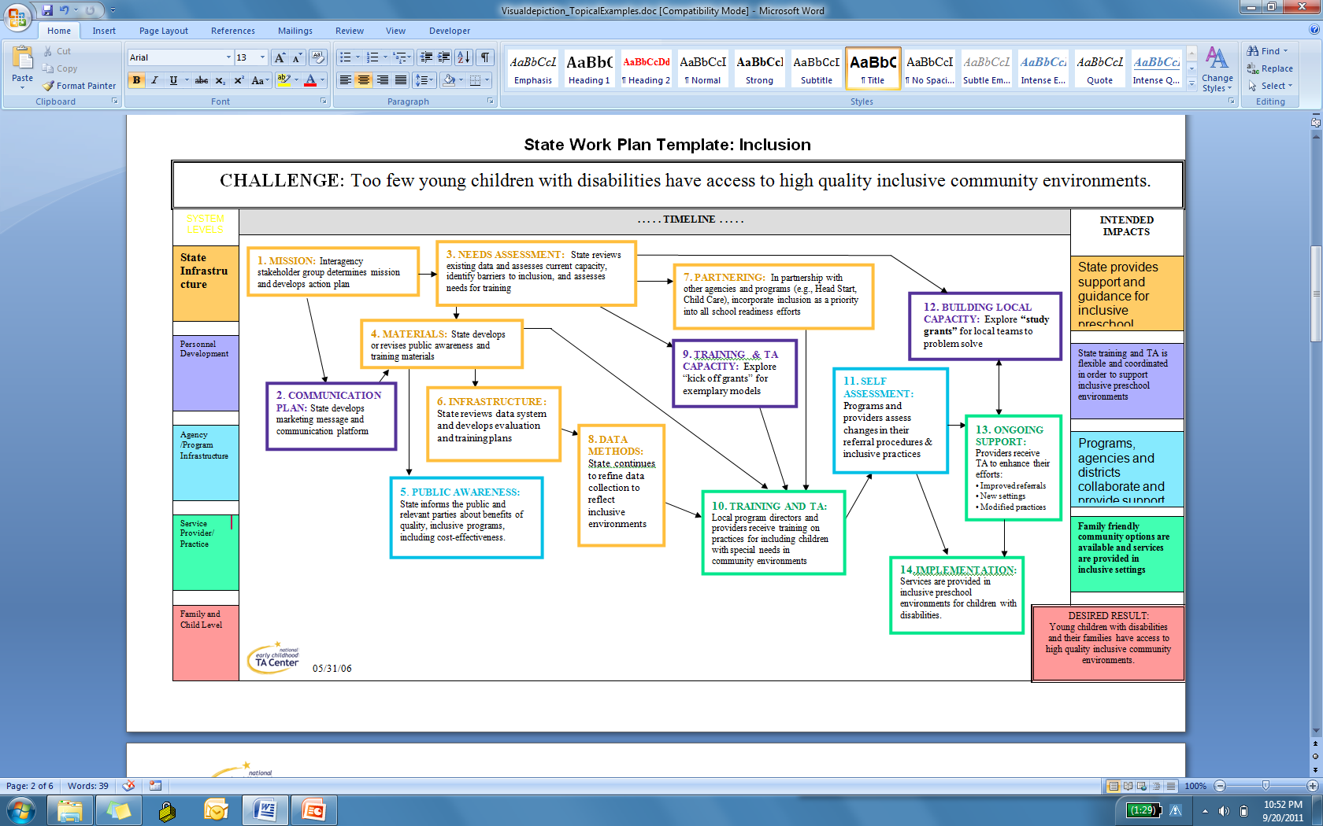
Notes:
Here’s an example. You can get an idea of the complexity by looking at the visual depiction of the plan.
The boxes represent the major strategies or activities that are determined by a team of who bring different perspectives to the table, from all levels of the system, always including families and their point of view.
There is a logical sequence of what needs to happen, with implementation of earlier strategies feeding into subsequent activites.
Just one strategy, such as changing policy, or training, or financing, is not sufficient. It’s the combination that creates the necessary changes to create a sustainable system.

Slide 12
Notes:
Let’s look at a some of the details on the plan.
In this case, the expressed challenge is that “too few children with disabilities have access to high quality community environments.”
There is a need to create more family friendly options in the community and for more opportunities for providing IFSP/IEP services in community settings.

Slide 13
NECTAC, 2011
Notes:
5. Public awareness: State informs the public and relevant parties about benefits of quality inclusive environments and programs, including cost effectiveness.
10. Training and TA: Local program directors and providers receive training on practices for including children with special needs in community environments.
12. Building local capacity: Explore “study grants” for local teams to problem solve. Incentive grants to communities and programs to broaden options for inclusion, using state discretionary funds.
Let’s play this example out a little bit further.

Slide 14

New resource by Wendy Banning and Ginny Sullivan, Redleaf Press, 2011
NECTAC, 2011
Notes:
As one part of the systems change, a community has written a proposal for improving outdoor learning opportunities in their community (both space and practices) as a means for improving child outcomes– the 3 ECO outcomes. They want to develop outdoor learning environments as an extension of the indoor learning environments to meet the unique needs of all children.
They believe that outdoors/ nature/ physical activity will be coming into the forefront with current the emphasis on preventing childhood obesity. Outdoors also serves as a different channel of learning, particularly important for young boys/kinesthetic learning. And it’s a good way of connecting health and education and focusing on the whole child.
The book, Lens on Outdoor Learning by Wendy Banning and Ginny Sullivan (2011) is about how children naturally explore and create their own learning experiences outdoors and is available through Red Leaf Press:
http://www.redleafpress.org/Lens-on-Outdoor-Learning-P366C1257.aspx

Slide 15
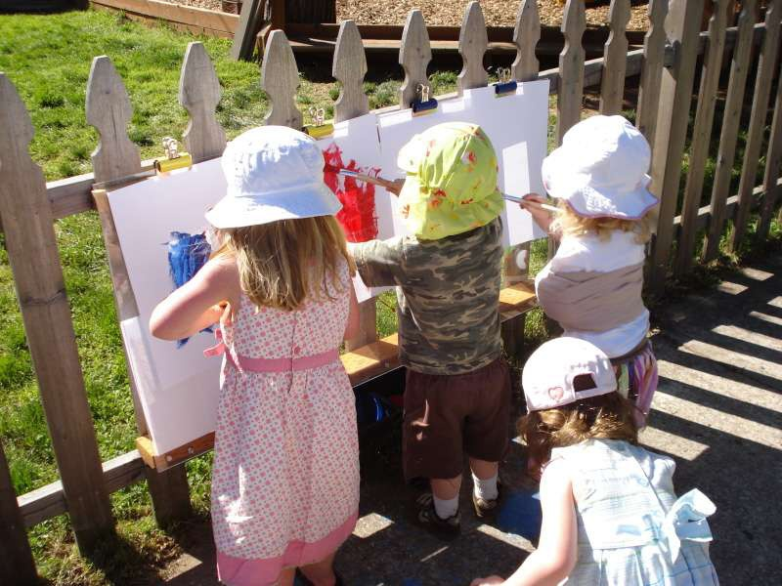
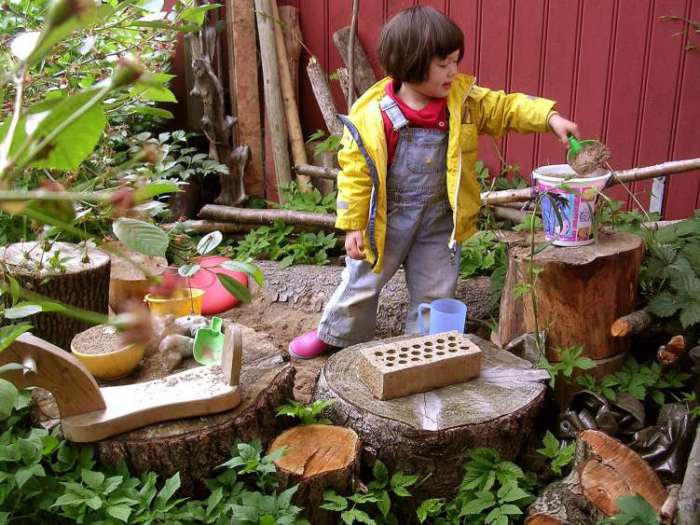
Take it OUT!
EVIDENCE BASE
Indoors
or
outdoors
New possibilities
for children’s learning
in all domains.
NECTAC, 2011
Notes:
Most anything that can be done indoors can also be done outdoors, (and it may be lots more fun!) Creating settings for art, for “cooking”, for dramatic play, for fine motor, gross motor, construction play . . . and taking advantage of natural “loose parts” provides new possibilities for children’s learning in all domains.
We’ll review some of the research that supports outdoor learning. Thanks to Janet McGinnis of the NC More at Four Program and the NC Outdoor Learning Alliance, and author of POEMS (a rating scale for preschool outdoor environments) for sharing her knowledge in this area.

Slide 16
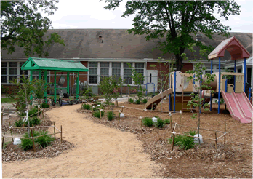
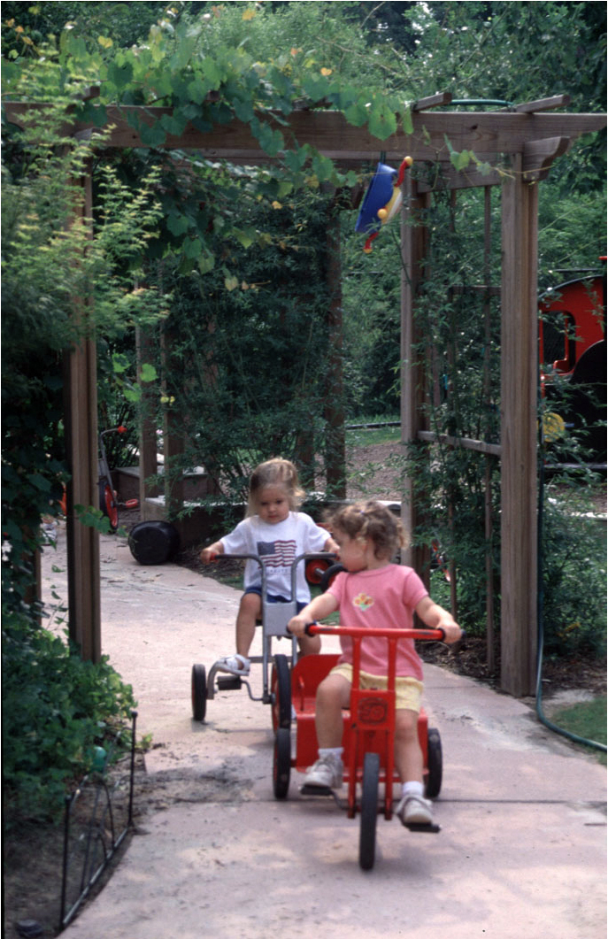
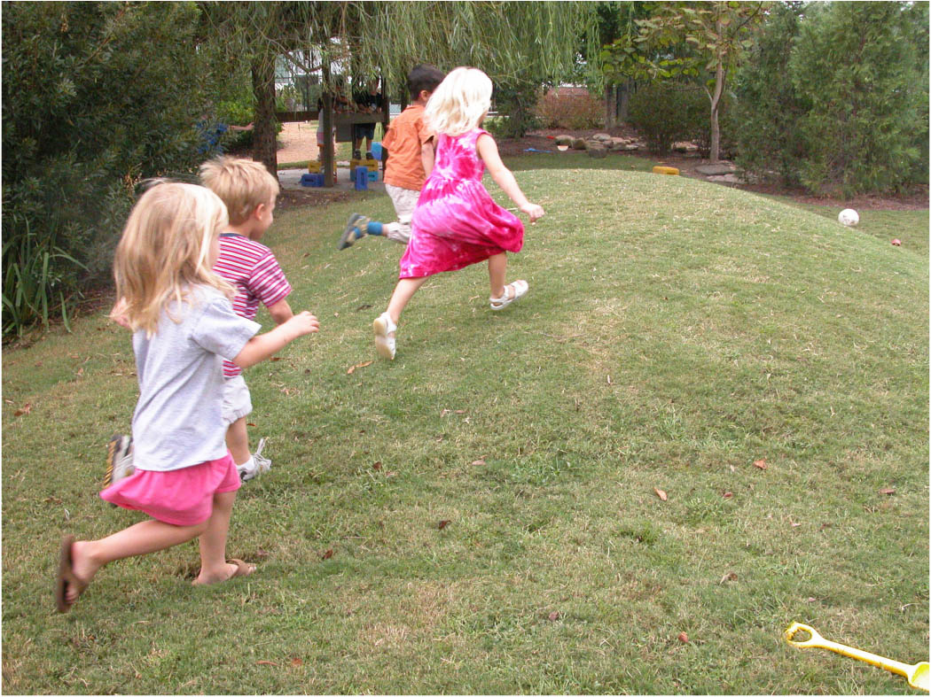
EVIDENCE BASE
Pathways
& hills
NECTAC, 2011
Notes:
We’re used to thinking of pathways to address the mobility needs of children and adults. Pathways can provide accessibility but they are also an important design feature to support physical activity and circulation throughout the outdoor learning environment. They are inviting and promote curiosity.
We can also broaden the way we think about accessibility.
There is no pathway to the top of these hills. Children may have to be creative to navigate to the top and call upon skills that we adults may not even think of. They may have to think about it. They may have to physically work hard to get to the top.

Slide 17
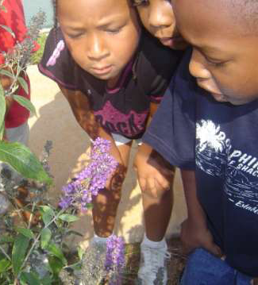
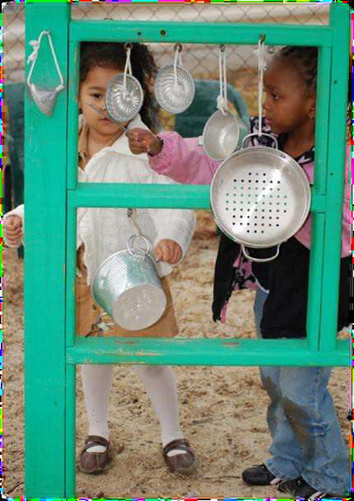
photo by Wendy Banning and Ginny Sullivan
EVIDENCE BASE
When the outdoor environment offers settings and materials that appeal to ALL senses it will more likely meet the needs of ALL children.
NECTAC, 2011
Notes:
When the outdoor environment offers settings and materials that appeal to ALL senses it will more likely meet the needs of ALL children.
Color, fragrance, shapes, sound – offer an opportunity for many conversations that build vocabulary and observation skills. Intentionally planning for these opportunities that stimulate all senses can be fun and exciting for teachers as well as children.

Slide 18
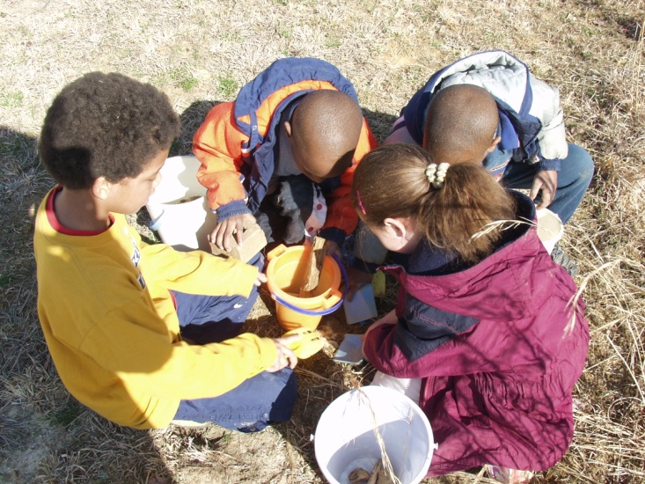
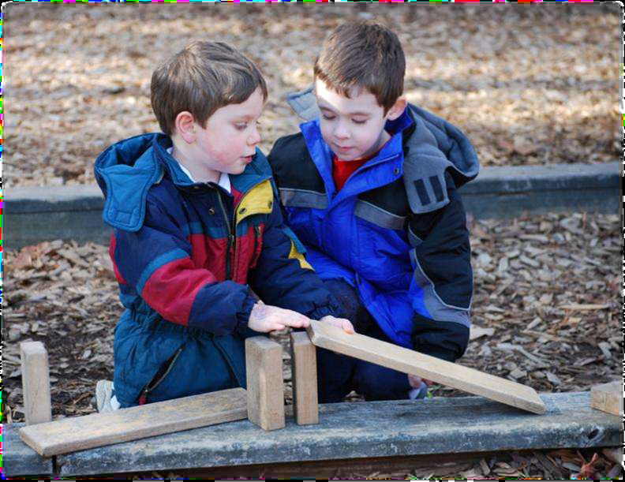
Importance of
High Quality Outdoor Settings
RESEARCH FINDINGS
More symbolic play
More constructive play (building, hypothesizing)
More complex forms of peer play (interactive dramatic play)
When quality of outdoor program decreases, negative behavior increases.
EVIDENCE BASE
photo by Wendy Banning and Ginny Sullivan
NECTAC, 2011
18
Notes:
There is an evidence base for outdoor learning through many studies. These are some of the benefits of outdoor settings.
In outdoor environments in high quality programs, you find more symbolic play in both boys and girls as compared to the indoor environment (Frost et al., 2001)
Higher quality outdoors promote more constructive play (building, hypothesizing) whereas in lower quality outdoor environments children demonstrate more functional or repetitive play; (DeBord, Hestenes, Moore, Cosco, & McGinnis, 2005)
Preschool children may show more complex forms of peer play (i.e., interactive dramatic play) outdoors (Shim, Herwig, & Shelly, 2001)
Quality of the outdoor program decreases - frequency of negative behavior increases (DeBord et al 2005).
The addition of loose parts can increase constructive and dramatic play (Maxwell, et al. 2008).

Slide 19
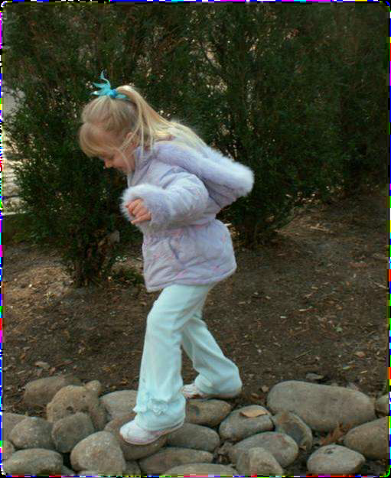
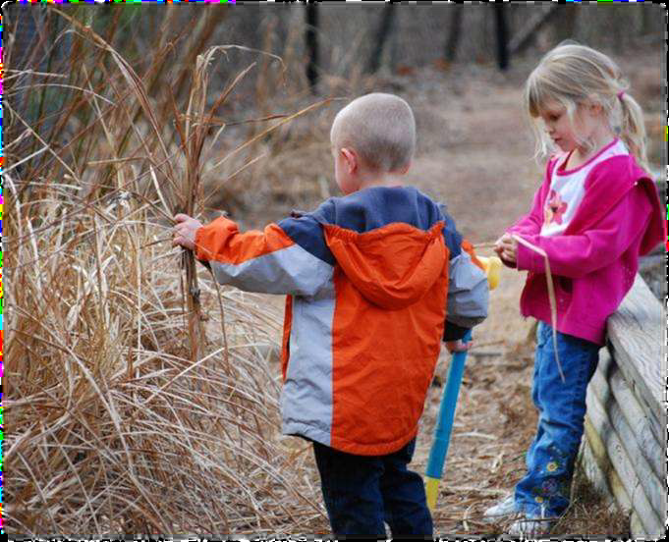
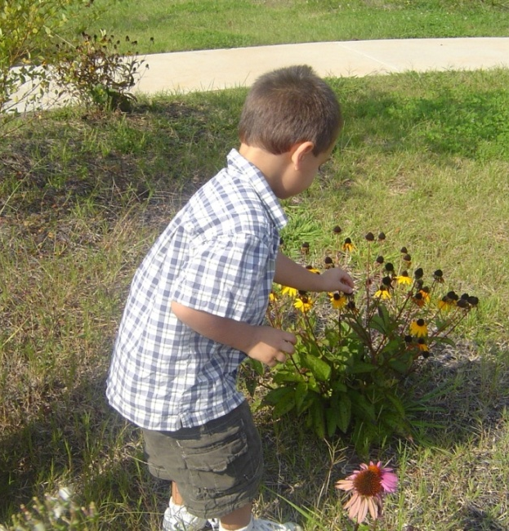
Importance of Natural Settings
RESEARCH FINDINGS
More spatial-cognitive awareness
Increased physical competence and motor skills
Improved socialization, for longer durations
More creativity and cooperation
Less functional/repetitive play
photo by Wendy Banning and Ginny Sullivan
EVIDENCE BASE
photo by Wendy Banning and Ginny Sullivan
NECTAC, 2011
19
Notes:
Benefits of natural settings
Installing natural materials and other landscape elements to outdoor environment have been shown to -
increase children’s spatial-cognitive awareness, physical competence and skills
improved children’s socialization and fantasy play which lasted for longer durations
(Herrington & Studmann, 1998)
Physically active play in natural environments can lead to improved motor abilities (Fjortoft, 2004).
On playgrounds with more natural elements- less functional or repetitive behavior and more constructive play (Hestenes, Shim, & DeBord, 2007)
Teachers with outdoor play settings with plants had significantly more positive responses in focus groups than teachers without natural elements (Herrington, 2008).

Slide 20
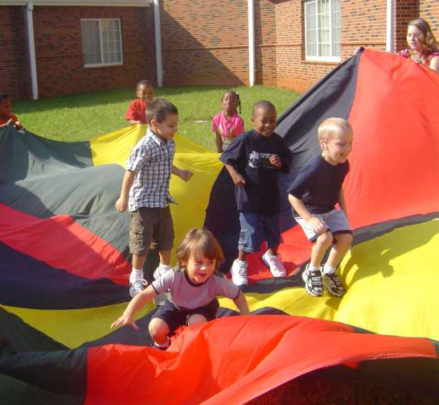
Importance of Physical Activity
RESEARCH FINDINGS
Strong relationship between physical activity levels and time spent outdoors
Preschool programs are significant predictors of physical activity levels in young children
Additional loose parts (hoops, tunnels, bean bags, balls, etc.) increase physical activity levels in preschool children
EVIDENCE BASE
Negative relationship between physical activity and fixed environment scores (anchored equipment, running space, balancing surfaces, indoor play space)
NECTAC, 2011
20
Notes:
Benefits of physical activity
Hinkley et al. (2008) reviewed 24 studies of preschool children and physical activity; they looked at physical activity in relation to 39 different variables; they found that the most consistent findings were that males were more active than females, children with active parents were more active themselves, and children who spent more time outdoors were more active.
There is a strong relationship between physical activity levels and time spent outdoors (Tucker, 2008; Bower et al., 2008).
Preschool programs- significant predictors of physical activity levels in young children (Pate, Pfeiffer, Trost, Ziegler, & Dowda, 2004)
Male preschoolers are more active than females (Tucker, 2008; Hinkley et al., 2008). Males consistently higher in physical activity (PA) than females; this is problematic since some studies show dramatic decreases in female PA between 6.5 and 9.5 years of age (50% decline) (Tucker, 2008).
The inclusion of additional of loose parts (hoops, tunnels, bean bags, balls, etc.) can significantly increase physical activity levels in preschool children (Hannon & Brown, 2008). Children’s sedentary behavior decreased.
Bower et al. 2008 studied 20 child care programs in NC as part of the NAPP SACC project. They looked at the relationship between preschool children’s physical activity behavior and the set up of the physical and social environment. Not surprisingly, physical activity was the highest when children had more opportunities for structured physical activity, more occasions of outdoor play, and minutes of active opportunities. Showed a positive relationship between PA and portable equipment/materials (balls, hoops, riding toys) and a negative relationship between PA and fixed environment scores (anchored equipment, running space, balancing surfaces, indoor play space).
Measuring & Improving Child & Family Outcomes, New Orleans, ECO/NECTAC
Diefendorf, September 21, 2011

Slide 21
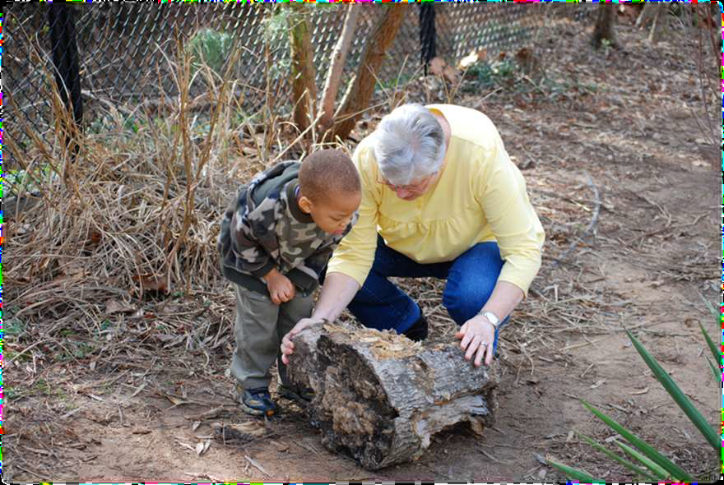
Importance of Teacher Engagement
RESEARCH FINDINGS
      view the outdoors as secondary to the learning which occurs indoors
underestimate the potential of outdoors to stimulate various aspects of children’s learning and growth
EVIDENCE BASE
photo by Wendy Banning and Ginny Sullivan
NECTAC, 2011
21
Notes:
Many teachers view the outdoors as secondary to the learning which occurs indoors (Dighe, 1993; Henniger, 1993).
Teachers in low quality outdoor environments either did not understand or underestimated the potential of outdoors to stimulate various aspects of children’s learning and growth (Jones, 1989)
Teacher behaviors supporting and facilitating children’s experiences on the playground- observed more frequently on higher quality outdoor environments (DeBord et al., 2005)

Slide 22
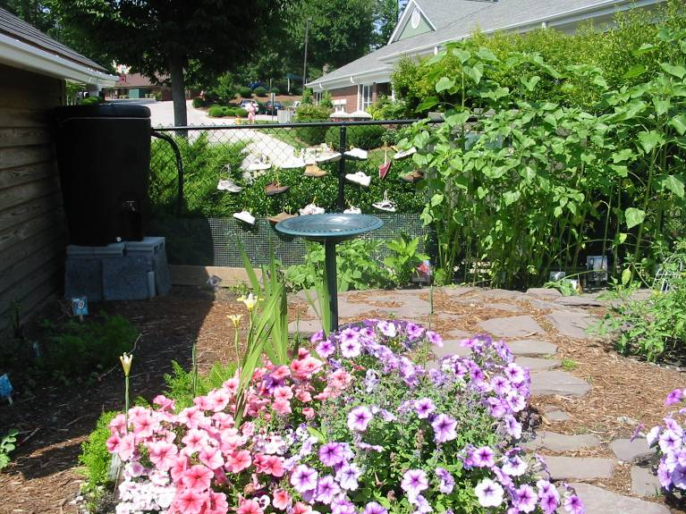
Creating and Supporting
Outdoor Learning Opportunities
– administrative support – local policy – professional
Children’s experiences – teacher facilitation
development – state policy & infrastructure
NECTAC, 2011
Notes:
How are they going to accomplish this? How can the community pull together town staff, program administrators, teachers, families, to make it happen on the ground--
to develop settings that offer opportunities to grow and learn (like this fence garden in the background – it is shoes tied to a chain link fence)
This example of outdoor learning environments ties in with the framework for implementation and scaling up.

Slide 23
Improved Early Childhood Outcomes
Conceptual Framework for Implementation Science
Why:
Evidence-Based and Evidence-Informed
Programs and Practices
What:
Performance Assessment
How:
Competency Drivers
Organization Drivers
Core
Implementation
Components
Leadership
© Fixsen & Blase, 2008
Notes:
A quick look at the NIRM framework for Implementation Science.
The How section (the red triangle) includes the core implementation components
which drive changes in the system.
Competency Drivers - mechanisms for developing staff capacity and competency
Organization Drivers- such as data system, administrative infrastructure, monitoring;
Leadership Drivers – provide direction and vision, and include methods to manage challenges
When these core components are in place and integrated they provide the support at the program and practitioner level to establish and maintain a successful implementation of an evidence-based practice or other innovation (The What) for improving early childhood outcomes (The Why).
To make this happen, the community team receiving the grant led the effort for implementation, communicating with all levels of the system (transformation zone) to ensure that the necessary changes were being made to support the development and optimal use of the outdoor learning environment
23
(c) Dean Fixsen and Karen Blase, 2008

Slide 24
Policy Practice Feedback Loops
Policy (Plan)
Policy
Practice Informed Policy
(PIP)
Policy Enabled Practices
(PEP)
Structure
Feedback
“External” System Change Support
Study - Act
Procedure
Practice
Practice (Do)
© Fixsen & Blase, 2008
Notes:
24
Feedback looks are one of the strengths of Implementation Science:
PIP: Practice informs policy
PEP: Policy enables practice
This is an ongoing cycle for enabling adjustments to be made. The team cycles through until the problem is clearer or the goal is reached to sustain the new innovation.
(c) Dean Fixsen and Karen Blase, 2008

Slide 25

NECTAC, 2011
Notes:
This example shows one way that the two different sustainability frameworks, which take a different view, fit together. Let me demonstrate (expandable plastic toy).

Slide 26
Commonalities
of Sustainability Frameworks
Clarity of vision and intent
Importance of leadership and accountability
    Engagement of stakeholders
    Attention to multiple system levels
            Ability to adapt to context
            Feedback loops/evaluation
NECTAC, 2011
Notes:
The bottom line is that the two frameworks cover the same components.
To review,
The improvement activities and intended outcomes are the basis of the long-term systems change plan.
The selected practice to be implemented is the basis of implementation science.
Regardless of the particular framework, there are key elements of LTSC and IS that are the same. We’ll look at these commonalities in more detail on the next several slides.

Slide 27
Working Together for Sustainability
Vision and mission
Intended outcomes
Scope and boundaries
Accountability and reporting requirements
Roles and responsibilities
Resources available
Decision-making process
Values and ways of work
NECTAC, 2011
Notes:
First and foremost, there needs to be agreement about the vision and intended outcomes and the “it” needs to be operationalized.
There also needs to be a common understanding of working together, whether it is called ground rules or terms of reference
The vision, mission and working guidelines are regularly referred to throughout the life of the project. Doing this helps maintain focus and serves as a prompt before a meeting, discussion, or a decision and keeps everyone going down the same path.

Slide 28
Leadership and Accountability
Leadership or management team with responsibilities:
Guides implementation of change initiative
Manages communication
Oversees working teams
Stakeholder engagement from all system levels
Cross agency representation
External facilitation or coaching
NECTAC, 2011
Notes:
For implementing a change effort and institutionalizing the changes, Leadership AND Engagement of stakeholders AND cross-agency representation are all critical. (It really is stakeholder engagement, not just stakeholder buy-in; that’s not enough).
We need the right people on the leadership team who can focus on the overall systems change, quality of practice, and sustainability– and who will keep it “real” (i.e., stakeholders, including family perspective, are part of the leadership) and who will make sure our work for C and 619 is infused into the broader EC system (partners from other sectors are part of the leadership).
They are “The Who” - to build implementation capacity and ensure that policies, funding, and support systems are aligned.
The leadership or management team is accountable for moving a project from beginning and through implementation of the plan, or implementation of the practice.
Work will be ongoing, and it will take time (several years).
There needs to be a clear purpose, rules and functions for implementation or work teams. And their work should be linked or embedded in other structures or ongoing initiatives to promote sustainability.
Both frameworks include external facilitation and TA to help maintain momentum and enable all team members to be active participants.

Slide 29
Multiple Levels of Improvement
State administrative level
Professional development level
Regional or local level administration
Practice or classroom level
Family level
NECTAC, 2011
Notes:
As succinctly described by NIRN:
State Level Leadership and Infrastructure
to provide policy/guidance and quality assurance, data, finance systems to support the vision and meet the challenge
Professional Development Capacity
to develop, improve, and sustain competent & confident use of innovations.
Regional or Local level Leadership
to create and sustain hospitable organizational and administrative environments for effective implementation of services
The first 3 levels collectively support the implementation level– which includes practitioners, families and, of course, children.
These are also the multiple levels for data collection
Transformation Zone – a “vertical slice” of the service system (from front-line to the Capitol) - small enough to be manageable but large enough to include all aspects of the system (different service settings, diverse communities, variety of geographic areas). It needs to be large enough to “disturb the system” or cause the system to shift/adjust.

Slide 30
Adapting to the Context
Current status of outcomes
Current state of implementation
Barriers and facilitators to moving forward
Existing initiatives or efforts to build on
Important steps that were skipped
Understanding stakeholders and how to engage them
NECTAC, 2011
Notes:
Before someone can adapt to context, they need to understand it, e.g., political and economic considerations, administrative structure, demographics, current level of service (or stage of implementation). This will help determine the state’s readiness to undertake a change effort or its readiness for replicating an evidence-based practice. They must consider whether the desired changes are feasible. Once the decision is made to move ahead and the change effort or replication is underway, flexibility and ability to adapt to context are essential. At the local level this might include differences in community’s culture, in demographics, population density, climate and other variables.

Slide 31
"People do not change when we tell them they should;
they change when their context tells them they must."
—Thomas Friedman, author ,The World is Flat
NECTAC, 2011
Notes:
“People do not change when we tell them they should;
they change when their context tells them they must."

Slide 32
Reflect and Revise
Planning and clear goals
Assessment of performance
Evaluation of impact
Feedback loops and cycles
Continuous improvement
NECTAC, 2011
Notes:
Once the plan is developed, it is a living document that guides the implementation of each strategy, and is amended as needed to fit changes in context or to be responsive to feedback and evaluation data. Regular feedback loops for monitoring implementation and improving alignment of policies, procedures, regulatory and funding mechanisms are a critical part of the implementation. Feedback loops/evaluation are developed to self-correct or make changes in the system or practice based on implementation and outcome data.
This may be one of the most important steps toward sustainability.

Slide 33
A bend in the road,
is not the end of the road ...
unless you fail to
make
the
turn.
NECTAC, 2011

Slide 34
Tools and Resources
Some evidence-based tools available to help with planning for sustainable change:
NGA Center for Best Practices – The Early Childhood System Self-Assessment
NIRN – Implementation Science process and tools
NECTAC – Long-Term Systems Change process and tools
ECO – Child Outcome Measurement System (COMS) Self Assessment Tool
RRCP – IT Kit
TACSEI /CSEFEL – The Pyramid Model process and tools
NECTAC, 2011
Notes:
There are many tools and resources available to help with planning for sustainable change and guiding through the process– some by TA providers and consultants, others by states. Here are just a few examples; the websites of these projects provide more information and detail.
Colleagues in states who are travelling toward the same destination, understand the rules of the road, are a few miles ahead and have managed to avoid potholes and take detours when necessary are a wonderful resource. That’s why it’s so important to have opportunities like this meeting as well as follow-up encore webinars to learn from each other.
Some state examples include:
KS – KITS
CA – Interagency Collaboration Handbook
KY – Interagency Agreement Process and Self-Assessment Tool
WI – Fidelity Outcomes Self-Assessment
So as you go careening around a corner, remember that these resources, and many more, are available.

Slide 35

Take Away Messages
Notes:
I’m going to leave you with 3 take-away messages. The first two are from NIRN and reinforce what some of you heard last year from Karen Blasé.

Slide 36
Business as Usual ≠ Impact
Methods, when used alone, do not result in either implementation as intended or sustainability:
  Passing laws/ mandates/ regulations
  Providing funding/ incentives
  Organization change/ reorganization
  Training
  Diffusion/ Dissemination of information
Necessary But Not Sufficient
© Fixsen & Blase, 2008
Notes:
Message 1: Business as Usual ≠ Impact
Continuing to do what we are already doing is not sufficient for making and sustaining improvements. Making only one change (e.g., new policy or training) is also not sufficient although they may be necessary. It is the combination of methods, effecting all levels, that is needed for making an impact.
(c) Dean Fixsen and Karen Blase, 2008

Slide 37
“What” and “How” Are Both Important
Effective Interventions
The “WHAT”
Effective Implementation
The “HOW”
Positive Outcomes for Children
Remember that any number times 0 is 0
© Fixsen & Blase, 2008
Notes:
37
Message #2 - Implementation Math
An effective practice implemented poorly produces poor outcomes.
Effective implementation of a poor practice produces poor outcomes.
You need effective practices implemented effectively to get positive outcomes.
Both the “What” and “How” matter.
(c) Dean Fixsen and Karen Blase, 2008

Slide 38

Relationships Matter
Make new friends and keep the old.
It takes action by people
to make “it” happen.
Can ≠ Is
Necessary and Essential
NECTAC, 2011
Notes:
Message #3: Relationships matter.
To make “It” happen, it takes action by people; very essential.
We need to involve partners and stakeholders.
We must involve our partners from other sectors because children with disabilities/families/communities are part of the larger EC system; it’s not that we’re imposing the special ed system on other systems. It’s just understanding that we can’t work in isolation. Interconnectedness makes it critical that we have a sense of collaboration and improvements are cross-sector. That will increase the sustainability of the EC Comprehensive System.

Slide 39
Future System
Alignment of
system components
across programs/sectors
Program Standards
Comprehensive Assessment Systems
Parent, Family and Community Engagement
Workforce & Professional Development
Health Promotion
Early Learning Standards
Data Systems
Program Standards
Comprehensive Assessment Systems
Parent, Family and Community Engagement
Workforce & Professional Development
Health Promotion
Early Learning Standards
Data Systems
Program Standards
Comprehensive Assessment Systems
Parent, Family and Community Engagement
Workforce & Professional Development
Health Promotion
Early Learning Standards
Data Systems
Program Standards
Comprehensive Assessment Systems
Parent, Family and Community Engagement
Workforce & Professional Development
Health Promotion
Early Learning Standards
Data Systems
Program Standards
Comprehensive Assessment Systems
Parent, Family and Community Engagement
Workforce & Professional Development
Health Promotion
Early Learning Standards
Data Systems
Alignment of
system components within a program
NECTAC, 2011
Notes:
Ideally, all system components would be aligned within each sector and across all sectors, at all levels of the system with smooth transitions across the age groups.
Does this remind you of anything? It’s the same idea as the diagram with the discs that Albert showed us yesterday on Coordinated State ECE Data Systems.

Slide 40
current System
Program Standards
Comprehensive Assessment Systems
Parent, Family and Community Engagement
Workforce & Professional Development
Early Learning Standards
Health Promotion
Data Systems
Program Standards
Comprehensive Assessment Systems
Parent, Family and Community Engagement
Workforce & Professional Development
Early Learning Standards
Program Standards
Comprehensive Assessment Systems
Parent, Family and Community Engagement
Workforce & Professional Development
Early Learning Standards
Program Standards
Comprehensive Assessment Systems
Parent, Family and Community Engagement
Workforce & Professional Development
Early Learning Standards
Program Standards
Comprehensive Assessment Systems
Parent, Family and Community Engagement
Workforce & Professional Development
Early Learning Standards
NECTAC, 2011
Notes:
This is more like what the EC current system looks like. Our collective work as the field of EC is to work toward alignment – to have one integrated system rather than multiple parallel systems.
Progress is being made. That’s been a theme of this conference.
I’d like to reinforce what you heard yesterday. At this point in time, EI and ECSE are in a good position to contribute to the development of overall state EC systems.
You already have experience in developing data systems (PSE has links to K12 and EI has links to Health), in measuring child and family outcomes outcomes, individualizing strategies based on child strengths, Part C experience in home visiting, emergent literacy, awareness of of promoting social-emotional competence using the Pyramid Model.
State QRIS systems are being developed or revised, and applications for the EL Challenge Grant are being prepared. This ups the ante for sustainability.
There is an opportunity to share your accomplishments and successes on behalf of children with disabilities and their families, and to have them appreciated and built upon by your partners who are also working to improve outcomes for children in family. Together you can help ensure that the larger EC system will establish a framework for continuous improvement that increases sustainability of the larger EC system for all children.

Slide 41

You Take the Wheel
Something that resonated with you OR that has implications for your work ?
Anything you want to discuss OR hear more about OR that you have questions about ?
NECTAC, 2011
Notes:
It’s your turn now. We have a little time for questions or comments.
Is there something that resonated with you or that has implications for your work?
Is there anything you want to discuss or hear more about or that you have questions about?

