Slide 1

ECO Family Experiences and Outcomes measurement system
Siobhan Colgan, ECO at FPG
Chelsea Guillen, Illinois
Melissa Raspa, ECO at RTI
Alice Rigeway, Connecticut
Judy swett, pacer center

Slide 2

Purpose of Session
Introduce the Family Experiences and Outcomes Measurement System
Hear feedback from states piloting the use of the framework
Discuss applications and uses with participants

Slide 3
Have you been wondering…
How well do we measure the experiences of families in our program or state?
What else do we need to do with our family outcomes data?
How do we know if we are heading in the right direction?
How can we prioritize improvements to our family outcomes measurement system?

Slide 4

Family Experiences and Outcomes Measurement System
Introducing……

Slide 5

Process of development
Followed and parallels the Child Outcomes Measurement Framework & Self-assessment
ECO workgroup
Partner state workgroup
  Connecticut
  Illinois
  Minnesota
  Texas
Ongoing revisions
Your feedback!

Slide 6
Two core aspects
Framework
Set of components and quality indicators
Provides the structure for the self-assessment
Self-assessment
Scale that provides criteria for levels of implementation within each quality indicator
Ratings are assigned based on level of implementation within each indicator

Slide 7
Purpose of the family framework
Provide a common language for ECO and other TA providers to use in discussing family outcomes measurement systems with states.
Identify key components of a system for measuring family experiences.
Provide an organizing structure for categorizing resources and state examples related to implementation or improvements to the measurement system.
Serve as the foundation for the self- assessment

Slide 8

Organization
Framework Component
Quality Indicator
Element
Element
Quality Indicator
Element
Element
Element

Slide 9
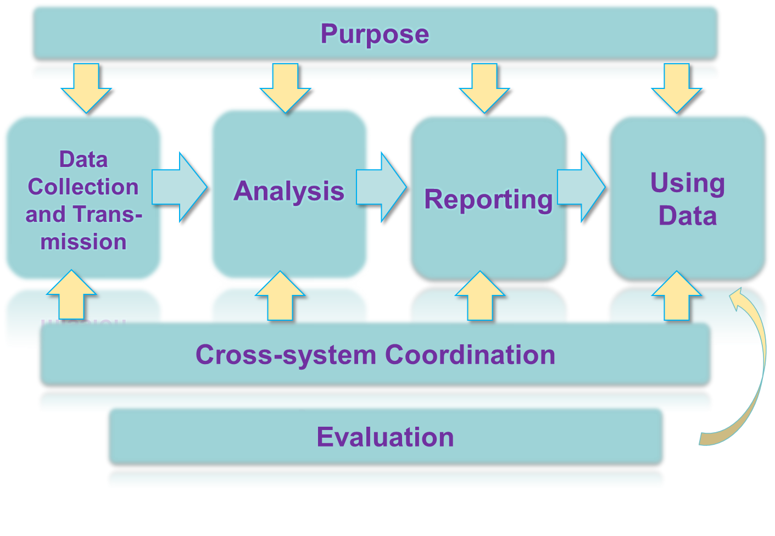
Framework components

Slide 10
Example Component: purpose
Quality Indicator: The state has articulated purpose(s) of the family experiences and outcomes measurement system
Elements:
  Stakeholders are involved in development of the purpose(s).
  Purpose includes examining multiple aspects of families’ experiences with the program and their outcomes (e.g., helpfulness of early intervention, family outcomes, family-centered services)
  Statement is easily accessible to local administrators, providers, families and general public.
  Families receiving services are fully informed of purposes of collecting data on family experiences and outcomes.
  Purpose includes meeting reporting requirements and providing ongoing information for data-based decision-making for program improvement.
  Written statement addresses why data are being collected and how data will be used. Statement specifies who will use the data and for what purposes.

Slide 11
Example Component: Using Data
Quality Indicator: State agency makes regular use of what it is learning from families to improve programs
Elements include:
  State regularly implements a stakeholder process that includes families for considering the implications of family experiences and outcomes and other data
  State uses data to develop a comprehensive plan for program improvement.
Quality Indicator: Local programs make regular use of what they are learning from families to improve programs
Elements include:
Local programs regularly implement a stakeholder process that includes families for considering the implications of family experiences and outcomes data and other data.
Local programs implement and evaluate program improvement activities on a regular cycle.

Slide 12





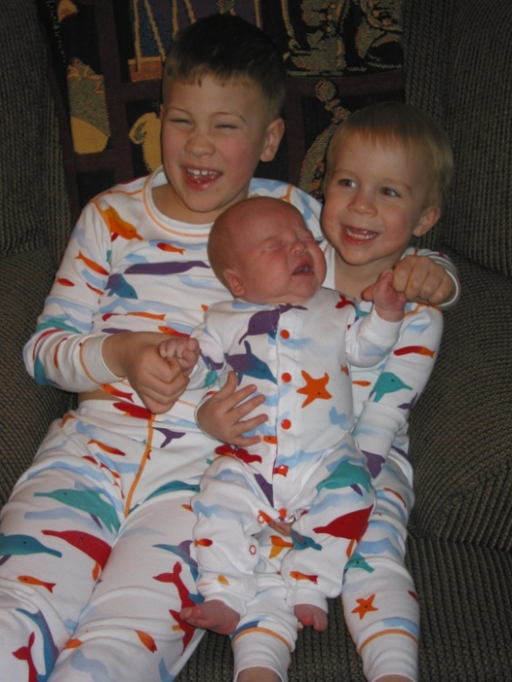


Our Families

Slide 13
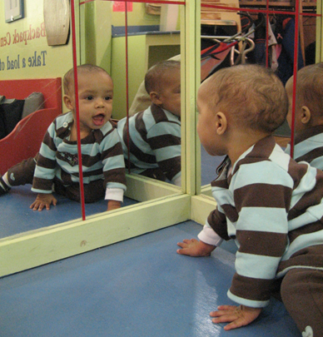
Purpose of the self-assessment
Provide guidance to states on what constitutes a high quality system for measurement of family experiences and outcomes.
Evaluate one’s current family experiences and outcomes system
Assist states in setting priorities for improvements in their measurement system
Provide information to assist states in advocating for resources for systems development

Slide 14
self-assessment Process: questions to consider
Who will participate in the assessment process?
What do you mean by “Family Experiences and Outcomes Measurement”?
What is the purpose of the self assessment for your program?
Do you want to complete the entire measure? Focus on one or two areas you are concerned about?
What will happen with the results of your assessment?

Slide 15
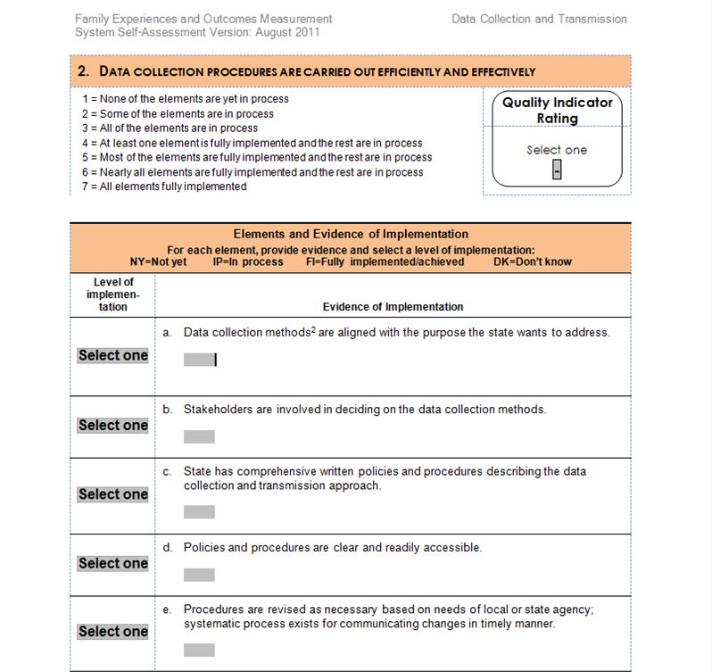
Sample rating page

Slide 16
Quality Indicator ratings
Implementation of Elements | Quality Indicator Rating
None of the elements are yet in process | 1
Some of the elements are in process | 2
All of the elements are in process | 3
At least one element is fully implemented and the rest are in process | 4
Most of the elements are fully implemented and the rest are in process | 5
Nearly all elements are fully implemented and the rest are in process | 6
All elements are fully implemented | 7

Slide 17
 | Quality Indicator Rating | Date of Rating (MM/YY)
Purpose
1. State has articulated purposes(s) of the family experiences and outcomes measurement system. | - | /
Data Collection and Transmission
2. Data collection procedures are carried out efficiently and effectively. | - | /
3. Providers, supervisors, and others involved in data collection have the required knowledge, skills, and commitment. | - | /
4. State’s method for entering, transmitting, and storing data is effective and efficient. | - | /
Analysis
5. State identifies accountability and program improvement questions related to family experiences and outcomes. | - | /
6. Local programs identify accountability and program improvement questions related to family experiences and outcomes. | - | /
7. State agency analyzes data in a timely manner. | - | /
8. Local programs analyze data in a timely manner. | - | /
9. State agency ensures completeness and accuracy of data. | - | /
Reporting
10. State agency interprets, reports, and communicates information related to family experiences and outcomes. | - | /
11. Local programs interpret, report, and communicate information related to family outcomes. | - | /
Using Data
12. State agency makes regular use of what it is learning from families to improve programs. | - | /
13. Local programs make regular use of what they are learning from families to improve programs. | - | /
Evaluation
14. State evaluates its family experiences and outcomes measurement system regularly. | - | /
Cross-system Coordination
15. Part C and 619 coordinate family experiences and outcomes measurement. | - | /
16. Family experiences and outcomes measurement is integrated across early childhood (EC) programs statewide. | - | /
Notes:
Profile/ Summary page

Slide 18
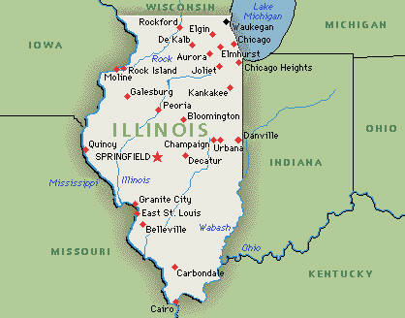

How’s it going?

Slide 19

Discussion questions
What uses can you see for the tool in your state or program?
How can families be involved in the self-assessment process?
What additional resources
might be useful?
Other ideas for ECO?

