Slide 1
Data as Light: Time to Walk on the Sunny Side of the Street
Kathy Hebbeler
ECO at SRI
Presented at the Measuring and Improving Child and Family Outcomes Conference
September 2011

Slide 2


Welcome to New Orleans!

Slide 3
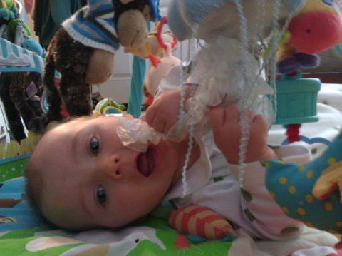
We have a new addition!
Measuring and Improving Child and Family Outcomes Conference
Notes:
Not just a title change – you will find new content in this meeting that differs from previous outcomes meetings. Why? 1) We have always been about improving outcomes – it has never just been about measuring – but as you all know measuring itself it a pretty complicated activity that has taken a lot of energy and resources over the last 7 years. We know states are in different places with regard to the quality of their child and family outcomes data and we will always need to address data quality issues but our sense from where we sit at ECO, is that as a field we are ready to move to the next step. Data is a tool, a utensil (and I apologize for the mixed methaphor – I am going to pick up the Data as light them too for at this moment data is a utensil. We feel like all of us have been polishing our silver for a long time now, it is time to sit down and eat.
My role today is as stage setter. I am going to give you some thoughts to launch you off on what we are sure will be an exciting and enriching few days together. I am also going to introduce you to the agenda and show the offerings we have for you at the meeting tie to bigger themes to help you make your session choices…And if you have looked at the agenda, you know they are going to be hard choices.

Slide 4
Building measurement system
Using data to improve programs
Implementing and sustaining quality practices

Slide 5
If you had to identify, in one word, the reason why the human race has not achieved, and never will achieve, its full potential, that word would be 'meetings.' "
--Dave Barry,
American author and columnist
Notes:
We hope this only applies to the meetings you have back home – not to your time here together!

Slide 6
Changing Role of Data

Slide 7
On the road to good outcomes
Expanding knowledge base
  More sophisticated about intervention
  What works for whom under what circumstances?
Research tells us what CAN be effective
We do know how to intervene to make a difference in children’s development

Slide 8
Can ≠ Is
Having a body of knowledge does not translate to all programs implementing effective practices.
How do we know if we have good programs?
Through the systematic use and collection of good data (i.e., valid data about the “right” things)
Notes:
If getting good practice in all programs was simply a matter of sending all providers a copy of the Journal of Early Intervention, we would have effective programs and good outcomes everywhere.
The data for the Perry Preschool Project is terrific for showing what preschool can do but it doesn’t mean every preschool in the country is reducing arrests.
The fact that EI and ECSE can be effective does not mean they are effective.
So that’s why we need good data about the right things that are collected and used on a regular basis.

Slide 9
Moving to a culture of data-informed decision-making
Data that can answer important questions
  E.g., are children and families experiencing good outcomes?
  What factors are contributing to those outcomes?
  What are the barriers?
Data that are collected regularly
  Last year’s program is not this year’s program
Notes:
Not data-driven. Data don’t make decisions. People do and people need to use data thoughtfully to inform their decisions.
We need to build a culture of data informed decision-making to see where programs are, to help the weak become better, and the good programs become excellent.
Showing the program was effective in 2008 does not mean it is effective in 2012, it doesn’t even mean it was effective in 2009.

Slide 10
Data is not just for researchers anymore
Good data will (already is) essential for anyone managing a program at any level
Good data is essential for teachers in the classroom
Having and using data to inform decisions should be a natural part of how all involved with EI or ECSE do business

Slide 11
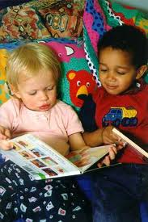
Contrasting Uses of Data
Performance Management
  E.g., OSEP indicators
  Few critical data elements with targets
  Ongoing
Evaluation
  Broader look; more data
  One time

Slide 12
Data-informed program improvement
Ongoing, cyclical
  not evaluation
Allows for a wider array of questions
  Not just a few indicators like a performance management system
States need to develop measurement systems that are powerful enough to generate data for program improvement

Slide 13

And there is accountability
Policy makers want to know investments are well spent.
Program advocates need numbers to make the case that this program TODAY HERE NOW is making a difference.
Notes:
Contrast program improvement – internal use of data; accountability – external use
Program improvement – more complex questions; accountability – is this program effective?

Slide 14

…..on behalf of the President and the White House…
We know that state collection of data is very complicated and can be very difficult related to infants and toddlers with disabilities. But the rewards far outweigh any complications because that data, that information that we gain, demonstrates that early intervention works and that Part C program can be a model for state coordination of statewide services.
And so what we know from these data, what we know from the data that everybody is collecting under the Part C program, which is vital, is that 74% of infants and toddlers with disabilities who receive Part C services show increases in their rate of development. And we also know that 60% of infants and toddlers with disabilities who receive the Part C services exit the program at the age of three or earlier with the skills expected, or that are expected, for their age. These are good numbers but we all know that we need to and we must do better and these percentages must go up.
These Part C regulations that we are releasing today support the development of high-quality state and local data so that we can collect the valid and reliable information that we need related to Part C Early Intervention, including data on early childhood outcomes.
Kareem Dale, Special Assistant to the President for Disability Policy
Part C Final Regulations Conference Call, September 6, 2011
Notes:
7 years ago when we started talking about what the outcomes should be who would have thought that someone would have been citing these data on behalf of the President.

Slide 15
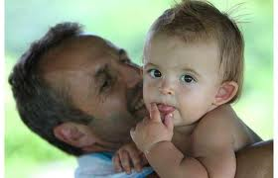
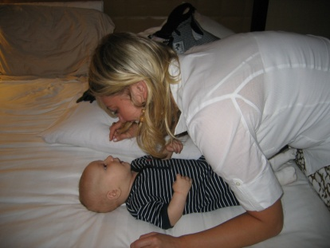


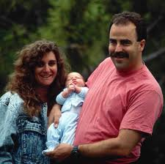


Another take on Accountability
Who should programs be accountable to?
Children and families

Slide 16

Go Deep,
Go Wide,
Go Long
Notes:
TO use data for program improvement you need to….

Slide 17
3 critical ingredients for program improvement
Leadership has a vision of what programs and practices should look like.
  If you don’t know where you are going…..
Leadership has access to information that allows a comparison of vision to current reality.
Leadership can implement strategies to address discrepancies.
Notes:
If you don’t know where you are going, you also can’t tell when you are not there.
Your role as EC leaders is critical to building a better system of services for children and families.
Heard someone yesterday talk about how programs 10 years ago were told they could do anything they wanted as long as it wasn’t illegal – that is NOT a vision for programs.

Slide 18
Want to learn more?
There’s a session for that!
Vision Stretchers
When | What | Who
Monday 3:15 – 4:30 | Integrating Outcomes Measurement with IFSP and IEP Processes | Marcella Franczkowski Sharon Ringwalt Kate Rogers Karen Walker
Monday, 3:15 – 4:30 | Linking Practices to Promote Language, Literacy, and Social Development | Lise Fox Carol Trivette
Monday, 3:15 - 4:30 | Using Digital Video to Enhance Quality Practices and Outcomes | Larry Edelman
Notes:
Sessions to feed your vision about what you might want your programs look like.
Integration – Is not just about improving data collection – this is a program improvement strategy. Making the 3 functional child outcomes the centerpiece of how programs do business – how they think about and communicate assessment results, how they develop goals and objectives – outcomes provide a useful and powerful lens, not just for Child Outcomes Summary process states
Larry, the penultimate vision stretcher.
Linking of writing outcomes and goals – vision enhancer, improving practice, also improving measurement – double coupons day at Savemart, improving data collection on child outcomes isn’t just about data, improving practive

Slide 19
Want to learn more?
There’s a session for that!
Vision Stretchers
When | What | Who
Tuesday, 3:15 – 4:30 | Writing Quality IFSP Outcomes/IEP Goals and Linking to the Child Outcomes Measurement Processes | Kathi Gillespi Anne Lucas Mary Peters
Wednesday 9:00 – 10:00 | Ensuring Sustainable Change: The Long and Winding Road | Martha Diefendorf
Wednesday 10:30-12:00 | It’s a Family Affair: Support Families To Improve Child Outcomes | Robin McWilliam

Slide 20
3 critical ingredients for program improvement
Leadership has a vision of what programs and practices should look like.
  If you don’t know where you are going…..
Leadership has access to information that allows a comparison of vision to current reality.
Leadership can implement strategies to address discrepancies.

Slide 21
Access to information
Question:
How to see the trees at 10,000 feet?
Answer:
Data
Next question:
Data about what?

Slide 22
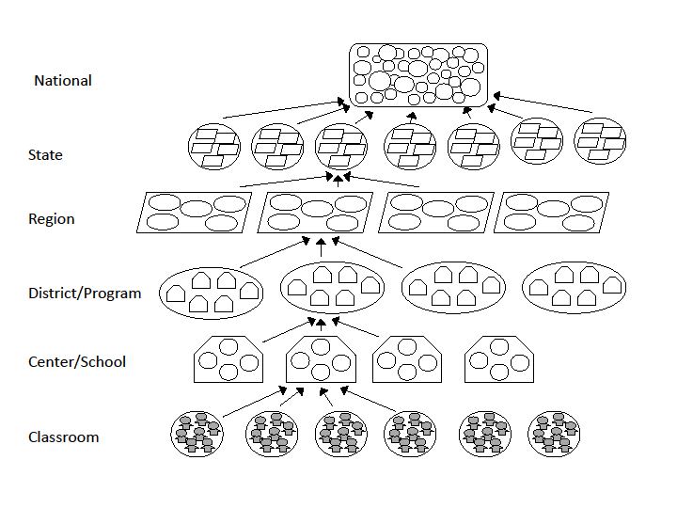
Notes:
Even worse for OSEP – they are at 100,000 feet – but still care about kids. At this level, we have over 1 million children in EI and ECSE across the states and territories.

Slide 23

Identifying the data needed for program improvement
What data will answer the important questions?
What are the important questions?

Slide 24
Nominees for Key Questions
What outcomes are children and families experiencing?
Which programs are producing good outcomes (or not)?
Which children and families are experiencing good outcome? (or not)
What is the impact of X change on child and/or family outcomes?

Slide 25
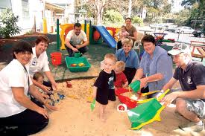
Go Deep
Need the data to drill down
Programs with exceptionally good (or not) outcomes
  Who are they serving?
  What are they doing?
Notes:
Some of you are already doing this. States were sharing some analyses like this that they have been doing yesterday in the data seminar.

Slide 26
Child Outcomes:
Where are we?
Good outcomes for children and families
Made tremendous progress toward building the measurement systems so we can answer that question
Need to continue to focus on improving quality of the data

Slide 27
Want to learn more?
There’s a session for that!
Quality of Child Outcomes Data
When | What | Who
Monday, 3:15 – 4:30 | Patterns in Child Outcomes Summary Data: Analytic Approaches and Early Findings from the ENHANCE Project | Lauren Barton Cornelia Taylor Donna Spiker
Monday, 3:15 – 4:30 | What’s New? Child Outcomes Training and TA Materials | Barbara Cohen Michelle Lewis Robin Rooney Pat Sue Spear
Tuesday 10:30 – 12:00 | BDI Group: Sharing Across States Using the BDI for Child Outcomes Measurement

Slide 28
Want to learn more?
There’s a session for that!
Quality of Child Outcomes Data
When | What | Who
Tuesday 10:30 – 12:00 | Using the Child Outcomes Measurement System (COMS) Self-Assessment Tool for State Planning and Action | Lauren Barton Ruth Littlefield
Wednesday, 10:30 – 12:00 | Do You See What I See? Assuring Fidelity of COS Implementation | Mary Beth Bruder Ruth Chvojicek
Where did the F go?

Slide 29
Family Outcomes:
Where are we?
Outcomes are what families know and can do.
Not their perceptions of the program.
Some measurement of family outcomes in some states.
Perceptions of program are important.
Not much measurement of family outcomes, perceptions, experience, satisfaction for ECSE.

Slide 30
Want to learn more?
There’s a session for that!
Improving Family Outcomes and Experiences
Data
When | What | Who
Monday 3:15- 4:30 | ECO Family Experiences and Outcomes Framework | Siobhan Colgan Chelsea Guillen Melissa Raspa Alice Ridgway
Tuesday 8:00 – 9:00 (8:50) | Early Bird: Q & A with ECO Staff on Family Outcomes Measurement and Data Quality Issues | Siobahn Colgan Melissa Raspa
Notes:
Framework
Early bird – not so early

Slide 31
System for Producing Good Child and Family Outcomes
Research
Prof’l Development
Evidence Based Practices
High quality services and supports for children 0-5 and their families
Good outcomes for children and families
Good Federal policies and programs
Good State policies and programs
Good Local policies and programs
Strong Leadership
Adequate funding
Information infrastructure
Notes:
Outcomes are what we care about
Outcomes are produced by what programs do
What programs do is supported or hindered by many factors in the system
A new an emerging one is an information infrastructure – having information about the components of the system.

Slide 32
Good outcomes for children and families
High quality services and supports for children 0-5 and their families
Data
Data
Notes:
We have focused a lot of attention on the outcomes side of this relationship. However, the only way programs produce outcomes is by doing something and it is what they do that is so important. If there is a problem with outcomes then the first place to look to understand the problem is in the services and supports box. You cannot improve outcomes without going through this box.

Slide 33
Using data for program improvement: Where are we?
Just starting
Need to build capacity of state and local staff to ask good questions, analyze, interpret and act on data

Slide 34
Want to learn more?
There’s a session for that!
Data analysis/Using data for program improvement
When | What | Who
Tuesday 10:30- 12:00 | Analyzing and Interpreting Family Data for Program Improvement | Siobhan Colgan Melissa Raspa
Tuesday 10:30-12:00 | Measuring and Improving Social-Emotional Development with the Pyramid Model: A Multi-Level Framework of Data Collection and Use | Lisa Backer Lise Fox Vivian James Kelly Pleasant Megan Vingh
Tuesday 3:15-4:30 | Partnering with Local Programs and Families to Interpret and Use Outcomes Data | Maureen Casey Tony Ruggerio Verna Thompson

Slide 35
Want to learn more?
There’s a session for that!
Data analysis/Using data for program improvement
When | What | Who
Tuesday 3:15-4:30 | Slicing, Dicing, Comparing and Contrasting: State Data System Capacity to Make Sense of Outcome Data | Lisa Backer Lisa Balivet Jen Kaufman
Tuesday, 3:15 – 4:30 | States Experiences Preparing OSEP On-Site Results Activity | Susan Boone Susan Evans Sherry Franklin Terry Harrison Joy Markovitz Lisa Wasacz
Wednesday 10:30 – 12:30 | A Mini-Workshop on Analyzing and Interpreting Data | Ann Bailey Lynne Kahn Cornelia Taylor

Slide 36
Want to learn more?
There’s a session for that!
Data analysis/Using data for program improvement
When | What | Who
Wednesday 10:30-12:00 | Linking Early Intervention Quality Practices With Child and Family Outcomes | Sherry Franklin Kathi Gillaspy Anne Lucas Beth Tolley Sharon Walsh
Wednesday 10:30 – 12:00 | How Can We Know What and How Much Is Enough? | Robin Nelson Kathy Hebbeler
Wednesday 10:30-12:00 | Reporting Local Child Outcomes Data: Facilitated Discussion about Challenges and Experiences | Lauren Barton Kim Carlson Holly Ford Sally Golden-McCord Joy Markowitz Connie Nink

Slide 37
Good outcomes for children and families
High quality services and supports for children 0-5 and their families
Data
Data
Notes:
We have focused a lot of attention on the outcomes side of this relationship. However, the only way programs produce outcomes is by doing something and it is what they do that is so important. If there is a problem with outcomes then the first place to look to understand the problem is in the services and supports box. You cannot improve outcomes without going through this box.

Slide 38
The essence of intervention
Child
Service Provider
Caregiver

Slide 39
The essence of intervention
Variation: EI
Child
Service Provider
Caregiver

Slide 40
Variation: ECSE
The essence of intervention
Child
Service Provider
Caregiver

Slide 42
Data needed for program improvement
High quality services and supports for children 0-5 and their families
Data about programs and practices:
  What is going on in the triangle?
  Is it high quality? (AKA: is it effective? how close is it to the vision of what should be happening?)
  What do families think about what is happening in programs?
Notes:
This goes so far beyond compliance.

Slide 43
Services vs. Practices
Services
  Type (e.g., speech therapy)
  Setting
  Frequency
  Intensity
  Duration
Practices
  The nature of the interaction between the provider and the child, the provider and the family, or all 3.
What do you have data on?
Which one is more important for child and family outcomes?

Slide 44
The need to measure the quality of EI and ECSE programs
Quality = Effective practices
Data on poor outcomes will indicate a problem but won’t tell you what the problem is.
If you don’t know what problem is, can’t fix it.
We need to be targeting improvements in quality.
Notes:
This is where we need to go next. We will hit a wall in our ability to use data for improvement without systematic information about the quality of what programs are doing .

Slide 45
Interesting developments in EC
EI and ECSE
Ongoing data on child outcomes
No data on program quality
Some data on family perceptions and outcomes (EI)
Child care, Head Start
No data on child outcomes
Ongoing data on program quality
Some data on family perceptions

Slide 46
Challenges related to data on program quality for EI and ECSE
Reaching agreement on what constitutes quality
Need tools to measure quality
Addressing quality for a population with diverse needs receiving individualized services
  Is quality unique to every child and family?

Slide 47
Want to learn more?
There’s a session for that!
Defining and Measuring Quality
When | What | Who
Tuesday, 10:30-12:00 | Program Quality and Child Outcomes: The Role of Quality Improvement Systems and Its Relationship to Early Childhood Special Education | Rena Hallam Kelly Maxwell Donna Spiker Verna Thompson
Tuesday, 1:30-2:45 | It’s Getting Better All the Time: Look at Practice Quality to Improve Outcomes | Robin McWilliam
Tuesday, 3:15-4:30 | Quality Practices for Preschoolers with Disabilities: How Do You Know It When You See It? | Debbie Cate Kathy Hebbeler Megan Vinh

Slide 48
Data wish list (continued)
Cost data
Need to be able to compute what services cost
Need to be able to compare costs for different children, different delivery approaches
Need to know if some ways of delivering services are more cost effective
Notes:
I hope we address this issue before we are required to address it by policymakers. We have been delivering EI and ECSE services in this country for several decades and we can’t put a dollar figure on what it takes to do it well. Many states cannot even tell you how much services, good or bad, cost. If we there is any possible truth to the proposition that in some places we may be paying more for services than we need to, we are wasting precious resources. Those resource could be going to the children and families who are getting cut out of Part C as states are redefining their eligibility criteria. No guarantee cost savings would stay in the system but it is highly likely that EI and ECSE will come under increasing pressure to do more with less.

Slide 49
Growing recognition of the power of comprehensive state level data systems
National movement to build state level longitudinal data set
  Grants from US Dept of Education
Emphasis in EC on cross agency data sets and data sharing
  Early Childhood Data Collaborative
With the right data elements, these data sets will be able to address “what works for whom under what circumstances?” across many EC programs
Notes:
How many of you have been involved in conversations or meetings in your states around your state’s longitudinal K-12 data system? How many of you are Part C? How many of you are Part C in a state where Ed is not the lead?

Slide 50
Want to learn more?
There’s a session for that!
Go Wide
Go Long
When | What | Who
Tuesday, 9:00 – 10:00 | ECE Data Systems: the Framework, the Realities, and the Possibilities | Phil Sirinides Albert Watt
Tuesday, 10:30 – 12:00 | Know Thy Children Well: A Three State Panel Discussion About Early Childhood Data Collection | Baron Holmes Susan Ilgren Phil Koshkin Phil Sirinides
Tuesday 3:15 – 4:30 | To See What Condition Our Condition is In…Aligning Child and Family Outcomes Across Early Learning and Development Systems | Geoffrey Nagle Cindy Oser

Slide 51
Repeat as Needed

Slide 52
Building measurement system
Using data to improve programs
Implementing and sustaining quality practices

Slide 53
Program improvement is a cycle
Using data to improve programs
Implementing and sustaining good practices
Notes:
Data-informed decision-making is ongoing.

Slide 54
Your measurement system is never built
Data Collection including PD
Analysis including quality checks
Reporting
Using data for program improvement including PD
Notes:
Similarly, your data system is never built.

Slide 55
So where are we?
With regard to data, a lot better off than we were 7 years ago.
Need to continue to improve quality in child outcomes data.
Need to improve “usability” family data
  Improve response rates
  ECSE – needs to get some family data.

Slide 56
So where are we?
Start/continue to use the data for program improvement.
Expand the data collected to allow even better questions to be addressed, especially questions about program quality.
Need to continue to establish linkages across early childhood and K-12 in many ways including coordinated data systems.

Slide 57

Surface Learning
Steve Wheeler, University of Plymouth, 2011
Deep Learning
Notes:
Thank, Larry for pointing me to these slides which were part of a presentation on K-12 assessment.

Slide 58
ENGAGEMENT
Data
Information
Steve Wheeler, University of Plymouth, 2011
Knowledge
Wisdom
Transformation
Notes:
Not just having your data, but engaging with your data such that what you are learning become knowledge and wisdom and ultimately results in transformations in programs.

Slide 59
ECO Updates
Frameworks and Self Assessments
  Child Measurement Outcomes System Framework
  Family Experiences and Outcomes Measurement Framework
OSEP Results Visits
Supports for quality data
  Conference calls, materials
  Process for verifying COS knowledge

Slide 60
ECO Updates
Supports for data analysis and use, including local programs
ENHANCE
Encore Presentations – help us decide

Slide 61
What we hope you get out of this meeting
Expand, enhance, refine your vision for quality programs and practices in your state
Learn new ways to improve your data (including collecting new kinds of information)
Acquire new tools and ideas for how to use your data to improve programs
Notes:
Big thank you to all of all presenters – would be no meeting without your willingness to share what you know.

Slide 62

We have a gift for you

