Slide 1
Data Workshop:
Analyzing and Interpreting Data
Kathy Hebbeler, ECO at SRI
Lynne Kahn, NECTAC/ECO at FPG
Cornelia Taylor, ECO at SRI
Ann Bailey, NCRRC
Presented at the Measuring and Improving Child and Family Outcomes Conference
New Orleans, LA September 2011

Slide 2
1. Using Data

Slide 3
Using data for program improvement = EIA
Evidence
Inference
Action

Slide 4

Evidence
Evidence refers to the numbers, such as
  “45% of children in category b”
The numbers are not debatable

Slide 5
Inference
How do you interpret the #s?
What can you conclude from the #s?
Does evidence mean good news? Bad news? News we can’t interpret?
To reach an inference, sometimes we analyze data in other ways (ask for more evidence)

Slide 6

Inference
Inference is debatable -- even reasonable people can reach different conclusions
Stakeholders can help with putting meaning on the numbers
Early on, the inference may be more a question of the quality of the data

Slide 7
Action
Given the inference from the numbers, what should be done?
Recommendations or action steps
Action can be debatable – and often is
Another role for stakeholders
Again, early on the action might have to do with improving the quality of the data
Notes:
Action steps = training and TA, for example – first to improve the quality of the data, then to improve programs when the inference is that improvement is needed

Slide 8
Good Data??
 |  | Programs
 |  | Bad/Weak | Good/Strong
Data | Bad/Weak | ?? | ??
 | Good/Strong | Program Improvement Questionable → Good | Program Improvement Good → Better

Slide 9
Good Data??
 |  | Programs
 |  | Bad/Weak | Good/Strong
Data | Bad/Weak | ?? | ??
 | Good/Strong | Program Improvement Questionable → Good | Program Improvement Good → Better

Slide 10
Good Data??
 |  | Programs
 |  | Bad/Weak | Good/Strong
Data | Bad/Weak | ?? | ??
 | Good/Strong | Program Improvement Questionable → Good | Program Improvement Good → Better

Slide 11
2. Primer on how to present data

Slide 12
What do you want your audience to notice? Where do you want their eyes to go?
Alternate presentation of the same data. What works?
Chartjunk and minimal ink
When pies don’t work?

Slide 16
Wasted ink

Slide 17
No 3-D

Slide 18
Notes:
Very difficult to compare across pies.

Slide 19
3. Making Comparisons

Slide 20
What constitutes a meaningful difference?
  Statistical significance refers to sampling from a population
  Your child outcomes data is the population.
What constitutes stability in your data?

Slide 21
Comparing to state numbers
Influence of big entities on totals
Demonstration with an example of how a huge change in a small entity makes almost no difference on a – e, but how that same proportionate change in a big entity makes a big difference (i.e., why state numbers will often look a lot like the biggest subunit.

Slide 22
a |  | b |  | c |  | d |  | e |  | Total N
228 | 0.07 | 112 | 0.04 | 1003 | 0.32 | 1361 | 0.44 | 410 | 0.13 | 3114
27 | 0.02 | 290 | 0.24 | 249 | 0.21 | 329 | 0.27 | 317 | 0.26 | 1212
81 | 0.01 | 1470 | 0.20 | 1110 | 0.15 | 1842 | 0.25 | 2751 | 0.38 | 7254
12 | 0.01 | 420 | 0.27 | 92 | 0.06 | 200 | 0.13 | 833 | 0.54 | 1557
11 | 0.00 | 688 | 0.28 | 379 | 0.15 | 564 | 0.23 | 821 | 0.33 | 2463
35 | 0.01 | 408 | 0.14 | 84 | 0.03 | 583 | 0.21 | 1706 | 0.61 | 2816
12 | 0.00 | 543 | 0.16 | 674 | 0.20 | 1121 | 0.33 | 1006 | 0.30 | 3356
37 | 0.02 | 701 | 0.28 | 687 | 0.28 | 614 | 0.25 | 429 | 0.17 | 2468
36 | 0.03 | 271 | 0.21 | 384 | 0.29 | 304 | 0.23 | 319 | 0.24 | 1314
1 | 0.00 | 100 | 0.30 | 51 | 0.15 | 96 | 0.29 | 88 | 0.26 | 336
15 | 0.03 | 65 | 0.13 | 48 | 0.10 | 142 | 0.29 | 215 | 0.44 | 485
6 | 0.01 | 298 | 0.29 | 320 | 0.31 | 336 | 0.32 | 84 | 0.08 | 1044
8 | 0.01 | 112 | 0.11 | 148 | 0.14 | 330 | 0.32 | 447 | 0.43 | 1045
61 | 0.03 | 382 | 0.18 | 378 | 0.18 | 714 | 0.33 | 619 | 0.29 | 2154
52 | 0.01 | 1161 | 0.19 | 1179 | 0.19 | 1994 | 0.33 | 1677 | 0.28 | 6063
1.7% |  | 19.1% |  | 18.5% |  | 28.7% |  | 32.0%

Slide 23
a |  | b |  | c |  | d |  | e
228 | 0.07 | 112 | 0.04 | 1003 | 0.32 | 1361 | 0.44 | 410 | 0.13 | Total N
27 | 0.02 | 290 | 0.24 | 249 | 0.21 | 329 | 0.27 | 317 | 0.26 | 3114
81 | 0.01 | 735 | 0.20 | 1845 | 0.15 | 1842 | 0.25 | 2751 | 0.38 | 1212
12 | 0.01 | 420 | 0.27 | 92 | 0.06 | 200 | 0.13 | 833 | 0.54 | 7254
11 | 0.00 | 688 | 0.28 | 379 | 0.15 | 564 | 0.23 | 821 | 0.33 | 1557
35 | 0.01 | 408 | 0.14 | 84 | 0.03 | 583 | 0.21 | 1706 | 0.61 | 2463
12 | 0.00 | 543 | 0.16 | 674 | 0.20 | 1121 | 0.33 | 1006 | 0.30 | 2816
37 | 0.02 | 701 | 0.28 | 687 | 0.28 | 614 | 0.25 | 429 | 0.17 | 3356
36 | 0.03 | 271 | 0.21 | 384 | 0.29 | 304 | 0.23 | 319 | 0.24 | 2468
1 | 0.00 | 100 | 0.30 | 51 | 0.15 | 96 | 0.29 | 88 | 0.26 | 1314
15 | 0.03 | 65 | 0.13 | 48 | 0.10 | 142 | 0.29 | 215 | 0.44 | 336
6 | 0.01 | 298 | 0.29 | 320 | 0.31 | 336 | 0.32 | 84 | 0.08 | 485
8 | 0.01 | 112 | 0.11 | 148 | 0.14 | 330 | 0.32 | 447 | 0.43 | 1044
61 | 0.03 | 382 | 0.18 | 378 | 0.18 | 714 | 0.33 | 619 | 0.29 | 1045
52 | 0.01 | 1161 | 0.19 | 1179 | 0.19 | 1994 | 0.33 | 1677 | 0.28 | 2154
1.7% |  | 17.1% |  | 20.5% |  | 28.7% |  | 32.0% |  | 6063
1.7% |  | 19.1% |  | 18.5% |  | 28.7% |  | 32.0%

Slide 24
a |  | b |  | c |  | d |  | e
 |  |  |  |  |  |  |  |  |  | Total N
228 | 0.07 | 112 | 0.04 | 1003 | 0.32 | 1361 | 0.44 | 410 | 0.13 | 3114
27 | 0.02 | 290 | 0.24 | 249 | 0.21 | 329 | 0.27 | 317 | 0.26 | 1212
81 | 0.01 | 1470 | 0.20 | 1110 | 0.15 | 1842 | 0.25 | 2751 | 0.38 | 7254
12 | 0.01 | 420 | 0.27 | 92 | 0.06 | 200 | 0.13 | 833 | 0.54 | 1557
11 | 0.00 | 688 | 0.28 | 379 | 0.15 | 564 | 0.23 | 821 | 0.33 | 2463
35 | 0.01 | 408 | 0.14 | 84 | 0.03 | 583 | 0.21 | 1706 | 0.61 | 2816
12 | 0.00 | 543 | 0.16 | 674 | 0.20 | 1121 | 0.33 | 1006 | 0.30 | 3356
37 | 0.02 | 701 | 0.28 | 687 | 0.28 | 614 | 0.25 | 429 | 0.17 | 2468
36 | 0.03 | 271 | 0.21 | 384 | 0.29 | 304 | 0.23 | 319 | 0.24 | 1314
1 | 0.00 | 100 | 0.30 | 51 | 0.15 | 96 | 0.29 | 88 | 0.26 | 336
15 | 0.03 | 33 | 0.13 | 80 | 0.10 | 142 | 0.29 | 215 | 0.44 | 485
6 | 0.01 | 298 | 0.29 | 320 | 0.31 | 336 | 0.32 | 84 | 0.08 | 1044
8 | 0.01 | 112 | 0.11 | 148 | 0.14 | 330 | 0.32 | 447 | 0.43 | 1045
61 | 0.03 | 382 | 0.18 | 378 | 0.18 | 714 | 0.33 | 619 | 0.29 | 2154
52 | 0.01 | 1161 | 0.19 | 1179 | 0.19 | 1994 | 0.33 | 1677 | 0.28 | 6063
1.7% |  | 19.1% |  | 18.6% |  | 28.7% |  | 32.0%
1.7% |  | 19.1% |  | 18.5% |  | 28.7% |  | 32.0%

Slide 25

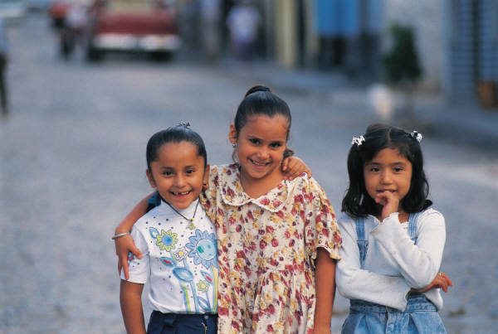
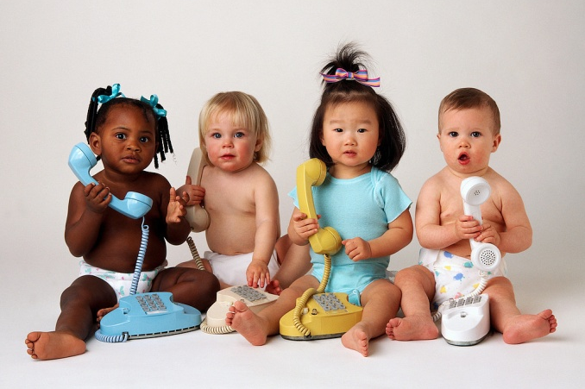
Find more resources at: www. the-eco-center-org
Thank you!!

