Slide 1
Partnering with Local Programs to Interpret and Use Outcomes Data
Delaware’s Part B 619 Program
September 20, 2011
Verna Thompson & Tony Ruggiero
Delaware Department of Education
Early Development and Learning Resources

Slide 2
Agenda
Delaware Information
Demographics
State COSF Data
2011 Part B 619 Local Program Visits
Purpose of visits
Information shared
What we learned
Data Analysis Process
Distribution by disability type and year
Possible explanations for unusual data
Improving Child Outcome Data
Plans for improving data quality

Slide 3
Delaware Demographics
Geography
1949.20 square miles
Three Counties
19 school districts
Population
897,934 people (2010 US Census)
Children
17% of young children 0-5 live in poverty (Center for Applied Demography and Survey Research, University of Delaware)
1,551 children with disabilities (3-5 years old) in Part B 619 (Delaware Department of Education)

Slide 4
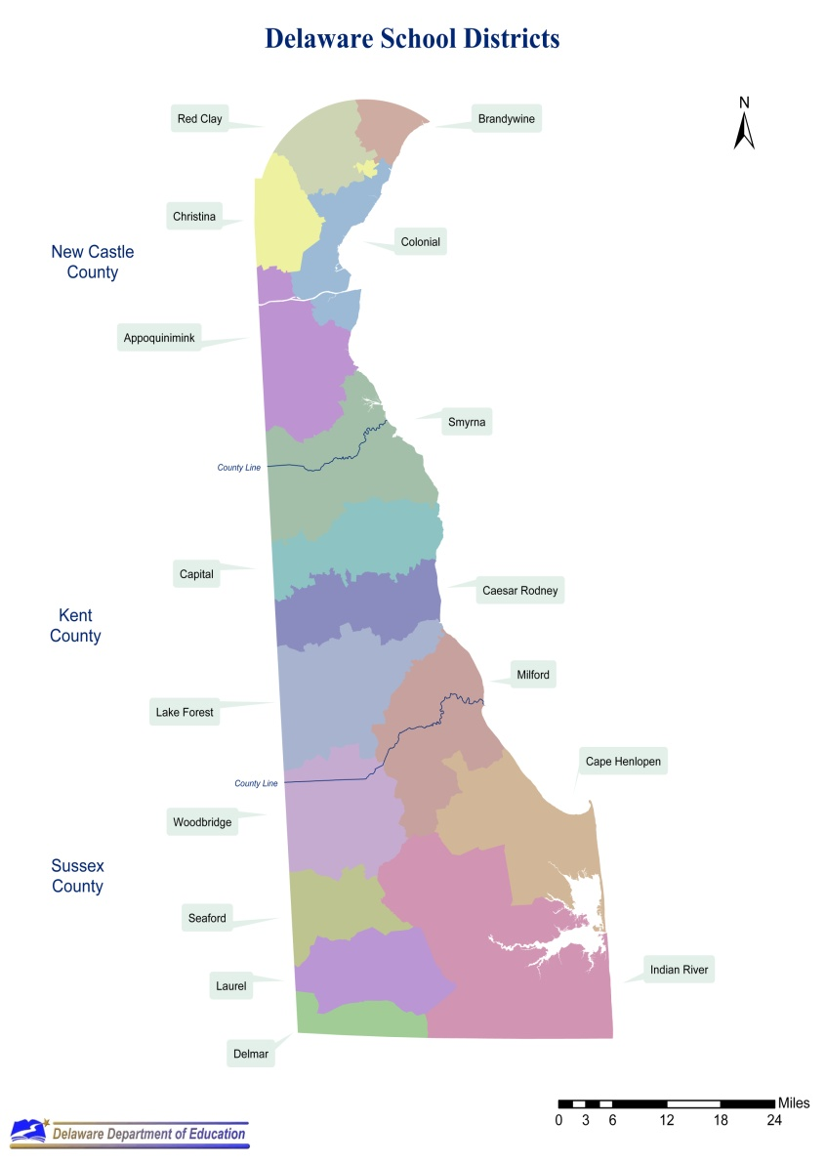
The First State - Delaware

Slide 5
Delaware Young Children in 619 Child Outcomes System
Children 3-5 years of age with IEP
Children receiving at least 6 months of services
6 months between the first and final assessment
Children who temporarily withdraw from services are included if they return within 30 days of the date they withdrew
Children with more than 30 day break in service are considered dropped from the program. If the child re-enrolls the 60 day assessment process must be initiated again.

Slide 6
Procedures for COSF Process
Child Outcomes procedures are available in Building BLOCKS Manual
Multidisciplinary teams complete COSF with parent input
COSF information is entered on state data system
COSF data is downloaded by Delaware DOE EDLR

Slide 7
Outcome 1 – Statewide (2010)
7

Slide 8
Outcome 2 – Statewide (2010)
8

Slide 9
Outcome 3 – Statewide
9

Slide 10
Average Entry and Exit Outcome Scores
Group | Social-Emotional | Knowledge and Skills | Action to Meet Needs
Delaware
Entry | 3.8 | 3.6 | 4.2
Exit | 5.4 | 5.2 | 5.7

Slide 11
Outcome 1: Positive Social Relationships
(DE 2010, Social and Emotional)
 | Entry
Exit | 1 | 2 | 3 | 4 | 5 | 6 | 7 | Total
1 | 3 | 2 | 0 | 0 | 0 | 0 | 0 | 5
2 | 12 | 15 | 1 | 5 | 1 | 0 | 0 | 34
3 | 11 | 14 | 3 | 4 | 0 | 0 | 0 | 32
4 | 8 | 34 | 24 | 13 | 2 | 2 | 1 | 84
5 | 12 | 19 | 32 | 40 | 17 | 4 | 0 | 124
6 | 6 | 13 | 32 | 35 | 53 | 19 | 2 | 160
7 | 3 | 8 | 19 | 19 | 31 | 34 | 47 | 161
Review Total | 55 | 105 | 111 | 116 | 104 | 59 | 50 | 600
11
Notes:
11

Slide 12
Outcome 2: Use Knowledge and Skills
(DE 2010, Knowledge and Skills)
 | Entry
Exit | 1 | 2 | 3 | 4 | 5 | 6 | 7 | Total
1 | 5 | 2 | 0 | 0 | 0 | 0 | 0 | 7
2 | 10 | 10 | 3 | 3 | 0 | 0 | 0 | 26
3 | 15 | 14 | 3 | 1 | 2 | 0 | 0 | 35
4 | 11 | 29 | 29 | 17 | 4 | 0 | 0 | 90
5 | 15 | 10 | 53 | 50 | 26 | 0 | 0 | 154
6 | 8 | 21 | 32 | 43 | 41 | 14 | 0 | 159
7 | 3 | 9 | 20 | 21 | 22 | 16 | 37 | 128
Review Total | 67 | 95 | 140 | 135 | 95 | 30 | 37 | 599
12
Notes:
12

Slide 13
Outcome 3: Appropriate Action
(DE 2010, Behavior Meets Needs)
 | Entry
Exit | 1 | 2 | 3 | 4 | 5 | 6 | 7 | Total
1 | 4 | 0 | 1 | 0 | 1 | 0 | 0 | 6
2 | 8 | 8 | 4 | 3 | 0 | 0 | 1 | 24
3 | 4 | 7 | 7 | 1 | 1 | 1 | 1 | 22
4 | 6 | 18 | 19 | 5 | 4 | 2 | 0 | 54
5 | 5 | 20 | 23 | 24 | 16 | 4 | 0 | 92
6 | 13 | 19 | 27 | 39 | 52 | 29 | 5 | 184
7 | 4 | 12 | 17 | 24 | 43 | 51 | 65 | 216
Review Total | 44 | 84 | 98 | 96 | 117 | 87 | 72 | 598
13
Notes:
13

Slide 14
Part B 619 Site Visits
Purpose of visits
Develop relationships with 619 coordinators
Gather information about 619 programs
Share Child Outcomes information
Discuss COSF process in the district
Begin the data analysis process with district
Determine strengths and needs for support

Slide 15
Part B 619 Site Visits
Procedure for Site Visits
District shared information
Early Childhood program and children
Child Outcomes procedures
DOE shared information
Delaware Child Outcomes data
State Child Outcomes targets
School district Child Outcomes data
Analyzed data together
Compared state and local data
Explored possible local trends, patterns
Discussed next steps

Slide 16
Samples of Local Child Outcomes Data

Slide 17
Delaware and District A Average Entry Scores on Outcomes
Group | Social-Emotional | Knowledge and Skills | Behavior Meets Needs
Delaware | 3.8 | 3.6 | 4.2
District A | 4.4 | 3.9 | 4.8

Slide 18
Delaware and District A Average Exit Scores on Outcomes
Group | Social-Emotional | Knowledge and Skills | Behavior Meets Needs
Delaware | 5.4 | 5.2 | 5.7
District A | 5.8 | 5.6 | 6.1

Slide 19
Outcome 1: Positive Social Relationships
(District A 2010, Social and Emotional)
 | Entry
Exit | 1 | 2 | 3 | 4 | 5 | 6 | 7 | Total
1 | 1 | 0 | 0 | 0 | 0 | 0 | 0 | 1
2 | 0 | 2 | 0 | 0 | 0 | 0 | 0 | 2
3 | 0 | 0 | 0 | 0 | 0 | 0 | 0 | 0
4 | 0 | 2 | 2 | 0 | 0 | 0 | 0 | 4
5 | 0 | 3 | 7 | 7 | 0 | 0 | 0 | 17
6 | 0 | 0 | 3 | 10 | 10 | 3 | 1 | 21
7 | 0 | 0 | 3 | 1 | 5 | 4 | 8 | 21
Review Total | 1 | 7 | 15 | 18 | 15 | 7 | 9 | 72
19
Notes:
19

Slide 20
Part B 619 Site Visits
What we learned – successes and challenges
Some children were not being included in Child Outcomes System
School districts had unique rating patterns
School districts assigned different staff to enter COSF ratings on data system
Progress question was not answered in consistent manner
Many special services directors had limited understanding of COSF process

Slide 21
After Completing Site Visits……
School Districts
Requested training for EC staff
Discussed COSF process during staff meetings
Called DOE often to discuss unusual data
Special Services shared COSF data with administrators
DOE EDLR
Participated in updating Child Outcomes manual
Continued analysis process

Slide 22
Child Outcomes Data Analysis Process
Activity:
Analyze entry and exit Child Outcomes data from 3 school districts
Do you notice any differences between the districts and the state Child Outcomes data?

Slide 23
Average Entry Outcome Scores, 2010
Group | Social-Emotional | Knowledge and Skills | Action to Meet Needs
Delaware | 3.8 | 3.6 | 4.2
District A | 4.4 | 3.9 | 4.8
District B | 2.7 | 2.6 | 2.7
District C | 4.1 | 4.0 | 4.2

Slide 24
Average Exit Outcome Scores, 2010
Group | Social-Emotional | Knowledge and Skills | Action to Meet Needs
Delaware | 5.4 | 5.2 | 5.7
District A | 5.8 | 5.6 | 6.1
District B | 4.5 | 4.1 | 5.1
District C | 5.0 | 5.0 | 5.2

Slide 25
Comments…….

Slide 26
Delaware and District Data
Explanations for differences
Programs serve different populations of children
Small numbers issues exist in some districts
Population shift of students who are assessed
Scores differ by special education type
Different levels of EC staff experience using COSF

Slide 27
Population of Young Children With Disabilities Delaware 2008-2010

Slide 28
Population of Young Children With Disabilities Delaware & Selected Districts 2010

Slide 29
Entry Scores Differ by Special Education Type
Group | Social-Emotional | Knowledge and Skills | Behavior Meets Needs
Autism | 3.1 | 3.2 | 3.2
Developmental Delay | 3.5 | 3.3 | 3.9
Preschool Speech Delay | 5.6 | 5.0 | 5.9

Slide 30
Exit Scores Differ by Special Education Type
Group | Social-Emotional | Knowledge and Skills | Behavior Meets Needs
Autism | 3.6 | 3.7 | 3.9
Developmental Delay | 5.3 | 5.2 | 5.7
Preschool Speech Delay | 6.3 | 6.0 | 6.6

Slide 31
OSEP APR Indicator 7
a Percent of preschool children who did not improve functioning
b Percent of preschool children who improved functioning but not sufficient to move nearer to functioning comparable to same-aged peers
c Percent of preschool children who improved functioning to a level nearer to same-aged peers
d Percent of preschool children who improved functioning to reach a level comparable to same-aged peers
e Percent of preschool children who maintained functioning at a level comparable to same-aged peers

Slide 32
2011 OSEP Indicator 7 Data
Category | Social-Emotional | Knowledge and Skills | Behavior Meets Needs
a | 1.6 | 0.6 | 1.4
b | 10.5 | 11.5 | 9.5
c | 36.6 | 41.9 | 24.1
d | 39.5 | 40.5 | 44.5
d | 11.9 | 5.4 | 20.4

Slide 33
OSEP APR Indicator 7 Summary Statement Data
1. Of those children who entered or exited the program below age expectations the percent who substantially increased their rate of growth by the time they exited the program.
2, The percent of children who were functioning within age expectations by the time they exited the program.
Statements | S&E | Targets | K&S | Targets | BMN | Targets
1 | 86.3 | 90.6 | 87.2 | 93.0 | 86.3 | 91.9
2 | 51.4 | 60.3 | 46.0 | 54.4 | 64.9 | 64.9

Slide 34
What are we planning to improve Child Outcome data?
New process for working with school districts to review Child Outcomes data
Revised Child Outcomes manual
Identify missing children who are not being entered in system
Communicate the COSF Process Provide ongoing training for completing COSF using multi-sources of information
Question unusual data
Troubleshoot problems

Slide 35
How can we improve Child Outcome data?
Provide professional development opportunities with Part B and C
Analyze teaming procedures for completing COSF using multi-sources of information
Encourage school districts to discuss and practice COSF process at staff meetings

Slide 36
Questions, comments?
Opportunity to share comments, experiences…..
Questions?
Thank you!
vthompson@doe.k12.de.us
truggiero@doe.k12.de.us

