Slide 1

Using the Child Outcomes Measurement System (COMS)
Self-Assessment Tool for
State Planning and Action
Lauren Barton, ECO at SRI
Ruth Littlefield, Dept. of Education, NH
Nick Ortiz, Department of Education, CO
Measuring and Improving Child and Family Outcomes Conference
New Orleans, Sept 19-21, 2011
Notes:
1

Slide 2
Today’s Session
Provide background on the COMS self-assessment tool
Describe an example of how the self-assessment has been used for state planning purposes
Simulate how stakeholder teams might use the self-assessment tool and learn about the content on the tool
Begin to plan how to use the tool in your state
Notes:
Bar size and circle size from April revision

Slide 3
Purpose
Developed as a tool for state and local Part C/619 programs
  to identify components of
  a high-quality system
  to evaluate their existing COMS
  to encourage decision making that supports their efforts to improve the state COMS
Notes:
Tool for your benefit
Note: there is a parallel self-assessment tool for family outcomes and experiences measurement system self-assessment….

Slide 4

Development Process
Extensive stakeholder input about key steps in COMS development
Repeated discussion and feedback with 6 partner states
Feedback from Part C and 619 coordinators, national advisors, and others
Continue to listen to feedback to clarify and improve the tool
Notes:
Smaller bar. Circle size from December.

Slide 5
Self-Assessment Structure
Measures progress of COMS toward full implementation
7 components
18 quality indicators (numbered)
Elements (lettered) – not yet, in process, fully implemented

Slide 6
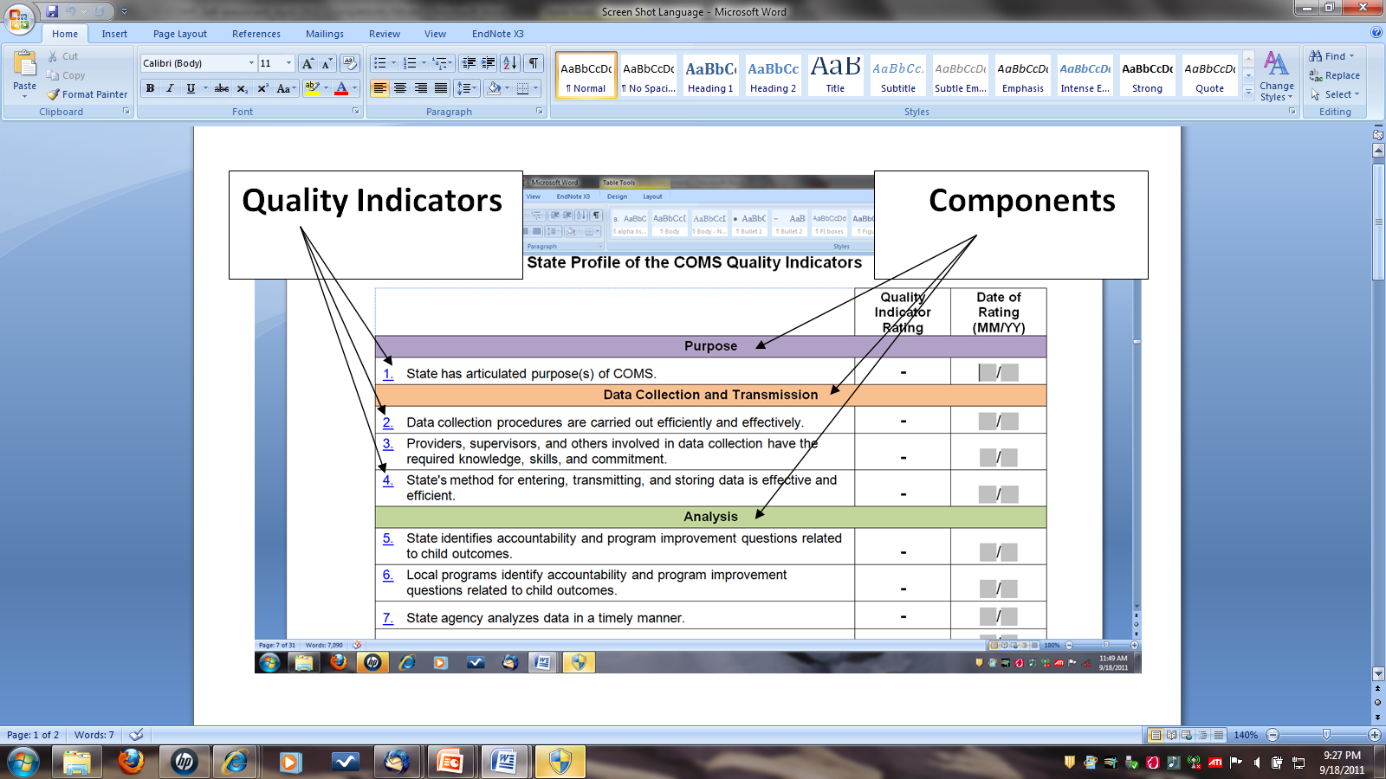
Notes:
Summary sheet

Slide 7
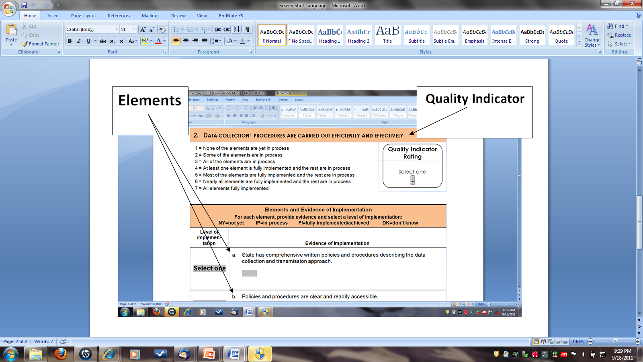

Slide 8
Features
Online interactive version is on the web http://www.fpg.unc.edu/~eco/pages/frame_dev.cfm
State profile page compiles overall scores
Space for notes about status on each element
Future plans to link elements to resources, state examples, and any clarifying information or definitions
Notes:
In the future watch for back-up – click on element with additional resources about state examples and information about the element

Slide 9
Use
States should determine the best use and process
Flexible
Notes:
States should determine the best use and process.
There is no right or wrong way to complete it. We have recommendations and suggestions around scoring, focus is on using the content to improve your systems… variety of ways you can do that.

Slide 10

Suggested Use
Group of knowledgeable stakeholders
Part of an ongoing strategic planning process
Reassess periodically
May be completed in total or in sections

Slide 11

Questions??

Slide 12
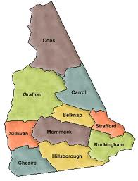
State Example

Slide 13
Small Group Activity 1
Individually, read over quality indicators under your group’s component.
As a group, select one of those quality indicators
Each individual reviews an assigned element & considers how his/her state is doing, with examples
As a group, each person is to describe how they see their state on their assigned element with others at the table acting as stakeholders.
Based on the discussion, select a rating and record the evidence for each element.

Slide 14
Activity 1 Reflection and Sharing
What did you think of the process of reviewing each element?
Did the process make sense? What was difficult?
Are these elements for which you would want stakeholder involvement? For which you would need multiple perspectives?
Notes:
In discussions did you find all stakeholders in the state would make the same appraisal ? What kinds of dialogue might occur within the state when thinking about this element?

Slide 15
Small Group Activity 2
How do you think the self-assessment might be useful in your state? With what process?
Who might you involve at different steps with the self-assessment?
Identify resources that would be helpful to benefit the most from the self-assessment process.
How would you begin to move from findings on the self-assessment to deciding on specific actions to improve your outcomes measurement system?

Slide 16

Getting Started
Jump in!
Use the self-assessment to help you improve your child outcomes measurement system!
Use the ECO Center as a resource for support
staff@the-eco-center.org

