Slide 1
Weighing the Pig DIDN’T Make it Fatter
Lessons Learned from a Decade Invested in Building a PD System
Lisa Backer | Early Learning Supervisor
Improving data! Improving outcomes! August, 2018

Slide 2
Today’s Focus: Using data analysis to check on the quality of your data [and your program]
Remember this is only weighing the pig
(not to be confused with putting lipstick on the pig!)
Weighing the pig does not make it fatter
Need to take what you learn from the analysis and do something with it.
Notes:
From webinar conducted 2009

Slide 3
Theory of change
Provide high quality professional development
Providers gain and apply knowledge and skills
Children benefit from higher quality programs/practices

Slide 4
Minnesota Embraced the Challenge
System Attributes | FFY 2008 | FFY 2018
Full Time Equivalents devoted to professional development | 0 FTE | 12.5 FTE
Funds invested in statewide professional development and enhancing program quality | $375,000 | $2.77 million
Statewide effort to build foundational quality across Part C/Preschool ECSE programs | On demand/ unfocused | Focused on 12 core components
Evidence-based practices formally supported | 0 | 3 bundles

Slide 5

Lesson 1: Fall in love with your vision, not your plan
All those whose efforts increase the likelihood that young children with and without disabilities and their families experience positive outcomes will have the knowledge, skills, attitude and supports necessary to be effective in their respective roles. [2006 vision statement]
Progress made through a series of short-
-term plans and thoughtful attention to
Identifying the “next right step”.
And we have a long way to go.

Slide 6
Continuous Improvement Cycle
Establish leadership team
Assess needs and priorities
Select strategies/create a plan
Implement the plan, then get better
  Do it and measure implementation
  Study results
  Adjust the approach
  Plan for changes
Reassess needs, priorities and strategies

Slide 7
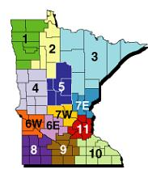
Lesson 2. Build a System
Centers of Excellence (CoE) for Young Children with Disabilities
11.5 FTE Professional Development Facilitator
1.0 FTE MN Dept. of Education dedicated staff
Partnership with University of MN
Focus on foundational quality
3 Innovations (bundles of EBP’s)
Data infrastructure

Slide 8
Roles of the Professional Development Facilitators (PDFs)
Each local program leader has a PDF assigned to them and their program to function as a “Guide on the Side”
  Foundational program quality
  External Coach: Exploration and implementation support for innovation
  Statewide resource development
3 PDFs are also half-time “content leads” to oversee statewide implementation of an innovation (bundled evidence-based practices).
  Convene a State Implementation Team
  Manage statewide trainers and training calendar
  Support all PDFs in their External Coaching role

Slide 9
Lesson 3: Focus the Efforts of your System:
Basic Quality
Support to local leaders from assigned PDF to build foundational program quality along 12 core components (INSPIRE ACTION)
Identification
Natural/Least restrictive environments
Services are coordinated
Partnerships with families
Intentional instruction within routines
Responsive interactions and environments
Effective technical and adaptive leadership
Assessment and Curriculum
Collaborative relationships
Transitions
Intensity
ON-going data-driven improvement
  Data collection/reporting
  Data use

Slide 10
Lesson 3: Focus the Efforts of your System:
Evidence-based Practices
System supports 3 bundles of evidence-based practices.
  Pyramid Model*
  Classroom Engagement Model (CEM)
  Family-Guided, Routines-Based Intervention (FGRBI)*
*Selected through a survey of all local program leaders in 2009
Initial focus on practices to be more responsive to cultural & linguistic has been embedded into foundational quality and across all innovations.
CEM added after revision of DEC Recommended Practices

Slide 11
Lesson 4: Implementation REALLY Matters
The National Implementation Research Network’s Active Implementation Hub
https://implementation.fpg.unc.edu/
ECTA’s Statewide Implementation Guide
http://ectacenter.org/sig/

Slide 12
Active Implementation Frameworks
Interventions
The What
The effective strategies and approaches that will improve outcomes
The How
Stage-related work necessary for successful change
Implementation infrastructure to support effective quality improvement strategies
Improvement cycles that efficiently solve problems and improve the state and local systems over time
The Who
The roles and responsibilities of state and regional implementation teams in supporting the change process
Stages
Drivers
Cycles
Teams
©Copyright Dean Fixsen and Karen Blase
Notes:
©Copyright Dean Fixsen and Karen Blase. This content is licensed under Creative Commons license CC BY-NC-ND, Attribution-NonCommercial-NoDerivs. You are free to share, copy, distribute and transmit the work under the following conditions: Attribution — You must attribute the work in the manner specified by the author or licensor (but not in any way that suggests that they endorse you or your use of the work); Noncommercial — You may not use this work for commercial purposes; No Derivative Works — You may not alter, transform, or build upon this work. Any of the above conditions can be waived if you get permission from the copyright holder. http://creativecommons.org/licenses/by-nc-nd/3.0
The value of frameworks is
To promote the ability to generalize beyond the immediate project or initiative
To enhance communication among partners (e.g. better understanding of one another)
To more easily share and apply improvements
To increase the relevance of the “lessons learned”
We want to move from “making lists”. . .
. . .to “making sense”

Slide 13
Implementation Stages
Exploration
Installation
Initial Implementation
Full Implementation
Sustainability
Implementation is “a specified set of activities designed to put into practice an activity or program of known dimensions.” These activities occur over time in stages that overlap and that are revisited as necessary dimensions. (AI Hub)
Stages are not always linear and are revisited as necessary

Slide 14
Stages Defined/Stage Matched Activities
During…
…Exploration: team examines the degree to which a program or innovation meets the programs needs and whether implementation is feasible.
…Installation: team conducts activities and makes changes within program to create state of readiness including training of staff.
…Initial Implementation: practices are put into use for the first time. Coaching, communication and improvement cycles are critical.
…Full Implementation: teachers/providers demonstrate competence with practices. The program systematically supports the new way of work.

Slide 15
Sustainability: An active component of every stage
Financial sustainability: ensuring that the funding streams for implementation are established, adequate and sustainable. This means funding for teacher, staff, and administrative time.
Programmatic sustainability: ensuring that the implementation infrastructure is established, reliable, effective, and sustainable. The infrastructure includes plans and activities for:
  Continuing to train, coach, measure fidelity of practice and implementation, and making data-driven decisions for continuous improvement and problem-solving
  Ensuring that policies and procedures continue to support and facilitate full implementation

Slide 16
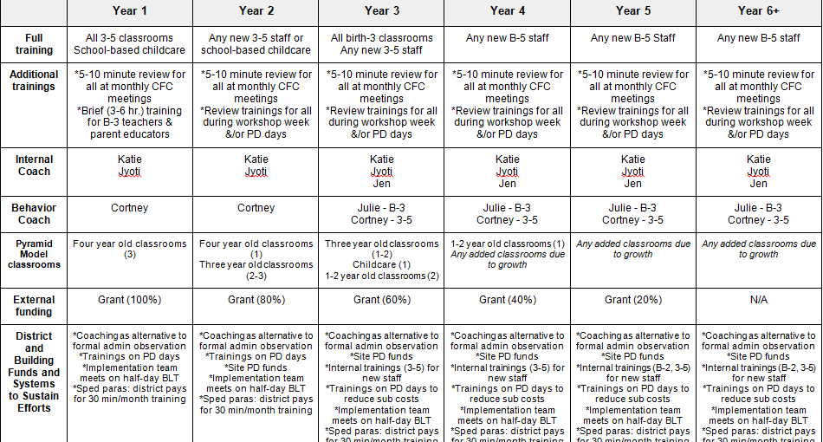
Local Scale Up & Sustainability Plan
Notes:
Hope

Slide 17
Active Implementation Drivers
Improved Outcomes
Consistent Uses of Practices
Performance Assessment
(fidelity)
Coaching
Systems
Intervention
Competency Drivers
Facilitative
Administration
Training
Organization Drivers
Integrated & Compensatory
Integrated & Compensatory
Selection
Decision Support
Data System
Leadership Drivers
Notes:
17

Slide 18
Practice-Based Coaching (PBC) Launched in 2014
PBC is a cyclical process for supporting use of effective practices.
Components:
planning goals and action steps,
engaging in focused observation, and
reflecting on and sharing feedback about teaching practices.
Notes:
Lisa

Slide 19
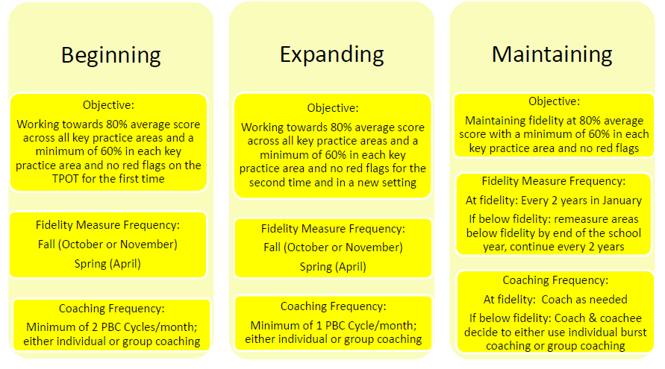
Measured Practitioner Fidelity Linked to PBC Cycle
Notes:
Hope

Slide 20
Linked Teams
Centers of Excellence State Leadership Team
 | Pyramid Model State Implementation Team |  |  |  | FGRBI State Implementation Team |  |  |  | CEM State Implementation Team
Local Teams
Communication
TEAM
TEAM
TEAM
TEAM
TEAM
TEAM
TEAM
TEAM
TEAM
TEAM
TEAM
TEAM

Slide 21
Local Implementation Team Membership
Pyramid Model Local Implementation Team Members meet monthly
Administrators from ECSE & Inclusion Partner
Behavior Coach
Data Manager
Internal Coach (1-2)
Teacher Representative (1-2)
Professional Development Facilitator (PDF)

Slide 22

Lesson 5: Attend to the Professional Development of Each Role in your System
PDFs
  Cognitive Coaching
  Active Implementation
  Data Use
Trainers
  Evidence-Based Practices
  Principles of Adult Learning

Slide 23
Training of Local Team Members-Plan for Efficiency
Local implementation team
  Practices
  Program-wide adoption*
  Sustainability*
  Data Tools
  Look! Think! Act!
Members of teaching teams
  Practices
  Data Tools
Internal Coaches
  Practices
  Practice-based Coaching*
  Data Tools including fidelity measure
Local Data Manager
  Data Tools*

Slide 24
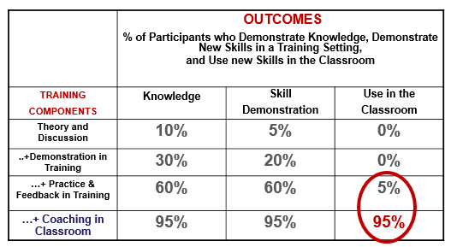
Lesson 6: Train Programs, Not Providers
Source: Joyce, B., & Showers, B. (2002). Student achievement through staff development (3rd ed.). Alexandria, VA: Association for Supervision and Curriculum Development.

Slide 25
Lesson 7: Program-Wide Adoption Takes Time and Money
Implementation Year | Local Investment | State Investment
1 | 0 | 100%
2 | 20% | 80%
3 | 40% | 60%
4 | 60% | 40%
5 | 80% | 20%
6+ | 100% | 0
Year 1 funding is a $12,000 base plus $50 for each infant and toddler or $100 for each child 3-5 on annual count

Slide 26
Lesson 8: Build Your Data and PD Systems Simultaneously
Identify the questions you want your data system to answer
Consider how data can be integrated across data collection tools and systems to answer your critical questions
Know which teems need to act upon the data
Plan for data reporting and use

Slide 27
MN Dept. of Education Data Infrastructure
Student Information System-
  Child demographics
  Federal Setting and Disability Category*
  Dosage—planned and received
Personnel Information System
Minnesota Common Course Catalog
  Attributes of early education (curriculum, assessment, site-based initiatives)
  Level of fidelity attained by teaching team (beginning, expanding or maintaining)
  Links instructional staff to enrolled children

Slide 28
MnCoE Data Infrastructure
Fidelity of Implementation
  State Benchmarks of Quality
  Local Benchmarks of Quality*
Quality and effectiveness of training
  End-of-event survey
  Follow-up survey
Coaching log*
  Coaching model
  Frequency and focus
PDF Time and Effort Log*
Fidelity of Practice*
  Pyramid: TPOT & TPITOS
  FGRBI: SS-OO-PP-RR Key Indicator Observation
  CEM: CEM Checklist
Child Event Tools
  Behavior Incident Report
  Scale for Teacher’s Assessment of Routines Engagement (STARE)
Fiscal Data
Data from tools marked with * are merged into EC Real-time Data Warehouses

Slide 29
Data Integration: Phase I
Connect MnCoE data to MnCoE data
  How much coaching is needed to support a teacher to reach fidelity?
  Are 1:1 coaching and group coaching equally effective?
  Does fidelity of implementation as measured by the Benchmarks of Quality increase fidelity of practice?
  Does PDF effort predict fidelity of implementation?

Slide 30
Data Integration: Phase I (cont.)
Connect MDE data to MDE data
  Does intensity of intervention services or time in a regular early childhood setting correlate with higher child and family outcomes?
  Does intervention environment or preschool instructional setting influence outcomes?
  To what extent is the use of a particular curriculum or assessment tool correlated with better child outcomes?

Slide 31
Data Integration Phase II:
Connecting MnCoE and MDE Data
Do children benefit more when teachers/providers demonstrate fidelity of practice?
OSEP Child Outcomes?
Mastery of Minnesota Early Learning Standards (ECIPS)?
Reduction in referrals to special education in kindergarten?
Reading well by 3rd grade?
Higher graduation rates?
Post school outcomes?
Notes:
Lisa

Slide 32
Lesson 9: Identify and Reallocate Underperforming Funds
Prior to 2011 Minnesota had 94 Interagency Early Intervention Committees (IEICs) responsible for public awareness and outreach and family support activities.
Each IEIC received share of 80% of Minnesota’s annual Part C allocation.
MDE retained 20% for state level activities including general supervision, professional development and technical support.
Interest-based process used to determine:
  How many IEICs should operate within the state
  What percent of the annual allocation was needed by IEICs to meet their statutory obligations?

Slide 33
Result of interest-based restructuring
 | 2011 | 2012 and ongoing
Interagency Early Intervention Committees: | 94 local | 13 regional
Part C funds allocated to IEICs: | 80% | 10%
Part C funds devoted to EI services: | 0% | 60%
Dedicated to professional development | 0% | 10%
Used by MDE for state level activities | 20% | 20%

Slide 34
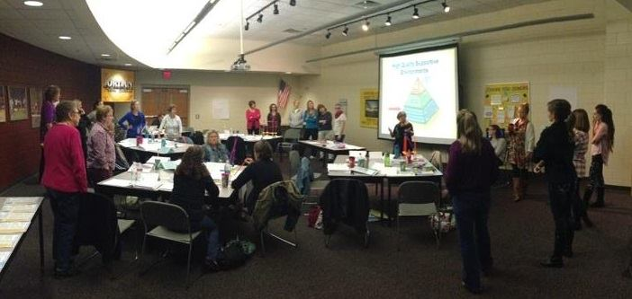
Lesson 9: Make Celebration an Annual Tradition

Slide 35
Lesson 10: Apply to Benefit from Intensive TA Opportunities
2006: National Professional Development Center on Inclusion (NPDCI)
2009: Technical Assistance Center for Social Emotional Interventions (TACSEI)
2009: Contracted to work with Juliann Woods on FGRBI
2012: National Implementation Research Network (NIRN)
2014: Center on Enhancing Early Learning Outcomes (CEELO)
2015: ECTA/DEC Recommended Practices
2016: DaSY-Powerful Data Cohort
2017: Early Childhood Personnel Center (ECPC)

Slide 36
Implementation and Scale-Up of the Pyramid Model
Notes:
Lise

Slide 37


Developed By
Faculty associated with

Slide 38

What We Built

Slide 39
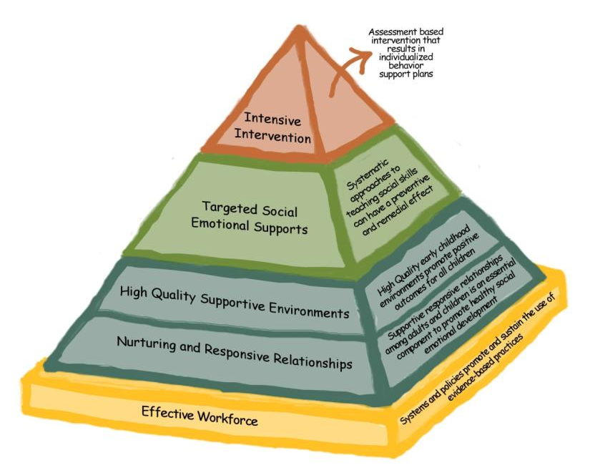
Pyramid Model
Tertiary
Intervention
Few
Secondary
Prevention
Some
Universal
Promotion
All
Notes:
Lise

Slide 40
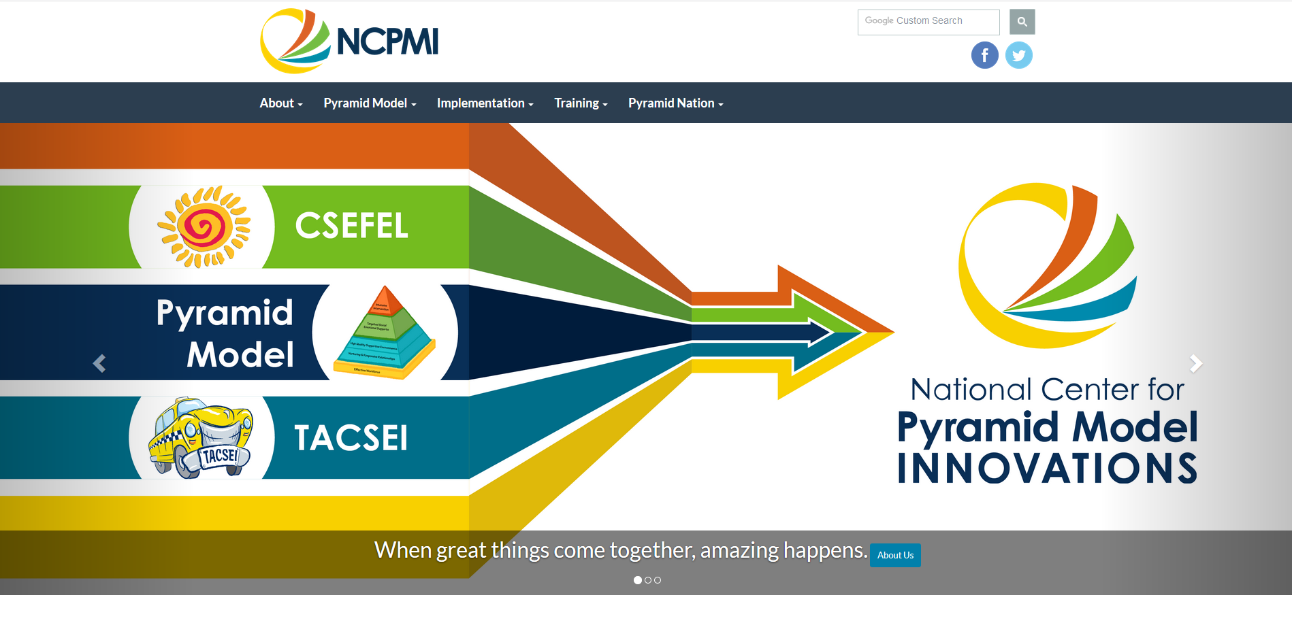
ChallengingBehavior.org
Notes:
Lise

Slide 41
Critical Issues
Inappropriate discipline practices
Segregation from inclusive programs
Lack of capacity within programs and states
Effective behavior interventions
Competence and confidence
Notes:
NCPMI is focused on addressing the following issues that challenge early childhood programs, services, professionals and families:
The use of inappropriate discipline practices including preschool suspension, expulsion, and corporal punishment and issues of implicit bias;
The need for effective behavior interventions that are focused on the promotion of young children’s positive social, emotional, and behavioral outcomes;
The importance of enhancing the competence and confidence of professionals and family members to teach social and emotional skills to young children;
The segregation of young children with behavior challenges from inclusive early education programs; and
The lack of capacity within programs and states to provide implementation supports for the use of evidence-based practices that promote the social and emotional competence of all children in a manner that is culturally responsive and values equity.

Slide 42
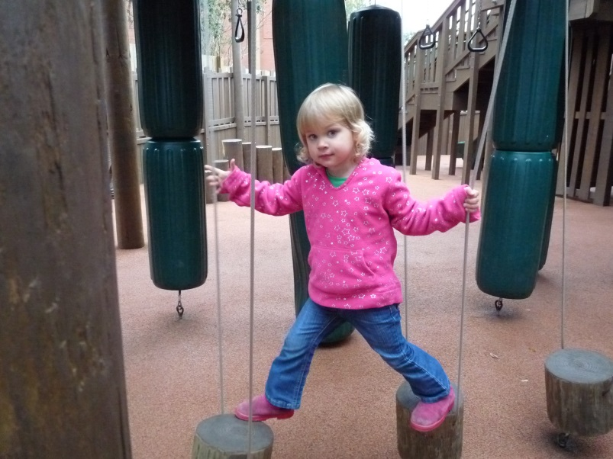
Systems Model for Implementation and Scale-Up
Incorporates best practice from:
  Systems Thinking
  Implementation Science
  Cross-Agency Collaborative Planning
Notes:
Lise

Slide 43
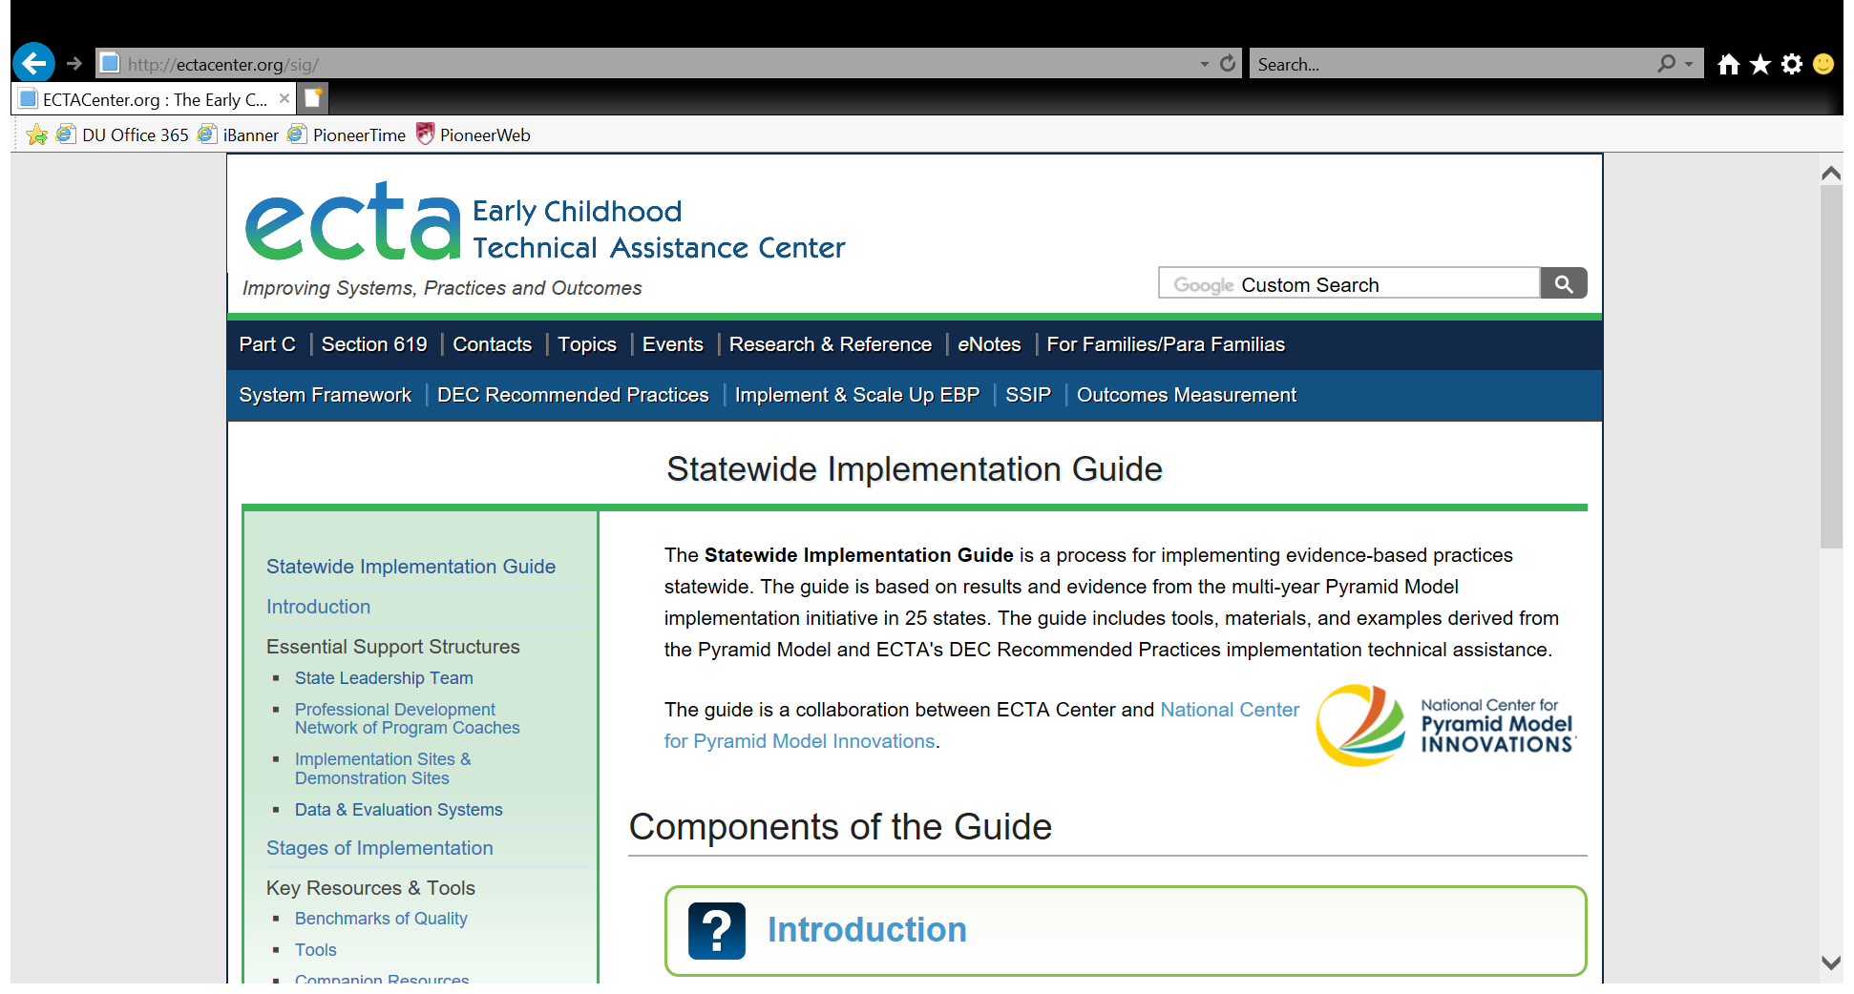
ECTA Statewide Implementation Guide

Slide 44
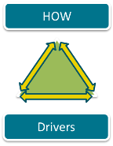
Implementation Drivers
Competency Drivers – coaching, training, fidelity
Organizational Drivers- data systems, administrative support, systems intervention
Leadership Drivers – technical and adaptive responding
Notes:
Lise

Slide 45
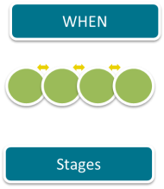
Stages of Implementation
Exploration
Installation
Initial Implementation
Full Implementation
Innovation, Sustainability, Scale-up
2 – 4 Years
Fixsen, Naoom, Blase, Friedman, & Wallace, 2005
Notes:
Lise

Slide 46
Pyramid Model Approach: Building State Capacity to Provide What Programs Need
State Leadership Team to plan and implement a sustainable, cross-agency, state infrastructure; develops sustainability and scale-up plans (Benchmarks of Quality)
A Master Cadre of External Coaches that support high fidelity use of Pyramid Model in programs
Implementation and Demonstration Sites with Leadership Teams and internal coaches; demo sites to demonstrate effectiveness and to model for others
Data/Evaluation and data feed-back systems for: data-based decision making at all levels for PD, ensuring fidelity, demonstrating effectiveness, planning, implementing and tracking systems change and making system recommendations
Notes:
Lise

Slide 47
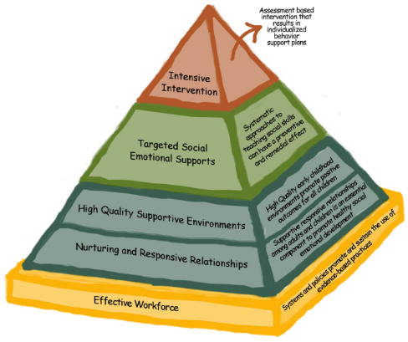
Components of Program-Wide Approach
Leadership Team
Staff Buy-In
Program-Wide Expectations
Procedures for Responding to Challenging Behavior
Continuous Professional Development and Classroom Coaching
Data Decision-Making Examining Implementation and Outcomes
Family Engagement

Slide 48
State Training &
Technical Assistance Opportunities
Pyramid Model Implementation Innovations and Systems Building
State Pyramid Model Planning, Readiness and Early Implementation Activities
Application available
October 2018.
Application available July 2018.
Intensive TA: Implementation of the Pyramid Model within
Part C Home Visiting
Intensive TA: Statewide Implementation and Scale-Up of the
Pyramid Model
Application available
August 2018.
Application available
October 2018.
Questions? Contact Lise Fox at lisefox@usf.edu

Slide 49
Thank You

