Slide 1
Teaming and Collaboration: Making the Child Outcomes Summary Process Reflect our Priorities
2018 Improving Data, Improving Outcomes Conference
Arlington, VA
August 2018

Slide 2
Agenda
Introductions
Illinois Background
Changing Infrastructure
Preparing the Field
Evaluating Impact

Slide 3
Illinois Background
Annual Early Intervention Training Program Needs Assessment
Initial work with Technical Assistance centers and stakeholders

Slide 4
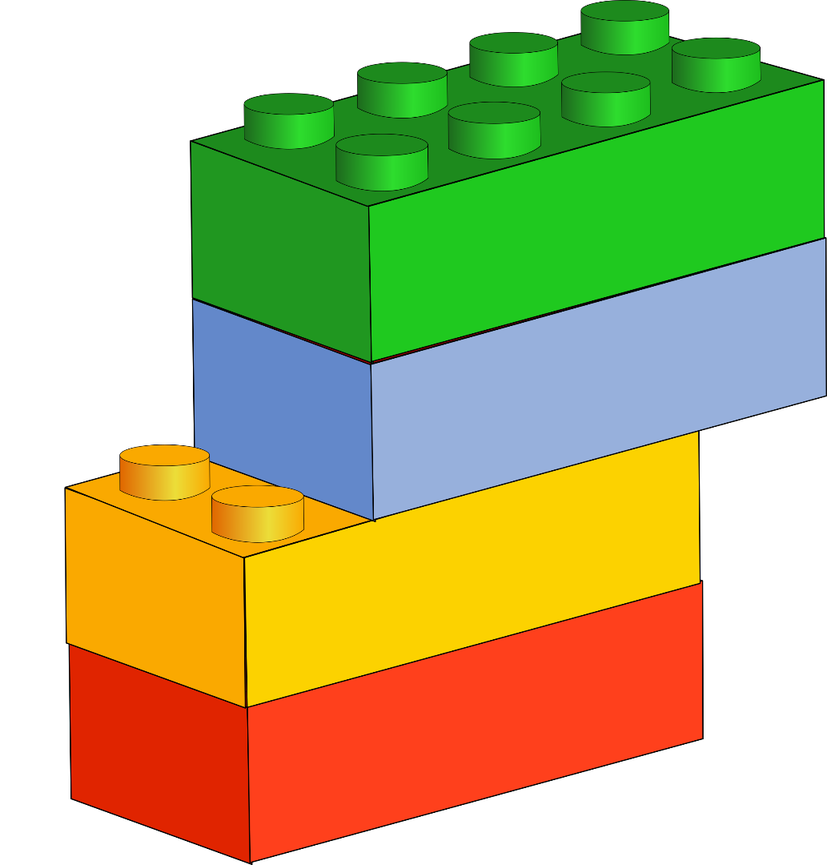
Changing Infrastructure

Slide 5
Illinois Theory of Action for Part C Early Intervention (EI)
Focused and consistent policies, procedures, manuals and forms
External and Internal Knowledge of Family-Centered Practices
Provider Training & Technical Assistance (TA)

Slide 6
Illinois Theory of Action for Part C Early Intervention (EI)
Focused and consistent policies, procedures, manuals and forms
External and Internal Knowledge of Family-Centered Practices
Provider Training & Technical Assistance (TA)
IF
…The Lead Agency ensures policies, procedures, manuals and forms reflect family centered practices and desired practices for data collection and use
…Providers receive training on EBPs (family capacity building & engagement), Child Outcome process and Infant/Toddler (I/T) Development
…Referral sources and EI stakeholders understand the role of families in early intervention processes

Slide 7
Illinois Theory of Action for Part C Early Intervention (EI)
Focused and consistent policies, procedures, manuals and forms
External and Internal Knowledge of Family-Centered Practices
Provider Training & Technical Assistance (TA)
THEN
…CFCs and providers will have materials to support the practices they learned through training and TA and will use available data to guide decision-making when engaging families in EI processes
…Providers will increase their knowledge about best practices in early intervention to increase I/T acquisition of skills and to support families in day to day activities that enhance child skills
…Families will increase their ability to make informed decisions related to their children and increase their capacity to support their children’s development

Slide 8
Illinois Theory of Action for Part C Early Intervention (EI)
Focused and consistent policies, procedures, manuals and forms
External and Internal Knowledge of Family-Centered Practices
Provider Training & Technical Assistance (TA)
THEN
…CFCs & providers will be more responsive to the child and family’s evolving strengths and needs
…Providers will use EBPs to support families in promoting the development of I/Ts receiving EI services
…Families will increase their use of daily activities to support their I/Ts development

Slide 9
Illinois Theory of Action for Part C Early Intervention (EI)
Focused and consistent policies, procedures, manuals and forms
External and Internal Knowledge of Family-Centered Practices
Provider Training & Technical Assistance (TA)
THEN
Infants and toddlers will demonstrate a greater acquisition and use of knowledge and skills

Slide 10
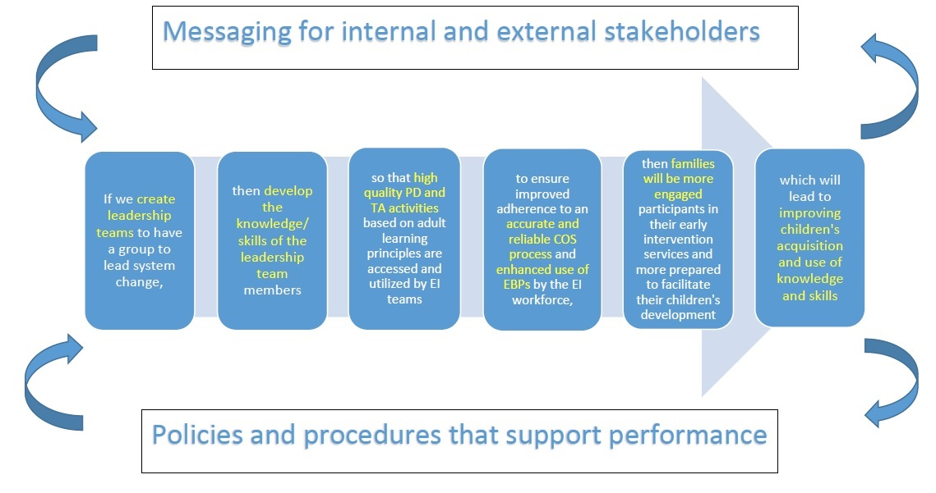

Slide 11
Leadership Teams
Preparation
Membership

Slide 12
SSIP Workgroups
Leadership Teams
Messaging
Performance Support
Professional Development/ Technical Assistance

Slide 13
Leadership Teams Workgroup
Survey
Kickoff
Benchmarks of Quality
Action Plans
State Supports
Capacity Building

Slide 14
Messaging
Family Documents
EI Brochure
Messaging Checklist

Slide 15
Performance Support
Policy and Procedure
Appendix
Family Materials Feedback
Data System Revision
Fidelity Checklist
Fidelity Process

Slide 16
Professional Development/ Technical Assistance
Rubric
Resource Package

Slide 17
Policy and Procedure Development
Opportunity to outline what we wanted to see
Teaming
Family Engagement
Focus on evidence-based/informed resources
Aligned with Child Outcomes Summary Team Collaboration

Slide 18
Professional Development
DaSy modules as prerequisites
Regional differences in initial outreach to providers

Slide 19
Preparing the Field
Leadership Teams training
Policy/procedure
Provider handbook
Leadership Team events
Focused conversations/reflections
Resource packages
Leadership Team page

Slide 20
Evaluating Impact
Preparing teams to use data
Quarterly event data
Fidelity- regional differences, initial results

Slide 21
Questions

Slide 22
THANK YOU!!
Shameka Brown luvteach5@gmail.com
Ann Freiburg ann.freiburg@Illinois.gov
Chelsea Guillen cguillen@Illinois.edu
Maria Kastanis mkastani@Illinois.edu

