Slide 1



Supporting Emerging Family Leaders

Slide 2


To log into Poll Everywhere
    Text number: 37607
Text message: ECPCTA233
Tablet or Laptop:
PollEv.com/ecpcta233
This Photo by Unknown Author is licensed under CC BY-NC-SA

Slide 3

Today’s Presenters/Facilitators
Darla Gundler
Federation for Children with Special Needs/Early Childhood Personnel Center(ECPC)
gundler@uchc.edu
Judy Swett
Early Childhood Technical Assistance Center(ECTA)/PACER Center
jswett@pacer.org
Stephanie Moss
Early Childhood Technical Assistance Center(ECTA)/Parent to Parent of Georgia/Region 3 Parent Technical Assistance Center
stephanie@p2pga.org
Sherry Franklin
Early Childhood Technical Assistance Center(ECTA)/The Center for IDEA Early Childhood Data Systems (DaSy)
sherry.franklin@unc.edu

Slide 4
Workshop Purpose
Family leaders can be crucial in developing and implementing policies, procedures, and practices that meet the needs of the children and families served by EI and ECSE programs. It is important to provide appropriate supports so that family members feel prepared and confident to take on leadership roles.

Slide 5
Workshop Outcomes
Presenters will support participants to:
  Explore approaches for effectively supporting family leaders and;
  Describe collaborative work they are doing to build family leadership development programs in States

Slide 6
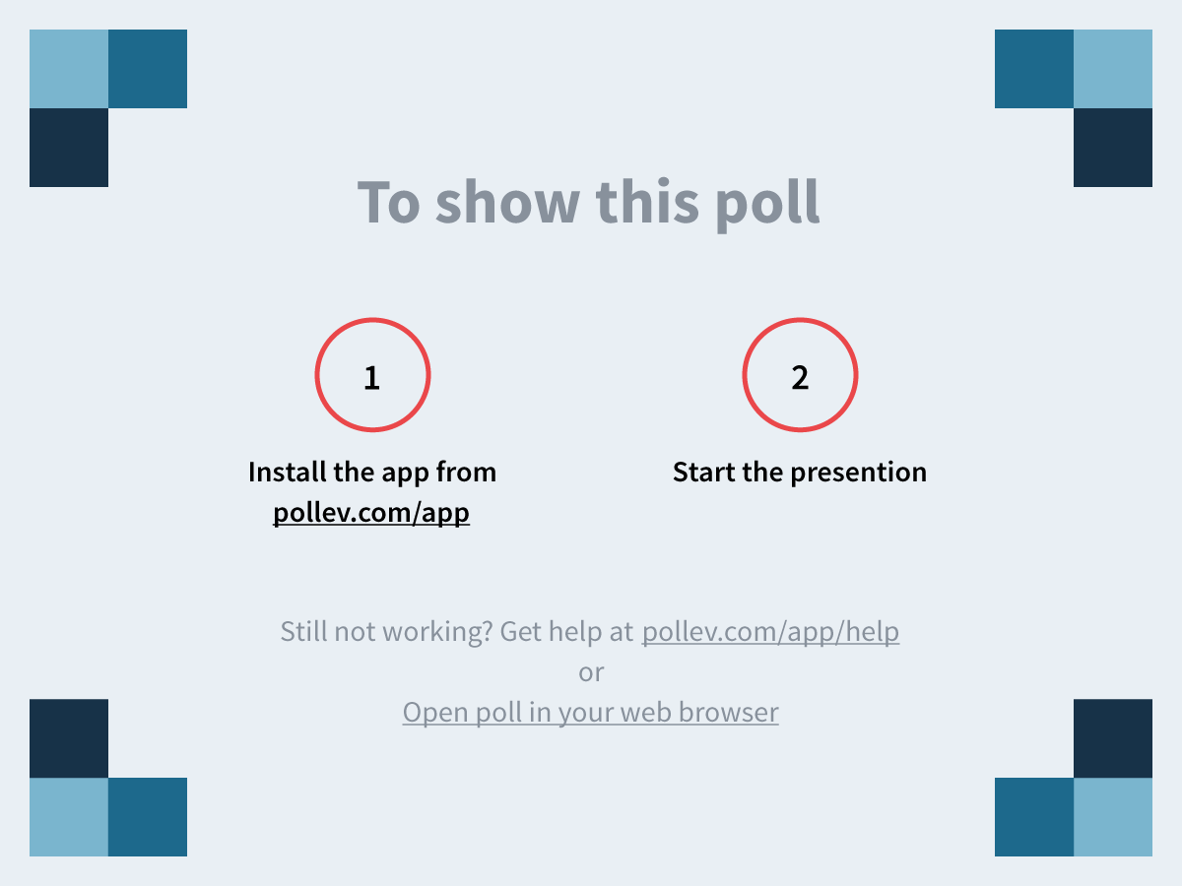

Slide 8
From Family Participation to Family Involvement to Family Engagement…What’s the Difference?
In the 1990’s, we called it family participation. Families participated as members of IFSP teams and served on program advisory councils/boards, e.g., State Interagency Coordinating Councils (SICCs).
In the 2000’s, we called it family involvement. “Principles of Family Involvement” was published by the Federal Interagency Coordinating Council (FICC).
In 2016, we started calling it family engagement. The U.S. Department of Health & Human Services & U.S Department of Education published their joint “Policy Statement on Family Engagement from the Early years to the Early Grades.”
Moving from individual child/family advocacy to systems level advocacy.

Slide 9
U.S. Department of Health and Human Services and U.S Department of Education (2016)
Policy Statement on Family Engagement from the Early Years to the Early Grades
Highlights from The Executive Summary: Research and Best Practice
Families have strong and sustained effects on children’s learning, development, and wellness.
Family activities such as reading and talking to young children lead to positive outcomes.
Promoting enriching learning activities in the classroom and in the home contributes to children’s learning and development.
Family well-being is a strong predictor of children’s school readiness, and promoting families’ strengths and resilience through comprehensive services and promising practices such as two- generation approaches support young children.
Strong, positive relationships between families and providers reinforce learning at home and in the community and are enabled by two-way communication and cultural and linguistic responsiveness.
Parents who have more supportive and extensive social networks create more stimulating home environments for their children, communicate better with their children, and feel more confident in their role as parents

Slide 10

Family Engagement
Family engagement refers to the systematic inclusion of families in activities and programs that promote children’s development, learning, and wellness, including in the planning, development, and evaluation of such activities, programs, and systems.

Slide 11
Families as Leaders & Advocates
Expressing viewpoints
Thinking creatively “outside of the box”
Working toward win-win solutions
Advocating for children, families, practitioners, and systems

Slide 12
Families as Leaders & Advocates (cont.)
Taking advantage of resources from Parent Training and Information Centers
Participating in advocacy and leadership training
Mentoring other families and being mentored by families in advocacy activities
Informing other families about program and community advocacy events and encouraging them to consider participating

Slide 13
Beliefs About Leadership
Leaders are not born – they rise out of a person’s passion for how they want the world to be.
Leadership isn’t a gift – it’s accessible to anyone who wants it.
Leadership isn’t a calling – it’s a matter of listening to a question and trying to come up with an answer.
A leader is anyone who has a very big and compelling story of how it could all turn out.
Source: Serving on Groups That Make Decisions

Slide 14
Shared Decision-Making
“Decision-making means a process of partnering, of shared views and actions toward shared goals…not just a power struggle between conflicting ideas.”
- Dr. Joyce Epstein
Source: Serving on Groups That Make Decisions

Slide 15
Benefits to Shared Decision-Making
For Families
For Professionals
Awareness and input on policies
A feeling on ownership
Shared experiences and connections with professionals and other families
Awareness of family perspectives
Increased confidence and ability to partner with families
Acceptance of family representatives in leadership roles
Source: Serving on Groups That Make Decisions

Slide 16
Policies and Frameworks

Slide 17
Federal Laws that Emphasize the Importance of Family Engagement
Head Start Act
Child Care Development Block grant (CCDBG )
Maternal, Infant and Child Health Home Visiting Program
Public Health, Title V
Individuals with Disabilities Education Act (IDEA)
Every Student Succeeds Act (ESSA)

Slide 18
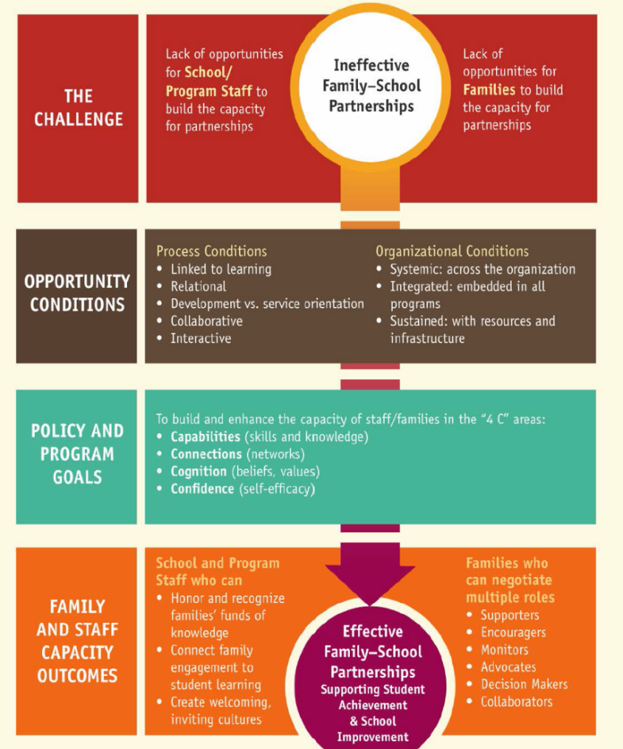
U.S. Department of Education’s Dual Capacity-Building Framework for Family-School Partnerships
Partnering with families in multiple roles:
Supporters
Encouragers
Monitors
Advocates
Decision Makers
Collaborators

Slide 19

U.S. Dept. of Health & Human Services/Dept. of Education
Policy Statement on Family Engagement in the Early Grades
Provides recommendations to early childhood systems and programs on family engagement.

Slide 20
U.S. Office of Special Education Programs (OSEP)
Parent Training and Information Center Priorities
Working with families of infants, toddlers, children, and youth with disabilities, birth to 26
Helping parents participate effectively in their children’s education and development
Partnering with professionals and policy makers to improve outcomes for all children with disabilities

Slide 21
Families and High-Quality IDEA Early Childhood Systems

Slide 22

High-Quality IDEA Early Childhood Systems
Family engagement cuts across all components of high-quality systems.
Governance
Result
Quality
Standards
Finance
Building
High-Quality
Systems
Implementation
of
Effective Practices
Good outcomes for children with disabilities and their families
Accountability & Quality Improvement
Personnel / Workforce
Data
System
ectacenter.org/sysframe

Slide 23
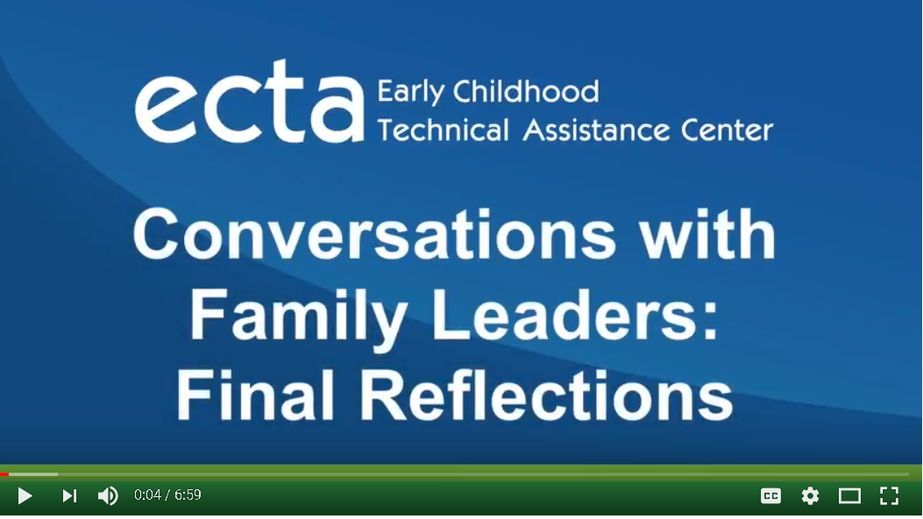

Slide 24


Slide 25
What Do Families Need to Serve in Leadership Roles

Slide 26

DEC Recommended Practices: Family Practices
F10. Practitioners inform families about leadership and advocacy skill-building opportunities and encourage those who are interested to participate.

Slide 27
Supporting Families as Leaders
Parents, grandparents, and other family members can become family leaders by gaining the knowledge and skills needed to build positive partnerships with professionals and other families and shape the services received by their child and other children with disabilities.
Family Leadership Project

Slide 28
When do parents become parent leaders?
Parents are more likely to become parent leaders when they…
Feel accepted, encouraged, and supported by other parents and professionals
Are recognized for their successes and contributions
Receive positive feedback and reinforcement
See other parents like themselves taking on leadership roles
Family Leadership Project
http://familieslead.org/index.php/what-family-leader/

Slide 29
Do You Support Parent Leaders?
Do you support parent involvement by empowering parents with the skills and knowledge they need to become more actively engaged in the educational lives of their children?
Do you provide leadership opportunities for ALL parents, especially to the underrepresented, and seek to change parent attitudes toward becoming involved in their child’s school?
Do you create opportunities for parents to become informed, organized, and work actively as a parent advocate for ALL children?
Answering YES to any of these questions means that you are creating a positive environment for family leaders to flourish

Slide 30
Providing Roles for Parent Leaders
Some parents may not see themselves as leaders; therefore, you may need to encourage them to take on a leadership role. A personal invitation let’s the family know that you recognize leadership traits in them
Ask a parent to volunteer taking on a specific role that is compatible with what you know about his/her individual experiences, expertise, or skills.
Establish leadership roles that parent leaders can progress towards and move into.
Provide opportunities to speak publicly, present at conferences, serve on committees or task forces, participate in staff development, and plan special events

Slide 31
Training/Knowledge and Skill Development
  Understanding Leadership
    For example: Defining and understanding family leadership; characteristics of family leaders; discovering your own leadership qualities, passions and interests
  Advocacy Skills
    For example: How to tell your story; public speaking strategies, writing skills for letters, newspaper stories, articles
  Human relations strategies
  Effective team functioning
  Communication skills
Family Leadership Project
http://familieslead.org/index.php/what-family-leader/

Slide 32
Additional Training
Families leaders may need training on such skills as:
  Collaborating with professionals
  Use of a variety of data
  Goal setting, planning, and program evaluation
  Developing an organizational constitution, bylaws, and procedures
  Defining roles for parents and parent leaders
  Understanding and working with people from different cultures and backgrounds
  http://familieslead.org/index.php/what-family-leader

Slide 33
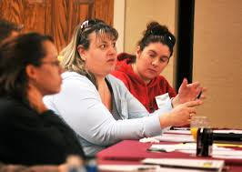
What Do Family Leaders Need?
Encouragement
Coaching
Mentoring
Follow-Up Support
Sources: National Center for Deaf Blindness
http://familieslead.org/
https://nationaldb.org

Slide 34
Examples of Leadership Training
Massachusetts: MASSPac sponsored by the Federation for Children with Special Needs
        Training for parents and professionals serving on Special Education Advisory Councils
Minnesota: PACER Center (Encouraging parents to serve on IEICs, SEACs and the SICC
  Early Childhood Parent Leadership Summit
  Early Childhood Parents as Stakeholders training
Colorado: PEAK
  A parent leadership course for families of children with disabilities to heighten skills to become viable stakeholders and partner with others to improve outcomes and to change systems to become responsive to children’s individual needs
Connecticut: CPAC
  Next STEPS Parent Leadership Training Series

Slide 35
Supports to Help Parent Leaders be Effective
A defined meaningful role
Access to training
Tangible supports such as assistance with child care and transportation and compensation for wages lost from work
Opportunities to work in partnership with staff and professionals in organizations that address key issues related to the Parent Leader’s area of interest and commitment.
Clear opportunities to contribute to program development, implementation, oversight and evaluation, policymaking, training and technical assistance, public awareness and outreach

Slide 36
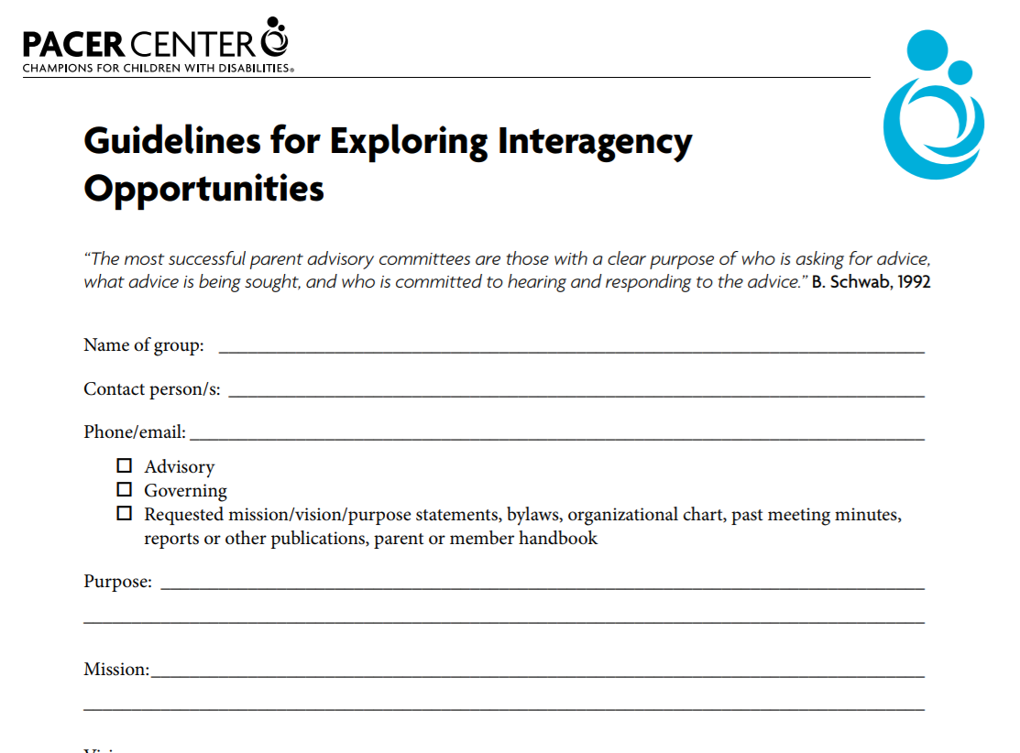
Resource Tool for Parents
A tool for making decisions about what type of group would be the best fit for you.
http://www.pacer.org/parent/php/PHP-c99.pdf

Slide 37
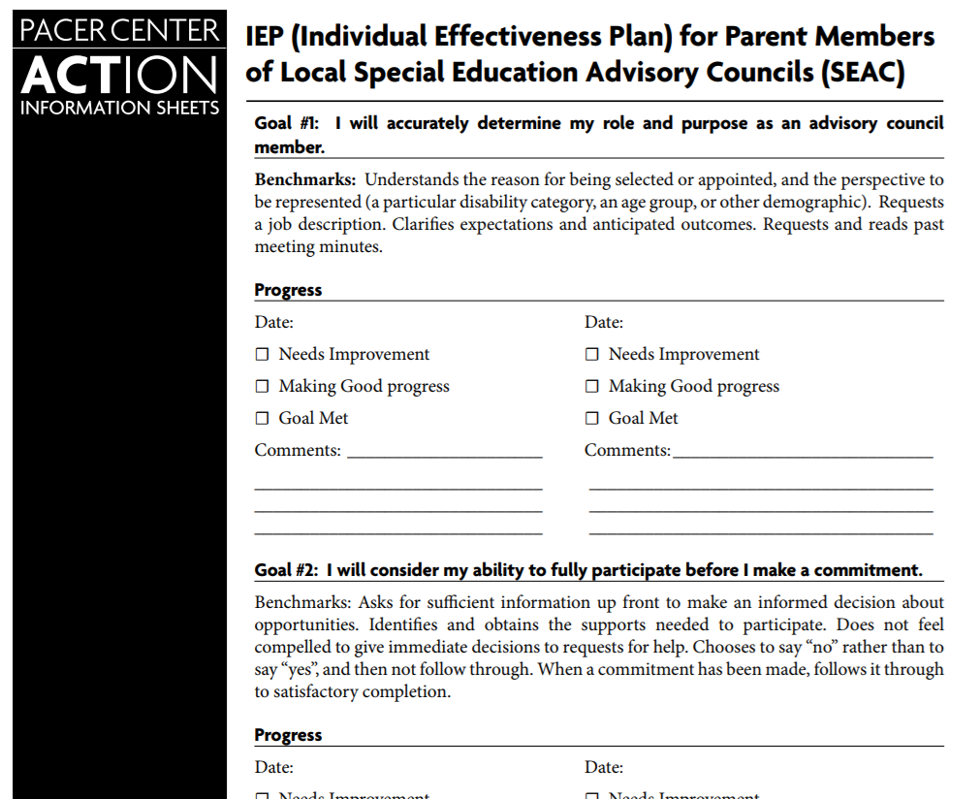
Parent Leadership IEP
Planning for Serving on an Advisory Council
http://www.mnseacinfo.org/leadership/handouts/PHP-c154IEPParent.pdf

Slide 38
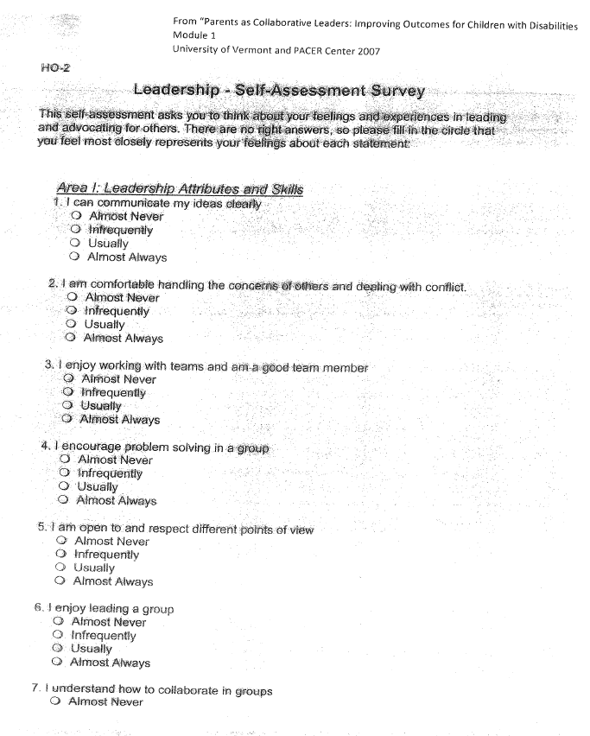
Family Self Assessment Tool
Family Leadership Self-assessment Tool
Taken from Parents as Collaborative Leaders: Improving Outcomes for Children with Disabilities
University of Vermont and PACER Center 2007

Slide 39
Takeaways
Move toward authentic partnerships.
Identify programmatic activities in which families can participate and articulate a clear, intentional clear purpose for their involvement.
Use a variety of methods to Inform families of opportunities to become involved.
Close the loop about decisions.

Slide 40
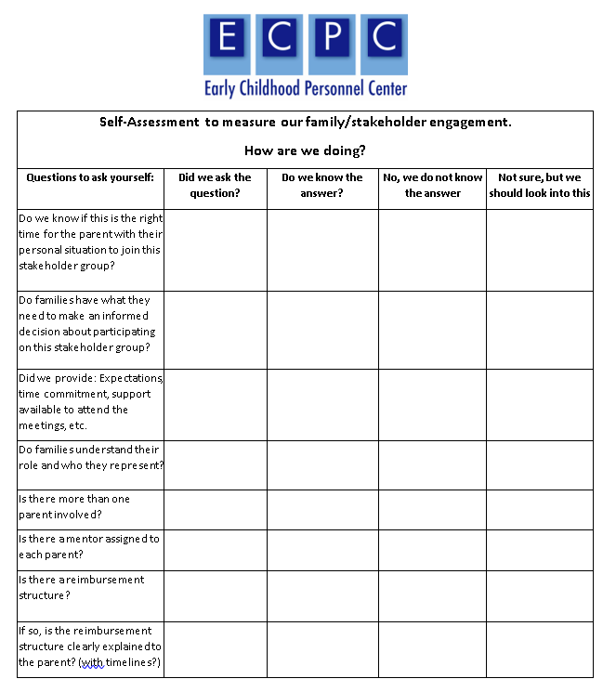
Continuous Improvement
Self-Assessment to Measure Family/Stakeholder Engagement

Slide 41
National Technical Assistance Resources

Slide 42





























No one group can do it alone, so we leverage our resources to partner among national TA centers and organizations.
The Association of University Centers on Disabilities (AUCD)

Slide 43
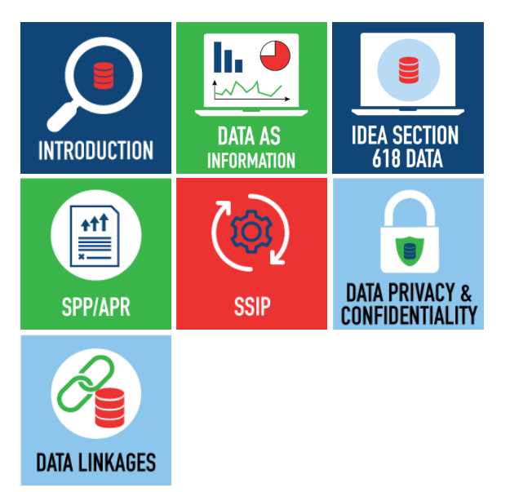

Online Toolkit:
Building Stakeholder Knowledge About Data
This toolkit provides stakeholders with an orientation to IDEA data and other data-related topics to help them meaningfully participate in conversations about important programmatic issues and decisions.

Slide 44
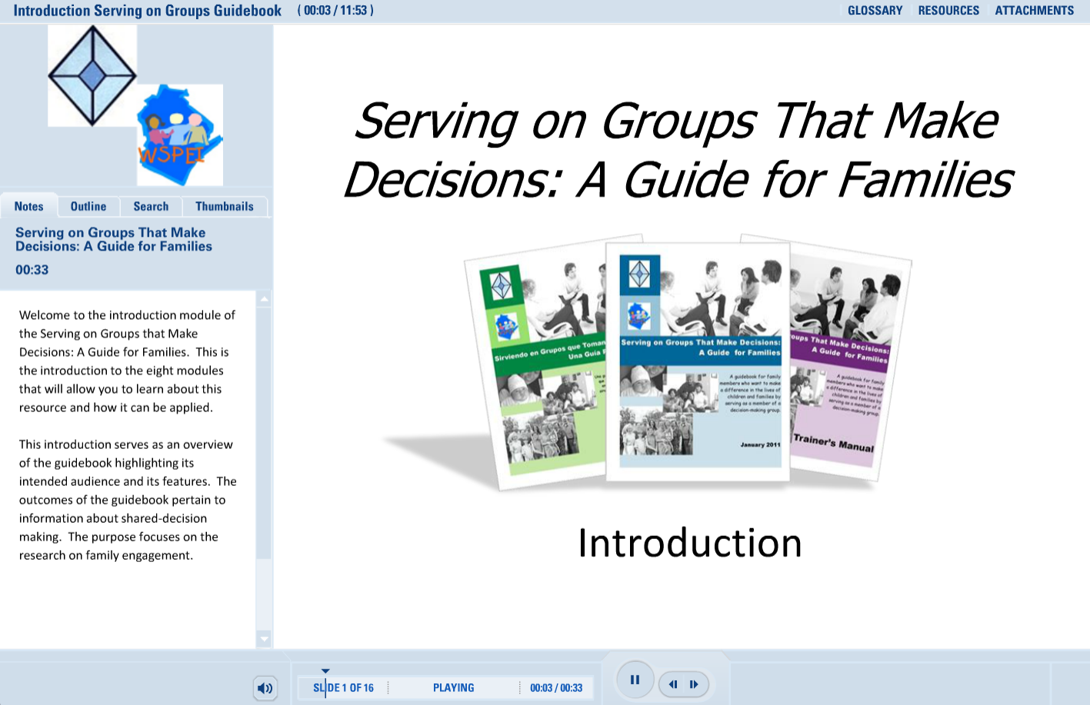

Serving on Groups—Online Module & Book
http://www.servingongroups.org/guidebook

Slide 45

10 Great Things You Will Find on the “CPIR Hub” at parentcenterhub.org
Resources Galore
Buzz from the Hub
Daily Facebook and Twitter Posts
Private Workspaces for Parent Centers
Survey Item Bank
Materials from Other Parent Centers
Buzz from the Hub
Webinars & Webpages on Priority Topics
Central Event Calendars
Who Knows What?

Slide 46




The ECTA Center is a program of the FPG Child Development Institute of the University of North Carolina at Chapel Hill, funded through cooperative agreement number H326P170001 from the Office of Special Education Programs, U.S. Department of Education. Project Officer ,Julia Martin Eile.
The DaSy Center is a program of SRI International, funded through cooperative agreement number H373Z120002 from the Office of Special Education Programs, U.S. Department of Education. Project Officers, Meredith Miceli and Richelle Davis.
The Early Childhood Personnel Center is a project of the A.J. Pappanikou Center for Excellence in Developmental Disabilities at the University of Connecticut Health, funded through cooperative agreement number H325B120004 from the Office of Special Education Programs, U.S. Department of Education. Project Officer, Dawn Ellis
Parent to Parent of Georgia is the Region 3 Parent Technical Assistance Center funded through grant number H328R130008 from the Office of Special Education Programs, US Department of Education. Project Officer, David Emenheiser.

Slide 48
Find Us Online
ECTA Center: http://ectacenter.org
DaSy Center: http://dasycenter.org
ECPC: https://ecpcta.org/
Parent to Parent of Georgia: http://p2pga.org/

Slide 50

Thank You
The contents of this presentation were developed under grants from the U.S. Department of Education (#s H326P170001, H373Z120002, H325B120004, H328R130008). However, those contents do not necessarily represent the policy of the U.S. Department of Education, and you should not assume endorsement by the Federal Government.

