Slide 1
Broadening Impact: Scaling Up and Sustaining SSIP Activities
August 15, 2018

Slide 2
Session Objectives
Learn background information about why it is important to focus on scaling up and sustaining SSIP
Learn about implementation science factors to consider when preparing for scale up
Hear from states that have started the process of scaling up and sustaining their SSIPs

Slide 3

Background
Definitions:
  Scale up: A systematic effort to increase the number of communities and settings using the targeted practices with fidelity within the state so that more children and their families have ready access to effective interventions and supports. (ECTA website)
  Sustainability: The capacity of an innovation, intervention, or program to continue to deliver its intended benefits over a long period of time.

Slide 4

Background (concluded)
For maximum impact on SiMR, need to scale up SSIP interventions
Critical to plan for scale up and sustainability early

Slide 5



What Can Implementation Science Tell Us About Scaling Up?
Lots of research (see resource list)
Implementation stages (NIRN)
  Exploration stage
  Installation stage
  Initial implementation
  Full implementation
Notes:
Resource list will be presented towards end of presentation
Several schema for talking about implementation; we chose to highlight the stages presented by the National Implementation Research Network
They have 4 stages:
Exploration stage
Installation stage
Initial implementation
Full implementation
In coming up with the recommendations for each stage, we pulled information from several sources including Child Trends and Nectac (national early childhood technical assistance center)

Slide 6

Exploration Stage
Create implementation team
Identify and bring together stakeholders
Explore options
Decide on approach
Use data to inform decisions and planning
Determine what resources will be needed
Document plan
Think about scale up and sustainability early!
Notes:
Key activities for the exploration stage

Slide 7
Installation Stage
Acquire/create needed resources (e.g., training materials, fidelity tools, technology, dissemination)
Make infrastructure changes (e.g., policy changes, securing fiscal/human resources)
Prepare staff for change
Initiate training with staff
Use data to inform decisions and planning
Share information with/gather input from stakeholders
Update plan as needed

Slide 8
Initial Implementation
Provide support for staff as they begin to use new skills (e.g., coaching, training, time, managerial support)
Provide support for administrators/leaders
Evaluate progress
Assess fidelity
Continue to use data to inform decisions and planning
Continue to share information with/gather input from stakeholders
Continue to update plan as needed

Slide 9
Full Implementation
Train new staff, administrators, and leaders as turn over occurs
Ensure effective practices are maintained
Continue to evaluate progress
Continue to assess fidelity
Continue to use data to inform decisions and planning
Continue to share information with/gather input from stakeholders
Continue to update plan as needed

Slide 10

Sustainability
Consider sustainability early in process
Share successes
Keep stakeholders aware and involved
Identify and nurture new “champions”
Explore/expand fiscal resources
Provide training for new staff
Provide support for existing staff
Update documentation
Monitor fidelity
Continue to use data to inform decisions and planning
Notes:
Successes, e.g., data on fidelity and results achieved for children and families

Slide 11
Take Aways
Scale up is difficult for many reasons:
  Can’t just work with programs that are ready for change
Focus on scale up and sustainability as early in process as possible
Share successes; address barriers
Data data data – use data for planning and on an ongoing basis
  Track progress
  Identify issues

Slide 12
Take Aways (concluded)
Implementation takes time
Implementation stages aren’t linear – may need to go back to earlier phase
Grow support for implementation early
Planning is key

Slide 13
State Presentations
Three states will share information on their scale up/sustainability:
  Massachusetts
  New York
  South Dakota

Slide 14


Massachusetts Part C
Scaling Up and Sustaining SSIP Activities
August, 2018
Notes:
14

Slide 15
SYSTEM OVERVIEW
40,110 children served in FY’17
$200 Million Annual Budget
  Allocation from State Legislature
  Federal Office of Special ED
  Health Insurance companies
Services are provided by 60 Certified EI Providers throughout the state

Slide 16
Massachusetts Part C: SIMR
Summary Statement 1: the statewide percentage of children showing positive growth in social-emotional skills (including social relationships).
It is Massachusetts’s intent that of those children who enter Early Intervention below age expectations in social-emotional skills, the percent who substantially increase their rate of growth by the time they exit the program will be increased as a result of the state systemic improvement plan (SSIP)

Slide 17
What is the SSIP?
The State Systemic Improvement Plan (SSIP) is a multi-year process to drive innovation in the use of evidence-based practices in the delivery of service to children with disabilities and delays. It is mandated by the US Department of Education to improve outcomes in the State-Identified Measurable Result which, for MA, is positive social-emotional outcomes.
Major SSIP Activities
What to Expect
Expected Outcome
BDI-2 Administration
New training to support fidelity of administration
All EI specialists administer the BDI-2, accurately following the standardized procedures
Online module to support administering the Interview Procedure (coming soon)
BDI-2 fidelity checklist
Embedding the Key Principles Into the IFSP Process
Training completed at ALL programs
All EI specialists will complete functional assessment using clinical skills and develop high quality IFSP outcomes that engage families in EI services
Training will become Day 1 of EI Orientation by EITC
(formerly BAC)
EI services based on evidence-based best practices
New IFSP Document & Toolkit
ICC IFSP task force developed an IFSP document to support the IFSP process
Relevant information from evaluation and assessment activities informs IFSP outcomes development and service delivery plan
IFSP Document approved by ICC and recommended to DPH for use (currently under review at DPH)
Timeline has NOT be determined for implementation: Potentially October 2016
Parents Interacting With Infants (PIWI)
PIWI is comprised of evidenced based practices and is a component of the Pyramid Model
EI specialists will intentionally engage in PIWI strategies in home visits to support families in achieving their IFSP outcomes
Focuses on supporting the parent-child relationship (dyad)
Trainings will be completed in cohorts. 20 programs every 6 months from July 2016-December 2017
Expected High-Level Outcome: improved social-emotional skills (including social relationships) as measured by using BDI-2 raw scores and DQ’s for entry and exit evaluation/ assess for children receiving 6+ months of services.

Slide 18
MA EI SSIP FY18
Are we making progress towards our SiMR?

Slide 19
  Evaluation Plan Summary: how will we know?
Will be combined into one
BDI-2:
Evaluation
IFSP Outcomes Evaluation
IFSP:
Evaluation
PIWI:
Evaluation Cohorts
Programs to submit videos of BDI-2 administration for DPH review. 1 video per site | Randomly selected IFSP outcomes.10 records (no more than 3 outcomes per IFSP) per site | Program staff survey and focus groups. Optional parent survey | Program action plans, PIWI videos, and home visit observations
Round 1 video submissions | Baseline data will be collected from outcomes developed prior to Key Principles training | N/A | Baseline data will be collected through online ‘pre-test’ survey in Pyramid Online Training And Initial PIWI observation data
All programs | All programs | EI Program Staff and Parents | 3 Cohorts, All programs
Present-May 31, 2018 (video submissions due) June-Sept 2018 (evaluation of videos) | Baseline: July-August 2016 Ongoing: Sep-Jun | End pilot in March Evaluate in April | Cohort 1-complete Cohort 2-17 submitted Cohort 3-due June 30, 2018 Additional programs-due Dec. 2018
DPH staff | DPH staff | DPH staff | PIWI Champions
Data
To Be
Collected:
Baseline
Data:
Particip-
ants:
Timing:
Who:
19

Slide 20
  Where are we?
Combined to: IFSP Process
BDI-2:
IFSP Outcomes
IFSP:
PIWI:
FY17 was year 1 (baseline data) FY18 videos are due: May 31, 2018 | IFSP Outcome data was collected for FY18 | The impact of the new Universal IFSP will be analyzed in FY19 | Cohort 3 data is due June 30, 2018
20

Slide 21
What’s next?
Use baseline data to determine supports needed in the system for continued implementation
Evaluate impact of supports/strategies on implementation
Allocate resources and determine General Supervision activities based on evaluation

Slide 22
  BLANK
Intensive Support Activities
Action Items:
Targeted Support Activities
Admin. Resources
Support Activities
Prof. Dev. Resources

Slide 23
  SUPPORT TO PROGRAMS
Intensive Support Activities
Multi-step plans (QI, CAP, TA)
On-site process
Recurrent requests for common training/technical assistance
Need to engage in a higher level of support
Finding through general supervision activities
Issue related to program discovered
Pattern of concern found through data analysis
Targeted Support Activities
Discrete face-to-face support activities at the program site
Pattern of related questions/concerns raised by programs
Admin. Resources
Dropbox
Update
Webinar
EIOS
SDR manual
Support Activities
Call or email DPH staff with questions/concerns
Prof. Dev. Resources
Face-to-face trainings
On-line modules
Communities of Practice
Grab and Go’s

Slide 24
Lessons Learned
Use Data to inform decision making!
Evaluate activities to determine impact on priority areas
Align all activities with priorities
Focus on developing supports that programs can access and use with their staff

Slide 25

Questions?

Slide 26
New York State’s SSIP
Improving Family Centeredness Together (IFaCT)
IDIO Conference
August, 2018

Slide 27
a few things we all know…
Developmental delays can have a long-term impact on the child’s development and the family unit
Part C supports the child and the family, and measures outcome for both
Across the lifespan, family engagement leads to improved child outcomes

Slide 28

How are we doing in NYS?
Based on responses to a survey sent to families from 2008-2013, only 65% of families reported that they received enough help on family outcomes.*
We have room for improvement.
Note: NY uses the NCSEAM Impact on Family Scale with Rasch analysis

Slide 29
Family
Outcomes
AND
A State-level Quality Improvement Advisory Team is established to guide state implementation
Learning collaboratives/communities of practice are formed and use Plan-Do-Study-Act cycles to improve family-centered practices
A baseline-level of family-centered practices is assessed in accordance with State standards and re-assessed periodically,
Evidence-based strategies to improve family-centered services are identified
Providers use family-centered practices in delivering EIP services
Families are engaged as partners and meaningfully involved in promoting their children’s development
then
if
The percent of families who achieve the State standards for achieving positive family outcomes, as measured by the New York State Impact on Family Scale, will increase and State improvement targets will be met.
The quality of Early Intervention Program Services to families improves, by increasing family-centered practices as measured by the Family-Centered Services Scale (FCSS) ….
Theory of Action

Slide 30
How will we improve?
Family-centered services lead to improved family outcomes
Parents who report that their experience was family centered and of high quality are very likely to report positive outcomes
Quality Improvement Science to effect and sustain positive change

Slide 31
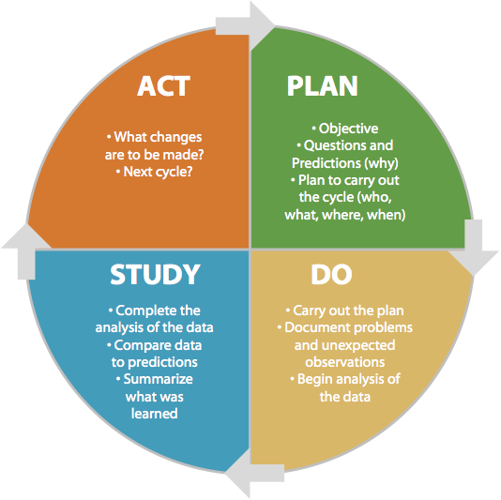
PDSA Cycle
        Abandon: Discard initial idea and make a plan to test a different change
        Adapt: Improve the change and make plan to test with more families and/or in different contexts
        Adopt: Indicate changes for large-scale implementation and make a plan for sustainability of the change
        Requires at least 6 months of action periods, testing different contexts
Notes:
JENNA

Slide 32
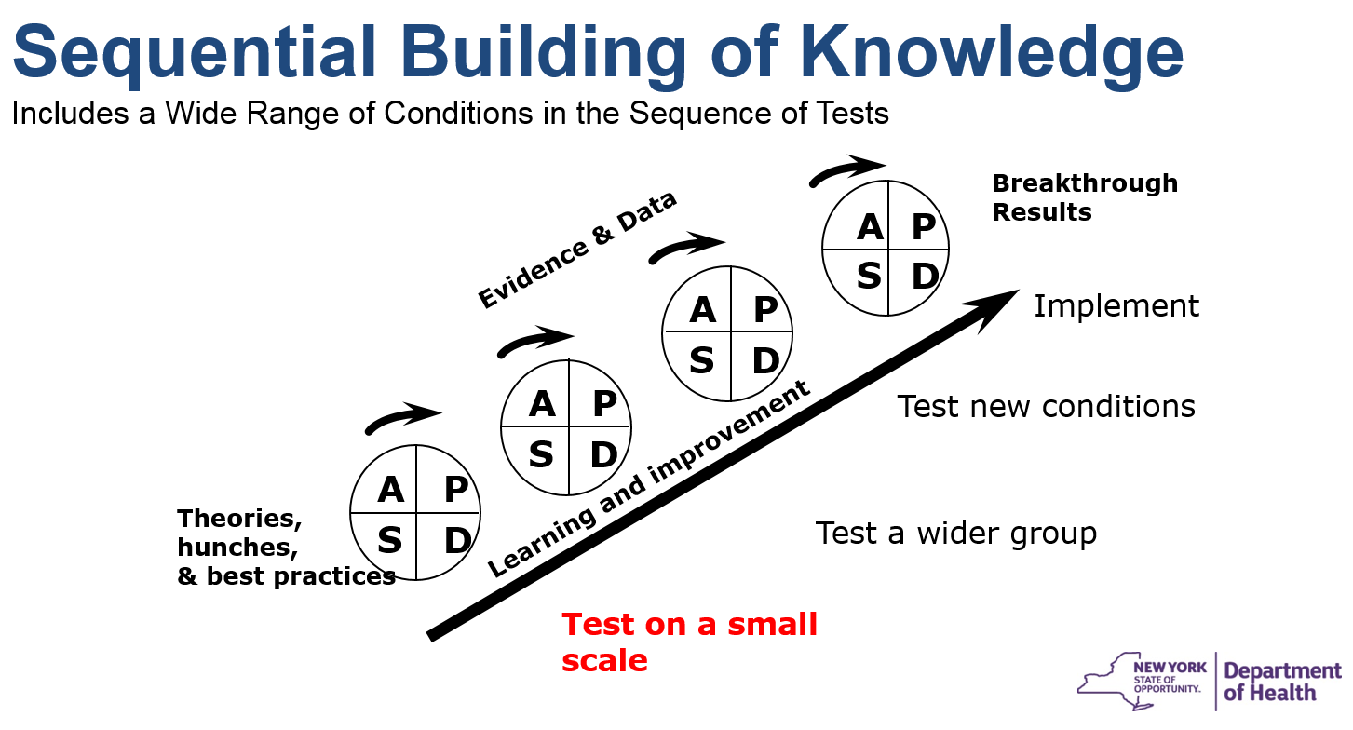

Slide 33
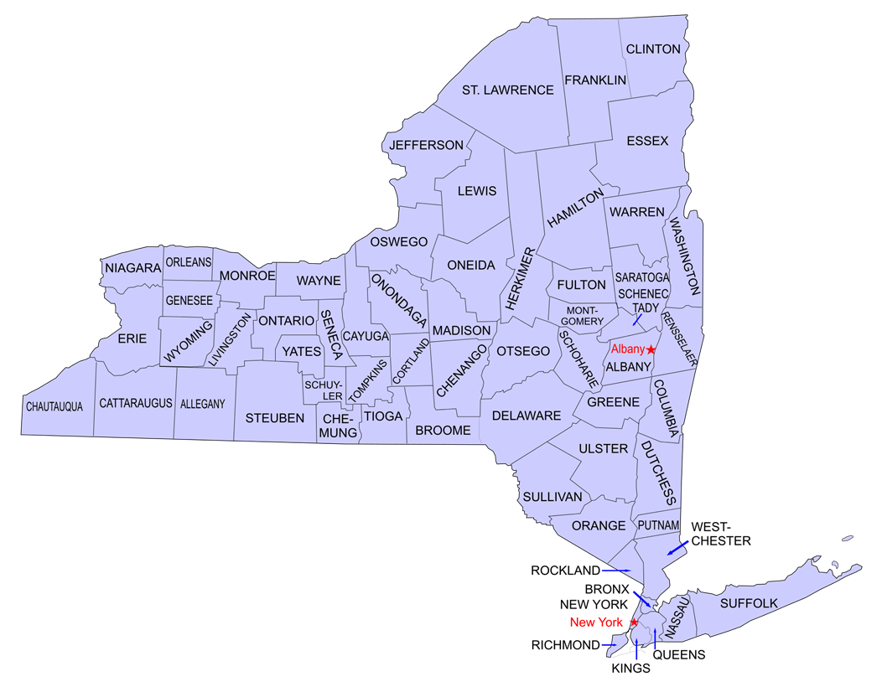
University Centers of Excellence for Developmental Disabilities
Strong Center for Developmental Disabilities
(Rochester, NY)
Westchester Institute for Human Development
(Valhalla, NY)
Rose F. Kennedy Center
(Bronx, NY)

Slide 34
IFaCT
IN PERSON SESSION
Learn about process
Create initial PDSA plan
PRIOR TO MONTHLY CALLS
Submit data on progress to UCEDD
Submit updated PDSA plan
MONTHLY CALLS
County teams report on progress
Receive feedback and brainstorm next steps
AFTER MONTHLY CALLS
Modify PDSA plans
Engage in another PDSA cycle
Notes:
JENNA

Slide 35

IFaCT Teams
Each county will have one team to lead this effort consisting of up to 7 people
Team members will include:
  EI providers
  Family members
  Quality assurance officers
  EI officials/designees
  Service coordinators
** Each team requires at least one service provider/coordinator and one parent

Slide 36
Next Steps
Cohort 1 Support & Coaching
Jan-Dec18
Recruit Cohort 2
Summer 2018
Cohort 2 In-Person Meeting
Fall 2018
Cohort 2 Support & Coaching
Oct18-Sep 19
Engage Stakeholders
Review Data and Adapt Plan
Notes:
2nd Cohort Dates: WIHD October 26, Rochester October 11, and NYC Oct 16 or 18

Slide 37
Sustainability
Short-term Outcomes:
Capacity building
Locally identified solutions
Tested with evidence of improvement in family outcomes
Long-term Outcomes:
Integrate best practices into professional development and training
Update policies and procedures to support family-centered practices across state system

Slide 38
Thanks!
Any Questions:
NYS Department of Health Bureau of Early Intervention
Email: bei.ssip@health.ny.gov
Call: 518-473-7016

Slide 39


SD Department of Education (LEA)
7 Regional
Service Coordination Contracts
450+
Direct Service Providers

Slide 40
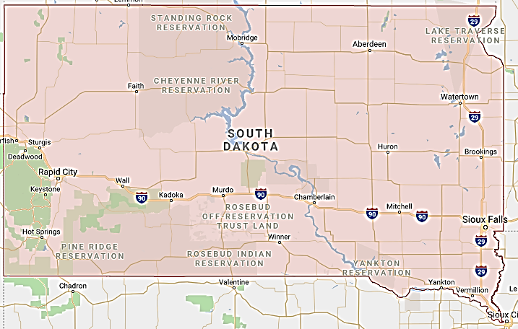
Geographical Considerations

Slide 41
SSIP Overview
Identified Needs:
Improve data quality by increasing evaluator reliability utilizing and reporting Battelle Developmental Inventory (BDI-2) data.
Monitoring protocol of evidence-based practices designed to improve child outcomes.
Training for all partners (i.e. service coordinators, providers, and families) to enhance understanding and commitment to quality early intervention.
Implementation of an evidence-based service delivery model that emphasizes routines-based family and caregiver engagement.

Slide 42
Strands of Action
Data Quality
Accountability
Professional Development
Recommended Practices

Slide 43
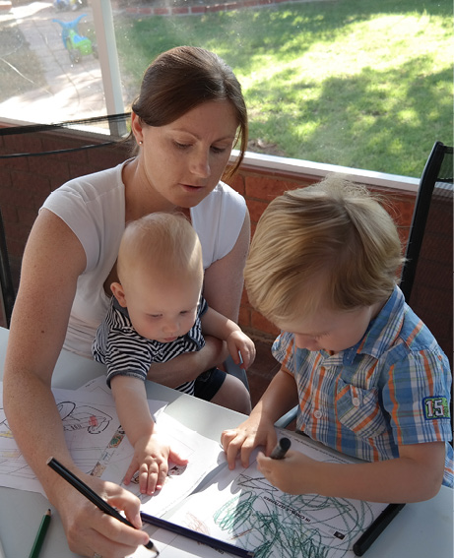
Emphasis on Family Engagement
Evaluation and Assessment
Routines-Based Interview
IFSP
Functional Outcomes
Service Delivery
Routines-Based Home Visiting

Slide 44



Evidence-Based Practices
Evaluators
Service Coordinators
Direct Service Providers
Routines-Based Interview
(Dr. R.A. McWilliam)
&
Practice-Based Coaching

Slide 45




Technology Resources

Slide 46

Lessons Learned
Promoting change is a process,
not an event.

Slide 47
Recommendations
Planning … start small and build a solid foundation.
Communication … listen to the voices of practitioners.
Collaboration … utilize existing resources whenever possible.
Coaching … practitioners value peer-to-peer support.
Data-driven decisions … collect and monitor data along the way.

Slide 48
Discussion

Slide 49
RESOURCES
National Implementation Research Network:
  https://nirn.fpg.unc.edu/
ECTA System Framework:
  http://ectacenter.org/sysframe/
How to Scale Up Effective Programs Serving Children, Youth, and Families:
  https://www.childtrends.org/publications/how-to-scale-up-effective-programs-serving-children-youth-and-families-2
Implementing and Sustaining an Effective Service Delivery Approach: Stages and Steps
  http://ectacenter.org/~pdfs/pubs/effectiveservicedelivery-long.pdf
]

Slide 50
Thank you
Visit the DaSy website at:
http://dasycenter.org/
Like us on Facebook:
https://www.facebook.com/dasycenter
Follow us on Twitter:
@DaSyCenter

Slide 51

Thank you
The contents of this tool and guidance were developed under grants from the U.S. Department of Education, #H326P120002 and #H326P170001. However, those contents do not necessarily represent the policy of the U.S. Department of Education, and you should not assume endorsement by the Federal Government. Project Officers: Meredith Miceli, Richelle Davis, and Julia Martin Eile.

