Slide 1
Pacific Entity/Caribbean Island/Bureau of Indian Education Technical Assistance Meeting
Arlington, VA
August 16, 2018

Slide 2
Welcome!

Slide 3
Agenda
Thursday August 16th (12:30 pm-5:00 pm)
12:30-1:00 | Welcome, Introductions, and Review of Agenda
1:00-1:45 | OSEP Updates/Working Lunch
1:45-2:45 | Data Quality
2:45-3:00 | Break
3:00-3:45 | Table Topics
 | Data Visualization
 | Engaging Families in Implementation of EBPs
 | OSEP Q&A
 | SSIP Progress
3:45-4:45 | Child/Family Outcomes Data Quality
4:45-5:00 | Next Steps, Meeting Evaluations
5:00 pm | Meeting Adjourned and Safe Travels!

Slide 4
OSEP Updates
Freely Associated States, Outlying Areas and BIE
August 16, 2018

Slide 5
Objectives
OSEP’s Differentiated System of Monitoring and Support
State Systemic Improvement Plan-Phase III, Year 3 and Beyond
The role of results in determinations

Slide 6
Overview: Rationale for Including Results
Promotes the Purposes of IDEA
Equality of Opportunity
Educational Results and high expectations for all children
Full participation in the community
Independent living
Economic self-sufficiency

Slide 7
Overview: Results Data for FFY 2018 Determinations
% of CWD participating in regular Statewide assessments across all available grade levels (3 through 8);
% of CWD exiting school by dropping out; and
% of CWD exiting school by graduating with a regular high school diploma.

Slide 8
Overview: FFY 2018 Data Calculations
# CWD participating with and without accommodations in regular Statewide assessments in SY 2016-2017
# CWD participants and non-participants in regular and alternate Statewide assessments in SY 2016-2017, excluding medical emergencies
# CWD ages 14 through 21 reported in the exit reason dropped out for SYs 2015-2016, 2014-2015, and 2013-2014
# CWD ages 14 through 21in the five exit from special education and school categories for SYs 2015-2016, 2014-2015, and 2013-2014
X 100

Slide 9
2018 Scores for Results Elements
Results Elements | RDA Score= 0 | RDA Score= 1 | RDA Score= 2
Participation Rate of CWD on Regular Statewide Assessments (reading and math, separately) based on an average of participation rates across all available grade levels (3 through 8) in which the assessment was administered. | <80 | 80-89 | >=90
Percentage of CWD Exiting School by Graduating with a Regular High School Diploma based on the percentage of CWD exiting school by graduating with a regular high school diploma in SYs 2013-2014, 2014-2015 and 2015-2016. | <65 | 65-75 | >=76
Percentage of CWD Exiting School by Dropping Out based on the percentage of CWD exiting school by dropping out in SYs 2013-2014, 2014-2015 and 2015-2016. | >22 | 22-15 | <=14

Slide 10
Questions?
Kuestion-mu?
Kajjitok?
Fesili?

Slide 11

Data Quality Counts!
Pacific Island/Caribbean Island/Bureau of Indian Education
2018 Improving Data, Improving Outcomes Post-Conference Meeting
Arlington, VA
August 16, 2018
Tony Ruggiero, IDC

Slide 12
Participant Outcomes
By the end of the session, meeting participants will
Understand the importance of high-quality data
Be familiar with the risks of poor data quality
Understand the importance of documenting the data collection and cleaning process to obtain high-quality data
Learn about other jurisdictions’ processes for monitoring data quality and the supports provided to both state and local agency staff

Slide 13
The Connection Between Data Governance and High-Quality Data
Data Governance is the overarching collection of practices and processes which help to ensure the formal management of data.
Processes
Business Rules
Notes:
Data Governance is the overarching collection of practices and processes which help to ensure the formal management of data assets within an organization
Business rules are lists of statements that tell you whether you may or may not do something, or give you the criteria and conditions for making a decision. Typically they are built into an IT system to diminish the probability of error and align the system with external requirements
Data Processes are detailed steps undertaken to complete the cycle of collection, validation, analysis, and submission of data to meet required reporting

Slide 14
What Does This Have to Do With Data Quality?
Poorly managed IDEA data collection, validation, analysis, and submission processes can lead to poor data quality.

Slide 15
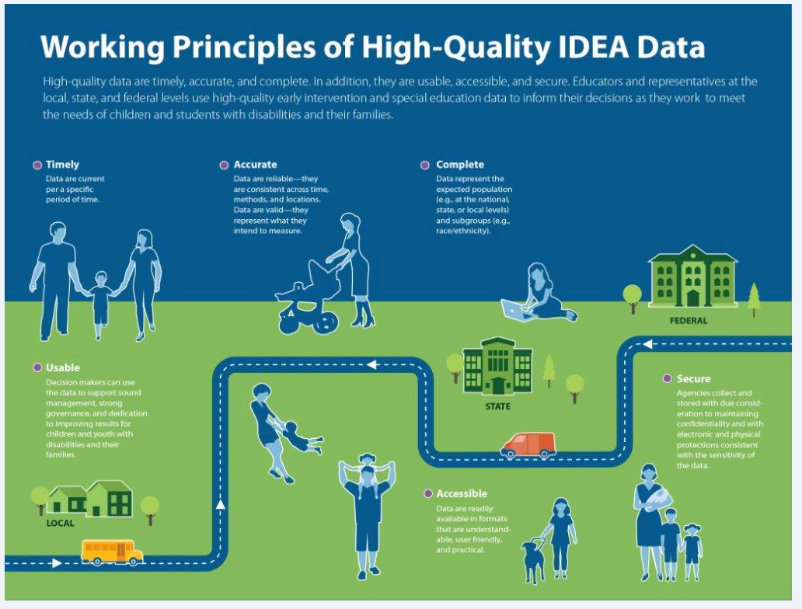
Working Principles of High-Quality IDEA Data
  Timely
  Accurate
  Complete
  Secure
  Accessible
  Usable
  https://ideadata.org/sites/default/files/media/documents/2017-09/idc-hqd_source.pdf
Notes:
https://ideadata.org/sites/default/files/media/documents/2017-09/idc-hqd_source.pdf
Pull up the infographic. The definitions are on the infographic. Also placed below in case infographic does not pull up.
Timely – data are current per a specific time period.
Accurate - data are reliable: they are consistent across time, methods, and locations. Data are valid – they represent what they intend to measure.
Complete – data represent the expected population. For example, at the national, state, or local levels and subgroups (e.g., race/ethnicity)
Secure – agencies collect and store data with due consideration to maintaining confidentiality and with electronic and physical protections consistent with the sensitivity of the data.
Accessible – data are readily available in formats that are understandable, use friendly, and practical.
Usable – decisionmakers can use the data to support sound management, strong governance, and dedication to improving results for children and youth with disabilities and their families.

Slide 16
The Importance of High-Quality Data
High-quality data have become increasingly important to state agencies and the Office of Special Education Programs (OSEP) for:
Reporting
  State Performance Plan/Annual Performance Report (SPP/APR)
    Evaluates a state’s efforts to implement the requirements of IDEA
    Describes how the state will improve implementation
    Informs the public on the performance of each local education agency (LEA) or local early intervention service (EIS) program in the state on targets in the SPP/APR
    Informs the Secretary and the public on the performance of the state under the SPP/APR
Notes:
Source: 2018 Part B SPP/APR Memo and https://sites.ed.gov/idea/spp-apr/ and Part C Memo
In accordance with 20 U.S.C. 1416(b)(2)(C)(ii)(II) of the Individuals with Disabilities Education Act (IDEA or Part B), each State must report annually, through the Part B SPP/APR. SPP – each state must submit its SPP at least once every six years and submit amendments to the Secretary.
APR - State must also report annually to the public on the performance of each LEA located in the State on the targets in its Part B SPP/APR as soon as practicable, but no later than 120 days following the State’s submission of its Part B SPP/APR to the Secretary.

Slide 17
The Importance of High-Quality Data (cont.)
States need high-quality data to go beyond reporting.
Shift at OSEP from monitoring to Results Driven Accountability (RDA)
State Systemic Improvement Plan (SSIP)
Research and Evaluation
Notes:
However, over the past several years, data have been needed and even required to go beyond reporting. There has been a shift at OSEP from monitoring to Results Driven Accountability (RDA). There is also the State Systemic Improvement Plan (SSIP) in which the states are to use data to evaluate their efforts to increase their SiMRs. Data are used to provide evidence for grants, funding from legislatures, and to inform policy and program decisions.

Slide 18
The Importance of High-Quality Data (cont.)
IDEA data reported to OSEP are critical for
  Developing and improving policy
  Improving programs
  Increasing children’s achievement
Notes:
States and OSEP rely on data they collect to make decisions in an ever-changing environment. Changes in this environment mean changes in the internal processes for States and OSEP, which in turn puts more emphasis on the need for high-quality data.

Slide 19
The Importance of High-Quality Data (cont.)
Example
IDEA Part C coordinators and data managers can use Timeliness data to
Work on solutions to increase the number of children who receive services in a timely manner
Investigate the relationship between receiving services in a timely manner and child outcomes
Identify professional development opportunities for staff to ensure infants and toddlers are receiving services in a timely manner
Notes:
Timeliness = Indicators 1 and 7
Indicator 1 - Percent of infants and toddlers with Individual Family Service Plans (IFSPs) who receive the early intervention services on their IFSPs in a timely manner.
Indicator 7 - Percent of eligible infants and toddlers with IFSPs for whom an initial evaluation and initial assessment and an initial IFSP meeting were conducted within Part C’s 45-day timeline.

Slide 20
The Importance of High-Quality Data (cont.)
Example
IDEA Part B state program directors and data managers can use least restrictive environment (LRE) data to
Work on solutions to increase the number of students in more inclusive education settings
Investigate the relationship between education environments and student outcomes
Review and adjust funding models to reduce fiscal incentives that might reduce access to the LRE
Notes:
Within the context of RDA, states are using data to identify performance gaps, and then to assess the effectiveness of targeted, evidence based reforms that were implemented to address those gaps. For example, States may be asking these types of questions:
Are Part B initiatives and policies around least restrictive environments increasing the number of students in an inclusive educational environment? Are student outcomes improving when a student is in an inclusive environment? How might the SEA adjust fiscal incentives to support policies that have shown improvement in student outcomes?
High-quality data can help SEAs answer these questions.

Slide 21
Data As an Asset
The need for high-quality data has been universally identified and can be:
  An organizational, program, or policy asset that
    Serves as a reliable source for data driven decision making
    Serves as a reliable source that can help secure additional resources
Notes:
Source: Redman.
High-quality data can be a business asset by providing the organization an opportunity to turn data into information. It can serve as a reliable source by allowing an organization the opportunity to demonstrate need or evidence when applying for a grant or requesting funds from the legislature.

Slide 22
The Risks of Poor Data Quality
Poor data quality can
  Reduce customer satisfaction
  Breed organizational mistrust
  Make it difficult to start efforts that lead to improvement
  Support bad decision making
  Inhibit good data-driven decisionmaking (e.g., allow stakeholders to make policy decisions based on erroneous data)
Notes:
Source: Redman.
Poor data quality can:
Reduce customer satisfaction – for example, if a cabinet secretary, legislator, or the public requests to see trend data on the percent of students with IEPs dropping out of high school but does not feel comfortable because of large fluctuations in the data from year to year.
Breed organizational mistrust – for example, targets for graduation rates have been set too high because they were based on incomplete data.
Make it hard to start efforts that lead to improvement – where do you begin without evidence?
Inhibit good data-driven decisionmaking – when stakeholders make policy decisions on erroneous data, this can lead an organization or program down the wrong path.

Slide 23



Getting to High-Quality Data
There are points in the data collection and use process to increase the probability of getting to high-quality data.
    Prevent
    Detect and Repair
    After the Fact
Notes:
Source: Redman.
Preventing data from being entered incorrectly is the recommended time for quality assurance.
An example of “Prevent” is when a data system has in-field and across-field edit checks that prevent erroneous data from being entered.
Business rules
Business rules are a proactive approach to improving data quality at the source (Redman, 2013).
Edits that are programmed into data entry software restrict data entry to valid entries.
Prevention is better than rework.
Business rules are the “prevent” part of getting to high-quality data. Business rules help define the given set of requirements that are consistency checks that identify errors. Appropriate stakeholder engagement is required to accurately capture the business rules. This means that Part C should be at the table and contributing when edit checks are built into the data system.
An example of “Detect and Repair” is when the data are in the data system, and checks are made before the data are ready for data consumers. When errors are found they must be corrected at the source data system.
An example of “After the Fact” occurs when data are being used, and the data consumer notices errors. The data consumer may or may not report the error. And the error may or may not be fixed.

Slide 24

Data Collection Process
Notes:
A documented process should be in place that details the activities, timelines, and staff responsible. Business Rules should be documented as well.

Slide 25
Data Collection Process (cont.)
Collaboration is key.
  How does the state support LEA or local EIS programs
  What supports are in place
  How does the state deliver supports
Collaboration is important because it feeds into data use for both state and LEA or local programs – benefits for both
Notes:
A documented process should be in place that details the activities, timelines, and staff responsible. Business Rules should be documented as well. Someone who is detail oriented and skilled in document control should be assigned to document. Documentation serves as a reference for new IDEA Part C and Part B data managers due to staff turnover.

Slide 26
Data Quality and Integrity
IDEA Data Center Part B Data System Framework— Quality Indicator DG5:
State staff or authorized representatives implement monitoring procedures and technical assistance to ensure consistent application of data quality and integrity policies.
Notes:
The listed Quality Indicator, elements of quality, and guiding questions are from the IDC Part B Framework.

Slide 27
Data Quality and Integrity (cont.)
Elements of Quality
State staff or authorized representatives communicate regularly to system users (e.g., local staff) about data quality procedures.
State staff or authorized representatives regularly monitor the implementation of the quality procedures for data.
State staff or authorized representatives have a data collection and quality orientation training for data managers at the state and local levels.

Slide 28
Data Quality and Integrity (cont.)
Elements of Quality (cont.)
State staff or authorized representatives create and maintain standardized training materials regarding policies, procedures, and responsibilities for data collection and quality operations, and update training materials as needed.
State staff or authorized representatives ensure adherence to data quality procedures when data are exchanged or transferred.
The data collection and quality procedures for the state’s data system are reviewed and revised periodically as new management needs arise.
Notes:
The listed guiding questions are from the IDC Part B Framework.

Slide 29
Data Quality and Integrity (cont.)
Elements of Quality (cont.)
State staff or representatives support state/local programs and agencies to implement policies and procedures in a manner consistent with state policies and procedures, while allowing for local variation in context.
State staff have a system or method for ensuring data proficiency for the state data manager.
State staff have a system or method for supporting data proficiency for local data managers.
Notes:
The listed guiding questions are from the IDC Part B Framework.

Slide 30
Data Quality and Integrity (cont.)
Elements of Quality (cont.)
State staff or authorized representatives provide multiple resources (e.g., procedural guides, webinars, help desk) to facilitate and support local staff with implementation of data collection and quality procedures.
State staff or authorized representatives provide guidance and support for the assessment of state and local capacity to implement quality procedures.
State staff or authorized representatives provide guidance and support in response to staff capacity needs at the state and local levels.
Notes:
The listed guiding questions are from the IDC Part B Framework.

Slide 31
Data Quality and Integrity (cont.)
Guiding Questions
What guidance (e.g., Q and A, knowledge base, guidance documents, data tips, etc.) does the state publish on data quality procedures?
How does the state communicate data quality procedures to system users (e.g., website, distribute to LEAs, schools, local programs or providers)?
What is the process for LEAs, schools, local programs, or providers to report and resolve known data quality issues?
  Is this process included in written data quality procedures?
Notes:
The listed guiding questions are from the IDC Part B Framework. These questions are about State staff or authorized representatives communicating regularly to system users (e.g., local staff) about data quality procedures.

Slide 32
Data Quality and Integrity (cont.)
Guiding Questions (cont.)
What is the established data quality review period for Part C and Part B data collections?
How does the state confirm that the data validations are working as intended?
How does the state run data quality analysis on final data to determine potential data quality issues?
Notes:
The listed guiding questions are from the IDC Part B Framework. These questions are about state staff or authorized representatives regularly monitoring the implementation of the quality procedures for Part C or Part B data.

Slide 33
Data Quality and Integrity (cont.)
Guiding Questions (cont.)
Does the state provide any training on data quality for LEA or local program staff?
  What kind of training is provided?
  How often?
Who (role) at the LEA or local program participates in data collection and quality orientation training?
Notes:
The listed guiding questions are from the IDC Part B Framework. These questions are about State state staff or authorized representatives have a data collection and quality orientation training for data managers at the state and local levels.

Slide 34
Data Quality and Integrity (cont.)
Guiding Questions (cont.)
What do the standard training materials include? Where are they located?
  Who (role) has access to the training materials?
  How often are they updated?
  Who (role) is responsible for updating the training materials?
Who (role) is involved in the development and review of content?
  How are Part C or Part B State staff involved?
  How is internal and external stakeholder and participant feedback used to improve the materials?
Notes:
The listed guiding questions are from the IDC Part B Framework. These questions are about state staff or authorized representatives create and maintain standardized training materials regarding policies, procedures, and responsibilities for Part C or Part B data collection and quality operations, and update training materials as needed.

Slide 35
Data Quality and Integrity (cont.)
Discussion Questions
What data quality training is provided to new state data managers?
  What is included in the training?
  How is it delivered?
  How often?
What follow-up coaching occurs?
How does the state address any existing capacity issues to meet the demand for training and coaching?

Slide 36
Data Quality and Integrity (cont.)
Discussion Questions (cont.)
How does the state provide training to LEAs, schools, local programs, or providers to address data quality issues?
As part of the training, how are the roles and responsibilities clearly defined and communicated regarding implementation of data quality procedures?
Notes:
Q5. As part of the training, how does the state clearly define and communicate the roles regarding implementation of data quality procedures?

Slide 37
Data Quality and Integrity (cont.)
Discussion Questions (cont.)
What is the process for monitoring the data quality of LEAs, schools, local programs, or providers’ data?
  How often does the LEAs, schools, local programs, or providers monitoring occur?

Slide 38

Barriers to Collecting High-Quality Data
Notes:
Need a picture

Slide 39
Barriers to Collecting High-Quality Data (cont.)
There are several potential barriers to collecting high-quality data
Data System
Buy-in
Resources
Content and Assessment Knowledge
Notes:
There are barriers to collecting high-quality data.
Data System – having in-field and across field edit checks.
Buy-in – what is the purpose for collecting all of this data?
Resources – money, time, expertise to establish a process that works and to build a new data system or enhance an existing system.
Content and Assessment Knowledge – knowing content is just as important as having a good data system and collection process. For example, understanding the definitions for Least Restrictive Environments to properly categorize where a student is receiving services or knowing how to assess a child, knowing what functional skills are, and knowing what age-anchoring is.
We’ve identified these barriers as cultural, technical, political, and financial. Does anyone have experience with these barriers?

Slide 40
Let’s Review
Understand the importance of high-quality data
Be familiar with the risks of poor data quality
Understand the importance of documenting the data collection and cleaning process to obtain high-quality data
Learn about other jurisdictions’ processes for monitoring data quality and the supports provided to both state and local agency staff

Slide 41
Contact Us
Tony Ruggiero
tony.ruggiero@aemcorp.com

Slide 42

For More Information
Visit the IDC website
http://ideadata.org/
Follow us on Twitter
https://twitter.com/ideadatacenter
Follow us on LinkedIn
http://www.linkedin.com/company/idea-data-center

Slide 43




The contents of this presentation were developed under a grant
from the U.S. Department of Education, #H373Y130002. However, the contents do not necessarily represent the policy of the U.S. Department of Education, and you should not assume endorsement by the federal government.
Project Officers: Richelle Davis and Meredith Miceli

Slide 44
Break

