Slide 1
Opportunities for Providing Seamless Birth to Five services
2018 Improving Data, Improving Outcomes Conference
August 15, 2018

Slide 2
Presenters
Kathleen Heck, OSEP
Kathy Whaley, ECTA Center
Marcella Franczkowski –Maryland State Department of Education
Pam Thomas, Missouri Department of Elementary and Secondary Education
Sandy Drangmeister, University of New Mexico
Center for Development & Disability
Heather Staab, Kansas Kansas Department of Health and Environment

Slide 3
IDEA- Part C Extended Option: Age 3 to Kindergarten Age
Allows flexibility to make Part C services available to children from age 3 until eligible to enter kindergarten or elementary school [635 (c)(1)]
Adds requirements in implementing this option [635 (c)(1)]
Adds a reporting requirement [637(b)(4)(A)
Requires identification of funding sources in the state’s policy
[635(c)(4)
Allows the use of funds for the Part C option [638(4)]
Notes:
Statute

Slide 4
IDEA- Part C Extended Option: Age 3 to Kindergarten Age
34 CFR §303.211 allows each State to develop and implement a policy under which parents of children who are receiving early intervention services and who are eligible to receive services under section 619 of Part B of the Act can choose for these children to continue receiving early intervention services under Part C of the Act
Children whose parents elect to continue to receive Part C services beyond age three must have an individualized family service plan developed that includes an educational component that promotes school readiness and incorporates pre-literacy, language, and numeracy skills consistent with the requirements in 34 CFR §303.344(d)(4). 34 CFR 303.211(b)(2)
Notes:
Regulations:

Slide 5
The Seamless System of Birth to Five Services
Innovative state approaches
Flexibility of options available
Maryland, Missouri,
New Mexico & Kansas

Slide 6
Questions

Slide 7
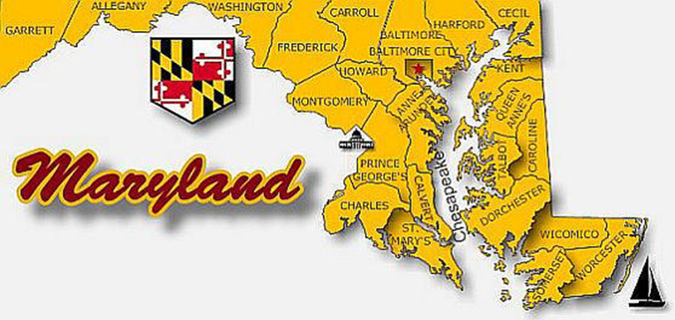
Marcella Franczkowski, Assistant State Superintendent Maryland State Department of Education Division of Special Education/Early Intervention Services August 15, 2018
Opportunities for Providing Seamless B-5 Services
Maryland State Department of Education DIVISION OF SPECIAL EDUCATION/EARLY INTERVENTION SERVICES | Marcella E. Franczkowski, Assistant State Superintendent | IDIO CONFERENCE| AUGUST 2018

Slide 8
Birth to Kindergarten System of Services Points of Transition
Maryland State Department of Education DIVISION OF SPECIAL EDUCATION/EARLY INTERVENTION SERVICES | Marcella E. Franczkowski, Assistant State Superintendent | IDIO CONFERENCE| AUGUST 2018

Slide 9
Transition at Age 3: Extended IFSP
Maryland State Department of Education DIVISION OF SPECIAL EDUCATION/EARLY INTERVENTION SERVICES | Marcella E. Franczkowski, Assistant State Superintendent | IDIO CONFERENCE| AUGUST 2018

Slide 10
Family Choice at Age 3: IFSP vs IEP
Source: MD Online IFSP October 1, 2017
Maryland State Department of Education DIVISION OF SPECIAL EDUCATION/EARLY INTERVENTION SERVICES | Marcella E. Franczkowski, Assistant State Superintendent | IDIO CONFERENCE| AUGUST 2018

Slide 11
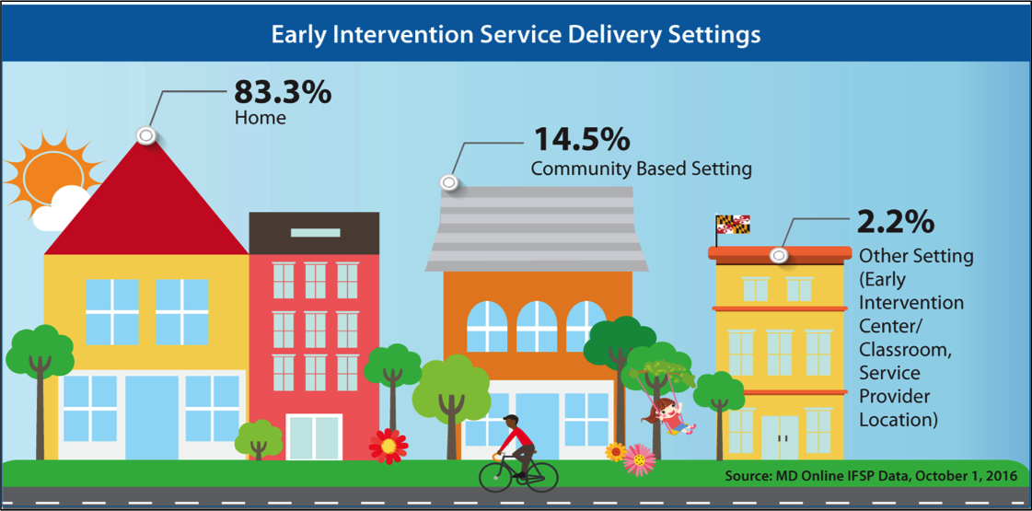
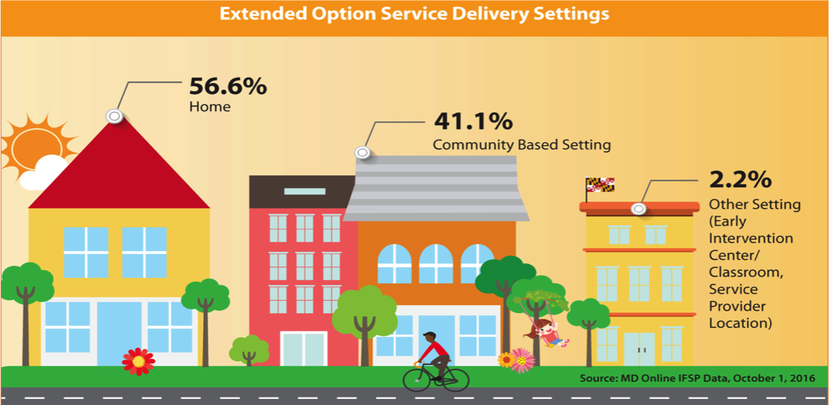
Maryland Infants and Toddlers Program Services in the Natural Environment
Source: MD Online IFSP data October 1, 2017
Source: MD Online IFSP data October 1, 2017
Maryland State Department of Education DIVISION OF SPECIAL EDUCATION/EARLY INTERVENTION SERVICES | Marcella E. Franczkowski, Assistant State Superintendent | IDIO CONFERENCE| AUGUST 2018

Slide 12
Birth to Kindergarten System of Services Key Principles Side-By-Side (IFSP/IEP)
Maryland State Department of Education DIVISION OF SPECIAL EDUCATION/EARLY INTERVENTION SERVICES | Marcella E. Franczkowski, Assistant State Superintendent | IDIO CONFERENCE| AUGUST 2018

Slide 13
Birth to Kindergarten System of Services Early Childhood Outcomes
Maryland State Department of Education DIVISION OF SPECIAL EDUCATION/EARLY INTERVENTION SERVICES | Marcella E. Franczkowski, Assistant State Superintendent | IDIO CONFERENCE| AUGUST 2018

Slide 14
Maryland Infants and Toddlers Program
IMPACT DATA
Return to General Education
68%
Students in Grade 3 through Grade 6
Students who received early intervention
returned to general education
by 2017
Data Sources: Maryland Special Education Census Data; Maryland Online IFSP

Slide 15
Maryland Infants and Toddlers Program
IMPACT DATA
Family Outcomes
98%
Maryland Infants and Toddlers Program 2017
Source: MITP Family Survey Report, December 2017

Slide 16
Maryland Birth to Kindergarten Resources
A Look At My Child’s Development
A Family Guide to Next Steps: When Your Child in Early Intervention Turns Three
Maryland’s Birth to K System of Services for Young Children with Disabilities and Their Families – Legislative Booklet
Technical Assistance Bulletins
Effective Transition Practices: Supporting Family Choice At Age 3
Flowchart A – Transition at the Beginning of the School Year Following the 4th Birthday
Flowchart B – Transition After Age 3
Flowchart C – Transition By Age 3
Maryland State Department of Education DIVISION OF SPECIAL EDUCATION/EARLY INTERVENTION SERVICES | Marcella E. Franczkowski, Assistant State Superintendent | IDIO CONFERENCE| AUGUST 2018
Notes:
Maryland Birth to Kindergarten Resources

Slide 17
Questions

Slide 18
Missouri
Eligibility Criteria: Part C is half-age delay, and Part B/619 is two standard deviations in one area, or 1.5 in two areas.
Data: Approximately 70% of three-year-olds in Part C are eligible for Part B/619.
Policy: Extend the Part C program for children with summer third birthdays.
Purpose: Prevent a gap in services and promote a seamless transition from Part C to Part B/619 for children with summer birthdays.

Slide 19
Missouri – Part C Extension Program
Definition: A summer birthday is April 1 through August 15.
Options: Parents of children with summer third birthdays may choose to continue in Part C over the summer months, or transition to Part B/619 on the child’s third birthday.
Opt-out: Missouri has an opt-out policy. If the parent opts out of sending directory information to Part B/619, then the Part C extension program is not available.

Slide 20
Missouri – Part C Extension Options
To continue in Part C after age three, the child must meet the following additional criteria:
The child is determined eligible for Part B/619 before age three, or
The child’s eligibility determination is in process before age three (i.e., the Part C service coordinator confirmed the school district received the referral).
In the Part C extension program, the child continues in Part C until the day before school begins in the fall following the child’s third birthday.

Slide 21
Missouri – Part C Extension Data
Calendar Year 2017
Children with IFSPs: 10,861
Children with IFSPs with Third Birthdays between 4/1/17 – 8/15/17: 1,814
Children utilizing Part C Extension: 857 (approx. 50% of eligible children)
Total Program Annual Costs: $45.9 million
Total Costs Per Child Per Year: $3,114*
Services Costs Per Child Per Year: $2,305
*includes administration, direct services, testing/protocols, training, etc.
Notes:
3,459 children with STB, but 1,814 eligible at the time

Slide 22
Questions

Slide 23
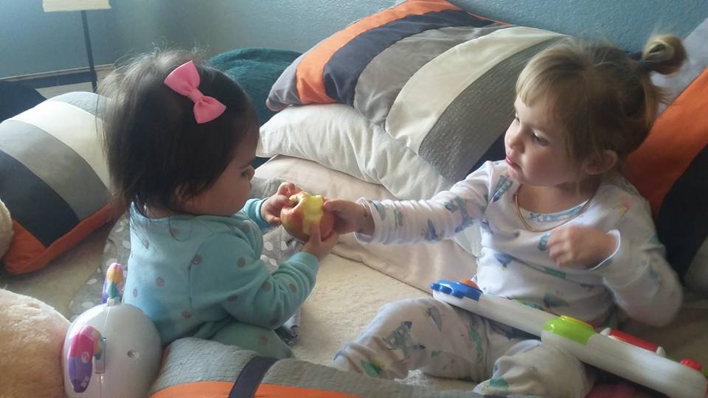
New Mexico Early Childhood Transition

Slide 24
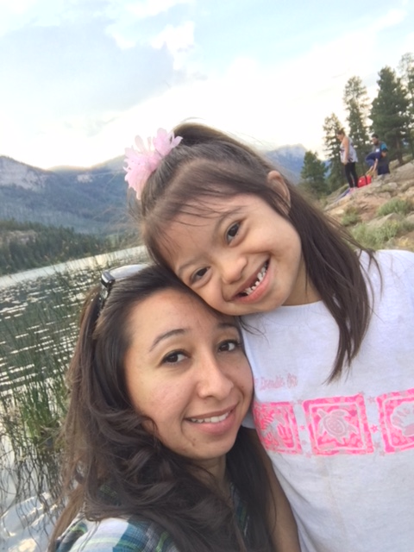
Vision
All children and families will experience a smooth and
effective transition as a result
of collaborative intentional community planning.
Notes:
The transition process requires collaboration of all parties involved in a child’s transition. NM has found that bringing community partners together in collaboration around transition has helped ensure that families are fully informed of the process and that Part B and Part C are better able to meet their timelines and indicators related to transition as a result of this collaboration.

Slide 25
NM Transition Initiative
“The strength of the team is each individual member. The strength of each member is the team” - Phil Jackson
Notes:
Since 1999 the NM Early Childhood Transition Initiative has worked to improve systems across NM in order to foster smooth, effective transitions for children and families as they exit IDEA Part C, Early Intervention services and move into other services and supports.
NM’s Transition Initiative supported the formation of statewide transition teams and 31 teams continue to meet in regions of the state. Here is a diagram of the NM Transition Initiative.

Slide 26
Community Transition Teams
Coach
Team Leader
Family
Members
Agency Reps
Improve transition from Part C to Part B
Develop MOU
Ongoing meetings
Coach, parent & other partner involvement
Early Intervention agencies, Part C
School Districts, Part B
MOU
Notes:
Each teams’ members vary based on the local partners in that region. School districts & EI agencies are part of a transition team as well as other partners with whom they share responsibilities in the transitioning of children. Some EI agencies, State supported schools (NM School for the Blind and Visually Impaired and NM School for the Deaf, home visiting programs and other partners may be part of more than one team but most schools only participate in one.
The purpose of the team is to provide a place for members to address transition procedures at the local level because each community agency may have internal procedures that are unique to them.
Each team meets based on an agreed upon schedule outlined in their MOU. In some cases this is monthly and in others it is 2 times a year. However, it is the RESPONSIBILITY of the members of EACH team to attend!
Teams support parent involvement at team meetings which is helpful for all to hear a parent perspective on their experience in the transition process.
Each team develops a community MOU and reviews the MOU, at a minimum annually, and refers regularly to the MOU to clarify transition roles and processes.

Slide 27
Transition Coaches
UNM CDD ECLN Contracts
DOH FIT Program
14 Transition Teams
NM PED – SEB
7 Transition Teams
NM Regional Education Cooperatives
6 Transition Teams
Notes:
Coaches for transition teams are assigned by the state Transition Coordinator and based on availability of funding from the Department of Health Family Infant Toddler Program and the Public Education – Special Education Bureau. Over the years our funding has decreased and to support coaching coverage, we reached out to the Regional Education Cooperative in NM and they have stepped up and support 6 transition teams around the state.
Through ECLN we have Training and Development Consultants who support the EI agencies and school districts and they are also Transition coaches in the region of the state where they provide TA and support. ECN, PSN, RECs
The coaches come together three times a year to share transition team celebrations as well as concerns. Utilizing the experiences of other coaches and the transition coordinator, they work to problem solve and discuss strategies that might be working in other areas of the state that they can use with their teams.
The Transition Coordinator works closely with the DoH FIT Lead and PED-SEB lead to provide additional support to teams & coaches facing challenges with transition processes. These concerns are shared with the Steering Committee who determines if guidance needs to be revised.

Slide 28
Transition Coach Role
Foster collaboration
Assist in working through barriers
Address technical assistance needs
Encourage parent involvement
Serve as a resource
Foster sustainability
Identify issues and keep NM Early Childhood Transition Coordinator informed
Promote continuous improvement
Notes:
The coaches’ role is to support the team in achieving smooth and effective transitions for children and families in their region.
Ensure team members understand the Vision & Mission of the NM Early Childhood Transition Initiative and facilitate an understanding of the transition process among and between systems
Foster collaboration and relationship building
Facilitate the interagency process and partnership and assist teams in working through barriers
Address technical assistance needs; secure appropriate resource(s).
Encourage parent involvement and foster a family focus
Serve as a resource in the development of interagency agreements
Assist teams in recognizing and celebrating accomplishments
Foster sustainability
Identify issues relevant to the system and keep the NM Early Childhood Transition Coordinator informed
Promote continuous improvement
The coach acts as a resource person for the team and may also play the role of facilitator when problem solving or disruptive issues occur between agencies. The coach may also be a person to call upon when there are questions outside of meetings.

Slide 29
Memorandum of Understanding MOU
Promote smooth transitions for young children
Tied to funding at the LEA level
Agreed upon transition processes
Clarification of roles
Defined timelines
Notes:
Each Transition Team develops a Memorandum of Understanding (MOU). It is a shared responsibility to create it and to get signatures from agency and district personnel who have the role of signing such documents.
Once it is signed, it is a legally binding document.
Mandatory signees include all EI agencies, school districts and state supported schools, NMSD and NMSBVI. Partners such as Head Start, Early Care, Home Visiting, etc. are not required signees but are encouraged to sign.
The MOU outlines procedures for promoting a smooth and effective transition for children and their families. It is reviewed annually in most teams (this is recommended and revised (as needed, required by the state usually because of regulation/policy changes or every 4 years.)
Along with the timeline for transition, the MOU is a document that is made available for each staff member participating in the process. This, as well as the guidance document, are to be referred to regularly to make sure everyone is following regulations (both state and federal) and the procedures agreed to by all partners.
Districts must attach a copy of the signed MOU with their applications for IDEA Part B funding in the spring and are submitted to the Special Education Bureau, Public Education Department.

Slide 30
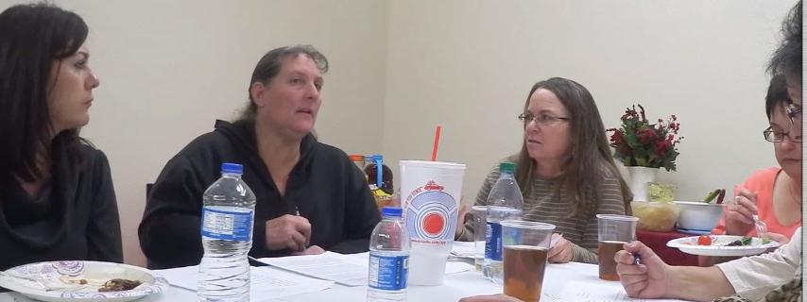
Transition MOU Library
http://www.cdd.unm.edu/ecln/Transition/index.html
Notes:
To find a copy of each Transition Team’s MOU, visit the NM Early Childhood Transition MOU Library website.
The Statewide Transition Coordinator keeps a repository of al the MOUs, both in PDF and Word so that if school and EI personnel move away, we always have a working document that each team can work from as they review their MOU annually.

Slide 31
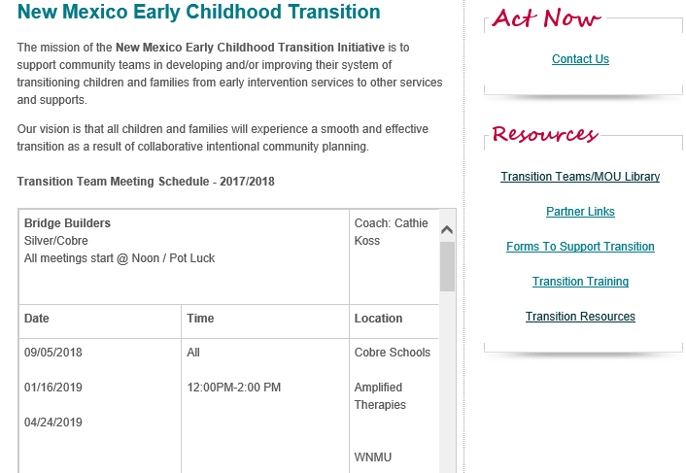
NM Early Childhood Transition Website
http://cdd.unm.edu/ecln/Transition/index.html
Notes:
Here is a screenshot of the NM Early Childhood Transition website. This illustrates the calendar of meetings for the 31 regional transition team’s.
We created this calendar to support districts in having a central location for finding information about upcoming meetings.

Slide 32
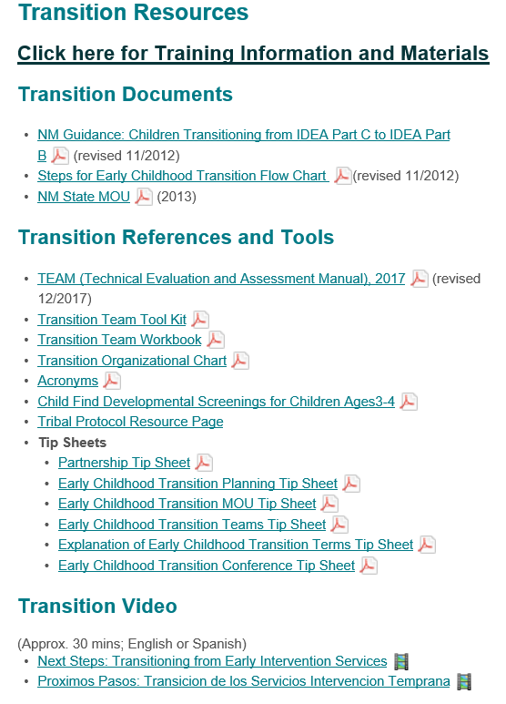
Transition Resources
Team Toolkit
Team Workbook
Tip Sheets
Tribal Protocol
Video
http://cdd.unm.edu/ecln/Transition/transitionResources.html
Notes:
Support for new staff and team members has been an ongoing concern and so we developed a team toolkit that is utilized by the coach and team lead to support new team members in understanding early childhood transition and their role on the team.
We also have tip sheets that support common questions like how long is our MOU good for…whose signatures are required on the MOU, who is responsible for facilitating the Transition Conference, etc.

Slide 33
NM Early Childhood Initiative Transition Website
http://www.cdd.unm.edu/ecln/Transition/index.html
NM DOH FIT Website
https://nmhealth.org/about/ddsd/pgsv/fit/
NM PED SEB Website
https://webnew.ped.state.nm.us/bureaus/special-education
Resources
Notes:
If you have any questions, or would like to know more about NM Early Childhood Transition Teams or processes, please contact me at sdrangmeister@salud.unm.edu or 505-917-6044.
Thank you.

Slide 34
Questions

Slide 35
Kansas Birth to 5 Services

Slide 36
Kansas
Memorandum of Agreement (MOA) – KDHE & KSDE
FAQ – KDHE & KSDE
Conferences and Regional Trainings
Database
C to B Electronic Referral (CBER)
Notes:
Part C and Part B have different lead agencies
32 local Part C programs and ### LEAs
CBER
FAQ and MOU

Slide 37
C to B Electronic Referral System - CBER
CBER Purpose
Prevent multiple State IDs from being assigned to the same child, and to ensure that the information being transferred is accurate.
Create an easy, efficient method for locating and reconciling discrepancies found in child records during the Part C to Part B transition process.
Notes:
The C to B electronic referral system was developed to create an easy, efficient method for locating and reconciling discrepancies found in child records during the Part C to Part B transition process. The purpose of this system is to prevent multiple State IDs (KIDS IDs) from being assigned to the same child, and to ensure that the information being transferred is accurate.

Slide 38
C to B Electronic Referral - CBER
KDHE maintains the web-based referral system and provides user instructions and reports for authorized users.
Referrals – local Part C programs contact the LEA (phone call, email, or letter), AND use the electronic process to enter referral information.
Notes:
The C to B electronic referral system was developed to create an easy, efficient method for locating and reconciling discrepancies found in child records during the Part C to Part B transition process. The purpose of this system is to prevent multiple State IDs (KIDS IDs) from being assigned to the same child, and to ensure that the information being transferred is accurate.

Slide 40
https://dasycenter.sri.com/downloads/DaSy_papers/DUY305_TransitionSpotlight_FINAL_20160420_Acc.pdf

Slide 41
Questions

