Slide 1
State Strategies for Improving Inclusion:
From Infrastructure to Practice
2018 Improving Data, Improving Outcomes Conference
Arlington, VA
August 2018

Slide 2
Welcome and Introductions
Kathy Thompson Whaley, ECTA Center
Dawn Hendricks
Virginia Department of Education
Catherine Quick
New Mexico Public Education Department

Slide 3
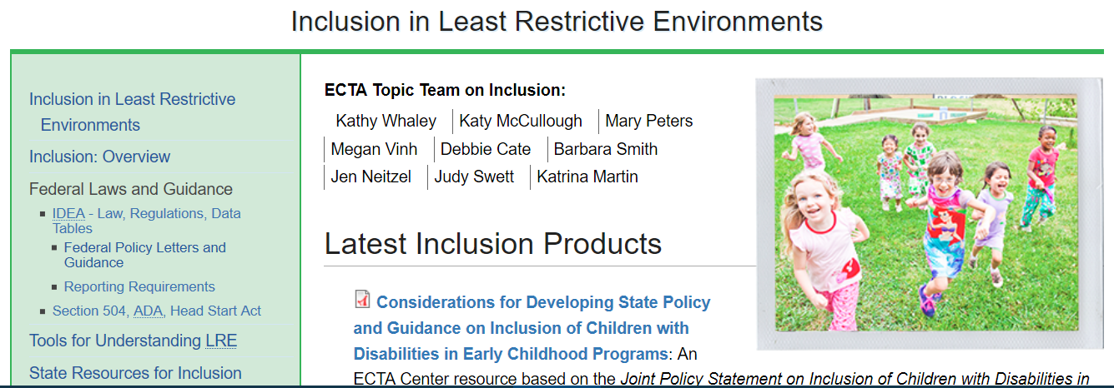
http://ectacenter.org/topics/inclusion/default.asp

Slide 4
Session Overview
Provide an overview of how an infrastructure approach can be used to examine and improve inclusion
Describe components of and resources for infrastructure analysis and alignment
Highlight New Mexico and Virginia strategies to improve inclusive practices

Slide 5
What do we mean by infrastructure?
the basic, underlying framework or features of a system or organization.
the fundamental facilities and systems serving a country, city, or area, as transportation and communication systems, power plants, and schools.(Dictionary.com)

Slide 6
Alignment Strategies
All infrastructure resources have similar components
Some are focused broadly on early childhood, ECSE or EI components
Some focus on inclusion specifically
Others can be aligned and used to look at inclusion even if not designed to do so

Slide 7
Phase I SSIP – Infrastructure Analysis
Purpose of the Infrastructure Analysis
  Determine the capacity of the current state system to support improvement and build capacity in LEA/EIS’s to implement, scale up, and sustain evidence-based practices to improve results for children and youth with disabilities
Notes:
As part of Phase I of the SSIP, the infrastructure analysis is meant to provide information about states’ capacity to support improvement at the local level. Through a detailed data and infrastructure analysis, States must assess the capacity of their current systems and their ability to enhance these to increase the capacity of Local Education Agencies (LEAs) and Early Intervention Service (EIS) programs to implement, scale up, and sustain, evidence-based practices that will result in improved outcomes for infants, toddlers and preschoolers with disabilities.

Slide 8
Infrastructure Analysis
Broad
Infrastructure Analysis
Governance
Fiscal
Quality Standards
Professional Development
Data
Technical Assistance
Monitoring and Accountability
Address State system components including:
  Governance
  Fiscal
  Quality standards
  Professional development
  Data
  Technical assistance, and
  Accountability
Notes:
Specifically, this analysis should include an assessment of certain state system components. These include: governance, fiscal, quality standards, professional development, data, technical assistance, and accountability. States must not only provide information about these specific components of their systems, but the coordination, connections, and alignment of these components with one another. As you begin your infrastructure analysis, you might consider where you have descriptions of these components already developed. For example, in policies and procedures, and other documentation. From there, you can begin to assess those areas to determine where you might need more alignment or where you need to enhance specific components.

Slide 9
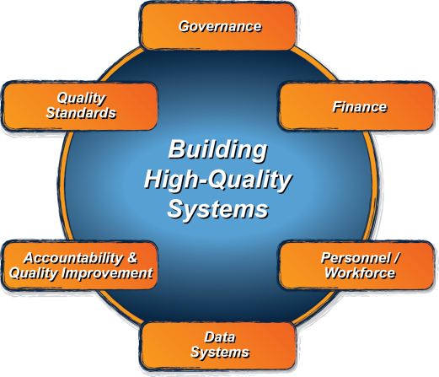
ECTA System Framework
What does a state need to put into place in order to encourage, support, require local implementation of effective practices?
ectacenter.org/sysframe
Notes:
Another resource for examining infrastructure is the ECTA Framework for Section 619 and Part C state systems.

Slide 10

Policy Statement
Notes:
The joint HHS and Ed Policy Statement on the Inclusion of Children with Disabilities in Early Childhood Programs provides nine recommendations for categories of state infrastructure practices. The policy statement offer recommendations for local action as well. It is available online at https://ed.gov/policy/speced/guid/earlylearning/joint-statement-full-text.pdf

Slide 11
Focusing on Inclusion
Explicitly states a position that all young children with disabilities should have access to inclusive high quality early childhood programs
Organized by legal foundations, research, acknowledgement of challenges, and recommendations/resources
Legal foundations apply to all early childhood programs
State and Local recommendations

Slide 12
State Level Recommendations
Create a cross-sector state-level interagency taskforce and plan for inclusion
Ensure state policies support high-quality inclusion
Set goals and track data
Review and modify resource allocations
Ensure Quality Rating frameworks are inclusive

Slide 13
State Level Recommendations
Strengthen accountability and build incentive structures
Build a coordinated early childhood professional development system
Implement statewide supports for children’s social-emotional and behavioral health
Raise public awareness

Slide 14
Alignment Strategies
All infrastructure resources have similar components
Some are focused broadly on early childhood, ECSE or EI components
Some focus on inclusion specifically
Others can be aligned and used to look at inclusion even if not designed to do so

Slide 15
Alignment Makes Sense: Examples
Review and Modify Resource Allocations
(HHS & ED Inclusion Policy Statement)
  Governance: Subcomponent 4: Leadership & Performance Management
  Finance
  Accountability and Quality Improvement
Notes:
State leadership advocates for and leverages fiscal and human resources to meet the needs for implementation and oversight of the statewide system and services.

Slide 16
Examples of Alignment
Build a Coordinated Early Childhood Professional Development System (HHS & ED Inclusion Policy Statement)
  All Personnel Subcomponents but specifically:
  Leadership, Coordination and Sustainability
  Personnel Standards
  Inservice Personnel Development
  Preservice Personnel Development

Slide 17
Examples of Alignment
Ensure Quality Frameworks are Inclusive
(HHS & ED Inclusion Policy Statement)
  Quality Standards
    Child Level Standards
    Program Level Standards

Slide 18
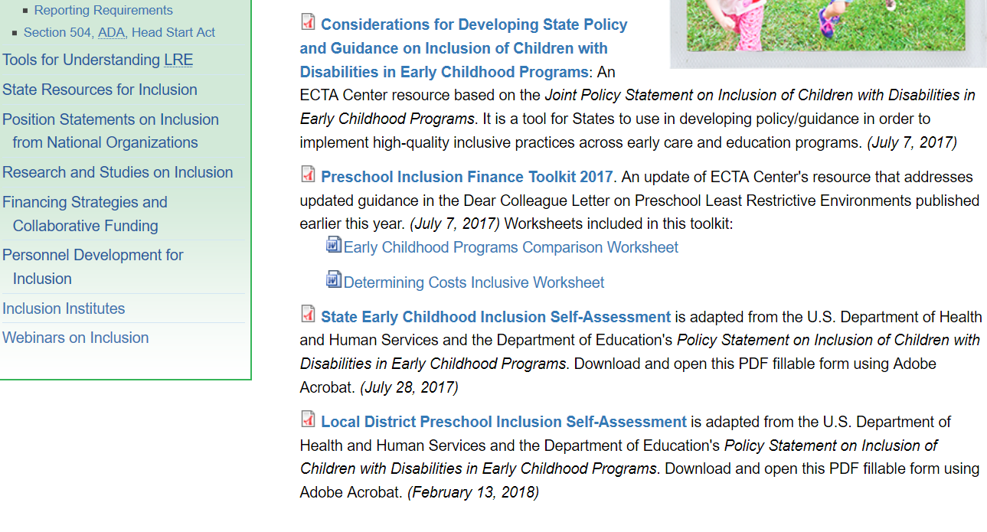
Infrastructure Tools
http://ectacenter.org/topics/inclusion/default.asp

Slide 19
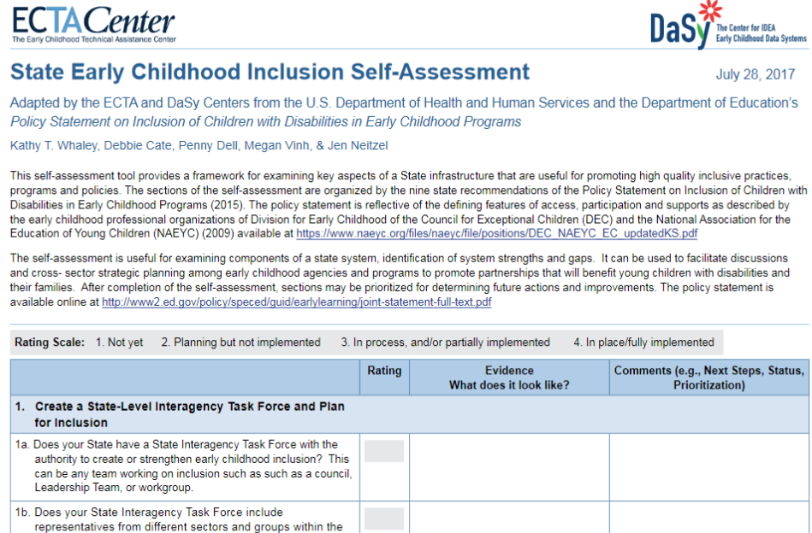

Slide 20
Find out more at ectacenter.org
The ECTA Center is a program of the FPG Child Development Institute of the University of North Carolina at Chapel Hill, funded through cooperative agreement number H326P170001 from the Office of Special Education Programs, U.S. Department of Education. Opinions expressed herein do not necessarily represent the Department of Education's position or policy.

Slide 21

of ALL
Children!

Slide 22
State Level Recommendations
Create a state-level interagency taskforce and plan for inclusion
Ensure state policies support high-quality inclusion
Set goals and track data
Build a coordinated early childhood professional development system

Slide 23
State-Level Interagency Work
Department of Education
Early Intervention
Head Start
Department of Social Services
Higher Education (2 and 4)
Local Education Agencies
Training and Technical Assistance Centers (TTACs)
Department of Health
VA Quality

Slide 24

Connect, support, and empower local leaders to build capacity and provide high-quality programs and services throughout the Commonwealth for young children, ages 2-5 years, with Individualized Education Programs
http://va-leads-ecse.org/
Notes:
Website purpose and walk through
Purpose of the website
ECSE Network
Data
Resources
IPOP

Slide 25

Guidance/ Standards/ Consistency
Data Story
Data for Program Improvement
Resources
Networking
Professional Development
Group/ Problem Solving

Slide 26

State Policies

Slide 27
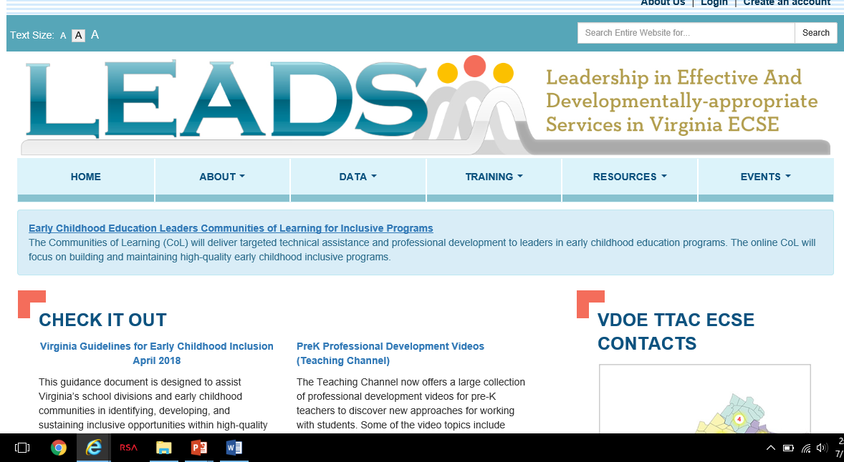
Coordinated Professional Development

Slide 28
Training and Technical Assistance Centers
  Provides professional development resources to support the development of young children with disabilities and families;
  Fosters collaboration with EC interventionists, service providers, agencies, and school and community programs;
  Promotes state priorities, federal guidance, and EBPs, supporting implementation and;
  Build the capacity of early childhood systems and programs

Slide 29

Early Childhood Education Leaders Community of Learning for Inclusive Programs

Slide 30

Inclusive Placement Opportunities for Preschoolers

Slide 31
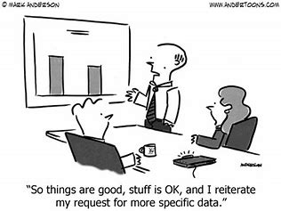
Set Goals and Track Data

Slide 32
Virginia 32%
Each bar represents one state or territory
Notes:
This is a graph comparing Virginia 2016-17 Indicator 6A data: Percent of children attending and receiving the majority of special education services in the regular early childhood program to past performance and the national average. The national average is 45% and VA’s data is at 32% an increase from 22% in the past reporting period.

Slide 33




Notes:
RTT
Legislation of the PreK Act 2005
Cross Sector: Development of Criteria 2012
Early Learning Guidelines (validated)
Consultants
Special Education
Full Participation Institute 2015
Post RTT
Special Education Director
Title 1
NMPreK
Coaches with Practice-Based Coaching
Distance Coaching
Resources
Validation Self-Study of 5⬇ Programs
Validation Confirmation Process

Slide 34
State Level Recommendations
Hired Early Childhood Special Education Coordinator to begin accelerating inclusion 2015
OSEPs Policy Guidance Letters, Dear Colleague Letter
High Quality Preschools: What’s the Evidence and What Gets in the Way – Regional discussions: struggles, lack of progress, ratios, gains, how,
Secretary’s Memo for the support FOCUS Criteria covers all state preschool programs
Ensure state policies support high-quality inclusion
Tie Special Education policy/law to the general education settings and law
Build a coordinated early childhood professional development system
Notes:
Alignment with Early Childhood Outcomes and state assessment

Slide 35
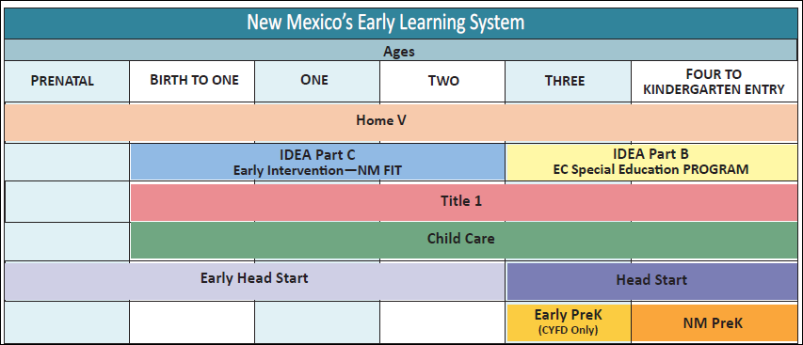

Slide 36

Resources
The State of
New Mexico
PreK Initiative
Notes:
https://prek.ped.state.nm.us/FocusSite
https://prek.ped.state.nm.us/PreKHome Resource Library
New Mexico Early Childhood Guide for Inclusion
Birth-5 https://prek.ped.state.nm.us/Docs/InclusionResourcesLib/Inclusion%20Guide%20April%201.pdf

Slide 37
Preschool Program Participation Requirements
Essential Element I: FOUNDATIONS OF QUALITY
A. Full Participation of Each Child
1. Family Engagement
2. Inclusive Practices for Children with Diverse Abilities
3. Culture and Language, Including the Support of Dual Language Learners
4. Promoting Social Relationships

Slide 38
Preschool Program Participation Requirements
B. Health, Safety, Nutrition, and Developmental Screenings
C. Ratios and Group Size
Professional Qualifications
1. Preschool Administrator/Internal Coaches
2. Teachers and Educational Assistants

Slide 39
Preschool Program Participation Requirements
Essential Element II: QUALITY PRACTICES THAT SUPPORT CHILDREN’S GROWTH DEVELOPMENT AND LEARNING
A. Intentional Teaching
1. ERS
2. Effective Early Literacy Instruction
3. Lesson Plans
4. Assessment
B. Continuous Quality Improvement Process
Notes:
FOCUS Verification Phase I and Phase II

Slide 40
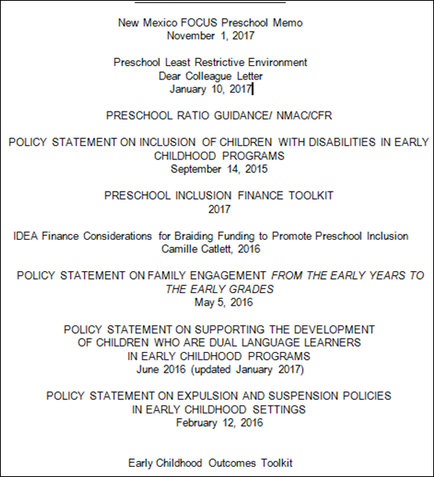
FOCUS
CRITERIA
RESOURCES

Slide 41
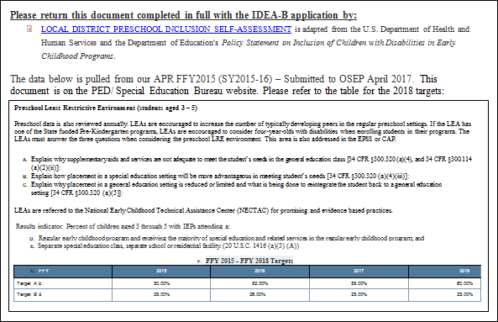
I
N
D
I
C
A
T
O
R
6
2018
60%
25%
Notes:
Latest initiative: Self Assessment, state target, FOCUS
Current Reality 44% for 2018
11 New Districts Funded
? Expansions

Slide 42
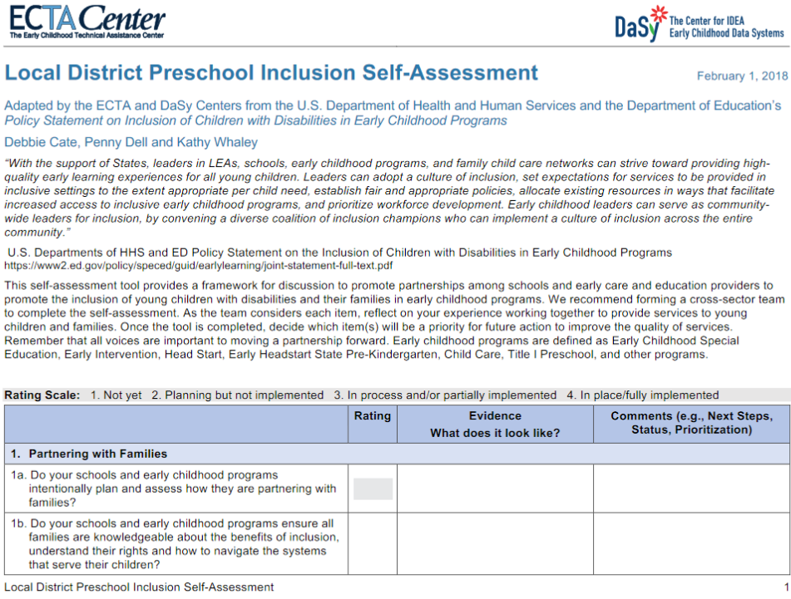
Notes:
Located at http://ectacenter.org/~pdfs/topics/inclusion/local-inclusion-self-assessment.pdf

Slide 43
Professional Development
Infrastructure Strategies
Full Participation Institute December 2015
System of Coaches
Early Childhood Observation Tool
ECERS-3
*The Full Participation of Each Child
*New Mexico Pyramid Framework
*Intentional Teaching
Special Education Guidance
Validation Modules for all Prek Programs

Slide 44
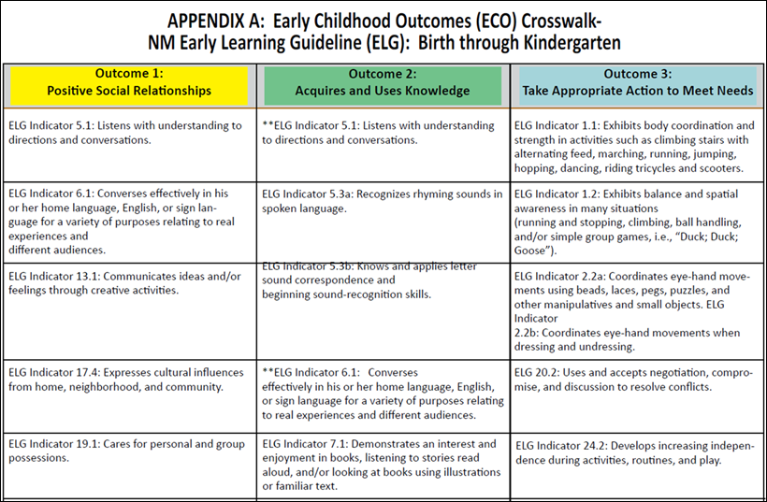
Phase 3
Alignment
Database

Slide 45
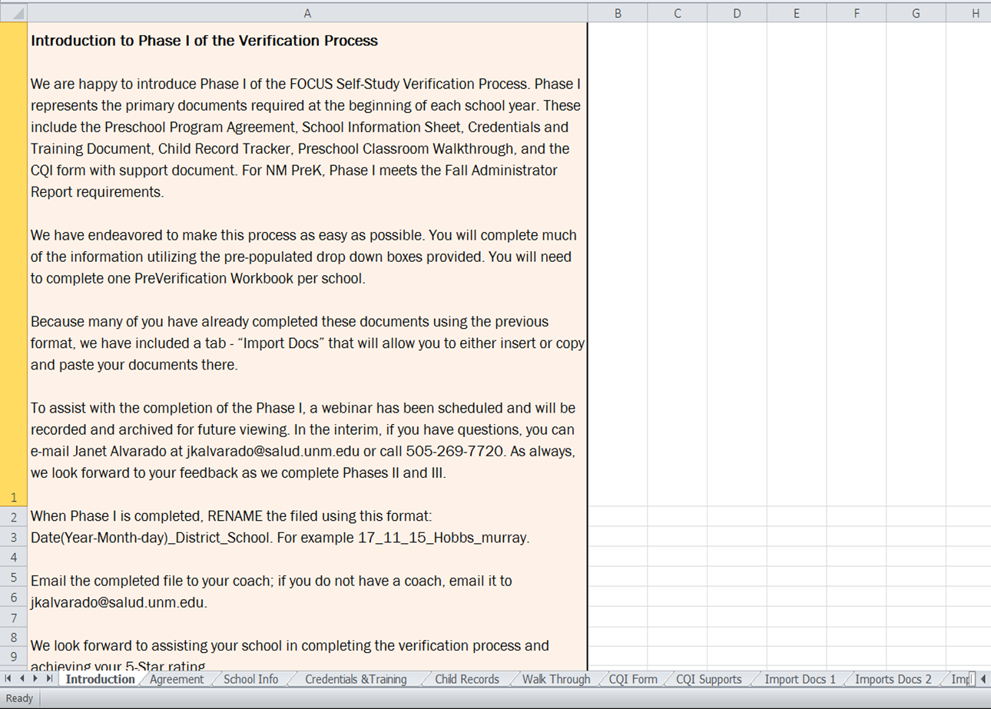
FOCUS Verification Process Phase I

Slide 46
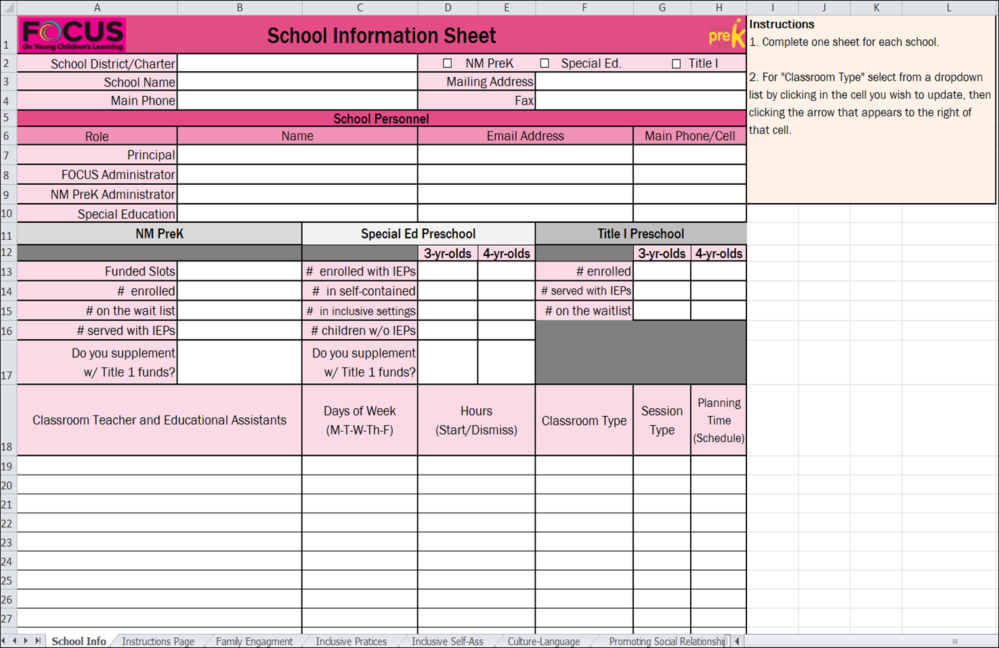


Slide 47
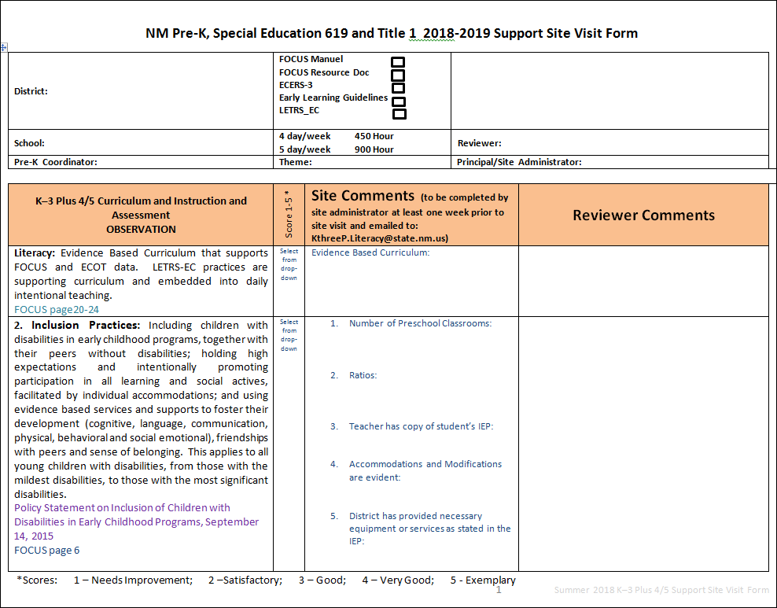
Public Education Department
Site Visit Form
Aligned across
Title1,
Special Education, and NM PreK

Slide 48
Collaboration with our VALUABLE Partners
This work does not happen in isolation!
Federal—ECTA/OSEP in helping to increase inclusion; CCSSO and CEELO in reaching high quality standards through CQI; AIR in standards and assessment validation studies
State—CYFD, DOH, Early Childhood Governance Team, Governor’s Early Learning Advisory Council, Early Childhood Higher Education Task Force, UNM Center for Development and Disability
Interdepartmental—Language and Culture Bureau, Indian Education Bureau, Information Technology Bureau, Priority Schools Bureau, and Regional Educational Cooperatives

