Slide 1
Building Inclusive Practices: Strategic Use of State Infrastructure Analysis and Data
2018 Improving Outcomes, Improving Data Conference

Slide 2
Welcome and Introductions
Megan Vinh & Kathy Thompson Whaley, ECTA Center
Suzanne Perry
Early Childhood Special Education Director,
  Arizona Department of Education
Kristy Doan
Principal Consultant, Early Childhood
Illinois State Board of Education

Slide 3
Workshop Outcomes
Participants will gain an understanding of infrastructure components in a system that relate to inclusion
Participants will gain information about state approaches to modify or improve aspects of their infrastructure to improve inclusion
Participants will become aware of resources and tools to support infrastructure self-assessment

Slide 4
Session Overview
Provide an overview of how an infrastructure approach can be used to examine and improve inclusion
Describe components of and resources for infrastructure analysis and alignment
Highlight Arizona and Illinois strategies to improve inclusive practices

Slide 5
What do we mean by infrastructure?
the basic, underlying framework or features of a system or organization.
the fundamental facilities and systems serving a country, city, or area, as transportation and communication systems, power plants, and schools.(Dictionary.com)

Slide 6
Alignment Strategies
All infrastructure resources have similar components
Some are focused broadly on early childhood, ECSE or EI components
Some focus on inclusion specifically
Others can be aligned and used to look at inclusion even if not designed to do so

Slide 7
Infrastructure Analysis
Purpose of the Infrastructure Analysis
  Determine the capacity of the current state system to support improvement and build capacity in LEA/EIS’s to implement, scale up, and sustain evidence-based practices to improve results for children and youth with disabilities
Notes:
As part of Phase I of the SSIP, the infrastructure analysis is meant to provide information about states’ capacity to support improvement at the local level. Through a detailed data and infrastructure analysis, States must assess the capacity of their current systems and their ability to enhance these to increase the capacity of Local Education Agencies (LEAs) and Early Intervention Service (EIS) programs to implement, scale up, and sustain, evidence-based practices that will result in improved outcomes for infants, toddlers and preschoolers with disabilities.

Slide 8
Infrastructure Analysis Components
Addressed in analysis:
  Governance
  Fiscal
  Quality standards
  Professional development
  Data
  Technical assistance, and
  Accountability
Broad
Infrastructure Analysis
Governance
Fiscal
Quality Standards
Professional Development
Data
Technical Assistance
Monitoring and Accountability
Notes:
Specifically, this analysis should include an assessment of certain state system components. These include: governance, fiscal, quality standards, professional development, data, technical assistance, and accountability. States must not only provide information about these specific components of their systems, but the coordination, connections, and alignment of these components with one another. As you begin your infrastructure analysis, you might consider where you have descriptions of these components already developed. For example, in policies and procedures, and other documentation. From there, you can begin to assess those areas to determine where you might need more alignment or where you need to enhance specific components.

Slide 9
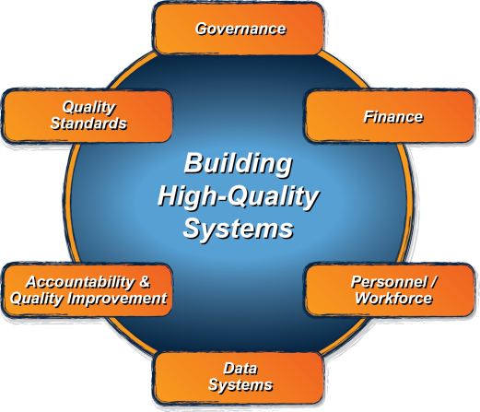
ECTA System Framework
What does a state need to put into place in order to encourage, support, require local implementation of effective practices?
ectacenter.org/sysframe
Notes:
Another resource for examining infrastructure is the ECTA Framework for Section 619 and Part C state systems.

Slide 10

Policy Statement
Notes:
The joint HHS and Ed Policy Statement on the Inclusion of Children with Disabilities in Early Childhood Programs provides nine recommendations for categories of state infrastructure practices. The policy statement offer recommendations for local action as well. It is available online at https://ed.gov/policy/speced/guid/earlylearning/joint-statement-full-text.pdf

Slide 11
Focusing on Inclusion
Explicitly states a position that all young children with disabilities should have access to inclusive high quality early childhood programs
Organized by legal foundations, research, acknowledgement of challenges, and recommendations/resources
Legal foundations apply to all early childhood programs
State and Local recommendations

Slide 12
State Level Recommendations
Create a cross-sector state-level interagency taskforce and plan for inclusion
Ensure state policies support high-quality inclusion
Set goals and track data
Review and modify resource allocations
Ensure Quality Rating frameworks are inclusive

Slide 13
State Level Recommendations
Strengthen accountability and build incentive structures
Build a coordinated early childhood professional development system
Implement statewide supports for children’s social-emotional and behavioral health
Raise public awareness

Slide 14
State Indicators of High Quality Inclusion
Cross Sector Leadership Team. The state has a cross-sector leadership team with the authority to plan and make decisions related to statewide inclusion.
Mission and Vision. The state has a mission and vision related to high-quality inclusion for all young children that guides all planning and improvement activities.
Policy/Guidance. State early childhood agencies/programs have policies that promote high quality inclusion in all early care and education environments, and are aligned with one another.
Family Engagement. State policies and activities related to increasing high-quality inclusion promote, support and evaluate family engagement at both the state and local level.
Incentives. All state early childhood agencies/programs provide incentives (e.g., grants, QRIS rating) for providing access to and participation within high-quality inclusive environments.
Accountability and Continuous Quality Assurance Systems . All state agencies hold programs accountable (e.g., sanctions, corrective action plans, QRIS rating) for providing access to and participation within high-quality inclusive environments.

Slide 15
State Indicators of High Quality Inclusion
Collaborative Funding Strategies. All state early childhood agencies/programs allow and actively support cross-sector collaborative funding to leverage and ensure high-quality inclusion is adequately funded (e.g., accountable funding mechanisms or braided funding, and interagency agreements).
Data on Access and Participation. Federal and state early childhood agencies require the collection and use of data to improve their understanding of how well children are accessing and participating in early childhood programs (e.g., LRE data; suspension/expulsion data, observation data; equity data).
Quality Rating and Improvement Systems (QRIS). QRIS quality ratings, program standards and indicators address procedures and practices for providing high quality care for children with diverse abilities
Early Learning Standards/Guidelines. Early Learning Standards or Learning Guidelines provide specific strategies and adaptations to support children with special needs and inform the development of personnel standards.

Slide 16
State Indicators of High Quality Inclusion
Allocate Professional Development Resources. State early childhood agencies/programs allocate professional development resources (e.g., coaching, itinerant teachers, professional development providers, Infant Mental Health consultants) to ensure all administrators and practitioners have the supports needed to effectively include all children and ensure that they are actively engaged in all daily routines and activities.
Effective Cross-Sector PD system Focusing on Inclusion. The state employs a cross-sector approach that coordinates professional development efforts strategically using program data and evidence-based adult learning strategies to support the capacity of program staff to provide high quality inclusive services, including those children with significant needs.
EC Personnel Standards, Certification, Licensure Requirements. Early childhood personnel standards, certifications, licensure requirements include competencies for supporting children with disabilities and their families (e.g., evidence-based practices aimed at reducing challenging behaviors) and are aligned with the state early learning standards.

Slide 17
State Indicators of High Quality Inclusion
Institutes of Higher Education. Institutes of higher education include specific courses and practicum experiences to prepare practitioners to effectively support children with disabilities (including those with the most significant needs) and their families, and to partner with practitioners across sectors.
Public Awareness. States implement an ongoing public awareness campaign to inform the early childhood field and community-at-large of the importance of inclusion and to elicit advocacy for high-quality inclusion.

Slide 18
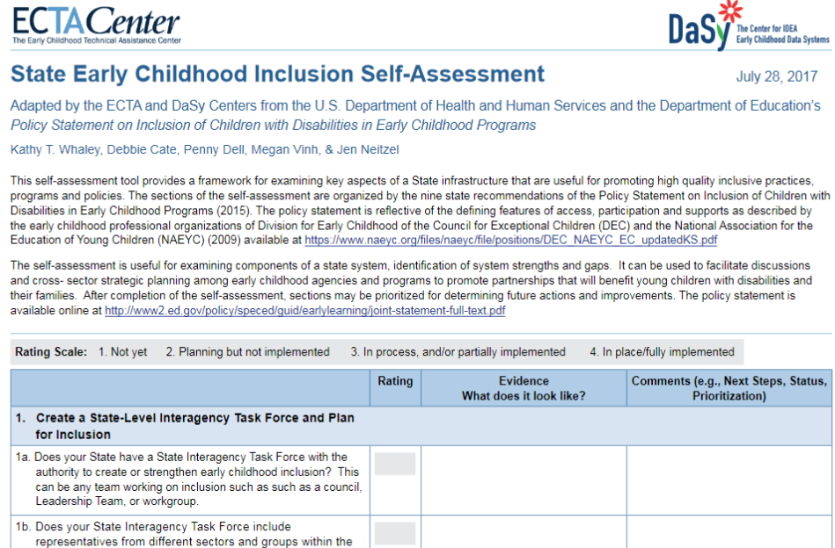

Slide 19


Slide 20
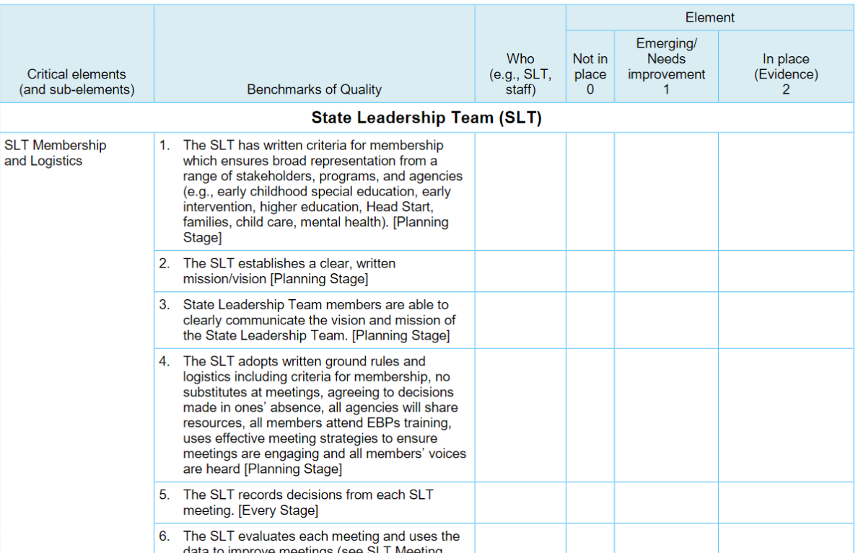

Slide 21
Alignment Makes Sense: Examples
Review and Modify Resource Allocations
(HHS & ED Inclusion Policy Statement)
  Governance: Subcomponent 4: Leadership & Performance Management
  Finance
  Accountability and Quality Improvement
Notes:
State leadership advocates for and leverages fiscal and human resources to meet the needs for implementation and oversight of the statewide system and services.

Slide 22
Examples of Alignment
Build a Coordinated Early Childhood Professional Development System (HHS & ED Inclusion Policy Statement)
  All Personnel Subcomponents but specifically:
  Leadership, Coordination and Sustainability
  Personnel Standards
  Inservice Personnel Development
  Preservice Personnel Development

Slide 23
Examples of Alignment
Ensure Quality Frameworks are Inclusive
(HHS & ED Inclusion Policy Statement)
  Quality Standards
    Child Level Standards
    Program Level Standards

Slide 24
Activity

Slide 25
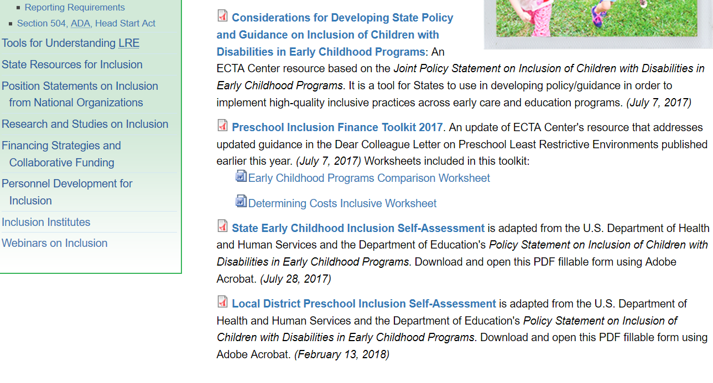
Additional Infrastructure Tools
http://ectacenter.org/topics/inclusion/default.asp

Slide 26

Arizona’s Inclusion Task Force
2018

Slide 27
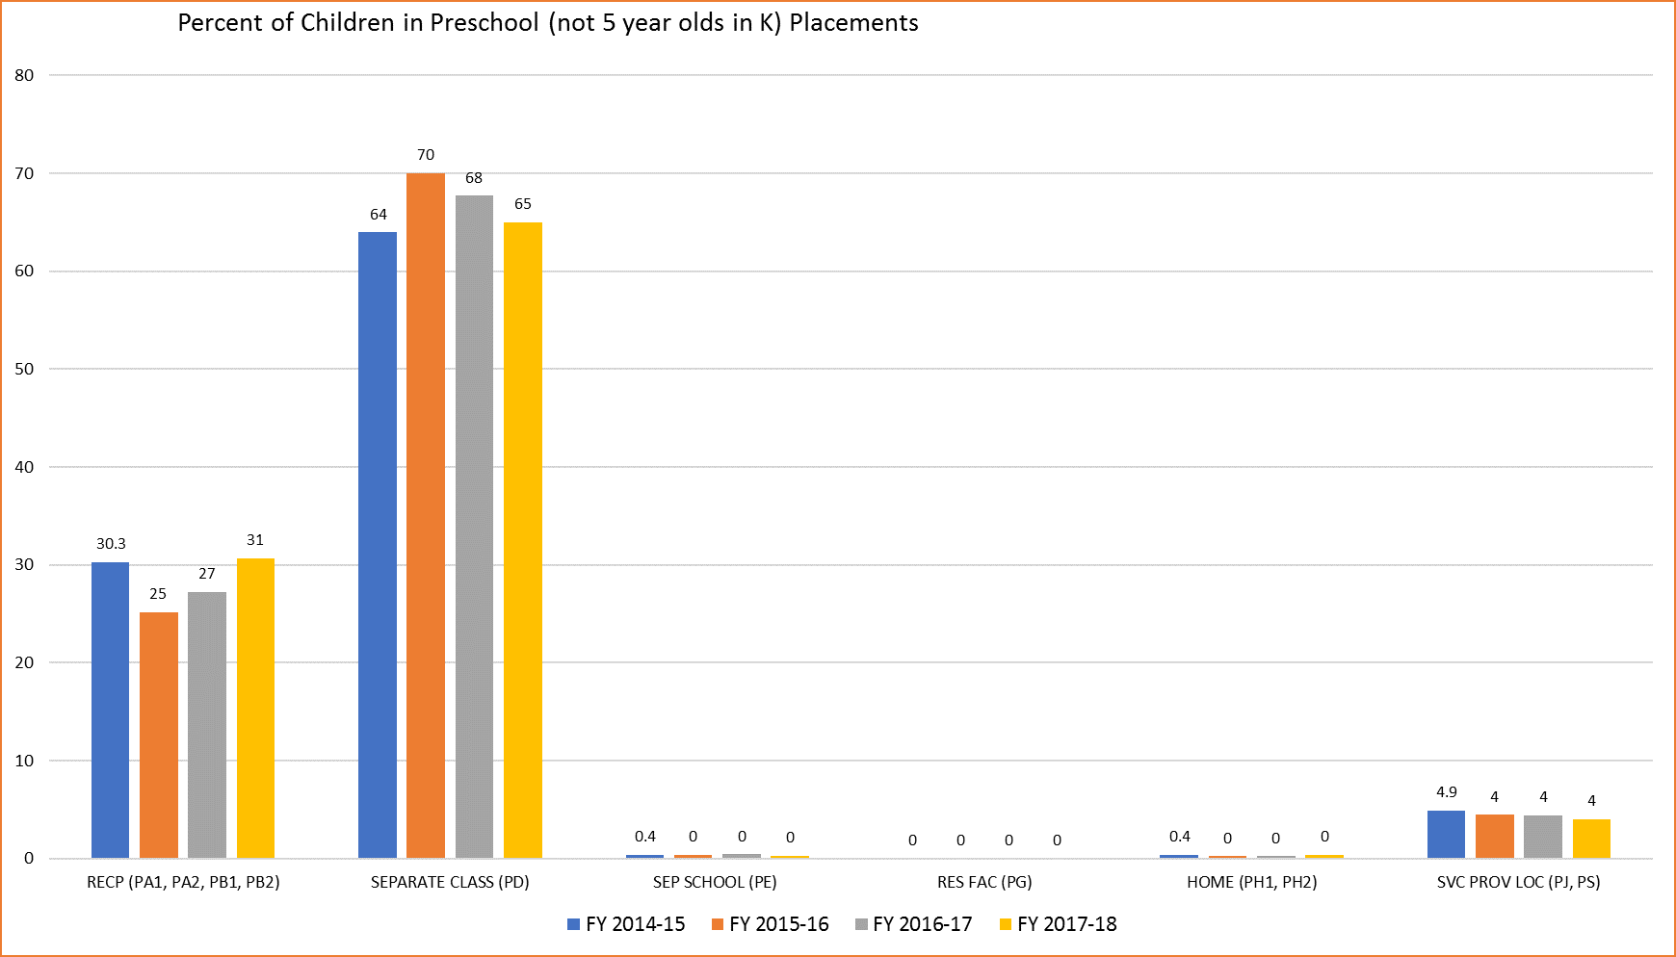
Inclusion Rates SY 2014-18

Slide 28
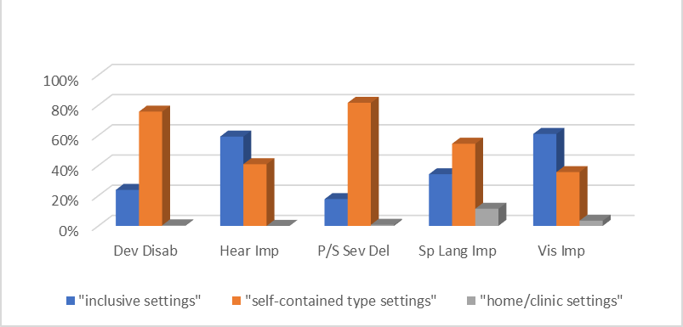
Percent of Children by Eligibility Type and Setting

Slide 29
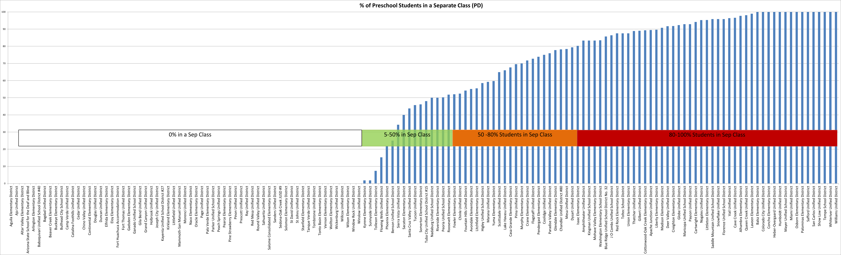
Percent of Children in Separate Settings by School District

Slide 30
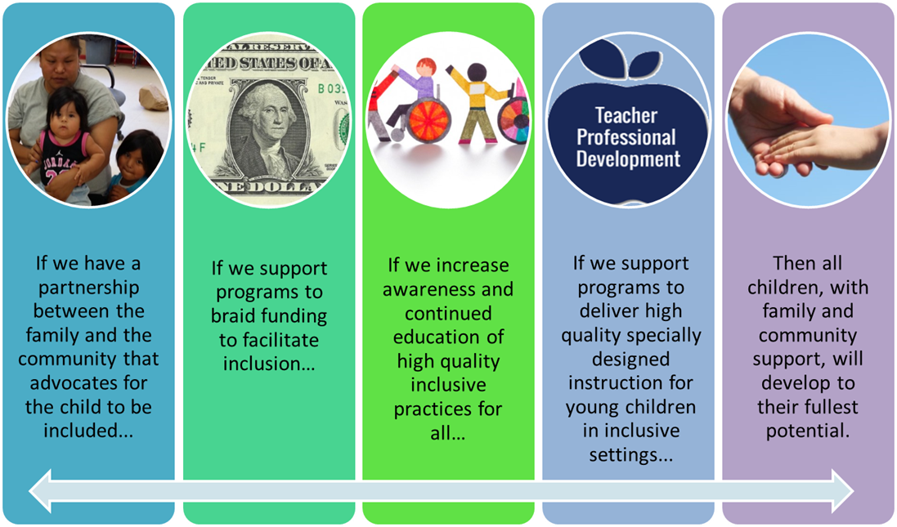
Inclusion Task Force Theory of Change
http://www.azed.gov/ece/inclusion/

Slide 31
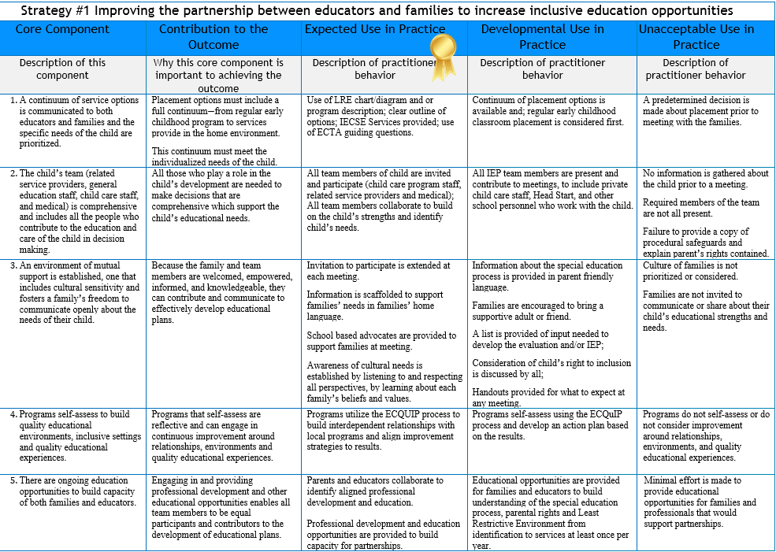
Strategy 1: Support School and Family Partnerships

Slide 32

Strategy 2:Braid Funding Streams

Slide 33

Strategy 3: Build Awareness through Partnerships

Slide 34
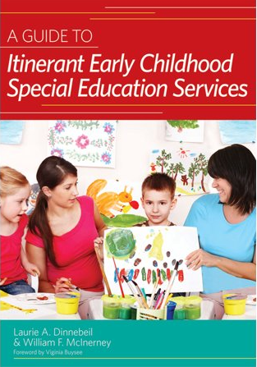

Strategy 4: Offer Professional Development on SDI

Slide 35
Illinois
Kristy Doan
619 Coordinator
Principal Consultant
Illinois State Board of Education

Slide 36
Preschool Environments
SPP Indicator 6
Percent of children aged 3 through 5 with IEPs attending a:
6A: Regular early childhood program and receiving the majority of special education and related services in the regular early childhood program;
6B: Separate special education class, separate school or residential facility.
852 school districts in Illinois
Indicator 6A Actual 16-17 | Indicator 6A Target 16-17 | Difference
40.00 | 32.70 | 7.30
Indicator 6B Actual 16-17 | Indicator 6B Target 16-17 | Difference
26.76 | 30.70 | 3.94
Notes:
These tables represent where we are in Illinois regarding inclusive education for students. In our most recent data we have available, Illinois has improved to 40.0% of students being served in a regular early childhood program. This is 7.30% above our goal for our SPP.
26.76% of students continue to be educated in a separate setting. This is 3.94% ahead of our goal. We are moving in the right direction!
It is also important to share that Illinois has 852 school districts throughout the state. Not all of these serve early childhood students, as some are high school only districts, but still a large number of districts.

Slide 37
SPP 6A: ISBE Early Childhood Students Ages 3-5 in Regular Early Childhood Programs and Receiving the Majority of Special Education Related Services in that Location
Notes:
This graph shows our Indicator 6A data throughout the years. The blue line represents our data, the red line is our goal, and the green line is the national average. You can see we have had a steady increase in students served in a regular education environment. The 2013-2014 data is where you start to see a larger increase in our data. This is when our concentrated efforts began on targeted LEA TA, which I will share with you during this time today.

Slide 38
SPP 6B: Percent of ISBE Early Childhood Students Ages 3-5 in a Separate Special Education
Notes:
This graph shows our trend for Indicator 6B data. Again, the blue line represents our data, the red is our target and the, and the green is the national average. We have steadily been decreasing the number of students served in a separate setting.

Slide 39

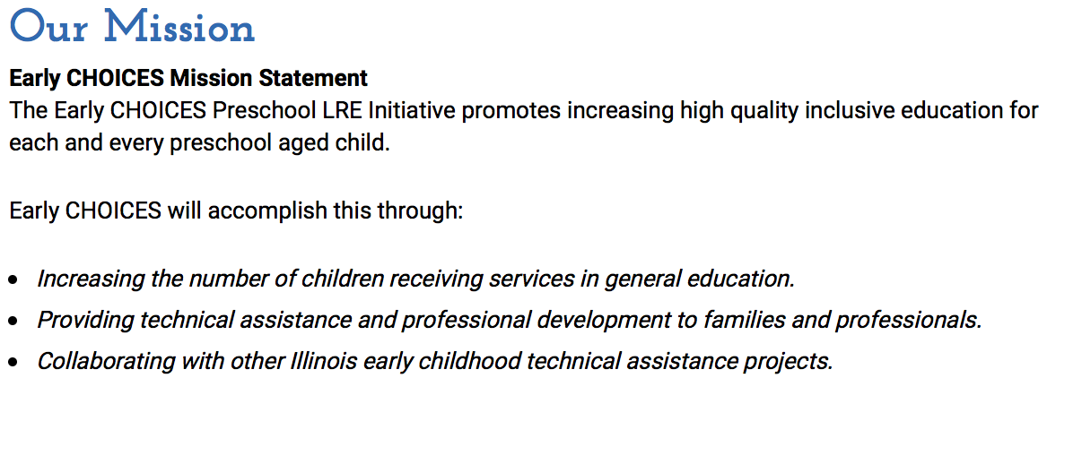
Notes:
In Illinois, we are lucky to have a couple of wonderful professional development and technical assistance projects supported through preschool discretionary funds.
Early CHOICES is our preschool LRE initiative. They are small, but mighty and serve the whole state through workshops TA and collaborating with the districts to support change. They have been an integral part of the activities we have completed to work on our LRE data.

Slide 40

Our Mission
Illinois STARnet provides a variety of opportunities for personal and professional growth for those who touch the lives of young children, ages birth through eight, with an emphasis on children with special needs. STARnet supports family-centered, researched and effective practices in early childhood education and care.
Notes:
STAR NET is our other discretionary project and they work closely with Early CHOICES. They are divided in to 6 regions throughout the state. Early CHOICES works with STAR NET to provide more ongoing support to programs. STAR NET expands beyond focusing on inclusive practices. They provide professional development and technical assistance with a focus on early childhood special education best practices.
Without these two systems, our LRE efforts would be much more difficult.

Slide 41
Inclusion Cohort
Monthly Phone Meetings
In person Meetings
Self Assessment using Policy Statement
DaSy Systems Framework-Accountability
Set Goals
Notes:
Illinois was lucky enough to have the opportunity to take part in the Inclusion Cohort the ECTA Center put on beginning in May of 2016 and lasted for just over a year. Through this cohort, we had the support of TA providers, which has actually continued on past the close of the cohort. We had monthly Cohort team calls with our TA providers and got to have cross state meetings two times to hear about the work of our fellow states participating in the cohort. We used the different self-assessment tools ECTA provided in order to set our goals and get to work. Several of the items we will talk about today were a result of this cohort.

Slide 42
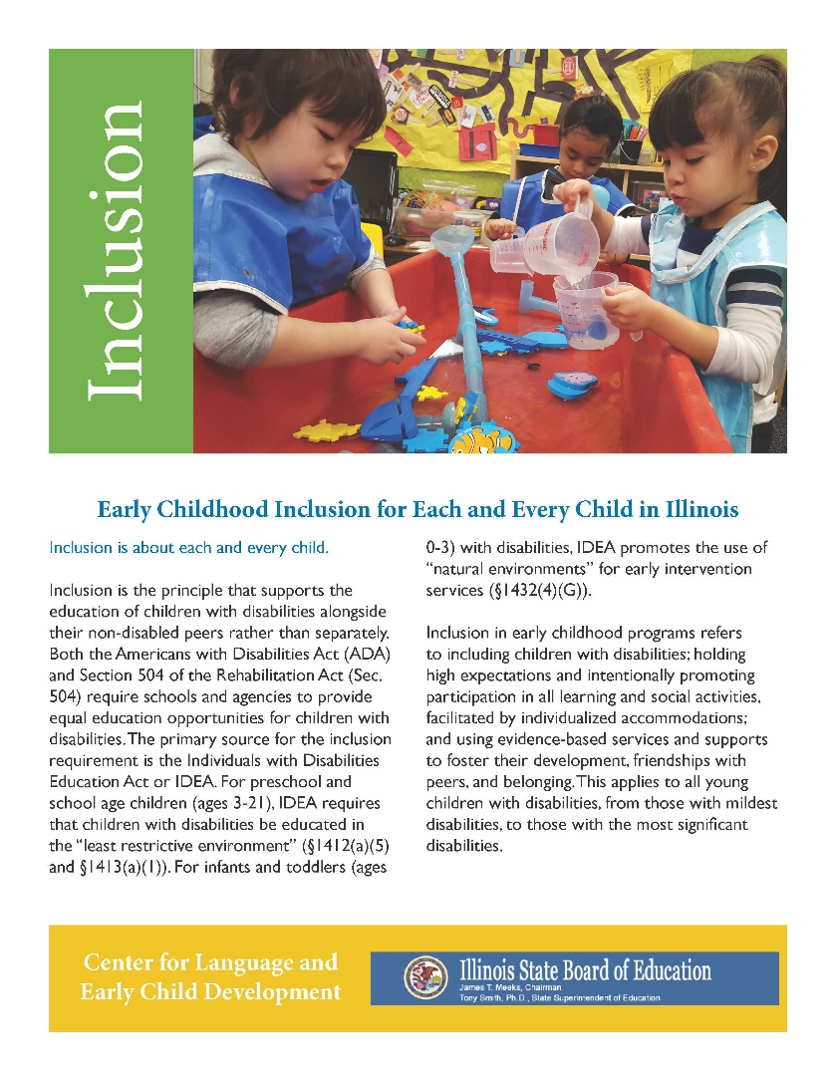
EC LRE Stakeholders
Accountability Priority Group
Statewide Supports for Children’s Social Emotional and Behavioral Health
Policy Advisory Workgroup
http://www.eclre.org/ec-lre-consortium.aspx
Notes:
Another support for inclusion we have is the Early Childhood LRE Stakeholders Consortium. This includes representation from state level staff (education, child care, head start, and Early Intervention), TA providers, LEAs and parents. This group meets quarterly. We used the Policy Statement to discuss our strengths and weaknesses as a state and developed three priority groups from this discussion.

Slide 43
LEA Roundtables
121 LEAs Invited in 16-17, continued in 17-18
  43 already have improved data
  77 still working towards improved data
145 LEAs will be invited in 18-19
  Less 10% of children with IEPs served in a regular early childhood program with majority of supports in the regular in program
  More than 50% of the children with IEPs ages 3-5 served in separate placements with no access to regular early childhood program
Notes:
Perhaps our most effective activity that has worked towards improving LRE data is our LRE Roundtables.
Different programs are targeted in two year cycles. Programs are invited to participate because of their data. The training session consists of information about accurate data, hearing from programs who have successful inclusive programs, breakout sessions to discuss different barriers to inclusion more in depth, and an Inclusive Inquiry Cycle. Programs were then required to submit an improvement plan. Early CHOICES and STAR NET then followed up with programs to give support throughout the year.
This year we will be targeting a new group of programs.

Slide 44
Inclusive Inquiry Cycle
1. Analyze Data
2. Identify Key Issues and Questions
3. Set Learning and Improvement Goals
4. Investigate Resources
5. Develop and Tune Action Plan
6. Implement Plan and Collect Data
Notes:
Illinois is an Expansion Model state. When this was first awarded, a “Lead, Learn, Excel” program was developed to provide professional development to leaders to then bring back to their programs. One of the topics was using an inquiry cycle for program improvement. We worked with The Ounce, the developers of Lead Learn Excel, to adjust the inquiry cycle to focus on inclusive practices specifically. This cycle is used in our roundtable. The steps are used for check in points. Programs receive a survey 4 times a year, which includes questions from the step of the cycle they are currently on. This is to keep programs accountable to the work and not forget about their plan.

Slide 45
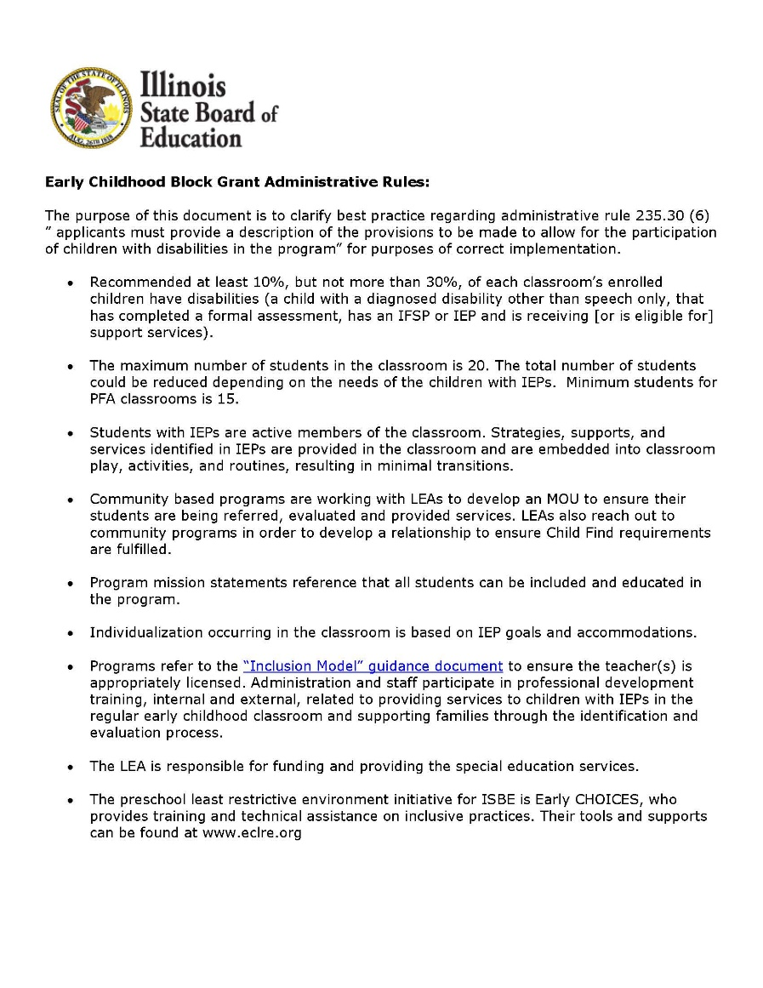
Inclusion Clarification/RFP
Clarify best practice regarding administrative rule 235.30 (6) ”applicants must provide a description of the provisions to be made to allow for the participation of children with disabilities in the program” for purposes of correct implementation.
https://www.isbe.net/Documents/Inclusion_for_RFP.pdf
Notes:
Last spring ISBE issued this clarification on the administrative rule regarding including children with disabilities in programs in Preschool for All programs, our state funded competitive grant based preschool program. The rule you see on the screen is what guides the PFA programs. When we looked at this, we decided that it is very general, so we issued a clarification document. The clarification document discusses a recommendation that PFA classes contain at least 10% of students with special needs, that students with IEPs should be active members of the classroom, mission statements should reference all students, an inclusion model document and professional development support.
Programs competed for the PFA program over the past year for 2019 school year funding. The information from this clarification document was embedded in the Exemplary column of the PFA RFP, so if programs committed to these high quality inclusive practices, they essentially cored higher on the application process.

Slide 46
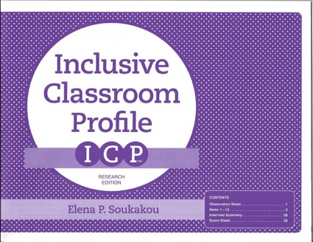
The Inclusive Classroom Profile (ICP)
Research based, rooted in best practices
Professional Learning
Self reflection
Outstanding Practices in Inclusion
Notes:
Our friends at Early CHOICES love the Inclusive Classroom Profile. If you are not familiar with it, it is an observational tool to look at classroom environment and interactions through the lens of a student with special needs in order to encourage high quality inclusive practices. Early CHOICES uses this in giving TA to programs. Programs are also encouraged to use it for self reflection, and items from this have also become the basis for developed PD on inclusive practices.

Slide 47
Outstanding Practices in Inclusion http://www.eclre.org/good-to-know/outstanding-practices-in-inclusion.aspx
High Quality programs with a philosophy and practice of inclusion
Gather and present information to that highlights program and classroom practices using the Illinois Inclusion Guidelines. Presentation reviewed to meet the Illinois Inclusion Guidelines at least 80%
Verify with a qualified assessor to complete the Inclusive Classroom Profile with average score of 5 or higher on a 7 point scale across 12 practices.

Slide 48
Federal Policy Statement Module
Developed by Early CHOICES
Reviews the Federal Policy Statement on Inclusion of Children with Disabilities
Three sections and summary:
  Introduction to the policy statement
  Strategies to overcome challenges
  Partnerships to build a culture of inclusion
  Summary of the module
Reflection Guide and Resource Guide
http://www.eclre.org/good-to-know/inclusion-policy-statement-module.aspx
Notes:
This module developed by Early CHOICES reviews the Federal Policy Statement on Inclusion of Children with Disabilities in Early Childhood Programs that was issued by the U.S. Department of Health and Human Services U.S. Department of Education on September 14, 2015.
The module is in three sections and a summary:
Introduction to the policy statement: overview of what inclusion is and why it is important.
Strategies to overcome challenges to inclusion within early childhood program
Partnerships to build a culture of inclusion
Summary of the module
Each section includes activities and additional resources to consider as you reflect on the ways that inclusion impacts your practices. A Reflection Guide can be downloaded to manage your reflections and any resources you’d like to further explore. Also, available is a Resource Guide with all of the documents and links used in the modules.

Slide 49

Illinois Inclusion Summit
Funded through Illinois Council on Developmental Disabilities
Leaders across all Illinois early childhood systems
Create shared awareness of the state of early childhood inclusion
Follow-Up
http://www.eclre.org/good-to-know/illinois-early-childhood-inclusion-policy-summit.aspx
Notes:
The Illinois Council on Developmental Disabilities (ICDD) funded Early CHOICES to convene an Illinois Early Childhood Inclusion Summit. The Summit provided a unique and critical opportunity for leaders across all Illinois early childhood systems to advance the priorities in the United States Departments of Education (ED) and Health and Human Services (HHS) jointly released Policy Statement on Inclusion in Early Childhood Programs.
The purposes of the Summit were to:
Create a shared awareness of the state of early childhood inclusion policy in Illinois
Develop priorities for improving policy to support inclusion of young children across all agencies and stakeholders in Illinois
Facilitate a true working meeting among leaders in early childhood systems in Illinois
This event was a success and a follow up was held this spring in order to continue the conversation. Updates were provided by each of the state agencies participating and more in depth discussion was held on these three areas. Work groups were developed to further advance this work.

Slide 50
Going Forward
Formalized monitoring
Inclusion Policy Statement
Community Based Programs
Improve data to the national average and beyond
Notes:
Going forward, we have done quite a bit to advance inclusion, but we have more to go.

Slide 51
Kristy Doan kdoan@isbe.net
217-524-4835

Slide 52
Activity

Slide 53
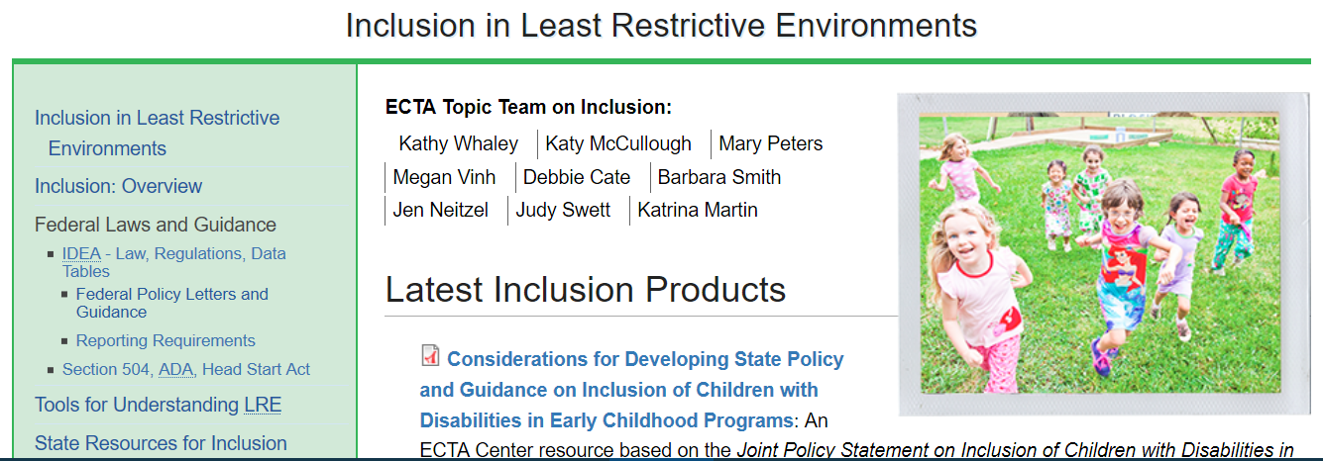
http://ectacenter.org/topics/inclusion/default.asp

