Slide 1
Taking leadership to a new level
Helping early intervention leaders adapt to change and move programs and policies to success for young children
Notes:
INTRO - Lori

Slide 2
Our Session
Leadership development is an on-going process and it involves complex skills and abilities related to establishing vision and direction, providing motivation and guidance, and promoting collaboration within and across agencies and programs. This session will help participants better understand the characteristics of a good leader and reflect on your own leadership skills. State experiences and resources will be shared that support knowledge and skill development in individual leaders.
Notes:
Intro Lori
Discuss purpose and intended outcomes
Understanding of skills and capacity needed to be an effective leader in EC, EI/ECSE
Awareness of existing (and coming) tools and resources related to leadership
Leadership challenges identified by ECPC through TA to-date
Characteristics of effective leaders as identified through ECPC work
Motivate people around the topic of leadership development

Slide 3
Who is in the room?
Presenters
Mary Beth Bruder, ECPC
Lori Connors-Tadros, CEELO
Jana Martella, CEELO
Stacy Kong, Part C Hawaii
Lisa Wasacz, 619 Michigan
Participants
Notes:
Jana - Very short intros by each of us and Jana to Facilitate and find out who is in the room as participants -

Slide 4
Notes:
Mary Beth run through intro slides on systems and leadership

Slide 5
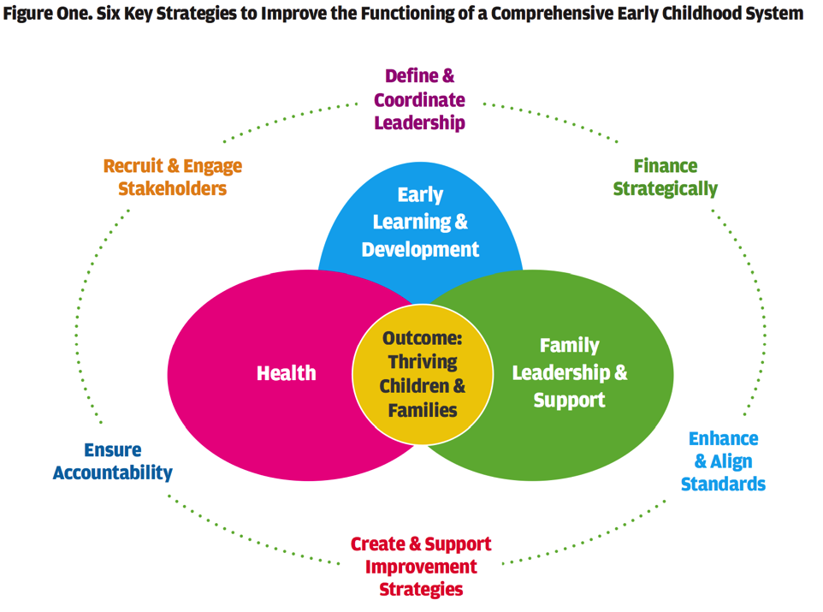
WHAT WE THINK THE SYSTEM LOOKS LIKE
Notes:
Jana

Slide 6
WHAT WE THINK THE SYSTEM LOOKS LIKE
Notes:
Mary Beth

Slide 7
Personnel Standards
State and/or national certification or licensure requirements for all personnel who provide early childhood intervention
Recruitment and Retention
Strategies to attract and maintain a quality workforce in early childhood intervention
Leadership, Coordination & Sustainability
Mechanisms to insure a CSPD maintains itself over time
Preservice Training
Learning experiences provided to early childhood intervention personnel as part of a degree or certificate program
Inservice Training
Ongoing job-related learning for personnel who provide early childhood intervention
WHAT WE THINK THE SYSTEM LOOKS LIKE
Evaluation
Progress monitoring of all CSPD activities
Notes:
Mary Beth

Slide 8
Purpose of the ECPC Leadership Program
To Integrate
Part C/Part B 619 Systems
into State Early Childhood Systems:
Policies, Practices, Programs, and
Personnel Development Activities
Notes:
Mary Beth
Project work: ECPC (10)
Project work; needs around leadership; supports provided
Summary of literature review from Carl

Slide 9
Leadership Teams
Part C Coordinator
Part B 619 Coordinator
State Early Childhood Coordinator
IHE Faculty
Family Member

Slide 10
* Leadership Institute
Cohort 1:
Arizona*
Colorado
Connecticut
Delaware*
Idaho
Rhode Island
South Carolina*
Cohort 2:
Alaska
Massachusetts
Minnesota*
Nevada*
Tennessee
Texas
Virginia
Washington D.C.
Cohort 3:
Hawaii
Michigan*
New York
Ohio
Puerto Rico*
Cohort 4:
Illinois
Mississippi
New Mexico
Vermont
Washington
Cohort 5:
Connecticut
Florida
Illinois
Indiana

Slide 11
Strategic Plan Work Plan
Goals/Objectives | Strategy | Persons Responsible | Timeline | Completion | Evaluation
GOAL 1.
Objective 1.
Objective 2.
Objective 3.
GOAL 2.
Objective 1.
Objective 2.
Objective 3.
GOAL 3.
Objective 1.
Objective 2.
Objective 3.

Slide 12
Percent of Themes Across All Action Plan Goals

Slide 13
Objectives of the Leadership Research Synthesis
Identify the relationships between different types of leadership practices and seven different study outcomes
Determine if different leadership practices are differentially related to the study outcomes
Evaluate the extent to which relationships between the leadership practices and study outcomes to inform adoption of particular types of leadership practices to have outcomes of interest
Determine if the relationships between the leadership practices and study outcomes are the same or different as a function of other factors (e.g., type of program or organization)
Use the findings from different sets of analyses to prepare R2P (Research to Practice) Leadership Briefs to inform adoption of evidence-informed leadership practices

Slide 14
Overview of the Studies in the Synthesis
112 studies of leadership practices-outcome measure relationships
The studies included 39,433 participants
Approximately half of the participants were male and half were female
Studies were conducted in 31 different countries
Studies were conducted in for-profit and not-for-profit organizations, programs, businesses, etc.

Slide 15
Relationships Between the Leadership Practices and the Combined Study Outcomes

Slide 16
Leadership Practices Constituting the Focus of Investigation
Leader-Centered Practices | Shared Responsibility Practices
Organizational Visioning | Encouraging Employee Input & Feedback
Motivational Communication | Soliciting Creative Employee Solutions
Modeling Desired Behavior | Shared Decision-Making
Capacity-Building Practices | Behavioral Practices
Relationship-Building Practices | Performance Expectations
Confidence-Building Practices | Performance Rewards
Coaching Practices

Slide 17
Leadership Training Content and Methods and Measurable Competencies
A Multi-Tiered Curriculum for Those
Preparing or Supporting
Part C and Part B (619)
Administrators, Practitioners and Families

Slide 18
Leadership Beyond Role/Agency:EC Systems
Leadership within the Role/Agency: IDEA Programs
Coordinators Orientation and More

Slide 19
LESSONS IN LEADERSHIP FROM HAWAII

Slide 20
Key Concepts and Competencies of the CEELO Leadership Academy
Become systems thinkers
Master the skills of “adaptive leadership”
Identify the self as an instrument of change
Be results-based and data-driven
Collaborate with powerful Communication
Bring attention to and act on disparities
Notes:
Jana & Lori
Project work: CEELO (15)
Project work; needs around leadership; supports provided
Summary of some of CEELO’s work related to characteristics of a good leader

Slide 21
LEADERSHIP SKILLS GAINED - MICHIGAN
Development and honing of Five Core Competencies specifically focusing on:
Use one self as an instrument of change to move a result
Results based and data-driven
Development around the four core skills on Results Based Accountability specifically focusing on:
Whole Population vs. Program Population
Using Factor Analysis to inform the development of strategies
Notes:
Lisa

Slide 22
MICHIGAN Accomplishments
Convened cross department stakeholder group for inclusion
Review and discussion of disparities around inclusion
Identified top six barriers to inclusion in Michigan
Discussed strategies to overcome barriers
Identified “needs” to move forward
Personal agreements to be involved in the stakeholder group
Future meetings dates/space set and secured
Notes:
Lisa

Slide 23
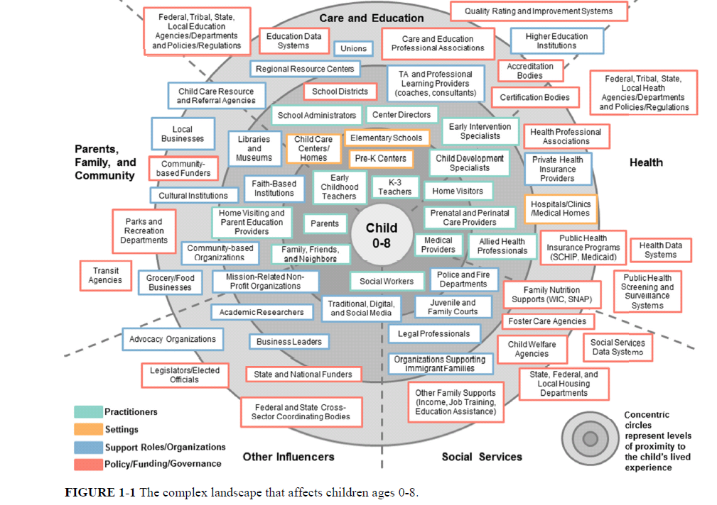
WHAT THE SYSTEM ACTUALLY LOOKS LIKE
PRACTICING THE ART OF LEADERTHIP
Notes:
Jana – Lori
Practicing the Art of Leadership to Navigate our Complex System
3 Leadership Table Exercises
B/ART and
Person/Role/System
Adaptive - Leadership - Exercise

Slide 24
ECPC Exercise
System Self Assessment
Leadership Sub Component
Quality Indicators
Elements of Quality

Slide 25
Leadership, Coordination, & Sustainability | Quality Indicator 1: A cross sector leadership team is in place that can set priorities and make policy, governance, and financial decisions. Quality Indicator 2: There is a written multi-year plan in place to address all sub-components of the CSPD.

Slide 26
A cross sector leadership team is in place that can set priorities and make policy, governance, and financial decisions related to the personnel system.
The composition of the leadership team represents key partners from cross-sector early childhood systems, technical assistance programs, institutions of higher education, parent organizations and other across disciplines.
Additional stakeholder input, including from families, is actively solicited and considered by the leadership team in setting priorities and determining governance decisions.
The leadership team members are aware of other related early childhood and school-age personnel development systems and align efforts when appropriate.
The leadership team develops an overall vision, mission, and purpose for the CSPD and makes decisions and implements processes that reflect these.
The CSPD vision, mission and purpose are aligned with the overall early intervention and preschool special education systems.
The leadership team examines current policies and state initiatives (e.g. quality rating and improvement systems, educator effectiveness frameworks) to identify opportunities for collaboration and the coordination of resources, including ongoing and sustained funding across cross-sector early childhood systems.
The leadership team advocates for and identifies resources for cross-sector priorities and activities.
The leadership team disseminates information on the CSPD plan to relevant public and private audiences.

Slide 27
There is a written multi-year plan in place to address all sub-components of the CSPD.
The development and implementation of the CSPD plan is based on the specific vision, mission, and purpose for a CSPD.
The CSPD plan is aligned with and informed by stakeholder input, national professional organization personnel standards, state requirements, and the vision, mission, and purpose of the cross-sector early childhood systems involved in the CSPD.
The CSPD plan articulates a process for two way communication between stakeholders and the leadership team for soliciting input and sharing information on the implementation of activities.
The CSPD plan includes strategies for engaging in ongoing formative and summative evaluation of the activities.
The leadership team monitors both the implementation and effectiveness of the activities of the CSPD plan.
The leadership team plans for and ensures that funding and resources are available to sustain the implementation of the CSPD plan.

Slide 28
Resources
ECPC Leadership Resources
https://ecpcta.org/what-is-leadership-collaboration/
https://ecpcta.org/leadership/
CEELO RESOURCES
http://ceelo.org/leadership-self-assessment/
http://ceelo.org/highly-effective-soel/
http://ceelo.org/leadership-academy/

Slide 29
Contact Us
Mary Beth Bruder - bruder@uchc.edu
Lori Connors-Tadros - ltadros@nieer.org
Stacy Kong – Stacy.Kong@doh.hawaii.gov
Jana Martella - jmartella@edc.org
Lisa Wasacz - WasaczL@michigan.gov

