Slide 1
Leveraging Medicaid to Support Part C: State Processes and Lessons Learned
Kim Wedel (ITCA)
Alice Ridgway (CT)
Christy Cronheim (ID)
Chad Cardwell (ID)
Notes:
Kim
Ask panelists to introduce themselves.

Slide 2
Overview
Introductions
Session Objectives
Brief points on Medicaid for Part C
State Experiences Connecticut & Idaho
Key Takeaways

Slide 3
Quick Show of Hands
Local lead agencies/districts vs. centralized system
Access Medicaid reimbursement
Centralized plan for accessing Medicaid
Up to localities/practitioners to bill
State mandated private insurance legislation to cover services, birth-three
Notes:
How many of you have . . .

Slide 4
Objectives
What do you hope to learn in the session?
Prioritization
Notes:
The objectives for this session – will be your objectives. We would like to collect your hopes, questions, areas of interest.
The session will prioritize issues with broad interest. If you identify a topic specific to your state we would like to make sure we address it but we may do that in another forum.
Collect and Vote – Katy to chart

Slide 5
Menu of Possible Topics
Services (descriptions, State Plan)
Delivery structures (FFS /Managed Care, prior authorizations decisions)
Funding (sources, Agency roles)
Operations (rates, payments and data)
Agreements for oversight
Impact on MOE
Notes:
May hold this until audiences priorities are shared.

Slide 6
Brief Orientation to Medicaid
Benefits and State Plan sections
Early Periodic Screening Diagnosis Treatment (EPSDT)
Operations
Evolving State Directions and Context

Slide 7
Medicaid Benefits
Typically Accessed by Part C:
Mandatory Benefits
Early Periodic Screening, Diagnosis and Treatment (EPSDT)
Non-emergency transportation
Optional Benefits
OT, PT and Speech Therapy
Targeted Case Management (TCM)
Rehabilitative Services
Medical and Remedial Care from other licensed providers (e.g. Psychologists)
Notes:
Noting States have the option of including therapies as a benefit – but services within EPSDT are mandatory

Slide 8
Early Periodic Screening Diagnosis Treatment (EPSDT)
Benefits for children are guaranteed and are required to prevent and treat conditions.
Treatment is defined as:
Necessary health care diagnosis services, treatment, and other measures classified as medical assistance to correct or ameliorate defects and physical and mental health conditions discovered by screening services, whether or not such services are covered under the state medical assistance plan
Notes:
Noting within EPSDT necessary health care are mandatory whether or not such services are covered under the state medical assistance plan
The broad requirement has been affirmed in litigation

Slide 9
Evolving Systems
Medicaid systems are large and complex
State and Federal requirements continually evolve
Structures for care coordination
Benefits
Program Integrity and other cost containment
Importance of maximizing use and establishing patterns of use
Notes:
Large and complex but are charge with addressing emerging needs.
Rapid changes in care coordination including Managed Care
Benefits including services for children with autism and managing opioid prescribing practices, addiction, and neo natal abstinence syndrome
Large part of Federal and State budgets so focus on program integrity – provider enrollments, audits, and other cost containment strategies
Dining patters of use – and its potential value (getting your state in a prime position to maximize drawdown) should states have to manage Medicaid differently (move to block granting).

Slide 10
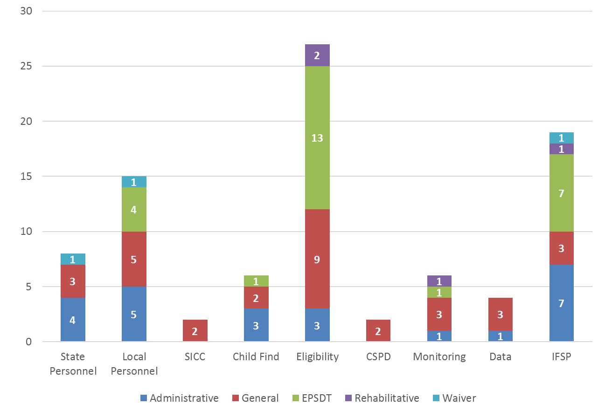
Medicaid Utilization for Infrastructure
Data from 2018 ITCA Finance Survey

Slide 11
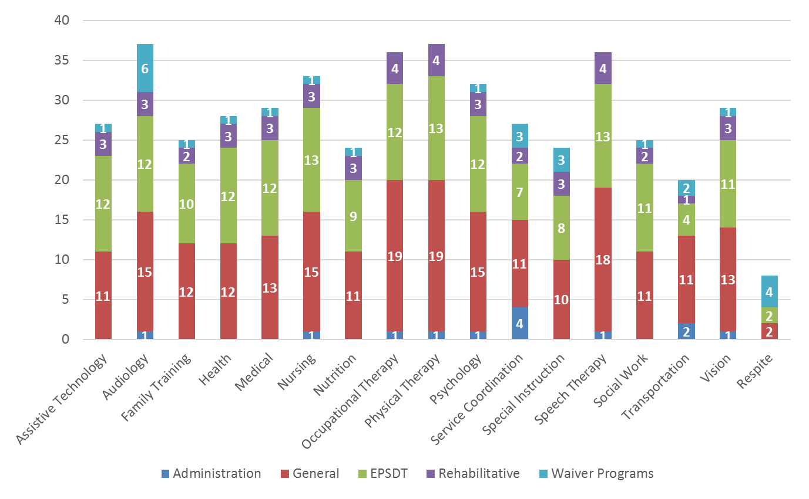
Medicaid Utilization for Direct Services
Data from 2018 ITCA Finance Survey
Notes:
States are mainly using general (red) or EPSDT (green).
This data is not validated.

Slide 12
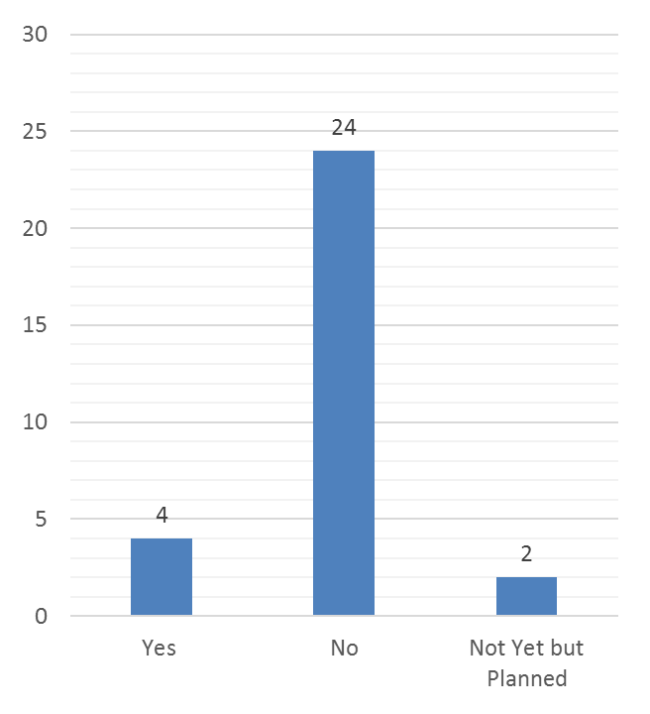
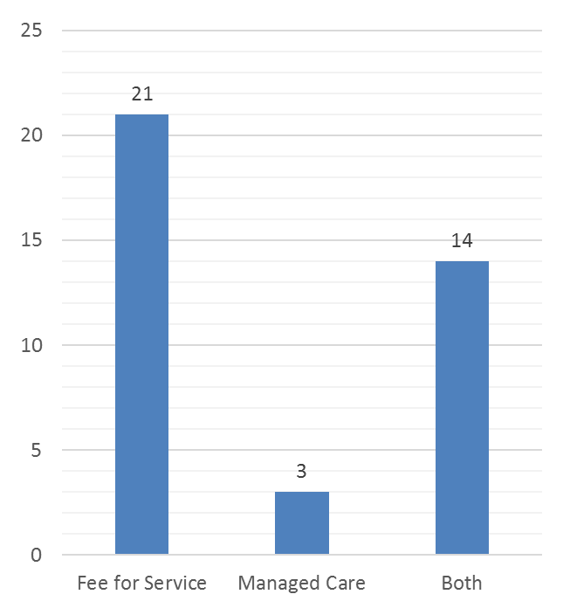
Medicaid Administration
Autism Waiver
Data from 2018 ITCA Finance Survey

Slide 13
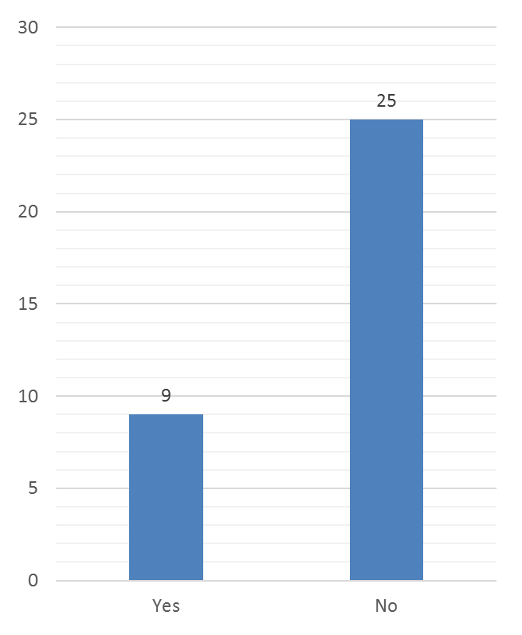
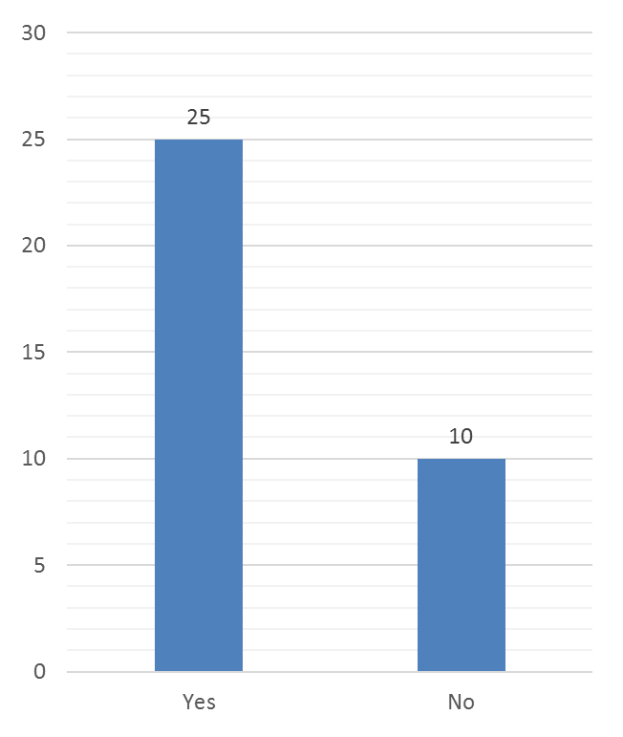
Physician Signature Required
IFSP as Authorizing Document for Medical Necessity
Data from 2018 ITCA Finance Survey

Slide 14
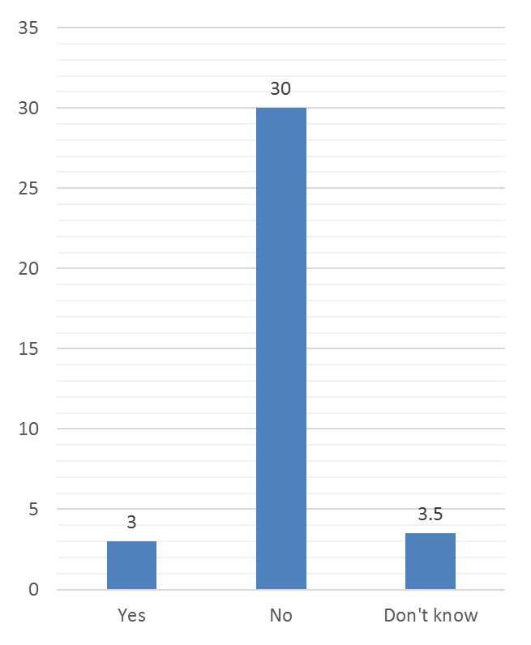
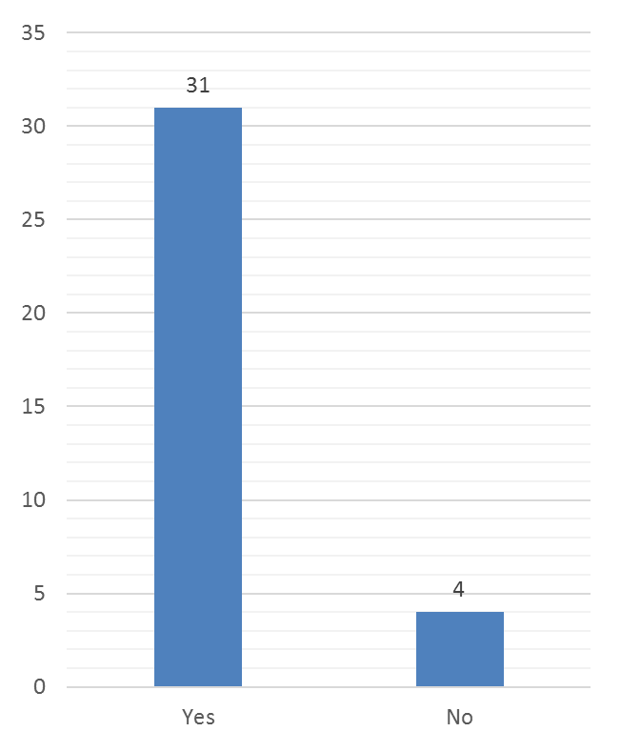
Require Use of Private Insurance prior to Accessing Medicaid
Decline in Medicaid Revenue due to Parent Denial for Access
Data from 2018 ITCA Finance Survey

Slide 15
Ratio of Medicaid Revenue to All Fund Sources
Data from 2018 ITCA Finance Survey
Notes:
Medicaid includes GR match.

Slide 16
State Experiences: Connecticut & Idaho
Sharing hot off the press experiences responding to your requests
Resources
Notes:
Resources:
Glossary of Medicaid Terms
SPAs
Rules and Regulations
Protocols and Agreements
Idaho Task Plan
ITCA Finance Survey

Slide 17
Takeaways
Timing and persistence
Multiple efforts
Sense of humor and detaching from specific outcomes
Relationships
Stakeholder involvement at each step
Importance of Data
Administrative support
Not a quick fix

Slide 18
Connecticut Resources
5) EI Treatment Services:
a) Description
“For the benefit of the child, in accordance with and subject to Connecticut Office of Early Childhood procedures, early intervention treatment services are provided in accordance with the IFSP and includes assisting caregivers with enhancing the functional development of the child with an emphasis on specific developmental areas appropriately tailored to each child’s needs, including, but not limited to, cognitive processes, communication, motor, behavior and social interaction.”

Slide 19
Connecticut Resources
State Plan Amendment
http://www.birth23.org/providers/provider-resources/dssb23page/
http://portal.ct.gov/DSS/Health-And-Home-Care/Birth-to-Three/
http://portal.ct.gov/DSS/Health-And-Home-Care/Birth-to-Three/Related-Resources
http://portal.ct.gov/-/media/Departments-and-Agencies/DSS/Health-and-Home-Care/Birth-to-Three/CMS-Approved-SPA-17_0019EIS-Pursuant-to-EPSDT.pdf?la=en

Slide 20
Connecticut Resources
Regulations
https://eregulations.ct.gov/eRegsPortal/Search/getDocument?guid={90B20763-0000-C4C8-A0A9-E6394A1564F9}
Rates
http://www.birth23.org/providers/provider-resources/b23rates/
http://portal.ct.gov/-/media/Departments-and-Agencies/DSS/Health-and-Home-Care/Birth-to-Three/BirthtoThree_Services_Chart_Proc-Codes_Limits_Rates_REVISED_12_5_17.pdf?la=en

Slide 21
Connecticut Resources
Audit Protocol
http://www.birth23.org/wp-content/uploads/procedures/Audit-protocol-ProcedureReferencesMay2018.docx

Slide 22
Idaho Resources
Idaho’s new Early Intervention Services rules:
https://adminrules.idaho.gov/rules/current/16/160309.pdf
16.03.09.585-587

Slide 23
Idaho Resources
You can also find the following information on our Infant Toddler Program Website under the Partners tab: www.infanttoddler.idaho.gov
Idaho Medicaid Early Intervention Services Brochure
Early Intervention Services Fee Schedule
Intra-agency Agreement between Medicaid and Family and Community Services
Notes:
Intra-agency Agreement between Medicaid and Family and Community Services (not a live link yet as we are still waiting for final signatures. Hope to have it before the conference)

Slide 24
Thank You!
Kim Wedel (ITCA)
kawedel@austin.rr.com
Alice Ridgway (CT)
Alice.Ridgway@ct.gov
Christy Cronheim (ID)
Christy.Cronheim@dhw.idaho.gov
Chad Cardwell (ID)
Chad.Cardwell@dhw.idaho.gov

