Slide 1
POLL EVERYWHERE
WE WILL BE USING “POLL EVERYWHERE”
FOR AN INTERACTIVE DISCUSSION. PLEASE HAVE
YOUR TELEPHONES OR OTHER ELECTRONIC
DEVICES AVAILABLE FOR THIS ACTIVITY.
INSTRUCTIONS WILL BE FORTHCOMING!

Slide 2
Getting to the Root Cause:
Improving Timely Receipt of EI Services
Jennifer Barrett-Zitkus, OSEP
Anne Lucas, ECTA
Sherry Franklin, ECTA
Brian Deese, NC Part C
Kyla Patterson, VA Part C
Notes:
Sherry

Slide 3
Session Outcomes
Participants will:
Understand Indicator 1 – Timely Services measurement requirements
Increase their knowledge of national trend data related to Indicator 1 – Timely Services
Learn what two states did to successfully address root causes of timely services noncompliance and sustain high performance over time
Explore the use of root cause analysis to develop strategies to address timely services noncompliance

Slide 4
Indicator 1 – Timely Services
Measurement Requirements
Jennifer Barrett-Zitkus

Slide 5
Indicator 1
Timely Receipt of Services, is a compliance indicator with a target of 100%.
Each state defines what constitutes timely services.
The indicator refers to the percentage of children for whom all services are timely, not the percentage of services that are timely; if one or more of the services for a child are not delivered within the defined timeline, then the child would not be counted in the percentage of children receiving timely services.
Notes:
Data Source:
Data to be taken from monitoring or State data system and must be based on actual, not an average, number of days. Include the State’s criteria for “timely” receipt of early intervention services (i.e., the time period from parent consent to when IFSP services are actually initiated).
Measurement:
Percent = [(# of infants and toddlers with IFSPs who receive the early intervention services on their IFSPs in a timely manner) divided by the (total # of infants and toddlers with IFSPs)] times 100.
Account for untimely receipt of services, including the reasons for delays.

Slide 6
Indicator 1 - Timely Services
National Trend Data
Anne Lucas and Sherry Franklin, ECTA

Slide 7
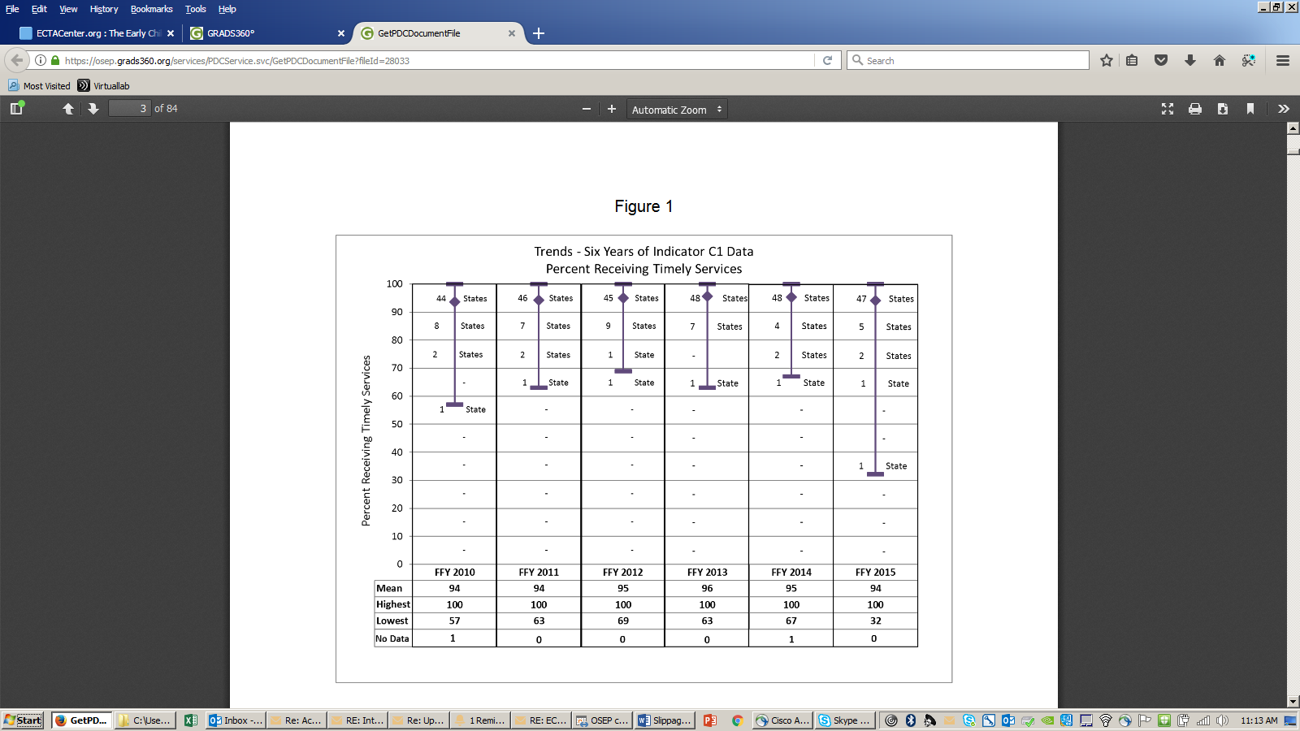
Trends: Percent of Children Receiving Timely Services

Slide 8
Primary Reasons States Reported for Not Providing Timely Services
Personnel shortages and turnover (e.g. recruitment/retention issues, new personnel not adequately trained on procedures/requirements)
Financial challenges (e.g. budget cuts, revenue shortfalls, hiring freezes, increased number of children referred, third party billing issues)
Inadequate data (e.g. lack of documentation of start date or reasons for delay)
Data collection strategies (e.g. change in monitoring process/selection of programs, data system reporting)
Same/large programs with long standing noncompliance impacting statewide data
Notes:
Main reasons that states reported
Root cause analysis is process to determine what factors contribute to low performance
Root cause =contributing factors

Slide 9

Poll Everywhere
What are your state’s primary reasons for not meeting timely services requirements?

Slide 10
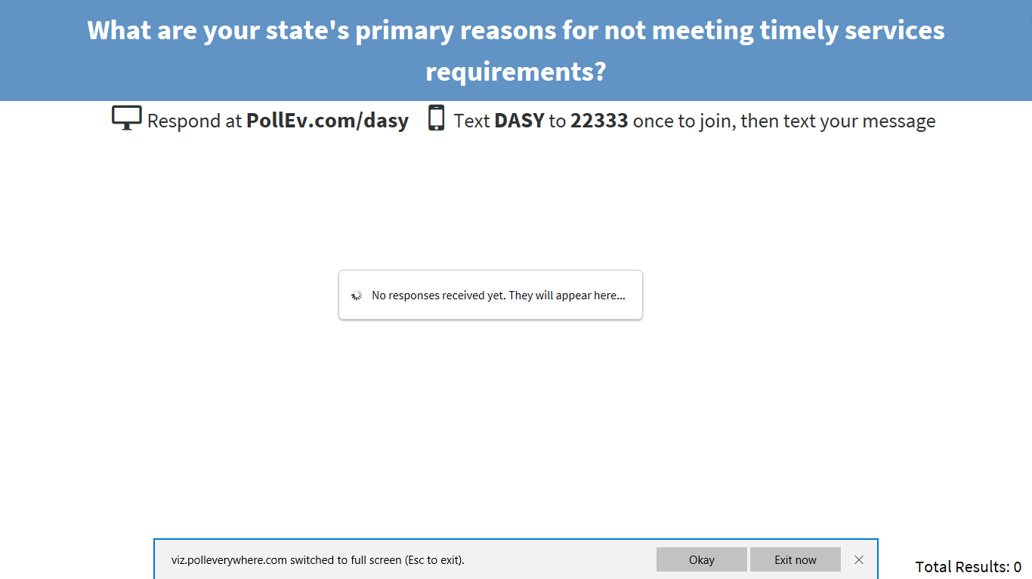
Word Cloud

Slide 11
Contributing Factor/Root Cause - Definition
The earliest, most basic or deepest factor that causes either a condition or a result
Adapted from:
Wikipedia: https://en.wikipedia.org/wiki/Root_cause
Merriam-Webster: https://www.merriam-webster.com/dictionary/contributing%20factor

Slide 12
Determining Root Cause
Use existing infrastructure/practice information and/or data and what is known about the issue
Conduct additional analysis of data (e.g. which services, which providers)
Gather additional information as needed (e.g. Are timely services policies and procedures clear? Do providers understand timely services definition and how to implement the procedures?)
Collect historical and trend data (This data may impact formality of actions needed to determine the root cause)
Root cause(s) should be in sufficient detail to ensure corrective actions/improvement efforts are meaningful and effective (change policies, procedures, practices, personnel development, administration/oversight, etc.)

Slide 13
Common State Level Root Causes Impacting Timely Services Data
Monitoring methods (e.g. cyclical vs. annual monitoring, all children vs. sampling)
No definition of exceptional family circumstances
No verification of data accuracy before issuing findings in some states (e.g. issuing findings on missing data without opportunity to provide data)
Correction of Noncompliance policies (e.g. lengthy time-periods that local programs need to maintain 100% compliance for state to verify correction)
Not conducting root cause analysis at state and local level to identify effective correction strategies

Slide 14
Common Local Level Root Causes Impacting Timely Services Data
No ongoing provider training to ensure consistent interpretations or levels of understanding of state and/or local policies and procedures related to timely services
No local management of timely services process as well as provider caseloads
No regular local program quality assurance measures in place to:
  Monitor child record data entries to minimize missing data
  Determine the level and extent of the issue (e.g. 1 provider vs. multiple providers)
  Monitor timely service data on an ongoing basis
Identifying and implementing correction strategies that do not address the root cause

Slide 15
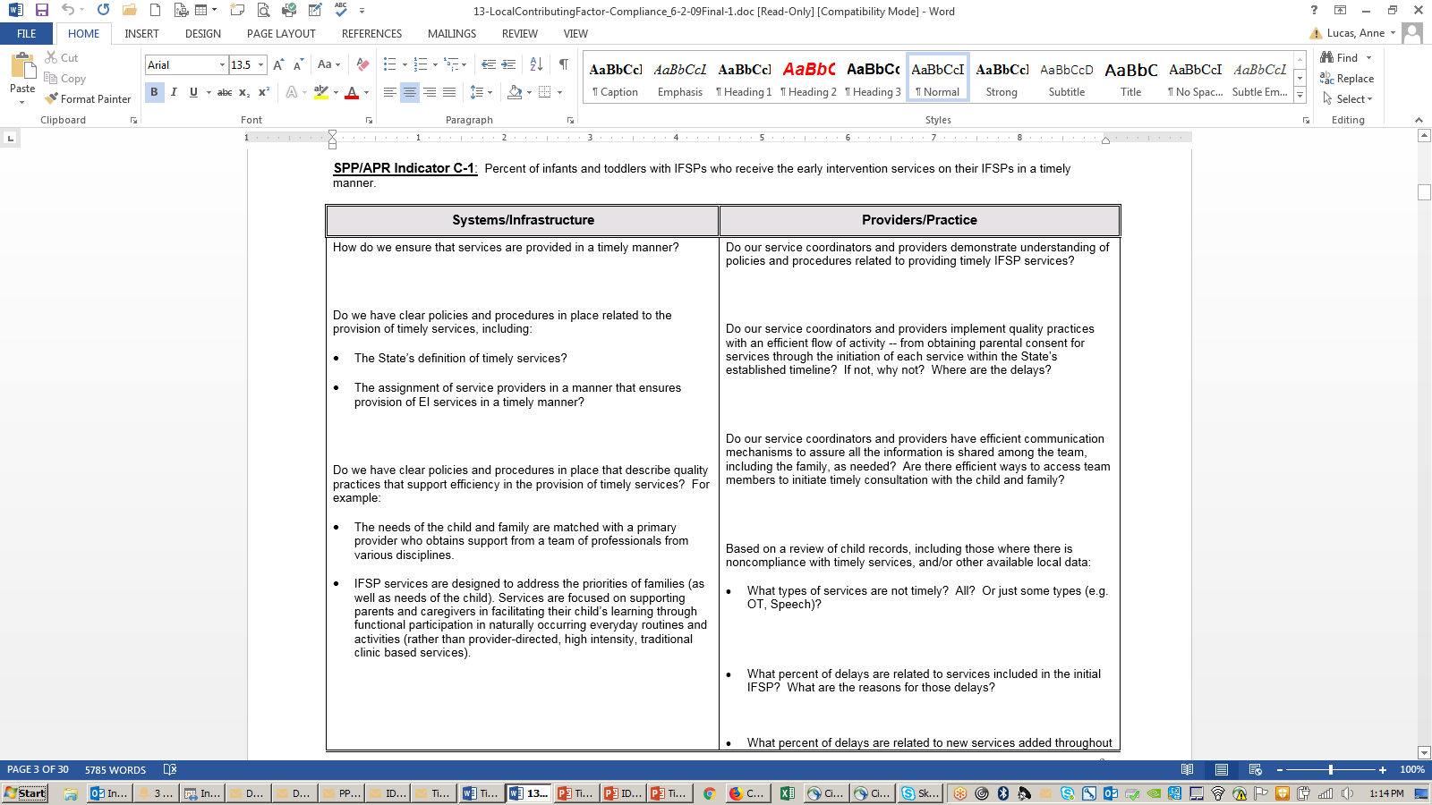
Local Contributing Factor Tool for SPP/APR Compliance Indicators

Slide 16
Find out more at ectacenter.org
The ECTA Center is a program of the FPG Child Development Institute of the University of North Carolina at Chapel Hill, funded through cooperative agreement number H326P170001 from the Office of Special Education Programs, U.S. Department of Education. Opinions expressed herein do not necessarily represent the Department of Education's position or policy.

Slide 17
Virginia
Kyla Patterson

Slide 18

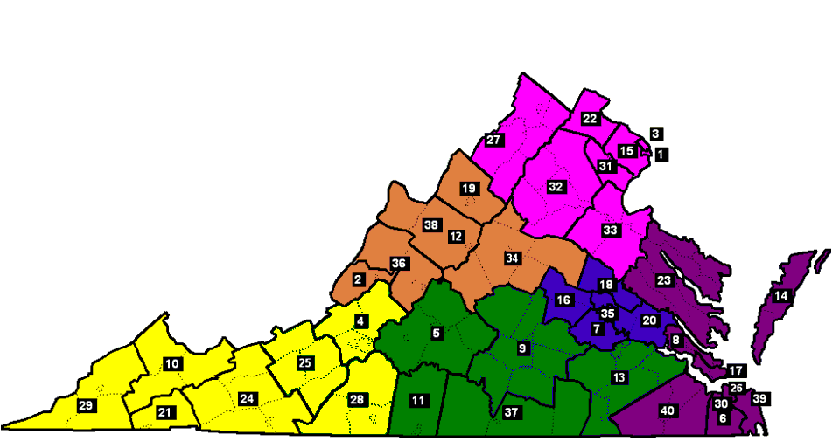
Virginia
Notes:
State Lead Agency is Department of Behavioral Health and Developmental Services
Contract with 40 local lead agencies to oversee and implement Part C early intervention across the Commonwealth

Slide 19



Challenges
Documentation
Provider Unavailability
Definition of Timely
Notes:
From FFY 2005 – FFY 2006, we had a series of challenges with meeting the requirement for timely start of services. I’m going to walk you through how these unfolded and how we addressed them in order to reach and sustain a high level of compliance with Indicator 1.

Slide 20
Challenge: Documentation
Contributing Factors
  Lack of documentation for reason
  Lack of awareness of requirement to document
Strategies
  TA and training to local system managers and service coordinators
Notes:
FFY 2005 – 72%
So we needed to know why. Luckily, in thinking about what factors were contributing to our less than optimal performance on this indicator, we already had some data that pointed us in an initial direction.
For the annual local record review (which is how we gather data for Indicator 1), local systems must identify the reason for any delay in the timely start of services … there are a set of family reasons to choose from and a set of system reasons. Among the system reasons is the option to select no documentation found. Of the children whose services did not begin timely because of a system reason, 73% were due to no documentation found.
We then asked ourselves, and more importantly, local system managers why there was this lack of documentation; and they told us … service coordinators didn’t know this kind of documentation was needed.
Based on this data and follow-up information, the state provided training and follow-up TA to all local system managers and service coordinators to ensure complete and consistent documentation when there was difficulty scheduling an initial visit or a planned initial visit was cancelled.

Slide 21

Problem Solved!!
FFY 2006 – Lack of documentation no longer a big issue!

Slide 22
Not so fast …
Contributing Factors
  Provider unavailability
  Local oversight and management practices
  Definition of timely
Notes:
We had our solved the documentation issue, but we had NOT solved our compliance issue with Indicator 1.
We were now at 81% and had dealt with the “low hanging fruit,” but clearly we had not identified or corrected the real root cause.
Using the kinds of questions available in the Local Contributing Factors Tool, which you’ll hear more about today, we reviewed additional data, talked with local system managers and identified the bigger root causes that were barriers to meeting the requirement for timely start of services:
Provider unavailability - Shortages varied across local systems but included OT, PT, SLP and Special Instruction
Local oversight and management practices – This related to the provider unavailability issue because some local systems were doing a better job than others in addressing shortages (communication from SC to LSM, ongoing local monitoring, LSM to state, openness to out-of-the-box thinking, ability to hire, etc.)
Definition of timely start of services – Virginia had one of the most stringent definitions of timely in the nation – 21 days from date of parent signature on the IFSP. This was compounding the provider issue.

Slide 23
Strategies
Provider Unavailability and Local Oversight
  Long-Term: Medicaid Early Intervention Services Program
    Increase reimbursement rates
    Reduce duplicate paperwork
    Expand services covered
    Goal – Attract and retain providers
  Short-Term: Required notification to the State office
    If unable to identify provider within 10-15 calendar days of IFSP meeting
    Goal – Brainstorm creative options in time
    Added benefit – Helped TAs better understand challenges
Notes:
Long-term, in order to attract and retain providers and better compete with school systems and other agencies …. Collaborated with state Medicaid agency. The efforts that began in FFY 2006 resulted in the Medicaid EI Services Program that was implemented 2009 and the Medicaid EI Targeted Case Management Program that was implemented in 2011.
But even in 2006 we knew this was not going to be a quick fix, so we needed to have some short-term strategies too. The big one we used was to require local system managers to notify their state TA Consultant (read from slide). This allowed TAs to quickly support the local systems in brainstorming creative strategies when needed in order to get services started, rather than responding after the timeline was missed. It also forced the LSM to pay attention to the timeline (that oversight and management piece that was not as strong in some local systems).

Slide 24
More Progress
Notes:
FFY 2007 – 89%

Slide 25
Strategy
Revised State Definition of “Timely”
21
Days
30
Days
Notes:
You’ll recall I mentioned that our state definition for timely start of services was a contributing factor compounding the provider shortages we were seeing. So another strategy we used to address Indicator 1 was to revise that definition.
On July 1, 2008
Seems like a quick and easy solution, but it was not a quick or easy decision or process – What do we say to families if we make this change? Many providers also felt it was important to keep it at 21 days. Talked about it for a couple of years; reviewed national data indicating that 30 days was the most common definition among states and that Virginia was one of only 2-3 states with a definition more rigorous than 30 days; discussion with families, VICC

Slide 26
Success
Notes:
The change in definition certainly helped as we went from 89% (FFY 2007) to 94% (FFY 2008). And you can see in this chart that all of these efforts plus implementation of the Medicaid programs in 2009 and 2011 got us to 95% in FFY 2011 and we have stayed above that since.

Slide 27

Keys to Sustaining
Identifying and Addressing Root Causes
Monitoring and Technical Assistance
Notes:
Because we were able to effectively identify and address the root causes, we’ve mostly had to deal with only a couple of local systems at a time that had specific provider shortage issues. In these instances, the TA Consultant and Monitoring Consultant work closely with the local system manager to explore options including using providers from a nearby local system, sharing providers regionally, checking with providers in the local schools to see who might want a few additional hours, hiring through another agency (when positions are frozen in the local lead agency), etc. We have also had folks higher up in the State Lead Agency meet with higher level administrators at the local level when initial improvement efforts have not been successful.

Slide 28

Lessons Learned
Celebrate progress
Use your data
Can’t just be about more money
Notes:
Celebrate progress – small victories
Use your data … so you use your time wisely
Takes time to address the big issues (like more money) and you may or may not be successful … so figure out what you can do in the meantime

Slide 29
North Carolina
Brian Deese

Slide 30


North Carolina Infant-Toddler Program
CAMDEN
NORTHAMPTON
GATES
16
CURRITUCK
ALLEGHANY
ROCKINGHAM
CASWELL
PERSON
VANCE
WARREN
HERTFORD
2
ASHE
SURRY
STOKES
GRANVILLE
HALIFAX
PERQUIMANS
PASQUOTANK
WILKES
8
9
10
FRANKLIN
BERTIE
CHOWAN
WATAUGA
YADKIN
ORANGE
NASH
FORSYTH
GUILFORD
ALAMANCE
DURHAM
13
EDGECOMBE
WASH-
AVERY
WASHINGTON
TYRRELL
DARE
MITCHELL
MARTIN
ING-
CALDWELL
ALEXANDER
DAVIE
14
TON
YANCEY
WAKE
WILSON
MADISON
IREDELL
DAVIDSON
RANDOLPH
CHATHAM
11
PITT
HYDE
1
3
BEAUFORT
MCDOWELL
BURKE
CATAWBA
ROWAN
JOHNSTON
GREENE
HAYWOOD
BUNCOMBE
LINCOLN
6
7
LEE
HARNETT
WAYNE
15
SWAIN
RUTHERFORD
CLEVELAND
5
CABARRUS
STANLY
MONTGOMERY
MOORE
LENOIR
CRAVEN
PAMLICO
GRAHAM
JACKSON
HENDERSON
POLK
4
GASTON
MECKLENBURG
JONES
CHEROKEE
MACON
TRANSYLVANIA
RICHMOND
HOKE
CUMBERLAND
SAMPSON
DUPLIN
CLAY
UNION
ANSON
SCOTLAND
ONSLOW
CARTERET
ROBESON
BLADEN
PENDER
12
Department of Health and Human Services
Division of Public Health
Women’s and Children’s Health Section
Early Intervention Branch
Counties Served by CDSAs
COLUMBUS
NEW
HANOVER
BRUNSWICK
Early Intervention Branch Central Office
CDSA of Western North Carolina
CDSA of the Blue Ridge
Morganton/Hickory
Shelby
CDSA of Charlotte-Mecklenburg
Concord
CDSA of the Sandhills
Winston-Salem
9. Greensboro
10. Durham
11. Raleigh
CDSA of Cape Fear
Rocky Mount
Greenville
New Bern
Elizabeth City
Map Updated 7/3/18
Notes:
State Lead Agency: Department of Health and Human Services, in the Division of Public Health
Local Lead Agencies: 16 Children’s Developmental Services Agencies (CDSAs)
Eligibility
Service Coordination
Provider Network:
EI Services

Slide 31
Why Improvement was Needed

Slide 32
NC ITP System Change
Redesigned Service System
Substantial increase in Referrals
Inadequate resources
CDSA Staff
Provider Reimbursement
Notes:
Unprecedented number of referrals received in 2004-2005
4,500-5,000 to 17,000

Slide 33
Strategies
Received additional State Funding:
EI Service Reimbursement
CDSA Positions
Revised eligibility definition:
4 categories to 2
Increased the specific level of delay

Slide 34
Local Program Contributing Factors
Inadequate documentation
Service initiation delays
Lack of enrolled service providers

Slide 35
Strategies
Expectations
Documentation
QA/QI Committees established in the CDSAs:
Quarterly Statewide QA/QI Meetings
Revised IFSP
Streamline Local Processes
Corrective Action Plans
Root Cause Analyses
Strategies, Benchmarks, and Timelines
Evidence of Correction
Focused Technical Assistance and Training
Progress Reporting
To efficiently document and track the timeliness of services.
Additional State Funds
To provide services when a community based provider is unavailable
Quarterly Self-Assessment Reviews
To monitor local programs progress

Slide 36
How are we sustaining?
Balance of responsibility for compliance was shifted for both State and Local Levels
Ongoing Technical Assistance and Training
Increasing the use of our Statewide database for Ongoing Monitoring
Identifying and Addressing noncompliance and its root causes

Slide 37
GOOD JOB!!!

Slide 38

Questions? Reactions?
Notes:
Sherry
Time permitting

Slide 39

Small Group Discussions
Notes:
Instructions:
Ask how many people want to discuss:
Personnel/Workforce
Financing
Inadequate Data
Data Collection Methods
Same/Large Programs with Longstanding Noncompliance
Assign tables with topics – people can move

Slide 40
Small Group Work Discussion
Review the questions related to the topic assigned to your table on the handout “Indicator 1 Root Cause Questions”
Discuss your answers to these questions to uncover root causes
Discuss successful strategies that states have used to address identified root causes
Be prepared to share one root cause and one successful strategy to address this root cause
Notes:
Inform participants there will be a facilitator at each table. The facilitator will:
Introduce challenge
Ask states to answer the root cause questions for the challenge and discuss what is contributing to the challenges
Ask states to discuss if they have strategies that have been successful in addressing any of the root causes identified
Ask group to be prepared to share one root cause and one strategy that a state found successful to address it during report out related to the topic being discussed.

Slide 41

Full Group Sharing and Discussion

Slide 42
Resources
Streamlining and Integrating General Supervision Activities: Monitoring and Program Improvement – http://ectacenter.org/topics/gensup/interactive/
Local Contributing Factor Tool for SSP/APR Compliance Indicators -http://ectacenter.org/~docs/topics/gensup/13-LocalContributingFactor-Compliance_6-2-09Final.doc
Determining the Extent and Level of the Noncompliance –http://ectacenter.org/~docs/topics/gensup/11-DeterminingExtentNoncompRes-2011.doc
WA Identifying Noncompliance, Root Cause and Corrective Action - http://ectacenter.org/~docs/topics/gensup/12-WA_IdentifyingNoncomplianceFlowChartInstructionsMay2012.doc

Slide 43
Contact Us
Jennifer Barrett-Zitkus, OSEP
Jennifer.Barrett-Zitkus@ed.gov
Kyla Patterson, Virginia
K.Patterson@dbhds.Virginia.gov
Brian Deese, North Carolina
Brian.Deese@dhhs.nc.gov
Sherry Franklin, ECTA
Sherry.Franklin@unc.edu
Anne Lucas, ECTA
Anne.Lucas@unc.edu

