Slide 1
IDEA Part C Fiscal Monitoring: Getting Your Ducks in a Row
Improving Data, Improving Outcomes Conference
Arlington, VA
August 2018
Susan Kauffman (OSEP)
Maureen Harwood (Alaska)
Anne Lucas (ECTA)
Katy McCullough (ECTA)
Notes:
Katy
Agenda
Intro 5 min
OSEP 10 min
AK 15
TA 10
Q & A 15
Discussion 20
Report out 10
Wrap-Up 5

Slide 2

Outcomes
Participants will:
Understand what OSEP SOP/Method fiscal monitoring looks like
Understand activities that can take place: pre, during, and post
Understand one state did to prepare for OSEP fiscal monitoring and what they found helpful
Identify strategies that states can do now to prepare for OSEP fiscal monitoring

Slide 3
ECTA/DaSy Framework Connection
QI FN10: State and regional and/or local system entities regularly monitor finances and resources to ensure that spending is in compliance with contract performance and all Federal, State, and local requirements.
Participate in fiscal audits
Fiscal monitoring data are shared to inform improvement planning
Fiscal noncompliance is corrected in a timely manner
Fiscal monitoring methods and tools are reviewed and revised as necessary
Monitoring methods and tools are aligned whenever possible with other early care and education programs

Slide 4
              OSEP’s Differentiated Monitoring and Support Process (DMS)
Monitoring and support based upon needs of State and best use of OSEP resources.
Based upon assessment of risk to the Department and IDEA:
  Starts with Organizational Assessment in key areas
  Evaluates additional factors about State and OSEP resources
  All States receive designation of intensive, targeted or universal in each key area

Slide 5
OSEP’s Differentiated
Monitoring and Support Process
Each State designation is based on a rubric in the following areas:
Results
Compliance
Fiscal
SSIP

Slide 6
What risk factors did OSEP consider in the DMS process?
Turnover in leadership
Size of the award
Lapsed funds
Late liquidation requests
Conditional approval due to methods or systems of payment
Change in lead agency
Number of early intervention programs
Special conditions, including Department-wide special conditions/ high risk designation
Other factors

Slide 7
Potential areas for fiscal monitoring
IDEA fiscal requirements including:
Responsibility of lead agency (including fiscal oversight)
Application (& budget)
Payor of last resort
System of payments
Maintenance of effort
Cross-cutting fiscal requirements, including:
Obligation/liquidation
Use of funds
Prior approvals
Indirect costs (restricted)
Audits

Slide 8
What monitoring activities did OSEP’s risk assessment drive?
Intensive Monitoring: Visits (on-site or virtual) concentrating on:
  System of Payments
  Methods
  *Related Requirements
Targeted Monitoring and Support: Individualized supports based on the needs of the State
Universal Support: Webinars, national calls, resources on GRADS 360, TA by phone and email

Slide 9
Federal requirements for lead agency monitoring
IDEA specific requirements:
34 CFR § 303.120- Lead agency role in supervision, monitoring, interagency coordination, and other responsibilities
Government-wide requirements:
2 CFR § 200.328- Monitoring and reporting program performance
2 CFR § 200.302- Financial Management
2 CFR § 200. 303- Internal Controls

Slide 10
Overview of Recent OSEP Monitoring Activities
Use of the Protocol- SoP and Method Specific Requirements
Document Requests
Virtual /On-Site meetings
Preliminary issues
Lessons Learned

Slide 11
TA Support for State Preparation
System of Payments Self-assessment Worksheet
  OSEP Questions
  Current Processes
  Available Evidences
  Additional steps/documents needed
Individualized state TA calls
  Facilitate completion of the worksheet
  Overall preparation for the OSEP visit/virtual meeting
Finance Component of the ECTA System Framework (FN10)
  Individualized TA to states to complete the self-assessment and plan for improvement

Slide 12
Department of Health & Social Services

Slide 13
Alaska OSEP SOP Monitoring Preparation
Used SOP Self-Assessment Worksheet
Organized document requests
Developed an overview of AK system and structure for OSEP
Conducted OSEP Fiscal Monitoring via virtual meetings
Lessons learned

Slide 14
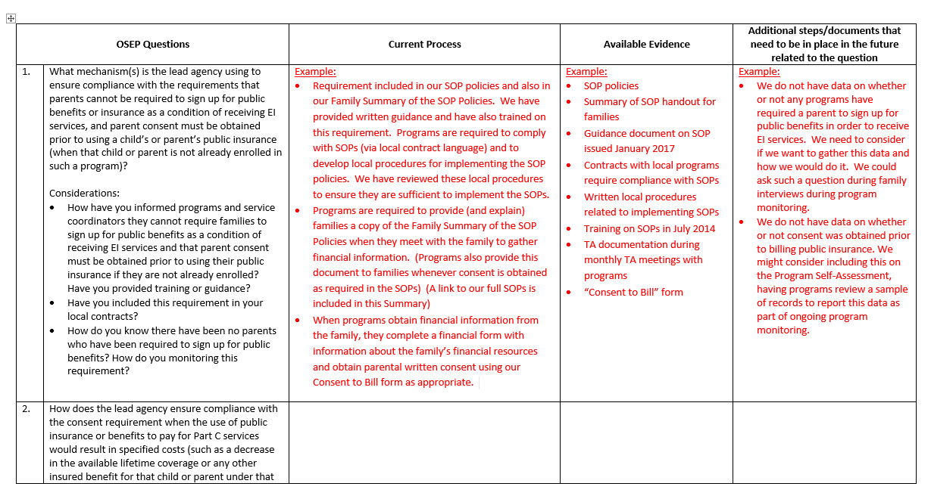
System of Payment Self-Assessment Worksheet

Slide 15
Organizing Document Requests

Slide 17
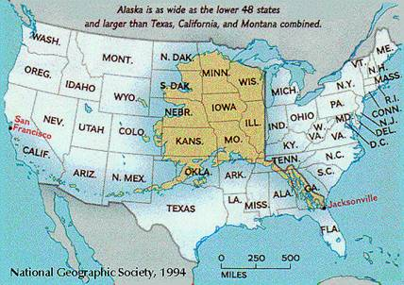
Area: 663,267 square miles Population: 741,894 (2016)

Slide 18
Grants Electronic Management System (GEMS)
DHSS grants are administered electronically via GEMS. GEMS has re-engineered the way DHSS manages all of its outbound operating and capital grants. GEMS was designed to improve the DHSS grant process, to simplify and unify procedures across Divisions, reduce administrative burdens for the State and grantees, and enhance communication to improve user satisfaction. It includes features such as payment tracking and accounting, online grant application submissions, grantee performance tracking, management reporting, and forward capability to be integrated with other State systems as they come on line.

Slide 19
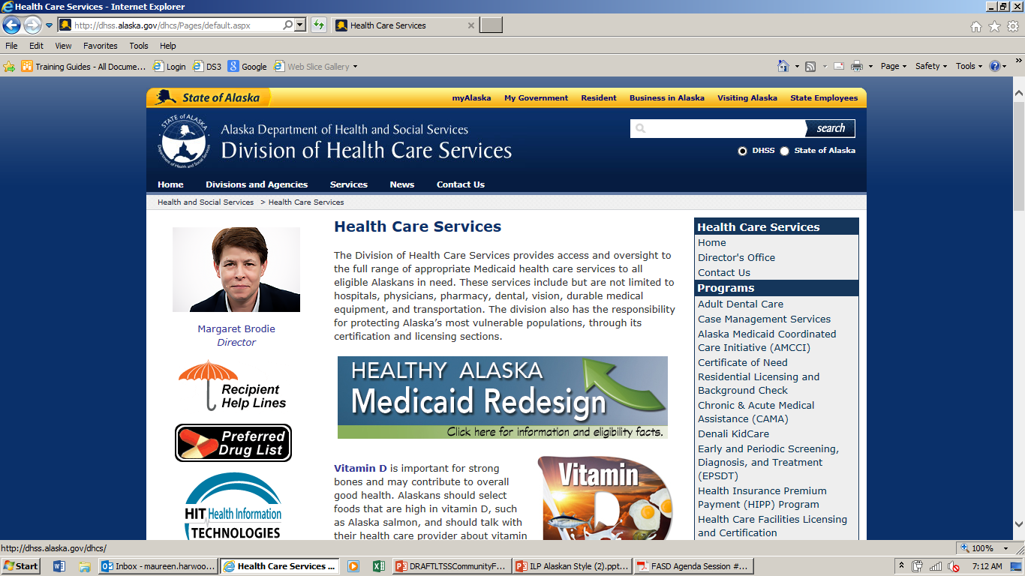
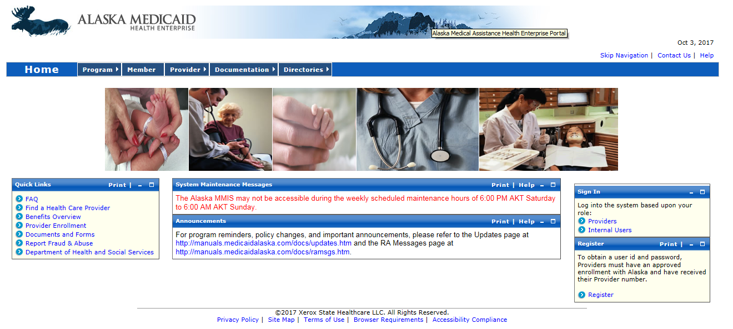

Slide 20
Some Facts About ILP Providers
12% of service providers are occupational therapists,
9% are physical therapists,
19% are speech/language pathologists,
7% social workers/counselors, and
53% are educators.
Nationally, people working in Early Intervention are referred to by the generic term "Early Interventionist." In Alaska, we refer to service providers as "Developmental Specialists" regardless of the discipline.

Slide 21
Alaska Part C Database Report Capabilities
The system includes many custom-built reports. Examples:
Creates required federal child-count, performance and outcomes reports
Warn state staff and grantees when items are out of compliance with state or federal regulations
Alert grantees about family services and their due dates
Show records that were transferred to or from other entities
Monitor service delivery quality and quantity based on individual service plans
Manage exiting children and their transition status
Monitor grantee billing and financial information
Notify school districts and EED of federally required referrals

Slide 22
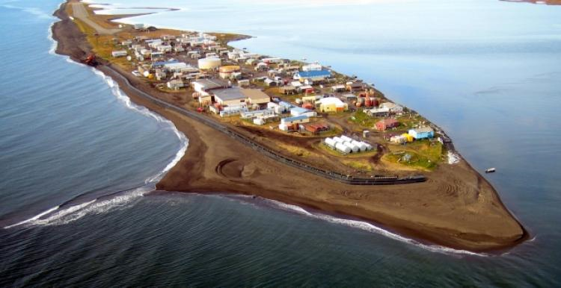

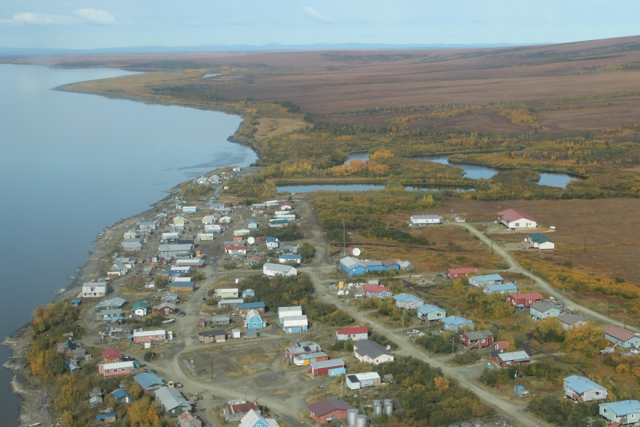
Virtual Meetings for OSEP SOP Fiscal Monitoring

Slide 23
Lessons Learned
Complete the SOP Self-Assessment Worksheet well before being selected for fiscal monitoring
Include local programs/providers in self-assessment discussion (to get a clear picture of how the SOPs are being implemented and what evidences they may be able to share)
Make changes to your fiscal monitoring system early based on the areas needing improvement as identified in your self-assessment
Be sure to work with your TA providers!

Slide 24

Questions

Slide 25
Small Group Discussion
What challenges do you face regarding monitoring implementation of System of Payments and Methods in your state?
What actions/steps do you need to take to look at what you are currently doing regarding implementation of SOP and Methods to improve fiscal monitoring in your state?

Slide 26
Report Out
Share a key point from your discussion

Slide 27
What states can be doing now to be prepared
Be familiar with the OSEP System of Payments and Methods protocols & checklists
Use those protocols as a self-assessment of the state system
  ECTA SOP Self-assessment Worksheet is available, as is TA to support states in that process
Make improvements to your fiscal monitoring system if necessary based on the self-assessment results
Talk with:
  OSEP Fiscal Implementation Team member or State Lead
  TA Providers

Slide 28
Resources
ECTA System Framework Resources:
http://ectacenter.org/sysframe/component-finance.asp#resources
Your OSEP State Lead, and Fiscal Implementation Team members.
Information related to the OMB Uniform Guidance can be found on the Department’s website at: https://www2.ed.gov/policy/fund/guid/uniform-guidance/index.html
Information related to OSEP’s current fiscal monitoring protocols for Methods and Systems of Payment are available at: https://osep.grads360.org/#program/fiscal-monitoring
System of Payments Monitoring Protocol Worksheet (ECTA developed from the OSEP SOP Protocol): http://ectacenter.org/topics/finance/partcfiscalmgmt.asp
Part C Federal Fiscal 101 Modules are pre-recorded on-line modules on federal fiscal requirements

Slide 29
Thank You!
Susan Kauffman (OSEP): susan.kauffman@ed.gov
Maureen Harwood (AK): maureen.harwood@alaska.gov
Anne Lucas (ECTA): anne.lucas@unc.edu
Katy McCullough (ECTA): katy.mcculloug29h@unc.edu

