Slide 1
Fiscal Data Visualization Workshop Using Local Data to Tell a Story Katy McCullough (ECTA) Maureen Greer (DaSy, ITCA) Kellen Reid (ECTA, DaSy) Ron Benham (ITCA) Kim Wedel (ECTA, ITCA)
Arlington, VA
August 14, 2018

Slide 2
Intended Outcomes
As a result of this workshop, participants will:
Gain knowledge about the data elements needed to answer critical fiscal questions.
Be able to generate a fiscal data profile with graphic illustrations of key program fiscal data for use at the state and the local levels.
Understand how to repurpose or alter the profile for their specific needs or how to access support to do so.
Be better able to use fiscal data for fiscal management.

Slide 3
Critical Questions

Slide 4
Goals for Critical Question Segment
Understand the Critical Questions
Understand how they can be used
Identify your critical question(s)

Slide 5
Where to Start?
DATA
Reports
Critical Questions
START ANYWHERE!

Slide 6
What are Critical Questions?
Questions that, when answered, provide information in areas deemed most important (i.e., help improve results for children and families).
Questions that a quality state data system should provide the data to answer.

Slide 7
What are the DaSy Critical Questions (cont.)
A jumping-off point for further discussion

Slide 8
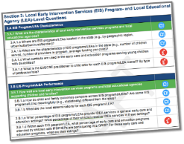
Navigating DaSy's Critical Questions
3 sections of questions
Child- and family-level
Practitioner-level
Local Early Intervention Services (EIS) program/Local education agency (LEA) level

Slide 9
Types of Questions
Broad & specific example questions
“Essential” & “Aspirational” questions
Essential (Bread and Butter) Questions
Aspirational (Mountain Climber) Questions

Slide 10
Section 3: Local Early Intervention Services (EIS) Program Level Questions
3.C. Funding and Expenditures
https://www.pexels.com/photo/close-up-photography-of-baby-1122891/

Slide 11
3.C.1. What is the cost of providing EI services to children and families?
What major funding streams and allocations support children participating in EI?
What is the total amount of funding from all sources that is supporting the operation of the EI program?
What is the cost to each local EIS program to provide EI services?
What is the average cost per child for EI services statewide? For each EIS program?
What are some of the factors that are related to differences across EIS programs in the average cost per child?

Slide 12
3.C.2. Does the state have sufficient revenue to provide quality IDEA services?
What is the comparison between projected revenues/budget and estimated need at the state level (i.e., revenue gap)?
What is the comparison between projected revenues/budget and estimated need for each local EIS program/LEA?

Slide 13
3.C.3 How can the state maximize efficiency in the operation of the EI program and maintain or improve outcomes?
What are the high-cost drivers within the state program configurations?
What are the characteristics of programs with relatively lower than average cost per child and relatively higher child outcomes?
What are alternative configurations of IDEA service provision that contribute to same or better outcomes without increased cost?

Slide 14
Where to start?
Who is your audience?
What do they want to know?
Why do they want to know it?
What format should you use?
How will they use it?

Slide 15
Don’t Go It Alone
Who can participate in generating Critical Questions?

Slide 16
Critical Questions Discussion:
What question(s) do you want to answer? How would the answer to the question be useful?
What data do you need to answer the question(s)?
Do you have that data? Does the Part C Coordinator have easy access to this data?
If not, how can you get the needed data?

Slide 17
Fiscal Profile Overview
https://www.pexels.com/photo/baby-in-white-tutu-skirt-beside-cake-206347/

Slide 18
Fiscal Data Profile Attributes
Communicate fiscal data visually
Provide simplicity for those within and external to your state system
Designed for a purpose, audience, and the critical questions you’re trying to answer

Slide 19
Fiscal Data Profile Utility
Answer | important fiscal questions
Monitor | general supervision
Support | fiscal management
Garner | political will

Slide 20
Walk-through of the DaSy Fiscal Profile Template

Slide 21
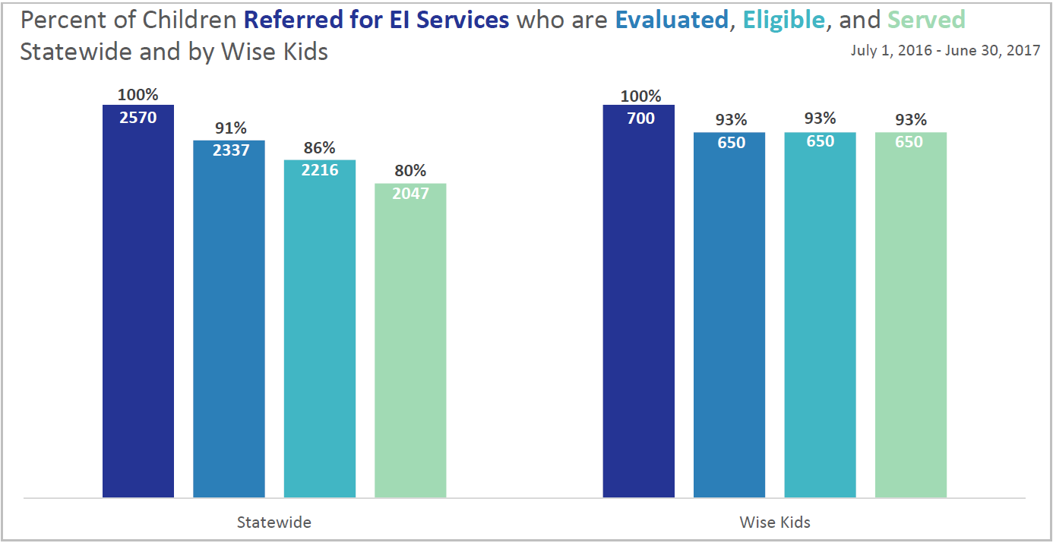

Slide 22
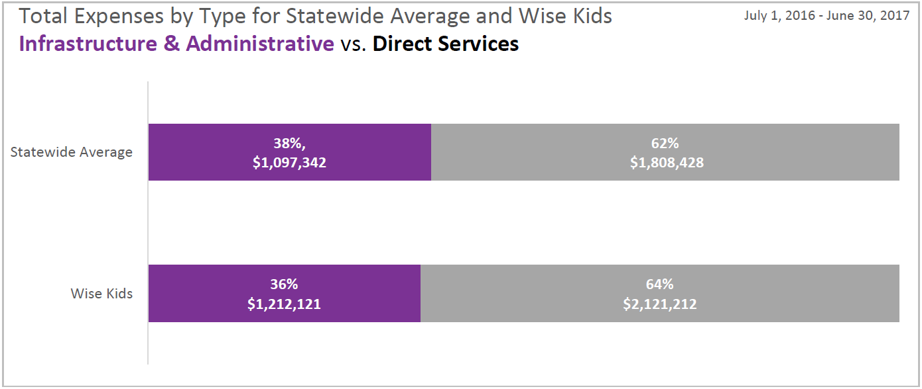

Slide 23
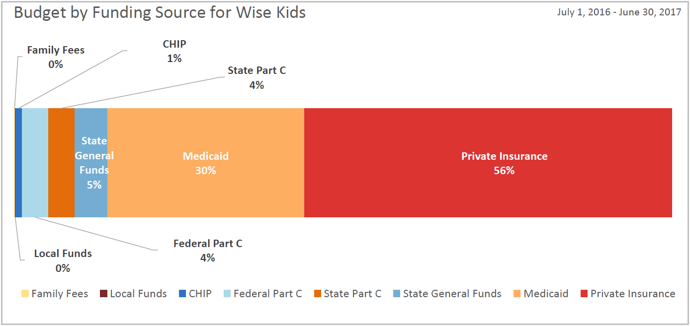

Slide 24
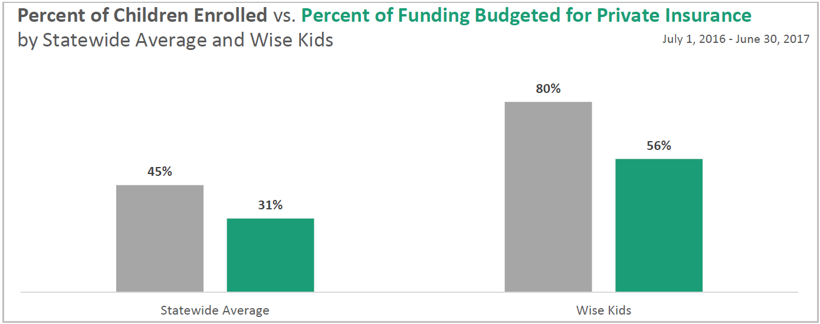

Slide 25
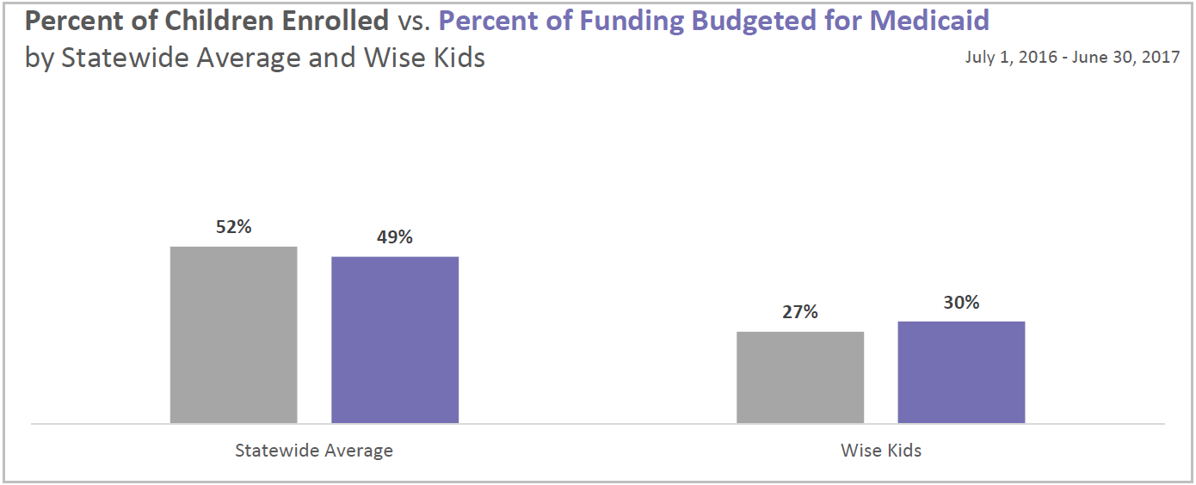

Slide 26
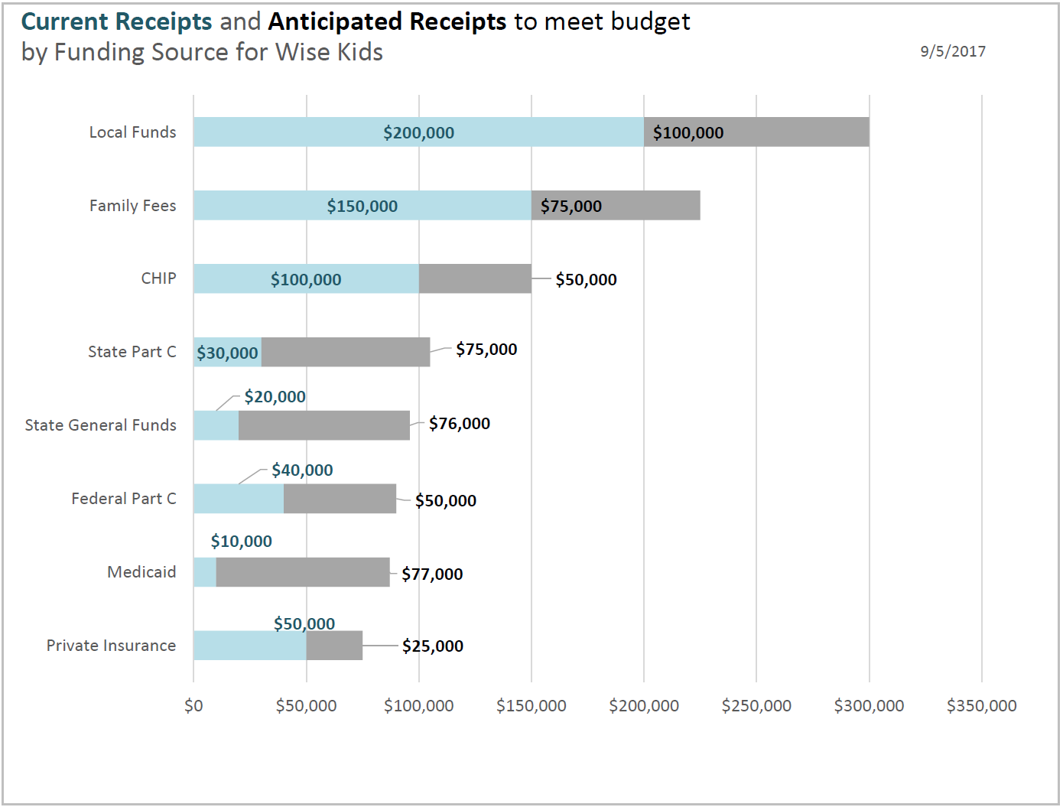

Slide 27
ACTIVITY TIME Fiscal Data Dive

Slide 28
Data Dive Activity Instructions
Share your fiscal profiles with those at your table.
Work with your table to better understand what they might mean.
Reflect on any strengths and weaknesses of the data visualizations.
Record any specific requests or unanswered questions about the fiscal profile tool on your “wishlist” (i.e., sticky note paper).
Be prepared to share back any highlights of your discussions to the larger group.

Slide 29
Data Dive Activity Shareback
What did you find to be interesting about this?
Have you done similar analyses in your state?
How could this be useful in your state?

Slide 30
BREAK!

Slide 31
Creating an Analysis Plan
Analytic Considerations for Question
Data Set for Analysis
Data Elements for Analysis
Steps for Conducting Analysis
Prepare and Review Data
Conduct the Analysis
Sample Output
Examples of Data Tables and Visualizations

Slide 32
Analytic Considerations Key Points
Analytic Considerations for Question
Data Set for Analysis
Data Elements for Analysis
Steps for Conducting Analysis
Prepare and Review Data
Conduct the Analysis
Sample Output
Examples of Data Tables and Visualizations
Include…
Focus of the question
Decisions to make related to data (e.g., what data to include, which children, programs, etc.)
Special requirements such as “must have x data for x timeline.”
The unit(s) of analysis for the question

Slide 33
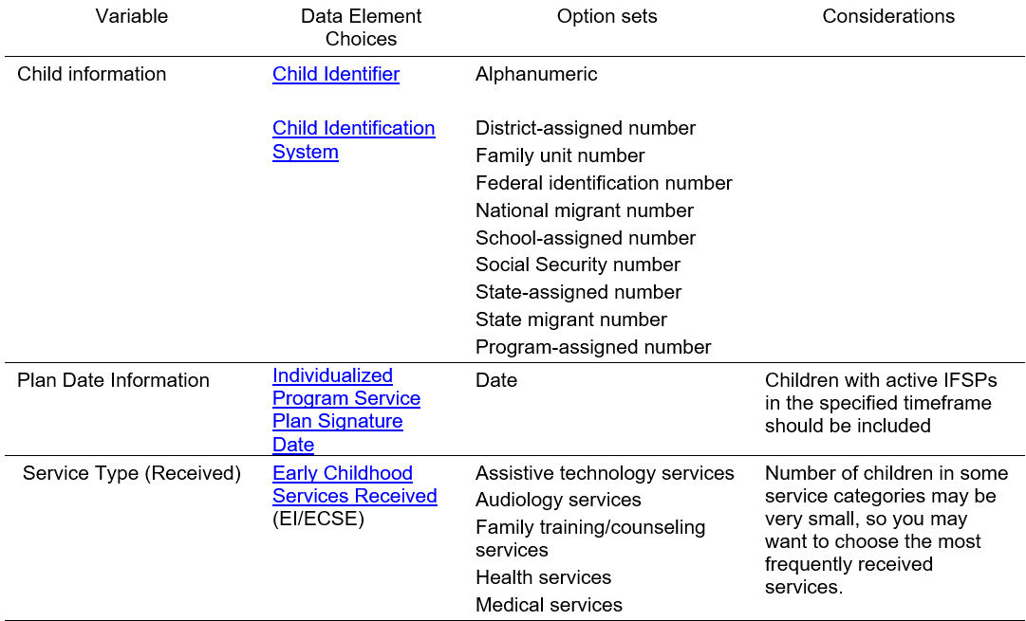
Data Elements Key Points
Analytic Considerations for Question
Data Set for Analysis
Data Elements for Analysis
Steps for Conducting Analysis
Prepare and Review Data
Conduct the Analysis
Sample Output
Examples of Data Tables and Visualizations

Slide 34
Data Preparation & Review Key Points
Analytic Considerations for Question
Data Set for Analysis
Data Elements for Analysis
Steps for Conducting Analysis
Prepare and Review Data
Conduct the Analysis
Sample Output
Examples of Data Tables and Visualizations
Include…
Selected timeframe used in analysis, subsets of children, other data decisions, etc.
How to calculate numbers, percentages, etc. in each category or subset.
What and how to check for outliers, missing data, and/or data that are unclear or out of range.
Considerations for handling data quality concerns.

Slide 35
Planning for Next Steps
Is the critical question(s) you identified still your key question(s) to answer?
What data do you need to answer that question(s)?
What additional supports do you need to collect it?
Who will get this information?
How often?
https://www.pexels.com/photo/topless-toddler-with-pants-sitting-on-white-surface-while-looking-up-1108195/

Slide 36
Large Group Discussion:
How could you use your past experience with analyzing and using fiscal data?
How does this fiscal data profile inform your approach to additional or deeper data analysis that you would like to conduct?
Who, within your Lead Agency, do you ask for the data you need to answer specific questions that are asked of you?

Slide 37
Wrap-Up: Reflections

Slide 38
Final presentation slide
Visit the DaSy website at: http://dasycenter.org/
Like us on Facebook: https://www.facebook.com/dasycenter
Follow us on Twitter: @DaSyCenter

Slide 39
Thank you
The contents of this tool and guidance were developed under grants from the U.S. Department of Education, #H326P120002 and #H373Z120002. However, those contents do not necessarily represent the policy of the U.S. Department of Education, and you should not assume endorsement by the Federal Government. Project Officers: Meredith Miceli, Richelle Davis, and Julia Martin Eile.

