Slide 1

Dollars and Cents: Collaborative Funding in Early Childhood programs and
Inclusion
Debbie Cate
Mary Peters
Technical Assistance Specialists

Slide 2
Collaborative Funding to Support Early Learning Programs

Slide 3



Defining Layering, Braiding, and Blending
Notes:
There are several terms that we’ll be working with today, and I hope these 3 images help distinguish funding mechanisms and service strategies to support inclusion.
Layered funding, just like a luscious layer cake have distinctive components that can be ‘stacked’ in different ways.
Braided funding, as with a braid of yarn, has individual pieces that can be tracked and identified.
The image of the blender suggests individual items going into the process, but what comes out doesn’t resemble the distinctive ingredients that were combined.
In each method, two or more funding sources are used to support a common goal. At ECTA, our lens for funding is to expand inclusive opportuunites for children with disabilities, from birth through age five.
Let’s take a closer look at each of these ideas.

Slide 4
Collaborative Funding
“… two or more funding sources are coordinated to support the total cost of a service.”
  Revenues are allocated
  Expenditures tracked by categorical funding source
  Cost-allocation methods are required
    No duplicate funding of service costs
    Each funding source is charged its fair share
Source:https://www.theounce.org/wp-content/uploads/2017/03/NPT-Blended-Funding-Toolkit.pdf
Notes:
The Ounce of Prevention Fund provides a clear definition of braiding: “When funds are braided, two or more funding sources are coordinated to support the total cost of a service. Revenues are allocated and expenditures tracked by categorical funding source. In braiding, cost-allocation methods are required to assure that there is no duplicate funding of service costs and that each funding source is charged its fair share across the partners.[1]”
The quote continues…At the state level … braiding [is a] are financing strateg[y]ies that federal, state, and local policymakers and program administrators can use to integrate and align discrete categorical funding streams to broaden the impact and reach of services provided.[2]
[1] Wallen, M., & Hubbard, A. (2013). Blending and braiding early childhood program funding streams toolkit: Enhancing financing for high-quality early learning programs (version 2). Chicago: The Ounce of Prevention Fund.
Retrieved from http://www.buildinitiative.org/Portals/0/Uploads/Documents/resource-center/community-systems-development/3E%202%20Blended-Funding-Toolkit.pdf.
[2] Colvard, J., & Schmit, S. (2012). Expanding access to Early Head Start: State initiatives for infants & toddlers at risk. Washington, DC: Center for Law and Social Policy and Zero to Three. Retrieved from http://www.clasp.org/resources-and-publications/files/ehsinitiatives.pdf.
[3] Oregon State Legislature. (2015). HB 3380 A, Overview [Web page]. Retrieved from https://olis.leg.state.or.us/liz/2015R1/Measures/Overview/HB3380.
[4] New York City Administration for Children’s Services. (n.d.). ACS child care options [Web page]. Retrieved from http://www1.nyc.gov/site/acs/early-care/acs-child-care-options.page#early.
[5] Flynn, M., & Hayes, C. D. (2003). Blending and braiding funds to support early care and education initiatives. New York: The Finance Strategy.

Slide 5

Layered Funds
Private / Philanthropic
Community Funds
State Pre-K
Title 1 Funds
Federal IDEA
Federal Head Start
Notes:
In layered funding, the base funding is clearly identified. In this image of a layer cake, you would still have a cake if the only piece you have is the bottom layer.
What makes it a much richer cake is by adding layers (and of course, the frosting on top!). In this illustration you see that we could easily name the fund sources (or layers) that have been put together to create a high quality cake!
The benefit of layering fund sources is that you will still have basic sources if one or more sources are removed at any time.

Slide 6

Layering – a North Carolina Early Childhood Partnership Example
First Layer*
  Funds the program is already receiving to operate (e.g., subsidy). *These funds cannot be supplanted.
Second Layer
  Funds for comprehensive services required by Early Head Start (e.g., staff training, equipment, and supplies).
Third Layer:
  Early Head Start funds exclusively to eligible children (e.g., screenings, home visits, assigned family service workers).
Source: https://pdg.grads360.org/services/PDCService.svc/GetPDCDocumentFile?fileId=26705
Notes:
This quote from BRAIDING, BLENDING, AND LAYERING FUNDING SOURCES TO INCREASE ACCESS TO QUALITY PRESCHOOL by Manuela Fonseca of the Preschool Development Grant – Technical Assistance center will help us understand the concept of layering [read this quote]
“Layered funding is a newer term that is often used in connection with Early Head Start (EHS) – Child Care Partnership Grants. The principle of “supplement not supplant” is a key feature of layered funding. The North Carolina Early Childhood Foundation (2014) provides a clear description of the concept of “layered funding”:
• First Layer: This is the foundational layer. These are the funds that the child care program is already receiving to operate (e.g., child care subsidy). These funds cannot be supplanted.
• Second Layer: These are the Early Head Start funds that pay for the program-level, comprehensive services required by Early Head Start that can benefit all children attending the child care center, regardless of their EHS eligibility (e.g., staff training, equipment, and supplies).
• Third Layer: These are Early Head Start funds that pay for individual child services only for Early Head Start eligible children (e.g., screenings, home visits, assigned family service workers). (NC Early Childhood Foundation, 2014, n.p.) Although primarily used in connection with EHS-Child Care Partnerships, the concept of layering can be applied to other early childhood programs

Slide 7
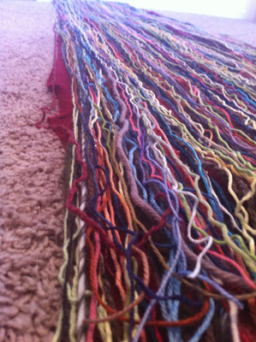
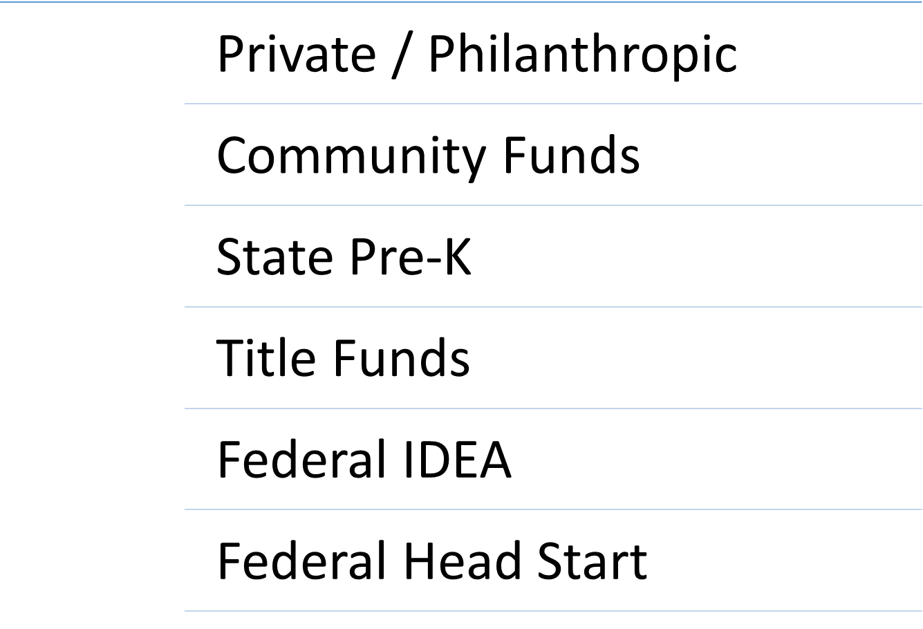
Braided Funds
Notes:
In braided funding, you also have individual fund sources, each with it’s own ‘string’ attached. When funds are combined, you are able to trace each source of money back to it’s origin sources. You are able to account for the use of funds and you would be able to describe the unique qualities of the ‘string’ – it’s regulations, limitations and opportunities.
When multiple funds are braided, something new emerges. Sometimes, however, when one fund is removed from the braid, the entire thing comes apart!

Slide 8
An Example of Braiding—NYC
New York City EarlyLearn NYC
Braided child care, Head Start, and state universal prekindergarten funds
Common Goal: improve access and continuity for low-income children and their families.
Achieved: higher program quality standards , redistribution of contracts, and increased supply of care in targeted high-need neighborhoods.
Source: https://childcareta.acf.hhs.gov/systemsbuilding/systems-guides/financing-strategically/maximizing-impact-public-funding/blending-braiding-funding [retrieved 10/31/2017]
Notes:
[Read the quote] “New York City reorganized its system of contracted child care through EarlyLearn NYC. This program braided funding from child care, Head Start, and state universal prekindergarten to improve access and continuity for low-income children and their families. EarlyLearn NYC has implemented higher program quality standards and redistributed contracts across the city to increase the supply of care in targeted high-need neighborhoods.[4]”
You see the partners in this effort: Child care, Head Start and universal pre-k. They had an identified common goal: To improve access and continuity of care for children and families living with low incomes. And notice the outcomes!
**is there anyone from NYC in a small group who might share their direct experiences (plus or minus) with EL NYC?
You may not be able to do exactly this, but the possibility of making significant change is inspiring.

Slide 9


Supplement = “ADDS TO””
Better!
Notes:
A word on the terms: To supplement” means to add to, such as you take a daily vitamin or supplement which adds to the healthy food you eat.

Slide 10

Supplant: “REPLACES”
Notes:
To supplant means to “replace” or “take the place of”
Federal law prohibits recipients of federal funds from replacing state, local, or agency funds with federal funds.
In layering of funds, the base or foundation layer is the funding that may not be replaced.

Slide 11

Blending Funds. . . Maybe Not
Notes:
Beautiful things are created when funds are blended, BUT it isn’t possible to identify each ingreditent, or fund source, and accountablity is not possible. So for the purposes of using this concept related to funding, it is not desired. As probably know, many funds, including special education funds, must be accounted for specifically, so this isn’t a funding strategy we can use.

Slide 12


Blended Programs – YES!
2017 - Photo by Ryan’s momma; hared with permission.
Notes:
Regardless of the funding mechanism that is used, we do heartily recommend blending programs. Blended programs are inclusive programs. Children share in the high-quality experiences provided without a distinction between which funds are paying for the which children or program components.

Slide 13
Collaborative Funding to Support Children with Disabilities in Early Learning Programs

Slide 14

Call to Action
2015
U.S. Department of Health and Human Services and the U.S. Department of Education Policy Statement on Inclusion of Children with Disabilities in Early Childhood Programs
2017
Dear Colleague Letter (DCL) related to Preschool Least Restrictive Environment (LRE).
2009
Early Childhood Inclusion: A joint position statement of the Division for Early Childhood (DEC) and the National Association for the Education of Young Children (NAEYC)

Slide 15

Valuing Inclusion
The Individuals with Disabilities Education Act (IDEA)
“…presumes that the first placement option considered for a preschool child with a disability is the regular public preschool program the child would attend if the child did not have a disability.”

Slide 16

Individuals with Disabilities Education Act (IDEA) Funds
IDEA Part B Section 611 funds for children ages 3-21 and 619 funds for children ages 3-5
State and local agencies also provide funds
Funds are used to provide special education and related services to children with disabilities, costs in excess of the regular education costs
Notes:
IDEA funds may be used for:
costs related to special education teachers, administrators and related services providers
specialized equipment or devices materials and supplies for children with IEPS professional development for special education personnel and general education teachers who teach preschool children with IEPs

Slide 17

Use of IDEA Funds
Special education teachers
Administrators
Related services providers
Specialized equipment or devices
Materials and supplies
Professional Development
Technology for recordkeeping, data collection
Case management activities for providing services described in a child’s IEP

Slide 18
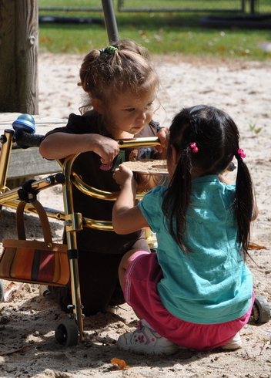
Use of IDEA Funds
Part B funds may pay for all education costs in a preschool program if no local or state funds are available for nondisabled children
This means, generally:
  if child is eligible for a public funded program, special education funds for services
  if no funded placement is available, special education funds may be used to pay for a preschool placement

Slide 19
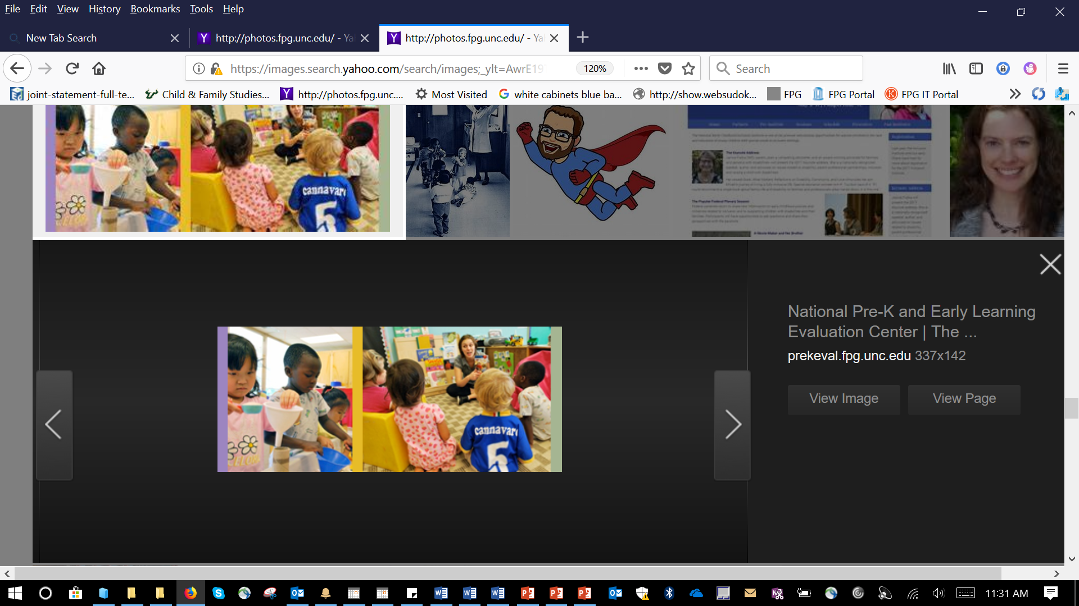
Children Attending
Early Childhood Programs
A child is attending a regular early childhood placement and is identified as a child with a disability
can the IEP be delivered in that program?
if the program is tuition based or child care, what does your state or LEA require as the financial arrangement?

Slide 20
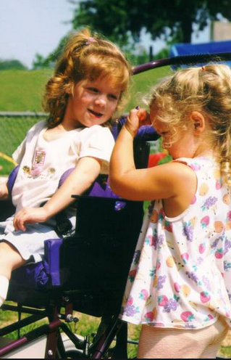
Use of IDEA Funds: Let’s Talk!
What guidance is available in your community to support collaborative funding?
What guidance do you need?

Slide 21

Incidental Benefit
IDEA funds may be used for services and aids that also provide incidental benefit to children without disabilities.
Special education and related services, supplementary aids and services, all provided in a regular early childhood setting to a child with an IEP may also benefit children without IEPs.

Slide 22
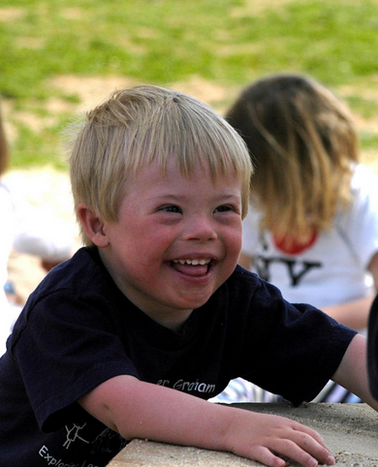
Comingling Funds is Not Allowed
IDEA funds must be used as intended and must not be comingled with state funds.
Use of a separate accounting system that includes an audit trail of the expenditure of funds is required.

Slide 23
Cost of Inclusive Programs
Lower costs were associated with more inclusive programs across public schools, community, and Head Start programs
Inclusive preschool models were less expensive for school districts than segregated models
Odom, Samuel L.; Hanson, Topics in Early Childhood Special Education, 2001

Slide 24
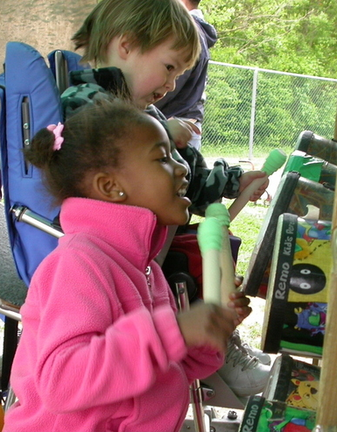
Community Collaboration
Build a coordinated system that supports high-quality learning experiences for all young children
Set expectations for services by establishing policies and allocating resources
Establish a task force, council or committee on early childhood inclusion
Understand each program’s requirements, it is key to working together

Slide 25

Collaborative Funding
Braided funding
Cost sharing
  each program pays the same amount
  cost contribution
Specific cost funding
In-kind sharing
Funded enrollment
Class size waivers
Holding slots
Professional competencies, certifications and licensure
Professional development
Notes:
Ask for examples after each type of funding

Slide 26

Cost Sharing
The same amount per child
Funds determined based on the
cost of the program or classroom.
Each funding source pays the same
amount for each child.
The cost of the classroom is divided it by
the number of children in the classroom.
Notes:
Ask for examples after each type of funding

Slide 27

Cost Sharing – Cost Contribution
Each funding source pays the amount per child generated by their program.
Funds for the classroom are based on the amount the funding program spends per child.
Example:
Pre-K $5,000 per child
Title I $4,600 per child
Notes:
Ask for examples after each type of funding

Slide 28

Specific Cost Funding
Each preschool program pays for part of the program cost.
One program pays for the teacher, another for an assistant.
Special education pays for an additional assistant to assist in the classroom.
Notes:
Ask for examples after each type of funding

Slide 29
In Kind Sharing
When one program provides a service or other operating functions:
A school may have extra rooms, or an older building no longer being used.
They provide space to a program – public or private, in return for spaces for children with disabilities
Notes:
Ask for examples after each type of funding

Slide 30

Funded Enrollment
When determining placement, always consider a regular program first.
If a child is not in a program, and the IEP team determines a regular placement is needed:
If there is not a public placement at no cost to the family, IDEA funds should be used to pay for the placement.
Pay for time needed to implement the IEP.

Slide 31

Discussion
As part of an IEP team, can the team make decisions to provide services in regular early childhood programs?
Do you have seats in regular early childhood programs available for children with disabilities?

Slide 32
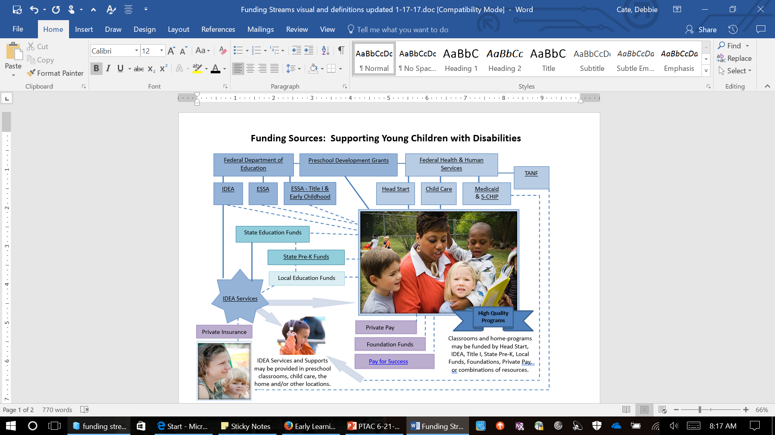

Slide 33
Service Delivery Models
Co-teachers (regular and special education) in classroom
Dually certified teacher who provides regular and special education
Additional support for the classroom by regular or special education paraprofessionals or teacher assistants
Consultation with the regular education classroom teacher
Itinerant special education teacher and/or teacher assistant work with the child (or children) in classroom. Related special education service providers (therapists) in classroom
Paraprofessional or assistant providing support to an individual child as specified in a child’s IEP

Slide 34
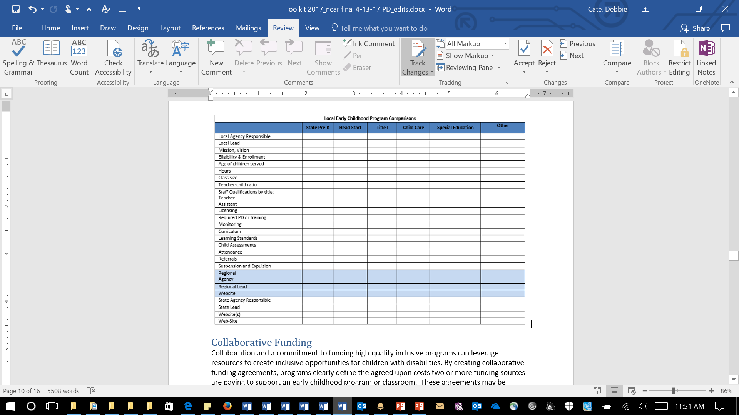
Comparison Chart

Slide 35
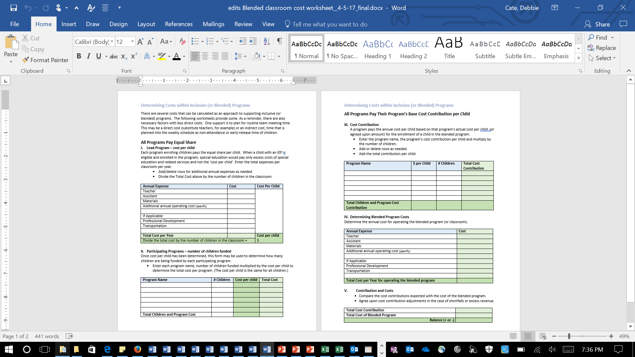
Determining Costs Worksheet

Slide 36


Preschool Funding Models
Sophie Hubbell, Assistant Director/619 Coordinator

Slide 37
Early Childhood Funding Sources
State Early Childhood Education
State Preschool Special Education
Federal Preschool Special Education
Title I
Head Start
Publically Funded Child Care
Private Pay
Local Sources

Slide 38

State Funding Sources

Slide 39
Early Childhood Education Grant
Primarily for 4 year olds
At or below 200% FPL
12.5 hours per week
$4000 per child
Can use PFCC and other funding to provide extended day services
Notes:
Privately funded child care

Slide 40
Preschool Special Education
Ages 3 through 5
Child with a disability
10 hours per week minimum
$4000 per child + differentiated amount based on district state share index and disability category

Slide 41

Federal Funding Sources

Slide 42
Preschool Special Education
Ages 3 through 5, including Kindergarten
District allocation based on historic child count, population, and poverty data

Slide 43
Head Start
Ages 3 – 5
At or below 100% Federal Poverty Level
Category: Homeless, Foster Care, Public Assistance
3.5 - 6 hours per day
4 / 5 days per week
School year / Full year

Slide 44
Publicly Funded Child Care
Ages infant through12 years
Initial Eligibility ≤ 130% Federal Poverty Level
Co-payment based on a sliding fee scale
Covers care during a qualifying event (work or school)
Eligibility hours vary based on the qualifying event

Slide 45
Title 1 Part A Funding
Schoolwide Program- 40% or more low-income students*
Targeted Assistance Program
May use funds to support the entire school
Do not need to identify individual students for services (may serve all students)
Do not need to demonstrate that individual activities/services are supplemental
May consolidate Federal, State, and local funds
Services provided to a select group of children- most at risk
Supplement not supplant
For questions, contact the Office of Federal Programs.
*For priority and focus school exceptions, contact the Office of Federal Programs

Slide 46
Title 1 Part A Funding
Examples of Uses of Funds in a Schoolwide Program (Based on the Needs Assessment)
Increased learning time
High-quality preschool or full-day kindergarten
Evidence-based strategies to accelerate the acquisition of content knowledge for English Learners
Activities that have been shown to be effective at increasing family and community engagement in the school
Family literacy programs

Slide 47


How to Use Multiple Funding Sources
Notes:
Ohio House Bill 64
nothing in this section shall be construed to prohibit program providers from utilizing other funds to serve eligible children in programs that exceed the twelve and one- half hours per week or that exceed the minimum school year.

Slide 48
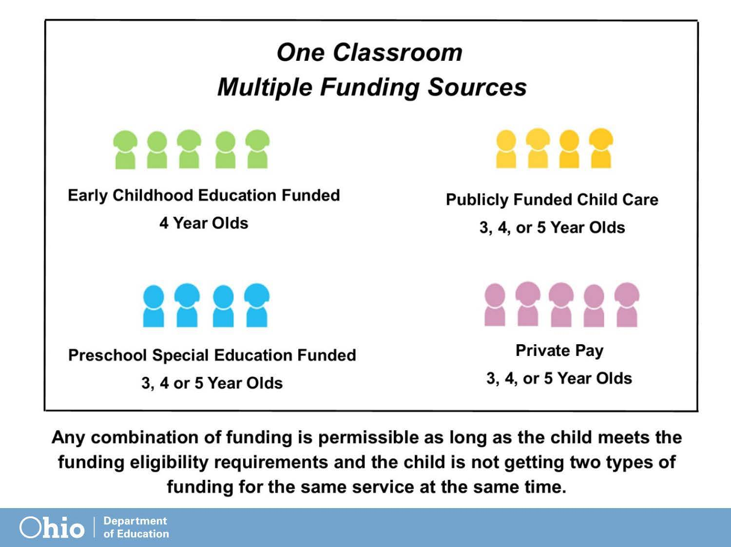

Slide 49
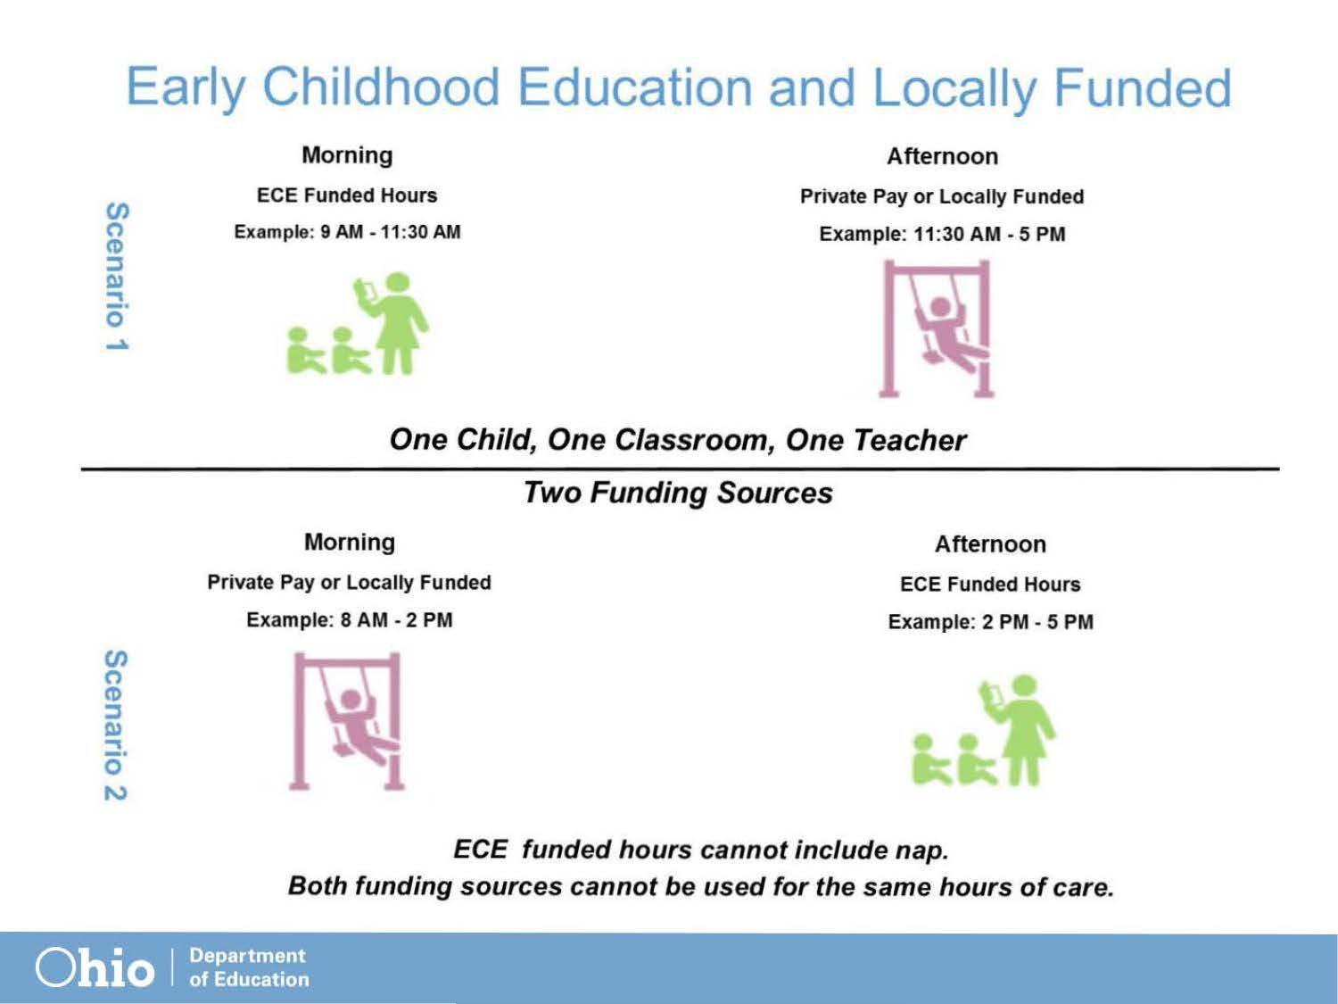

Slide 50
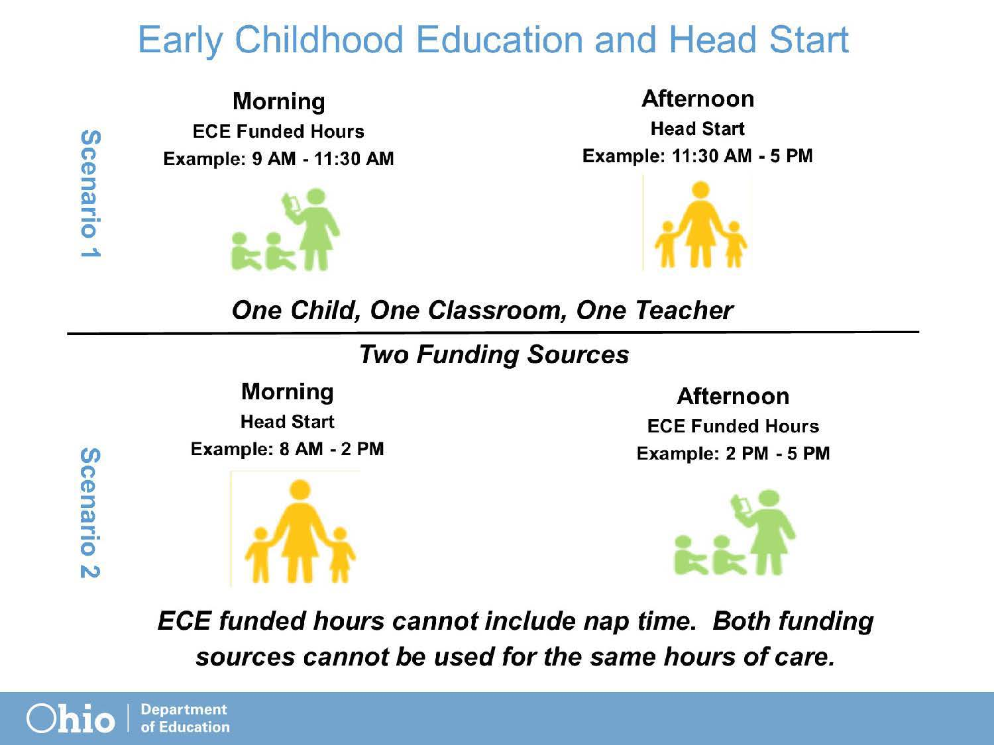

Slide 51
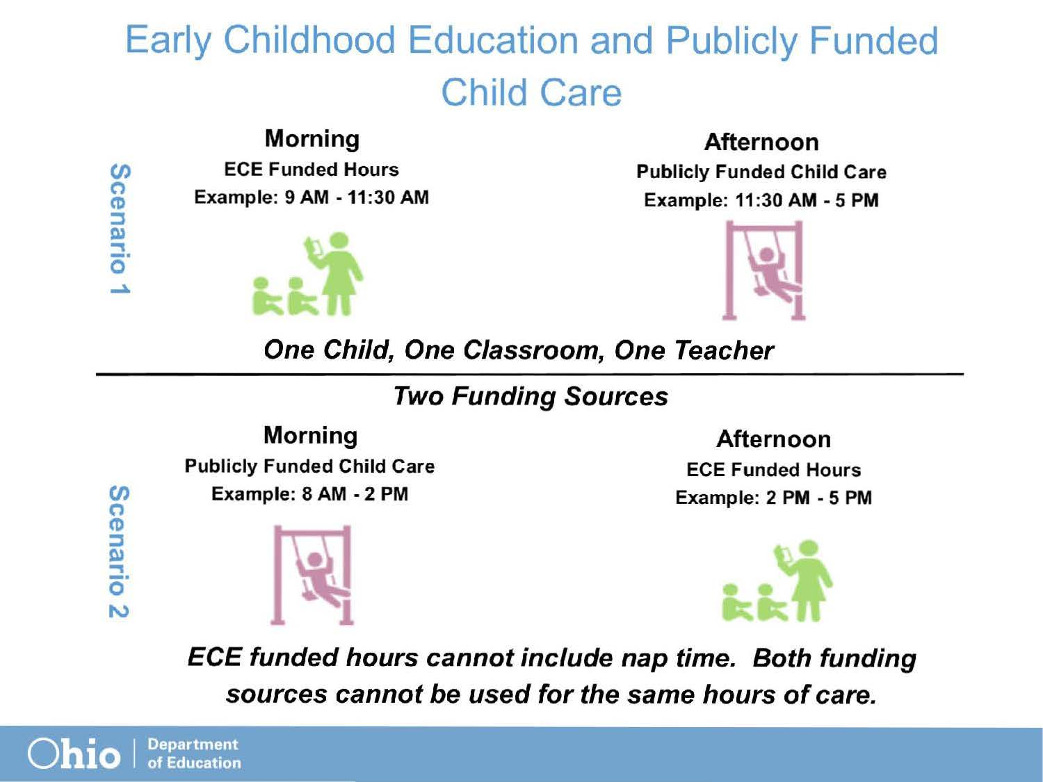

Slide 52
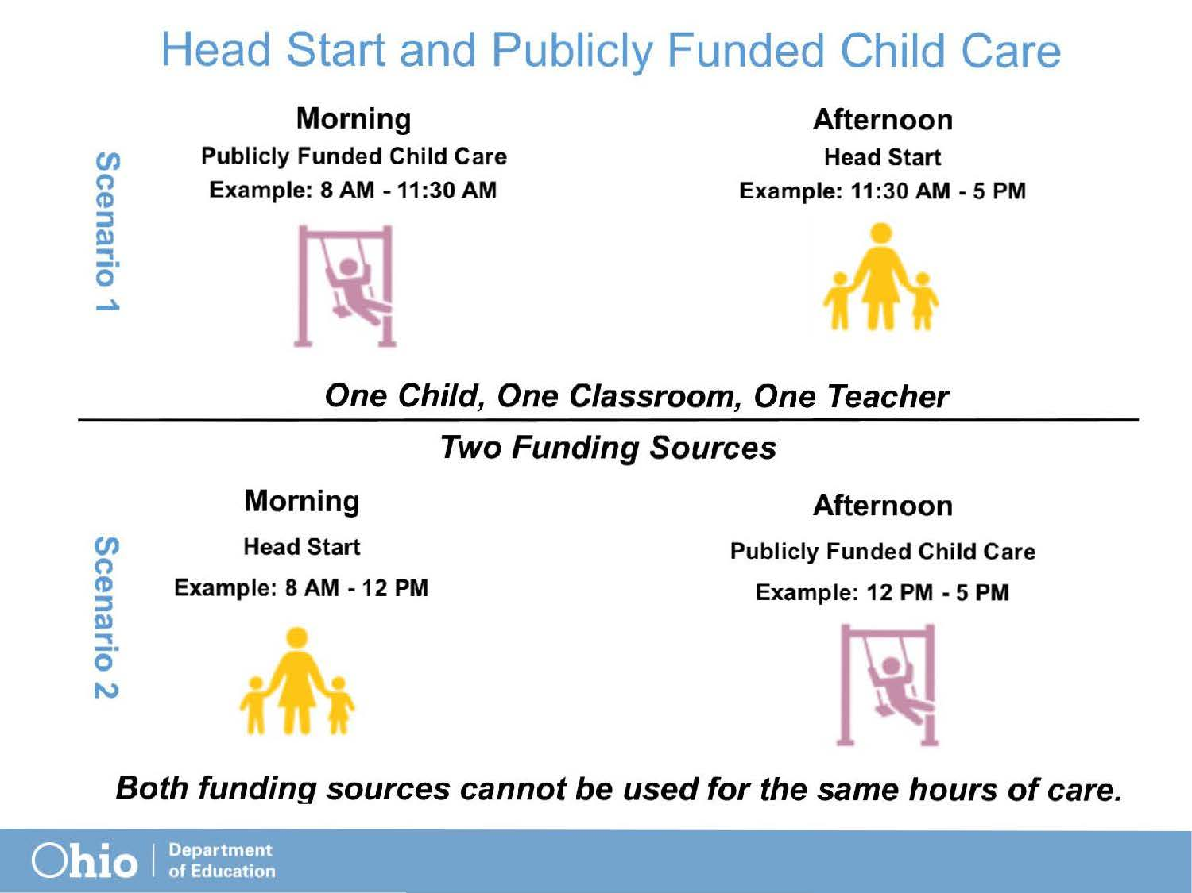

Slide 53
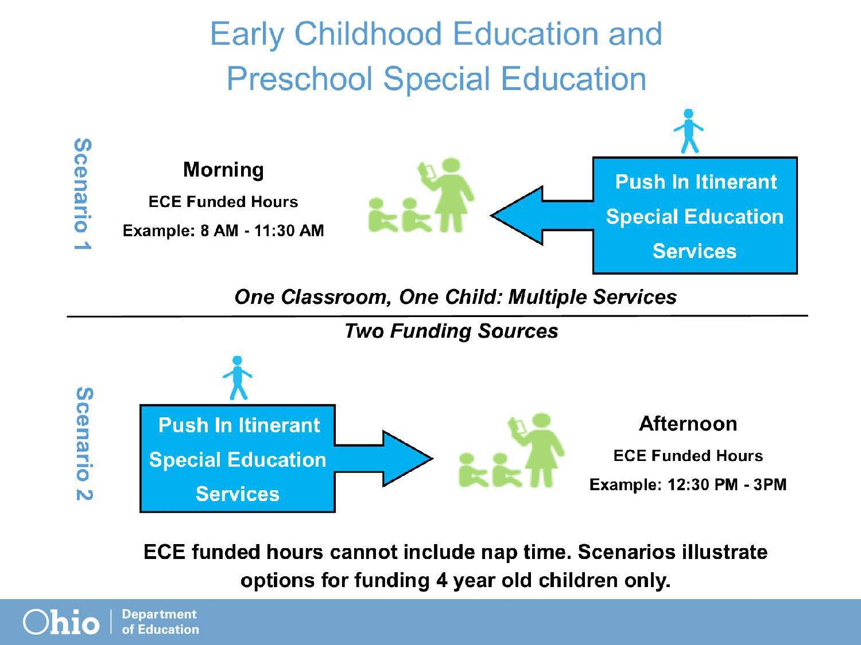

Slide 54
Program Models Discussion
What models are you using to fund inclusion?
How do you ensure a full continuum of services is available for each child?
What are the barriers to creating a full continuum?
What are the successes that you have had regarding funding effective models?
Notes:
Question to help stimulate discussion.

Slide 55

Questions

Slide 56
Contact Information
Sophie Hubbell
Assistant Director/619 Coordinator
Office of Early Learning and School Readiness
Sophia.Hubbell@education.ohio.gov

Slide 57

education.ohio.gov

Slide 58
Discussion
What is happening in your state or district?
What guidance is available to collaboratively fund programs?
How do you ensure that all children’s needs are met in programs that are collaboratively funded?

Slide 59
Find out more at ectacenter.org
The ECTA Center is a program of the FPG Child Development Institute of the University of North Carolina at Chapel Hill, funded through cooperative agreement number H326P170001 from the Office of Special Education Programs, U.S. Department of Education. Opinions expressed herein do not necessarily represent the Department of Education's position or policy.

