Slide 1
Introducing a New Interactive State Guide to Support Implementation of Evidence-based Practices
Barbara J. Smith, University of Denver/ECTA
Lise Fox, University of South Florida/ECTA
Katy McCullough, ECTA
Anne Lucas, ECTA

Slide 2
Welcome
Who’s in the room?
What’s our plan for the session?
Introduce you to the new resource: Online State Implementation Guide
Provide opportunities for you to use the Guide and to explore how it might assist you in your efforts

Slide 4
State Implementation Guide (SIG)
based on results and evidence from the multi-year Pyramid Model implementation initiative in 25 states as well as ECTA's DEC Recommended Practices implementation technical assistance in 4 states
is a collaboration between ECTA and the National Center for Pyramid Model Innovations (NCPMI)
includes tools, materials, and examples

Slide 5
Purpose
Provides a process for improving child and family outcomes by implementing evidence-based practices.
This includes how to identify areas of strength and need in your system, build key support structures, implement practices, track outcomes, and take the process statewide.

Slide 6
Major Components of the Guide
4 Essential Support Structures
State Leadership Team
Professional Development Network of Program Coaches
Demonstration and Implementation Sites
Data Evaluation Systems
Implementation Science: stages of implementation
Exploration and Planning
Installation
Implementation: Initial to Full
Scale-up
Resources, templates and examples

Slide 8
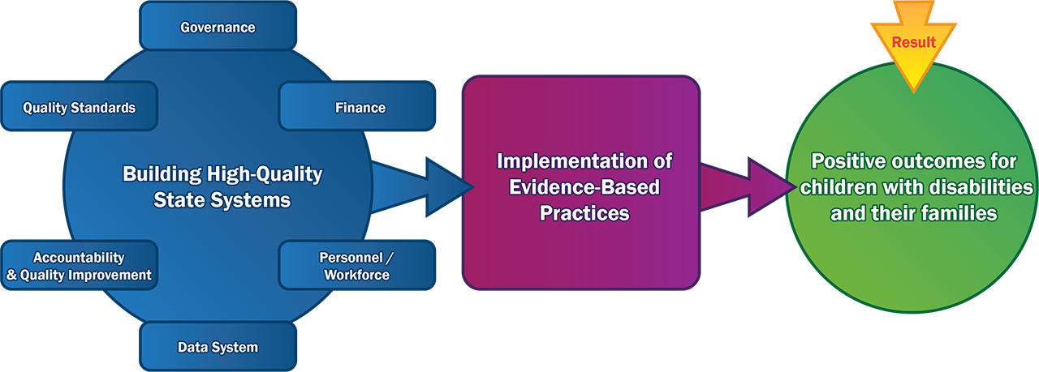

Slide 9
Shout Out
What challenges have you experienced with implementation at the state and/or program level?
Examples:
finding high quality sites
reaching fidelity
getting data to the state level that shows where practices are implemented

Slide 10
Finding Answers to Your Questions
Select a challenge to explore
On your electronic device, go to: http://ectacenter.org/sig/
Select the section(s) of the State Implementation Guide from the navigation bar that you think may address your challenge and review the information
Discuss with your partner(s) what information you found helpful in addressing your challenge
Notes:
Depending on time available, offer folks the opportunity to explore, in pairs, a challenge (question) they are particularly interested. - Katy
Activity (10-15 min)
Report Out (5 min)
Use current report out slide currently in PPT
Challenge,
Where on web site you found helpful info,
What was particularly helpful in what you found.

Slide 11
Report Out
Share:
Your challenge
What section(s) of the State Implementation Guide you reviewed
What information you found helpful to address your challenge

Slide 12
A Deeper Dive
Refer to your assigned essential support structure questions on the handout
Pick a question to start with
On your electronic device, go to the link(s) provided
Discuss with your partner(s) what information you found that answers the selected question
Be ready to share one thing you found particularly helpful
Notes:
Assign tables an essential support structure to explore, based on the shout out (handout of questions?). 10-15 min - Katy
See handout based on implementation questions. Select one of the questions within your essential support structure to answer (you may have time to explore additional questions). Be ready to report back on the following:
15 min to explore content
Report Back Questions (10 min):
Which question, of the ones you explored, would you like to share?
What information did you find that answered the question?
What one thing did you learn or find particularly helpful in the Statewide Implementation Guide?

Slide 13
Report Out
Share:
Your essential support structure and selected question
Information you found that answers the question
One thing you found helpful

Slide 14
Reflections/Take Aways
Notes:
How do you see this supporting your statewide initiative?

Slide 15
Find out more at ectacenter.org
The ECTA Center is a program of the FPG Child Development Institute of the University of North Carolina at Chapel Hill, funded through cooperative agreement number H326P170001 from the Office of Special Education Programs, U.S. Department of Education. Opinions expressed herein do not necessarily represent the Department of Education's position or policy.

