Slide 1

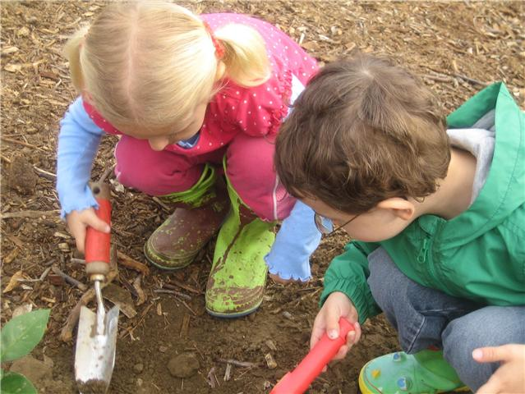
Digging Deeper:
What Educational Environments Data Reveal for Children, Ages 3-5
Nancy Fuhrman, WI
Gary Smith, TN
Debbie Cate & Mary Peters, ECTA

Slide 2
Valuing Inclusion

Slide 3

The Individuals with Disabilities Education Act (IDEA)
“…the first placement option considered for a preschool child with a disability is the regular public preschool program the child would attend if the child did not have a disability.”

Slide 4
National Data 2016-2017

Slide 5
Education Environments Indicator B6 2016-17
National Data
45%
25%
Children attending RECP Services in Program
Children attending Special Ed Class, Special School, Residential

Slide 6
Children who Attend a RECP and Receive the Majority of Services in the Program

Slide 7
Children who Attend a Special Education Class, Special School, or Residential Facility

Slide 8
Educational Environments Children 3-5, 2016-17

Slide 9
Indicator 6a Children 3-5 Attending and Receiving the Majority of Services in the Program, 2016-17
100%
45%
21%
Each bar represents a State or Territory

Slide 10
Indicator 6b Children 3-5 Attending Special Ed Class, Separate School or Residential Program
51%
25%
0%
Each bar represents a State or Territory

Slide 11
Clarifications to the Data Collection

Slide 12

Educational Environments for Children Ages 3-5
618 Reporting Clarifications
Debbie Cate
IDEA Data Center
June 21, 2018

Slide 13
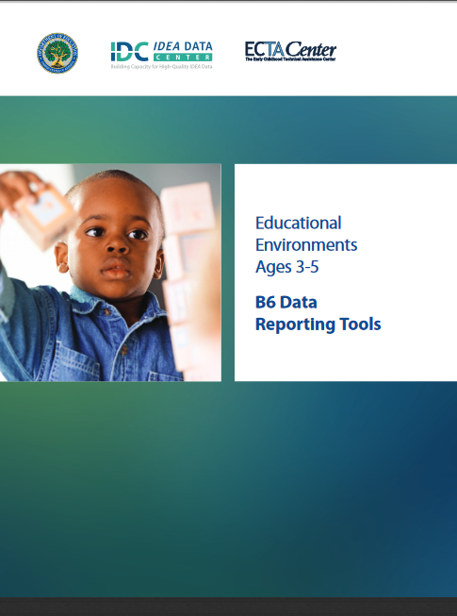
Resources for Reporting Educational Environments for Ages 3-5
Toolkit - Contains Guidance and Decision Tree
Interactive Decision Tree App
Webinars
Data Worksheet
https://ideadata.org/resources/resource/1426/b6-data-reporting-tools-educational-environments-ages-3-5

Slide 14

Educational Environments Ages 3-5
618 Reporting
Unduplicated count
State chosen date between October 1 and December 1
All children ages 3-5 with disabilities
  Include children who are 5 and in kindergarten on the count date
  Include children enrolled by parent in private school, receiving special education services on a services plan

Slide 15
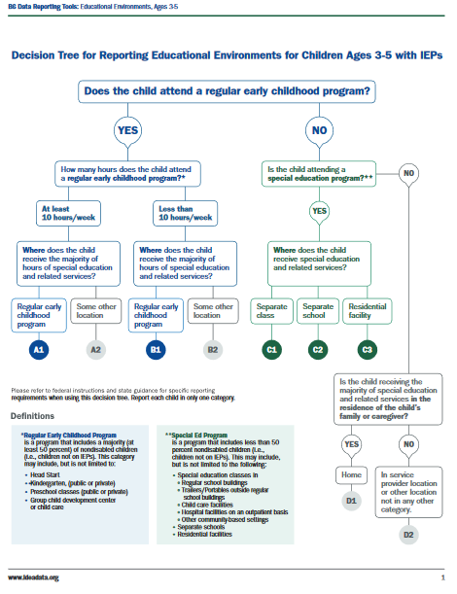
The Decision Tree
Consider the first question:
Does the child attend a regular early childhood program?
NEW! Clarification

Slide 16
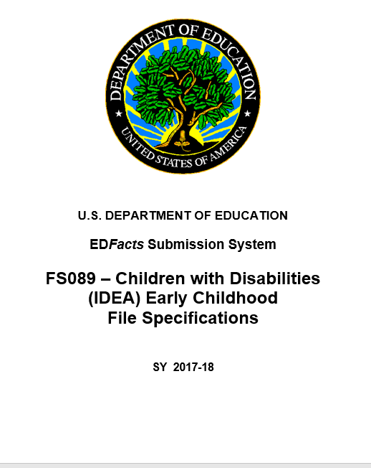
EdFacts
File Specifications FS089
https://www2.ed.gov/about/inits/ed/edfacts/sy-17-18-nonxml.html
Children with Disabilities (IDEA) Early Childhood File Specifications, 2017-18
New! Clarification

Slide 17
Regular Early Childhood Programs
A regular early childhood program includes a majority (at least 50 percent) of nondisabled children (i.e., children not on IEPs). Includes, but not limited to
  Head Start
  Kindergarten
  Preschool classes offered by the public school system
  Private kindergartens or preschools
  Group child development center or child care
  (See EDFacts, FS089.)

Slide 18
Play Groups and Home
Weekly informal school or neighborhood play groups may not be considered regular early childhood programs for reporting purposes
  These programs generally are not required to comply with state early learning standards or curricula
Home is not considered a regular early childhood placement
Dear Colleague Letter on Early Childhood LRE

Slide 19

NEW! Clarification: Family Chosen Programs
Should child care and other programs that families have chosen for their child be considered when reporting these data?
Yes, States should take into consideration child care and other programs that families have chosen for their child when determining the appropriate educational environment report category.
(See EDFacts, FS089.)

Slide 20

NEW! Clarification on “Attending”
When considering if a child is attending a regular early childhood program, does the child need to be enrolled in the program, vs. attending as a ‘visitor’ for a portion of time?
States should report these data based on children with disabilities being enrolled in these types of programs. CWDs [children with disabilities] being enrolled in a regular early childhood program most closely aligns with the intent of the least restrictive environment provisions of the IDEA.
(See EDFacts, FS089.)

Slide 21
The Decision Tree
If you determine the child attends a regular early childhood program, determine time in the program and consider where special education and related services are provided.
NEW! Clarification

Slide 22
NEW! Clarification: Services in the Program
Considered as Receiving Services in the Regular Early Childhood Program
How should states report children receiving the majority of special education and related services in a location other than the child’s classroom but within the same building?
Special education and related services delivered to the child in the course of daily activities and routines in which all children in the classroom participate (e.g., “circle time,” “learning centers”) would be considered as being received in the Regular Early Childhood Program.
(See EDFacts, FS089.)

Slide 23
NEW! Clarification: Services in the Program (cont.)
Not Considered as Receiving Services in the Regular Early Childhood Program
Services delivered in a location that removes the child from the opportunity to interact with nondisabled children.
These include, but are not limited to
Services delivered in a 1:1 therapeutic setting
Services in a small group comprised solely of children with disabilities whether or not they are provided in another location within the building where the regular early childhood program is located
(See EDFacts, FS089.)

Slide 24
The Decision Tree
If the child does not attend a regular early childhood program, does the child attend a special education classroom, separate special education school, or residential program?

Slide 25
The Decision Tree
If the child does not attend a regular early childhood program or a special education program, is the child receiving services in the home? If not, is the child receiving services in a service provider location?

Slide 26
Discussion—Changes in Data Collection
will your state have to make changes around children enrolled rather than ‘visiting’ other classrooms? Do you think it will significantly affect your data and performance?
Will your state have to make changes around family chosen programs? Do you think it will significantly affect your data and performance?
Will your state have to make changes around services in the classroom? Do you think it will significantly impact your data and performance?

Slide 27

For More Information
Visit the IDC website
http://ideadata.org/
Follow us on Twitter
https://twitter.com/ideadatacenter
Follow us on LinkedIn
http://www.linkedin.com/company/idea-data-center

Slide 28




The contents of this presentation were developed under a grant
from the U.S. Department of Education, #H373Y130002. However, the contents do not necessarily represent the policy of the U. S. Department of Education, and you should not assume endorsement by the federal government.
Project Officers: Richelle Davis and Meredith Miceli

Slide 29
Influences on State and Local Data Perceptions

Slide 30
Coding Considerations
Is the first consideration always, does the child attend a regular early childhood program?
  Is this true for children who receive only speech and language services?
  Is this true for children who attend a stand alone regular early childhood program?

Slide 31
Children Receiving Services in Other Locations
For children who attend regular early childhood programs, but receive the majority of their special education and related services in other locations
  What regular programs are these children attending?
  Are these programs chosen by their parents?
  How many children are attending 10 hours or more, versus 10 hours or less?

Slide 32
Children in Special Education Settings
Children in special education settings may be appropriately coded as children who:
  Attend a regular early childhood program but receive the majority of their special education and related services in other locations
  Other locations may be in self-contained classroom, separate special education school, or residential setting
    Do you know how many children attend a special education program, who are coded as attending a regular early childhood program but receiving services in other locations? What percentage?

Slide 33
Children 3-5 in Kindergarten
Children in kindergarten who are five on the state selected collection date should be included
  Approximately how many children are five in kindergarten on the collection date in your state?
  How do these children impact your data?
    Where are these children receiving special education services?
    From whom are these children receiving special education services?

Slide 34
Using your data for program improvement to create more inclusive opportunities

Slide 35
Jenny Giles
Nancy Fuhrman
Wisconsin
Department of Public Instruction

Slide 36
Preschool Inclusion
Preschool inclusion statewide initiative for many years
  Sharing of resources
  Discussion of preschool options
Efforts did not result in substantial change
Results Driven Accountability (RDA) and Preschool Inclusion Policy Statement made rethink efforts
  Resulted in focused LEA approach to increasing preschool inclusion
  Expectation that focused approach will impact educational environment data as well as child outcomes data

Slide 37
CESA Program Support Teachers
12 Regional Cooperative Educational Service Agencies (CESAs) within state
  Purpose is to provide technical assistance
IDEA discretionary dollars used to fund one or more early childhood program support teachers (PSTs) within each CESA
CESA PSTs leading the work at the LEA level
  SEA staff and statewide early childhood coordinator available to provide support and resources
  ECTA staff provided 1-day professional development
    Resource sharing
    Data analysis

Slide 38
Identifying Focus LEAs
Scoring Rubric
Three Years of Data
  Possible 15 points total
1 point | Did not meet the state target for Indicator 6A
1 point | Did not meet the state target for Indicator 6B
1 point | More children attending a special education program or receiving services in a service provider/other location than children attending a regular early childhood program
2 points | More children attending a regular early childhood program and receiving majority of services in another location than children attending a regular early childhood program and receiving majority of services in the program

Slide 39
Identifying Focus LEAs Continued
LEAs within CESA sorted high score to low score
SEA identified between three to seven LEAs within each CESA based on score and number of LEAs within the CESA
  LEA Child Count = At least 10 children ages 3-5
CESA Program Support Teacher provided scoring data for SEA identified LEAs
  Only shared scoring data for SEA identified LEAs as wanted selection to be data-based and not prior relationship based
Using data CESA Program Support Teacher selected a focus LEA

Slide 40
Focus LEAs – Year One
October - Selected LEAs invited by SEA to participate in focus work
  Recognition that this is a state initiative
  Assurance that LEA was not doing something wrong
November / December – CESA Program Support Teacher made initial contact with focus LEA
  Establish meeting/contact dates
    Required to connect monthly either face-to-face or through technology
  Establish focus team within LEA
January / April - CESA program support teacher and focus LEA continued to meet
  Focus on exploration/observations
June – Focus LEA and CESA program support teacher develop long-term preschool inclusion goal

Slide 41
Data Drill Down
  Educational Environment Data
    Percent by educational environment
    Percent by age and educational environment
    Percent by disability and educational environment
  Data Review Guide - Questions to Ask
    Where do most 3 year olds, 4 year olds, and 5 year olds receive their special education services?
      Are there more inclusive opportunities for children at different ages?
    What is the disability of the majority of children ages 3 through 5?
      Are there more inclusive opportunities for children of differing disability categories?
  Added benefit - Data accuracy discussions

Slide 42
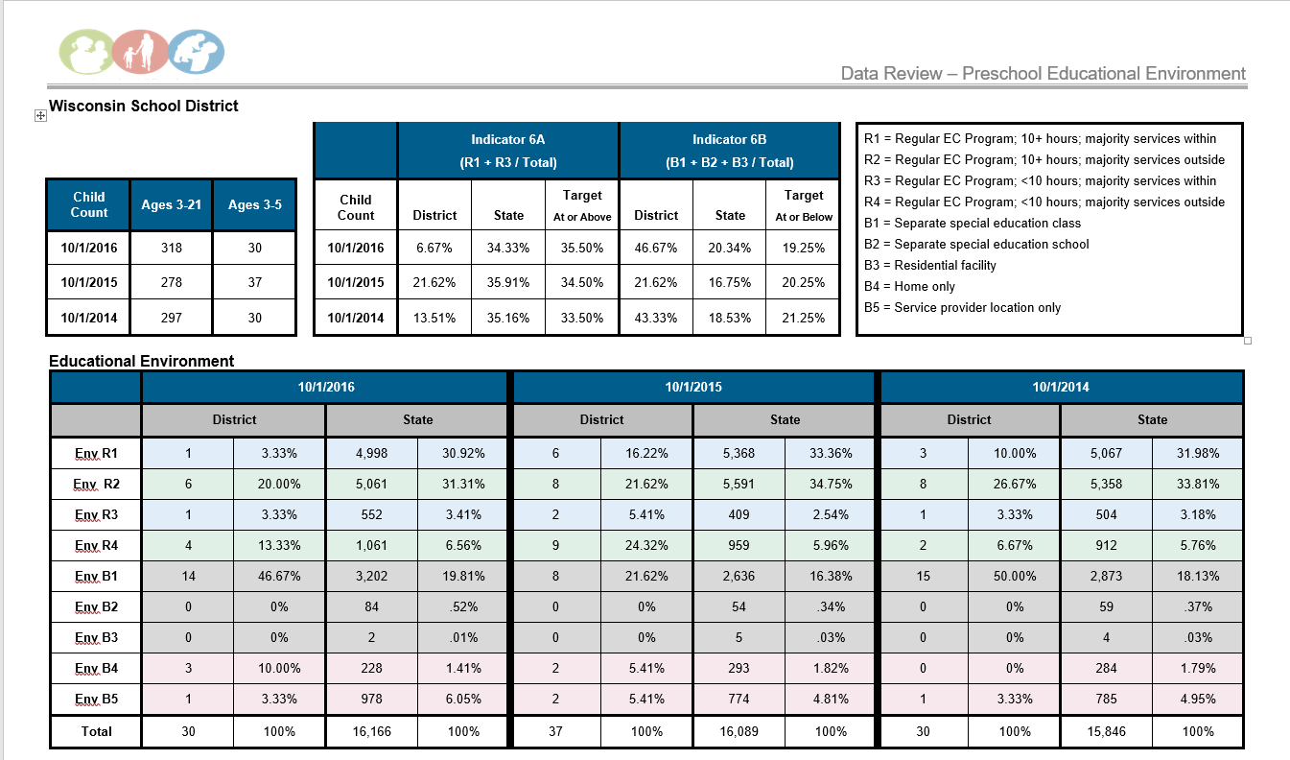

Slide 43
Year 1 Accomplishments – Addressing Barriers
Preschool inclusion video - https://dpi.wi.gov/sped/early-childhood
Relationship building within the LEA
Identification of possible community partners
Realization need to meet the LEA where the LEA is at
Realization that it is OK to not know
Realization that preschool inclusion is more than just changing the numbers
Lots of excitement from LEAs and CESA program support teachers

Slide 44
Next Steps
Each CESA Program Support Teacher will continue to work with their Year 1 focus LEA
Each CESA Program Support Teacher will be working with one to seven additional focus LEAs during the 2018-19 school year
  Determined by number of discretionary grant days available within the CESA
Rubric for identifying focus LEAs will include disproportionality and LEA determination data
  1 point if identified for Indicator 9
  1 point if identified for Indicator 10
  1 point if identified for Indicator 4B
  1 point if LEA determination does not meet requirements

Slide 45
Next Steps Continued
Encourage use of local data
Continued guidance in root cause analysis
  Development of measurable goals
Continued professional development related to coaching/facilitation
Educational Environment Data Displays
  Available to all LEAs
  Self-directed data analysis

Slide 46
Gary Smith
Tennessee
Department of Education

Slide 47
Find out more at ectacenter.org
The ECTA Center is a program of the FPG Child Development Institute of the University of North Carolina at Chapel Hill, funded through cooperative agreement number H326P170001 from the Office of Special Education Programs, U.S. Department of Education. Opinions expressed herein do not necessarily represent the Department of Education's position or policy.

