Slide 1
Using Data You Can Trust, Improving Survey Response Rates
Shilan Wooten, Alaska Early Intervention/Infant Learning Program
Sharon Loza, North Carolina Infant Toddler Program
Sheila Brookes, AEM Corporation
Tony Ruggiero, DaSy at AEM Corporation
Improving Data, Improving Outcomes
Conference Arlington, VA
August 14-16, 2018

Slide 2
Agenda
Overview of family outcomes (aka Indicator 4)
Advantages and disadvantages of different survey methodologies
Survey response rates
Considerations for improving response rates
Alaska’s experience with family survey
Group work and discussion
Wrap up

Slide 3
Concurrent Session Outcomes
Participants will learn:
How states collect family survey data
How Alaska Part C collaborates with a higher education agency to collect family survey data
How North Carolina Part C changed their survey methodology to increase response rates
About tools and technical assistance related to collecting family survey data

Slide 4
Overview of Family Outcomes
Performance Indicator
States allowed to set performance targets each year
Indicator C4
Percent of families participating in Part C who report that early intervention services have helped the family:
Know their rights
Effectively communicate their children’s needs
Help their children develop and learn
Source: OSEP Part B Measurement Table
Notes:
The data used for this report are based on information reported by 56 states and jurisdictions in their FFY 2014 APRs. States and jurisdictions are referred to as “states” for the remainder of this summary.” (Source: ECTA Part C Indicator Analysis)
All states use survey methodology to report – some states conduct themselves and some hire contractors

Slide 5
Overview of Family Outcomes (cont.)
All states use survey methodology to report
Four main survey approaches are used to collect data
NCSEAM Family Survey (18)
ECO Family Outcomes Survey, Revised – 2011 (17)
ECO Family Outcomes Survey, Original (9)
State developed surveys (12)
Source: ECTA
Notes:
Data from FFY 2015
The data used for this report are based on information reported by 56 states and jurisdictions in their FFY 2014 APRs. States and jurisdictions are referred to as “states” for the remainder of this summary.” (Source: ECTA Part C Indicator Analysis)
All states use survey methodology to report – some states conduct themselves and some hire contractors

Slide 6
Overview of Family Outcomes (cont.)
Survey Type Used by States between FFY14 and FFY15
Survey | FFY14 | FFY15
NCSEAM Family Survey | 20 | 18
ECO Family Outcomes Survey, Revised | 16 | 17
ECO Family Outcomes Survey, Original | 12 | 9
State developed surveys | 8 | 12
Source: ECTA
Notes:
Data from FFY 2015

Slide 7
Overview of Family Outcomes (cont.)
Some states tailor their surveys
Scoring metrics and indicator thresholds varied among states
States must report on representativeness of data and describe improvement strategies
Most states report a response rate
Response rates range from 9.2% - 100%
Source: ECTA
Notes:
Data from FFY 2015
Some states tailor their surveys - Some states tailored their surveys by removing questions not required for APR reporting, adding survey questions specific to their state, and/or making wording and formatting changes.
Most states report a response rate - Forty-two of 56 states (75% of states) reported a response rate. Among these 42 states, response rates ranged from 11% to 100% and the average was 38%. (Source: ECTA Part C Indicator Analysis)

Slide 8
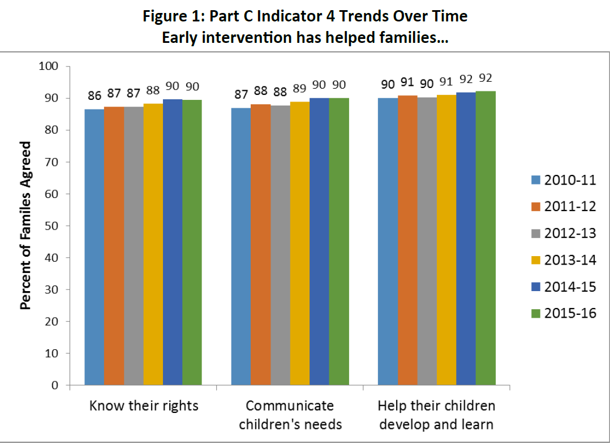
Performance Trends

Slide 9
Survey Methodology
Telephone
Mail
Face-to-face
Internet or web based
Mixed Mode

Slide 10
Telephone
Advantages
Less expensive than face-to-face interviews and mail surveys
Less time consuming than face-to-face interviews
Socially acceptable responses less likely
Random digit dialing
Train telephone interviewers to “stick to the script”
Develop skip patterns in the computer aided telephone interview (CATI) software
Notes:
Train telephone interviewers to “stick to the script” and can be monitored so not leading respondents into answering a certain way
Socially acceptable responses less likely – social desirability (Dillman, Total Design Method)
Random digit dialing – solves problem of unlisted numbers

Slide 11
Telephone
Disadvantages
Phone number no longer listed/out of service
Cell phones
People move and get new numbers
Phone number not provided or provided incorrect phone number
People can hang up
Too many surveys and hard to determine which ones are marketing calls
Notes:
Cell phones – some people have prepaid cell phones (expendable short term cell phones)
People can hang up without a second’s notice
Phone number not provided or provided incorrect phone number – if getting phone numbers from forms then could have been written wrong or numbers could be ineligible

Slide 12
Mail
Advantages
Respondents can answer in privacy
Less expensive than face-to-face interviews
Less time consuming than face-to-face interviews
Socially acceptable responses less likely
Notes:
Respondents can answer in privacy (e.g., own home)
Less expensive than face-to-face interviews (taking into account travel costs and time)

Slide 13
Mail
Disadvantages
People move and do not leave forwarding address
People may not open the mail when received
Mail not delivered/lost in mail
Respondent may not follow skip patterns
Notes:
People may not open the mail when received – think it is junk mail
Respondent may not follow skip patterns – particularly a problem if a respondent missed a question they should have answered (item non-response)

Slide 14
Face-to-face
Advantages
Success in avoiding item non-response
Respondents more likely to answer open-ended questions
Not as sensitive to questionnaire construction as telephone and mail surveys
Notes:
Not as sensitive to questionnaire construction as telephone and mail surveys – with telephone and mail surveys have to have clear directions, skip patterns, and questions need to be in order. Face-to-face interview questions can be ordered but may not be answered by respondent in order.

Slide 15
Face-to-face
Disadvantages
Respondents cannot answer in privacy
More expensive than mail surveys
More time consuming
Socially acceptable responses more likely

Slide 16
Internet or Web-based
Advantages
Good for inclusive groups (employee and customer satisfaction surveys)
Survey software has features to develop skip patterns and setting up dates for initial sending and follow up to non-respondents
Can reach a very large number of people
Cost-effective
Access via smartphones

Slide 17
Internet or Web-based
Disadvantages
Not all people have internet access or email addresses
Email addresses may not be up to date or not collected
People have multiple email addresses
Survey representativeness can be an issue
Notes:
Research is still out on this method for population based studies
Not all people have internet access or email addresses (and some have intermittent access)
Overall, 84% of U.S. households own a computer, and 73% of U.S. households have a computer with a broadband connection to the internet, the bureau reported. These findings are right in line with survey findings of the Pew Research Center, which found that 70% of Americans have broadband access. From 2014.
Source: Dillman, Mail and Internet Surveys The Tailored Design Method 2007 Updates. People have multiple email addresses. Will your survey go to the right one? Did your potential respondent give you a “junk” email address?

Slide 18
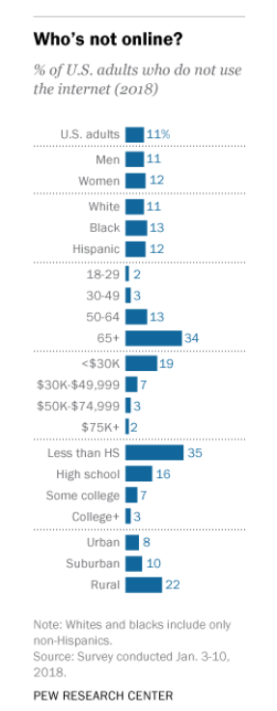
Notes:
11% of people do not use the internet. “But that 11% figure is substantially lower than in 2000, when the Center first began to study the social impact of technology. That year, nearly half (48%) of American adults did not use the internet.”
A 2013 Pew Research Center survey found some key reasons that some people do not use the internet. A third of non-internet users (34%) did not go online because they had no interest in doing so or did not think the internet was relevant to their lives. Another 32% of non-users said the internet was too difficult to use, including 8% of this group who said they were “too old to learn.” Cost was also a barrier for some adults who were offline – 19% cited the expense of internet service or owning a computer.
Rural Americans are more than twice as likely as those who live in urban or suburban settings to never use the internet.
Source: Pew Research Center, 2018

Slide 19
Survey Response Rates
Low response rates
Decrease the statistical power of the data which:
Hinders the ability to analyze the data
Hampers the ability to generalize results
Is indicative of non-response bias within the sample
Source: Grand Canyon University Center for Innovation in Research and Teaching
Notes:
Response rate of a survey is very important for the credibility of the results
Hinders the ability to analyze the data – e.g., disaggregating the data may produce small cell sizes (small Ns)
Source: https://cirt.gcu.edu/research/developmentresources/research_ready/designing_surveys/response_rates (Grand Canyon University Center for Innovation in Research and Teaching)

Slide 20
Considerations for Improving Response Rates
Methodological Considerations
Initial contact
Reminder
Initial dissemination of survey
Tickler
First follow-up with non-responders
Second follow-up with non-responders
Additional follow-up
Source: Adapted from Dillman
Notes:
Timing is key!
Initial Contact – at the initial meeting the service coordinator introduces the survey to parents or guardians and informs them that they will receive a survey at six months of service.
Reminder – a few days before the six-month service date the service coordinator reminds the parents or guardians that they will receive a survey.
Initial Dissemination of Survey – at the six-month service date the online survey is emailed or hard copy is sent via U.S. Post Office to the parents or guardians. Hard copy is sent at the request of the parents or guardians. Send 3-7 days after reminder.
Tickler – The tickler serves as a thank you and a reminder note. It is sent 7 to 10 days after the initial mailing of survey.
First follow-up with non-responders– e.g., the online survey is emailed or hard copy is sent via U.S. Post Office to the parents or guardians. Hard copy is sent at the request of the parents or guardians. Send 7-14 days after tickler has been sent.
Second follow-up with non-responders– e.g., the online survey is emailed or hard copy is sent via U.S. Post Office to the parents or guardians. Hard copy is sent at the request of the parents or guardians. Send 7-14 days after the second questionnaire.
Additional Follow Up –e.g., telephone follow-up is initiated for all non-respondents 7 to 14 days after mailing the last questionnaire.

Slide 21
Alaska’s Family Outcome Survey

Slide 22
Historical Development
Partnership with University of Alaska Anchorage Center for Human Development (UAA CHD)
Alaska adopted original ECO Center Family Survey and made modifications:
Simplified outcome language
Items on one page, comments on back
4-point Likert scale based on feedback from Alaska Native stakeholders

Slide 23
Participant Selection Procedure
In February, Alaska Part C Data Manager pulls potentially eligible survey participants for survey target group from Alaska Part C database based on following parameters:
Families need to have at least one child eligible for Part C services, enrolled during the previous calendar year, and enrolled for at least six months
Randomly select a target group of 158 families from a group of 700+ eligible families
Notes:
Families were removed from population if there was insufficient information to send a survey packet by mail. This included families with no address, families whose only address was a child protection office, and families identified by the USPS as moved with no forwarding address.

Slide 24
Survey Procedure
Provide multiple ways to respond
Initial survey packets are mailed to target families in March. Packets contain:
an invitational letter,
the survey instruments,
and a postage-paid return envelope

Slide 25
Survey Procedure
Introductory letter invites families to complete survey by
mail,
online,
or using a toll-free phone number
Letter informs families that UAA CHD will contact families if survey hasn’t been completed

Slide 26
Survey Procedure
Invest in return rate:
Phone calls to non-responding families
Requests to call at another time, opt out, or resend the survey are always honored
Reminder post cards

Slide 27
Analyses
Summary of responses
Comparisons across four regions
Comparisons between years
Comparisons by race
Qualitative data: De-identified positive/mixed/negative comments are included in report

Slide 28
2018 Results
Eligible population: 758 families
Target group: 152 families
Made contact with all 152 families:
69 opted out or did not respond
83 eligible families completed survey
Response Rate = 55%
30% completed surveys by mail or online
70% responded by phone

Slide 29
Response Rates by Region
Region | Sent | Received | Percentage
Northern | 34 | 21 | 62%
Anchorage | 62 | 34 | 55%
Southcentral | 24 | 12 | 50%
Southeast | 32 | 16 | 50%

Slide 30
Comparison

Slide 31
Response Rate Over Time

Slide 32
Challenges
Inconsistent phone numbers
Grouping responses by geographic region
Preparing families for the survey
Extra childcare items

Slide 33
North Carolina’s Family Outcome Survey

Slide 34
North Carolina Infant-Toddler Program
North Carolina Early Intervention Branch located in Division of Public Health (NC DHHS)
16 local Children’s Developmental Service Agencies (CDSAs)
100 counties across the state
range in enrollment size from approximately 400 to 2600 children
Serve approximately 23,000 children per year

Slide 35
Historical Development
Prior to April 2017, mail paper surveys to all families
State Systemic Improvement Plan
Initial broad stakeholder engagement
Family outcomes survey identified as priority to address low response rates and lack of representativeness
Implementation teams formed to address SSIP strands, including family outcomes (Family Engagement Team)

Slide 36
Family Engagement Team (FET)
Objective – provide recommendations for system improvements to enhance family engagement
Stakeholders
State staff
University partners
Local representation
Parent organization
Quarterly meetings (face to face and via webinar)

Slide 37
FET Recommendations
Adopted new survey - Family Outcomes Survey-Revised)
Added comments field to collect qualitative data
Change in survey methods
Data reporting frequency
Family Outcomes Coordinators
Evaluation of implementation
Strengthening Family Engagement overall in NC ITP
Notes:
Strengthening family engagement
-focus groups
-connecting across SSIP strands
-comments box on website
-Parent leadership trainings

Slide 38
Family Outcome Survey-Revised (FOS-R)
Part A (24 questions on ways families support child’s needs) and B (17 questions on program helpfulness)
NC added qualitative comments field
Developed by Early Childhood Outcomes Center
Ease of administration
Less time to complete

Slide 39
New Survey Methods
Service coordinators inform families of survey
Administered at 6-months/semi-annual visit
Offered in person with families to be completed via tablet, online, or paper
Unique ID
Family flyer

Slide 40
Family Outcomes Coordinators
Identified point person at each CDSA responsibly for quality assurance for FOS
Trained FOCs on new survey, methods and implementation
Convene quarterly meetings to review data and discuss strategies to improve response rates and data quality

Slide 41
Response Rates over Time
*FFY 2016 includes one quarter only, with a subset of local programs (pilot)
**FFY 2017 includes three of four quarters to date, with all local programs included
Notes:
FFY 2016 is the first year that the new system implemented (Pilot starter April 2017 and included data from one quarter only (April-June 2017)
All CDSAS included starting July 2017 (beginning of FFY 2017)
Year end data for FFY 2017 is still being finalized
Still see widespread variation in response rates in across CDSAs

Slide 42
Data Use and Evaluation
Local quarterly data reports
Evaluation of implementation process to identify successes and improvements
Directors use data to positive reinforcements to staff
Notes:
Directors share comments with staff

Slide 43
Challenges
Response rates not consistently improving and widely variable across the state
Ongoing turnover and training
Practice of offering survey is still being established
Data quality – FOUIs, paper submissions missing info, timeliness of completion

Slide 44
Next Steps
Implement Part A of FOS-R
Collectively setting a response rate goal for all CDSAs
Improving accountability/monitoring
Ongoing training, TA, and evaluation

Slide 45
Resources
Family Outcomes Data Community of Practice
Upcoming meetings September 10 & November 5, 2019
Register: http://ectacenter.org/events/communities.asp#familydata
ECTA Family Outcomes online resources: http://ectacenter.org/eco/pages/familyoutcomes.asp
Annual APR analysis, Graphing templates, Framework & self-assessment, Representativeness calculator, Family outcomes video, Using data resources
Building Stakeholder Knowledge about Data (DsSy) (https://dasycenter.org/building-stakeholder-knowledge-toolkit/ )
DaSy Critical Questions for Analyses (https://dasycenter.org/resources/critical-questions/)

Slide 46
Final presentation slide
Visit the DaSy website at: http://dasycenter.org/
Like us on Facebook: https://www.facebook.com/dasycenter
Follow us on Twitter: @DaSyCenter

Slide 47
Thank You
The contents of this presentation were developed under a grant from the U.S. Department of Education, # H373Z120002. However, those contents do not necessarily represent the policy of the U.S. Department of Education, and you should not assume endorsement by the Federal Government. Project Officers, Meredith Miceli and Richelle Davis.

