Slide 1
Collecting, Analyzing, and Sharing Qualitative Data
Megan Cox (DaSy)
Kerry Friedman (DaSy)
Brenda Sharp (LA Part C)
Debbie Shaver (DaSy)
2018 Improving Data, Improving Outcomes Conference
Arlington, VA
August 2018

Slide 2
Today’s Objectives
What are qualitative methods and when might you use them?
Why use qualitative methods?
How to obtain high-quality qualitative data
How to systematically analyze qualitative data
How to share qualitative data in engaging ways
Notes:
Debbie

Slide 3
Quantitative vs. Qualitative Data
Quantitative = numbers or information that can be counted/quantified
Qualitative = information that cannot easily be understood through numbers
Methods = how data are collected
and analyzed
This Photo by Unknown Author is licensed under CC BY-SA
Notes:
Debbie

Slide 4
When to Use Qualitative Methods
Consider qualitative methods when:
You want to collect information that isn’t easily quantifiable
You need a detailed understanding of an issue
You want to further explore and better understand findings from quantitative data
Your focus is exploratory
This Photo by Unknown Author is licensed under CC BY-SA
Notes:
Debbie

Slide 5
Why Use Qualitative Methods?
No single method can tell the whole story—use a mix of methods (e.g., quantitative and qualitative)
Qualitative data can be used to explore, understand, and explain what is happening
Qualitative data can bring numbers to life and help stakeholders relate to the findings
Notes:
Debbie

Slide 6
Qualitative Methods
What are some methods for collecting qualitative data?
Interviews
Focus groups
Journal/log
Open-ended questions on a survey
Notes:
Debbie

Slide 7
Would qualitative methods be appropriate to answer these questions?
POLL:
Are practitioners reaching fidelity on implementation of evidence-based practices?
What challenges are families having in accessing services for their child?
How many administrators and providers attended the trainings on child assessments?
Are children improving in their acquisition of early literacy knowledge and skills?
Notes:
Debbie

Slide 8
Using a Mix of Methods--Example
Example evaluation question:
Is interagency coordination and communication improving in the state? Why or why not?
Data collection methods:
Structured survey (e.g., to measure frequency of communication with other agencies)
Interviews with agency administrators (e.g., to better understand the “why’s”)
Notes:
Debbie

Slide 9
State Example--Louisiana
Louisiana SIMR:
to improve child outcomes through supports that are focused on Family Concerns, Priorities and Resources and provided through a team-based approach.
Notes:
Brenda

Slide 10
Selected Evidence-Based Practices (EBPs)
Louisiana selected the DEC RPs as the EBP and
completed some initial crosswalk with 3 practice components below in the Phase III, Year 1 development:
Family Assessment (DEC Family and Assessment Topic Areas)
Service Delivery supports Family Priorities (Family, Instruction and Teaming Topic Areas)
Team-based Practice Supports service delivery (Instruction and Teaming Topic Areas).
Notes:
Brenda

Slide 11
Phase III, Year 2 “Kick off Retreat” Outcomes:
Move from Infrastructure focus to Practice Improvement focus
Establish 3 workgroups aligned to the 3 practice areas
Assumptions:
Inconsistent implementation around the state
Use Implementation Science “Practice Profile Methodology” (PPM) and Switch
Define the Practice: Each practice area given a results statement
Assess how it’s being implemented in Louisiana
Define components of each practice
Identify Bright Spots

Slide 12
PPM: Identify principles, functions, activities
Two workgroups develop surveys using Survey Monkey (quantitative)
Family Assessment workgroup to conduct interviews with 4 groups (qualitative):
Families
Support Coordination agencies
SPOEs
Eligibility Evaluators

Slide 13
Qualitative Measure: Conducting the Interviews
Specific format and questions for each of the target groups based the components of the practice profile (4 interview formats)
Trained interviewers on the process
for consistency
Determined target number,
who would conduct interviews
Summarized the results
This Photo by Unknown Author is licensed under CC BY-NC-ND

Slide 14
Structuring the Interviews
Questions to ask: | Key Elements to Listen For | Record Comments/Discussion
Describe the conversation and the kinds of questions you were asked about your day and your concerns for your child and family. | Listen for answers to the following specific questions and if the answers are not shared ask the following specific questions/prompts: □. Give examples of the kinds of questions you were asked (e.g., were they open ended for you to respond to or were they examples for you to choose from). □. Describe how the Coordinator focused on your child and family’s needs and priorities with some examples. □ Describe how the Coordinator ask you follow-up questions to get more details about how your child can participate in his/her daily routines and activities? □ Describe how the Coordinator addressed your family’s routines—daily activities giving examples of the routines and activities discussed.

Slide 15
Result: EarlySteps Practice Profile
SSIP Outcome: Family Assessment | DEC RP | What it Looks Like in EarlySteps | Core Activities of the Practice | What is currently in place to support | What’s Missing/ Action to Complete | Evidence

Slide 16
Resources:
Metz, Allison, Practice Profiles: A Process for Capturing Evidence and Operationalizing Innovations, National Implementation Research Network (NIRN), January, 2016 https://implementation.fpg.unc.edu/resources/lesson-3-practice-profiles
Heath, Chip and Heath, Dan: Switch, How to Change when Change is Hard, Broadway Books, New York, 2010.
Shaver, et al: Strengthening SSIP Evaluations with Qualitative Methods, 2018
https://dasycenter.org/strengthening-ssip-evaluations-with-qualitative-methods/

Slide 17
Best Practices for High-Quality Qualitative Data
This Photo by Unknown Author is licensed under CC BY-SA

Slide 18
Start with Evaluation Questions
Don’t collect qualitative data without knowing the purpose
Evaluation questions should align with improvement activities
Do your questions
Suggest a need to explore a process?
Require in-depth information from individuals involved in improvement activities?
Examine past processes that were collected via documentation?

Slide 19
Select the Data Collection Method
Clarify the purpose of the data collection.
Will the data support answering your evaluation questions?
Ensure you have the resources to support data collection
Be very intentional on participants and expectations for data collection
This Photo by Unknown Author is licensed under CC BY-SA
Notes:
Reference handouts

Slide 20
Focus Groups & Interviews
Participants are able to respond in structured or unstructured ways
Can clarify questions found from quantitative results
Interviewer can probe for more details on specific topics
Can be difficult to plan
Skilled data collectors are required
Notes:
Review the table as a handout

Slide 21
Document Review
Standardized protocol supports in-depth review of documentation
Useful for examining early stages of implementation
Provides insight into the setting or historical trends
Requires less time to plan than interviews or focus groups
Accuracy may be an issue

Slide 22
Data Collection
Plan Ahead
Monitor
Develop and use protocols
Develop a plan for identifying participants
Recruit participants that represent the information you need
Train data collectors
Collect data using existing meetings
Develop a monitoring plan early in the process
Train data collectors to anticipate challenges
Check in with data collectors regularly
Make adjustments

Slide 23
Analyze Data
Prepare data
Develop an analysis plan
Transcribe notes
Choose analysis approach
Develop codes upon review of raw data
Train coding staff
Code data
Summarize and synthesize coded data
Identify themes, ensure reliability among coders

Slide 24
Coding Example—Focus Group Data
What challenges have you had with implementing the team-based approach for serving children and families?
Response Theme/Category | Code
Communication issues | C1
Unclear team assignments | C2
Scheduling/time to meet | C3
Billing for time in team meetings | C4
Conflicts between team members | C5
Other challenges | C6

Slide 25
Qualitative Analysis Exercise
Let’s do some coding of qualitative data!
This Photo by Unknown Author is licensed under CC BY-SA
Notes:
Megan

Slide 26
Summarize the Results
Summarize key findings
Overarching key themes
Use counts/numbers
Back-up with details, quotes, and examples
Notes:
Kerry

Slide 27
Qualitative Data Visualization
Step out of your comfort zone!
While sometimes useful, you don’t need to quantify qualitative data to effectively display findings.
Be intentional with titles, labels, visualization type, and color/boldness to emphasize the key takeaways from the data.
Notes:
Kerry

Slide 28
Word Clouds
Notes:
Kerry

Slide 29
Quotes
“Preparation is key to collecting high-quality data.”
- Megan Cox, DaSy Center
Notes:
Kerry

Slide 30
Organize Quotes in Evidence Matrix
Notes:
Kerry

Slide 31
Use Icons to Categorize Themes
http://stephanieevergreen.com/qualitative-chart-chooser/
Notes:
Kerry

Slide 32
Map Themes
Notes:
Kerry

Slide 33
Draw Comparisons
Notes:
Kerry

Slide 34
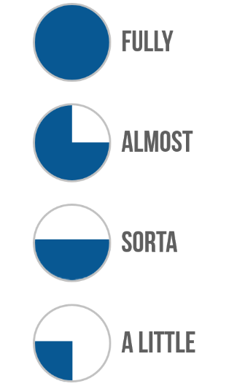
Draw Comparisons
Notes:
Kerry

Slide 35
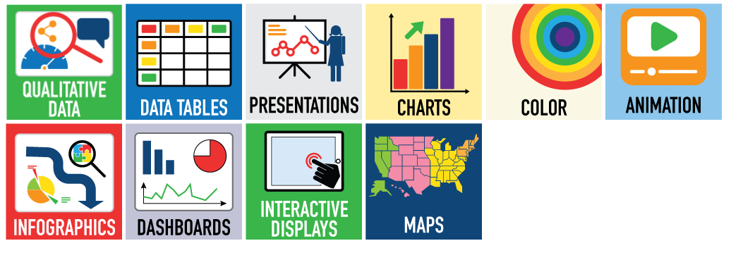
Data Visualization Toolkit
https://dasycenter.org/data-visualization-toolkit-2/qualitative-data/
Notes:
Kerry

Slide 36
Use the Results
Share With Stakeholders
Ask Questions About The Findings
Use Qualitative Data To Better Understand The Quantitative Findings
36
Notes:
Kerry

Slide 37
Using Qualitative Data in Your State
Are you using/planning on using qualitative data?
If yes, what are you using?
What is your experience using qualitative data?
Have you reported qualitative data?
How have stakeholders interpreted your results?
Notes:
Have you used the DaSy product?

Slide 38
Resource
Strengthening SSIP Evaluations with Qualitative Methods
https://dasycenter.org/strengthening-ssip-evaluations-with-qualitative-methods/

Slide 39
Thank you!
Visit the DaSy website at: http://dasycenter.org/
Like us on Facebook: https://www.facebook.com/dasycenter
Follow us on Twitter: @DaSyCenter
Notes:
Kerry

Slide 40
Thank You
The contents of this presentation were developed under a grant from the U.S. Department of Education, # H373Z120002. However, those contents do not necessarily represent the policy of the U.S. Department of Education, and you should not assume endorsement by the Federal Government. Project Officers, Meredith Miceli and Richelle Davis.
Notes:
Instructions to presenters: This slide is to be included as the last slide in your deck but you are not expected to show it to the audience. Please be sure to delete these instructions from this slide’s notes page in your presentation.

