Slide 1

Exploring IDC Tools & Products
2018 Improving Data, Improving Outcomes Conference—August 14-16, 2018
Part B data manager orientation
Lindsay Wise, IDC
Chris Thacker, IDC
Tony Ruggiero, IDC

Slide 2
Agenda
Introduction of IDC
Data Manager Roles
Working Principles of High-Quality Data
Learning to Use the Tools at Hand
  Peer Tools and Products Demonstration
  Interactive Public Reporting Engine
  Part B Indicator Data Display Wizard
Exploration of Tools
Questions and Wrap-Up

Slide 3
Participant Outcomes
State participants will increase their knowledge about available IDC resources
State participants will increase their knowledge about how to access the IDC resources
State participants will increase their knowledge about how to apply the IDC resources in their role as Part B data manager
State participants will increase their capacity to solve problems independently using the IDC available IDC resources

Slide 4
Introduction of IDC
The IDEA Data Center (IDC) is a national technical assistance (TA) center that the U.S. Department of Education’s Office of Special Education Programs funds to provide TA to build capacity within states for
  collecting
  reporting
  analyzing
  and using high-quality IDEA data
Notes:
Who we are and what we do
Website
Using IDC tools and products to build capacity
Overview of the morning:
First, participants will learn what IDC has to offer and how to find those tools.
Then they will hear from their peers on a few tools and how they are applied in a state
IDC will then go over a few more useful tools and we will have an interactive session with small groups and share-outs.

Slide 5

Data Manager Roles
Notes:
One rope can perform many functions. The rope is flexible and can adapt to the situation to keep things together. The need determines the function or role the rope will play – much like a data manager.

Slide 6
Data Manager Roles
How long have you been in your role?
How much interaction have you had with IDC tools and products?
Which have you used successfully?
How has your experience been with accessing tools?
Is there an area of IDEA data that you feel you would like to dig into more deeply and for which you would like to find resources?
Notes:
For e, write it down and keep cards, you will use this choice to select the group you are in in the final activity of the morning. (IDC will pass out index cards)

Slide 7
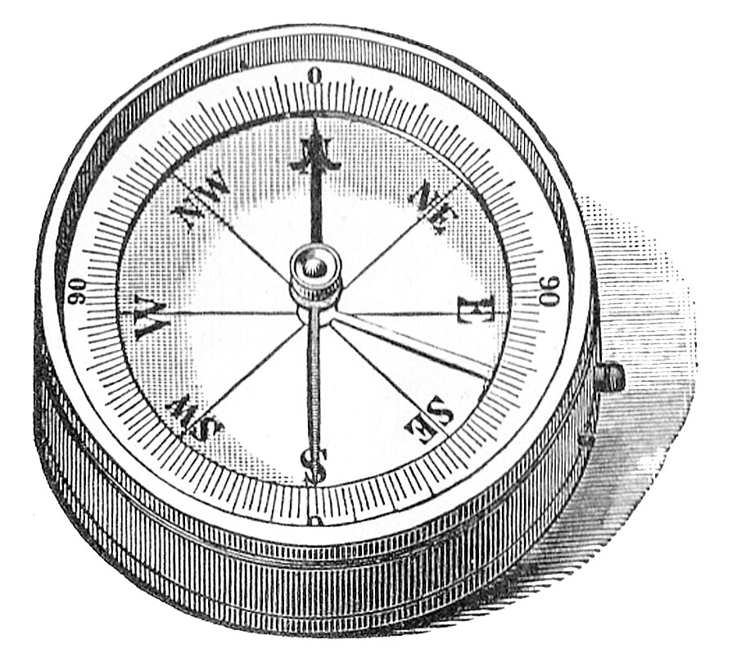
Working Principles of High-Quality IDEA Data
Notes:
States can use the Working Principles of High-Quality IDEA Data to guide their way to improving data quality.

Slide 8
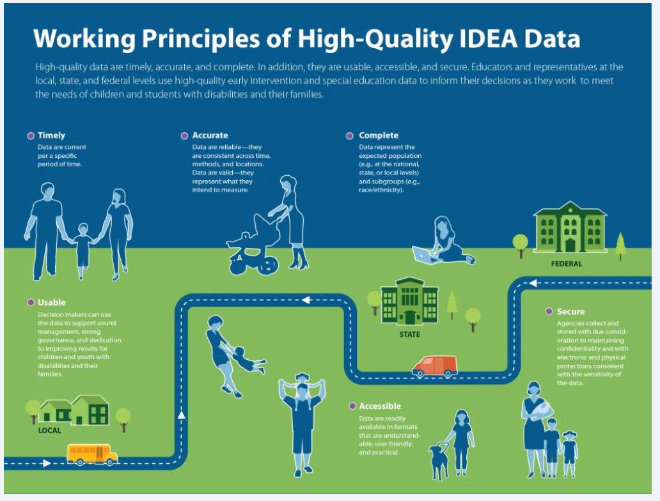
Working Principles of High-Quality IDEA Data
Timely
Accurate
Complete
Secure
Accessible
Usable
  https://ideadata.org/sites/default/files/media/documents/2017-09/idc-hqd_source.pdf
Notes:
https://ideadata.org/sites/default/files/media/documents/2017-09/idc-hqd_source.pdf
Pull up the infographic. The definitions are on the infographic. Also placed below in case infographic does not pull up.
Timely – data are current per a specific time period.
Accurate - data are reliable: they are consistent across time, methods, and locations. Data are valid – they represent what they intend to measure.
Complete – data represent the expected population. For example, at the national, state, or local levels and subgroups (e.g., race/ethnicity)
Secure – agencies collect and store data with due consideration to maintaining confidentiality and with electronic and physical protections consistent with the sensitivity of the data.
Accessible – data are readily available in formats that are understandable, use friendly, and practical.
Usable – decisionmakers can use the data to support sound management, strong governance, and dedication to improving results for children and youth with disabilities and their families.

Slide 9
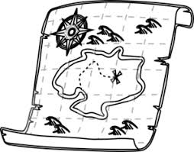
Learning to Use the Tools at Hand
Notes:
Participants will start their journey to find the right tools to trouble shoot and solve problems followed by peer demonstrations, and a review of the IDC Public Reporting Tool.

Slide 10
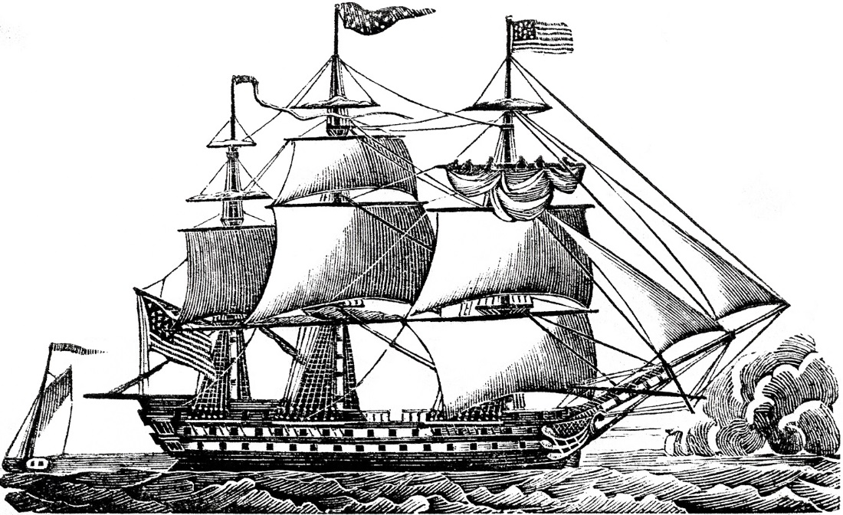
Exploration of Tools
Notes:
Participants will have thought about 2-3 areas of need and will have their index card with topics written on it. We will set up stations around the room with IDC tools open according to subject area. Groups will gather around the stations and explore the tools.

Slide 11

Final Destination: Questions and Wrap-Up
Notes:
Thank you for joining us today.
State participants will learn what IDC resources are available
State participants will learn how to access the IDC resources
State participants will learn how to apply the IDC resources in their role as Part B Data manager
State participants will increase their capacity to solve problems independently using IDC resources already available

Slide 12
Contact Us
Lindsay Wise
  LindsayWise@westat.com
Chris Thacker
  chris.thacker@uky.edu
Tony Ruggiero
  Robert.Ruggiero@aemcorp.com

Slide 13

For More Information
Visit the IDC website
http://ideadata.org/
Follow us on Twitter
https://twitter.com/ideadatacenter
Follow us on LinkedIn
http://www.linkedin.com/company/idea-data-center

Slide 14




The contents of this presentation were developed under a grant
from the U.S. Department of Education, #H373Y130002. However, the contents do not necessarily represent the policy of the U. S. Department of Education, and you should not assume endorsement by the federal government.
Project Officers: Richelle Davis and Meredith Miceli

