Slide 1
”Child Outcomes Data Workshop: Hands-on analysis of your own state child outcomes data”,
2016 Improving Data, Improving Outcomes Conference
New Orleans, LA
Monday, August 15, 2016

Slide 2
Small Group Discussion
Work with your State team to review and discuss your State Child Outcomes Data Quality Profile.
Use the Child Outcomes Data Quality Profiles Worksheet to guide your discussion.

Slide 3
Looking at Patterns in the Outcomes Data
Unexpected patterns may be red flags for data quality issues
What patterns would be expected?
Where do you see unexpected or unusual patterns?
Is there a reasonable explanation for unusual patterns?

Slide 4
Unexpected Patterns MIGHT be Reasonable
Unusual patterns need to be checked/verified
There may be actual differences in populations
There may be differences in other aspects of the context

Slide 5
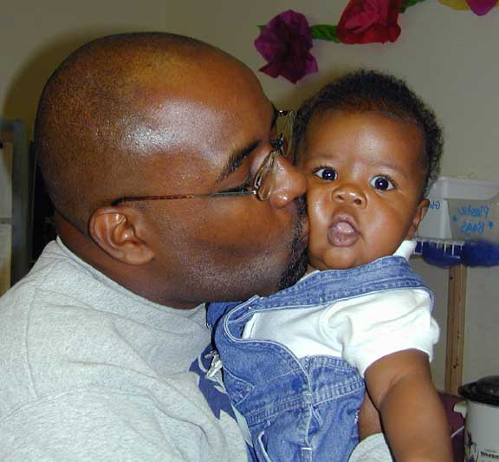
Thin about: How will you check to see if unusual patterns were actual differences or bad data?

Slide 6
Reviewing your State’s Data
We will look several ways at entry data as well as progress data
Why focus on entry data?
They give you a snapshot of children’s functioning before the receive intervention
They can be run on an ongoing basis without waiting until children exit your program.
They give you the first look at red flags that may indicate data quality issues.

Slide 7
Roll up your sleeves (or put on your apron)

Slide 8
For the first discussion
Discuss any unusual or unexpected patterns that you see in your data
What might you do to investigate whether the unusual pattern is a data quality problem or a real difference?
Identify one or 2 unusual patterns to focus on in the next discussion that you believe are signs of data quality problems

Slide 9
For the second discussion
For one or two selected data quality issues:
What strategies might you use to improve the quality of the data?

