Slide 1
Who’s in Charge?
Improving How You Manage and Govern Your Data System
2016 Improving Data, Improving Outcomes Conference
New Orleans, LA
August 2016
Notes:
DGM/PC Toolkit Pre-Conference Workshop
Monday, August 15th 8:30AM-11:30AM
JW Marriott New Orleans
Kathy or Donna to welcome

Slide 2
Agenda
Welcome and Overview of the Day
Review of Data Governance
Introduction to Data Governance Scenarios
Introduction to Data Governance Toolkit
Feedback/Plan for Next Steps

Slide 3
Session Takeaways…CHASE DGM
Conceptualize formalized data governance and management (DGM)
Hear about the DaSy DGM/PC Toolkit
Access TA supports
Start DGM policies/procedures
Engage in discussions on DGM challenges, successes

Slide 4
Workshop TA Team
Bruce Bull
Gary Harmon
Denise Mauzy
Sharon Walsh
Jeff Sellers
Missy Coffey Cochenour
Haidee Bernstein

Slide 5
Show of Hands- Which Program do you Represent?
Part C
619
Both
Birth to 21 or 3-21
TA Providers
Other

Slide 6
Show of Hands - What is your role?
Only state folks should raise their hands
Data manager/data steward
Program coordinator/director/administrator
Other state program staff/consultants

Slide 7
What is Data Governance?
The overall management of the availability, usability, integrity, quality, and security of data. Data governance is both an organizational process and a structure. It establishes responsibility for data, organizing program area/agency staff to collaboratively and continuously improve data quality through the systematic creation and enforcement of policies, roles, responsibilities, and procedures.
- DaSy Glossary

Slide 8
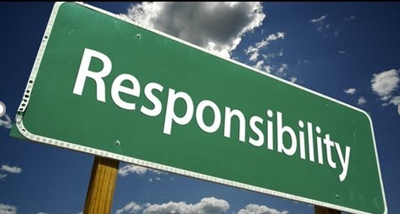
Formal Data Governance
Establishes data responsibility
Organizes program staff to
improve data quality . . .
through the systematic creation and enforcement of . . .
policies, roles, responsibilities, and procedures

Slide 9
Why Focus on Formal Data Governance?

Slide 10
Formal Data Governance Benefits
Increased probability of effective data practices
More confidence in data and associated processes
Data use consistent with purpose and vision
Increased data security
Supports
Data integration
Higher quality data
Improved data efficiency

Slide 11
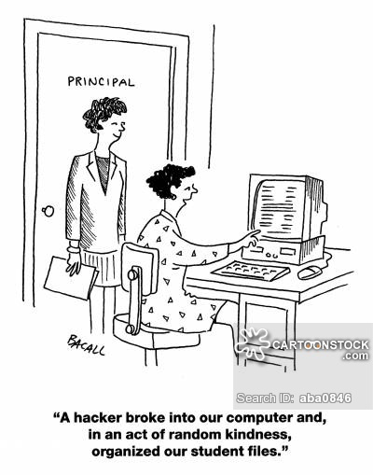
Because this Won’t happen…

Slide 12
Informal Data Governance Risks
Questionable data quality, security, and usefulness
Difficulty managing data and processes
Unclear data roles and responsibilities of staff (internal and external)
Inappropriate data sharing (internal, external, and across agencies)
Unprepared for data integration opportunities

Slide 14
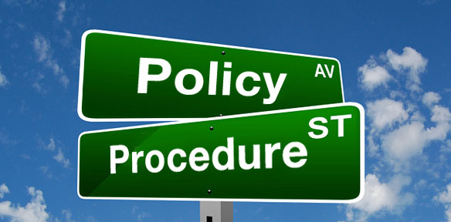
Documenting and Supporting Implementation of Formal Data Governance
Policies and Procedures are at
the center of data governance and management

Slide 15
Policy and Procedure Refresher
Policy
Procedure
Consistent guide to be followed under a set of circumstances
Broad, current, comprehensive, inviolate, written to specify responsibility for action, and used frequently
Described as the “work horse” of a company
A sequence of steps for completing a given activity
Change often based on staffing, software, space, etc.
Solid, precise, factual, short, and to the point

Slide 16
Why Create Data Governance P&Ps?
Establish common data understanding and consensus
Ensure consistent practices
Record historical processes
Define work
Increase productivity
Creates evaluation standard
“The Lottery” Scenario
Confusion
Clarity

Slide 17
When Creating Policies and Procedures
Communication is essential—involve as many implementing staff members as feasible
Make an organized process to develop P&Ps
Use DaSy DGM/PC Toolkit (Fall 2016)

Slide 18
What is Data Governance?
The overall management of the availability, usability, integrity, quality, and security of data. Data governance is both an organizational process and a structure. It establishes responsibility for data, organizing program area/agency staff to collaboratively and continuously improve data quality through the systematic creation and enforcement of policies, roles, responsibilities, and procedures.
- DaSy Glossary

Slide 19
Governance Bodies Are the Essential Foundation for Strong Data Governance and Management

Slide 20
2015 State of Part C and Part B State Data Systems: Data Governance
619: Does your state have a data governance body whose scope of responsibility includes data on children ages 3 through 5 years receiving special education?
Part C: Does your state have a data governance body whose scope of responsibility includes data on children and families receiving Part C services?

Slide 21
Presence of Data Governance Body

Slide 22
Change Over Time (2013 to 2015)

Slide 24
Poll Everywhere
Respond on either your cell phone or computer.
Go to https://pollev.com/presenter2
Text Message—
Text to #22333
Message: PRESENTER2
You’ll receive a response saying, “You’ve joined Sub User2’s session.”

Slide 25
Practice Poll
How many times do you plan on experiencing Bourbon Street this week?
Zero
1 time
2-4 or more times
I’ll be streaming the presentations from Pat O’Brian’s all week

Slide 26
How Formal is your Program’s Part C or 619 Data Governance?
(Formal = all necessary written policies in place)
Informal; considering formal policies
Actively pursuing written polices
Several written policies; more to come
Most are pretty darn formal
So formal we should be giving this presentation

Slide 27
619 - Who Develops Your Data Governance Policies? (check all that apply)
I don’t know
We develop our own 619 data governance policies
Our 619 data governance is directed by a larger governance body inside our parent agency (Department of Education)
Our 619 data governance is directed by a larger governance body outside our agency (Department of Administrative ____________)

Slide 28
Part C - Who Develops Your Data Governance Policies? (check all that apply)
I don’t know
We develop our own Part C data governance policies
Our Part C data governance is directed by a larger governance body inside our parent agency (Department of Health/Education/Developmental Disabilities)
Our Part C data governance is directed by a larger governance body outside our agency (Department of Administrative ____________)

Slide 29
What Data Governance Subcomponents of the DaSy Framework have you Completed?
Purpose and Vision
Data Governance and Management
Stakeholder Engagement
System Design and Development
Data Use
Sustainability

Slide 30
Exploring Data Governance and Management Scenarios

Slide 31
Scenario 1
Mr. Smith contacts the Part C program and requests that his child’s initial evaluation information be deleted from the data system. Although the child was evaluated and found eligible for services, the Smith family declined Part C services and sought services privately.

Slide 32
Scenario 2
Your agency was notified that training materials posted on an unsecure web page, included personally identifiable information about children. Your Director is calling a meeting in an hour. You are expected to present on the agency’s response, the existing C/619 policies and future mitigation strategies.

Slide 33
Scenario 3
Your agency is updating its overall records retention and destruction manual. You are new to your position and upon review of your program’s file list you note that many of your collections are not listed in the prior version of the manual. You have been asked to update your program’s information by end of the week.

Slide 34
Scenario 4
A local program calls the Data Manager. She requests that the Data Manager add a data element to the state data system (or data warehouse). She says the data element is key for local reporting and the program needs it added as soon as possible.

Slide 35
Scenario 5
An advocacy agency contacts your program to request aggregate data by county for a report:
Personnel (degrees, years of experience, positions)
Referrals and referral sources
Services planned/delivered

Slide 36
Instructions for Small Group Activity
Instructions
Discuss
Open envelope
Pick facilitator and recorder
Read scenario out loud
Discuss scenario
Record ideas
What would you do?
What policies do you have?
What procedures do you have?
How likely is this scenario?
What levels of authority or approval are needed?

Slide 37
Report Out

Slide 38
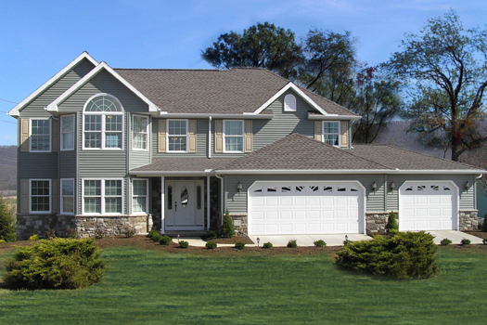
Governance Policies Provide the Structural Supports for Strong Data Governance and Management

Slide 39
A Sneak Peek: The DaSy Data Governance Toolkit

Slide 40
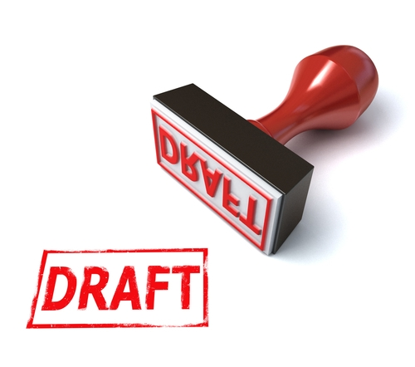
Overview of Toolkit
Assist Part C and Part B 619 programs with processes and policies for establishing formal data governance
Multiple sections
Each section includes:
Overview
Considerations
Fillable template (“mad libs” style)
DGM examples

Slide 41
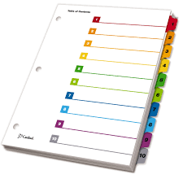
Table of Contents
Purpose, Structure, and Process Policy
Data Security/Risk Management Policy
Data Retention and Destruction Policy
Data Breach Response Policy
Electronic Communications Policy
Data Requests Policy – Internal/External/Third Party
Data Quality Policy
Data Collection Policy
Public Reporting Policy
Training Policy

Slide 42
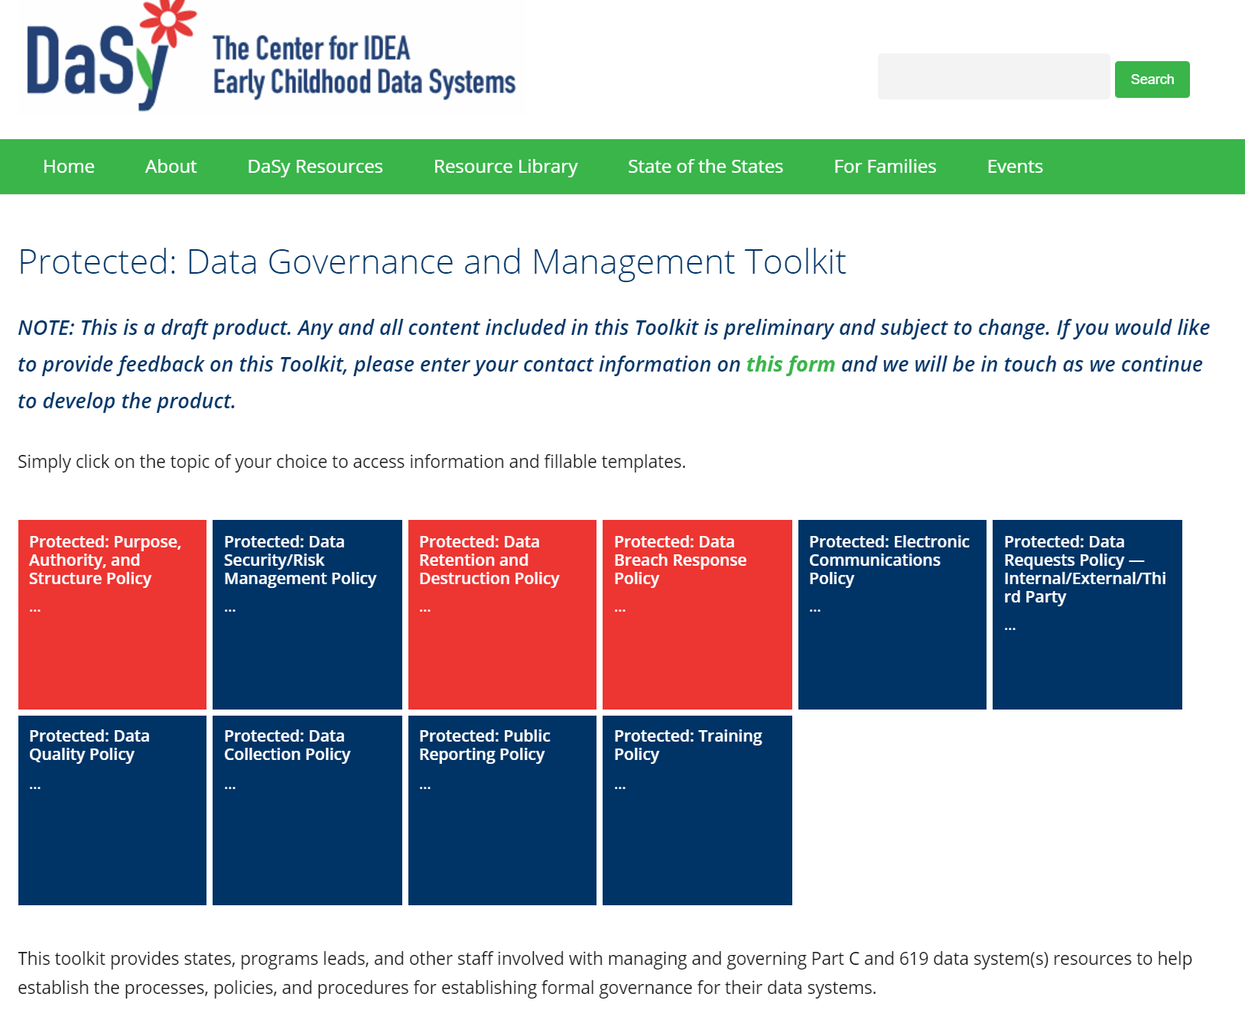
Online Toolkit Conceptualization
DRAFT

Slide 43
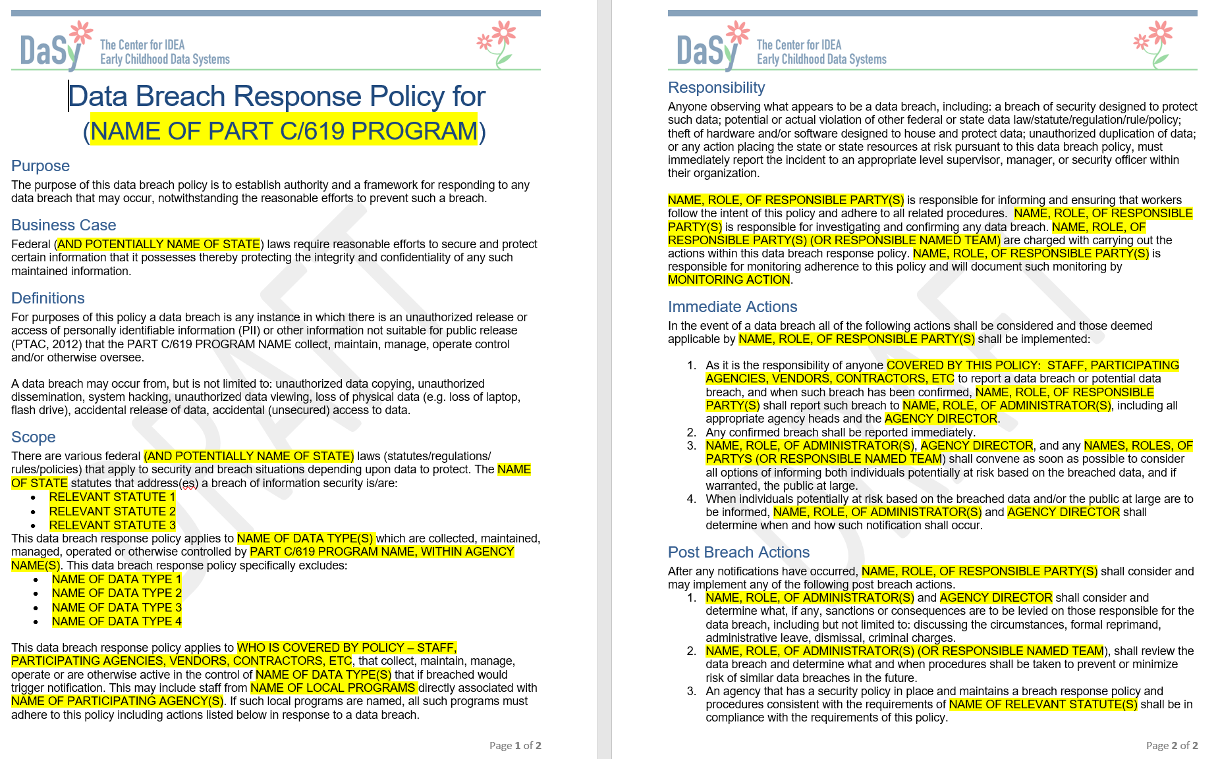
Data Breach Response Template

Slide 44
Pause a Moment
Toolkit is in DRAFT status
Looking for Part C and Part B 619 governance examples

Slide 45
Jumping in….Using the Toolkit
1. Purpose, Authority and Structure Policy
3. Data Breach Response Policy
4. Data Retention and Destruction Policy

Slide 46
Activity: Using the Toolkit
Pick policy section, find table
Independently read the policy
Discuss consideration questions
Complete the template (will not be collected)
Continue discussion
Share table observations with full group

Slide 47
Participant Feedback
What did you like about it?
What would you change? Add?
Is the content relevant?
What are the obstacles to policy creation?

Slide 48
To the Polls…Feedback on the Toolkit
In one word describe how you are feeling about your data governance policies

Slide 49
To the Polls…Feedback on the Toolkit
In one word describe how you are feeling about the toolkit

Slide 50
Which Section of the Toolkit Will you Start With? Select One
Purpose, Structure, and Process Policy
Data Security/Risk Management Policy
Data Retention and Destruction Policy
Data Breach Response Policy
Electronic Communications Policy
Data Requests Policy – Internal/External/Third Party
Data Quality Policy
Data Collection Policy
Public Reporting Policy
Training Policy
Not yet convinced we need to do this

Slide 51
Future Work and TA Support
Are you planning to work on data governance policies in the next 6-12 months?
Contact:
Gary Harmon Gary.harmon@unc.edu
Tate Gould tgould@anlar.com

Slide 52
Assistance Needed
How much help do you need to complete?
Help us:
Share your DGM policies and procedures
as potential examples
Share DGM scenarios to inform toolkit development
Work with us to develop a policy we can include as a sample
Be an external reviewer
Contact:
Gary Harmon
Gary.harmon@unc.edu
Tate Gould
tgould@anlar.com

Slide 53
Want more of the toolkit?
Come to the DaSy Playground!
Toolkit Introduction
Tuesday
8:30am – 9:00am
Orleans Room (2nd Floor)

Slide 54
Visit the DaSy website at: http://dasycenter.org/
Like us on Facebook: https://www.facebook.com/dasycenter
Follow us on Twitter: @DaSyCenter

Slide 55
The contents of this presentation were developed under a grant from the U.S. Department of Education, # H373Z120002. However, those contents do not necessarily represent the policy of the U.S. Department of Education, and you should not assume endorsement by the Federal Government. Project Officers, Meredith Miceli and Richelle Davis.

