Slide 1
Unpacking Inclusion: A System’s Framework Perspective l
Presentation for the
Improving Data, Improving Outcomes Conference
August 2016

Slide 2
Welcome and Introductions
Kathy T. Whaley,
ECTA and DaSy Centers
Kristy Doan,
Illinois state Board of Education
Ann Kremer,
Early Choices

Slide 3
Session Overview
Provide an Overview of How the System Framework Can be Used to Examine Inclusion
Describe how the Framework Aligns with the Joint Policy Statement on Inclusion Recommendations
Highlight the Illinois Efforts to Improve Inclusive Practices

Slide 4
Inclusion Cohort Outcomes
Use data to identify strengths and challenges to providing services in inclusive settings.
Design and implement strategies and activities based on data analyses to increase high quality inclusive opportunities.
Improve capacity to promote and support practitioner use of high quality inclusive practices by assessing and making changes to their infrastructure.
Improve coordination and collaboration with other early childhood programs and services.

Slide 5
Infrastructure Assessment
Analyze state infrastructure and or local program practices to identify system strengths and areas needing improvement
All states complete an assessment based on HHS/ED Joint Policy Statement on Inclusion Recommendations
Consider use of most pertinent ECTA/DaSy System Framework Components

Slide 6
Policy Statement

Slide 7
Focusing on Inclusion
Explicitly states a position that all young children with disabilities should have access to inclusive high quality early childhood programs
Organized by legal foundations, research, acknowledgement of challenges, and recommendations/resources
Legal foundations apply to all early childhood programs
State and Local recommendations

Slide 8
State Level Recommendations
Create a state-level interagency taskforce and plan for inclusion
Ensure state policies support high-quality inclusion
Set goals and track data
Review and modify resource allocations
Ensure Quality Rating frameworks are inclusive

Slide 9
State Level Recommendations
Strengthen accountability and build incentive structures
Build a coordinated early childhood professional development system
Implement statewide supports for children’s social-emotional and behavioral health
Raise public awareness

Slide 10
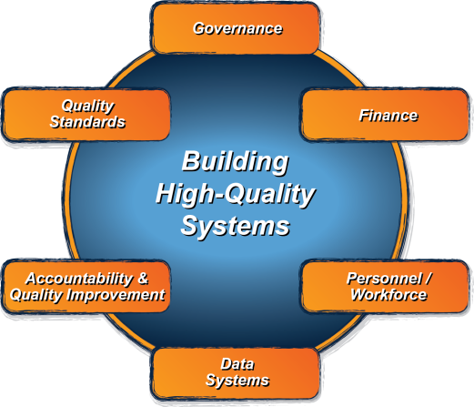
ECTA System Framework
What does a state need to put into place in order to encourage, support, require local implementation of effective practices?
ectacenter.org/sysframe

Slide 11
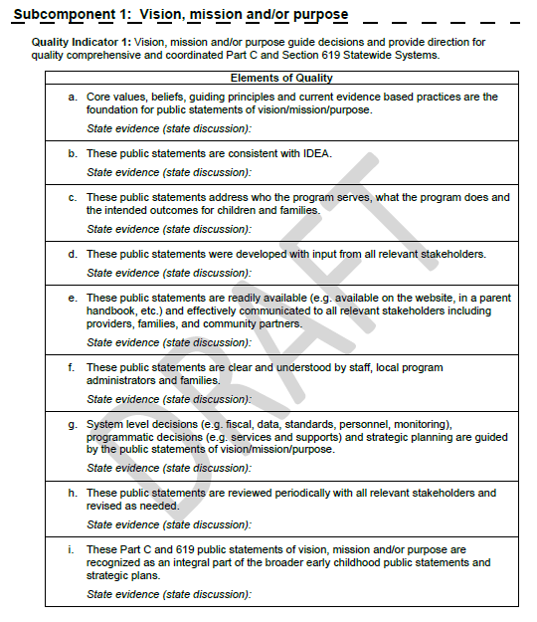
Framework Structure
Framework
Subcomponents
Quality Indicators
Elements of Quality
Self-assessment
Scale for assessing quality indicators
Place for state evidence

Slide 12
Examples of Alignment
Create a State-level Interagency Task Force and Plan for Inclusion
2. Ensure State Policies support High Quality Inclusion
Governance
Subcomponents:
Vision, Mission, Purpose
Administrative Structures
Leadership and Performance Management
Governance
Subcomponents:
Vision, Mission, Purpose
Administrative Structures
Leadership and Performance Management

Slide 13
Examples of Alignment
Set Goals
and
Track Data
Governance
Subcomponents:
Administrative Structures
Leadership and Performance Management
Accountability & Quality Improvement
Subcomponents:
2. Collecting and Analyzing Performance Data
Data System
Subcomponent:
5. Data Use

Slide 14
Examples of Alignment
4. Review and Modify Resource Allocations
5. Ensure Quality Frameworks are Inclusive
Finance
Quality Standards
Subcomponent:
2. Program Level Standards

Slide 15
Examples of Alignment
Strengthen Accountability and
Build Incentive Structures
Finance
Subcomponents:
3. Procurement
4. Resource Allocation, Use of
Funds and Disbursements
Accountability and Quality Improvement
Subcomponents:
1.Planning for Accountability
and Improvement
2. Collecting and Analyzing
Performance Data
3. Using Results for Continuous
Improvement

Slide 16
Examples of Alignment
Personnel/Workforce
All Subcomponents but specifically:
1. Leadership, Coordination and
Sustainability
2. Personnel Standards
3. Inservice Personnel
Development
4. Preservice Personnel
Development
7. Build a Coordinated Early Childhood Professional Development System
8. Implement Statewide Supports for Social- Emotional and Behavioral Health

Slide 17
Examples of Alignment
Raise Public
Awareness
Governance
Subcomponent:
Mission, Vision and Purpose
Legal Foundations
Leadership and Performance
Management
Quality Standards
Subcomponent:
2. Program Level Standards

Slide 18
Example of Key Considerations Statewide Supports for Social/Emotional/Behavioral Health
What programs and agencies support children's social- emotional and behavioral health? Are the different programs coordinated?
Is there a cross-sector leadership team or group that focuses on the statewide supports needed to address children’s social-emotional and behavioral health?
Does this entity have the power to set priorities and make policy, governance, and financial decisions, which will enable programs to provide support to children’s social-emotional and behavioral health?
Does this entity inform or coordinate the identification, collection and analysis of key data to support effective program administration and practices?

Slide 19
Example of Key Considerations Statewide Supports for Social/Emotional/Behavioral Health
How do state personnel standards address the knowledge and skills needed to work with this population in inclusive settings?
Is there a statewide criterion that standardizes certification or credentialing of practitioners with a specialization in children’s social-emotional and behavioral health? Is this aligned with both national and state personnel standards?
Do state Institutes of Higher Education have curricula addressing children’s social-emotional and behavioral health embedded within their curricula, across disciplines?
Is there statewide implementation of in-service personnel development addressing children’s social-emotional and behavioral health?

Slide 20
Example of Key Considerations Set Goals and Track Data
How do you use data to inform inclusion accountability and improvement planning efforts?
Are stakeholders engaged in the process of using educational environments data for program improvement?
Are the current targets for educational environments rigorous?
Are educational environments data used to continuously 1) track progress on access to inclusive high-quality early learning opportunities, 2) monitor and make program determinations, and 3) provide TA and/or other quality assurance activities?

Slide 21
Example of Key Considerations Set Goals and Track Data
Are various data sources used to track the rate and incidence of inclusion (beyond educational environments data), such as suspension and expulsion data, IEPs/IFSPs, etc.?
Are various data sources used to track the quality of inclusion, such as QRIS, program and classroom assessment tools, etc.?
Are data shared with stakeholders in a way that supports the use of the data?

Slide 22
Illinois’ Story

Slide 23
Started the Early Childhood LRE Stakeholders in 2011
Issued by the Illinois State Board of Education’s Early Childhood Division Administrator
“ISBE is forming a dynamic systems change consortium to focus on Least Restrictive Environment in Early Childhood. … The goal will be to help ISBE address the issues related to implementing best practices around LRE for young children.”
“We will focus on State Performance Plan Indicator 6.”
Notes:
Illinois turned its attention to Early Childhood inclusion in 2011with a realization that it takes a village to raise a child, especially when the child has a development delay, special needs.
To improve opportunities for all our young children, it would take a collaborative movement. We needed a diverse early childhood group to tend to this. It needed to be ongoing and produce actions and products to increase the number of children with IEPs in the regular EC environment, and decreasing the number of preschoolers in self-contained ECSE classrooms.
(click)

Slide 24
The Early Childhood Least Restrictive Environment Stakeholder Consortium
Mission Statement
The EC LRE Stakeholder Consortium promotes inclusion of children with special needs with typically developing peers in all environments where they learn, grow and have appropriate supports to succeed.

Slide 25
Notes:
Some of our stakeholders

Slide 26
Adaptations & Support Systems
Evidenced Based Practices
Collaboration & Teaming
What makes inclusion work in Early Childhood?
Vision & Attitude
Family & Community Partnerships
Professional Learning
Administrative Support
Formal Time to Plan & Reflect
http://www.eclre.org/media/84508/ec-what-makes-inclusion-work-12014.pdf
http://www.livebinders.com/play/play?id=1658940#anchor
Notes:
First product of EC LRE stakeholders- a Framework for inclusion

Slide 27
What Makes Inclusion Work Planning Tool
http://www.eclre.org/media/84776/planning_tool.pdf
Notes:
Planning form to go with the wheel

Slide 28
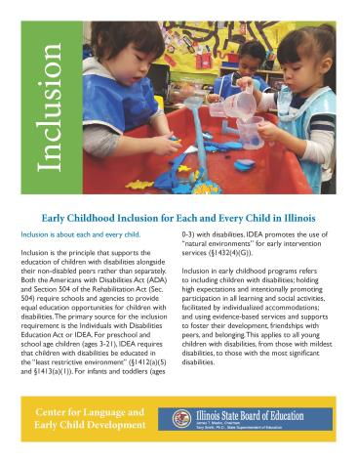
Early CHOICES & EC LRE Stakeholders
http://www.eclre.org/media/100525/master-2016-inclusion-brochure-427-16print.pdf
Notes:
Inclusion Brochure 2013 – Now we are on our second version- we just re-wrote to include Policy statement info.

Slide 29
Started the Early Childhood LRE Stakeholders in 2011
Issued by the Illinois State Board of Education’s Early Childhood Division Administrator
“ISBE is forming a dynamic systems change consortium to focus on Least Restrictive Environment in Early Childhood. … The goal will be to help ISBE address the issues related to implementing best practices around LRE for young children.”
“We will focus on State Performance Plan Indicator 6.”
Notes:
Illinois turned its attention to Early Childhood inclusion in 2011with a realization that it takes a village to raise a child, especially when the child has a development delay, special needs.
To improve opportunities for all our young children, it would take a collaborative movement. We needed a diverse early childhood group to tend to this. It needed to be ongoing and produce actions and products to increase the number of children with IEPs in the regular EC environment, and decreasing the number of preschoolers in self-contained ECSE classrooms.
(click)

Slide 30
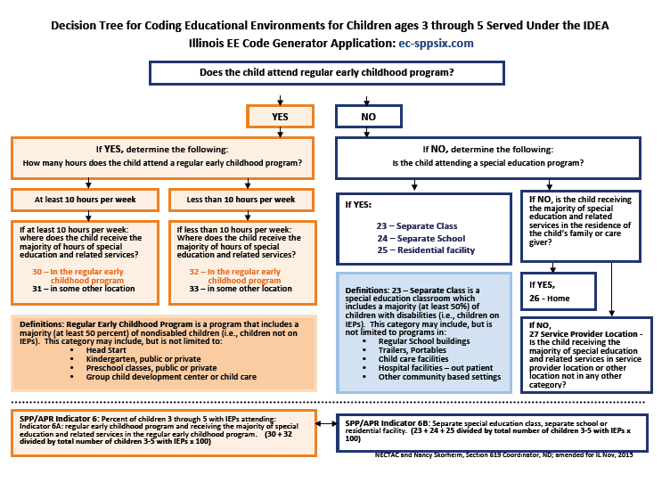
Notes:
The Decision tree was a huge focus to help everyone understand Ed Environment codes. We focused lots of energy on sharing and and helping LEAs see how this worked

Slide 31
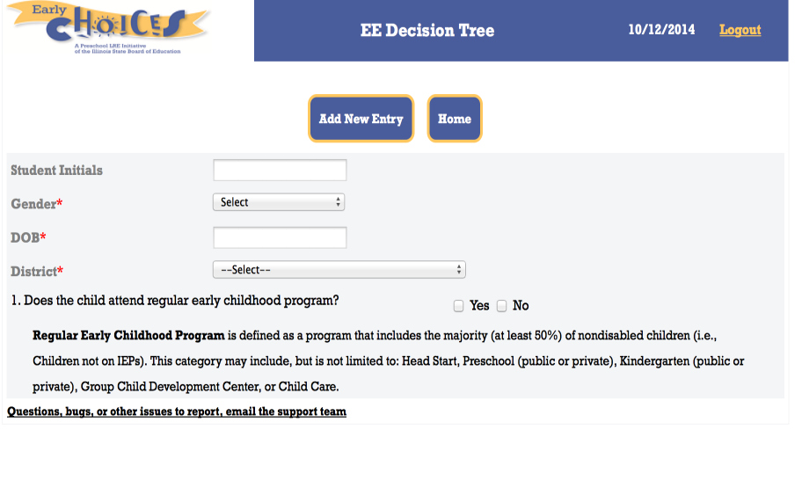
Ec-sppsix.com
Notes:
Early CHOICES created an App to act like the tree--

Slide 32
Policy Statement
Notes:
Policy statement was so supportive of our efforts we used the State recommendations for our 12/4/2015 meeting to prioritize our efforts.

Slide 33
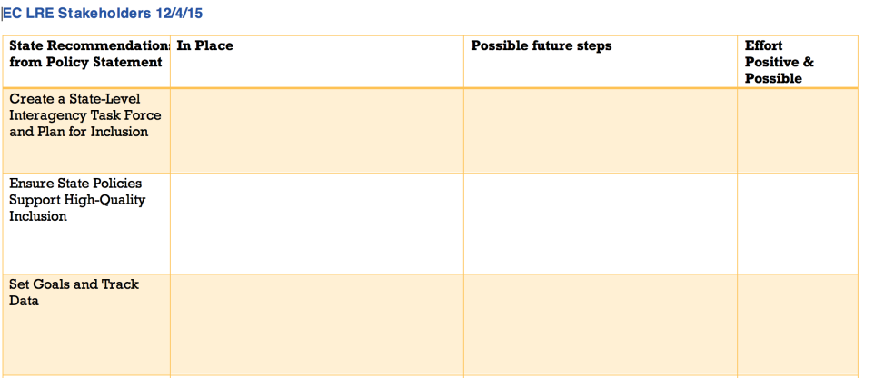
State Recommendations Note-taking tool
Notes:
Pass out Handout (or Ref handout if its in a folder)

Slide 34
Where should we spend our efforts as EC LRE Stakeholders?
Spend 100 Pennies
Notes:
Interagency task force: LRE Stakeholder’s Consortium meets 4 times a year and consists of representatives from agencies, higher education, parents, school administration, early intervention, childcare, Head Start and advocacy groups.
Policies: Support Inclusion. Compliance checklist has an indicator on inclusion. The models recommended support inclusion. With Excelerate, there is an Inclusion component for the gold level and also offer the Award for Inclusion.
Goals: As Ann showed on a previous slide, there are goals set for where we would like districts to be in regards to inclusion. This year’s goal is
Review Resource Allocations: This is an item we need to work on in order to review how our resources are allocated and what we can do to better support inclusion.
Quality Rating Frameworks: Through Excelerate, inclusion is built in to the framework.
Accountability: This is another area we are working on. We will need to look at the barriers to our accountability system and provide support to help districts make placement decisions individualized and consistent with LRE.
PD System: Excel in this area. Starnet, early choices, statewide calendar.
Social-Emotional: Starnet is now offering training on the CSEFEL and supporting overall social-emotional needs of students. We know this is an important area and impacts overall development.
Public Awareness: Trainings, round table discussions, website, OSEP Policy Statement
Refer to Handout - ISBE Inclusion Brochure

Slide 35
Where did you spend the most money?
Identify the top 3
Policy
Accountability, Incentives, Goals & Data
Social Emotional & Professional Development

Slide 36
Policies Priority Group
Challenges across the state and in localities
Conflicting policies, funding streams and regulations impeding the coordination, partnering and collaboration of stakeholders for the creation and expansion of high quality inclusive preschool
Opposing philosophies, attitudes, visions and cultures
Lack of awareness of current scientific and evidence-based research
Ideas to move forward
Minimize isolation through statewide work group problem solving
Effect future Illinois and local policymaking through the creation and promotion of a state policy with recommendations, the legal foundation and evidence-based research on Preschool Inclusion
Notes:
impeding the coordination, partnering and collaboration of stakeholders for the creation and expansion of high quality inclusive preschool

Slide 37
Policies Priority Group
Challenges across the state and in localities
Conflicting policies, funding streams and regulations impeding the coordination, partnering and collaboration of stakeholders for the creation and expansion of high quality inclusive preschool
Opposing philosophies, attitudes, visions and cultures
Lack of awareness of current scientific and evidence-based research
Ideas to move forward
Minimize isolation through statewide work group problem solving
Effect future Illinois and local policymaking through the creation and promotion of a state policy with recommendations, the legal foundation and evidence-based research on Preschool Inclusion
Notes:
impeding the coordination, partnering and collaboration of stakeholders for the creation and expansion of high quality inclusive preschool

Slide 38
Accountability Priority Group
Challenges
Limited strategies
Data is only one dimension
Few incentives
Ideas to Move Forward
Sharing SPP Indicator 6 data with all districts
Use consistent data inquiry model
Celebrate improvements
Identify programs who need to improve and require a plan supported with TA from statewide projects

Slide 39
Early Childhood Social Emotional Health Supports for Children Priority Group
Challenges
Training
Mentoring/Coaching
Other professionals who provide consultation to classrooms
Lack of administrative support/understanding
Ideas to move forward:
Work with higher education
Collaborate with other statewide entities to look into the Pyramid model
Advocate for para-educators to be included in training
Notes:
Training- classroom management/social emotional learning and development not required or not enough content in college courses
Mentoring/Coaching-not enough, need to build internal coaching capacity
Other professionals who provide consultation to classrooms- without training in Early Childhood social/emotional development
Lack of administrative support/understanding
Work with higher education to identify possible areas to increase content regarding social/emotional development
Collaborate with other statewide entities to look into the Pyramid model- particularly for PEG programs
Advocate for para-educators to be included in training, have access to training, as they are usually the staff supporting the children with special needs and/or challenging behaviors

Slide 40
Inclusion Cohort
State Inclusion Self-Assessment
Based on the 9 recommendations from the policy statement
Illinois focused on our three priority areas only
Discussed what was in place/what needs are
Identified a primary area to focus on for the cohort
Will serve as a baseline for improvement
Notes:
Our process with the Cohort-

Slide 41
Inclusion Cohort
ECTA System Framework Tool
Completed Accountability and Quality Improvement section based on our primary area identified (accountability structure)
Based on results from these two assessment tools, the team developed a measurable goal and activities to meet that goal over the course of the 16 month cohort

Slide 42
Positive Actions in Place
Indicator 6 data reports to be sent to all districts before 9/2016 Roundtables in fall.
Award of Excellence for Inclusion of Children with Special Needs (QRIS)
Inclusive Classroom Profile (ICP)
STARNET and Early CHOICES Technical Assistance and Professional Learning
Upcoming IL Preschool Inclusion Summit 2017
Notes:
So we have a few others things already underway in IL that support our work-
We had a process to ID district who needed some TA and we are tightening that up by requiring some LEAs do a plan to change practices.
We have the Award- as a fifth level of QRIS
ICP- we have 9 people in IL trained to reliability on ICP using to help programs self assess for high quality and create PD to support their practices.
We have our TA projects in place
Finally we have the summit coming up to bring the multiple agencies together to assure future policy decisions support inclusive practices.

Slide 43
For More Information from Illinois
Illinois State Board of Education
www.isbe.net/earlychi/html/spec-ed.htm
Early CHOICES
www.eclre.org
Early Childhood LRE Stakeholders Livebinder
http://www.livebinders.com/play/play?id=1272970
Notes:
Places to visit to see our tools, guidance etc.

