Slide 1
Linking Transition Notification Data from Part C to Part B: Designing and Implementing Effective Data System Processes
Presentation for the
Improving Outcomes, Improving Data Meeting
August 2016

Slide 2
Transition Notification Spotlight featuring Kansas & Wisconsin
Notes:
In 2015, We completed a DaSY publication entitled the DaSy Spotlight: Data Linkages Between Part C and Part B featuring the work of Kansas and Wisconsin state agencies

Slide 3
Center Presenters
Kathy T. Whaley – DaSy and ECTA
Bruce Bull – DaSy, CIID and IDC

Slide 4
State Presenters
Wisconsin
Sarah Kate Johnson, Data Manager, Birth to 3 Program, DHS
Jenny Giles, 619 Consultant, Educational Consultant, DPI
Nancy Fuhrman, Data Manager, DPI
Kansas
Sarah Walters, IDC, Former Part C Coordinator
Barbara Dayal, Section 619 Coordinator, KSDE

Slide 5
Audience
Role
Interest
(“Why this session over others?”)

Slide 6
State Selection
Spotlight features Kansas and Wisconsin.
Sought states with effective data sharing and coordinated processes for C to B transition notification.
KS and WI each have two lead agencies

Slide 7
2011 Regulation Overview
Key change in 2011 regulations:
Part C lead agencies must notify the SEA AND local education agency (LEA) of residence
This caused many states to create new notification processes.

Slide 8
Spotlight Organization and Structure
Data Use between State and Local Programs
Communication, Coordination and Collaboration
Use and alignment of Part C Exiting Data and APR Reporting Requirements

Slide 9
Organization and Structure
Technical Considerations
Benefits of a single statewide data system
Unique Identifiers
Data elements
Missing data
Conclusions and Implications
Resources and References

Slide 10
Historical Context Kansas
2011 Part C Regulations – Indicated need for notification to SEA
SEA did not want 50 billion emails notifying them of when a referral to Part B was made
Already had a history of sharing data “system” with Early Childhood Outcomes data system
Strove to keep from adding extra duties to local providers

Slide 11
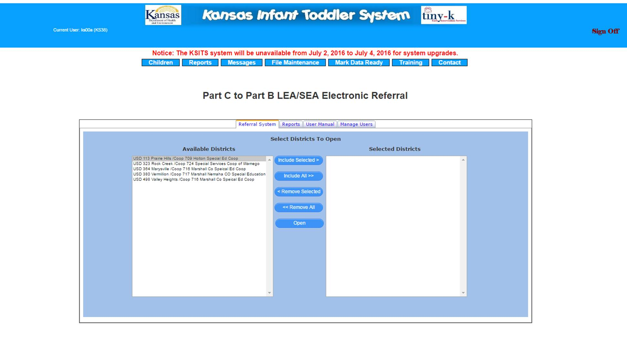
Data Use Between State and Local Programs
Kansas Developed the C to B Electronic Referral System (CBER)

Slide 12
Data Use Between State and Local Programs - Continued
Local tiny-k programs enter transition data into Kansas ITS Database *
Via Web-based IFSP, or
Directly into the ITS Database
SEA and LEA staff log into CBER to get IDEA Required PII for transition.*
LEA’s accept or reject referral based on whether or not the child’s address is actually in the LEA boundaries
* Local programs continue to use local referral process to keep the “human” touch to the process.

Slide 13
Communication, Collaboration and Coordination
Joint letter sent to LEAs and copied to local tiny-k programs
On-going Communication by KSDE with LEAs

Slide 14
Communication, Collaboration and Coordination - Continued
Jointly developed User’s Guide and Video

Slide 15
Communication, Collaboration and Coordination - Continued
Local Memorandums of Understanding are essential!
WHO
WHAT
HOW
WHEN
WHERE
WHY

Slide 16
Communication, Collaboration and Coordination
On-going communication between KDHE and KSDE
List of districts and personnel who need access to CBER at LEAs
Yearly review of State Interagency Agreement to refine system as needed.

Slide 17
Use and Alignment of Part C Exiting Data with APR Reporting Requirements
Back to Interagency Agreements – Very Important
Clearly articulate process to analyze and reconcile referral data as required by the B12 APR measurement and Part C exiting data.
Onus on locals to work together to fix discrepancies

Slide 18
Technical Considerations
Unique Identifiers
Longitudinal data system birth to 21
Parent permission considerations
Data Elements
Agreement on what is to be shared
With parental permission and with out
Missing Data
“Real Time” data helps to alleviate this but doesn’t completely solve it

Slide 19
Where Are We Today?
Ongoing training for school district staff each summer on CBER at Leadership Conference
Integration into Kansas Integrated Accountability System (KIAS) to minimize burden on local school district and align with existing authenticated application (automatic notification) at KSDE
Alignment of Early Childhood system at KSDE due to Kansas State board goal of Kindergarten Readiness

Slide 20
Data Linkages between Special Education Part B and Part C
Kate Johnson, Wisconsin
Department of Health Services
Nancy Fuhrman, Wisconsin Department of Public Instruction
August 16, 2016

Slide 21
Context
Program Participation System (PPS)
Created in fiscal year (FY) 2007-2008
Previous data collection system and notification process
Purpose
Reporting federal indicators
Improving communication
Standardizing process
Improving compliance

Slide 22
Notification process in Wisconsin
PPS
One-way data transmission system
Purpose of making referral
Includes basic notification information
Additional information may be shared through or outside of PPS with parental consent

Slide 23
Key points
Meet federal requirements
Notification of State Education Agency (SEA) and Local Education Agency (LEA)
Statewide Annual Performance Report (APR) data reporting
Comply with state requirements
All notification is electronic
Monitor and review data
Support local program practice
Support families through transition process

Slide 24
Collaboration
State level
Interagency agreement
Ongoing transition meetings
Include data review
Local level
Interagency agreement or Memorandum of Understanding
Technical assistance – both Part B and C

Slide 25
Considerations for implementation
Infrastructure components
Professional development
Technical assistance
Funding and sustainability
Additional components
Application of Implementation Science
Phases and drivers
Local data use

Slide 26
Continued work
Ongoing communication
State and local levels
Support for local data use and program improvement
Data governance
Race to the Top Early Learning Challenge Early Childhood (RTT-ELC)Integrated Data System (ECIDS)
Fiscal considerations

Slide 27
Considerations for Practice
Provide state and local Part C and Part B staff real-time access to the same data on transitioning children.
Consider a single statewide data system to support accurate and efficient transfer of transition data to minimize manual processing and reduce errors.
(Alternatively, consider designing data integration between data systems.)
Consider creating and using a single unique child identifier across both Part C and Part B.

Slide 28
Contact Information: Nancy Fuhrman
Contact information:
Nancy Fuhrman
Early Childhood Special Education
Department of Public Instruction
(608)266-6438
Nancy.Fuhrman@dpi.wi.gov

Slide 29
Considerations for Practice
Establish routine communication between local Part C and Part B staff to:
Ensure timely and effective access to services and supports for children and their families.
Coordinate processes and problem-solving issues.
Establish routine transition notification training for local Part C and Part B program staff.
Develop transition interagency agreements that specifically address data sharing responsibilities, processes, and training for Part C and Part B staff.

Slide 30
Lessons Learned
Having a database solution is only part of what makes C to B transition notification successful
Cross agency communication & coordination is critical
Must have accurate algorithms for pulling, sending, and handling the data
Continual training and communication with C and B is critical for accurate and timely data
Effective system approaches are reflective of purposeful intent and coordinated efforts over time

Slide 31
Questions / Contact
Kathy T. Whaley – Kathy.Whaley@unc.edu
Bruce Bull – Bruce.Bull@SPEDSIS.com

