Slide 1
Let's get to work! Implementing and evaluating state systemic improvement
Anne Lucas, ECTA/DaSy
Abby Schachner, ECTA/DaSy
Ardith Ferguson, NCSI
Carolee Eslinger, IDC
Grace Kelley, DaSy/NCSI/ECTA
Megan Vinh, ECTA/DaSy
Improving Data, Improving Outcomes Conference
New Orleans, August 17, 2016
Notes:
Anne
With planning support from Joicey Hurth and Tamara Nimkoff as well!

Slide 2
Intended Outcomes
Participants will:
Understand strategies that can be used to implement, evaluate, and make mid-course corrections to their state’s SSIP improvement and evaluation plans during Phase III.
Understand how other states are implementing and evaluating their SSIP.
Practice applying strategies related to implementing, evaluating, and making mid-course corrections to their state’s SSIP improvement and evaluation plans through use of scenarios.
Notes:
Anne
Participants will come together to gain skills to carry out Phase III of their State Systemic Improvement Plans (SSIPs). Information about implementation, evaluation, and revision of systemic improvement plans will be shared. This workshop will provide opportunities for states to practice developing or strengthening aspects of their improvement and evaluation plan, including measures to evaluate implementation of evidence based practices. Activities will be used to build state capacity to implement and evaluate their SSIP.

Slide 3
Agenda
Introductions (15 min.)
Communication & Stakeholder Engagement (40 min.)
Choose Your Own Adventure (40 min. + 15 min. break)
Practice Profiles
Performance Indicators
Making Mid-Course Plan Corrections (40 min.)
State Planning & Sharing (30 min.)
Notes:
Anne
Also remind people of the Next Steps handout (located in their folders) that they can use throughout the workshop.

Slide 4
Phase III Considerations & Resources Guide
SSIP Phase III Guide
coming soon!
http://ectacenter.org/topics/ssip/ssip.asp
Notes:
Grace

Slide 5
Phase III Overview & Requirements
Phase III SSIP
Improvement Plan
Implement activities as planned
Monitor implementation and make revisions based on data
Document progress and outcomes
Engage stakeholders
Evaluation Plan
Conduct evaluation activities
Track progress toward outcomes and SIMR targets
Prepare summaries of evaluation data for planning teams
Engage stakeholders
Notes:
Grace
“Phase III: Implementation and Evaluation. In Phase III, the State must, consistent with the evaluation described in Phase II, assess and report on its progress in implementing the SSIP. This will include data and analysis on the extent to which the State has made progress toward and/or met the State-established short-term and long-term objectives for implementation of the SSIP and its progress in achieving the State-identified Measurable Result(s) for Infants and Toddlers with Disabilities and their Families.”
(additional detail on modifications) “If the State intends to continue implementing the SSIP without modifications, the State must describe how the data from the evaluation support this decision. Also, the State must provide a rationale for any revisions that have been made, or revisions the State plans to make, in the SSIP in response to evaluation data, and describe how stakeholders were included in the decision-making process.”

Slide 6
Kicking Off Phase III
Educate and engage stakeholders in the implementation and evaluation of the plan
Project Management: How will the various activities of the plan be managed?
Appoint a lead person for each major activity or initiative
Communicate with and engage staff, stakeholders, providers, families, and communities
Link the implementation to everyday activities
Track and summarize progress
Learn from experience
Clarify roles, responsibilities, and expectations for implementing the improvement and evaluation plans
Notes:
Grace
Some key considerations for implementation in Phase III:

Slide 7
Implementing the Improvement Plan: Infrastructure Development
Infrastructure Development
Implement improvement strategies and associated activities to enhance the state infrastructure
Work toward further aligning and leveraging other state plans and initiatives
Continue to engage multiple offices within the state in implementing improvement activities
Notes:
Grace

Slide 8
Implementing the Improvement Plan: Implementing EBPs
Implementing EBPs
If not yet selected, identify the EBPs that EIS programs/EIS providers will implement to achieve the SIMR
Operationalize Phase II plans for implementing EBPs based on the activities, steps, and timelines included in their plans
Support EIS programs and/or EIS providers in implementing evidence-based practices (EBPs) to achieve the SIMR(s)
Take into account implementation approach (i.e., other sites or statewide)
If needed, make adjustments to the implementation plans based on data and stakeholder input
Notes:
Grace

Slide 9
Evaluating Implementation Process & Outcomes
Collect, analyze, report, and use evaluation data based on the methods and timelines outlined in the Phase II plan
Use data regularly to monitor the improvement process and revise the improvement plan, as needed
Review performance criteria and indicators and make adjustments as needed
Make adjustments in data collection strategies/sources as needed
Notes:
Grace
Review intended outcomes and ensure that they remain related to and logically follow the improvement strategies and related improvement activities.
Review performance criteria and indicators and make adjustments as needed based on implementation.
Make adjustments in data collection strategies/sources as needed to better measure intended outcomes
We will have the opportunity to choose between an activity related to measuring practices – creating practice profiles – or drafting performance indicators

Slide 10
Communicating Implementation Progress and Outcomes
Effective and timely communication will be essential to successful implementation and to achieving desired outcomes
Feedback loops are critical:
Implementers will need a way to communicate with the state to convey related barriers, successes, and outcomes
Implementation and planning teams will need to communicate on a regular basis to review data and information provided through feedback loops
Notes:
Grace
More on this during communication activity

Slide 11
Making Adjustments in the Improvement and Evaluation Plans
Ongoing review and analysis are essential to meeting targets and achieving SIMR
Organizations that are most effective at achieving results and sustaining change revisit plans and update on a regular basis, celebrating successes, taking advantage of opportunities and addressing challenges that arise
Notes:
Grace
More on this during mid-course plan adjustments activity

Slide 12
Let’s Get To Work!
Notes:
Grace

Slide 13
Communication and Engagement Plan
Notes:
Carolee and Ardith

Slide 14
For systemic change, stakeholder engagement is critical
Stakeholders:
Represent diverse perspectives
Provide feedback on what activities are working, and what planning needs to be tweaked (mid-course corrections)
Encourage sustained focus on selected priority areas over time
Notes:
Carolee
We know about Planning, but why keep stakeholders engaged in the Do, Study and Act phases?
We know all the reasons to have them help with the planning: `
Promotes well informed and appropriately targeted selection of core issue as primary focus area,
Can help to identify and leverage existing resources and other supports to get the work done
Promotes reasonable selection of" expected outcomes"
Provides opportunity for broad and diverse perspectives to plan relevant, effective, and efficient intervention strategies.
Why keep them engaged in the Do, Study and Act phases?
Diverse perspectives - Helps ensure implementation and evaluation activities are well targeted and meaningful to all levels of the organizational structure. Supports good communication flow (all directions) which helps to ensure that implementation and evaluation activities are well targeted and meaningful to all levels of the organizational structure.
Provides feedback and input for assessing what targeted activities are working and what needs to be tweaked to work better (mid-course corrections tracked during summative evaluation).
Sustained focus - can help buffer when there is staff turnover, leadership changes, and other winds of change and political factors start blowing a different direction.

Slide 15
For systemic change, effective, timely communication flow is critical
Communication and routine feedback are a necessary part of the PDSA cycle and continuous improvement
Information must flow through frequently used, multi-directional and multi-level feedback loops to convey barriers, successes, and outcomes of the implementation and evaluation activities
Notes:
Carolee
Feedback loop concept is key to continuous improvement – cycle
In order to implement and evaluate improvement activities there needs to be information flowing in a thoughtful way to ensure smooth and effective implementation and evaluation process (feedback is critical to improvement and sustainability)
A communication plan/strategy can guide the flow of information and avoid gaps in information and ensure efficiency of process and progress. Upfront work to plan communication strategies will strengthen and streamline future efforts.
“In Phase III, effective and timely communication will be essential to successful implementation and achieving desired outcomes.”
Information from implementers will flow to the state implementation and planning teams to convey implementation barriers, successes, and outcomes.
The implementation and planning teams will need to communicate on a regular basis to review data and information provided through feedback loops.
This will enable the teams to make adjustments in policy, implementation, and resources as needed and convey these changes to local programs and practitioners.
This feedback loop between the state and local programs and practitioners will support effective and successful communication.”

Slide 16
For systemic change, effective, timely communication flow is critical, cont’d…
Messaging regarding the implementation, evaluation and outcomes must be current and reflective of the work
Information flow enables teams to make timely adjustments in policy, implementation, evaluation strategies and/or resources as needed
A Communication Plan can guide the flow of information, help avoid gaps, and ensure efficiency of process and progress
Notes:
Carolee
A communication plan will describe how stakeholders are included in planning, implementation, evaluation and accountability for the SSIP.
Feedback loop concept is key to continuous improvement – cycle
In order to implement and evaluate improvement activities there needs to be information flowing in a thoughtful way to ensure smooth and effective implementation and evaluation process (feedback is critical to improvement and sustainability).

Slide 17
A strong Communication Plan will:
Illustrate how team members/stakeholders are included in planning, implementation, and accountability-related activities
Support meaningful communication flow with effective feedback loops across all critical parties
Help identify effective and ineffective practices, and needed adjustments to the implementation plan and process (formative evaluation)
Help identify when the targeted infrastructure change and system adjustments actually occur (summative evaluation)
Notes:
Carolee
Communication plan is critical part of the PDSA cycle.
A good Communication plan will describe how stakeholders are included in planning, implementation and accountability .
A strong multi dimensional communication process could help to illustrate infrastructure changes and adjustments to the system. A detailed communication plan that is being well implemented could help document an infrastructure change even before the actual numbers that are measured for the formative evaluation begin shifting.
Communication must flow all directions to get critical information about what is and isn’t effective and to help inform any needed corrections. (3-D Communication loop – flow goes all directions.
A communication plan will support both your formative and summative evaluations
Upfront work to plan communication strategies will strengthen and streamline future efforts.

Slide 18
Tips for developing a strong Communication Plan:
Continue to engage existing stakeholders to discuss strategies for improving the feedback loops enhancing their involvement in the process
Explore using existing communication channels (meetings, newsletters, email blasts)
Consider using infographics to share progress data to variety of stakeholders and in the SSIP Phase III
Include narrative description of plan in the SSIP
Notes:
Carolee
Tell your story about what’s working and not working. Justify the changes in the SSIP and how the data and stakeholder input was used to determine the necessary changes.

Slide 19
Leading by Convening Engagement Levels
Moving stakeholder involvement from simply informing to higher levels of engagement
Notes:
Ardith
Introduce the activity: (need to have at each table the LbC Engagement Levels (maybe on nice cardstock); draw participants attention to the Leading by Convening Handout at each table. Walk through two examples illustrating the levels of engagement, one for data staff (Ardith).
We will suggest they work individually or state team on planning worksheet that will be at each table (1 per person) – 15 min. Then, engage in sharing at table the topic and a strategy and method/channel of communication you intend to use. (Have instructions on the sharing activity at the table)
Regardless of how simple or elaborate your current communication plan/strategy is, what is an immediate communication need that is critical to advance your work/ensure success of the next step of your implementation plan
Multiple levels of engagement and operational needs, thinking about the activity and where they are in their process, encourage them how to consider where they are now on the LbC, is that effective or does it need to be expanded to a next level (what resources would you need to get to a more complex level of engagement). Would it serve you better if your communication could be at the next level. (Could be internal state team, ICC, SEAC, providers, LEAs/EISs, parents, legislators, etc.)
Resources we might highlight:
Engagement science
LbC – Creating Active Engagement, Engage Everybody (circles), Measuring Progress, One-Way and Two-Way Learning
Elements of a Strategic Communications Plan
Infographic (maybe the DaSy Toolkit if it’s ready)
Circles of Involvement pdf
https://ideadata.org/files/resources/55c24f96140ba04b138b4571/55c250b8140ba013528b4570/handout-circles_of_involvment-handout/2015/08/05/handout-circles_of_involvment-handout.pdf

Slide 20
Resources
Phase III Process Guide, Communicating Implementation Progress and Outcomes Section
Circles of Involvement
Leading by Convening
Elements of a Strategic Communications Plan
http://ectacenter.org/topics/ssip/ssip.asp
DaSy Data Visualization Toolkit
http://dasycenter.org/data-visualization-toolkit/
Notes:
Ardith
Tips from OSEP-
Is helpful to have narrative that describes and provides additional context to the information presented in table format.
It’s important to talk about the steps you’ve taken and the process you are going through. (discuss formative assessment and your progress because summative changes will take longer to demonstrate progress (include a link to the infographic toolkit DaSy sent out and other resources re: data visualization)). You will want to describe in some depth how the state has thoughtfully communicated the activities, what discussions you’ve had with stakeholders, and how you plan to continue to engage stakeholders in implementation and evaluation of the SSIP.
Resources that are available to support this work are:
Circles of Involvement pdf
https://ideadata.org/files/resources/55c24f96140ba04b138b4571/55c250b8140ba013528b4570/handout-circles_of_involvment-handout/2015/08/05/handout-circles_of_involvment-handout.pdf
In “A Guide to the Implementation Process: Stages, Steps and Activities” one of the steps to developing a communication plan for statewide buy-in is: “Step 2.e. Use multiple communication strategies and feedback loops to evaluate the impact of the messages.” and “Step 4.b. SLT and Implementation Teams frequently use communication strategies and feedback loops to receive and provide information.”
Key point of our section: How to take stakeholder involvement from simply informing to higher levels of engagement?
Resources we might highlight: Engagement science
• LbC – Creating Active Engagement, Engage Everybody (circles), Measuring Progress, One-Way and Two-Way Learning
• Elements of a Strategic Communications Plan
• DaSy Toolkit

Slide 21
Choose Your Own Adventure: Practice Profiles and Performance Indicators
Notes:
Megan and Abby
Practice Profiles: Tamara
Performance Indicators: Kim

Slide 22
Raise your hand if…
You are planning on developing or adapting a tool/assessment to measure fidelity/implementation of practices?
You might need to develop specific statements to measure whether outcomes are achieved and track progress in your SSIP evaluation?
Notes:
Abby

Slide 23
Purpose
In Phase III you will need to track progress through evaluation and to do this you need
Ways to measure practices and strategies being implemented
Clearly defined performance indicators
Provide overview practice profiles and performance indicators
Opportunity to select and complete activity based on what is most relevant or of interest to you

Slide 24
Measuring Implementation/Fidelity of Practices: Practice Profiles
Notes:
Add Archer picture

Slide 25
What are Practice Profiles?
Practice profiles are a tool for operationalizing a strategy or practice so that it is clear what practitioners will do as they carry out the intervention or practices
Developed through systemic review, stakeholder vetting and consensus, and testing and evolving the profile
Goal of practice profiles:
Identify the intervention or practice principles that guide successful work with children and families, and
Identify the specific activities that bring these principles to life
VIDEO! https://unc-fpg-cdi.adobeconnect.com/_a992899727/ai-lesson3-p1/
Notes:
Practice profiles a useful tool when developing fidelity assessments
Video: Lesson Part 1 starting at Criteria through Fidelity Assessments – about 4.5 min.

Slide 26
What are Benefits of Practice Profiles?
Provide operationalized practice model for consistent implementation of intervention or practice
Facilitate development of training protocols, coaching strategies, and other assessments
Refine infrastructure and systems supports needed to be installed to facilitate consistency across practitioners
Clarify “what” is being implemented
Use to develop fidelity/implementation checklists

Slide 27
Practice Profile Planning Tool
http://implementation.fpg.unc.edu/resources/lesson-3-practice-profiles
Notes:
http://implementation.fpg.unc.edu/sites/implementation.fpg.unc.edu/files/NIRN-Education-PracticeProfilePlanningTool.pdf

Slide 28
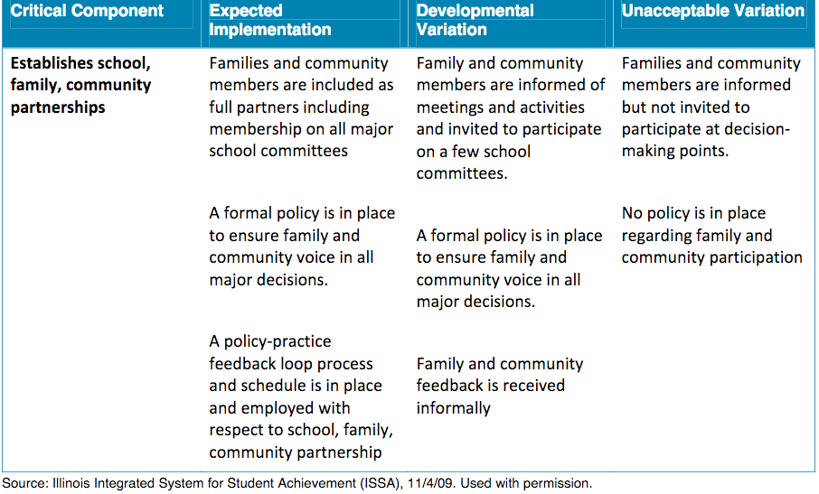
Practice Profile, Critical Component Example:

Slide 29
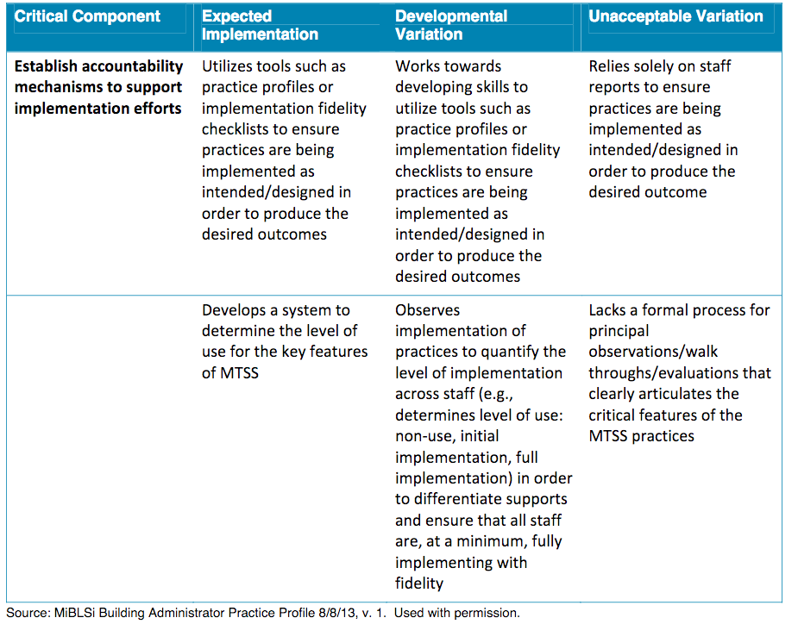
Practice profile, Critical Component Example: Accountability Mechanisms

Slide 30
Performance Indicators

Slide 31
What is a Performance Indicator?
An indicator is the piece of information that measures whether outcomes are being achieved
Evidence that will allow the SSIP Team to track change or progress
Outcome: Children have improved social emotional skills
Indicator: % of children with IFSPs/IEP who substantially increased their rate of growth by the time they exited the program

Slide 32
What are Benefits of Performance Indicators?
Align the evaluation plan with the theory of action and logic model
Add clarity and focus
Can help prioritize activities
Can help limit/focus scope and cost of evaluation
Move from global or abstract terms to specific, observable, measurable statements
Guide adjustments to data collection and implementation

Slide 33
What is a “Good” Indicator?
A few criteria:
The indicator is clearly related to the outcome and is a measurement of the outcome
Usually contains a statistic, a number (e.g., a percentage, an average, a total) to track to see whether it goes up or down
State whether you want to see an increase or decrease
The wording of an indicator should suggest how you are going to measure the outcome
Feasible for you to collect the data

Slide 34
Well-Written Indicators
An increase (direction) in the average score (number) on the Proficiency Test given at the end of training (method of measurement)
An increase (direction) in the average score (number) on the Provider Skills Checklist (method of measurement)
90% (percentage) of practitioners report implementing practices on the Team-Based Services Practice Profile (method of measurement)

Slide 35
Activity: Choose Your Own Adventure!
Option 1: Practice developing a practice profile
Option 2: Practice developing performance indicators
Take a minute to decide, move to side of room for the activity you choose & take a short break!
15 min. break
25 min. for activity
Notes:
Go over instructions for each activity

Slide 36
Resources
AI HUB Fidelity assessment module
http://implementation.fpg.unc.edu/module-7/active-implementation-frameworks/fidelity-assessment-and-implementation
AI HUB Practice profiles lesson & resources
http://implementation.fpg.unc.edu/resources/lesson-3-practice-profiles
Sample Action Plan Template
http://ectacenter.org/~docs/topics/ssip/ssip_improvement_plan_template.doc
IDC White Paper: Using a Theory of Action to Develop Performance Indicators to Measure Progress Toward a SIMR
https://ideadata.org/resource-library/5682ad18140ba01a6a8b45d0/
Recommended Resources for Evaluation Program Improvement
http://ectacenter.org/topics/ssip/plan_eval_program_improvement.asp

Slide 37
Making Mid-course Corrections
Notes:
Anne and Grace

Slide 38
Making Mid-Course Corrections
Making a mid-course correction is the time to:
Determine if your plan is an accurate reflection of:
What you want to achieve (outcomes)
How you are going to achieve it (process)
The environment you are working in – opportunities and threats
Celebrate/recognize what you have achieved so far
Notes:
The idea behind updating your SSIP is to allow for the flexibility of meeting your targets and goal; adjusting your plan to the current realities, are you meeting your targets, are

Slide 39
Considerations
Make mid-course corrections over time as implementation occurs, not just annually
Use data from feedback loops to make plan modifications
Use evaluation data on effectiveness and impact of (outcomes) to determine needed implementation plan modifications
Assess if difference between actual performance data and target in performance indicator is significant enough to warrant plan change
Assess if activity being evaluated is essential for success and make plan changes if actual performance data falls below target in performance indicator

Slide 40
Considerations
Dig deeper into your data, if necessary, to identify potential issues impacting your progress
Assess the impacts of the environment (opportunities and threats) to determine if plan modifications are needed
Determine if changes need to be made to the evaluation plan (e.g. performance indicators, data collection methods, analysis plan/measurement, frequency of data collection) independent of implementation plan modifications or as a result of those changes
Think strategically about how best to engage stakeholders in making mid-course corrections

Slide 41
Applying Considerations: Scenario
SSIP Activity: Supporting providers in implementing high quality child outcomes summary (COS) rating processes

Slide 42
Scenario: Steps
Review/modify COS modules
Modify local contracts to require completion of COS modules
Develop mechanism to track module completion
Develop pre-/post-test
Modify family survey
Select coaches for initial implementation sites

Slide 43
Scenario: Steps
Develop scale-up plan
Adapt COS-TC
Train coaches
Implement the COS training modules in initial implementation sites
Provide coaching to initial implementation sites
Implement scale-up plan statewide

Slide 44
Activity Instructions
Tables have different scenarios to discuss:
Implementation evaluation data
Impact/outcomes evaluation data
Environmental threat
Table facilitator will provide instructions and facilitate discussion
Select a recorder/reporter
Turn in worksheet

Slide 45
Sharing
What were the key decisions you made for your scenario?

Slide 46
Wrap up!
Summary points
Compiling the scenario and information into a resource

Slide 47
State Planning and Sharing
Take 20 minutes to reflect on the information shared and your experiences with the activities
Jot down ideas for next steps you might do when you go home to enhance your improvement and evaluation plans or to support implementation
Be prepared to share a key next step with the full group
Notes:
Megan (and Anne?)

Slide 48
The contents of this presentation were developed under grants from the U.S. Department of Education, # H373Z120002, #H326P120002, H326R140006, and H373Y130002. However, those contents do not necessarily represent the policy of the U.S. Department of Education, and you should not assume endorsement by the Federal Government. Project Officers: Meredith Miceli, Richelle Davis, Julia Martin Eile, Perry Williams, and Shedeh Hajghassemali.

