Slide 1
What does it Take to Create a Good RFP for a New Data System?
Bruce Bull
Jamie Kilpatrick
2016 Improving Data, Improving Outcomes Conference
New Orleans, LA
August 2016

Slide 2
Presenters
Bruce Bull, DaSy, CIID, SPEDSIS
Jamie Kilpatrick, DaSy, PCG
Experience: Higher Education, State Government, TA Providers, For Profit Business
Notes:
As state emp written RFPs, dealt with state agency procurement, IT, and politics
As TA providers reviewed draft RFPs for states
As private vendors written proposals (and chose NOT to write proposals)
Read and scored dozens of proposals at state and at federal levels (old days)

Slide 3
Description / Overview
Session Description: A single session support group for those who experience (or might in the future) RFP-itis. Is there a RFP for a data system in your state's future? Learn from the experiences (thumbs up and down) of TA providers with both state agency and contractor backgrounds. Audience will also be encouraged to share their lessons learned.

Slide 4
Session Expectations
Share stories: Yours and Ours
What we know (or think we know)
Share land mines: “Didn’t see ___.”
What worked for us . . .
What we’d do differently next time . . .
Where to go for help

Slide 5
Audience
Your roles?
Your RFP experience?
Notes:
1) Roles: Data manager / program administrator / Local agency (what role)
Private consultant/vendors) / TA provider / Parent rep / DBA / OthersR
RFP Involvement:
NOT been involved with writing RFP for new data system?
Somewhat involved?
Main RFP author or one of the main authors?
How many have written PROPOSALS to RFP specifications?

Slide 6
RFP and DaSy Framework Connection
System Design and Development
Subcomponent 1: Initiation of New System/Enhancement and Requirements Analysis
Subcomponent 2: System Design and Development
Subcomponent 3: System Acceptance and Deployment
Main takeaway #1
Notes:
One of two MAIN Takeaway: Study and consider SDD content to help you determine what your new data system should be AND what to include in RFP

Slide 7
RFP to Secure a Create Solution
RFP should focus on the end, not the means
Main takeaway #2
Notes:
Two of two MAIN Takeaway: Focus on the “what” NOT the “how” in your RFP

Slide 8
Agenda
RFP defined
RFP content
RFP development
RFP challenges

Slide 9
RFP—Request for Proposal
RFP is a solicitation to potential suppliers for a commodity or service. RFPs often request:
technical expertise
specialized capability/product
develop new service/product

Slide 10
(RFI—Request for Information)
RFI is a solicitation to potential suppliers to gather information to inform next steps. RFIs often precede an RFP.
Notes:
When might you use?
Pros and cons?

Slide 11
RFP New Data System Content
What do you think should be included?

Slide 12
High Level RFP Content
Boiler plate
Background information
Budget and timelines
Desired functionality
Evaluation factors
Data system RFP content

Slide 13
Boiler Plate (agency lawyer speak)
Procurement will provide some contractual language BUT READ IT!!
There is content you can’t change, but often you can change some, (though colleagues might say you can’t)
Ask procurement, “How can we ____?”

Slide 14
Work WITH Procurement
Write as much flexibility as possible into the RFP—things inevitably change.
Consider pros and cons of scoring criteria by section.
Secure examples of “good” data system RFPs; your agency AND other agencies. Talk with and learn from others.

Slide 15
Within Your State
Study copies of other agency data system RFPs
Ask questions of other agency project managers about processes used (RFP writing, project management, etc.)
Study copies of final contracts

Slide 16
Ask Other States
Copies of their data system RFPs
Amounts of final contracts
For copies of final contracts
Copies of submitted proposals
Satisfaction with vendor
How vendor resolves problems
List of responding vendors, so you can notify as many qualified proposers as possible

Slide 17
Background Information
Briefly describe
Reason for new data system (e.g., federal and state reporting)
Connections to other systems and work of agency
User levels and high level functions

Slide 18
Background Information
Reference applicable parts of DaSy Data System Framework within the RFP

Slide 19
Budget (Realistic)
Get costs from other states
Compare apples to apples (e.g., hosting, level of support, training)
Secure adequate fiscal resources
Budget for updates, maintenance
Include “maximum amount available” in RFP?
Notes:
Check with supervisors – is now a good time?
Politics (e.g. internal IT vs external vendor)

Slide 20
Budget Con’t
Request a “bank of hours” (agency controls) and vendor includes in fixed price for features not in RFP
Establish amount/hr to support work, as needed, not in RFP
Notes:
Write up control of hours in a way that agency controls, not vendor
How many hours? 200 or more.

Slide 21
Desired Functionality
Too much detail can result in bidders who simply deliver to your specification without thinking strategically. Overly detailed lists discourage vendors from offering their best approach and can lock you into particular solutions or approaches. If you (or IT) insists on a specific collection of web tools, you risk missing better solutions.
Edited from: www.fivepaths.com/resources/writing-request-proposal

Slide 22
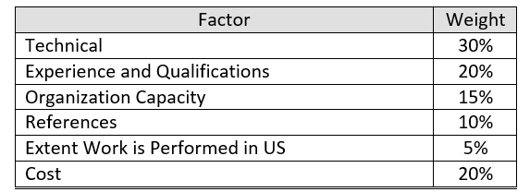
Evaluation Factors
One of many configurations and assignments of points x factors.

Slide 23
Evaluation Factors Con’t
Clear description of factors, what is being sought
Assign points to factors based on what is important
Is there a “preferred” vendor? Establish sensible criteria

Slide 24
Evaluation Factors Con’t
Cost points are (usually) proportional
Max cost points to lowest bidder
All other bidders receive proportional
Technical Points
Think through scoring criteria and review process
Technical points vs cost proportion
Notes:
Qualifications of reviewers – especially for a data system. (Are content staff qualified?)
If 30% or more of total points are based on cost, award is much more likely to go to lower bidders regardless of experience and technical expertise

Slide 25
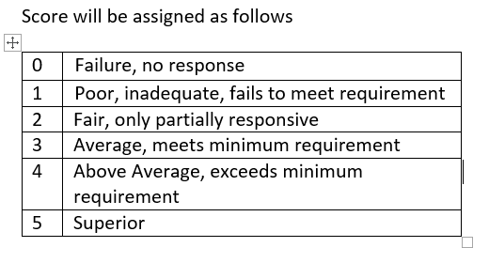
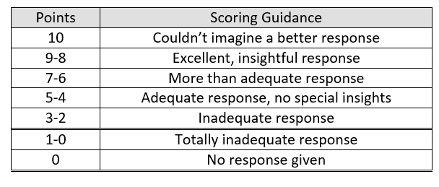
Scoring Criteria
Notes:
Preference for the second one: point spread, 10 hard to achieve.
Reviewers tend to score high – spreading points out helps differentiate. AND lead to discussion as to “why” reviewers scored what they did.

Slide 26
Review Process
Select qualified reviewers.
Train reviewers. Don’t assume they know.
Encourage point spread
Practice
Calibrate (reach high interrater reliability)
Score individually
Meet to discuss, as things get missed

Slide 27
New Data System RFP Content
What would you include?
Technical requirements
Security, back up
Data integration
Environments (vendor, cloud, agency, dev, test, etc.)
User roles and functions

Slide 28
New Data System RFP Content Con’t
Technical Requirements (con’t)
Important timelines (annual agency list, start dates)
Functional requirements by users
Business rules/logic

Slide 29
New Data System RFP Content Con’t
Within RFP describe role of agency IT:
Project management
Decision making
Acceptance testing
(Helpful for vendors to know, critical for program staff to know.)

Slide 30
New Data System RFP Content Con’t
Training requirements
Documentation requirements
Expected response time for bug fixes
Agency FTE commitment to project management (Plan for it!)
Onsite work and technical access

Slide 31
New Data System RFP Content Con’t
Previous system docs (as applicable)
Documents supporting importance of data system (e.g., APR, SSIP)
References to agency expectation to system development life cycle
Process and data models

Slide 32
New Data System RFP Content Con’t
Schedule of implementation
Stakeholder input processes

Slide 33
Time needed to write RFP
1-2 years
Political/fiscal acceptance, THEN 1 year to write RFP
(Even if building data system internally, 1 year to develop requirements and specifications)
You may have to build the “business case” to establish the (RFP) solution
Notes:
Measured in years (or at least quarters) not months
Idea to RFP in 1 year? No
Idea to political/fiscal acceptance, initial ground work, THEN one year to plan/build the RFP
If internal, (not RFP), still takes a year to develop much of the same content that would be in
You may have to build the “business case” to establish the (RFP) solution
Understand the time it takes to for tasks OTHER THAN writing RFP content:
IT review (who may or may not write content)
Procurement review
Rewriting RFP
Establishing point criteria
Posting RFP
RFP question and answer period
Training proposals readers
Proposal reviewing and scoring
Best and final offer opportunities
Contracting
Other

Slide 34
Time for tasks OTHER THAN writing RFP
IT review
Procurement review
Rewriting RFP
Set point criteria
Post RFP
RFP question and answer period
Train proposals readers
Proposal scoring
Best and final offer
Contracting
Other

Slide 35
What we like to see¹
IT Role – defined and not cumbersome.
There is a reason new system is not being developed in house.
When IT suggests “how” a vendor “must” ask, “How does that solution support what is best for our program?”

Slide 36
Challenges?
Shout out your RFP challenges.

Slide 37
Challenges we’ve Experienced
Incomplete RFPs—not ready
RFPs without champion stuck in bureaucracy
Failure to ask the right procurement people the right questions
Notes:
Experienced, high level procurement staff can help you do what you want. But you have to ask them. We’ve had:
Awards (letter in hand) taken back
Competition nullified, and reissued AFTER written proposals submitted
“Don’t settle”

Slide 38
Challenges we’ve Experienced
Unnecessary page limitations
Too much canned response required (to satisfy boiler plate)
RFP too directive: “how to” focus not desired functionality focussed

Slide 39
Challenges we’ve Experienced
Poor point values for sections
Overlapping/redundant section content (E.g., Qualifications AND Experience sections.)

Slide 40
Challenges we’ve Experienced
Assume work ends with vendor selection. (Not budgeting enough agency time = poor project management = tyranny of the urgent)
Unrealistic Time Lines
To develop RFP
To respond to RFP
To meet RFP deliverables

Slide 41
Audience RFP Experience
Who has created an RFP for a new data system?
How long did it take?
What kind of TA did you get WHEN WRITING?
From whom did you get it?
What would you different next time?

Slide 42
Miscellaneous
Sole sourcing
Other?

Slide 43
Questions / Contact
“Hmms, buts, whats, and duhs”
Bruce Bull – Bruce.Bull@SPEDSIS.com
Jamie Kilpatrick - jkilpatrick@pcgus.com

Slide 44
How to Stay in Touch with DaSy
Visit the DaSy website at: http://dasycenter.org/
Like us on Facebook: https://www.facebook.com/dasycenter
Follow us on Twitter: @DaSyCenter

Slide 45
The contents of this presentation were developed under a grant from the U.S. Department of Education, # H373Z120002. However, those contents do not necessarily represent the policy of the U.S. Department of Education, and you should not assume endorsement by the Federal Government. Project Officers, Meredith Miceli and Richelle Davis.

