Slide 1
Preschool Outcome Reporting in Montana
Anne Rainey – Part B Data Manager Montana
2016 Improving Data, Improving Outcomes Conference
New Orleans, LA
August 2016

Slide 2
Why is it done?
For any student who is 3, 4 or 5 years of age, Preschool Outcomes must be completed when he or she is initially found eligible for Special Education Services.
The document must also be completed for any student who then leaves preschool special education, either by moving out of a district, leaving IDEA completely before age 6, or by turning 6.

Slide 3
Who completes it?
Case Manager
Speech-Language Pathologist
Special Education Teacher

Slide 4
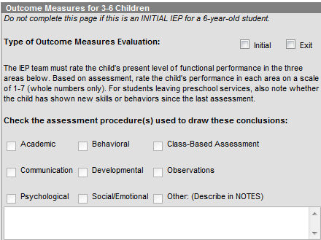
How are they completed?
Statewide Student Information System
For Initial or Exit

Slide 5
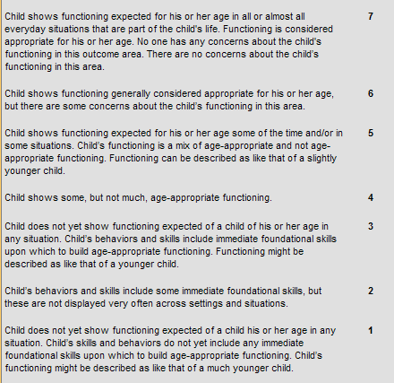

Slide 6
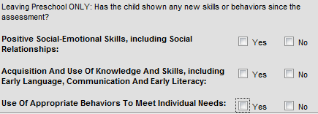
Exiting Outcomes Only
No longer has a disability or needs special education and related services and exits from the IDEA program; or
Is no longer 3, 4 or 5-years of age, regardless of continued eligibility under the IDEA; or
For children 3, 4 or 5 years of age who are exiting special education and related services completely, the assessment(s) and Outcome Measures Form must be completed at the time the child is determined to be no longer eligible for services; or
For children who are turning 6, but are continuing to receive special education and related services, the assessment(s) and Outcome Measures Form must be completed within 90 days of the child’s 6th birthday.

Slide 7
How are they collected?
Data Draw from SIS

