Slide 1
Learning From One Another: Occupational Therapy Practitioners as Valuable Team Members in the COS Process
Improving Data, Improving Outcomes Conference
August, 2016
New Orleans, LA

Slide 2
Collaborative Presenters/Planners:
Ashley Stoffel, UIC and Aspire Kids, Chicago, IL
Jenn Rhein, Aspire Kids, Chicago, IL
Lesly James, University of South Carolina, BabyNet
Anne Lucas and Christina Kasprzak, ECTA/DaSy
Sandra Schefkind, Pediatric Program Manager, Professional Affairs Division, AOTA

Slide 3
What we’ll cover:
Challenges and strategies related to including occupational therapy practitioners and other team members in a high-quality Child Outcomes Summary (COS) team process.
What do you see as some of the biggest challenges?

Slide 4
Three Child Outcomes
Children have positive social-emotional skills (including social relationships).
Children acquire and use knowledge and skills (including early language/communication and early literacy).
Children use appropriate behaviors to meet their needs.
Notes:
On the basis of the stakeholders’ input, OSEP required all state early intervention and preschool special education agencies to report data on three child outcomes:
Children have positive social-emotional skills (including social relationships).
Children acquire and use knowledge and skills (including early language/ communication and early literacy).
Children use appropriate behaviors to meet their needs.

Slide 5
Child Outcomes Are Functional
meaningful to the child in the context of everyday living
an integrated series of behaviors or skills that enable the child to achieve important everyday goals
Notes:
A critical characteristic of the three child outcomes is that they are functional. Functional outcomes refer to skills and behaviors that are meaningful to the child in the context of everyday living. Recommended practice for many years in early intervention and preschool special education has been to write functional outcomes on Individualized Family Service Plans (which are referred to as IFSPs) and Individual Education Programs (or IEPs).
Nonfunctional outcomes are discrete behaviors taken out of context. Some assessment measures look at skills in isolation rather than context, such as how many rings a child can place on a stacking toy. Observing the child do this may provide valuable information for a skilled clinician, but it is not a functional, or meaningful, outcome for a young child. Similarly, compare a young child smiling to a child smiling back at her mom in interactive social play. Smiling in the context of social interaction represents a meaningful, functional outcome. Note the focus on the child’s ability to engage in activities that are meaningful to the child’s daily life. The three child outcomes reflect this emphasis on functioning, which is consistent with recommended practice for identifying individualized outcomes.

Slide 6
Outcomes Reflect Global Functioning
The three outcomes reflect
The integration of multiple skills
Functioning across settings and situations
Rather than
Skill by skill
A standardized way
Split by domains
Notes:
The three outcomes are broad. They reflect how the child functions throughout the day at home and wherever the child spends time. The outcomes cross developmental domains to capture how children integrate the skills and behaviors needed to participate in everyday activities. For example, we may observe a child who uses three-word phrases to engage another child in play. This tells us how he integrates language with social functioning. Think about a child who can point to juice to indicate that she would like a drink. This tells us the child can point and shows that child can point to communicate.
Mapping assessment domains to each outcome never captures the full extent of the outcome, although there are aspects of some assessment domains that are more closely connected to a particular outcome than others. For example, communication skills are needed for each of the outcomes. Similarly, motor skills cut across all the outcomes. They enable children to build with blocks with friends, pour water at the water table, and walk across the room to get a toy.
It is also important to keep in mind that there are many different ways children demonstrate each outcome, and how a child demonstrates an outcome is different for children of different ages.

Slide 7
What is the COS Process?
A team process for summarizing information on a child’s functioning in each of the three child outcome areas
Notes:
The Child Outcomes Summary process was developed to reflect the content of the three child outcomes and to provide a systematic method for teams to summarize information from multiple sources about a child’s functioning.

Slide 8
Features
Uses information from multiple sources to describe how a child is functioning
Relies on team-based discussion and decision-making
Uses a 7-point rating scale to describe the child’s functioning across settings and situations
Is completed upon program entry and exit (at a minimum)
Notes:
There are four key features of a quality Child Outcomes Summary process.
First, the process produces a description of the child’s functioning at a single point in time by synthesizing multiple sources of information.
Second, this approach is a team process, involving professionals and family members contributing to decision-making.
Next, the process involves team members using the information gathered about a child to rate his or her functioning in each of the three outcome areas on a 7-point scale. Using the 7-point rating scale requires the team to compare the child’s skills and behaviors with those expected for his or her age.
Finally, the Child Outcomes Summary process is completed at two points in time, at a minimum--when the child enters the program and when the child exits the program. Each state has its own policy for when entry and exit data are collected, and some states are choosing to complete the ratings more frequently, such as at annual IFSP or IEP reviews.
Let’s discuss each of these four features in more detail.

Slide 9
Team-Based Discussions & Decision-Making
A team of people knowledgeable about the child:
Parents
Teachers
Child care providers
Service providers
Service coordinators
Discussing the child’s functioning across variety of settings and situations
Notes:
The next key feature of the Child Outcomes Summary process is that it is completed by a team. Team members can include family members, professionals who work with the child, and others familiar with the child’s functioning such as child care providers. Teams can range in size from two people to many more.

Slide 10
DEC Recommended Practices:
Assessment
Involves multiple sources of information
Includes multiple measures
Teaming and Collaboration
Practitioners representing multiple disciplines and families work together
Practitioners and families work together as a team … to solve problems, plan, and implement interventions
http://ectacenter.org/decrp/

Slide 11
The COS Process:
Relies on team-based discussion and decision-making.
Uses information from multiple sources to describe how a child is functioning
Uses a 7-point rating scale to compare a child’s functioning across settings and situations with what is expected for the child’s age.
Is completed at entry and exit (at a minimum).
Notes:
In conclusion, the Child Outcomes Summary process involves team-based discussion and decision-making around multiple sources of information. The process produces a rating for each of the three child outcomes. The rating is determined, at a minimum, at program entry and program exit.
As you progress through this training module, you will learn more about how to identify a Child Outcomes Summary rating, including the criteria for each of the 7 points on the rating scale.

Slide 12
State Approaches to Measuring Child Outcomes – FFY 2013-14
Approach | Part C (N=56) | Preschool (N=59)
COS 7 pt. scale | 42/56 (75%) | 37/59 (63%)
One tool statewide | 8/56 (14%) | 9/59 (15%)
Publishers’ online analysis | 1/56 (2%) | 6/59 (10%)
Other | 5/56 (9%) | 7/59 (12%)

Slide 14
Occupational therapy promotes function and engagement in every day routines
…participation in daily life activities
or “occupations” such as…

Slide 15
Areas of Occupation
Activities of Daily Living
Rest and Sleep
Work
Play/Leisure
Social Participation
Education

Slide 16
Evidence-based practice
AOTA systematic review (AOTA, 2013) examines the effectiveness of early childhood interventions used by occupational therapy practitioners.
The review reports positive effects for interventions that promote parent–child interaction, are provided in the child’s natural environments, and use individualized play-based, educational, or behavioral approaches.

Slide 17
Occupational Therapy’s Distinct Value
OT practitioners bring distinct contributions to the team including:
Expertise in activities and routines
Advanced skills in modifying the environment and recommending adaptive equipment to improve participation
Holistic approach and focus on functional participation
Advanced knowledge in Childhood Development
Advanced knowledge in Education and Interprofessional teaming
Knowledge and skills in both Mental and Physical Health

Slide 18
Role of Occupational Therapy
Builds the family’s capacity to care for their child
Promotes their growth and development in natural environments.
Fosters secure attachment or bond between the child and the primary caregiver/family
Empowers families to advocate for themselves and
their child.

Slide 19
Occupational Therapy Process
Evaluation
Screenings
Formal and informal assessments
Parent/family interview
Collaboration with family & team
Intervention
Collaboration with family & team
Develop Individualized Family Service
Plan (IFSP)
Incorporate evidence-based practice
Outcomes
Promote function
Meet family and child’s goals & needs
Copyright AOTA
Notes:
Evaluation
Screenings
Formal and informal assessments
Parent/family interview
Collaboration with family & team
Intervention
Collaboration with family & team
Develop Individualized Family Service
Plan (IFSP)
Incorporate evidence-based practice
Outcomes
Promote function
Meet family and child’s goals & needs

Slide 20
Occupational Therapy Practitioners in Action
Occupational therapy practitioners support
children and families to be successful in their
everyday routines.
Service examples include…

Slide 21
Participation in Play Time
Increase social skills
Advance motor coordination
Develop problem-solving abilities
Copyright AOTA

Slide 22
Participation in Meal Time
Promote independence in
self-feeding
Improve ability to eat a variety of foods and textures
Create family-friendly schedules
Copyright AOTA

Slide 23
Participation in Bath Time
Address positioning needs
Ensure safety
during activities of daily living
Promote sensory-
rich experiences
Copyright AOTA

Slide 24
Social Participation
Manage emotions
Develop self-advocacy
skills
Strengthen family bonds
Copyright AOTA

Slide 25
Infant Mental Health
Occupational therapy promotes infant mental health and secure attachment by:
Supporting positive interactions during co-occupational engagement.
Being attentive to the overall mental health of the caregivers and family members.

Slide 26
Occupational Therapy Practitioners and the COS Process
OT practitioner is an essential member of the assessment and IFSP/IEP Team
OT practitioner is ideally suited to be a key team member in COS process by contributing the following:
Applying their holistic view of the child in the assessment process
Sharing their expertise of assessing functional performance in everyday routines and activities to help the team identify the child’s level of participation and functioning in each of the 3 global child outcomes
Applying their knowledge of child development when determining the child’s functioning compared to same-age peers when deciding the child outcomes ratings

Slide 27
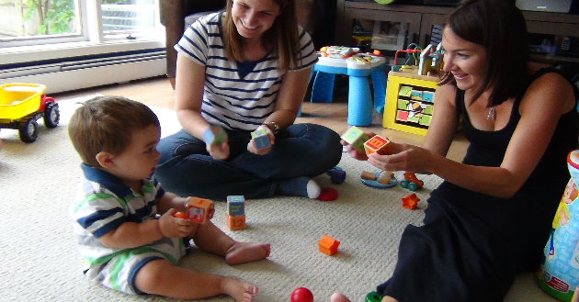
Local Program and Practice Level – Aspire Kids, Chicago, IL

Slide 28
Example of OT Participation in COS Process

Slide 29
Scenario 1
The person facilitating an IFSP meeting says, “We are going to rate the child outcomes now. We need to make sure we rate her higher than we did last time.”
What are some strategies that team members could use in this scenario?
Do you think this happens in your state?
What system level supports (policies, guidance, PD) could support a more effective process?

Slide 30
Scenario 2
The person facilitating the meeting looked at the outcomes herself and said that based on the therapy reports, the child was basically in the same place that he was a year ago for the outcomes.
What are some strategies that team members could use in this scenario?
Do you think this happens in your state?
What system level supports (policies, guidance, PD) could support a more effective process?

Slide 31
Strategies for Team Participation in the COS Process
Before the rating, team members can:
Prepare families-team members can check in with families and remind them that the Child Outcomes will be discussed and explain the purpose of collecting that information
Identify the sources of information that will be used for the rating
Bring specific examples of the progress the child has made
Notes:
Family involvement should include initial and ongoing information gathering through
Intake information such as evaluation, parent interview, and observation
Review of assessment(s), medical records, therapist reports, and parent report(s)
Meeting notes with child and family and observations
Discussion with family and other IFSP/IEP team members while completing the outcome ratings

Slide 32
Strategies for Team Participation in the COS Process
During the rating, team members can:
Make sure everyone has a copy of the outcomes and read them aloud
Allow enough time for everyone to read the 3 outcomes and the components
Provide information on each outcome; don’t allow the outcomes to become discipline-specific
Work with family members and other team members to build consensus
Notes:
If providing input on an outcome, look to other team members and the family to make sure they agree

Slide 33
Strategies for Team Participation in the COS Process
After the rating, team members can:
Share successful stories and lessons learned of participating in the rating process with other team members
Discuss how the Child Outcomes can guide IFSP outcome/IEP goal development

Slide 34
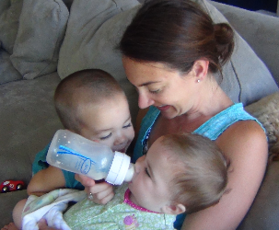
Supporting Team Members in Linking Child Outcomes to the IFSP/IEP
Team members should:
Discuss with families how the Child Outcomes link to IFSP outcomes/ IEP goals
Use specific examples related to the child
Encourage the family to give examples from their daily routine

Slide 35
Family Example-Child Outcomes Rating
“We went to the park last week, and Brady looked at another child, ran down the hill after him, and both kids laughed when they reached the bottom.”
Outcome 1: Positive social-emotional skills (including social relationships)
Brady looked at another child. Brady laughed with other children.
Outcome 2: Acquisition and use of knowledge and skills
Brady imitated the action of another child (i.e. ran down the hill after him).
Outcome 3: Use of appropriate behaviors to meet their needs
Brady explored his environment by running down the hill safely.

Slide 36
Family Example-IFSP Outcomes
Possible IFSP Outcome: We want Brady to play with other children by imitating their actions so that he can learn to interact with others.
Possible IFSP Outcome: Brady will initiate and complete a new motor task one time per week so that he can play safely at the playground.

Slide 37
Family Example-Liliana
Mother says, “Liliana picked up the spoon and brought it to her mouth for several bites of applesauce.”
Daycare teacher says, “Liliana holds her spoon and bangs it on the table during mealtimes and the other children all join in. Then Liliana smiles and laughs!”

Slide 38
Family Example-Child Outcomes Rating
Let’s try it!
Outcome 1: Positive social-emotional skills (including social relationships)
Outcome 2: Acquisition and use of knowledge and skills
Outcome 3: Use of appropriate behaviors to meet their needs
Which outcomes did we learn about from Liliana’s mother and daycare teacher?
How can we describe Liliana’s participation using the outcomes?

Slide 39
South Carolina BabyNet~ COS Process
ENTRY is defined as at the Initial IFSP. For all children age 30 months or less when the Initial IFSP is developed the BabyNet Service Coordinator of record at the time the initial plan is signed by the family will complete and document the COS Ratings within 30 days of initial IFSP
EXIT is defined as at the time of exit from the system. For all children who have been continuously enrolled in BabyNet system for at least 6 months of service, the BabyNet Service Coordinator of record at the time of exit will complete and document COS Ratings within 10 days of exit
Notes:
Explain SC COS Process.

Slide 40
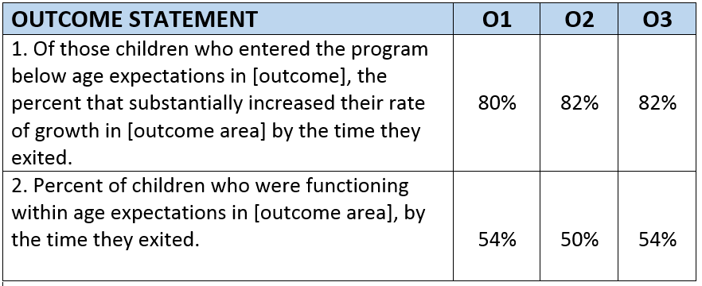
South Carolina BabyNet ~ COS Statewide Ratings FFY2014
Notes:
N=1792
O1= the child’s ability to develop and maintain positive social emotional skills (including positive social relationships)
O2= the child’s ability to acquire and use knowledge and skills
O3= the child’s ability to use appropriate actions to meet their needs
Facilitate discussion:
Concern about low participation in the OTs based on just one state data
Idea about using data to improve the process
Concern when only one person is the ‘team’ and implications for not getting the full picture of the child across settings and situations; multiple perspectives

Slide 41
South Carolina BabyNet ~ COS Participation
Notes:
N=1673 (93% of the 1792 captured) IFSP team composition
Facilitate discussion/engagement w/ participants – who is participating in your state? Who is missing? What strategies for improving participation?

Slide 42
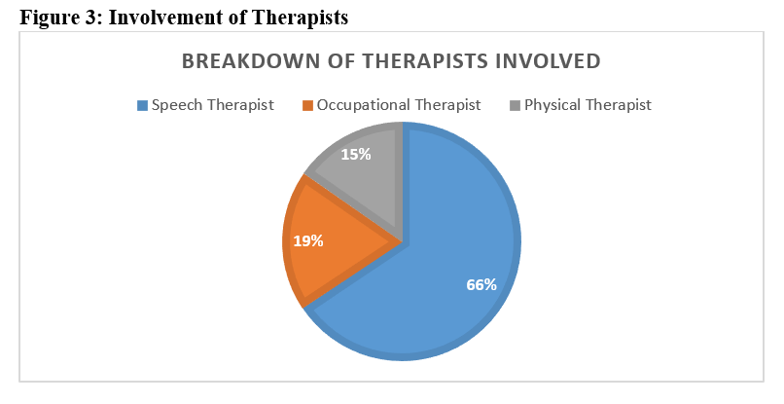
Notes:
Further breakdown of types of therapist who where involved in process. (14%)

Slide 43
South Carolina BabyNet ~ Strategies to Improve IFSP Team Participation
Reviewed current policy, procedure, DaSy Framework, Child Outcomes Framework, and DEC Recommended practices
Updated some policy and procedures (i.e. COS and Transition)
Updated/developed resources that supported policy and procedure (i.e. COS Webpage; Transition Toolkit; COS Tip Sheet)
Developed professional development to focus on data quality (i.e. COS module included in Data Quality Series and BabyNet Basics)
Developed general supervision tools to assists with maintenance of data quality (i.e. COS inclusion in QA processes)
Notes:
Shared COS Discussion Prompts & Decision Tree tools.
Facilitate Discussion:
Who is participating in the COS Process in your state?
Do you have data about the team process?
Who is missing from the team process?
What strategies are you (might you) use to improve team composition (including OTPs)?
Encourage closer look at team composition and impact of COS Ratings. Discuss hypothesis of possible rating slippage during process of building IFSP/IEP team capacity in number and knowledge of COS process/use of tools.

Slide 44
Discussion:
Who is participating in the COS Process in your state?
Do you have data about the team process?
Who is missing from the team process?
What strategies are you (might you) use to improve team composition (including OTPs)?

Slide 45
Possible Next Steps:
Meet with LEAs/EI programs to identify their challenges with COS team process
Develop a plan to address the statewide challenges and improve COS team process such as:
Reviewing and modifying policies, procedures and training materials to strengthen COS team process
Collecting data on team composition
Integrating COS into the IFSP/IEP process
Working with various professional organizations in your state to create consistent messages on benefits of OTPs/other therapist participation in COS team process
Promoting ongoing dialogue about experiences and contributions of OTPs/other therapists in COS team process
Provide TA to LEAs/EI programs to support them in addressing specific local barriers to an effective COS team process

Slide 46
What Resources are Available?

Slide 47
Resources:
Outcomes Measurement website: http://ectacenter.org/eco/
NEW! COS-TC Toolkit (Child Outcomes Summary Team Collaboration Toolkit)
ONLINE MODULES! Child Outcomes Summary (COS) Process Module: Collecting & Using Data to Improve Programs
Decision Tree for Summary Rating Discussions http://ectacenter.org/~pdfs/eco/Decision_Tree.pdf
State Approaches (Maps) http://ectacenter.org/eco/pages/states_approaches.asp#FamilyOutcomes

Slide 48
AOTA Resources
Occupational Therapy Programs
http://www.aota.org/Education-Careers/Find-School.aspx
Affiliated State Associations
http://www.aota.org/Advocacy-Policy/State-Policy/State-OT-Associations.aspx
AOTA Pediatric Virtual Chats
www.talkshoe.com/tc/73733
AOTA Pediatric virtual chat on Early Childhood Outcomes https://otconnections.aota.org/galleries/aota_podcasts/m/pediatric_virtual_chats/121002.aspx
James, L.W., Stoffel, A., Schefkind, S., & Khetani, M.A. (2016, March). Occupational therapy involvement in child outcome summary process in early intervention and preschool. OT Practice, 13-16.

Slide 49
AOTA Early Childhood Resources
Early Childhood section of the AOTA website:
http://www.aota.org/Practice/Children-Youth/Early-Intervention.aspx
AOTA Policies, Guidelines & Resources
Early Childhood Systematic Review
Early Childhood Practice Guidelines
Official Documents on EI and Schools
Fact Sheets
Tip Sheets
Practice advisories
Checklists
Powerpoints
FAQs
Training & Certification Standards
ACOTE Accreditation
NBCOT Exam
Additional State Requirements
Contact:
Sandy Schefkind
AOTA Pediatric Program Manager
sschefkind@aota.org
301-652-2682 ext 2000
Notes:
Messages: AOTA interest in engaging with states; wanting to collaborate; free resources for use; desire for two-way learning

Slide 50
AOTA Childhood Occupations Toolkit
http://www.aota.org/en/About-Occupational-Therapy/ Patients-Clients/ChildrenAndYouth.aspx
Geared for the parent or caregiver
Informative tip sheets that review tips and strategies for increasing a child’s ability to participate in daily activities or “occupations”
Describe how OT can support everyday routines of children and families
Include:
Morning routine
Bath time routine (also available in Spanish)
Bed time routine (also available in Spanish)
Mealtime routine
Toileting routine (also available in Spanish)
Tummy time routine

Slide 51
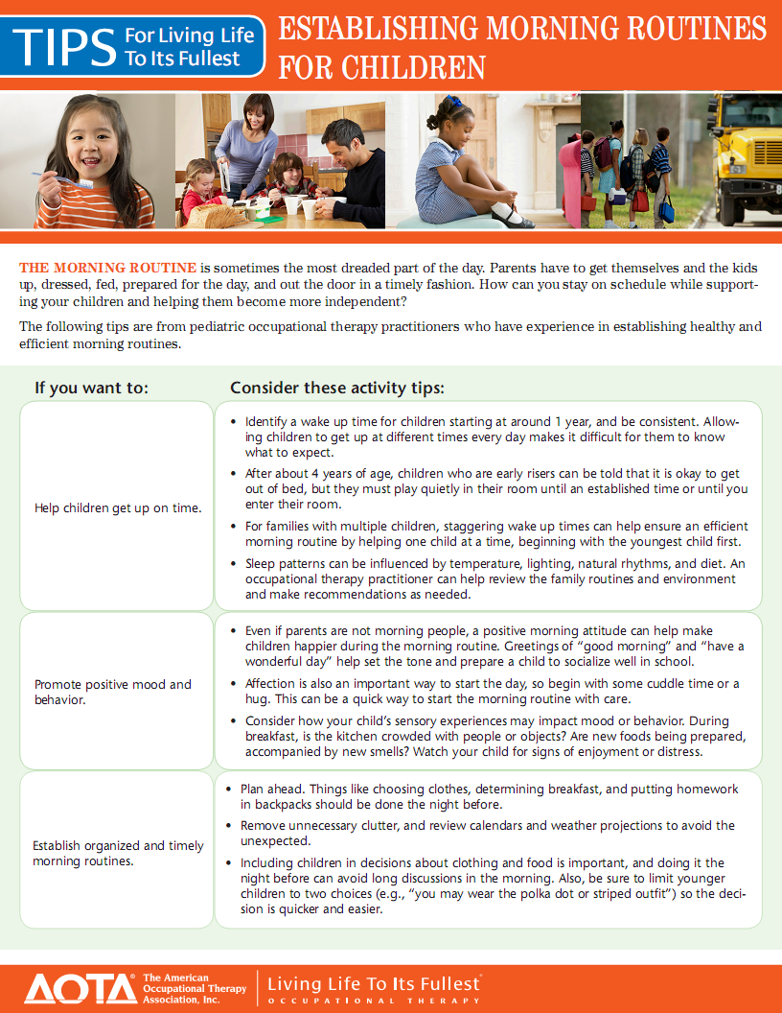

Slide 56
Occupational Therapy
Living Life to Its Fullest

Slide 57
References and Resources
AOTA Children and Youth Fact Sheets
http://www.aota.org/About-Occupational-Therapy/Professionals/CY.aspx
AOTA Children and Youth Tip Sheets
http://www.aota.org/About-Occupational-Therapy/Patients-Clients/ChildrenAndYouth.aspx

Slide 58
References and Resources
Evidence Based Children and Youth Resources
http://www.aota.org/Practice/Children-Youth/Evidence-based.aspx
Official Document 2011
http://ajot.aota.org/article.aspx?articleid=1865197

Slide 59
The contents of this presentation were developed under grants from the U.S. Department of Education, #H373Z120002 (Project Officers: Meredith Micelli and Richelle Davis) and #H326P120002 (Project Officer: Julia Martin Eile). However, contents of the presentation do not necessarily represent the policy of the U.S. Department of Education, and you should not assume endorsement by the Federal Government.

