Slide 1
Improving and Using Family Survey Data
Christy Cronheim, Part C Coordinator, Idaho
Jennifer Surrusco, Part C Data Manager, Idaho
Melissa Raspa, ECTA, RTI International
Siobhan Colgan, ECTA, IDC; FPG Child Development Institute

Slide 2
Purpose of the Session
Provide a brief overview to data quality issues with survey methodologies
Share a state example of improving C4 survey data quality
Discussion about family survey data use

Slide 3
Survey Methodology
Define what you want to measure
  Use stakeholders as a source
  Review relevant research and literature
  Determine which elements of the construct to measure
Create your questions
  Use simple, straightforward language
  Avoid double-barreled and double-negative questions
  Use mutually exclusive and exhaustive response options

Slide 4
Testing Your Questions and Survey
Expert review
Questionnaire appraisal
Cognitive interviewing
Usability testing
Pretest/pilot study
Focus groups

Slide 5
    Establishing Reliability and Validity
      Reliability: the consistency of answers over repeated administrations of the survey
        Test-retest reliability
        Inter-rater reliability
      Validity: the extent to which the survey measures the intended construct
  Content validity
  Concurrent validity

Slide 6
Survey Methodology and Data Quality
Who will be invited to participate in the survey?
How will you select the families to invite?
  Census
  Sampling
When will the survey be administered?
  Annually
  Ongoing (e.g., at exit or during IFSP/IEP meeting)

Slide 7
Survey Methodology and Data Quality, cont
How will the survey be distributed and returned?
  In person
  Online
  Mail
  Combination
Who is responsible for distributing and communicating about the survey?
Notes:
Others involved in dissemination may include parent centers or other community partners, contractors, etc

Slide 8
Response Rate
Percentage of surveys received from sample population
  Calculated by dividing the number of completed surveys by the number of surveys distributed
Consider response rates
  Overall state
  By local program
  By family variables
A measure of the amount of data received

Slide 9
Factors that May Affect Response Rates
Length and complexity of the survey
Family-friendly “look and feel”
Availability of survey in multiple languages
Personalized cover letter
Advance notice and reminders
Timing and length of the data collection period
Quality of parent/family contact information
Mode(s) used
Incentives
Concerns about confidentiality

Slide 10
Representativeness
Proportion of surveys received compared to proportion of those that were distributed
  Calculated by comparing received and expected surveys by subgroups
  Use statistical test or +/- margins
  Consider assessing multiple variables
A measure of the type of the data received

Slide 11
Tools to Calculate Response Rate and Representativeness
ECTA calculator
Post School Outcomes Center calculator
AAPOR calculator

Slide 12

Idaho Infant Toddler Program Family Survey
Christy Cronheim, Part C Coordinator
Jennifer Surrusco, Part C Data Manager

Slide 13
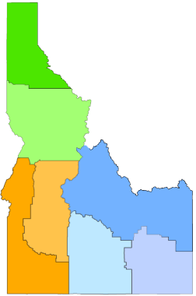
Idaho’s Landscape
276
Birth-3 Count
409
North Hub – Regions 1 and 2
West Hub – Regions 3 and 4
East Hub – Region 5, 6, and 7
133
493
841
328
717
186
348
203

Slide 14

Previous Process
NCSEAM Family Survey
Contracted
Mailed surveys
Point in time data collection

Slide 15

Challenges
Low response rates
Invalid addresses
Time consuming
Randomly generated Survey ID could not be linked to Child Outcomes

Slide 16

Project Goals
Increase response rates
Identify new Family Survey tool
Identify new survey distribution method
Create feedback loop

Slide 17

New Process: April 2015
Internal
Electronic and paper surveys
Rolling surveys
Improved response rates

Slide 18

Benefits
Increased response rates
Local control to modify
calculations
Better understanding
of the process

Slide 19
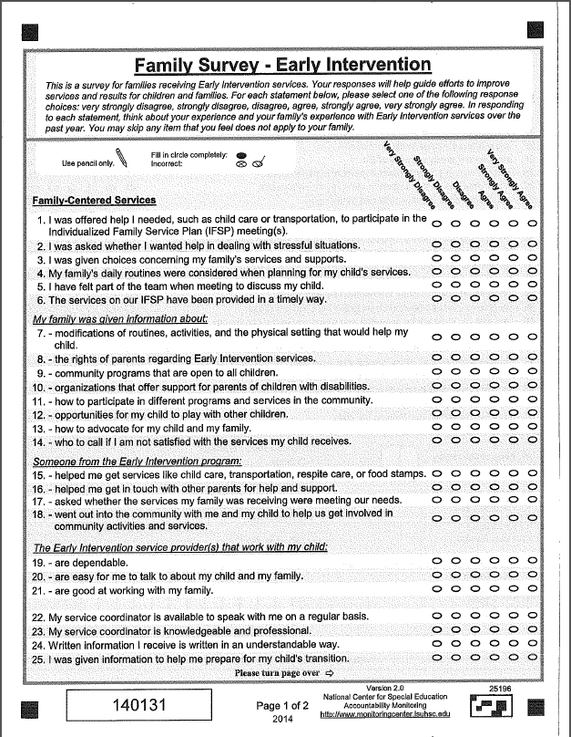

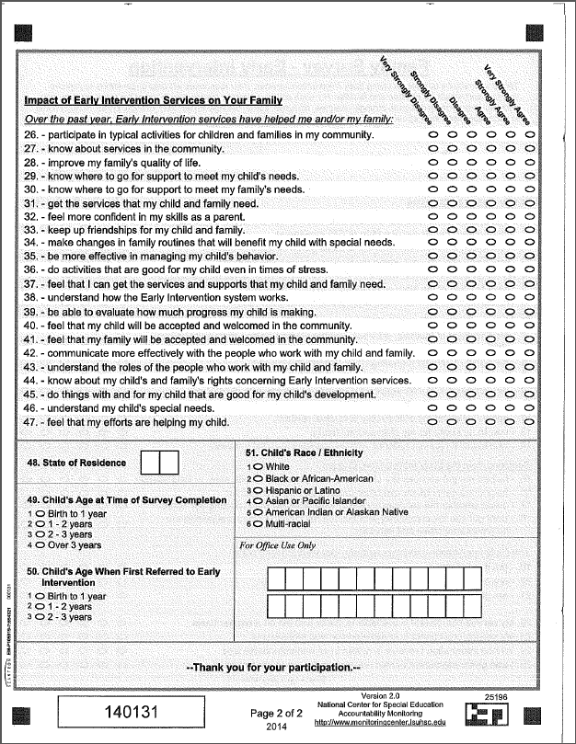
Family Survey
NCSEAM
ECO-Revised

Slide 20

What Happened – Q1
Presented new procedure to leadership
Gauge implementation
Changed calculation methodology
New methodology = new lag in analysis
Report for FFY 2014 – only 2 months of data

Slide 21

What happened – Q2
More gauging - Realized some regions had not begun to implement (waiting on sample lists)
Feedback about burdensome steps – modified process
Monitored response rate – improvement!

Slide 22

What happened – Q3
Request- report to know whether families responded
All responses received still on paper
Began receiving increased amounts of invalid surveys
  No survey ID
  Not given at a 6 month review
  Multiples for the same family

Slide 23

What happened – Q4
Reminded leadership of online option – demonstrated using phones to complete survey
Invalid surveys began being tracked
(~1 out of 7)
Began gauging consistency
Started looking to improve process for year 2

Slide 24

Drawbacks
Invalid responses
Delays between survey
date and data entry
Consistency in presentation
of survey/accurate response rates
Delay meant difficult to QA process

Slide 25

Solutions – aka Family Survey 2.0
Electronic Surveys
  Valid Survey IDs
  Valid survey responses
Clearer instructions for Service coordinator interactions
Service coordinator only presents importance of survey and the option of completing it

Slide 26

Other Modifications
1-on-1 calls with leadership to ensure understanding of new process
Paper Surveys only by request from Central Office
QA calls to ensure survey is being offered and determine next steps

Slide 27

Long Term Goals
Integrate survey into the existing database
Program in logic checks to allow parents access at appropriate times
Link Family Outcomes to Child Outcomes

Slide 28

Questions

Slide 29
Discussion Questions
What are your biggest challenges with regard to data quality?
What types of strategies have you used to examine data quality?
  Are additional resources needed to help with this?
What types of strategies have you used to improve data quality?
  Are additional resources needed to help with this?
What types of tools are states using to analyze and use your data for program improvement?
  Are additional resources needed to help with this?

Slide 30
Presenter Contact Information
Christy Cronheim, Idaho Part C Coordinator
cronheic@dhw.idaho.gov
Jennifer Surrusco, Idaho Part C Data Manager
surruscj@dhw.idaho.gov
Melissa Raspa, ECTA
mraspa@rti.org
Siobhan Colgan, ECTA, IDC
siobhan.Colgan@unc.edu

