Slide 1

Equity, Inclusion, and Opportunity: Addressing Success Gaps for Infants, Toddlers, and Preschool Children
improving Data, Improving Outcomes
Aug. 15-17, 2016
Amy Bitterman, IDC
Haidee Bernstein, IDC
Nancy O’Hara, IDC

Slide 2

Take a closer look…
Equity
Inclusion
Opportunity
Notes:
The US Ed focus on equity in education for all children.
Take a poll of the audience in the room about their role in the state.

Slide 3
Purpose
What is a success gap?
How do we determine if we have any success gaps?
How do we determine causes of success gaps?
Overview of the Success Gaps Toolkit
Discussion of success gaps for infants and toddlers

Slide 4

Notes:
The good news is that high-quality early education programs can improve outcomes, narrow
achievement gaps, and convey long-term benefits for children in school and life. This is especially
the case for children from low-income families (Minervino, 2014). However, just over one third of
three- and four-year-olds from low-income families were enrolled in preschool in 2013 (Kids Count,
2015), and even fewer children participate in quality infant and toddler programs. Children at risk
who do not participate in high-quality early
education programs are 50 percent more likely to
be placed in special education, 25 percent more
likely to drop out of school, 60 percent more likely
to never attend college, 70 percent more likely to
be arrested for a violent crime, and 40 percent
more likely to become a teen parent (Save the
Children, 2015). With the achievement gap beginning to manifest in children as young as nine
months, and 90 percent of brain development occurring during the first five years of life, chiefs are
committed to expanding and upgrading early childhood programs and strengthening early
elementary teaching and learning to provide equal educational opportunities for every young child from birth through third grade.

Slide 5
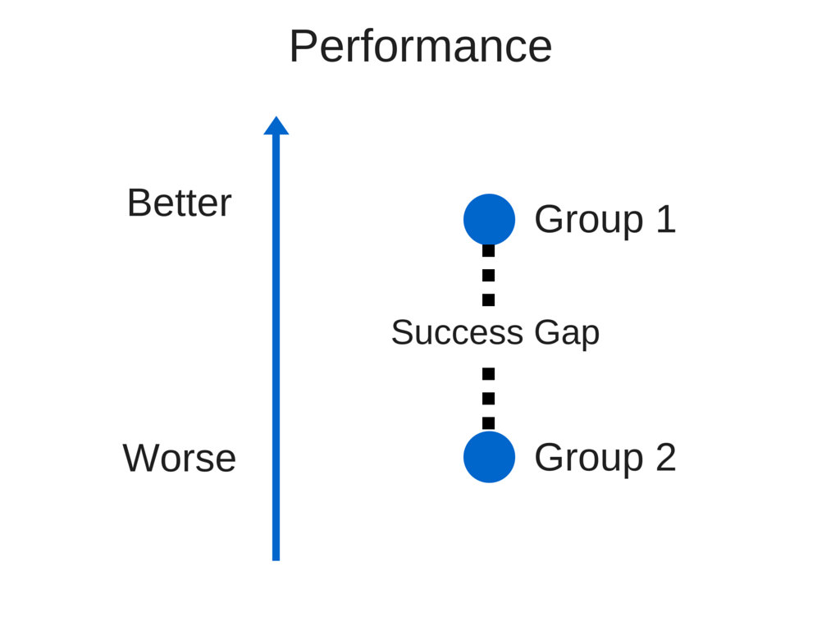
What is a success gap?
Notes:
Success gaps are differences in a variety of learning factors and outcomes that affect the likelihood of success for some groups of children and families compared to their peers.
It includes any areas where some children’s performance or opportunity is significantly discrepant/different from other groups.
Our definition of a “success gap,” which encompasses all of these gaps or discrepancies, is “ A gap in educational outcomes between different groups of students.” We call all these gaps Success gaps because they result in poor outcomes or lack of success for the students in those affected groups.

Slide 6
What are some types of success gaps for infants, toddlers, and preschool children?
Social-emotional skills
Knowledge and skills
Appropriate behaviors
Family outcomes
Suspensions/expulsions (Preschool)
Notes:
Success gaps are differences between children with disabilities and nondisabled peers or between different groups of children with disabilities. There are gaps related to child outcomes and family outcomes, identification as a child with a disability or in the settings in which young children are placed. There may be gaps or discrepancies between groups of preschool children in terms of discipline and in the transition from early intervention to Part B.

Slide 7
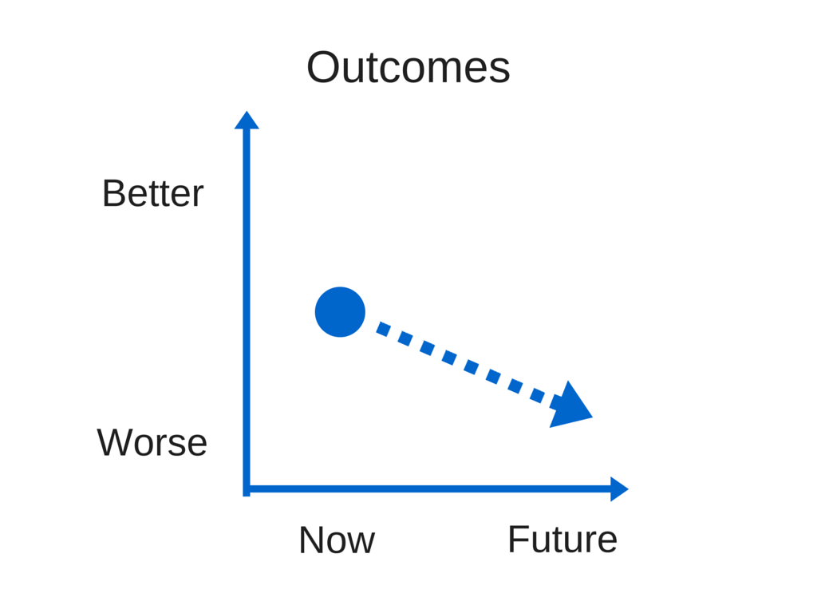
Why is it important to look at success gaps?
Notes:
If you don’t address “success gaps” the likelihood of poor long-term outcomes for particular groups of children greatly increases.
As you well know, success gaps, particularly if they continue over the years or over the course of a child’s early intervention and preschool experience, result in poor long-term outcomes for individuals and entire groups of children as they enter school and later.

Slide 8

What are the results of success gaps for young children?
Poor social-emotional skills can lead to social isolation or inability to get along with others.

Slide 9

What are the results of success gaps for young children?
Children do not acquire knowledge and skills at the same rate as their peers; gaps become larger.

Slide 10
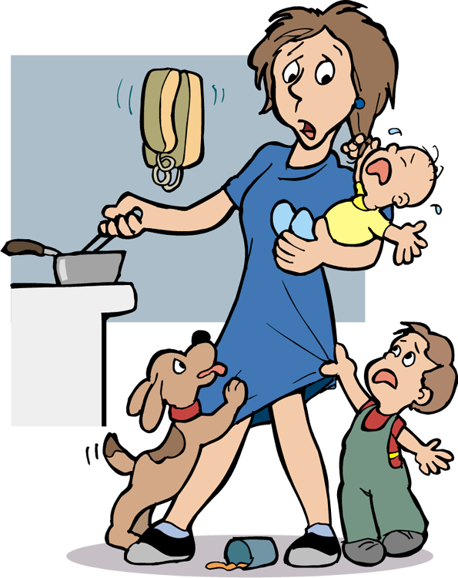
What are the results of success gaps for young children?
Children do not develop appropriate behaviors to support their independence, continuing to depend on adults in their environments for daily needs.

Slide 11

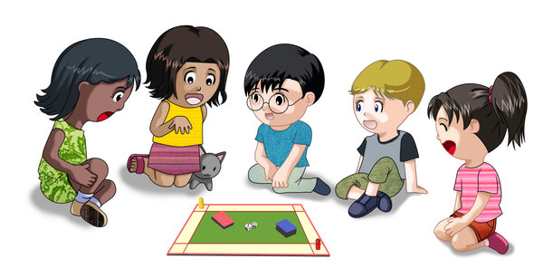
What are the results of success gaps for young children?
Families are not well informed about their rights and fail to access appropriate services and supports for their children, resulting in a success gap.

Slide 12


What are the results of success gaps for young children?
Gaps that are present at a young age and not addressed can lead to bigger challenges as children get older...academic failure, missed instruction, dropping out, failure to graduate.

Slide 13


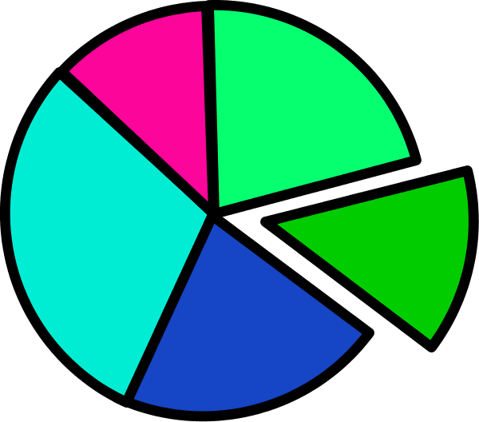
How do I determine if there is a success gap?
Data disaggregation!
Different methods for comparing groups of children.
Notes:
In Part B states use a number of different methods including a risk ratio and variations of the risk ratio and composition. The most common method used in Part B is the risk ratio, so we’ll describe that method now.

Slide 14
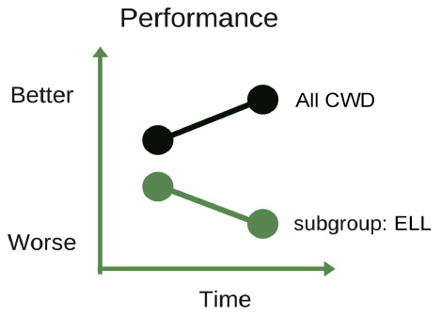
Disaggregating Data Within a Subgroup May Reveal Success Gaps

Slide 15
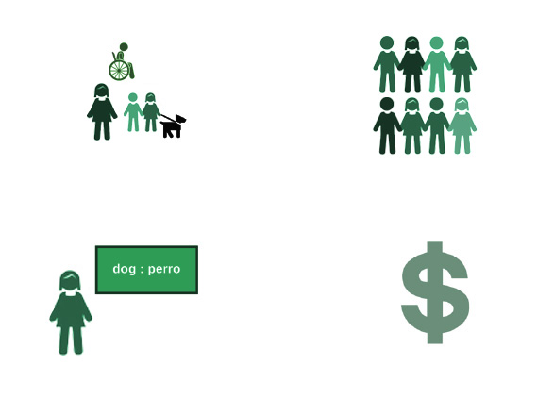
Which are the affected subgroups based on your data disaggregation?
Children with Disabilities
Racial/Ethnic Groups
English Language Learners
Income Levels
Notes:
Ask: are there others?

Slide 16
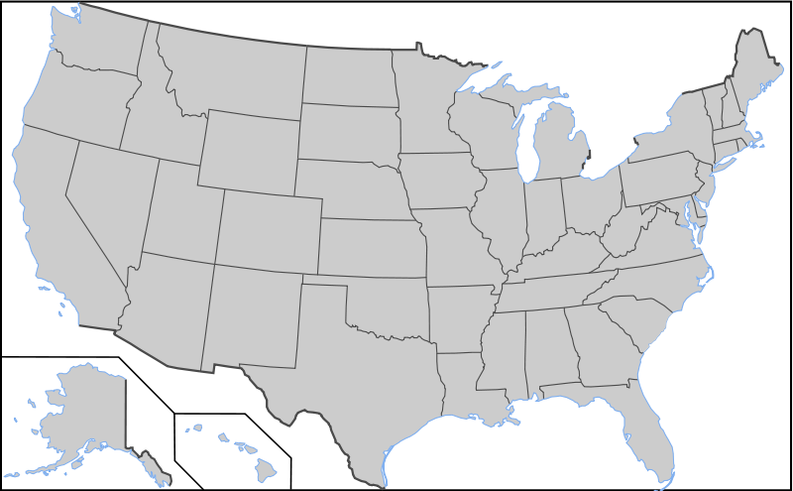

Are there success gaps nationally? Or factors that can lead to success gaps for infants, toddlers and preschool children?

Slide 17
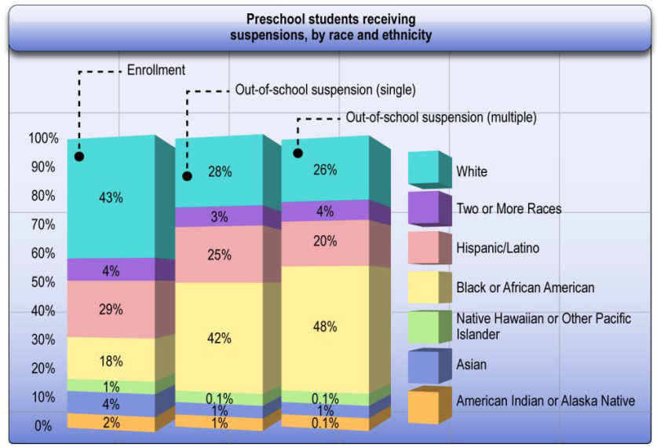
SOURCE: U.S. Department of Education, Office for Civil Rights, Civil Rights Data Collection, 2011-12.
Notes:
Note this is preschool
Students with disabilities (served by IDEA):
• Five (5) states reported a four percentage point or smaller gap in out-of-school suspension rates between students with disabilities served by IDEA and students without disabilities: North Dakota, (2%), Utah (3%), Idaho (4%), Mississippi (4%), and Wyoming (4%).
• Five (5) states (and D.C.) reported a ten percentage point or higher gap in out-of-school suspension rates between students with disabilities served by IDEA and students without disabilities: Florida (15%), Nevada (14%), District of Columbia (13%), Wisconsin (11%), and Louisiana (10%).

Slide 18
Percentage of Preschool Students Receiving Suspensions, by Race/Ethnicity
SOURCE: U.S. Department of Education, Office for Civil Rights, Civil Rights Data Collection, 2011–12.
Notes:
The graph on the right breaks down in-school suspensions data by race. Black students comprise 18% of enrollment but 42% of out-of-school suspensions. White students comprise 43% of enrollment and only 28% of out-of-school suspensions. The data show there are disproportionate disciplinary data as early as preschool.

Slide 19
What is a Risk Ratio?
Risk Ratio: What is a specific racial/ethnic group’s risk of:
Receiving early intervention services or special education
Exiting the program not functioning within age expectations in knowledge and skills
Experiencing a particular disciplinary removal (619)
As compared to the risk for all other children?

Slide 20
Participation in Part C, 619 and Part B by Race/Ethnicity
Percent of children in each race/ethnicity category receiving early intervention/special education compared to the percent of children in all other races/ethnicities receiving early intervention/special education (2013) (risk ratio)
 | Race/ethnicity
 | Hispanic / Latino | American Indian or Alaska Native | Asian | Black or African American | Native Hawaiian or Other Pacific Islander | White | Two or More Races
Part C | 0.96 | 1.09 | 0.78 | 0.94 | 1.08 | 1.16 | 0.69
619 | 0.97 | 1.31 | 0.69 | 1.01 | 1.57 | 1.11 | 0.75
Part B 6-21 | 0.89 | 1.30 | 0.46 | 1.27 | 0.87 | 1.06 | 0.92
Notes:
Make sure to point out that identification itself is not a success gap, but children who are identified inappropriately or not identified at all will not access the services and supports they need and that results in success gaps.
Disproportionality in identification rates, placements or disciplinary rates can lead to success gaps in outcomes such as achievement, social skills. Language acquisition, and eventually graduation

Slide 21
Part C Settings by Race/Ethnicity
Percent of children ages birth through two with disabilities nationally in each race/ethnicity and setting compared to percent of children ages birth through two with disabilities nationally in all other race/ethnicities in the same setting (risk ratio)
 | Race/ethnicity
Setting | Hispanic / Latino | American Indian or Alaska Native | Asian | Black or African American | Native Hawaiian or Other Pacific Islander | White | Two or More Races
Community-based | 1.13 | 1.51 | 1.18 | 1.17 | 0.88 | 0.79 | 1.13
Home | 1.00 | 0.98 | 0.97 | 0.98 | 1.00 | 1.02 | 0.99
Other | 0.89 | 0.68 | 1.31 | 1.06 | 1.27 | 1.02 | 1.04
Notes:
Settings are not a success gap, but inappropriate services or services that do not lead to interactions in a natural environment can contribute to success gaps

Slide 22
619 Settings by Race/Ethnicity
Percent of children ages 3-5 with disabilities nationally in each race/ethnicity and setting compared to percent of children ages 3-5 with disabilities nationally in all other race/ethnicities in the same setting (risk ratio)
 | Race/ethnicity
Setting | Hispanic / Latino | American Indian or Alaska Native | Asian | Black or African American | Native Hawaiian or Other Pacific Islander | White | Two or More Races
Other location in regular early childhood program | 0.72 | 1.07 | 0.85 | 1.00 | 0.89 | 1.29 | 1.01
Home | 1.01 | 0.62 | 1.08 | 0.68 | 1.31 | 1.17 | 0.98
Separate class | 1.15 | 0.81 | 1.37 | 1.13 | 1.21 | 0.80 | 1.08
Separate school or residential | 1.12 | 0.73 | 1.23 | 1.59 | 0.81 | 0.70 | 0.86
Service provider location | 0.90 | 0.67 | 0.96 | 0.48 | 0.65 | 1.48 | 0.93
Regular early childhood program | 1.09 | 1.14 | 0.87 | 1.00 | 0.99 | 0.95 | 0.98
Notes:
Black children are 1.6 times as likely as all other children with disabilities to be receiving services in a separate school or residential facility and 0.5 times as likely as other children to be receiving services in a service provider’s location while White children are 1.5 times as likely as all other children with disabilities to receive services in the service provider’s location.

Slide 23
Participation in Part C, 619 and Part B at the State Level
Percent of Black children receiving early intervention/special education services compared to the percent of children in all other races/ethnicities in a sample state (2013) (risk ratio)
 | State | National
Part C | 1.23 | 0.94
619 | 1.29 | 1.01
Part B 6-21 | 1.76 | 1.27

Slide 24
Example State ECO Data by Race/Ethnicity
Race/ethnicity | % of infants and toddlers functioning within age expectations in social -emotional skills by age 3 or exiting the program
American Indian or Alaska Native | 51%
Asian | 66%
Black or African American | 50%
Hispanic/Latino | 56%
Two or More Races | 71%
Native Hawaiian or Other Pacific Islander | 64%
White | 80%

Slide 25
Have you examined your data for success gaps, (e.g., for your SSIP), in your state or districts/programs?
What data have you examined and what method(s) did you use?
Have you found any success gaps? If so, in what areas (e.g., discipline, early childhood outcomes)?

Slide 26
What are the most glaring success gaps that you find in the programs with which you work?

Slide 27
How are success gaps addressed?
For children who are preschool or school-age, there are lots of school improvement activities.
A new toolkit specifically for success gaps has been developed and is available.

Slide 28
Success Gaps Tools for Preschool and School-age Children
Success Gaps white paper and rubric
Newly revised to be more inclusive of preschool
Updated language to be more inclusive of Every Student Succeeds Act (ESSA) language
Success Gaps Rubric offers one way to consider reviewing the practices component of a self-assessment to determine root causes of success gaps present in your program or school.
Success Gaps Toolkit will provide support to district and school leaders to “lead” this work.

Slide 29
How to Address Success Gaps
Form a local district or school stakeholder team to focus on that success gap
Determine the root cause(s) of that success gap using the rubric
Provide evidence
Consider the students experiencing a success gap
Ensure equitable participation
Develop a plan of action
Identify the target group and topic area of your key success gap
Notes:
Script: Once you have identified the success gap you want to address in your district/school, consider these steps as a way to get started.
Form a stakeholder group/team.
Be sure this team includes: Families (and, in the upper grades, students) representing the group that is of concern in your school or district;
Special education and general education professionals who work with the target group;
Special education and general education professionals who work with the students who are succeeding;
Professional support staff such as school psychologists, school counselors, and others who may provide support to students who are struggling; and
Leaders with the authority to make the necessary changes.
Then review data…disaggregated by subgroups, use the rubric and as a team conduct the self-assessment…identify areas for improvement and develop a plan to address them.

Slide 30

Notes:
Success gaps toolkit includes:
Guidelines (instructions) for using the Success Gaps materials
Meeting agendas for a series of meetings and presentation shells for each meeting
Some materials for pre-reading
Two videos, one to invite participants to be part of the success gaps work, one to introduce success gaps during the first meeting
Sample action plan formats and meeting evaluation formats
Written stories or examples of work in other states or districts

Slide 31
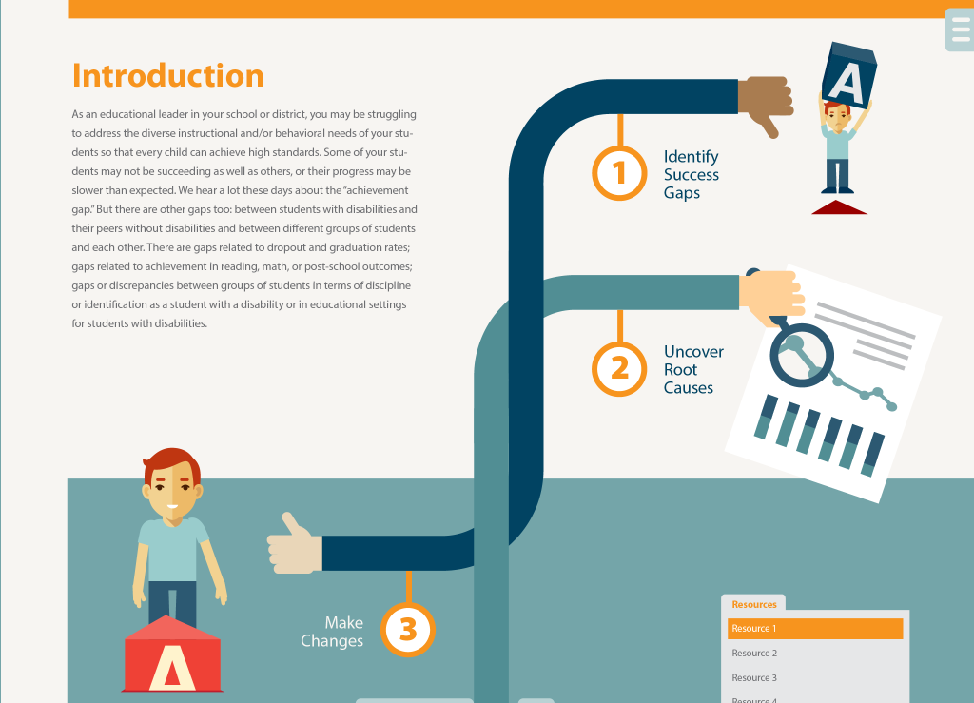

Slide 32


Slide 33
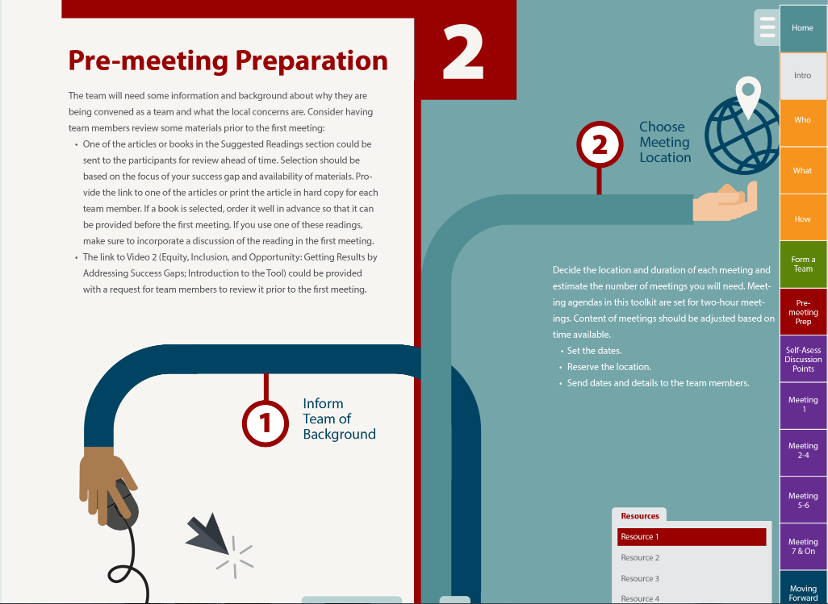

Slide 34
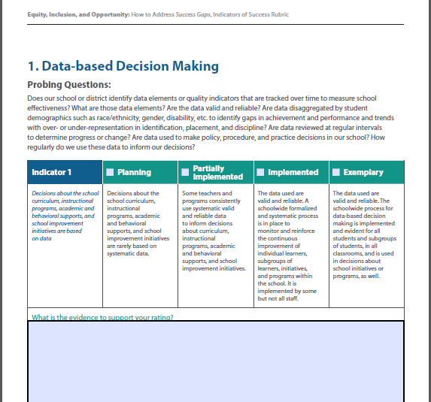
Notes:
Main Idea: Understanding how the rubric is structured.
Script: Using the Self-Assessment Rubric, there are four suggested possible ratings:
Planning,
partially implemented,
fully implemented or
exemplary.
Probing questions are provided to assist the team in determining where they are at this point.
Document what evidence exists to support the rating that the team selects.

Slide 35



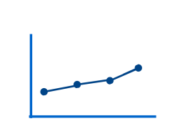

Self-assessment Components
Data-based decisionmaking
Cultural responsiveness
High-quality core instructional program
Assessment–universal screening and progress monitoring
Evidence-based instructional/behavioral interventions and supports
Notes:
Main idea: We present five components of an “appropriate education.” Are these available to all students in your school or district? Especially the target group? Keep the topic area of the success gap in mind!

Slide 36
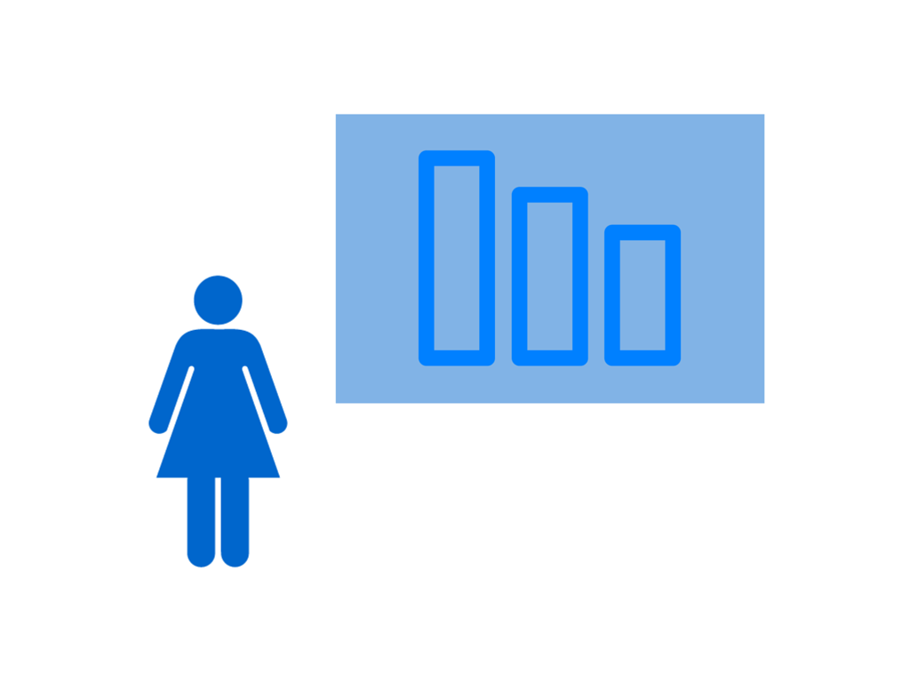
Data-based Decisionmaking
Notes:
Main Idea: What is meant by “data-based decisionmaking?”
Decisions about instructional programs, academic and behavioral supports, social/emotional, etc. and school improvement initiatives are based on data that are disaggregated for the program, school, or district reflecting the differences in subgroups by gender, race/ethnicity, socioeconomic factors, disability, and native or home
language. For example, early childhood outcomes are all examined and considered individually and collectively.
Decisions about student interventions (behavioral and/or academic) are made based on multiple data sources, including screening, progress monitoring, and formative and summative assessment data.
Is data-based decision making used for all students and all subgroups of students? If not, could this be part of the cause of your success gap?

Slide 37

Cultural Responsiveness
Notes:
Script: What is meant by “cultural responsiveness?”
Effective academic and behavioral practices for all learners are based on a program’s or school’s recognition of diversity across student ethnicity, language, and socio- economic status.
Training and resources are provided and designed so teachers can meet the linguistic needs of all students, including students with disabilities who are also English learners.
Parents from all backgrounds are included in discussions/meetings about the school, the school programs or initiatives, and their children’s academic and behavioral progress.
Is your school responsive to the cultures of all students and all subgroups of students? If not, could this be part of the cause of your success gap?

Slide 38

Core Instructional Program
Notes:
Main Idea: What is meant by “core instructional program?”
There is a rigorous, consistent and well-articulated PreK-12 instructional program (i.e., curriculum and instructional delivery) aligned with standards and delivered with fidelity. The DEC recommended practices are incorporated into the instructional program for young children.
Effective differentiation in the core curriculum addresses the needs of the full range of learners, learning styles, and cultural and linguistic backgrounds.
Universal design for learning guidelines are an integral component of the instruction.
Parents are informed, in their native or home language, about the differentiation of instruction and assessment data based on their child’s unique learning or behavioral needs.
Do all students and all subgroups of students have access to an equally high-quality core instructional program? If not, could this be part of the cause of your success gap?

Slide 39

Assessment: Universal Screening and Progress Monitoring
Notes:
Main Idea: What is meant by “assessment?”
All students are screened for early identification of academic or behavioral risk factors using valid and reliable tools.
All student progress is monitored to make needed adjustments to instruction and/or interventions. Valid and reliable progress monitoring tools are identified and available at each school, with reasonable intervals for monitoring defined and implemented; performance data reviewed at regular intervals; and instruction/interventions adjusted based on data review cycles.
Parents and guardians are regularly informed in their native or home language of their child’s screening and progress monitoring results for academic or behavioral progress.
Could a differential access to early screening or effective progress monitoring (outside of special education!) be part of the cause of your success gap?

Slide 40

Evidence-based Instructional and Behavioral Interventions and Supports
Notes:
Main Idea: What is meant by “evidence-based instructional and behavioral interventions and supports?”
Evidence-based interventions and behavioral supports are embedded within a multi-tiered framework and implemented with fidelity.
School-level practices use evidence-based behavioral interventions and tiered response methods such as positive behavioral interventions and supports, restorative practices, etc.
District-level discipline policies that use tiered response protocols as opposed to zero tolerance policies.
Parents and guardians are regularly informed, in their native or home language, of interventions provided to their children and their children’s responses to those interventions for academic and behavioral skills.

Slide 41
To address success gaps…make a plan of action.
  Recognize the need for change in your school’s or district’s current practices and policies to address a success gap
  Identify the root causes of the success gap
  Make a plan to address those root causes
Notes:
Main Idea: The first step in the process is to recognize the need for change based on the identification of a success gap. The second step is to identify the root causes of that success gap – we have a toolkit to help you and your clients with this step. The third step is to make a plan to address the root causes of your success gaps. Integrate these actions into your local school improvement or accountability plans that are probably already in existence. Identifying and developing actions to address will support your improvement activities already in place.

Slide 42
Work in Small Groups and Be Prepared to Share
Review the content of the section.
Look closely at the probing questions.
Are these the appropriate questions for your state or states you work with?
Would you add, delete, or re-word any of the probing questions?
What are the challenges that a district or school would face completing this section?
Whom do they need in the meeting?

Slide 43

Discussion
What, in your experience, has worked to address success gaps?
Do you see a way to use these materials/toolkit within the state?
What did you like about these materials?
43

Slide 44
Take a closer look…
Equity
Inclusion
Opportunity
Notes:
Main Idea: The success gaps tools can provide an opportunity to “take a closer look” at equity, inclusion, and opportunity in your district/school so that each and every child has access to quality education that result in positive long-term outcomes.

Slide 45


Success Gaps
English Learners in PreK lag behind their peers in acquisition of language skills
Children ages 3-5 with autism perform 15% lower than others in all 3 outcomes
18% gap on KDG assessment between SWD and non-SWD
Black children are underidentified compared to their peers (ages 3-5) and perform 15 points below their peers on the KDG assessment
Black preschool children are suspended at twice the rate of other students
Gap between Hispanic students absent more than 15 days and others
Data –Based Decision-making
Assessment: Universal Screening & Progress Monitoring
Cultural
Responsiveness
Evidence-based instructional & behavioral interventions
High-Quality Core Instructional Program
Root Causes
(EIO)
Cause
Notes:
This is a preschool example thinking about success gaps, what are the gaps or fathers

Slide 46
Success Gaps for Infants and Toddlers
Success gaps may occur at the earliest point of development, during early intervention for children ages birth to three with disabilities.
How can early intervention program administrators and providers improve their policies and practices and provide equitable opportunities to all children that reduce disparities between subgroups of children with disabilities and their families?

Slide 47

Discussion
What are success gaps for infants and toddlers?
The success gaps documents for preschool and school-age children note gaps in all subgroups, for all children. Is that true for infants and toddlers?
What are the causes of success gaps for infants and toddlers?
What are the elements that would contribute to success for all infants and toddlers?

Slide 48
Gaps between social- emotional skills for Hispanic children and their peers
Gaps in all three ECO among regions of the state
Success Gaps
Gaps in family knowledge between those with low income and other income levels
Gaps between knowledge and skills for Black children and their peers
Children who are ELL are more likely to need to access support services due to gaps in skills acquisition
Low-income children are less likely to be included in child outcomes compared to higher SES children
Root Causes
(EIO)
Cause
Notes:
Use this slide to facilitate discussion about what additional success gaps for infants and toddlers. might be there and what are the root causes.

Slide 49

Tools and Resources
Success Gaps White Paper and Rubric and other significant disproportionality resources can be found in the IDC Resource Library at: https://ideadata.org/resource-library/
For technical assistance or resources, contact one of the following:
  Your IDC State Liaison (https://ideadata.org/technical-assistance/)
  Part B 619
    Nancy O’Hara, nancy.ohara@uky.edu
  Part C
    Amy Bitterman, amybitterman@westat.com
Resources

Slide 50

For More Information
Visit the IDC website
http://ideadata.org/
Follow us on Twitter
https://twitter.com/ideadatacenter

Slide 51




The contents of this presentation were developed under a grant
from the U.S. Department of Education, #H373Y130002. However, the contents do not necessarily represent the policy of the Department of Education, and you should not assume endorsement by the Federal Government.
Project Officers: Richelle Davis and Meredith Miceli

