Slide 1
Federal Early Learning
Policy Statements
A Focus on Supporting All Children
in High-Quality Early Learning Settings
Libby Doggett, Deputy Assistant Secretary for Policy and Early Learning, ED, Office of Early Learning
Richard Gonzalez, Senior Advisor for Early Childhood Development, HHS, Administration for Children and Families
Christy Kavulic, Associate Division Director, ED, Office of Special Education Programs

Slide 2
Presentation Agenda
Provide an overview of the Administration’s early learning agenda, with a focus on the joint Policy Statements:
Context that prompted action
Purpose and rationale
Recommendations for States and local programs
Examples of State and local action
Resources and HHS/ED activities to continue supporting progress

Slide 3
The Interagency policy board (IPB)
Established by the Secretaries of ED and HHS
The IPB works to develop policy recommendations and improve program coordination and quality across federally funded early learning and development programs serving children from birth through age eight.

Slide 4
The Interagency policy board (IPB)
ED’s IPB members
Office of Special Education and Rehabilitative Services (OSERS)
Office of Elementary and Secondary Education (OESE)
Office of Early Learning (OEL)
Office of Planning, Evaluation and Policy Development (OPEPD)
Institute of Education Sciences (IES)
Office of English Language Acquisition (OELA)
HHS’s IPB members
ACF Office of the Deputy Assistant Secretary for Early Childhood Development
Office of the Associate Deputy Assistant Secretary for Early Childhood Development
Office of Head Start (OHS)
Office of Child Care (OCC)
Office of the Assistant Secretary for Planning and Evaluation (ASPE)
Health Resources and Services Administration (HRSA)
Additional IPB members
U.S. Office of Management and Budget (OMB)
White House Domestic Policy Council (DPC)

Slide 5
Key Activities & collaborations
Communication and outreach activities
Issuing statements on critical early learning and development topics
Highlighting and sharing information about effective early learning and development programs
Discussion of key early learning policy proposals
Reauthorizations of relevant ED and HHS laws
Policy recommendations
Development of joint ED/HHS guidance
Developing recommendations for coordination of effective technical assistance strategies and research

Slide 6
Policy statements
Suspension and Expulsion (released December, 2014)
Inclusion in Early Childhood (released September 2015)
Family Engagement (released May 2016)
Dual Language Learners (released June 2016)
Health Promotion (in progress)
Early Childhood Technology (in progress)

Slide 7
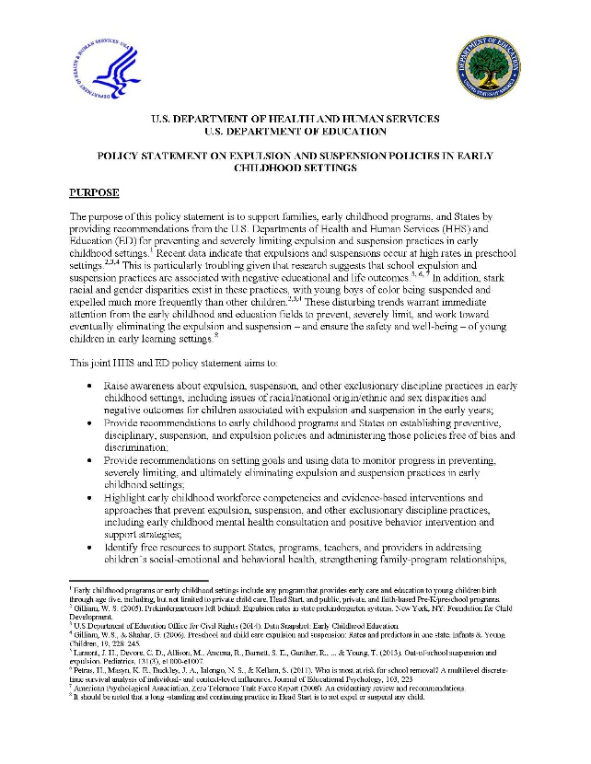
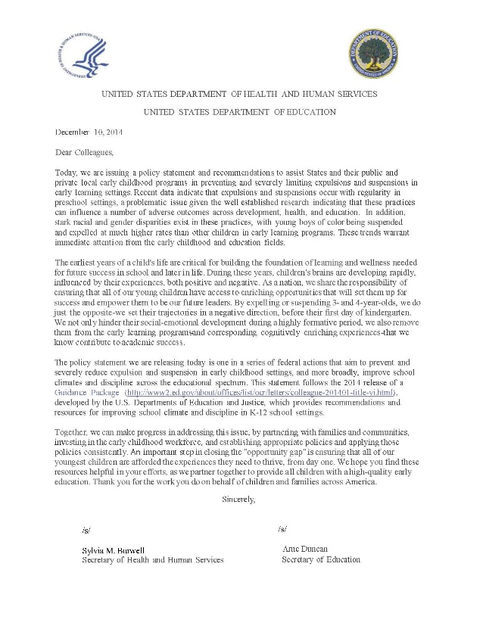
Federal Policy Statement
Suspension and Expulsion in Early Childhood Settings
www.ed.gov/early-learning
www.acf.hhs.gov/ecd/child-health-development/reducing-suspension-and-expulsion-practices

Slide 8
Why Focus on Expulsion and Suspension?
Importance of the early years to brain development and later outcomes.
Negative and stressful experiences early in life can have lasting consequences.
Children most in need of intervention are the ones suspended or expelled.
Children who are expelled or suspended are as much as 10 times more likely to drop out of high school, experience academic failure and grade retention, hold negative school attitudes, and face incarceration than those who are not.
Early expulsion or suspension predicts later expulsion or suspension.
Estimates indicate that rates in early education are higher than in K12 settings.
Data consistently indicate large racial disparities, with young boys of color being suspended and expelled at disproportionately high rates.

Slide 9
Context for Federal Policy Statement
Dr. Gilliam’s landmark studies identifying high rates of expulsion in early learning settings- 3-4 times the rate of K12 settings.
My Brother’s Keeper Taskforce includes a focus on eliminating expulsion and suspension in early learning settings.
U.S. Department of ED’s Office of Civil Rights data on preschool suspension released in Spring of 2014- data indicate large racial disparities.
Department of Education and Justice’s release official guidance to address school climate and discipline.
Advances in brain science reveal that stress and negative experiences can have long lasting consequences on development, learning, and broader outcomes.
Expansion of high quality early education

Slide 10
Federal Policy Statement Goal
Raise awareness
Review the research base and legal foundation
Provide State and local recommendations
Disseminate free resources

Slide 11
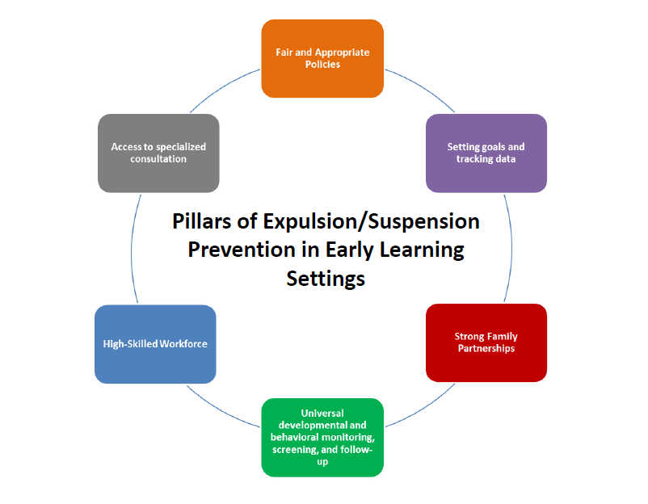

Slide 12
Recommendations for Early Childhood Programs
Develop and clearly communicate preventative guidance and discipline practices
Develop and clearly communicate expulsion and suspension policies
Assess technical assistance in workforce development to prevent expulsion and suspension
Set goals and analyze data to assess progress

Slide 13
Recommendations for States
Develop and clearly communicate expulsion and suspension policies
Set goals for improvement and analyze data to assess progress
Invest in workforce preparation and development
Establish and implement policies regarding program quality

Slide 14
Tools and Resources
Expulsion and Suspension Resources
www.acf.hhs.gov/programs/ecd/child-health-development/reducing-suspension-and-expulsion-practices
www2.ed.gov/about/inits/ed/earlylearning/initiatives.html
Civil Rights Data Collection
www2.ed.gov/about/offices/list/ocr/data.html
Information Memorandum for Child Care www.acf.hhs.gov/programs/occ/resource/im-2015-01

Slide 15
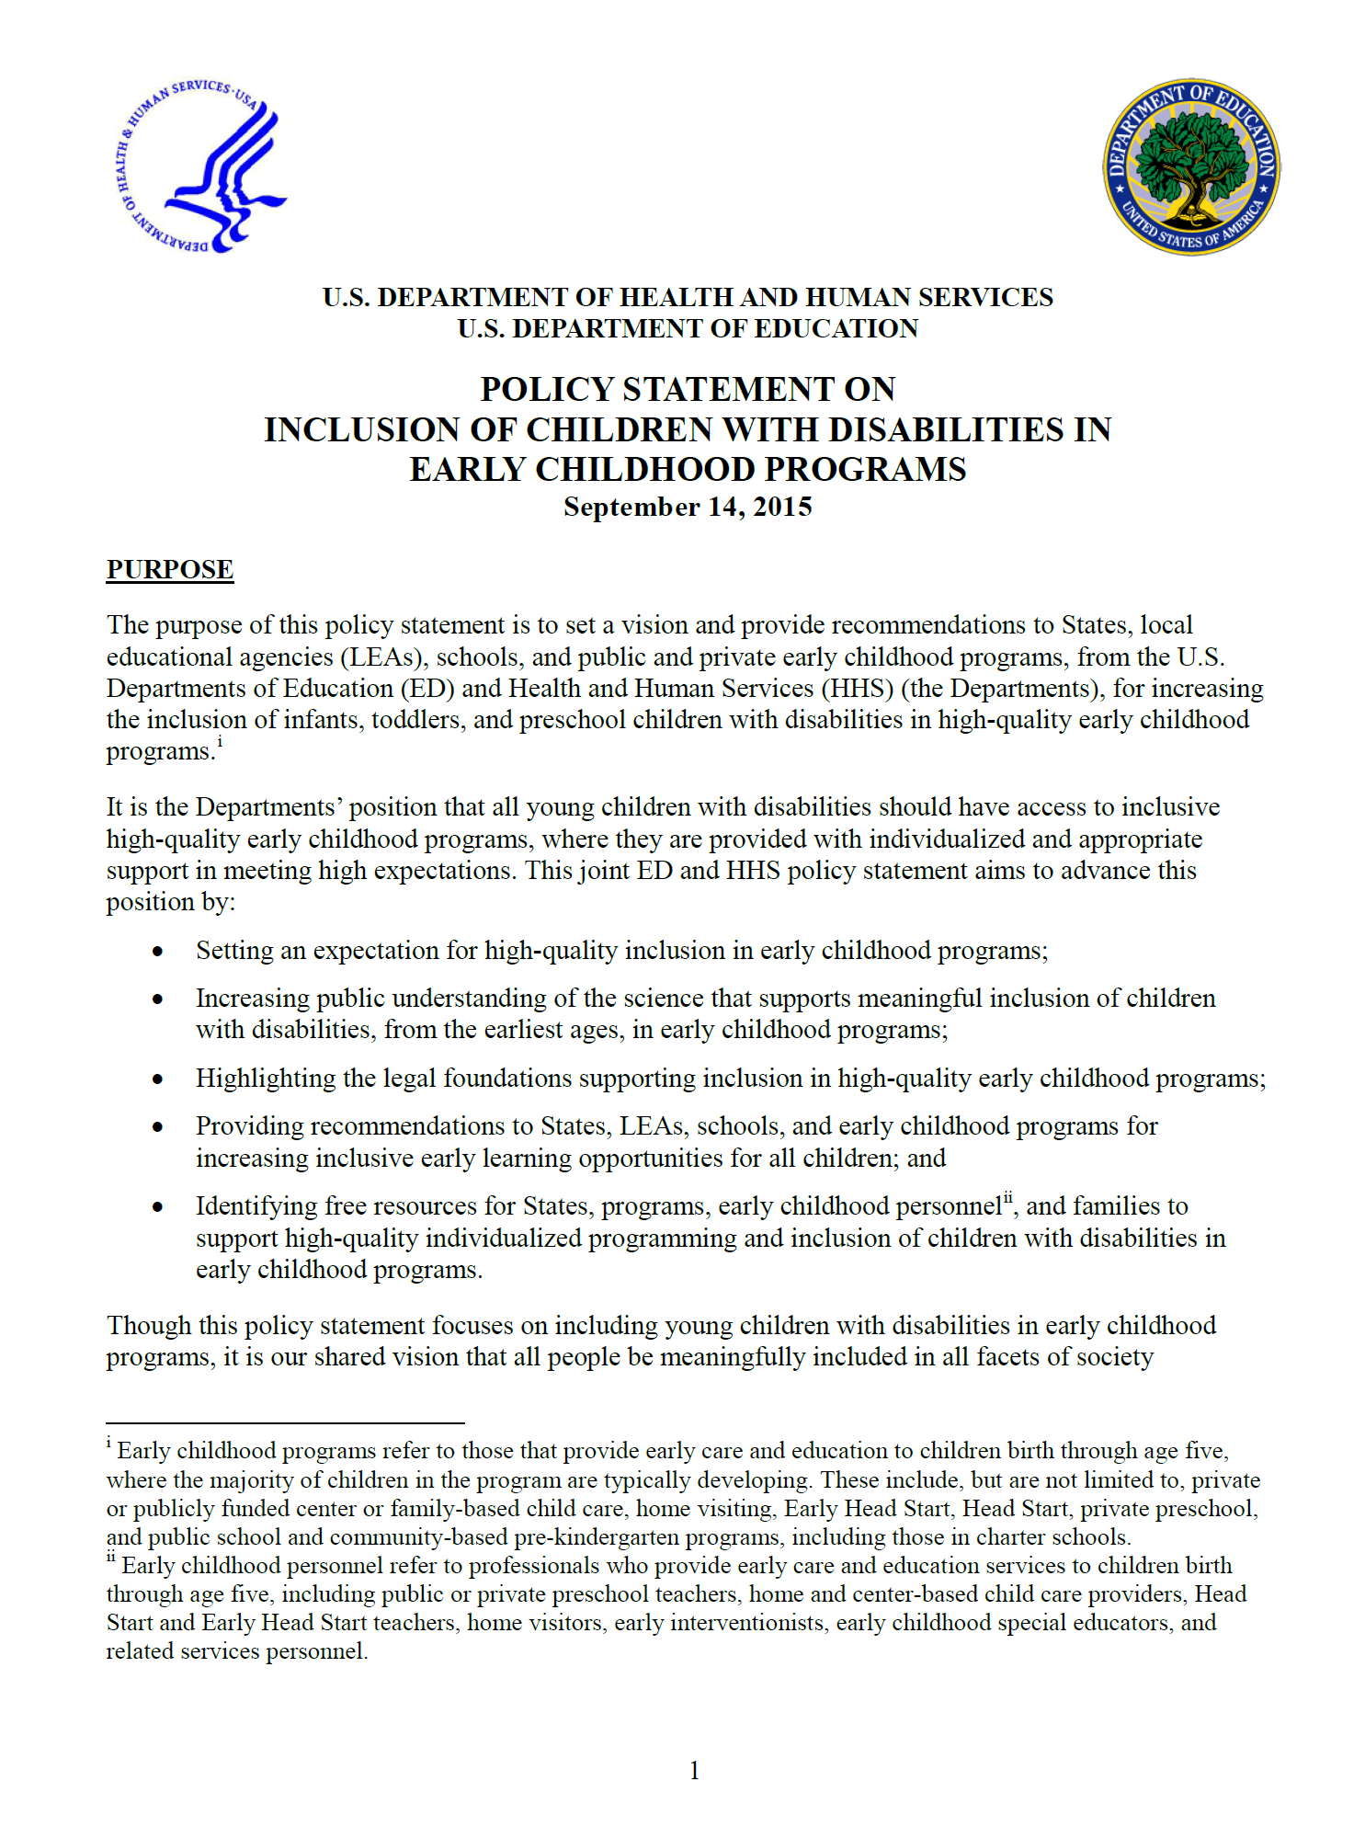
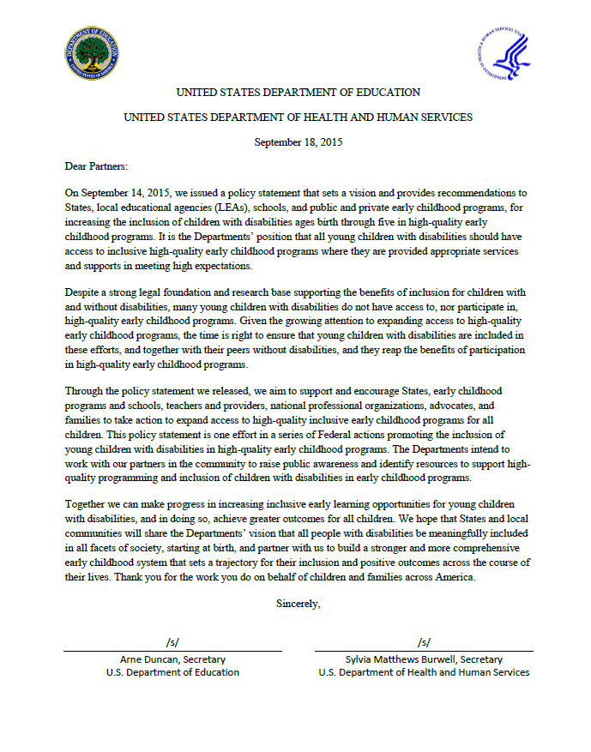
Federal Policy Statement
Inclusion of Children with Disabilities in Early Childhood Programs
www.ed.gov/early-learning/inclusion
Notes:
Inclusion is a shared responsibility and a top priority

Slide 16
Policy Statement on Inclusion of Children with Disabilities in Early Childhood Programs
It is the Departments’ position that all young children with disabilities should have access to inclusive high-quality early childhood programs where they are provided with appropriate support in meeting high expectations
Notes:
The policy statement was released on September 14, 2015 with the intent of providing a vision and recommendations to increase the number of infants, toddlers, and preschool children with disabilities in early childhood positions because the Departments believe that all children with disabilities should have access to inclusive high-quality early childhood programs where they are provided with appropriate support in meeting high expectations.

Slide 17
Policy Statement on Inclusion of Children with Disabilities in Early Childhood Programs
The importance of early childhood inclusion:
Being meaningfully is the first step to equal opportunity, and is every person’s right
Research indicates that meaningful inclusion is beneficial to children with and without disabilities
Meaningful inclusion in high-quality early childhood programs can support children with disabilities in reaching their full potential resulting in broad societal benefits
Inclusion in early childhood programs can set a trajectory for inclusion across the course of an individual's life

Slide 18
Policy Statement on Inclusion of Children with Disabilities in Early Childhood Programs
The need to focus on inclusion in early childhood:
Children with disabilities continue to face significant barriers to accessing inclusive early childhood programs
Too many preschool children with disabilities receive special education services in settings separate from their peers without disabilities
While States have worked to expand access to high-quality early learning programs, there has not been a proportionate expansion of inclusive early learning opportunities for young children with disabilities

Slide 19
Policy Statement on Inclusion of Children with Disabilities in Early Childhood Programs
A “high-quality” early childhood program is one that is inclusive of children with disabilities and their families and ensures that policies, funding, and practices enable their full participation and success
Notes:
The Departments believe that

Slide 20
Policy Statement on Inclusion of Children with Disabilities in Early Childhood Programs
The Policy Statement:
Sets an expectation for high-quality inclusion in early childhood programs;
Highlights the legal and research base for inclusion;
Provides recommendations to States and local programs and providers for increasing inclusive early learning opportunities for all children; and
Links to free resources for States, local programs and providers, and families that have been developed to support inclusion of children with disabilities in high-quality early education programs
Notes:
To advance the Departments’ position, the policy statement: (bullets)

Slide 21
Policy Statement on Inclusion of Children with Disabilities in Early Childhood Programs
Inclusion in early childhood programs:
including children with disabilities in general early childhood programs together with their peers without disabilities;
holding high expectations and intentionally promoting participation in all learning and social activities, facilitated by individualized accommodations; and
using evidence-based services and supports to foster their development, friendships with peers, and sense of belonging.
This applies to all young children with disabilities, from those with the mildest disabilities, to those with the most significant disabilities.
Notes:
We are building on the work of DEC/NAEYC and their position statement.
Myths are powerful things
Too expensive
Illegal to blend funds
Children need to be ready (developmentally) to benefit
Parents do not want it
Harm typical child learning
Cannot deliver necessary intensity of instruction
Too stimulating

Slide 22
Policy Statement on Inclusion of Children with Disabilities in Early Childhood Programs
Recommendations for State Action
Create a State-Level Interagency Task Force and Plan for Inclusion
Ensure State Policies are Consistent with High-Quality Inclusion
Track Data on Goals on Inclusion
Review and Modify Resource Allocations
Ensure Quality Rating Frameworks are Inclusive
Notes:
To reach high-quality inclusion, the policy statement lays out a number of recommendations

Slide 23
Policy Statement on Inclusion of Children with Disabilities in Early Childhood Programs
Recommendations for State Action
Strengthen Accountability and Build Incentive Structures
Build a Coordinated Early Childhood Professional Development System
Implement Statewide Supports for Children’s Social Emotional and Behavioral Health
Raise Public Awareness

Slide 24
Policy Statement on Inclusion of Children with Disabilities in Early Childhood Programs
Recommendations for Local Action
Partner with Families
Adhere to Legal Provision of Supports and Services in Inclusive Settings
Assess and Improve the Quality of Inclusion
Review and Modify Resource Allocations

Slide 25
Policy Statement on Inclusion of Children with Disabilities in Early Childhood Programs
Recommendations for Local Action
Enhance Professional Development
Establish an Appropriate Staffing Structure and Strengthen Staff Collaboration
Ensure Access to Specialized Supports
Develop Formal Collaborations with Community Partners

Slide 26
Policy Statement on Inclusion of Children with Disabilities in Early Childhood Programs
Families, early childhood programs, schools, communities, and government at all levels must develop a robust partnership to build a culture of inclusion to ensure that all children have an equal opportunity to thrive

Slide 27
Tools and Resources
Inclusion Resources
www.ed.gov/early-learning/inclusion
Webinar Series
September 7, 2016 at 2:00 EST: An Early Childhood Workforce to Support High-Quality Inclusion

Slide 28
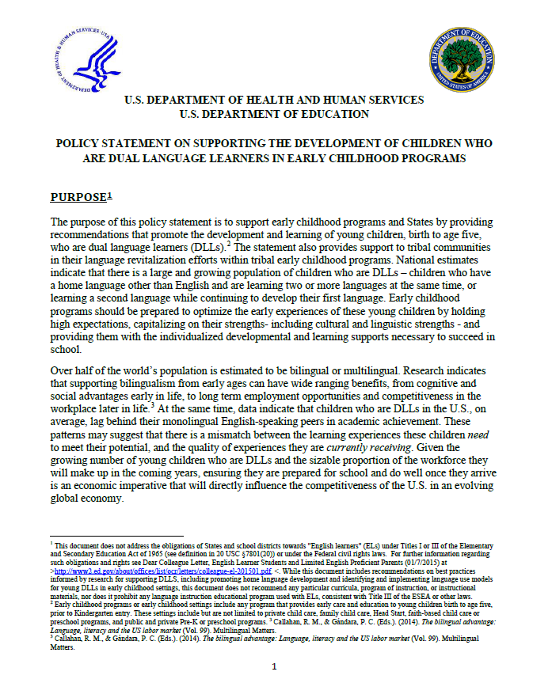
Federal Policy Statement
Dual Language Learners in Early Childhood Settings
www.ed.gov/early-learning
hwww.acf.hhs.gov/ecd/dual-language-learners

Slide 29
HHS-ED Policy Statement on Supporting the Development of Dual Language Learners
It is the vision of the U.S. Departments of Health and Human Services and Education, that all early childhood programs adequately and appropriately serve the diverse children and families that make up this country.

Slide 30
Purposes of Policy Statement
Setting an expectation for high-quality supports specifically designed for young DLLs in early education settings.
Increasing awareness about the benefits of bilingualism and the important role of home language development.
Reviewing the research on the unique strengths/challenges faced by this population and effective strategies to promote their development.
Providing recommendations to early childhood programs and States.
Providing considerations for tribal communities engaged in Native language revitalization, maintenance, restoration, or preservation efforts.
Identifying free resources to support States, tribal communities, programs, teachers, providers and families.

Slide 31
State Policy Recommendations
Develop and Implement a Plan to Support DLLs Across the Early Childhood Systems
2. Establish Policies that Support DLLs:
State Early Learning Guidelines/Standards for DLLs
Quality rating and improvement systems
Kindergarten Entry Assessments
3. Invest in Targeted Outreach and Recruitment
4. Engage Families

Slide 32
State Policy Recommendations
5. Invest in Workforce Development
Ensure staff have skills to support DLLs
Partner with IHEs to improve preparation
Establish pathways for bilingual staff
6. Invest in Statewide Technical Assistance
7. Support DLLs with Disabilities
8. Establish Community Hubs

Slide 33
Policy Recommendations for Early Learning Programs
1. Promote a Climate that Embraces Diversity
2. Partner with Families
Gather input about children’s language experiences at home
Encourage support of the home language; share benefits of bilingualism
Communicate in family’s preferred language

Slide 34
Policy Recommendations for Early Learning Programs
3. Identify and Implement Intentional Approach to
Language Use in the Classroom
Dual Immersion
Home Language with English Support
English with Home Language Support
English Only
For young DLLs, research indicates that English-only models are suboptimal, while high-quality dual immersion models- which support both English and the home language- confer the greatest benefits.

Slide 35
Policy Recommendations for Early Learning Programs
4. Establish a Culturally Responsive Learning
Environment
5. Ensure Staff, Including Monolingual English
Staff, Has Support and Skills to Support DLLs
Ongoing training and professional development
Support career pathways for existing bilingual staff or volunteers
Equip monolingual English teachers with strategies to support DLLs

Slide 36
Policy Recommendations for Early Learning Programs
6. Ensure Developmental and Behavioral Screening and
Assessments are Appropriate
Use tools that are valid and reliable
Conducted by qualified bilingual staff or interpreter
Give assessments in child’s preferred language
Assess language skills in both languages
7. Ensure Curriculum is Appropriate

Slide 37
Policy Recommendations for Early Learning Programs
8. Promote Positive Teacher-Child Relationships
9. Support Monolingual English-Speaking Staff
10. Accurately Identify and Support Children
with Disabilities who are DLLs
11. Facilitate transitions across programs

Slide 38
Policy Recommendations for Early Learning Programs
Children from tribal communities have unique experiences and face distinct challenges.
English is often home language; Heritage language may no longer be spoken by many.
Tribes may be interested in engaging in language revitalization, preservation, or maintenance efforts.
Early childhood optimal period to learn language.
HHS and ED support full integration of tribal language and culture into early childhood programming

Slide 39
Federal Resources
Joint HHS/ED Federal Policy Statement on Dual Language: https://www.acf.hhs.gov/sites/default/files/ecd/dll_policy_statement_final.pdfwww.ed.gov/early-learning
Dual Language Learners Toolkit: http://eclkc.ohs.acf.hhs.gov/hslc/tta-system/cultural-linguistic/Dual%20Language%20Learners/toolkit
National Center on Cultural and Linguistic Responsiveness: http://eclkc.ohs.acf.hhs.gov/hslc/tta-system/cultural-linguistic
Talk, Read, and Sing Together Every Day! http://www.ed.gov/early-learning/talk-read-sing; http://www.acf.hhs.gov/programs/ecd/child-health-development/bridging-the-word-gap
White House Task Force on New Americans Educational and Linguistic Integration Webinar Series: http://www2.ed.gov/about/offices/list/oela/webinars/new-americans/index.html

Slide 40
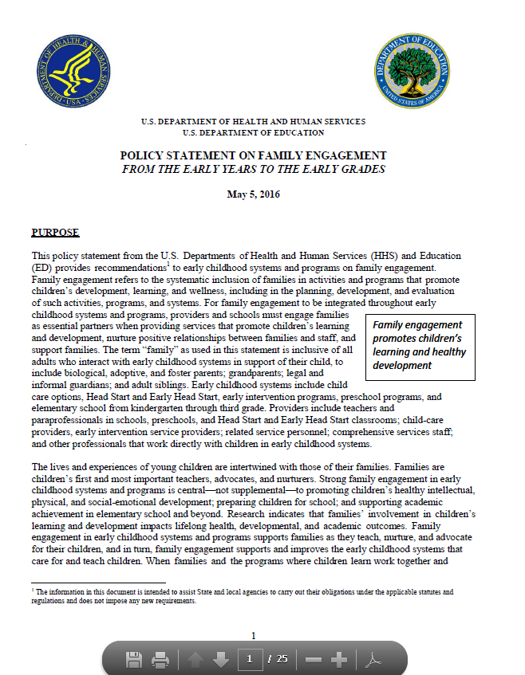
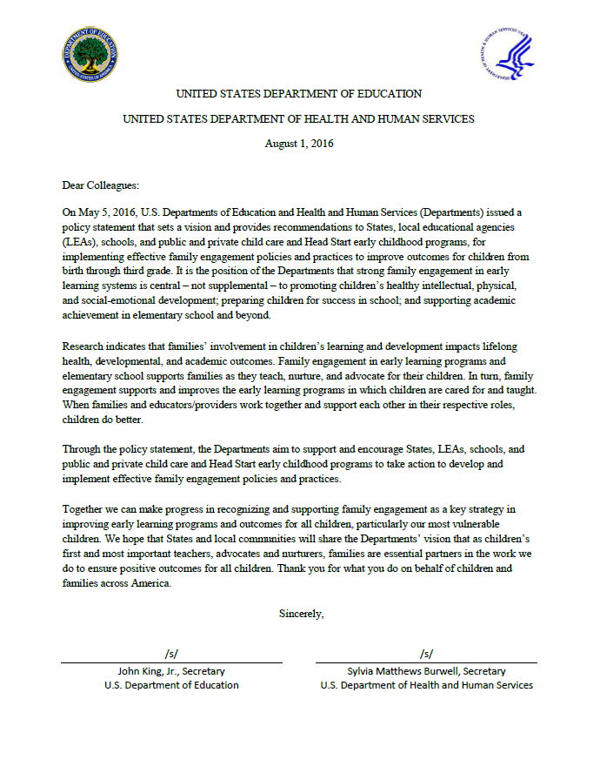
Federal Policy Statement
Family Engagement
From the Early Years to the Early Grades
www.ed.gov/early-learning
www.acf.hhs.gov/ecd/family-engagement

Slide 41
Policy Statement on Family Engagement
It is the goal of the Departments that all early childhood systems recognize and support families as essential partners in providing services that improve children’s development, learning and wellness.
Notes:
The lives and experiences of young children are intertwined with those of their families. Families are children’s first and most important teachers, advocates, and nurturers. Strong family engagement in early childhood systems and programs is central—not supplemental—to promoting children’s healthy intellectual, physical, and social-emotional development; preparing children for school; and supporting academic achievement in elementary school and beyond.

Slide 42
Family Engagement
Family engagement refers to the systematic inclusion of families in activities and programs that promote children’s development, learning, and wellness, including in the planning, development, and evaluation of such activities, programs, and systems.
Notes:
For family engagement to be integrated throughout early childhood systems and programs, providers and schools must engage families as essential partners when providing services that promote children’s learning and development, nurture positive relationships between families and staff, and support families.

Slide 43
The Importance of Family Engagement
Families’ involvement in children’s learning and development impacts children’s lifelong health, developmental, and academic outcomes
Family engagement in early childhood systems and programs supports families as they teach, nurture, and advocate for their children
Family engagement supports and improves the early childhood systems that care for and teach children
When families and the programs work together and support each other in their respective roles, children have more positive attitudes toward school, stay in school longer, have better attendance, and experience more school success.

Slide 44
The Need to Focus on Family Engagement
Despite the demonstrated importance of family engagement, family engagement is not equally valued or implemented across early childhood systems and programs
Family engagement practices are often seen as supplemental, rather than necessary, to successfully promote children’s learning and development.
Many States, districts, programs, and schools provide few requirements, limited guidance, and insufficient resources to adequately support systemic approaches to family engagement.
Notes:
Systems and programs that serve young children may place low priority on family engagement because they perceive their mission as focused on directly supporting children’s intellectual, social-emotional, and physical development exclusively

Slide 45
Policy Statement on Family Engagement
Reviews the research base and best practices that support effective family engagement;
Identifies core principles of effective family engagement practices from HHS’ and ED’s family engagement frameworks;
Provides recommendations to States and community-based early childhood systems and programs to implement effective family engagement; and
Highlights resources to build programmatic and family capacity to be effective partners.

Slide 46
Principles of Effective Family Engagement
Create continuity and consistency for children and families.
Value respectful and trusting relationships between families and professionals.
Develop goal-oriented relationships with families that are linked to children’s development and learning.
Engage families around children’s health, mental health and social and emotional well-being.
Ensure that all family engagement opportunities are culturally and linguistically responsive.
Notes:
The first step in systemically embedding effective family engagement in early childhood systems and programs is to establish a culture in which families are seen as essential partners in the systems and programs that serve their children. The Departments consider the following practice principles foundational to establishing a culture that values family engagement. The practice principles are drawn from our respective frameworks, and they are embedded in the recommendations that follow. Adopting these practice principles across systems and programs in a strategic and coordinated manner will result in more benefits to children and families.
The Frameworks:
The Head Start Parent, Family, and Community Engagement (PFCE) Framework uses a research-based, organizational development approach to high performance family engagement. It specifies the structures and functions in early childhood organizations that can be integrated to bring about continuous learning and improvement, and to institutionalize and sustain effective family engagement practices.
ED’s Dual Capacity-Building Framework for Family-School Partnerships offers guidance to States, districts and schools for providing opportunities to build both staff and family capacity to work as partners to improve student outcomes. The framework outlines both process and organizational conditions that support implementation of effective family engagement practices.
Principles:
Create continuity and consistency for children and families. Promote a vision for family engagement that is consistent across systems and programs, and that can set the stage for families’ involvement in their children’s development and education at all ages.
Value respectful and trusting relationships between families and professionals. Promote shared responsibility for children’s healthy development, learning and wellness by valuing families’ experiences and strengths, and providing opportunities for shared learning. Encourage two-way communication by welcoming information from families on all aspects of the child’s life and development, including their culture, traditions, and home language.
Develop goal-oriented relationships with families that are linked to children’s development and learning. Develop ongoing relationships centered on children’s well-being and success. Jointly work with families to identify specific strategies that support children’s development and learning at home and in the classroom and community.
Engage families around children’s health, mental health, and social and emotional well-being. Engage families around children’s development, learning, and wellness, including physical health, mental health, and social and emotional needs. Ensure that programs and families know about child development related to these areas and have access to the tools they need, including concrete strategies to promote child well-being at home and in the classroom. Ensure that families and staff are connected with relevant community partners, such as early childhood mental health consultants and children’s medical homes, as needed.
Ensure that all family engagement opportunities are culturally and linguistically responsive. Ensure to the maximum extent possible, that the environment, children’s curricula and learning, and all family engagement opportunities respect, reflect, and embrace families’ cultures, are devoid of bias, and are linguistically accessible.
Build staff capacity to implement family engagement practice principles. Prioritize professional development opportunities that support staff to view parents as capable, competent partners. Strengthen staff’s ability to form positive, goal-oriented relationships with all families. Develop professional capacity in working with culturally and linguistically diverse communities, including immigrant communities, and in partnering with families who have children with disabilities, special health care needs, or other unique needs.
Support families’ connections and capabilities. Provide opportunities for families to build upon their knowledge and skills to foster children’s development, learning and wellness; advocate for their child and family; share experiences and expertise with other families; and take on leadership and advocacy roles in early childhood systems and programs. Connect families to family organizations that support families of children with and without disabilities, special health care and mental health needs; parent to parent programs; child care resource and referral agencies; parent teacher associations; parent advisory councils; and community-based organizations that serve diverse families, including families of dual language learners.
Systemically embed effective family engagement strategies within early childhood systems and programs. Align, integrate and coordinate family engagement strategies in all aspects of programming, including but not limited to: involving families in governance; establishing positions that focus exclusively on family engagement; identifying specific family engagement responsibilities and professional development opportunities for all roles across systems and programs; providing families with multiple and diverse opportunities for engagement; and creating physical environments that are welcoming and culturally and linguistically responsive.
Develop strong relationships with community partners that support families. Establish formal partnerships with community partners, such as after-school programs, social service agencies, adult education programs, one stop career centers, medical homes, public housing authorities, and libraries, to promote family wellness and adult learning, and enhance children’s learning and family stability. Invite the community to celebrations and other events in the school and programs.
Continuously learn and improve. Improve integrated and systemic family engagement practices by regularly collecting and analyzing data on the effectiveness of the practices, in order to guide decision-making and policy change and to inform technical assistance and professional development.

Slide 47
Principles of Effective Family Engagement
Build staff capacity to implement family engagement practice principles.
Support families’ connections and capabilities.
Systemically embed effective family engagement strategies within early childhood systems and programs.
Develop strong relationships with community partners that support families.
Continuously learn and improve.

Slide 48
Recommendations to Promote Family Engagement
Plan for and prioritize family engagement.
Communicate consistent messages that support strong family engagement.
Invest and allocate resources.
Establish policies, procedures, and practices that support family engagement.
Establish workforce capacity building that supports family engagement.
Develop and integrate family engagement data for continuous improvement in systems and programs.
Notes:
Plan for and prioritize family engagement. Since family engagement is a critical component in promoting children’s learning and development across settings and services, States should develop statewide early childhood and early elementary school policies on family engagement.
Communicate consistent messages that support strong family engagement. Early childhood systems’ public messages should emphasize the strengths and resilience of families and communities.
Invest and allocate resources. Adequate resource allocation and support makes implementation of family engagement practices possible. Examples of specific investments may include establishing or enhancing related statewide technical assistance and hiring a family engagement specialist or designating an existing staff member to be responsible for oversight of family engagement plans.
Establish policies, procedures, and practices that support family engagement. States and districts should conduct a policy review and prioritize policies that will most effectively support family engagement practices and drive local and program procedures and practices. Examples of policies, procedures, and practices may include using Federal funds to support the implementation of family engagement practices in school districts; promoting the use of recommended practices and early childhood quality rating and improvement systems that include tiers of measurable and research-informed family engagement indicators; identifying supports for parents such as parenting interventions and leadership development; and providing examples of how to create opportunities for families to be involved in their child’s development, learning, and wellness, including opportunities for peer learning and peer networking.
In addition, programs and providers should establish procedures and practices that provide access to families and invite them to participate in learning activities. Procedures and practices should create family friendly environments, provide two-way communication between providers and families and support family connections to other families for peer support and learning. Providers should be sure to develop family and professional relationships that are linked to learning, development, and wellness and make data about children’s progress accessible and understandable to parents. Programs and providers should support families as leaders and advocates in programs and schools, and intentionally support families as their children transition to new learning settings. Providers should offer families needed supports through formal or informal relationships with community partners, and conduct voluntary home visits to build relationships with children and families.
Establish workforce capacity building that supports family engagement. States and programs should support all staff to receive training and coaching in implementing family engagement practices. States should incorporate core competencies specific to family engagement into existing competency frameworks for providers and support these competencies through their professional development systems, training and technical assistance, and ongoing coaching and consultation efforts.
Develop and integrate family engagement data for continuous improvement in systems and programs.
States and programs should collect data, to the extent permissible under applicable privacy laws, about the extent to which early childhood systems and programs are engaging families, the strategies that they are using, and the effectiveness of those strategies. States and programs can use this data to better understand current policy and practice, and provide technical assistance as needed to local systems and program staff.

Slide 49
Policy Statement on Family Engagement
Family engagement is central–not supplemental–to the success of early childhood systems and programs. Together, we all have the responsibility to promote and implement effective family engagement to improve children’s learning, development, and wellness.

Slide 50
Tools and Resources
Family Engagement Resources
www.ed.gov/early-learning
http://www.ed.gov/parent-and-family-engagement
http://www.acf.hhs.gov/ecd/family-engagement
Parenting Report
Parenting Matters: Supporting Parents of Children Ages 0-8
http://sites.nationalacademies.org/dbasse/bcyf/parenting_matters/index.htm

Slide 51
Discussion Questions
Within your community, how are you using the policy statements?
What data are you collecting to show your progress in working towards the recommendations in the policy statements?
What resources and materials could federal agencies disseminate or develop to promote the use of the policy statements?

Slide 52
We want to partner to promote high-quality programs and services for all children
Libby.Doggett@ed.gov
Richard.Gonzales@acf.hhs.gov
Christy.Kavulic@ed.gov
www.acf.hhs.gov/programs/ecd
www.ed.gov/early-learning

