Slide 1
State of the States: Progress in Part C and Part B 619 State Data Systems from 2013 to 2015
Laura Hudson & Donna Spiker
Improving Data, Improving Outcomes Conference
August, 2016

Slide 2
Today’s Goals
Share information about the state of state data systems
Summarize information about changes to state data systems between 2013 and 2015
Encourage discussion and gather feedback
Explore how current efforts in states are tied to changes
Provide demonstration of state of the states map
Highlight resources and products

Slide 3
First, let’s talk about you

Slide 4
Overview and background

Slide 5
What are the DaSy 10?
10 key indicators to capture data system capabilities
Some indicators were given to DaSy to measure
Others were developed by DaSy at start of project
Primary way to share information: State of the States map
One way to see changes in capabilities of state data systems over time

Slide 6
Child-level data
State has at least one electronic data system that contains personally identifiable child-level data about children who are receiving services.
Individual child-level data elements reside in one system or have been linked.
State data system(s) uses a unique identifier for children receiving services.

Slide 7
Workforce-level data
State has at least one electronic data system that contains personally identifiable workforce data about those providing services.
Child-level data have been linked to workforce-level data.

Slide 8
Data linkages & data governance
State data systems that contain data about children receiving Part C and Part B 619 services use the same unique child identifiers.
At least some child-level data are in the same data system or have been linked to child-level data from Part C.
At least some child-level data are in the same data system or have been linked to data from other early care and education (ECE) programs.

Slide 9
Linkages & governance, cont’d
At least some child-level data are in the same data system or have been linked to data from general education K-12.
State has a data governance body whose scope of responsibility includes data about children receiving services.

Slide 10
Why should we care about these indicators?
These are 10 indicators about the quality of state data systems.
Having key data elements in state data systems allows states to answer critical questions about:
Accountability and reporting
Program improvement
Program operations
Linkages across data elements, and across C, 619, other early childhood programs, and K12 data systems also allows states to answer critical questions.

Slide 11
If you do not know how to ask the right question, you discover nothing.
W. Edward Deming

Slide 12
About our data collection
Data collected via online surveys
Conducted surveys in 2013 and 2015
In 2015, collaborated with ITCA for Part C data survey
Carried out detailed data verification effort to ensure high-quality data
Surveys are the source for the DaSy 10 data systems indicators.

Slide 13
Data were collected twice, about 2.5 years apart.
Fall 2015
Part C
Late fall 2015
Mid 2013
Part B 619
54 days
Today
Part C and Part B 619
44 days
2013
2016
35 days
2014
2015

Slide 14
Findings

Slide 15
Child-level data

Slide 16
How many states have child-level data systems?

Slide 17
All
states that responded to the survey have an electronic data system with personally identifiable child-level data for all or nearly all children receiving Part C/Part B 619 services.
There was no change from 2013. No states in either survey year did not have a child-level data system.

Slide 18
Summary: have child-level data systems
Part C
Both C and 619 remained stable and high in this indicator.
Part B 619

Slide 19
How many states have child-level data in one data system or linked across data systems?

Slide 20
79%
of Part C programs have child data linked or in one data system.
16%
5%
do not.

Slide 21
Among Part C programs,
Two states
that could not link child data or did not have in one data system in 2013 reported that they had this in 2015.
One state
that could link child data or had it in one system in 2013 reported that they did not have this in 2015.

Slide 22
70%
of 619 programs have child data linked or in one data system.
7%
23%
do not.

Slide 23
Among Part B 619 programs,
Nine states
that could not link child data or did not have in one data system in 2013 reported that they had this in 2015.
One state
that could link child data or had it in one system in 2013 reported that they did not have this in 2015.

Slide 24
Summary: child-level data is linked or in one data system
Part C
619 programs are now more likely to link data or have it one system, but they still do not have this capability at the same rates as do Part C programs.
Part B 619

Slide 25
How many states use a unique identifier for children?

Slide 26
All
states (across C & 619) that responded to the survey use a unique identifier for children receiving services.

Slide 27
Among Part C programs,
Four states
that did not use unique child identifiers in 2013 reported that they had this in 2015.
No states
that did use unique identifiers in 2013 reported that they did not in 2015.

Slide 28
Among Part B 619 programs,
Two states
that did not use unique child identifiers in 2013 reported that they had this in 2015.
No states
that did use unique identifiers in 2013 reported that they did not in 2015.

Slide 29
Summary: has unique child identifiers
Part C
The majority of states use unique child identifiers.
Part B 619

Slide 30
Discussion questions: Child-level data
What do you make of these data?
What will it take for more states to have all child-level data linked or in one state data system?
Are there any current efforts in your state related to child data and data systems?

Slide 31
Workforce-level data

Slide 32
How many states have workforce-level data systems?

Slide 33
64%
of Part C programs have workforce data systems.
16%
20%
do not.

Slide 34
Among Part C programs,
Five states
that did not have workforce data systems in 2013 reported that they did have this in 2015.
Three states
that had workforce data systems in 2013 reported that they did not in 2015.

Slide 35
88%
of 619 programs have workforce data systems.
7%
5%
do not.

Slide 36
Among Part B 619 programs,
Five states
that did not have workforce data systems in 2013 reported that they did have this in 2015.
One state
that had workforce data systems in 2013 reported that they did not in 2015.

Slide 37
Summary: has workforce-level data systems
Part C
619 programs are more likely to have workforce level data systems, and they have made more gains across years.
Part B 619

Slide 38
How many states have linked child-level to workforce-level data?

Slide 39
48%
of Part C programs have linked child and workforce data.
16%
36%
have not.

Slide 40
Among Part C programs,
Six states
that could not link child and workforce data in 2013 gained this capability by 2015.
No states
that could link child and workforce data in 2013 could not in 2015.

Slide 41
34%
of 619 programs have linked child and workforce data.
5%
61%
have not.

Slide 42
Among Part B 619 programs,
Five states
of 619 programs that could not link child and workforce data in 2013 gained this capability by 2015.
One state
that could link child and workforce data in 2013 could not in 2015.

Slide 43
Summary: has linkages between child and workforce data
Part C
Most states cannot link child and workforce data, but both C and 619 have made progress across years.
Part B 619

Slide 44
Discussion questions: Workforce
What do you make of these data?
Why are so few states able to link child and workforce data?
What will it take for more states to have these data in state data systems?
Are there any current efforts in your state related to workforce data and data systems?

Slide 45
Data linkages & data governance

Slide 46
How many states share a unique child identifier across C & 619?

Slide 47
25%
of Part C programs report using the same unique child ID as 619.
16%
59%
do not.

Slide 48
Among Part C programs,
Three states
that did not share a unique child identifier with 619 in 2013 reported that they did in 2015.
One state
that did share a unique ID with 619 in 2013 did not in 2015.

Slide 49
29%
of 619 programs report using the same unique child ID as Part C.
11%
61%
do not.

Slide 50
Among Part B 619 programs,
Two states
that did not share a unique child identifier with Part C in 2013 reported that they did in 2015.
One state
that did share a unique ID with Part C in 2013 did not in 2015.

Slide 51
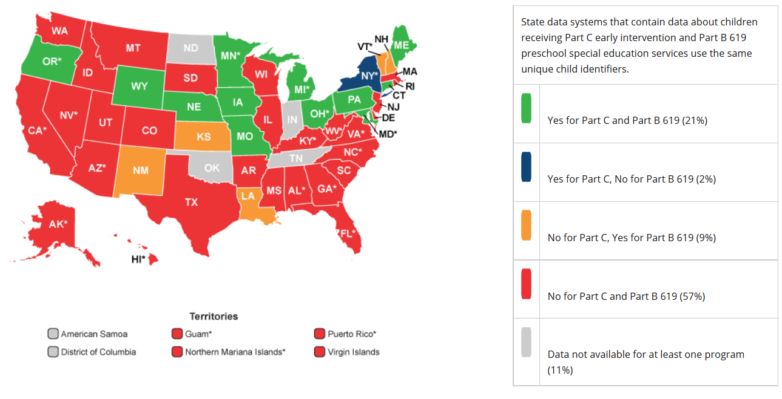
There are some mismatches between what Part C and 619 say within states about use of a common child ID.

Slide 52
Summary: has shared unique child identifiers across Part C and Part B 619
Part C
A few states share unique child identifiers across C and 619, and there has been little change across years.
Part B 619

Slide 53
How many states can link child data across C and 619 or share a data system?

Slide 54
34%
of Part C programs report linking child-level data to or using the same data system as 619.
16%
50%
do not.

Slide 55
Among Part C programs,
Two states
that could not link child-level data or share a data system with 619 in 2013 gained this capability by 2015.
Four states
that could link child-level data or share a data system with 619 in 2013 could not in 2015.

Slide 56
43%
of 619 programs report linking child-level data to or using the same data system as Part C.
7%
50%
do not.

Slide 57
Among Part B 619 programs,
Three states
that could not link child-level data or share a data system with Part C in 2013 gained this capability by 2015.
One state
that could link child-level data or share a data system with Part C in 2013 could not in 2015.

Slide 58
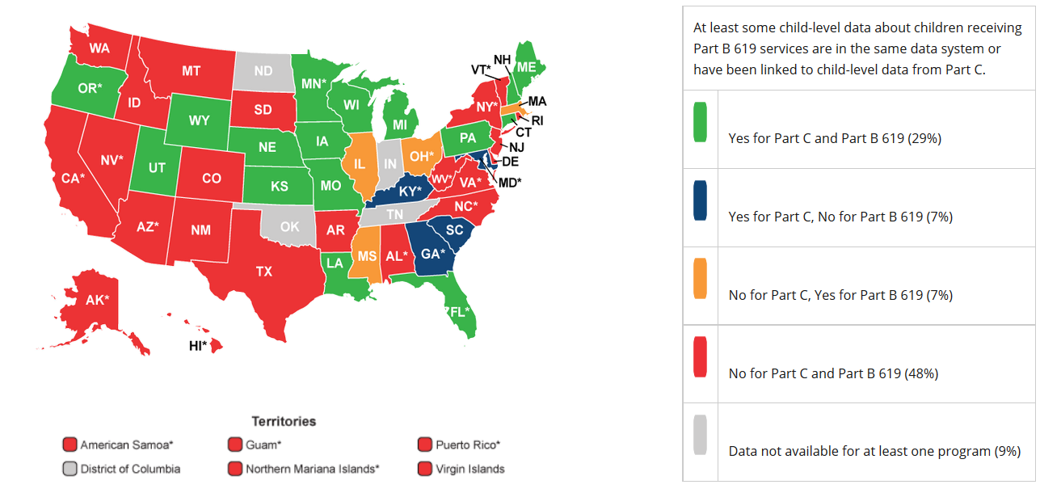
There are some mismatches between what Part C and 619 say within states about linking child-level data.

Slide 59
Summary: can link child-level data across Part C & Part B 619 or share a data system
Part C
About one-third of states link child-level data across C and 619 or share a data system. There has been little change across years.
Part B 619

Slide 60
How many states can link child data to other early care and education program data or share a data system?

Slide 61
13%
of Part C programs report linking data to or using same data system as other ECE programs.
18%
70%
do not.

Slide 62
Among Part C programs,
One state
that could not link data or share data system with ECE programs in 2013 gained this capability by 2015.
Three states
that could link data or share a data system with ECE in 2013 could not in 2015.

Slide 63
77%
of 619 programs report linking data or using same data system as other ECE programs.
7%
16%
do not.

Slide 64
Among Part B 619 programs,
Sixteen states
that could not link data or share data system with ECE programs 2013 gained this capability by 2015.
No states
that could link data or share a data system with ECE in 2013 could not in 2015.

Slide 65
Summary: can link data with ECE programs or share a data system
Part C
Many more 619 programs can link with ECE or share a data system compared to C, and this gap has widened across years.
Part B 619

Slide 66
How many states can link child-level data to K-12 general education data or share a data system?

Slide 67
16%
of Part C programs report linking child-level data to or using same data system as K-12.
18%
66%
do not.

Slide 68
Among Part C programs,
Two states
that could not link child-level data or share a data system with K-12 in 2013 gained this capability by 2015.
Two states
that could link child-level data or share a data system with K-12 in 2013 could not in 2015.

Slide 69
86%
of 619 programs report linking child-level data or using same data system as K-12.
7%
7%
do not.

Slide 70
Among Part B 619 programs,
Four states
that could not link child-level data or share a data system with K-12 in 2013 gained this capability by 2015.
No states
that could link child-level data or share a data system with K-12 in 2013 could not in 2015.

Slide 71
Summary: can link child-level data with K-12 or share a data system
Part C
Many more 619 programs can link child-level data with K-12 or share a data system compared to Part C.
Part B 619

Slide 72
How many states have a data governance body?

Slide 73
30%
of Part C programs report having a data governance body.
16%
54%
do not.

Slide 74
Among Part C programs,
Six states
that did not have a data governance body in their state in 2013 had one in 2015.
Three states
that did have a data governance body in 2013 did not in 2015.

Slide 75
75%
of 619 programs report having a data governance body.
13%
13%
do not.

Slide 76
Among Part B 619 programs,
Five states
that did not have a data governance body in their state in 2013 had one in 2015.
Two states
that did have a data governance body in 2013 did not in 2015.

Slide 77
Summary: has a data governance body
Part C
More 619 programs have data governance bodies, and there is been a small increase in the number of states with data governance bodies for both C and 619.
Part B 619

Slide 78
Discussion questions: Data linkages & data governance
What do you make of these data?
What will it take for more states to have these kinds of data linkages: C and 619; other early childhood programs; K12?
Are there any current efforts in your state related to data linkages and governance?
How can data governance help?

Slide 79
The value of an idea lies in the using of it.
Thomas Edison

Slide 80
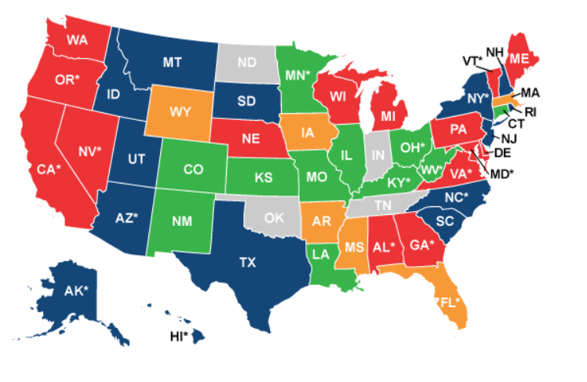
Map Demo

Slide 81
About the map
Individual state data shared with permission
2015 data presented where available
2013 data used if 2015 unavailable

Slide 82
Come play with the maps
We’ll be at the playground!
Live demo Wednesday at 8:30 am
Staff will be present at all times to show you the maps
Opportunity to interact with the maps
Can submit request to update information, get specific questions answered

Slide 83
Questions?

Slide 84
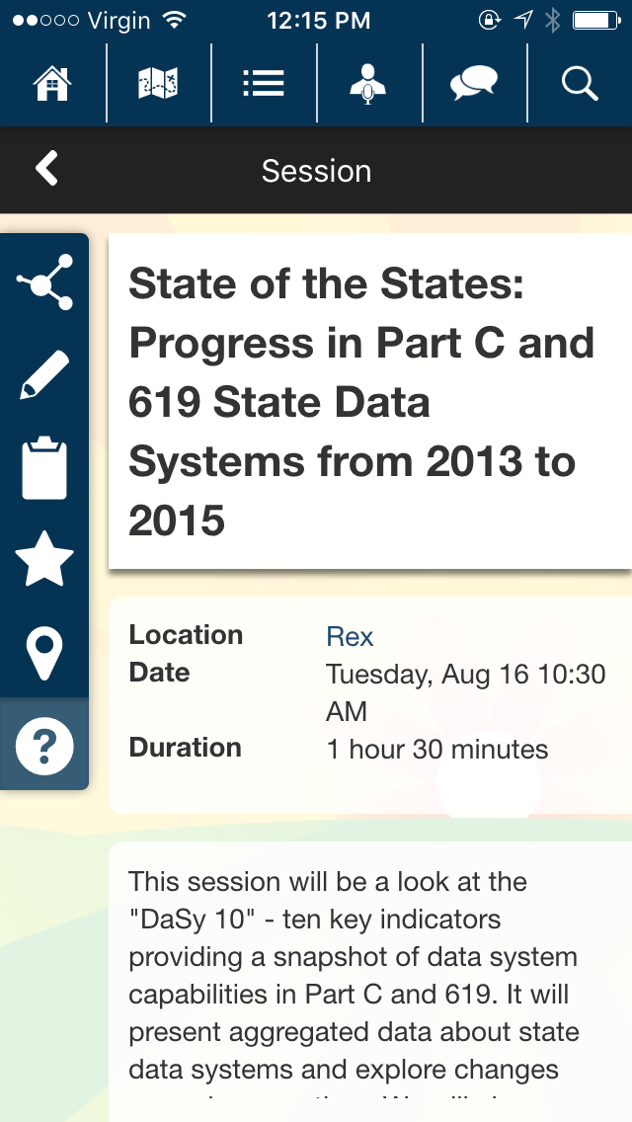
Tell us what you think
Click here to access the evaluation after the session is over.

Slide 85
Connect with us
We’re here to help.
Questions about the data? Laura.Hudson@sri.com
Visit the DaSy website at: http://dasycenter.org/

Slide 86
Photos
Baby: acjetter, CC license
Half dome: Thomas Hawk, CC license

Slide 87
The contents of this presentation were developed under a grant from the U.S. Department of Education, # H373Z120002. However, those contents do not necessarily represent the policy of the U.S. Department of Education, and you should not assume endorsement by the Federal Government. Project Officers, Meredith Miceli and Richelle Davis.

