Slide 1
Conquering the Trials and Tribulations of Data Sharing and Linking
New Orleans, LA
September 8, 2014

Slide 2
Presenters
Baron Rodriguez - DaSy, PTAC
Linda Goodman – Dep. Dir., CT Office of Early Childhood
Sherry Franklin - NC Part C Coordinator
Robin Nelson - DaSy, IDC
Notes:
Linda -- Deputy Director, Connecticut Office of Early Childhood
NC Dept of Health & Human Services, Division of Public Health, Women’s & Children’s Health Section, Early Intervention Branch

Slide 3
Agenda
Privacy and Data Sharing
Overview of Connecticut and North Carolina early childhood data systems
Discussion
  Key decisions
  Policy considerations
  Lessons learned
Notes:
Overview of data systems
Purpose/planned use
Participating agencies
Critical questions
Governance

Slide 4
Audience Poll
Involvement in early childhood and/or longitudinal data system?
  No, not in my lifetime
  Thinking about it
  Just getting started
  Well underway
  In the homestretch

Slide 5

What are the requirements under FERPA?

Slide 6

Key Points to Remember
Properly de-identified data can be shared without any FERPA considerations and should be your FIRST option as it limits the risk of unauthorized PII disclosure.
In most cases, consent is the best approach for sharing PII with non-profit organizations.
Directory Information is often misunderstood. Opt-out provisions do not prevent data from being shared under the Audit/Evaluation or School Official exceptions.

Slide 7
FERPA & IDEA
Translation of Terms
FERPA | Part C
Education record | Early intervention Record
Education | Early intervention
Educational agency or institution | Participating agency
School official | Qualified EIS personnel/Service coordinator
State educational authority | Lead agency
Student | Child under IDEA Part C

Slide 8
Privacy Concerns
Education records generally contain PII
Children and young adults particularly vulnerable
  Identity theft and fraud
  Security of medical and financial data
  Accidental misuse of information
Privacy concerns increase as more data are stored and accessed electronically
  Identity authentication
  Secure data transfer
  Data breaches

Slide 9
Privacy Protection — Laws and Regulations
Local policies, state, and federal laws governing
  Access rights of parents and eligible students
  Authorized disclosure of restricted information to external entities for specific and pre-approved purposes
Requirements and conditions for data disclosure
  Parental notification, informed consent, and recordation of data releases
  Data sharing agreements

Slide 10
Access to Student Records: Non-directory Information
Non-directory information
  Can be released with written consent
  The consent should specify the information that may be released, the purpose of the release, and the recipient
Notes:
FERPA Model Notice for Directory Information (Mar 2011)
Description:
This document is a template notice for notifying parents and eligible students about the type of information from student’s education records, designated by a School District as “directory information,” that Schools may disclose without consent, unless advised to the contrary.

Slide 11
Disclosure of Student Records Without Consent
FERPA and other federal statues, such as the Protection of Pupil Rights Amendment (PPRA), restrict the release or collection of different types of sensitive information without prior consent
Under FERPA, parents and eligible students have the right to consent to disclosures of PII
  Rights must be described in the Annual FERPA Notice

Slide 12
Disclosure of PII from Education Records under FERPA
FERPA permits non-consensual disclosure of PII from education records under several exceptions
Staff or employees who need access to perform duties
  School official exception
  “Legitimate educational interest”
External entities
  Studies exception
  Audit or evaluation exception
  Uninterrupted Scholars Act
  Other (e.g., court order, health or safety emergency)

Slide 13
What is the most common exception used for disclosure without consent?
Answer: Generally, the Audit and Evaluation exception.
Example:
A district could designate a non-profit early childhood provider as an authorized representative in order to disclose, without consent, PII from education records on its students to the non-profit organization. The district may then may disclose, without consent, data on these children to the non-profit provider to permit the district to evaluate placement decisions/outcomes.

Slide 14
New Definitions for Audits and Evaluations
Authorized Representative
  Any entity or individual designated by a State or local educational authority or an agency headed by an official… to conduct—with respect to Federal- or State-supported education programs—any audit or evaluation, or any compliance or enforcement activity in connection with Federal legal requirements that relate to these programs (FERPA regulations, § 99.3).
Education Program
  Any program principally engaged in the provision of education, including, but not limited to, early childhood education, elementary and secondary education, postsecondary education, special education, job training, career and technical education, and adult education, and any program that is administered by an educational agency or institution (FERPA regulations § 99.3).

Slide 15
FERPA Regulatory Changes – Audit and Evaluation
Authorized Representative
Written Agreements
Reasonable Methods
“Guidance on Reasonable Methods and Written Agreements”

Slide 16
FERPA’s Audit and Evaluation Exception
A state or local educational authority may designate a third party as their “authorized representative” and then disclose PII from education records to them for the purposes of conducting an audit or evaluation of a federal or state-supported education program.

Slide 17
FERPA’s Audit and Evaluation Exception - Requirements
Disclosing entity must be a state or local educational authority;
Must be for the evaluation of a federal or state-supported education program;
Must use a written agreement to designate the recipient as the authorized representative;
The written agreement must include a number of required elements;
(see “Guidance on Reasonable Methods and Written Agreements”)

Slide 18
FERPA’s Audit and Evaluation Exception - Requirements
The recipient must:
  Comply with the terms of the written agreement;
  Use the PII only for the authorized purpose;
  Protect the PII from further disclosure or other uses;
  Destroy the PII when no longer needed for the evaluation.

Slide 19
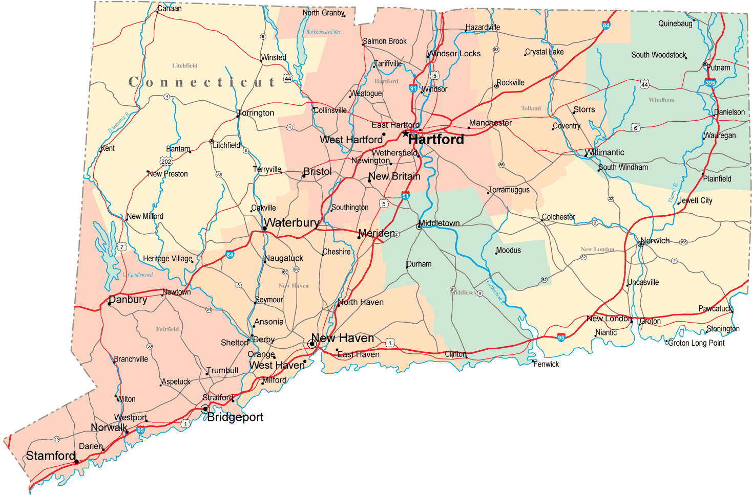


Slide 20

Governance
State Pre-K (School Readiness)
Head Start Collab Office
Head Start State Supplement
Child Care Subsidy (CCDF)
Child Care Licensing
State Funded Home Visiting
MIECHV
(10/1/14)
Part C
(7/1/15)
Section 619 (7/1/15)
Even Start
Workforce Registry
Scholarships for Child Care workforce
Child Care R & R
State Subsidized Child Care Centers
New “CT SMART START”
Help Me Grow

Slide 21
CT Early Childhood Governance
NOT part of the Office of Early Childhood
Dept. of Public Health
Birth Registry Data
EHDI
Birth Defects Registry
Dept. of Children and Families
Home-based services
Intensive Family Preservation
Foster Care
Dept. of Social Services
Medicaid
TANF
Dept. of Education
SLDS
Part B oversight
K-12 data, unique IDs

Slide 22
Transactional Systems:
To provide program management through access to real-time data for state or federally funded early childhood programs.
Purpose of System
Data Warehouse:
To answer basic policy questions

Slide 23

Proposed ECIDS Design
Education
Children and Families
ECIS DATA WAREHOUSE
CT SDE SASID Manager
Public Health
Medicaid
Transactional Data Systems
Part C
Workforce Registry
Child Care Subsidies
Home Visiting
State Pre-K /619
Subsidized Child Care Centers
Head Start and EHS
QRIS

Slide 24

Policy Questions for Data Warehouse
Do high-need children from birth to age five have access to high quality early childhood programs and services?
Which children have access to high quality early childhood programs and services?
Is the quality of programs improving?
What are the programs characteristics?
How prepared is the early childhood workforce to provide effective education and care for all children?
What policy/investments lead to a skilled and stable early childhood workforce?

Slide 25
Policy Questions (continued)
What child health and development service are being provided?
What are the family circumstances of children in early childhood programs and services?
What longitudinal information do we know about children enrolled in early childhood programs and services?
How is data used to align, prioritize, and mobilize resources?

Slide 26
Issues Addressed so far
Resources for system development through bond funds awarded to Dept. of Education in 2013.
Which programs are in or out of scope for the ECIS
Do we need both transactional data systems and a data warehouse?
How will unique identifiers be assigned
What is the “as is” state and the “to be” state of each transactional system’s business processes
Data governance structure for initial project

Slide 27
Issues still to be addressed
Resources for ongoing system management/help desk
Data sharing agreements with other agencies
Data governance for data warehouse
Specific linkages to SLDS/P20-WIN
Specific linkages to Kindergarten Entry Assessment data
Mechanism for districts to report Pre-K data without duplicate data entry

Slide 28
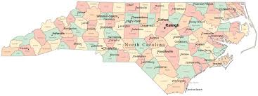


Slide 29
What is NC ECIDS?
A project and major goal of the NC RTT – Early Learning Challenge Grant
A data system that:
  integrates early childhood education, health, and social service information from key participating state agencies and
  is focused on all children receiving state and federal services from NC participating agencies ages 0-5.
Notes:
State and federal services from key participating agencies. Not all children in NC from birth, just those receiving services.
Programs/services– written into the grant are 3 programs/services- NCPK, Children receiving child care subsidies, and Infant/Toddler Part C program for young children with disabilities. After that other programs will be added to ECIDS and the specific ones we are in discussion about now- finalized once sign MOAs.

Slide 30
Mission
To develop and sustain a high quality integrated early childhood data system in North Carolina that integrates education, health and social service data from key participating agencies to inform policies and practices that ultimately support better outcomes for children and families.

Slide 31
Goals
  Provide state agencies, policymakers, and the general public with unduplicated counts of where children are being served.
  Provide policymakers and researchers with information about current programs and services to better address areas of need and effective practice within systems.
  Integrate with P-20W system, allowing for the examination of effects of early childhood programs and services over time.

Slide 32
Key Participating Agencies
NC DHHS
  NC Division of Child Development and Early Education (DCDEE)
  NC Division of Public Health (DPH)
  NC Division of Social Services (DSS)
NC Department of Public Instruction (DPI)
Smart Start & The North Carolina Partnership for Children (NCPC)
Technology provider: NC ITS

Slide 33
Key Questions
  How many and which NC children and families (especially children with high needs) are participating in early childhood programs and receiving services?
  What is the quality of early childhood programs? Is the quality improving over time?
  What are the characteristics of the early care and education workforce in NC and how prepared are they to provide effective education and care for all children?
Notes:
** Note: these questions are to serve as a framework for the system ECIDS is not designed to answer critical policy and research questions, but rather be a tool to provide data and information that can be used to answer these critical questions.

Slide 34
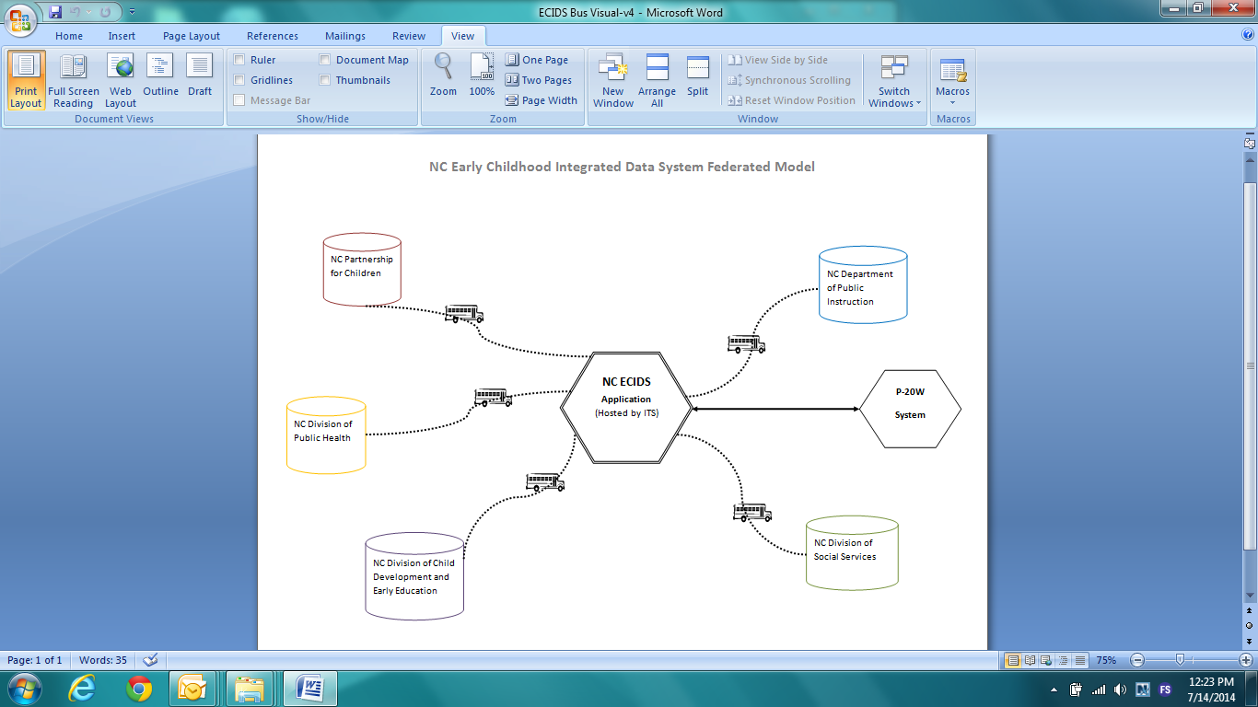

Slide 35
Governance Council
Data
Policy
Committee
Data Management Committee
Program Managers
Sec. of DHHS or Designee
Supt. of NCDPI or Designee
Division Directors, DHHS
Director of OEL, NCPDI
Director, HS Collab Office and agency reps
President of NCPC or Designee
IT/Data staff
External Stakeholders Panel
Research Panel

Slide 36
Policy Committee responsible for:
Decisions regarding governance policies
Decisions based on recommendations for current and future data use, analyses, and reporting
Compliance of state and federal data governance policies and standards
Resolves any conflicts, or pertinent issues
Policies for including additional programs and systems into NC ECIDS

Slide 37
Data Management Committee responsible for:
Data elements to be included in NC ECIDS
Addressing and resolving issues that arise on data request process
Approves and signs off on data requests
Recommends current and future data use, analyses, and reporting
Reviews and recommends issues to be forwarded to and resolved by the Policy Committee
Program Manager from Key Participating Agencies and Programs is voting member on Council; can bring an IT or data person to sit in on meetings

Slide 38
Reports & Data Requests
  Standard Reports: Aggregate level, produced on specified timeline, content determined by Governance Council, available to public on NC ECIDS website
  Query Reports: Aggregate level, produced on demand by segmenting the standard report data to create a customized report, available to public on NC ECIDS website
  Data Reports: An approved data request by researcher for specific data elements in the programs of interest to be used to conduct more detailed analyses

Slide 39
Project Timeline
Activity Description | When
Server Infrastructure setup for ECIDS | Aug 2014
Continued Governance Council meetings | Sept & Oct 2014
Master MOA, Agency Addendums and Data Use Agreement sent to agencies for signing and review | Oct 2014
Development cycle for application using AGILE methodology, including development of NC ECIDS website | Oct/Nov 2014
Initial pre-production application deployed, initial standard reports produced | Jun 2015
Master MOA signed by all agencies | Jul 2015
Production 4-week Iteration Cycles Continue | Dec 2015
Grant-funded ECIDS project complete | Dec 2015

Slide 40
Agency Memorandum of Agreement
NC ECIDS will have an agency-level MOA which will outline the data sharing agreement between the key participating agencies (KPA)
Then each KPA will have appendices to the MOA that will outline the programs and specific data elements to be included in NC ECIDS.

Slide 41
“Under Construction”
Assignment of unique identifiers
Authoritative Sources
Resources for ongoing system management/help desk
Data sharing agreements with agencies and data requesters
Specific linkages to P20W
Other participating agencies

Slide 42

Let’s Discuss

Slide 43
Issues for Discussion
Assignment of unique identifiers
Participating agencies – decisions about programs in and out of scope
Data governance (and authoritative sources)
Data sharing agreements – with agencies/requesters
Linkages to P20W
Resources for ongoing system management/help desk

Slide 44
Issues for Discussion (continued)
Specific linkages to Kindergarten Entry Assessment data
Mechanism for districts to report Pre-K data without duplicate data entry

Slide 45
For More on DaSy
Visit the DaSy website at:
http://dasycenter.org/
Like us on Facebook:
https://www.facebook.com/dasycenter
Follow us on Twitter:
@DaSyCenter

Slide 46



The contents of this presentation were developed under a grant from the U.S. Department of Education, #H373Z120002. However, those contents do not necessarily represent the policy of the U.S. Department of Education, and you should not assume endorsement by the Federal Government. Project Officers, Meredith Miceli and Richelle Davis.

